Slide 1
Neuroradiology interactive lecture
366 RAD (Radiology)
Prof. Ibrahim A. Alorainy

Slide 2
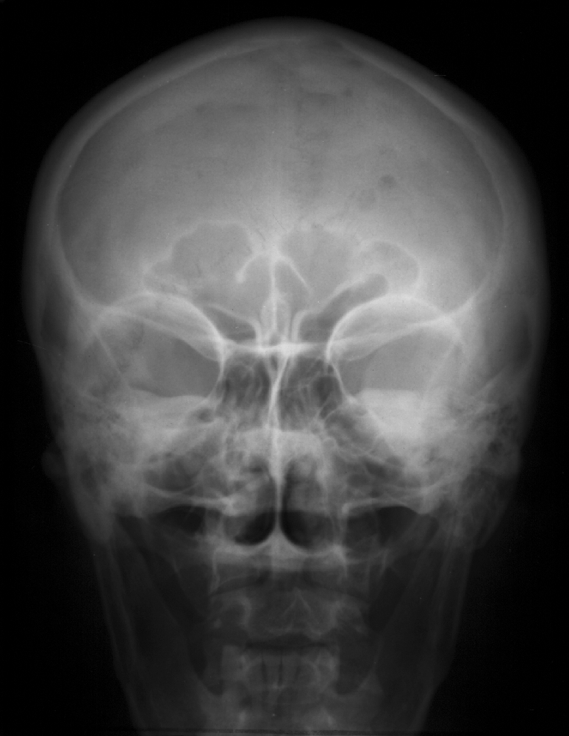
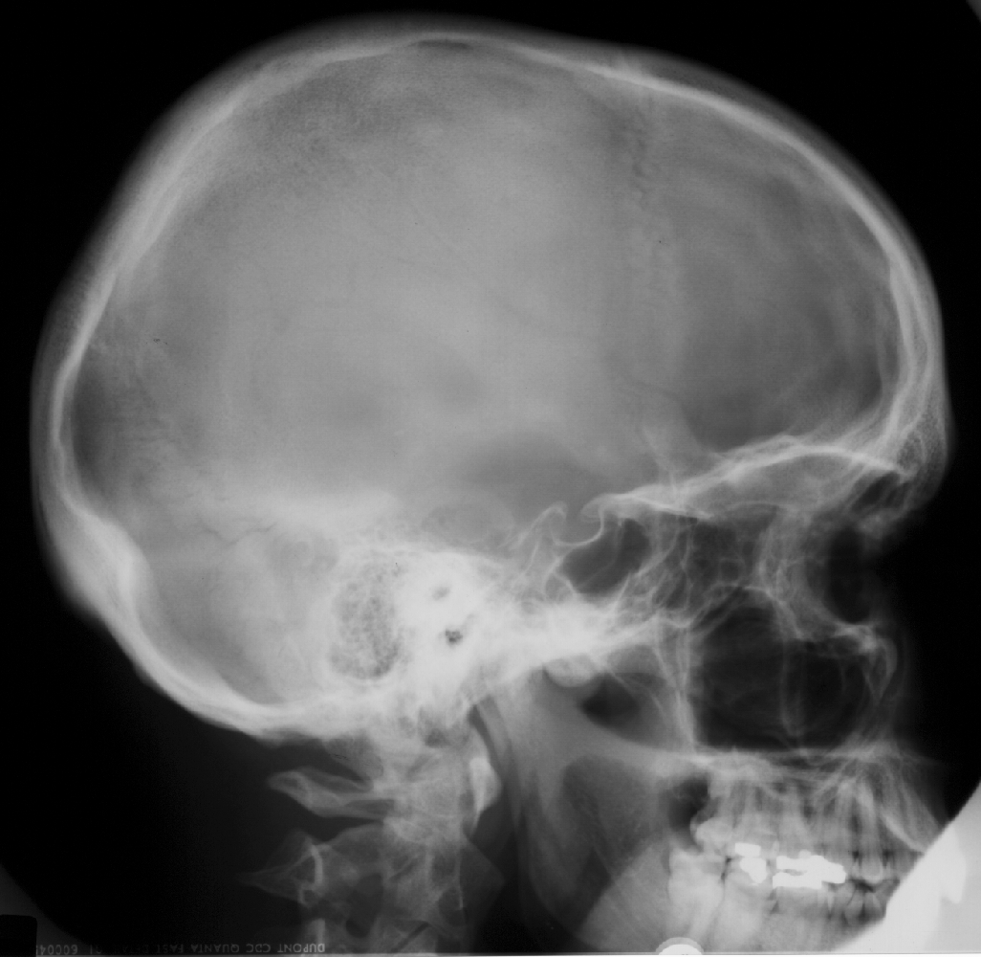
Skull X-RAY LAT. VIEW
Name the structures
L
SKULL PA VIEW

Slide 3
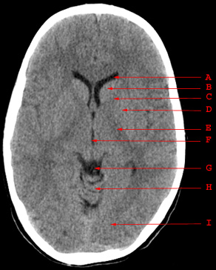
Name the structure

Slide 4
Name the structure
Frontal horn

Slide 5
Name the structure
B. Head of caudate nucelus

Slide 6
Name the structure
C. Anterior Limb of internal capsule

Slide 7
Name the structure
D. Lentiform nucleus

Slide 8
Name the structure
E. Posterior Limb of internal capsule

Slide 9
Name the structure
F. Third ventricle

Slide 10
Name the structure
G. Quadrigeminal cistern

Slide 11
Name the structure
H. Vermis of cerebellum

Slide 12
Name the structure
I. Occipital Lobe

Slide 13
Which is true in CT?
Bone is black
CSF is black
Gray matter is darker than white matter
Gray and white matter can not be differentiated

Slide 14
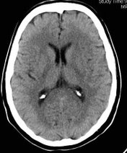
Which is true in CT?
Bone is black
CSF is black
Gray matter is darker than white matter
Gray and white matter can not be differentiated

Slide 15
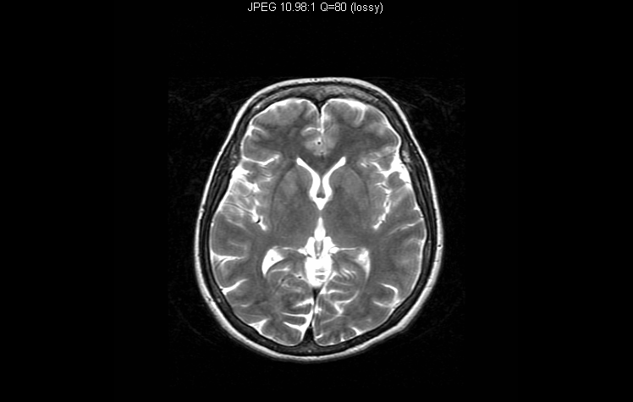

Slide 16
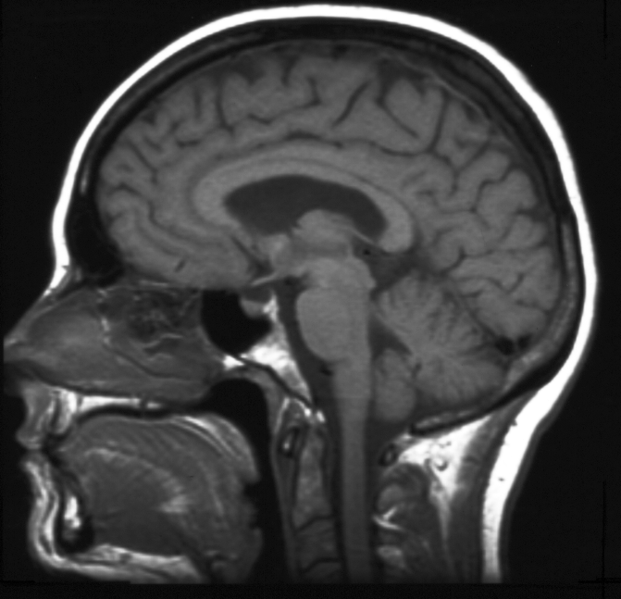
Name the structures

Slide 17
Contraindication of MRI include all the following EXCEPT:
cardiac pacemaker
cochlear implants
metal close to the eye
neurostimulators
pregnancy (3rd trimester)

Slide 18
Brain MRI diffusion (DWI) is particularly helpful in assessment of:
Infarction
Abscess
Tumors
Trauma
Myelination disorders

Slide 19
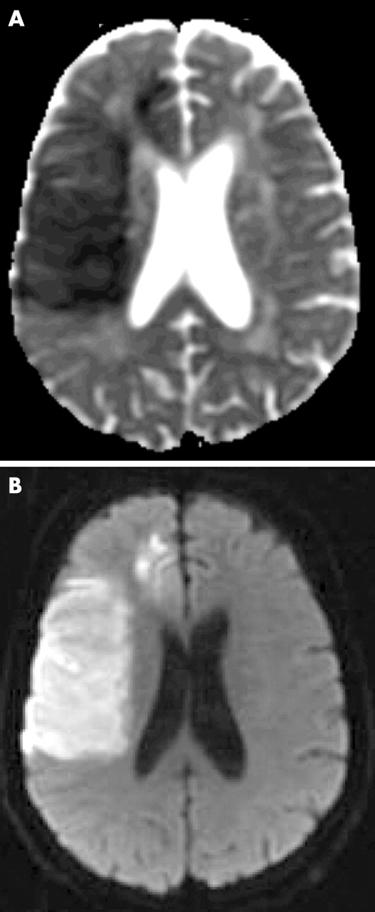
MRI Diffusion..
MR diffusion
Very helpful in assessment of:
Early brain infarction.
Brain abscess.
Certain types of brain tumor.
DWI
ADC map

Slide 20
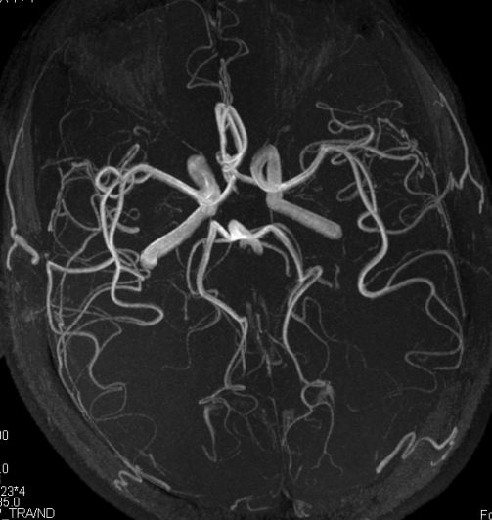
Which of the following is true?
This is CTA study
This is MRA study
This can only be done with contrast
This is good to diagnose cerebral venous thrombosis

Slide 21
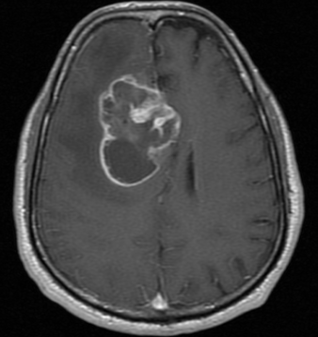
An MRI showed intra-axial lesion that is necrotic, irregular, strongly enhancing, and crossing midline.
This lesion is most likely:
A. Meningioma
B. Infarction
C. Multiple sclerosis
D. Glioblastoma multiforme

Slide 22
An MRI showed intra-axial lesion that is necrotic, irregular, strongly enhancing, and crossing midline.
This lesion is most likely:
A. Meningioma
B. Infarction
C. Multiple sclerosis
D. Glioblastoma multiforme

Slide 23
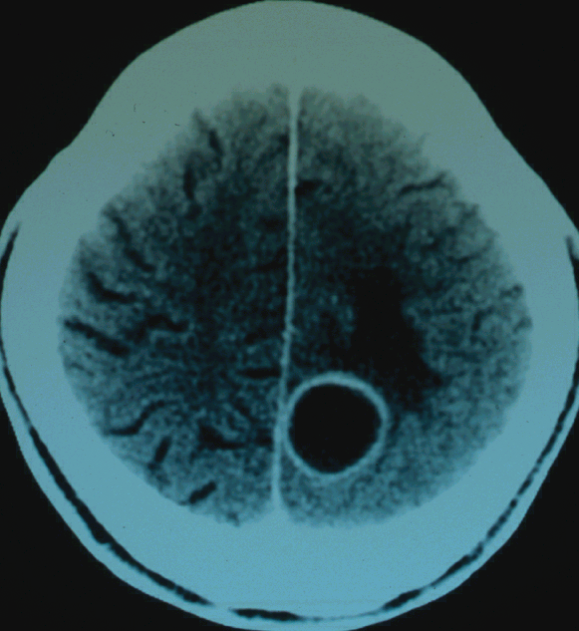
The lesion on this CT is:
Meningioma
Abscess
Multiple sclerosis
Glioblastoma multiforme

Slide 24
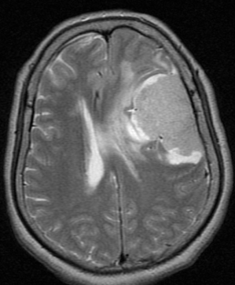
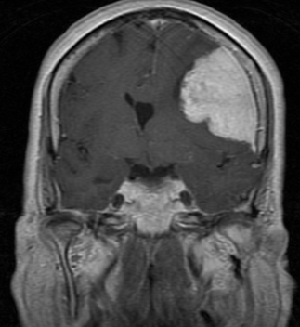
The lesion on this MRI is:
Meningioma
Infarction
Metastasis
Abscess

Slide 25
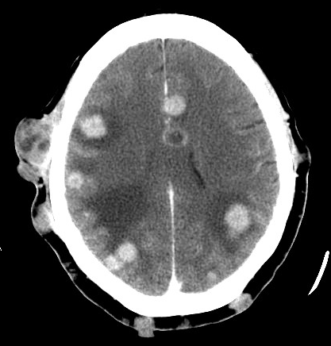
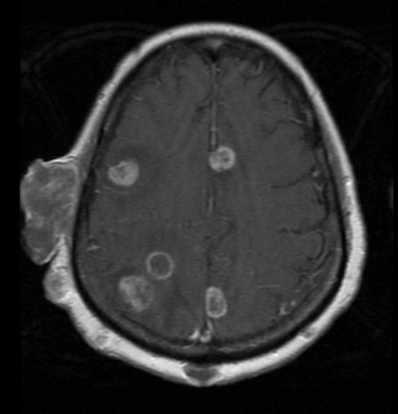
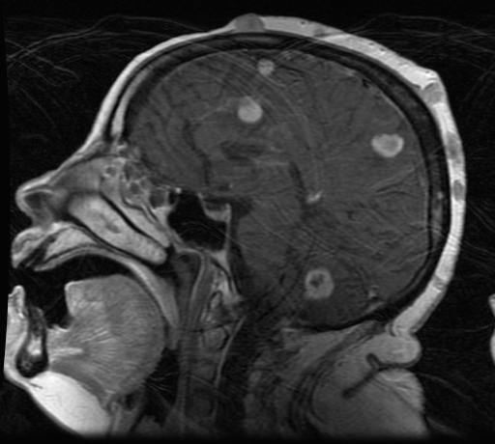
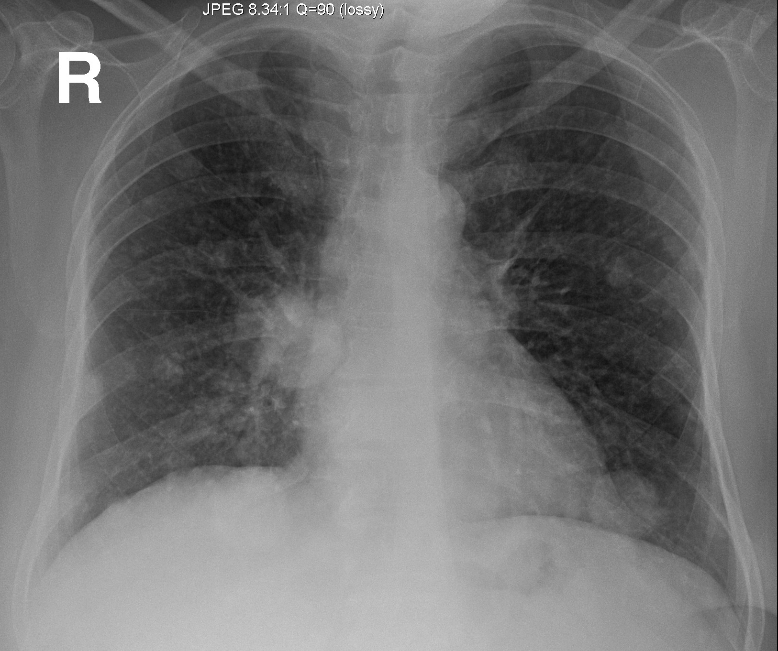
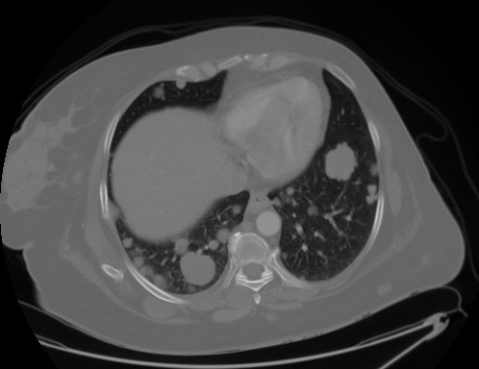

Slide 26
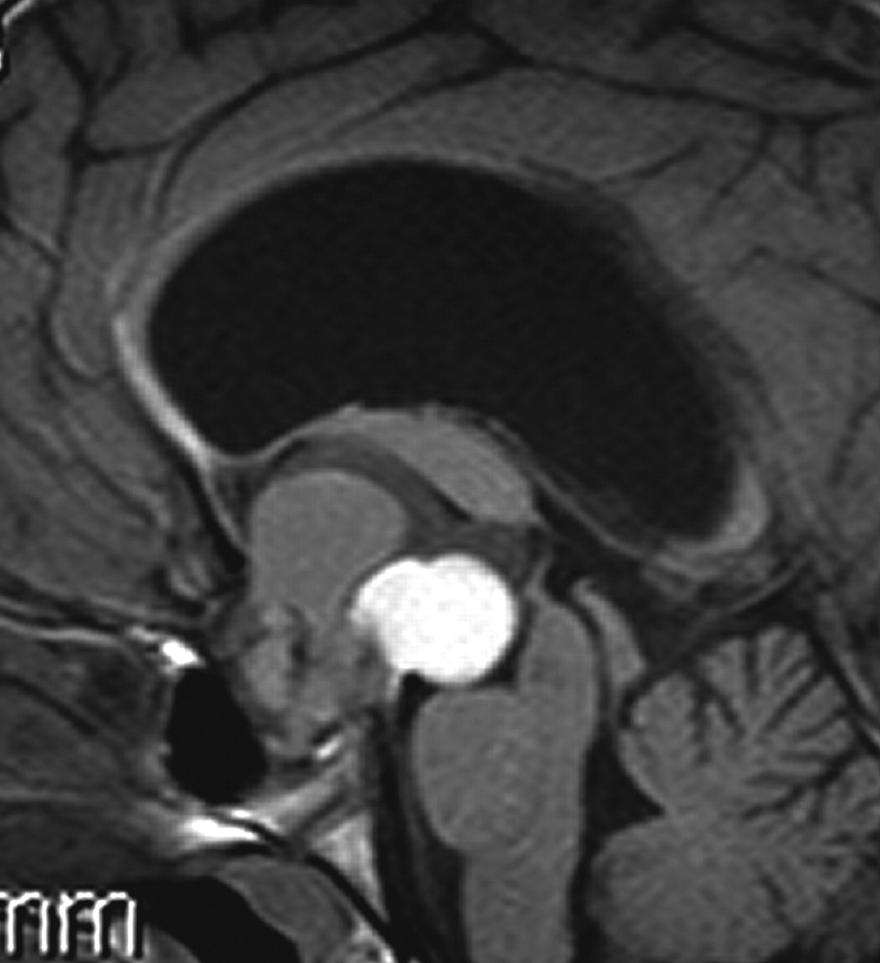
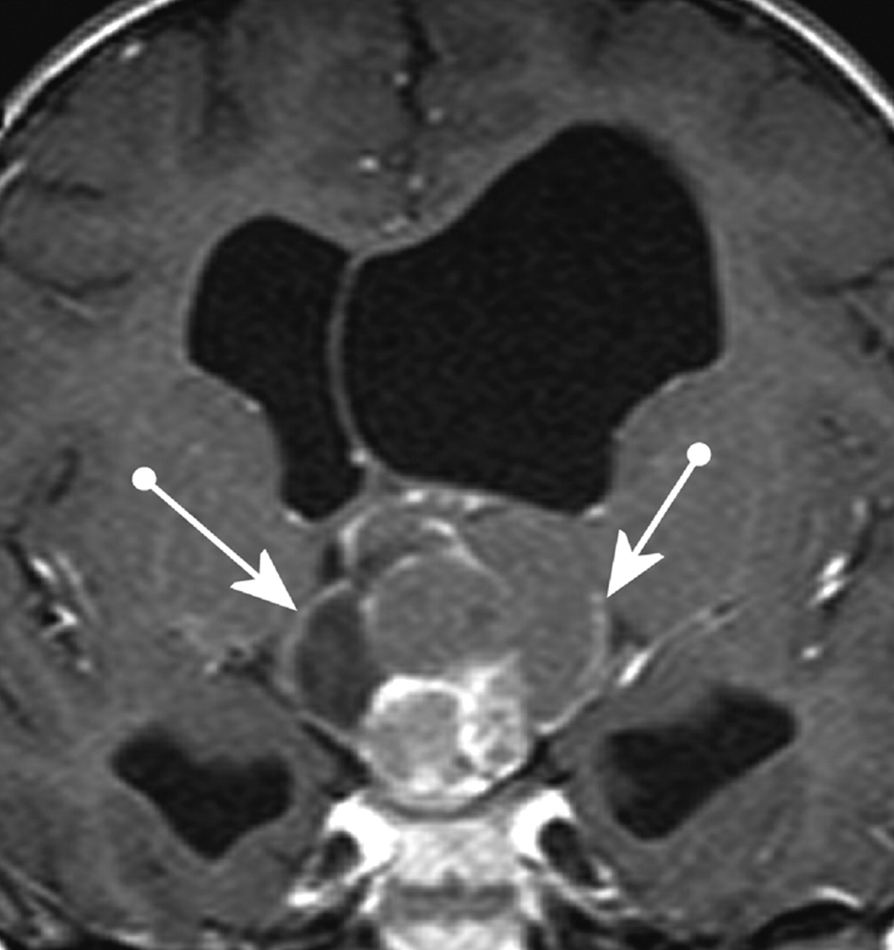
The lesion on this MRI is:
Pituitary adenoma
Craniopharyngioma
Meningioma
Glioblastoma multiforme

Slide 27
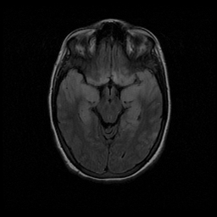
The abnormalities on this MRI are due to:
Multiple sclerosis
Meningitis
Brain tumor
Encephalitis

Slide 28
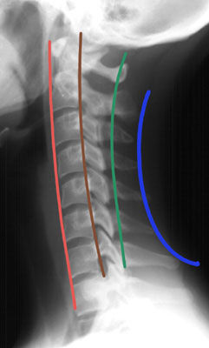
Which of the following is true about the lines of the cervical spine?
Red is intervertebral line
Brown is posterior spinous line
Green is spinolaminar line
Blue is posterior vertebral line

Slide 29
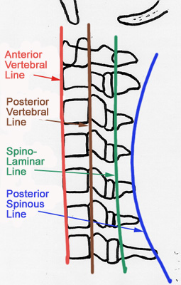

Slide 30
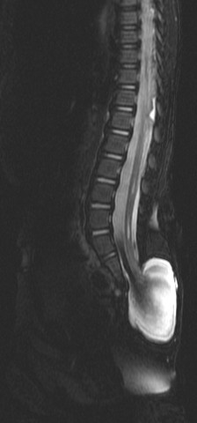
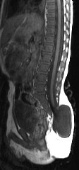
This MRI of the spine shows:
Meningocele
Extradural tumor
Discitis
Vertebral fusion

Slide 31
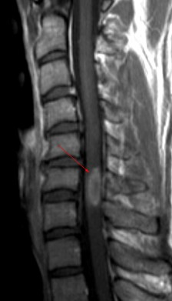
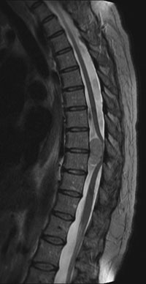
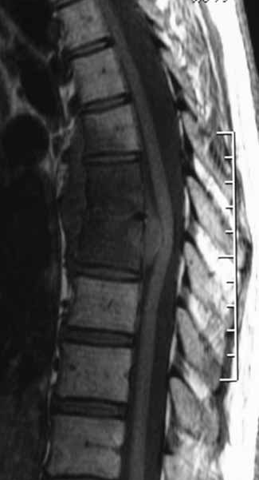
Patient A
Patient B
Patient C

Slide 32
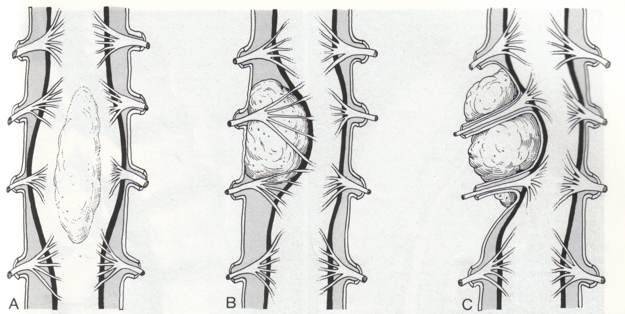

Slide 33
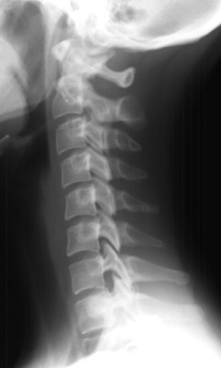
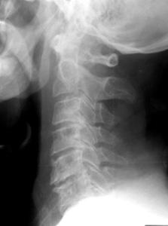
What is the difference?
Normal control
Patient

Slide 34
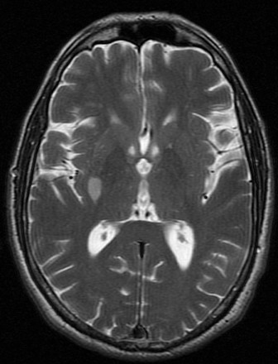
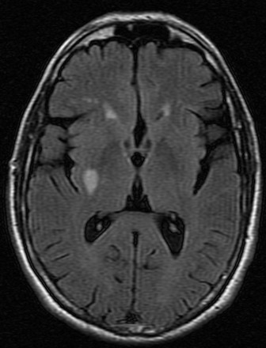
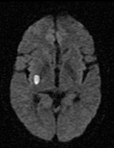
T2WI
FLAIR
DWI
This MRI shows an infarction in the right basal ganglia.
The infarction is:
  Acute (recent)
  Chronic (old)
  Hemorrhagic
  In PCA territory

Slide 35
T2WI
FLAIR
DWI
This patient is most likely to have:
  Left monoplegia
  Left hemiplegia
  Diplegia
  No symptoms

Slide 36
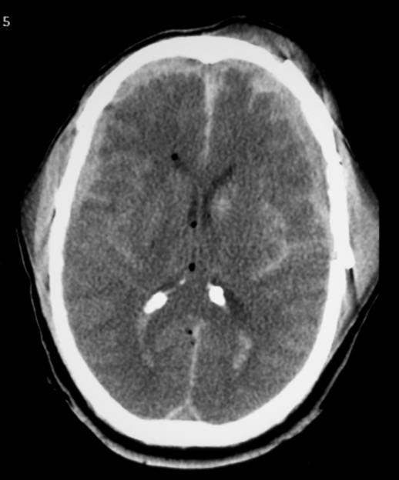
This CT shows:
Subdural hematoma
Subarachnoid hemorrhage
Intra ventricular hemorrhage
All of the above

Slide 37
The hematoma pointed by the arrow is:
Acute epidural
Chronic epidural
Acute subdural
Chronic subdural
None of the above

Slide 38
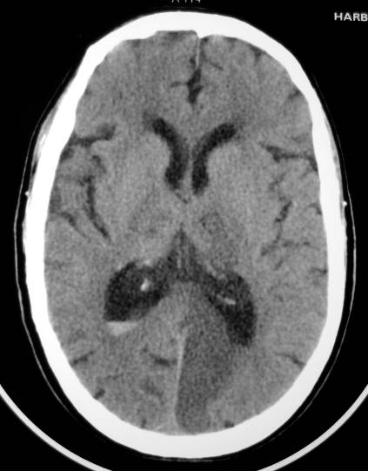
This CT shows:
Acute PCA infarct
Chronic ACA infarct
Subarachnoid bleeding
Meningioma
Abscess

Slide 39
Thank you

