Slide 1
IMAGING INVESTIGATION AND DISEASES HEPATOBILIARY SYSTEM
Sadeq Alshami Assistant Prof. of Radiology

Slide 2
ULTRASOUND:
Not expensive
allows comparison with the opposite side, normal side
uses no ionizing radiation,
performed at bed side or in the operating room.
It is a non invasive modality
Notes:
ULTRASOUND:
Over the past several years, ultrasound has made an enormous impact in the field of radiology, however it is only rarely used its skeletal radiology. It has a various inherit advantages, it is relatively inexpensive, allows comparison with the opposite side, normal side, uses no ionizing radiation, and can be performed at bed side or in the operating room. It is a non invasive modality, relying upon the interaction of propagated soundwaves with tissue interface in the body whenever the direct pulsating of sound waves encounters an interface of tissue an acoustic impedence reflection or refraction occurs. The sound waves reflected back through the ultrasound transducer are recorded and converted into images. Applications of ultrasound in orthopaedics include evaluation of the rotator cuff, injuries to various tendons, e.g. the achilles tendons, and occasionally soft tissue tumors such as hemangioma.
The most effective application however is in evaluation of the infant hip for which ultrasound has become the imaging modality of choice

Slide 3
sagital
transverse

Slide 4
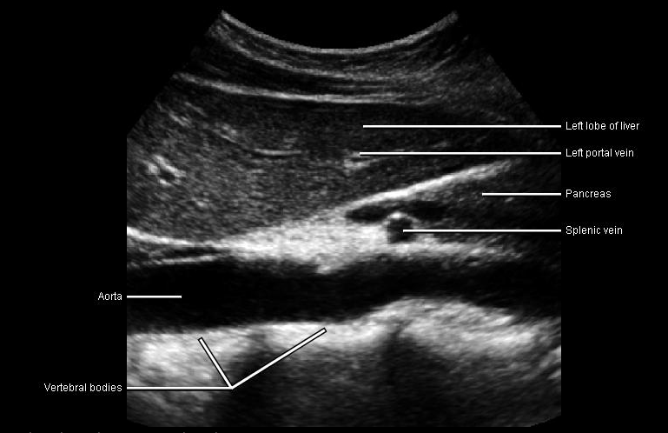

Slide 5
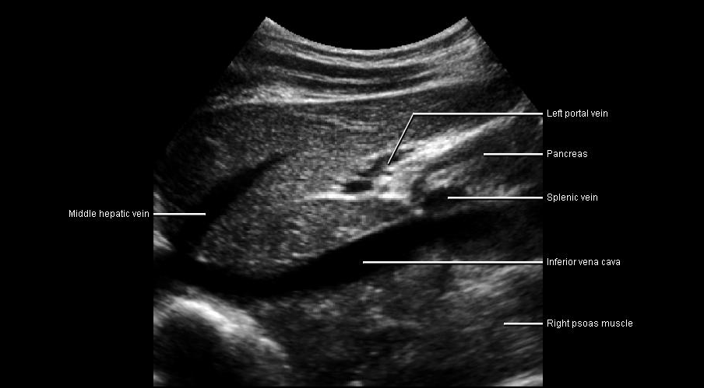

Slide 6
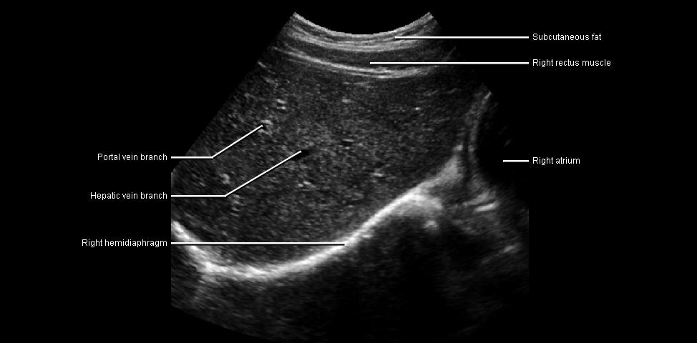

Slide 7
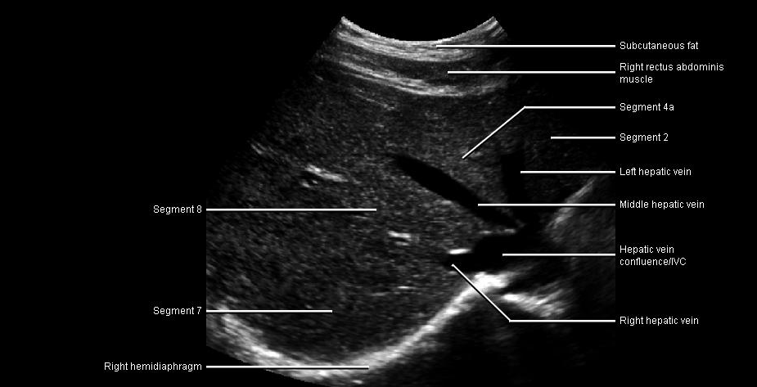

Slide 8
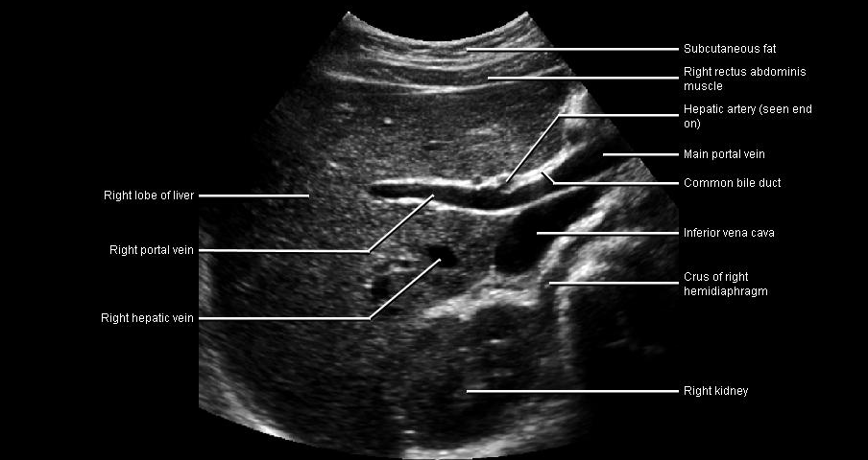

Slide 9
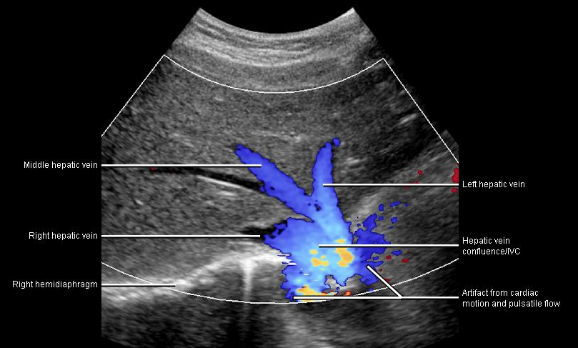

Slide 10
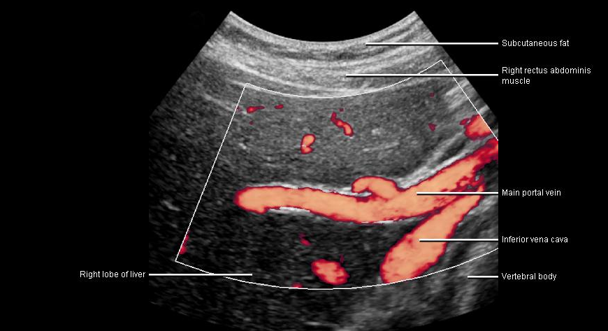

Slide 11
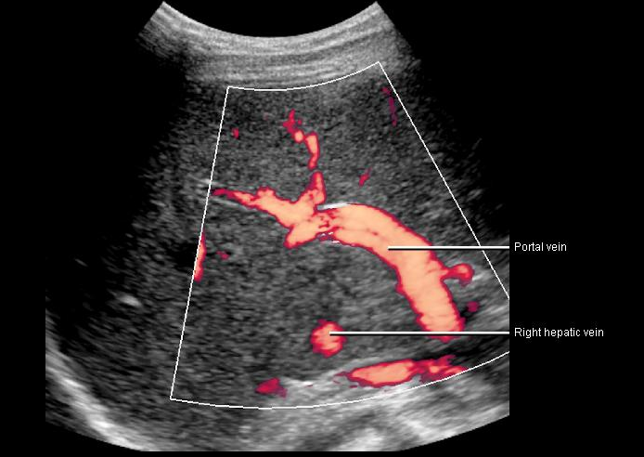

Slide 12
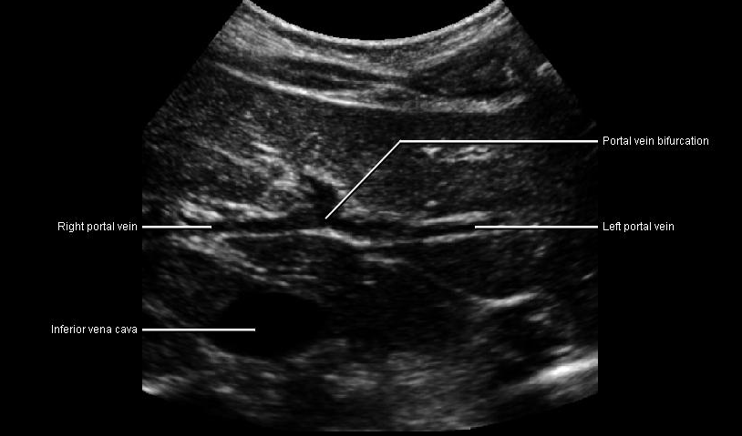

Slide 13
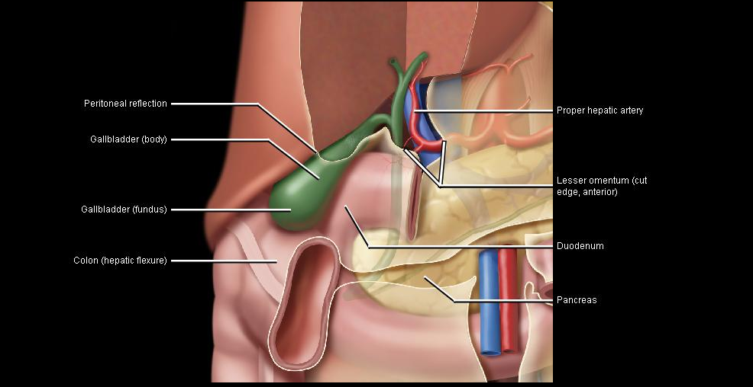

Slide 14
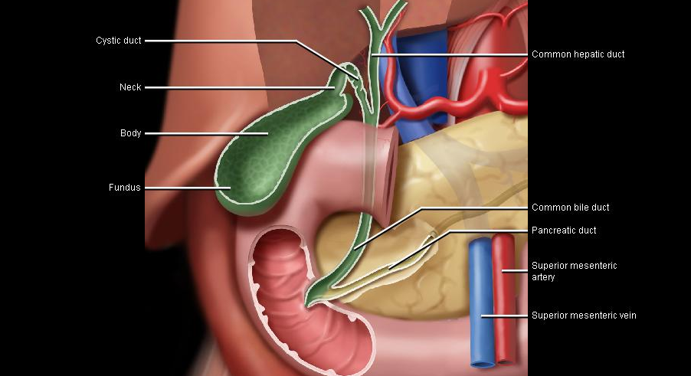

Slide 15
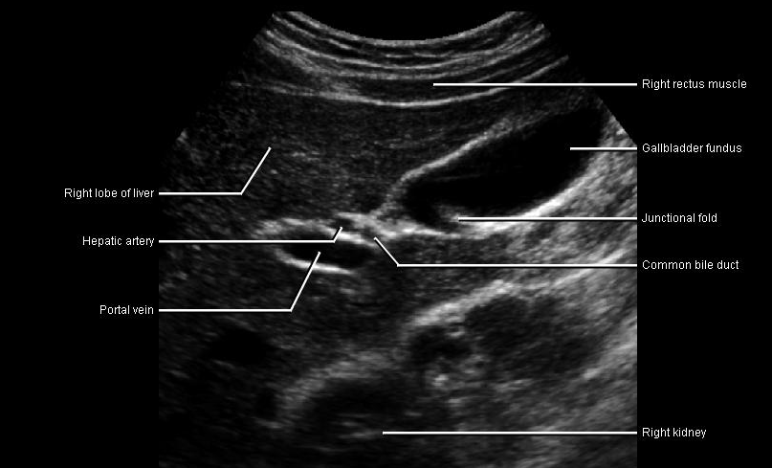

Slide 16
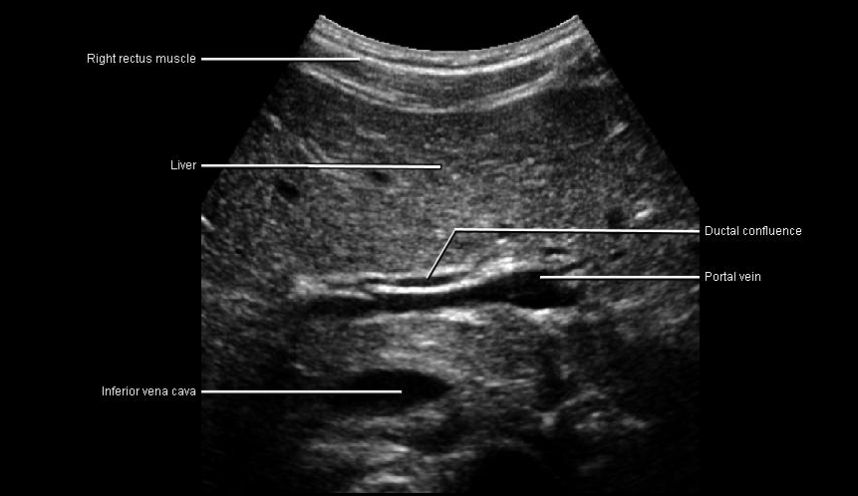

Slide 17
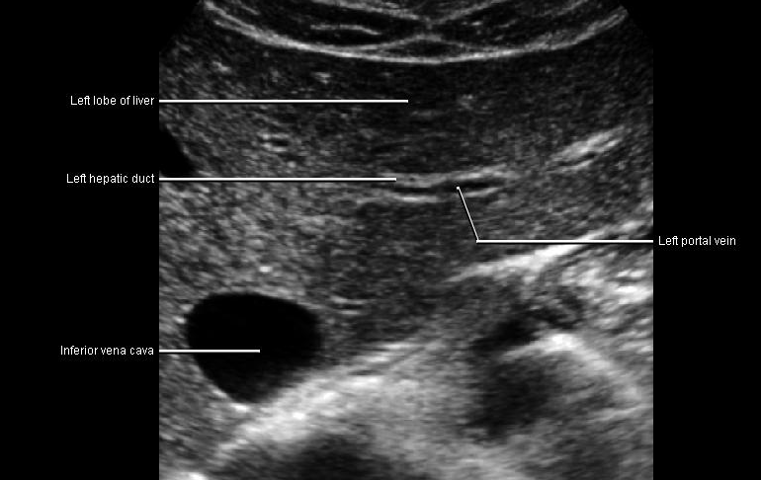

Slide 18
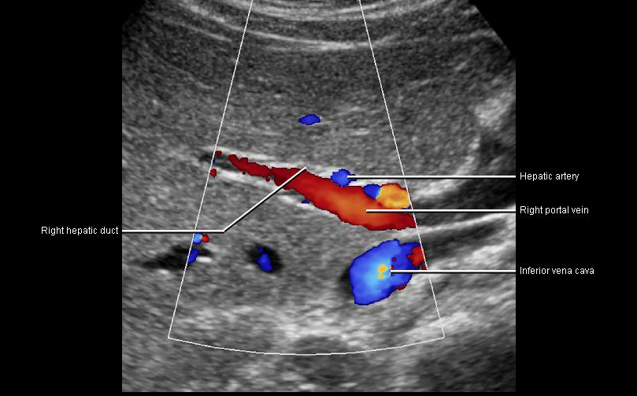

Slide 19
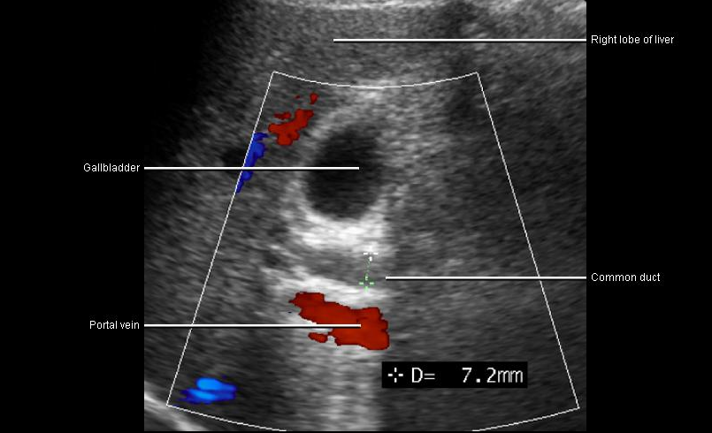

Slide 20
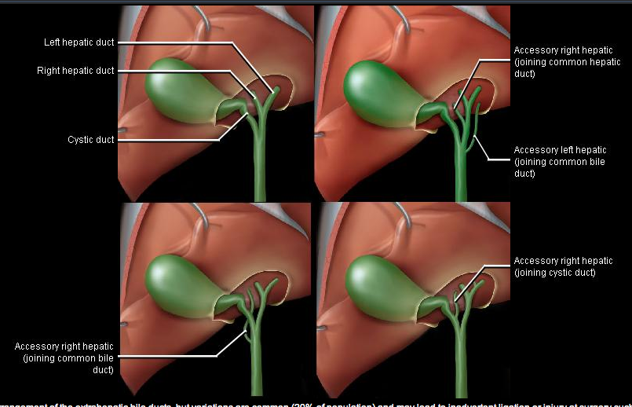

Slide 21
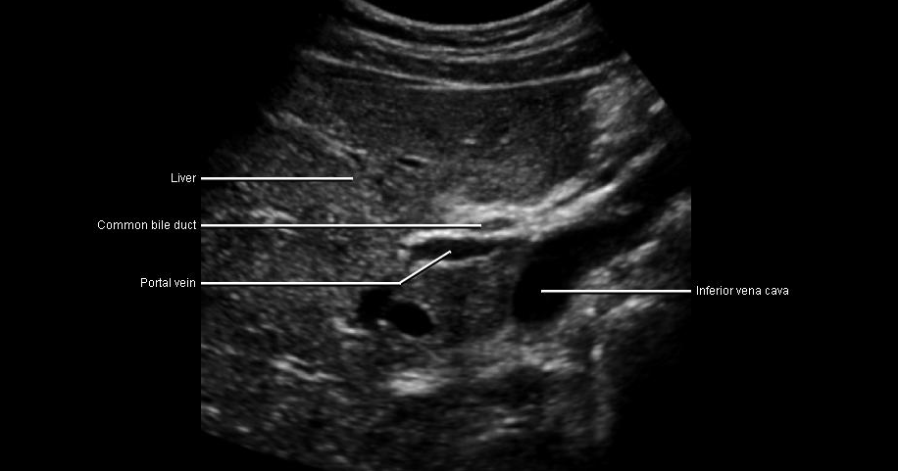

Slide 23
COMPUTED TOMOGRAPHY:
COMPONENTS:
-X ray source
-Detectors
- Computer data processing system
Notes:
COMPUTED TOMOGRAPHY:
CT is radiological modality containing an x-ray source, detectors and the computer data processing system. The essential component of a CT system include a circular scanning gantry which holds the x-ray tube, and imaging sensors, a table for a patient, an x-ray generator and a computerized data processing unit. The patient lies on the table and is placed inside the gantry.
The x-ray tube is rotated 3600 around the patient while the computer collects the data and formulates an axial image or slice. Each cross sectional slice represents a thickness between 3mm in 1.5cm of body tissue.

Slide 24
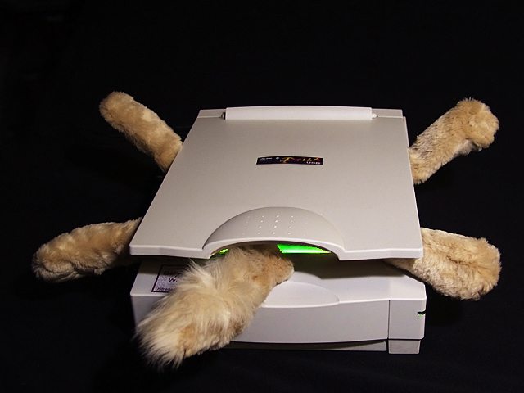
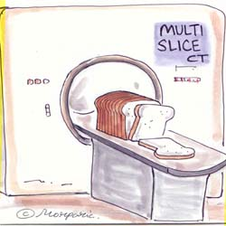
CAT SCAN

Slide 25
What is CT Scanning
CT scanning—sometimes called CAT scanning—is a noninvasive, painless medical test that helps physicians diagnose and treat medical conditions.
CT imaging uses special x-ray equipment to produce multiple images or pictures of the inside of the body and a computer to join them together in cross-sectional views of the area being studied. The images can then be examined on a computer monitor or printed.
CT scans of internal organs, bone, soft tissue and blood vessels provide greater clarity than conventional x-ray exams.

Slide 26
What are some common uses of the procedure Abdomen and pelvis?
This procedure is typically used to help diagnose the cause of abdominal pain and diseases of the bowel and colon, such as:
abscesses in the abdomen
inflamed colon
cancers of the colon, liver, pancreas and kidneys
pancreatitis
lymphoma
staging for cancer
diverticulitis
appendicitis

Slide 27
CT scanning of the abdomen/pelvis is also performed to:
visualize the liver, spleen, pancreas and kidneys
plan and properly administer radiation treatments for tumors
guide biopsies and other minimally invasive procedures
CT imaging can also play a significant role in the detection, diagnosis and treatment of vascular disorders that can lead to stroke, gangrene or kidney failure.

Slide 28
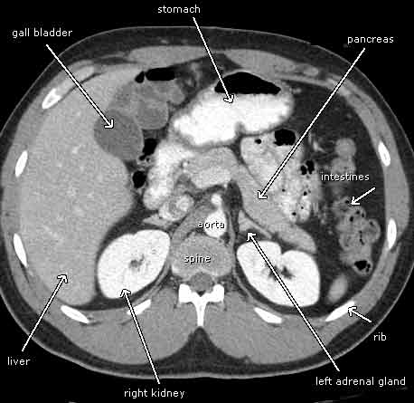
How does the procedure work?
In many ways CT scanning works very much like other x-ray examinations. X-rays are a form of radiation—like light or radio waves—that can be directed at the body. Different body parts absorb the x-rays in varying degrees.
In a conventional x-ray exam, a small burst of radiation is aimed at and passes through the body, recording an image on photographic film or a special image recording plate. Bones appear white on the x-ray; soft tissue shows up in shades of gray and air appears black.
With CT scanning, numerous x-ray beams and a set of electronic x-ray detectors rotate around you, measuring the amount of radiation being absorbed throughout your body. At the same time, the examination table is moving through the scanner, so that the x-ray beam follows a spiral path. A special computer program processes this series of pictures, or slices of your body, to create two-dimensional cross-sectional images, which are then displayed on a monitor.

Slide 29
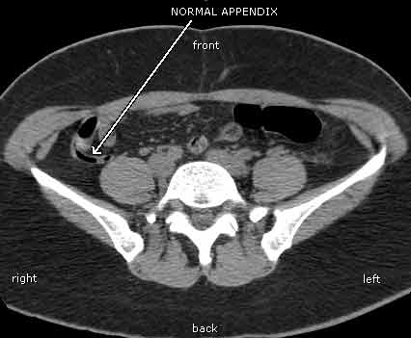
CT imaging is sometimes compared to looking into a loaf of bread by cutting the loaf into thin slices. When the image slices are reassembled by computer software, the result is a very detailed multidimensional view of the body's interior.
Refinements in detector technology allow new CT scanners to obtain multiple slices in a single rotation. These scanners, called "multislice CT" or "multidetector CT," allow thinner slices to be obtained in a shorter period of time, resulting in more detail and additional view capability.

Slide 30
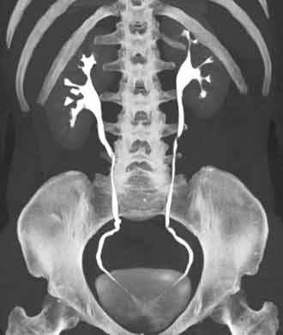
Modern CT scanners are so fast that they can scan through large sections of the body in just a few seconds. Such speed is beneficial for all patients but especially children, the elderly and critically ill.
For some CT exams, a contrast material is used to enhance visibility in the area of the body being studied

Slide 31
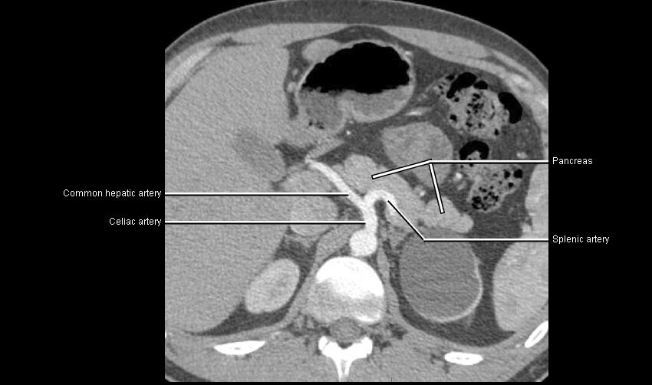

Slide 32
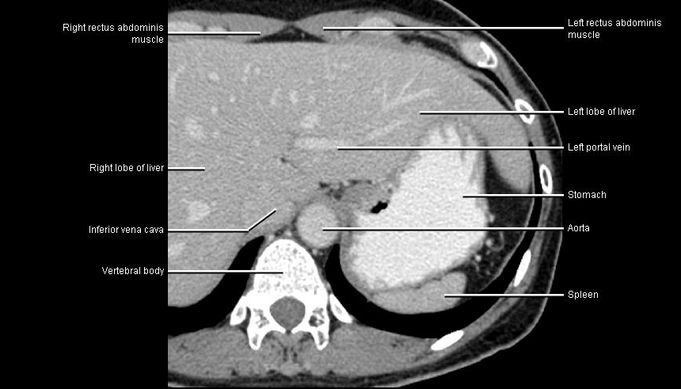

Slide 33
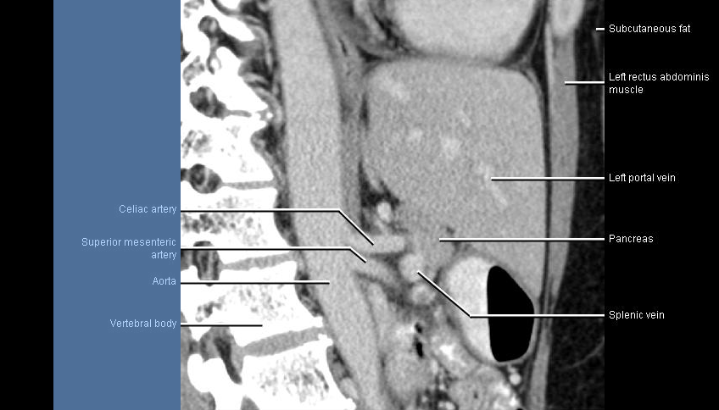

Slide 34
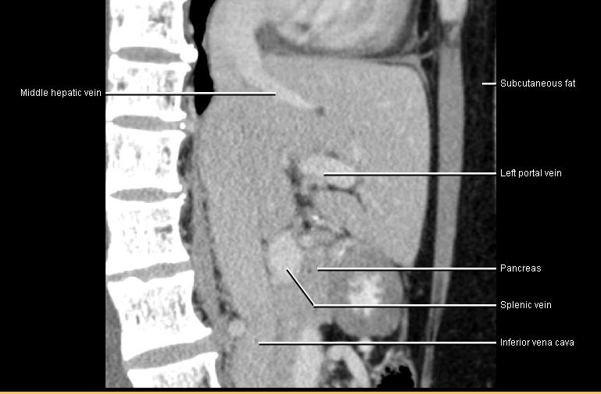

Slide 35
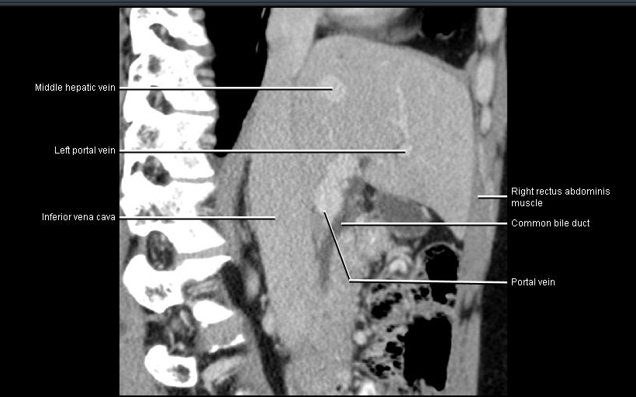

Slide 36
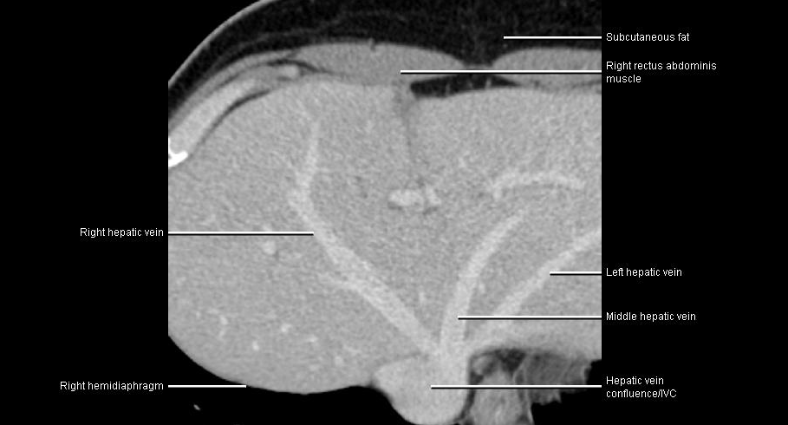

Slide 37
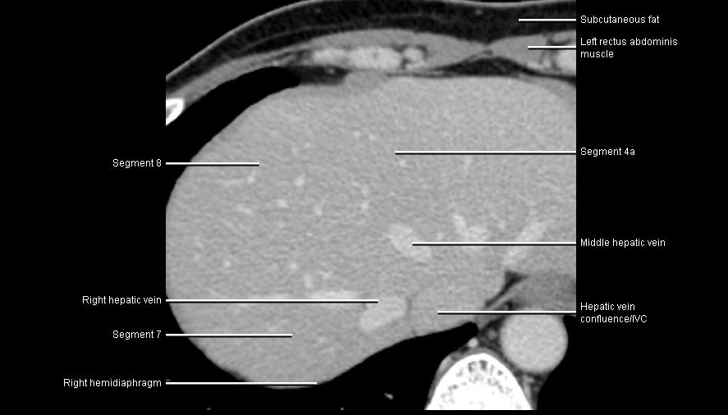

Slide 38
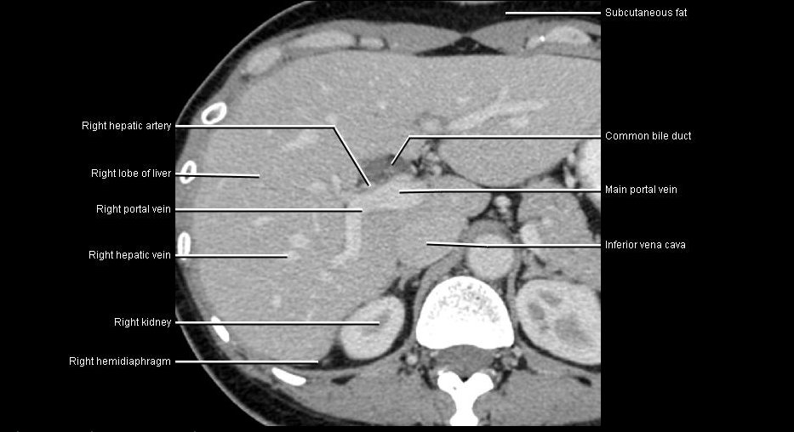

Slide 39
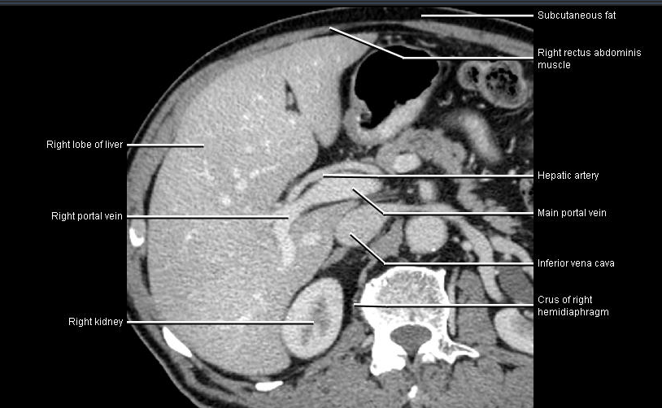

Slide 40
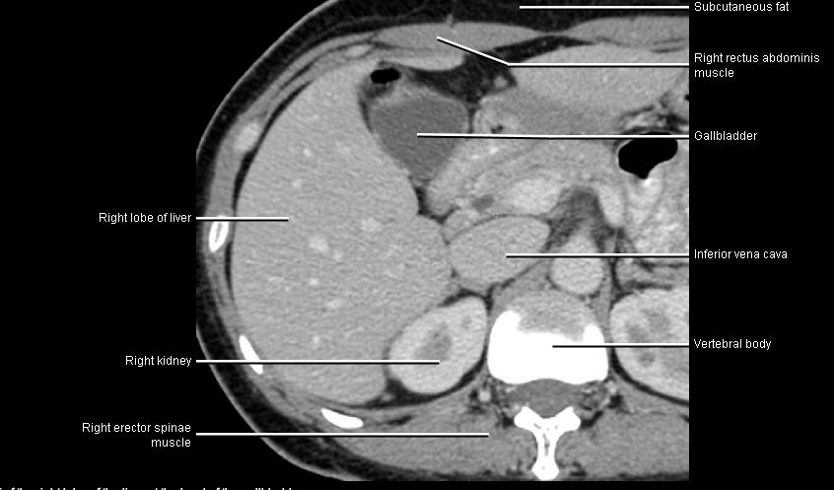

Slide 41
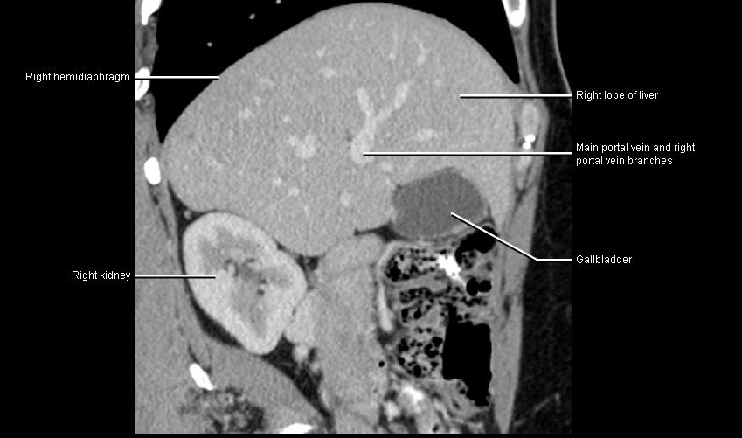

Slide 42
MRI
Magnet
RF coils
Computer
Notes:
MAGNETIC RESONANCE IMAGING:
MRI is based upon the remission of an absorb radio frequency signal while the patient is in a strong magnetic field. An external magnetic field is usually generated by a magnet with field strength of 0.2 to 1.5 Tesla. The system includes a magnet, RF coils (Transmitter and receiver), gradient coils, and a computer display unit with digital storage facilities. The principle of MRI cannot be discussed in detail.
The musculoskeletal system is ideally suited for evaluation by MRI since different tissue displayed different signal intensities on T1 & T2 weighted images. The images displayed may have a low signal intensity, intermediate signal intensity, or high signal intensity

Slide 43
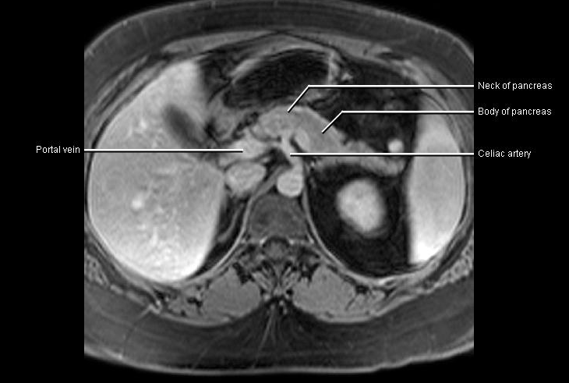

Slide 44
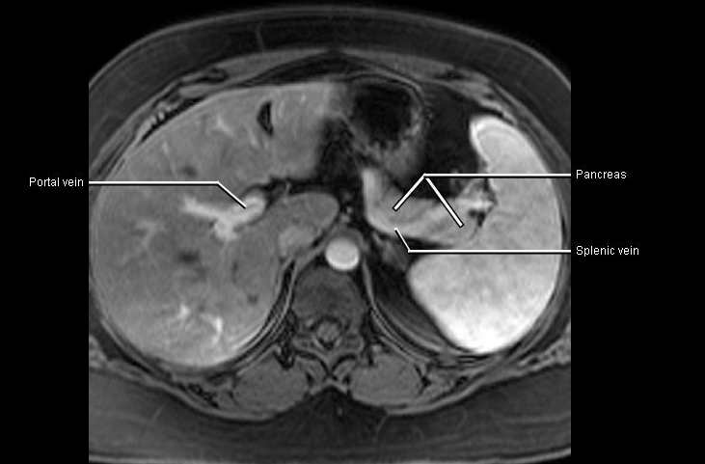

Slide 45
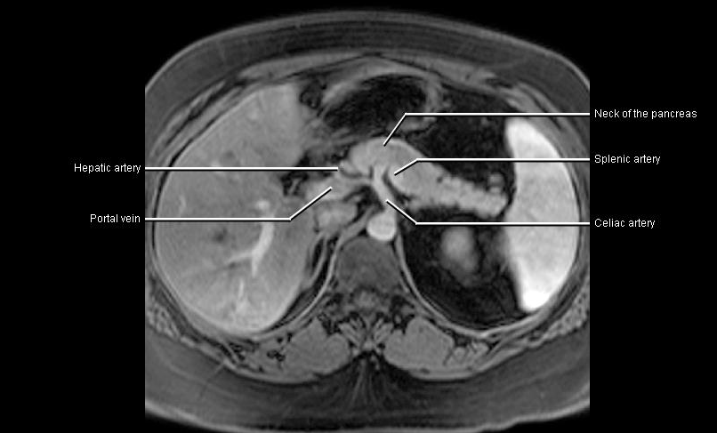

Slide 46
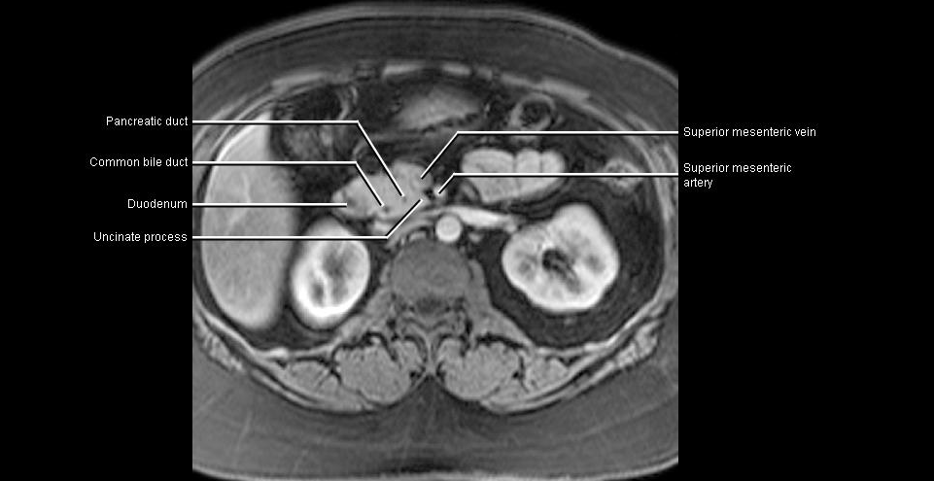

Slide 48
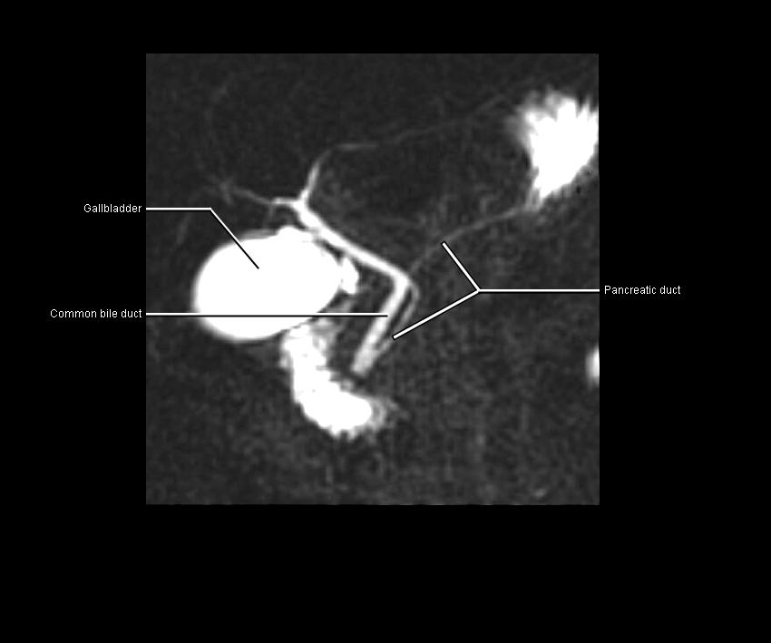

Slide 79
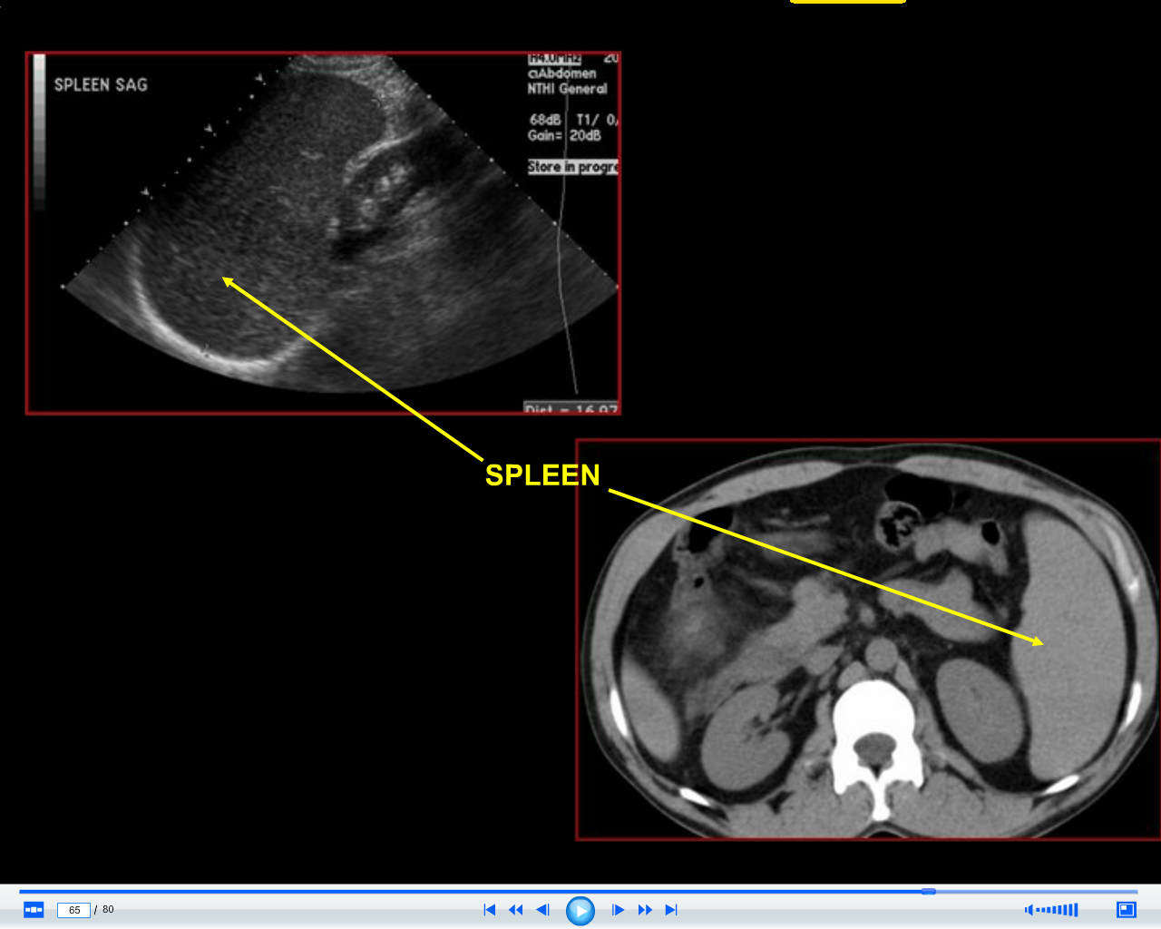

Slide 89
THANK YOU

