Slide 1
Breast disease
Dr.Amal Al-Abdulkareem

Slide 2
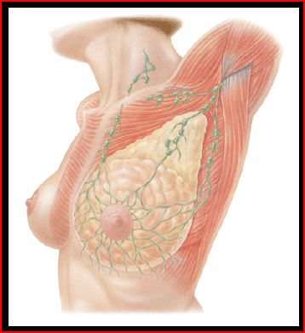
Breast Modified Sebaceous Glands
Upper border
- Collar bone.
Lower border. - 6th or 7th rib.
Inner Border - Edge of sternum.
Outer border
- Mid-axillary line.

Slide 3
Breast Divisions 5 Segments
Four Quadrants - By horizontal and vertical lines.
Tail of Spence
Majority of benign or malignant tumors in the Upper Outer Quadrant

Slide 4
External Anatomy of the Breast
Nipple -Pigmented, Cylindrical -4th inter-costal space * at age 18
Areola -Pigmented area surrounding nipple
Glands of Montgomery -Sebaceous glands within the areola -Lubricate nipple during lactation

Slide 5
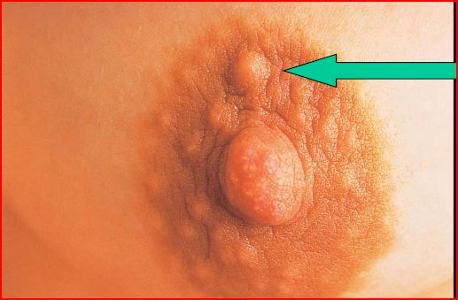
Montgomery’s Tubercles
Blocked Montgomery Tubercle

Slide 6
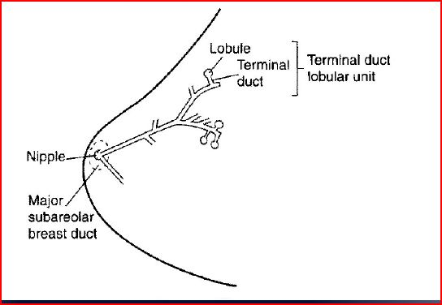
Terminal Lobular Unit and Branching Systems of Ducts

Slide 7
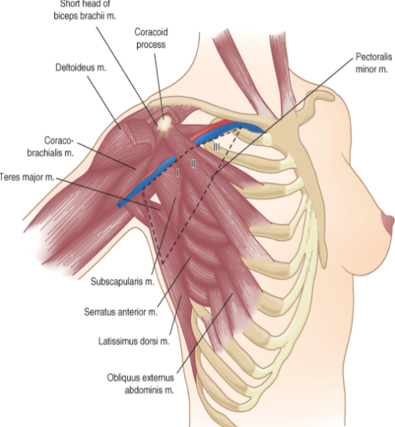
Anatomy
Axillary lymph nodes defined by pectoralis minor muscle:
- Level 1 – lateral - Level 2 – posterior - Level 3 – medial
Long Thoracic Nerve
- Serratus anterior
Thoracodorsal Nerve
- Latissimus Dorsi
Intercostalbrachial Nerve
- Lateral cutaneous - Sensory to medial arm & axilla

Slide 8
Tissue Types
Glandular Tissue - Milk producing tissue
Fibrous Tissue
Fatty Tissue

Slide 9
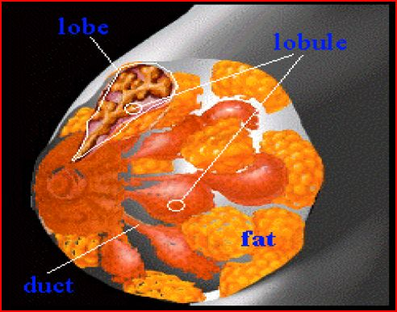
Internal Anatomy of the Breast

Slide 10
Fibrous Tissue
Cooper’s Ligaments -Suspensor ligaments
- Extending through the breast to underlying muscle - Benign or malignant lesions may affect these ligament - Skin retraction or dimpling

Slide 11
Fatty Tissue
Subcutaneous and retro-mammary fat
Bulk of breast.
No fat beneath areola and nipple

Slide 12
Chest Muscles
Pectoralis Major/Minor
Serratus Anterior
Latissimus Dorsi
Subscapularis
External Oblique
Rectus Abdominus

Slide 13
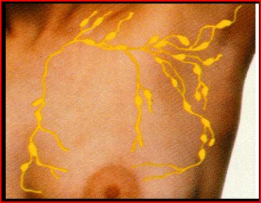
Lymph Nodes
Most drain towards axilla.
Superficial lymphatic nodes drain skin .
Deep lymphatic nodes drain mammary lobules

Slide 14
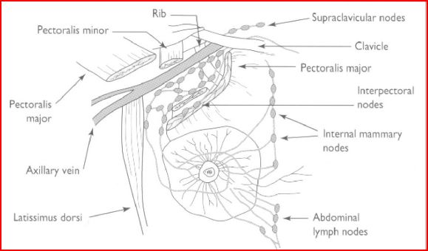
Lymph Drainage of Breast

Slide 15
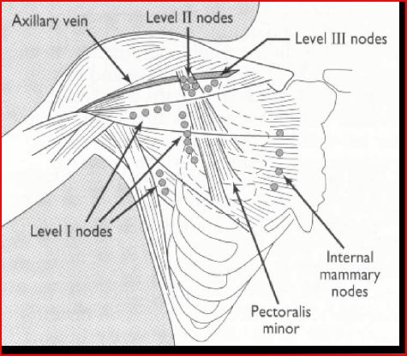
Levels of Axillary Nodes

Slide 16
Lymph Nodes
Palpate ALL nodes - From distal arm to under arm with deep palpation
Axillary
Supraclavicular
Infra-clavicular
Nodes deep in the chest or abdomen
Infra-mammary ridge - Shelf in the lower curve of each breast

Slide 17
Normal Variations of Breast
Accessory breast tissue.
Supernumerary nipples.
Hair
Lifelong Asymmetry

Slide 18
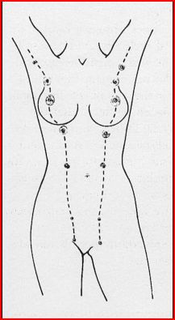
Milk Lines Sites of Accessory Nipples and Breasts

Slide 19
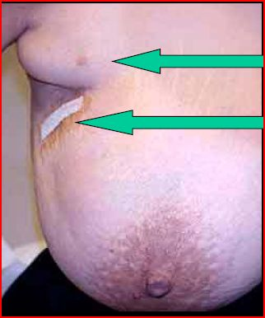
Accessory Beast Tissue
Accessory Tissue
Biopsy

Slide 20
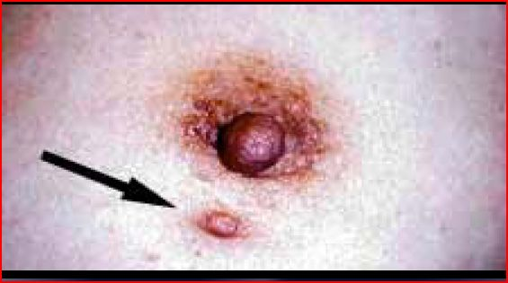
Accessory Nipple

Slide 21
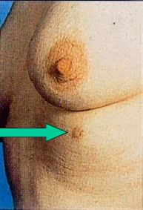
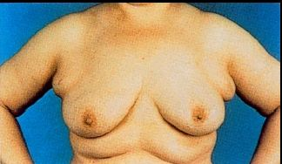
Accessory Nipple and Bilateral Accessory Breasts

Slide 22
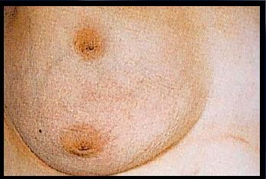
Breast with Two Nipples

Slide 23
Breast Hair

Slide 24
Physiology of Breast
Puberty - Need estrogen and progesterone
Estrogen - Growth and appearance - Milk-producing system
Progesterone - Lobes and alveoli - Alveolar cells become secretory
Asymmetry is common.

Slide 25
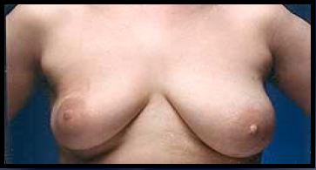
Breast Asymmetry

Slide 26
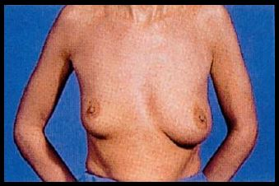
Breast Asymmetry

Slide 27
Physiology of Breast
Pregnancy and lactation
Glandular tissue displaces connective tissue
Increase in size
Nipples prominent and darker
Mammary vascularization increases
Colostrum present
Attain Tanner Stage V with birth

Slide 28
Physiology of Breast
Aging
Perimenopause
- Decrease in glandular tissue
- Loss of lobular and alveolar tissue
Flatten, elongate, pendulous
Infra-mammary ridge thickens
Suspensory ligaments relax
Nipples flatten
Tissue feels “grainy”

Slide 29
Clinical Breast Exam

Slide 30
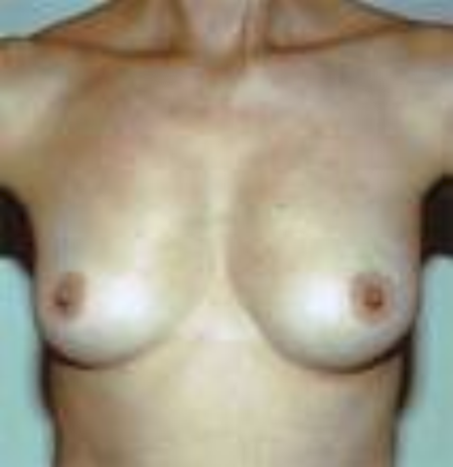
Clinical Exam
Inspection
Skin
Symmetry
Masses
Palpable
Gland
Axilla, Supraclavicular spaces
Nipple-areola complex

Slide 31
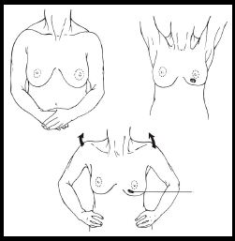
Inspect Both Breasts

Slide 32
Skin Dimpling and Change in Contour
Dimpling due to Carcinoma
Change in contour due to carcinoma

Slide 33
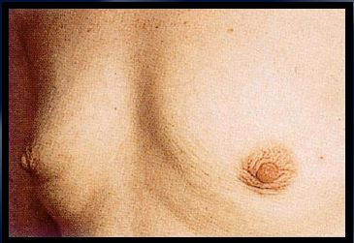
Skin Dimpling Both Breasts Involution Due to Aging

Slide 34
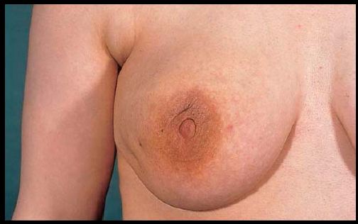
Skin Dimpling Breast Infection

Slide 35
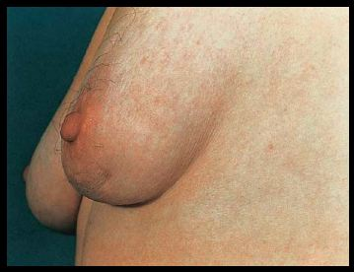
Skin Dimpling Previous Breast Surgery

Slide 36
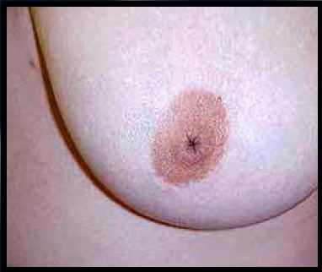
Inverted Nipple Since Puberty

Slide 37
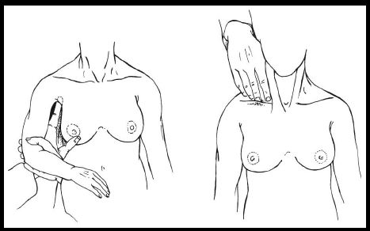
Palpate Axilla and Clavicular Nodes

Slide 38
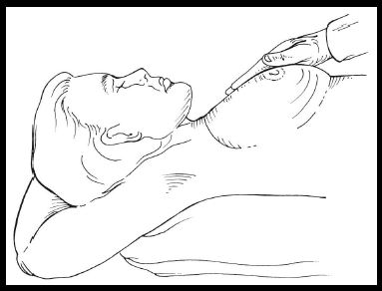
Breast Palpation

Slide 39
Common Benign Breast Disorders

Slide 40
Common Benign Breast Disorders
Fibrocystic changes
Fibroadenoma
Intraductal papilloma
Mammary duct ectasia
Mastitis
Fat necrosis
Phylloides tumor
Male gynecomastia

Slide 41
Fibrocystic Changes
Lumpy, bumpy breasts
50-80% of all menstruating women
Age 30-50 - 10% in women less than 21
Caused by hormonal changes prior to menses
Relationship to breast cancer doubtful

Slide 42
Fibrocystic Disease
Histology
Adenosis
Apocrine metaplasia
Fibrosis
Duct ectasia
Mild duct ectasia

Slide 43
Signs and Symptoms
Mobile cysts with well-defined margins
Singular or multiple
May be symmetrical
Upper outer quadrant or lower breast border

Slide 44
Signs and Symptoms
Pain and tenderness
Cysts may appear quickly and decrease in size
Lasts half of a menstrual cycle
Subside after menopause -If no HRT

Slide 45
Breast Mass
Breast Cysts
Fluid-filled
1 out of every 14 women
50% multiple and recurrent
Hormonally influenced
Needle aspirated

Slide 46
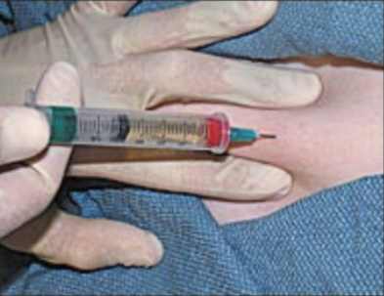
Breast Mass

Slide 47
Treatment
Aspirate cyst fluid
Imaging for questionable cysts
Treatment based on symptoms
Reassure
‘’Atypical Hyperplasia’’ on pathology report indicates increased risk of breast cancer

Slide 48
Breast Pain
Cyclical pain – hormonal
Dull, diffuse and bilateral
Luteal phase
Treatment: Reassurance, NSAIDS, evening primrose oil
Non-cyclical pain
Non-breast vs breast
Imaging
Treatment: Reassurance, NSAIDS, evening primrose oil

Slide 49
Fibroadenoma
Second most common breast condition
Most common in black women
Late teens to early adulthood
Rare after menopause

Slide 50
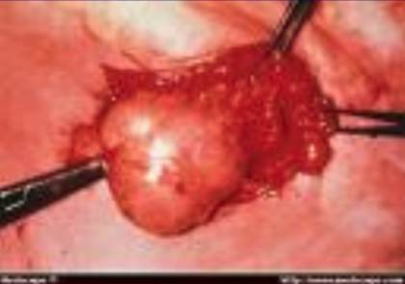
Fibroadenoma

Slide 51
Signs and Symptoms
Firm, rubbery, round, mobile mass
Painless, non-tender
Solitary - 15-20% are multiple
Well circumscribed
Upper-outer quadrant
1-5 cm or larger

Slide 52
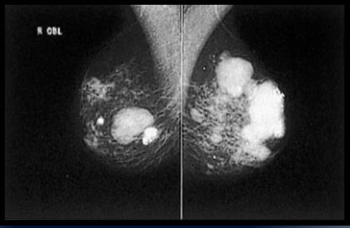
Mammogram Multiple Calcified Fibroadenomas

Slide 53
Intraductal Papilloma
Slow-growing
Overgrowth of ductal epithelial tissue
Usually not palpable
Cauliflower-like lesion
Length of involved duct
Most common of bloody nipple discharge
40-50 years of age

Slide 54
Signs and Symptoms
Watery, serous, serosanguinous, or bloody discharge
Spontaneous discharge
Usually unilateral
Often from single duct - Pressure elicits discharge from single duct
50% no mass palpated

Slide 55
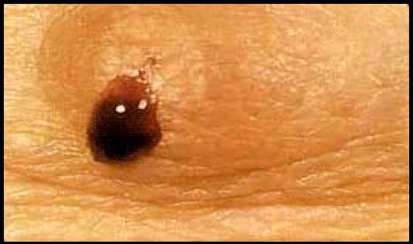
Bloody Breast Discharge

Slide 56
Treatment
Test for occult blood
Ductogram
Biopsy
Excision of involved duct

Slide 57
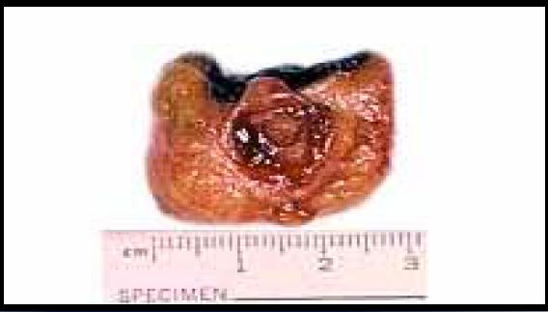
Intraductal Papilloma

Slide 58
Galactorrhea

Slide 59
Mammary Duct Ectasia
Inflammation and dilation of sub-areolar ducts
behind nipples
May result in palpable mass because of ductal
rupture
Greatest incidence after menopause
Etiology Unclear - Ducts become distended with cellular debris causing obstruction

Slide 60
Mammary Duct Ectasia versus Breast Cancer
Left breast – slit-like nipple characteristic of mammary duct eclasia
Right breast – nipple retraction from carcinoma

Slide 61
Signs and symptoms
Multi-colored discharge - Thick, pasty (like toothpaste) - White, green, greenish-brown or serosanguinous
Intermittent, no pattern
Bilaterally from multiple ducts
Nipple itching
Drawing or pulling (burning) sensation

Slide 62
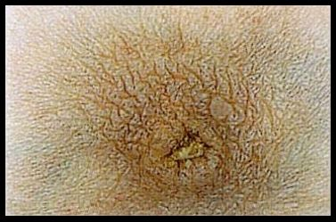
Dried Secretions from Mammary Duct Ectasia

Slide 63
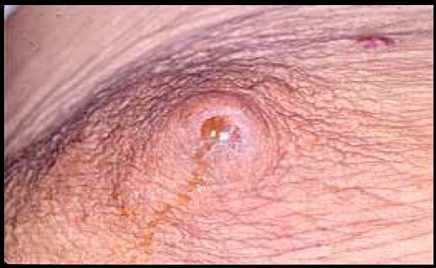
Yellow Breast Discharge Duct Ectasia

Slide 64
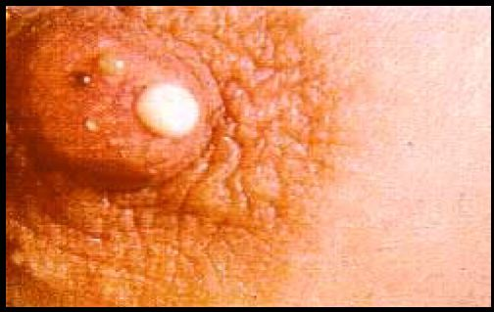
Multi-colored Breast Discharge

Slide 65
Treatment
Test for occult blood
Imaging - Mammogram - Sonogram
Biopsy - Excision of ducts if mass present
Antibiotics
Close follow-up

Slide 66
Mastitis
Breast infection when bacteria enter the breast via the nipple
Ducts infected
Fluid stagnates in lobules
Usually during lactation
Penicillin resistant staphylococcus common cause

Slide 67
Mastitis
Treatment
Antibiotics
Continue breast feeding
Close follow-up

Slide 68
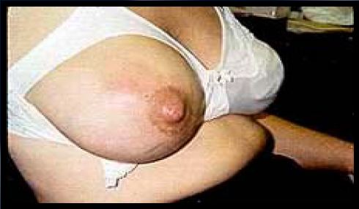
Puerperal Mastitis

Slide 69
Puerperal Mastitis Left Breast

Slide 70
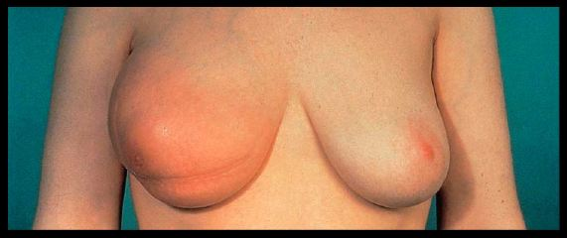
Inflammatory Carcinoma
Erythema and peau d’orange

Slide 71
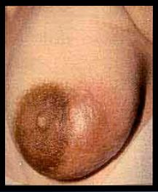
Signs and Symptoms of Mastitis
Pain
Nipple discharge - Pus - Serum - Blood
Localized induration
Fever
Breast Abscess

Slide 72
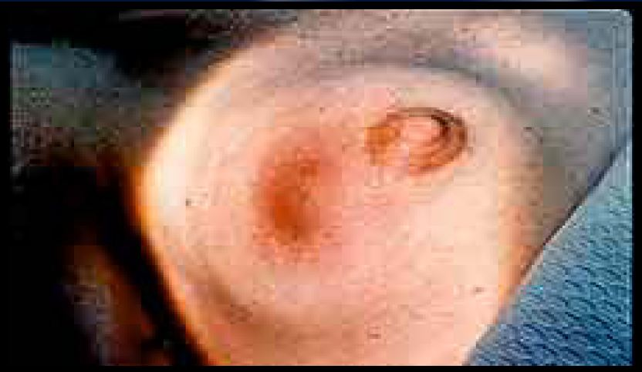
Breast Abscess

Slide 73
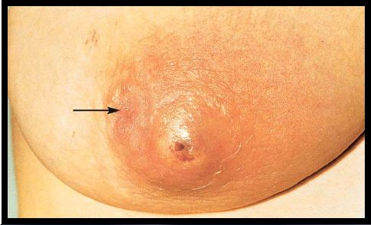
Non-Lactating Breast Abscess
Arrow points to inverted nipple

Slide 74
Breast Abscess
Treatment
Antibiotics
Needle aspiration
Incision and drainage

Slide 75
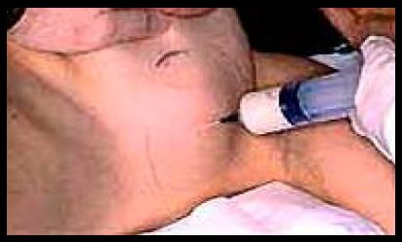
Draining Breast Abscess

Slide 76
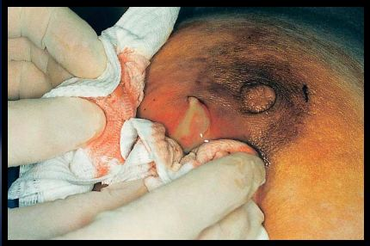
Abscess Drained under Local Anesthesia

Slide 77
Puerperal Breast Abscess
Before treatment
Local anesthetic
After treatment
Abscess occurred during lactation

Slide 78
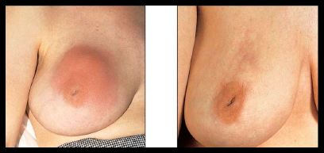
Peripheral Breast Abscess
Left – before management
Right – after recurrent aspiration and antibiotics

Slide 79
Fat Necrosis
Cause - Trauma to breast - Surgery
Necrosis of adipose tissue
Pain or mass - Usually non-mobile mass - Resolves over time without treatment -may be excised

Slide 80
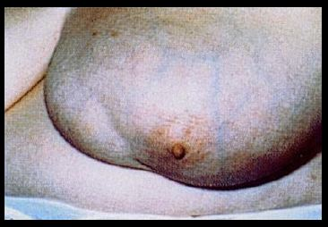
Fat Necrosis
Seat Belt Trauma

Slide 81
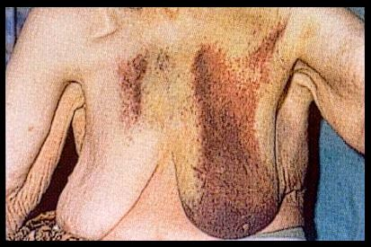
Breast Hematoma

Slide 82
Phylloides Tumor
Giant fibroadenoma with rapid growth
Malignant potential
Often occurs in women aged 40+
Treatment - Excision

Slide 83
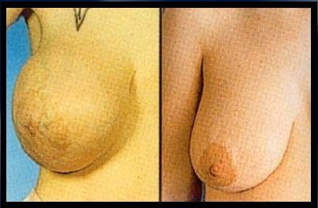
Giant Fibroadenoma
Before Surgery
After Surgery

Slide 84
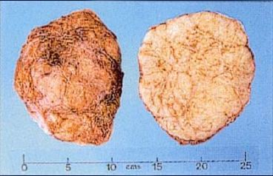
Cross Section of Giant Fibroadenoma

Slide 85
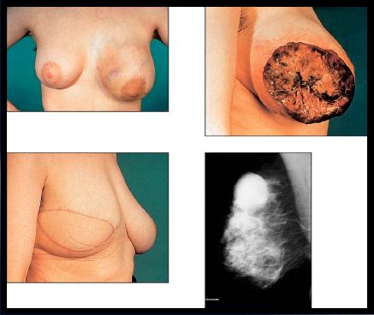
Malignant Phylloides Tumor

Slide 86
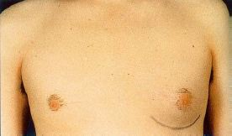
Left-Sided Gynecomastia

Slide 87
Treatment
If pre-puberty - Wait to see if it resolves
Change medication
Treat underlying illness
Occurs in families with genetic mutation - Colon, prostate cancer

Slide 88
Differential Diagnosis of Nipple Discharge
Common causes in non-pregnant women
Carcinoma
Intraductal papilloma
Fibrocystic changes
Duct ectasia
Hypothyroid
Pituitary adenoma

Slide 89
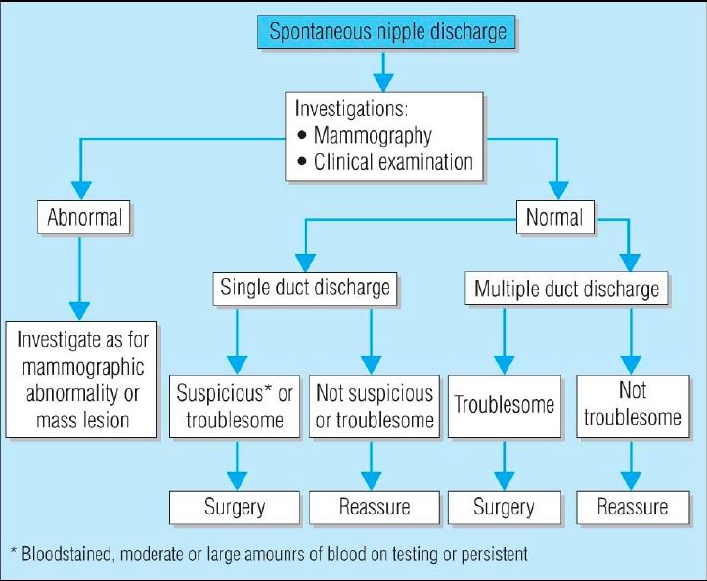

Slide 90
Clinical Characteristic
Physiologic - Usually bilateral - Multiple ducts - Non-spontaneous - Screen for phenothiazine use and stimulation

Slide 91
Physiological Breast Discharge

Slide 92
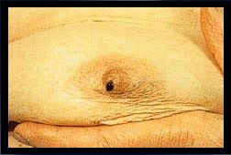
Clinical Characteristic
Pathologic discharge - Spontaneous - Unilateral - Single duct - Discolored discharge
Bloody discharge

Slide 93
Bloody Nipple Discharge

Slide 94
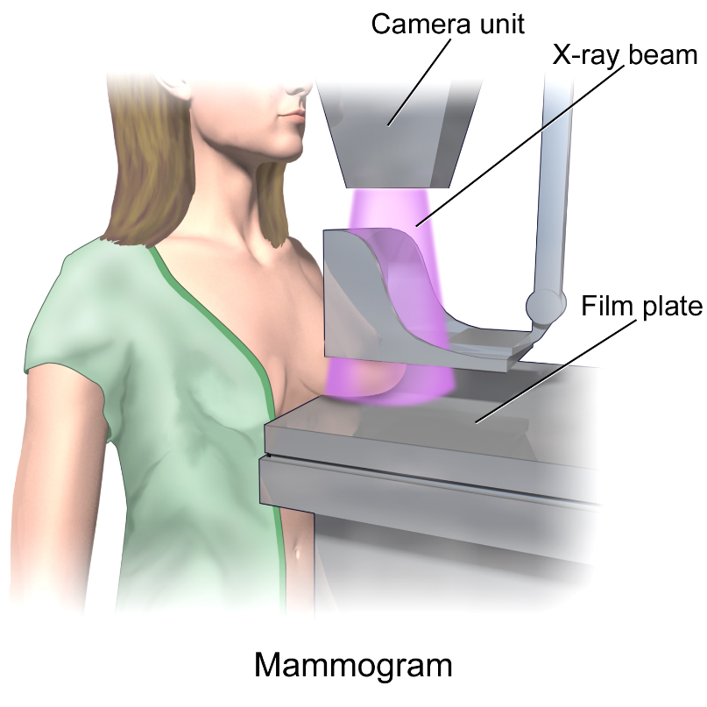
Mammography
Screening tool - Age of 40
Estimated reduction in mortality 15 – 25%
10% false positive rate
Densities and calcification

Slide 95
Calcification
Macrocalcifications - Large white dots - Almost always non-cancerous and require no further follow-up
Microcalcifications
- Very fine white specks - Usually non-cancerous but can sometimes be a sign of cancer
- Size, shape and pattern

Slide 99
BI-RADS Classification | Features
0 | Need additional imaging
1 | Negative – routine in 1 year
2 | Benign finding – routine in 1 year
3 | Probably benign – 6 month follow-up
4 | Suspicious abnormality – biopsy recommended
5 | Highly suggestive of malignancy – appropriate action must be taken

Slide 100
Ultrasound
Benign | Malignant
Pure hyperechoic | Hypoechoic, spiculated
Elliptical shape (wider than tall) | Taller than wide
Lobulated | Duct extension
Complete tine capsule | Microlobulation

Slide 101
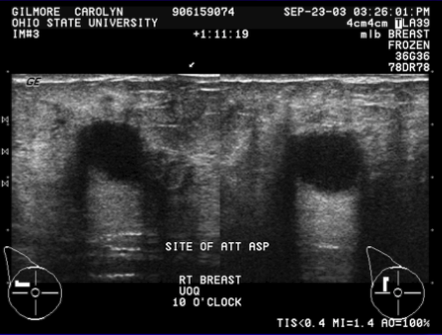
Ultrasound

Slide 102
MRI
High risk patients - History of breast cancer - LCIS, atypia - 1st degree relative with breast cancer - Very dense breast
High sensitivity
- 10 – 20% will have a biopsy

Slide 103
Diagnosis
Fine needle aspiration - Cytology
Core biopsy
- Image guided - Stereotactic
Excisional biopsy - Needle localization

Slide 104
Fine Needle Aspiration
Fast, inexpensive
96% accuracy
Institution dependent
Unable to differentiate between in-situ vs CA

Slide 105
Core Needle Biopsy
14 – 18 gauge spring loaded needle
Tissue
Multiple

Slide 107
Large Core Biopsy
6 – 14 gauge core
Large Samples
Single insertion

Slide 108
Core Biopsy Vacuum Assisted

Slide 109
Stereotactic Biopsy
Suspicious mammographic abnormalities
Patients lay prone

Slide 112
Excisional Biopsy
Atypical lesions
LCIS
Radial scar
Atypical papillary lesions
Radiologic-pathologic discordance
Phyllodes
Inadequate tissue harvesting

Slide 113
Screening
Prior breast cancer or atypia - Annual mammography - 6 month CBE
Family Hx
- 10 years younger than relative’s diagnosis - 6 month CBE
BRCA - 25 y.o, annual mammography - 6 month CBE

Slide 114
Genetics
Early age of onset
2 breast primaries or breast & ovarian CA
Clustering of breast CA with: - Male breast CA - Thyroid CA - Sarcoma - Adrenocortical CA - Pancreatic CA - Leukemia/Lymphoma on same side of family
Family member with BRCA gene
Male breast CA
Ovarian CA

Slide 115
BRCA
Account for 25% of early-onset breast cancers
36 - 85% lifetime risk of breast cancer
16 – 60% lifetime risk of ovarian cancer

Slide 116
BRCA Management
Monthly BSE – 18 y.o
6 month CBE & annual mammo – 25 y.o
Discuss risk reducing options
Prophylactic Mastectomies
Salpingo-oophorectomy upon completion of child bearing
6 month transvaginal US & CA125 – 35. y.o

Slide 117
Any Questions?

