Slide 1
Adrenal Gland
Dr Awadh Alqahtani MD,MSc, FRCSC(Surgery)FRCSC(Oncology),FICS
Laparoscopic Bariatric Surgeon and Surgical Oncologist.

Slide 2
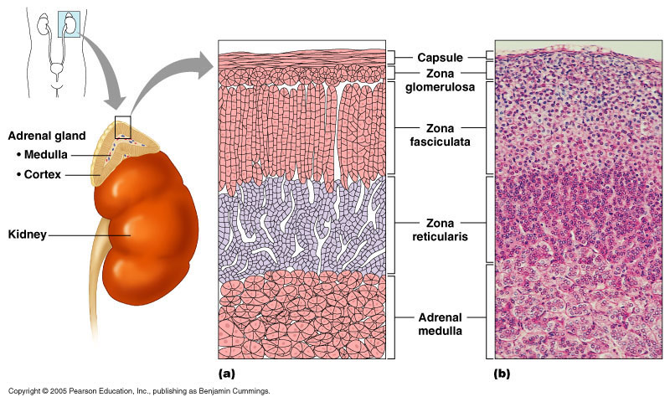
Adrenal Glands
Divided into two parts; each with separate functions
Adrenal Cortex
Adrenal Medulla

Slide 3
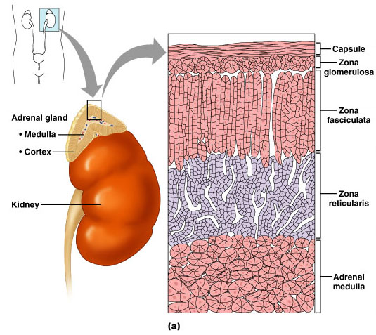
The Adrenal Cortex
Figure 25.9a

Slide 4
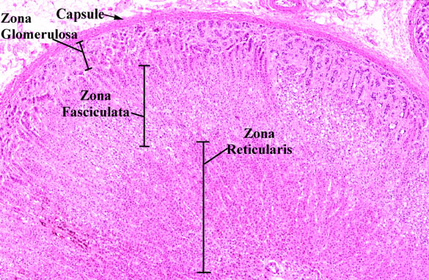

Slide 5
C. The Adrenal Glands
  Adrenal medulla
  Adrenal cortex
    Three specific zones and each produces a specific class of steroid hormone
    Zona glomerulosa – mineralocorticoids (Aldosterone)
    Zona fasciculata – glucocorticoids ( Cortisole )
    Zona reticularis - androgens

Slide 6
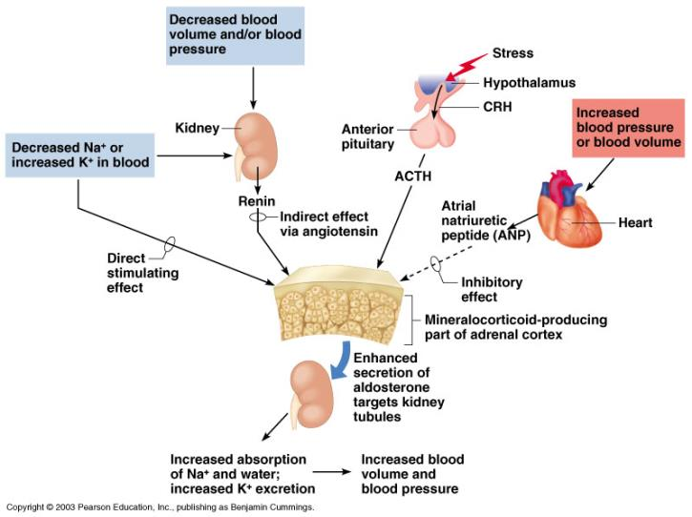
Hormones of the Adrenal Cortex
Figure 9.10
Copyright © 2003 Pearson Education, Inc. publishing as Benjamin Cummings
Slide 9.28b

Slide 7
ADRENAL CORTEX
Salt
Sugar
Sex

Slide 8
SALT
Mineralocorticoids (F & E balance)
  Aldosterone (renin from kidneys controls adrenal cortex production of aldosterone)
    Na retention
    Water retention
    K excretion

Slide 9
Question:
If your Na level is low, will aldosterone secretion
or
If your serum K+ level is high, will aldosterone secretion
or

Slide 10
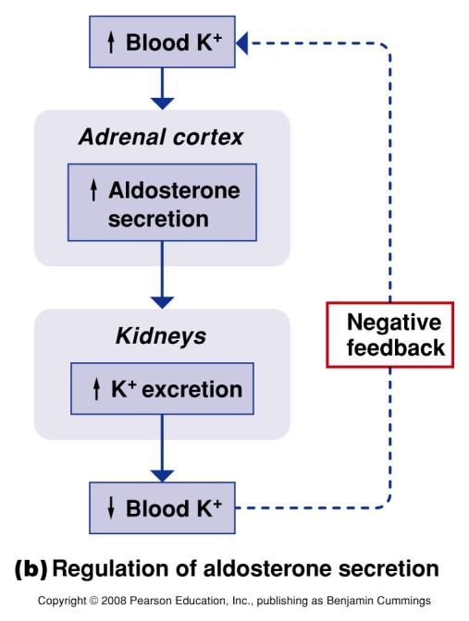
Figure 6.12b

Slide 11
SUGAR
GLUCOCORTICOIDS (regulate metabolism & are critical in stress response)
  CORTISOL responsible for control and & metabolism of:
  a. CHO (carbohydrates)
      amt. glucose formed
      amt. glucose released

Slide 12
CORTISOL
b. FATS-control of fat metabolism
    stimulates fatty acid mobilization from adipose tissue
c. PROTEINS-control of protein metabolism
  stimulates protein synthesis in liver
  protein breakdown in tissues

Slide 13
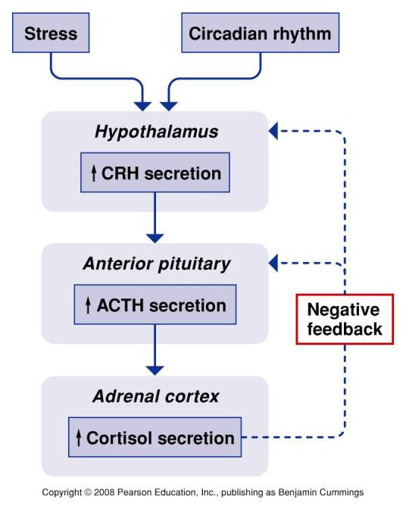
Figure 21.15

Slide 14
SUGAR
Other fxs of Cortisol
  inflammatory and allergic response
  immune system therefore prone to infection

Slide 15
SEX
ANDROGENS
  hormones which male characteristics
    release of testosterone
Seen more in women than men

Slide 16
RELEASE OF GLUCOCORTICOIDS IS CONTROLLED BY ______

Slide 17
LET’S LOOK AT ACTH
(adrenocorticotropic Hormone)
Produced in anterior pituitary gland

Slide 18
ACTH
Circulating levels of
cortisol
  levels cause stimulation of ACTH
  levels cause dec. release of ACTH
  think tank: What type of feedback mechanism is this??

Slide 19
AFFECTED BY:
Individual biorhythms
  ACTH LEVELS ARE HIGHEST 2 HOURS BEFORE AND JUST AFTER AWAKENING.
  usually 5AM - 7AM
  these gradually decrease rest of day
Stress- cortisol production and secretion

Slide 20
ADRENAL MEDULLA
Fight or flight
What is released by the adrenal medulla?

Slide 21
CATECHOLAMINE RELEASE
Epinephrine
Norepinephrine

Slide 22
HYPER AND HYPOFUNCTION ADRENAL CORTEX HORMONES
Too much
Too little

Slide 23
I. CUSHING’S DISEASE
(TOO MUCH CORTISOL!)
secretion of cortisol from adrenal cortex
4X more frequent in females
Usually occurs at 35-50
years of age

Slide 24
ETIOLOGY
Cushing’s
Primary-tumor on the adrenal cortex
Secondary-tumor on the anterior pituitary gland
Ectopic ACTH secreting tumor (lung, pancreas)
Iatrogenic-Steroid administration

Slide 25
SIGNS & SYMPTOMS
Cushing’s
protein catabolism
  muscle wasting
  loss of collagen support
    thin, fragile skin, bruises easily
  poor wound healing

Slide 26
SIGNS & SYMPTOMS
Cushing’s
s in CHO metabolism
  hyperglycemia
  Can get diabetes-insulin can’t keep up
  Polyuria

Slide 27
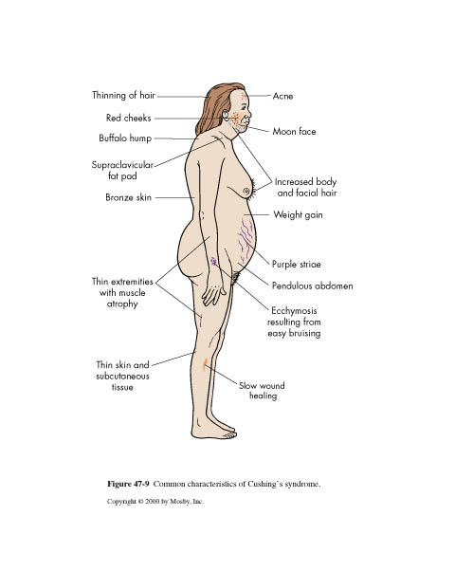

Slide 28
SIGNS & SYMPTOMS
Cushing’s
s in fat metabolism
  truncal obesity
  buffalo hump
  “moon face”
  weight but strength

Slide 29
SIGNS & SYMPTOMS
immune response
  More prone to infection
  resistance to stress
  Death usually occurs from infection

Slide 30
SIGNS AND SYMPTOMS
Cushing’s
androgen secretion
  excessive hair growth
  acne
  change in voice
  receding hairline

Slide 31
SIGNS & SYMPTOMS
mineralocorticoid activity
  ________ retention
_______ retention
  b.p. from ________

Slide 32
II. HYPERALDOSTERONISM
“Conn’s Syndrome”
Too much aldosterone secretion
Question: What does aldosterone do????
_____________________________
usually caused by adrenal tumor

Slide 33
SIGNS & SYMPTOMS
Hyperaldosteronism
Na and water retention
  H/A, HTN
K+ (hypokalemia)
What is the normal serum K+ level???
Usually no edema

Slide 34
DIAGNOSIS-Hyperaldosteronism
urinary K
plasma aldosterone levels with low plasma renin levels
CT scan
EKG changes

Slide 35
ADRENALECTOMY
PRE-OP
Stabilize hormonally
Correct fluid and electrolytes
Cortisol PM before surgery, AM of surgery and during OR.

Slide 36
ADRENALECTOMY
POST-OP
ICU-What type of problems to expect??
IV cortisol for 24 hours
IM cortisol 2nd day
PO cortisol 3rd day
Poor wound healing
If unilateral- steroids weaned
  other adrenal takes over 6-12 months

Slide 37
ADDISON’S DISEASE hypofunction of adrenal cortex
What hormones will you have too little of???
glucocorticoids or _______
mineralocorticoids or _______
androgens or ____________

Slide 38
ETIOLOGY of Addison’s
Idiopathic atrophy
  autoimmune condition Antibodies attack against own adrenal cortex
  90% of tissue destroyed

Slide 39
ETIOLOGY of Addison’s
TB/fungal infections (histoplasmosis)
Iatrogenic causes
  adrenalectomy, chemo, anticoagulant tx

Slide 40
SIGNS & SYMPTOMS
Addison’s Disease
fatigue, weight loss, anorexia
  Why? think of cortisol fx
Changes in skin pigment
  small black freckles
  cortisol -- ACTH-- MSH
Muscular weakness
  cortisol helps muscles maintain contraction
  and avoid fatigue

Slide 41
SIGNS & SYMPTOMS Addison’s
Fluid & electrolyte imbalances
  WHY???
b.p.
  WHY???
Hyponatremia-why?
Hyperkalemia-why?
Hypoglycemia-why?

Slide 42
SIGNS & SYMPTOMS Addison’s
androgens
  hair loss, sexual fx
mental disturbances
  anxiety, irritability, etc.
salt craving-why?

Slide 43
DIAGNOSIS-Addison’s
serum cortisol
urinary 17-OHCS and 17 KS
K,
Na
serum glucose

Slide 44
INTERVENTIONS
Addison’s Disease
Life long hormone replacement
  primary-need oral cortisone 20-25mgs in AM and 10-12mg in PM
  change dose PRN for stress
  also need mineralocorticoid-(FLORINEF)

Slide 45
INTERVENTIONS
Salt food liberally
Do not fast or omit meals
Eat between meals and snack
Eat diet high in carbs and proteins
Wear medic-alert bracelet
kit of 100mg hydrocortisone IM

Slide 46
INTERVENTIONS
Addison’s Disease
Keep parenteral glucocorticoids at home for injection during illness
Avoid infections/stress

Slide 47
COMPLICATIONS
Addison’s Disease
Adrenal crisis
Electrolyte imbalance
Hypoglycemia

Slide 48
PHEOCHROMOCYTOMA
rare, benign tumor of the adrenal medulla
oh no...what are we going to see a hypersecretion of????

Slide 49
SIGNS AND SYMPTOMS
Hallmark is hypertension-200/150 or greater
“Spells” -paroxymal attacks
  bladder distension,emotional distress, exposure to cold.
NE and Epinepherine released sporadically

Slide 50
SIGNS & SYMPTOMS
Deep breathing
Pounding heart
Headache
Moist cool hands & feet
Visual disturbances

Slide 51
DIAGNOSIS
24 hour urine-VMA (metabolite of Epinepherine)
Plasma catecholamines
CT to locate tumor

Slide 52
INTERVENTIONS-PRE-OP
Adrenergic blocking agents
  Minipress to bp
Beta blocking agents
  Inderal to hr, b.p., & force of contraction
Diet
  high in vitamin, mineral,calorie, no caffeine
Sedatives

Slide 53
INTERVENTIONS
Monitor b.p.
Eliminate attacks
If attack- complete bedrest and HOB 45 degrees

Slide 54
DURING SURGERY
GIVE REGITINE AND NIPRIDE TO PREVENT HYPERTENSIVE CRISIS

Slide 55
POST-OP
b.p. may be initially, BUT CAN BOTTOM OUT
Volume expanders
Vasopressors
Hourly I and O
Observe for hemorrhage

Slide 56
Adrenal incidentaloma
Mass lesion greater than 1 cm.
Serendipitiously discovered by radiologic examinations
Such as : - Computed tomography (CT)
- Magnetic resonance imaging (MRI)
Two questions
- Is it malignancy ?
- Is it functioning ?

