Slide 1
Benign Esophageal Diseases
Dr.Sami Alnassar MD, FRCSC.FCCP

Slide 2
Introduction
At the end of this Presentation , you will be able to :
  Understand the history related to common esophageal diseases such as GERD
  Understand the symptoms and signs of esophageal perforation
  Understand the symptoms and signs of esophageal motility disorder

Slide 3
Case 1
50 years old Male Presented to you in the clinic with history of Heartburn and Hoarseness.
He is obese
smoker
What else in the history ?

Slide 4
Clinical Presentations of GERD
Classic GERD
    Substernal burning and or regurgitation
    Postprandial
    Aggravated by change of position
    Prompt relief by antacid

Slide 5
Extraesophageal Manifestations of GERD
Pulmonary
  Asthma
  Aspiration pneumonia
  Chronic bronchitis
  Pulmonary fibrosis
Other
  Chest pain
  Dental erosion
ENT
  Hoarseness
  Laryngitis
  Pharyngitis
  Chronic cough
  Globus sensation
  Dysphonia
  Sinusitis
  Subglottic stenosis
  Laryngeal cancer

Slide 6
Clinical Presentations of GERD
Symptoms of Complicated GERD :
    Dysphagia
      Difficulty swallowing: food sticks or hangs up
    Odynophagia
      Retrosternal pain with swallowing
    Bleeding

Slide 7
Case 1
Examination was unremarkable
What is your next step in the management of this patient ?

Slide 8
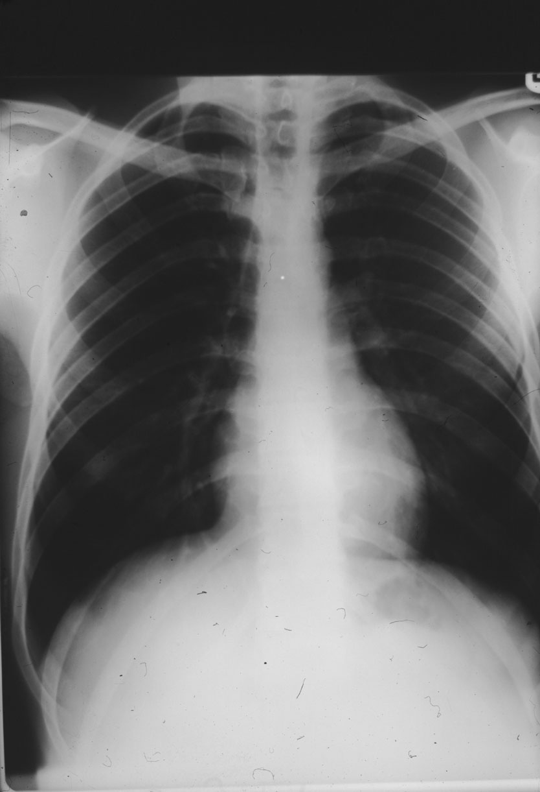

Slide 9
Barium Swallow
Barium swallow report :
    No stricture or tumor
    Small hiatus hernia
    Evidence of reflux of the contrast
What is the types of the hiatus hernia ?

Slide 10
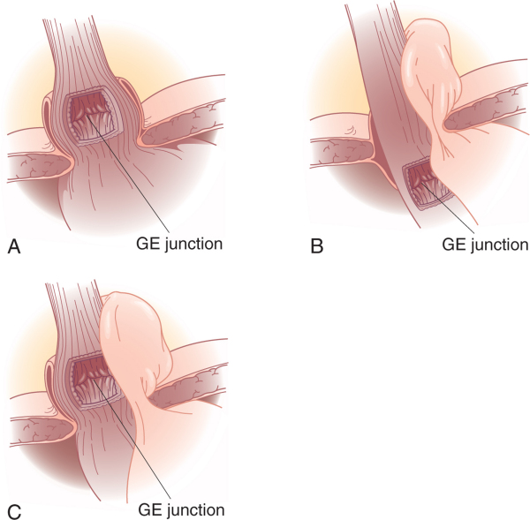

Slide 11
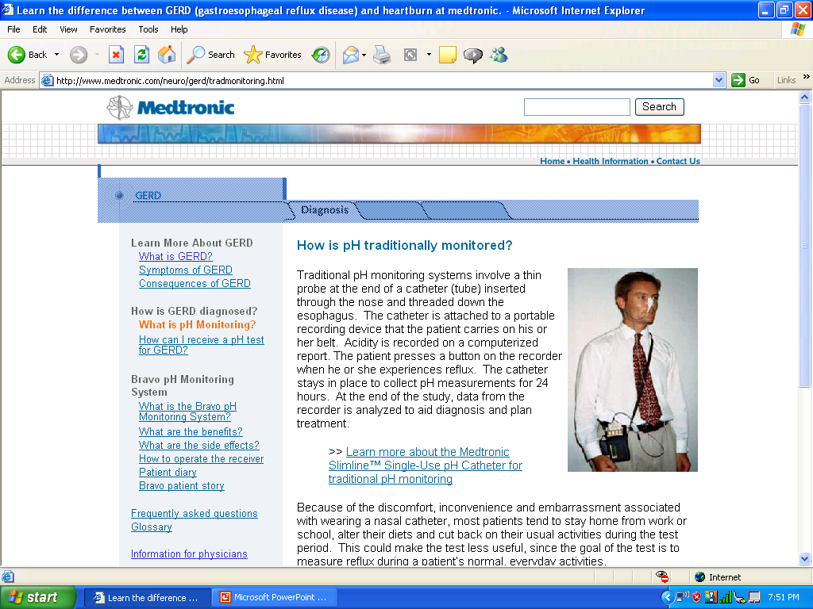
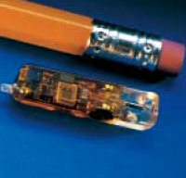
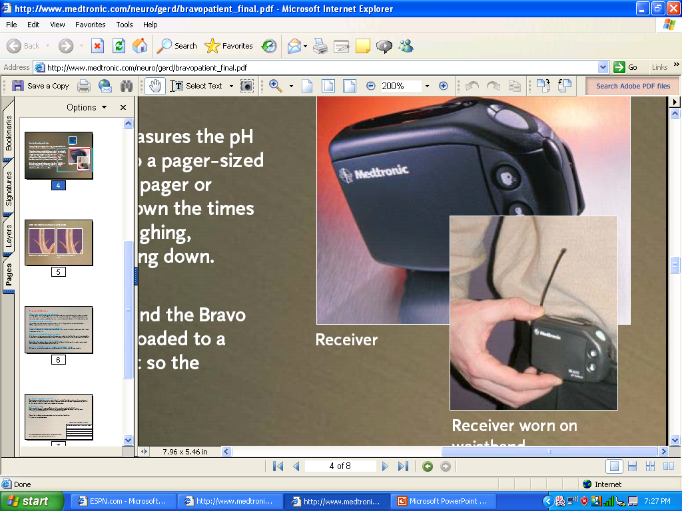
Esophageal pH Monitoring

Slide 12
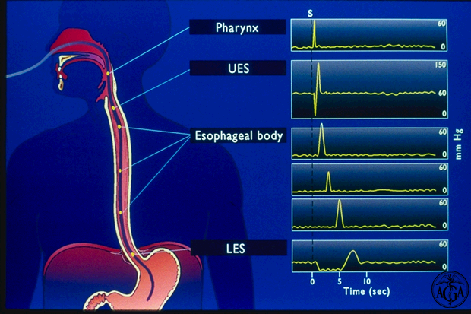
Esophageal Manometry

Slide 13
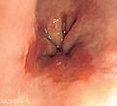
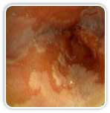
Endoscopy

Slide 14
Case 1
Biopsy was done
Pathology report :
    esophagitis with intestinal, columnar epithelium replaces the stratified squamous epithelium ( metaplasia) consistent with Barrett's Esophagus,
    No evidence of dysplasia
What is next ?

Slide 15
Treatment
Lifestyle Modifications
    Elevate head of bed 4-6 inches
    Avoid eating within 2-3 hours of bedtime
    Lose weight if overweight
    Stop smoking
    Modify diet
      Eat more frequent but smaller meals
      Avoid fatty/fried food, peppermint, chocolate, alcohol, carbonated beverages, coffee and tea
    OTC medications prn

Slide 16
Acid Suppression Therapy for GERD
H₂-Receptor Antagonists
(H₂RAs)
Cimetidine (Tagamet®)
Ranitidine (Zantac®)
Famotidine (Pepcid®)
Nizatidine (Axid®)
Proton Pump Inhibitors
(PPIs)
Omeprazole (Prilosec®)
Lansoprazole (Prevacid®)
Rabeprazole (Aciphex®)
Pantoprazole (Protonix®)
Esomeprazole (Nexium) ®)

Slide 17
Anti-Reflux Surgery
Indication for Surgery :
    have failed medical management
    opt for surgery despite successful medical management (due to life style considerations including age, time or expense of medications, etc)
    have complications of GERD (e.g. Barrett's esophagus; grade III or IV esophagitis)
    have medical complications attributable to a large hiatal hernia. (e.g. bleeding, dysphagia)
    have "atypical" symptoms (asthma, hoarseness, cough, chest pain, aspiration) and reflux documented on 24 hour pH monitoring

Slide 18
Case 1
you advise the patient t:
    Reduce wieght
    Quit smoking
Started the patient on
    Nexium 40 mg od
Advise patient to have
    Follow up endoscopy

Slide 19
Case 1
3 months later , you did endoscopy for the patient , 6 hour post endoscopy patient start to complain of :
    Chest pain
    Fever
What else in the history ?
What is your management ?

Slide 20
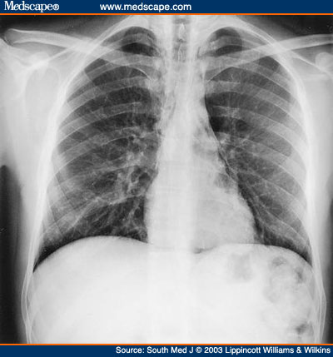

Slide 21
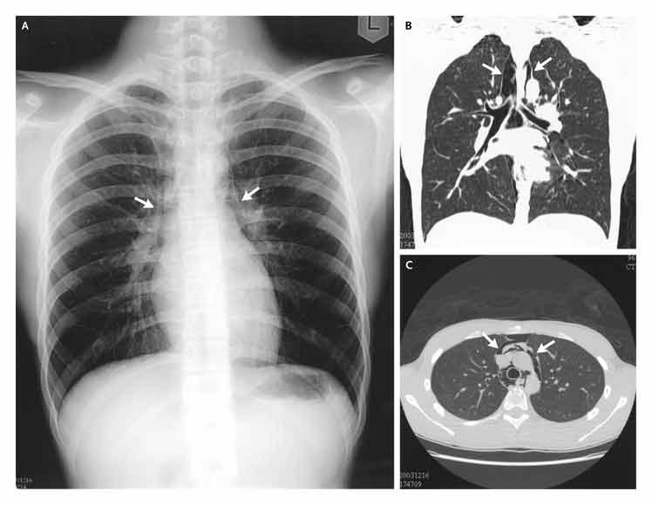

Slide 22
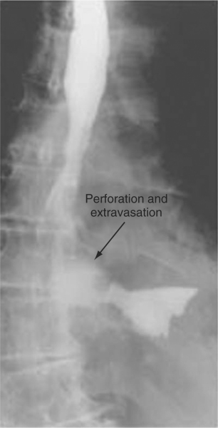

Slide 23
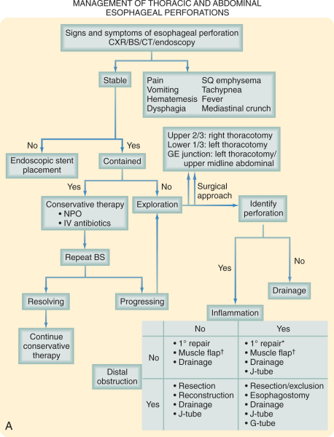

Slide 24
Treatment
IV fluids and broad-spectrum antibiotics are started immediately, and the patient is monitored in an ICU
The patient is kept NPO, and nutritional access needs are assessed
Patient improved and he was discharged home

Slide 25
Case 1
6 years later , he presented to your clinic complaining of :
Dysphagia
Weight loss
What else in the history ?
What is your differentials?
How you going to manage this patient?

Slide 26
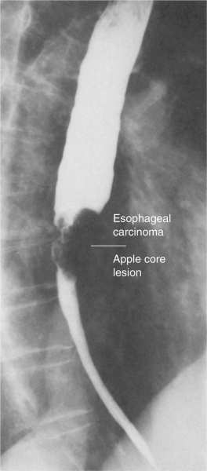

Slide 27
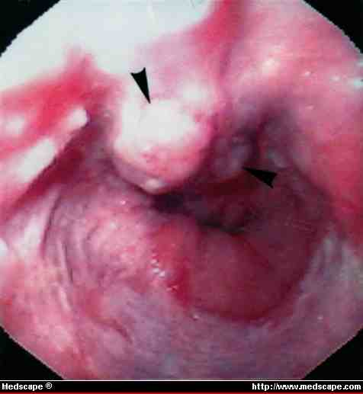

Slide 28
Case 1
The biopsy from the endoscopy revealed :
    Adenocarcinoma
What is your treatment options ?

Slide 29
Treatment
Chemotherpay
Radiation therap
Chemo-radiotherap
Surgical resection

Slide 30
Case 2
24 years old , healthy presented to your clinic complaining of :
    Dysphagia
How you going to manage this patient?

Slide 31
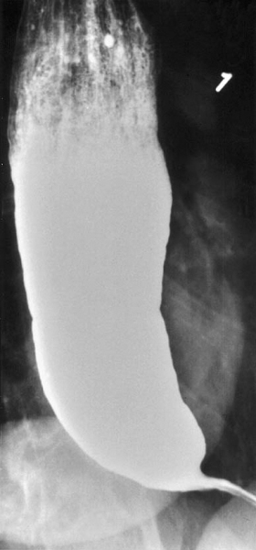
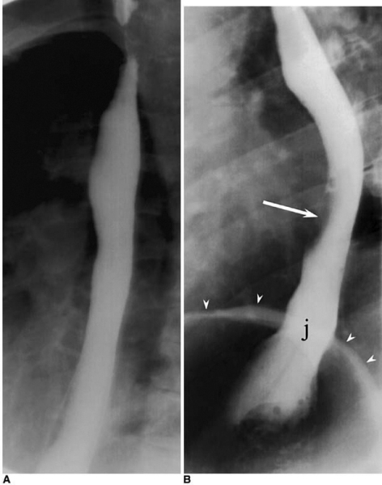

Slide 32
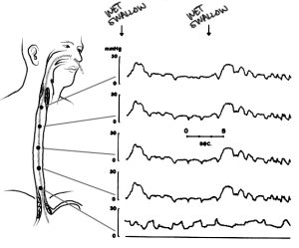

Slide 33
Case 2
His manometry consistent with Achalasia
Endoscopy showed :
    Dilated esophagus
    Retained food particles
How you going to treat this patient ?

Slide 34
Case 2
Treatment options :
    Medical therapy
    Botulinum toxin injection
    Bneumatic dilation
    Surgical myotomy
    Which option you will advice the patient to choose ?

Slide 35
Case 3
70 years old male , his wife bring him to your clinic Because :
    Bad breath
    Chronic cough especially after eating
How you going to manage this patient ?

Slide 36
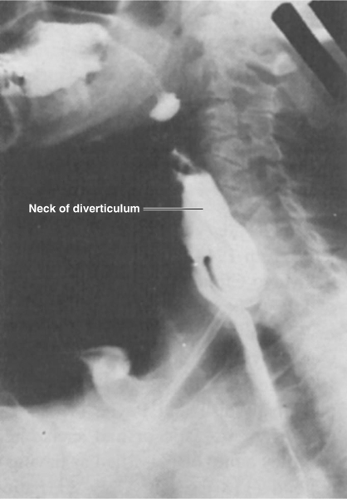

Slide 37
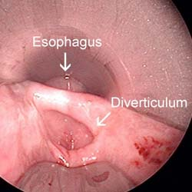

Slide 38
Treatment
Surgical or endoscopic repair of a Zenker's diverticulum is the gold standard of treatment
Open repair involve :
    myotomy of the proximal and distal thyropharyngeus and cricopharyngeus muscles
    diverticulectomy or diverticulopexy are performed through an incision in the left neck

Slide 39
Treatment
An alternative to open surgical repair is the endoscopic Dohlman procedure
Endoscopic division of the common wall between the esophagus and the diverticulum using a laser or stapler has also been successful

Slide 40
Case 3
What is the cause of the Esophageal Diverticula ?
What is the different types of the Esophageal Diverticula ?
And what is the most common sites ?

Slide 41
Esophageal Diverticula
most diverticula are a result of a primary motor disturbance or an abnormality of the UES or LES
can occur in several places along the esophagus
The three most common sites of occurrence are pharyngoesophageal (Zenker's), parabronchial (midesophageal), and epiphrenic

Slide 42
Esophageal Diverticula
Zenker's diverticulum and an epiphrenic diverticulum fall under the category of false, pulsion diverticula.
Traction, or true, diverticula result from external inflammatory mediastinal lymph nodes adhering to the esophagus

