Slide 1
Atherosclerosis: A Surgical Look
Badr Aljabri , MD, FRCSC
Associate Professor & Consultant
Vascular Surgery
King Saud University
Notes:
*

Slide 2
What is Atherosclerosis?
Clogging, narrowing, and hardening of large and medium-sized arteries
Notes:
*

Slide 3
What are the risk factors for Atherosclerosis?
Non-Modifiable Risk Factors:
Male gender
Advanced age
Family history
Modifiable Risk Factors:
Major
Smoking
Hypertension
Diabetes
Hyperlipidemia
Minor
Homocystenemia
Obesity
Hypercoaguable state
Physical inactivity
Notes:
*

Slide 4
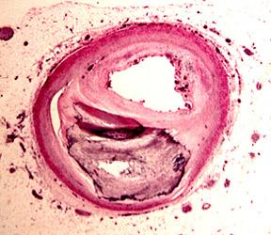
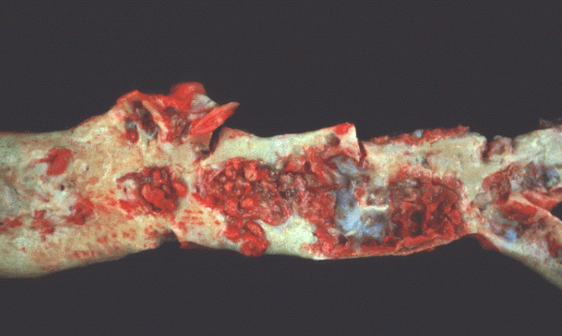
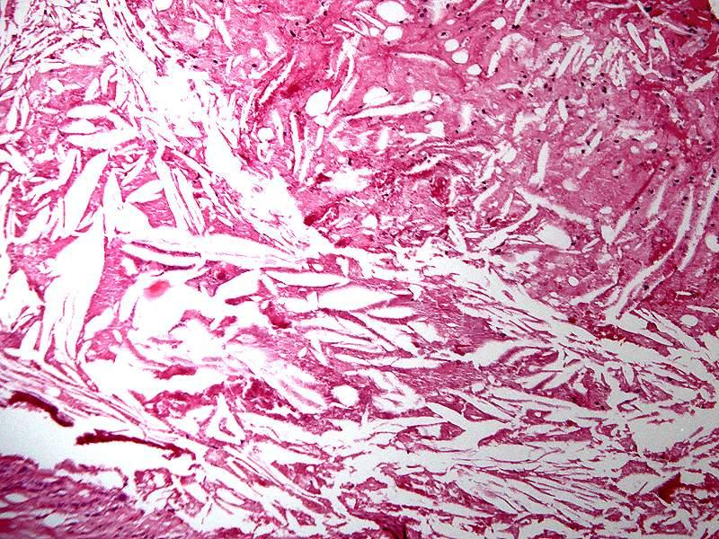
Pathogenesis
Notes:
*

Slide 5
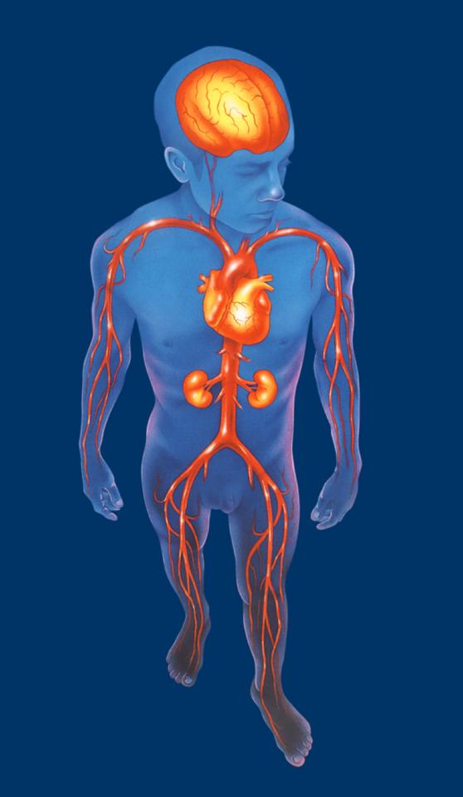
What is the Clinical Spectrum of Atherosclerosis?
Cerebrovascular disease
Coronary artery disease
Renal artery Diseases
Visceral arterial disease
Peripheral arterial disease
Intermittent claudication
Critical limb ischemia
Notes:
*

Slide 6
What is the burden of Atherosclerosis?
Notes:
*

Slide 7
Let’s Talk about PAD
Notes:
*

Slide 8
Why it is important to recognize patients with PAD?
PAD is a marker of systemic atherosclerosis
Patients with either symptomatic or asymptomatic PAD generally have widespread arterial disease
Notes:
*

Slide 9
Why it is important to recognize patients with PAD?
Coexisting vascular Disease:
CAD-- 35 % to 92%
CVD-- 25 % to 50%
Notes:
*

Slide 10
Why it is important to recognize patients with PAD?
Cause of death:
CAD– 40%-60%
CVD– 10%-20%
Non-cardiovascular causes--Only 20% to 30 %
Patients with PAD have a 6 fold increased risk of cardiovascular disease mortality compared to patients without PAD
Notes:
*

Slide 11
Natural History
Annual risk :
- Mortality 6.8%
- MI 2.0%
- Intervention 1.0%
- Amputation 0.4%
Ouriel K, Lancet 2001; 358: 1257-64.
Notes:
*

Slide 12
How do patients with PAD present?
Symptomatic
Intermittent claudication
Critical Limb Ischemia
Pain at rest
Tissue loss
Gangrene
Asymptomatic
Notes:
*

Slide 13
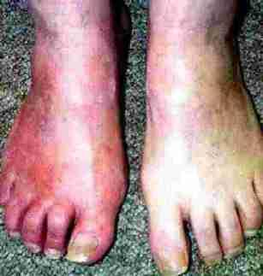
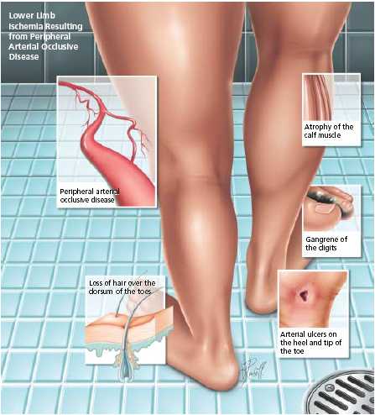
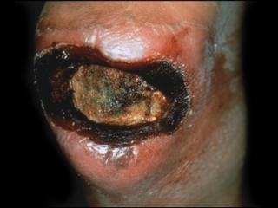
How do patients with PAD present?
Notes:
*

Slide 14
How do we diagnose PAD?
Symptomatic
History
Physical Examination
ABI measurement
Non-invasive tests (arterial duplex,
CTA, MRA)
Invasive test (Conventional angiogram)
Asymptomatic
ABI measurement
Notes:
*

Slide 15
How do we diagnose PAD?
Symptomatic
10%
Asymptomatic
90%
Notes:
*

Slide 16
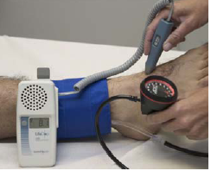
Ankle Brachial Index
ABI= Ankle SBP(PT or DP)/ Highest Arm SBP
Notes:
*

Slide 17
Ankle Brachial Index
ABI value | Indicates
<0.9 | Abnormal
0.8- 0.9 | Mild PAD
0.5- 0.8 | Moderate PAD
<0.5 | Severe PAD
<0.25 | Very Severe PAD
The ABI has limited use in evaluating calcified vessels that are not compressible as in Diabetics
Notes:
*

Slide 18
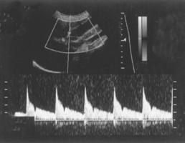
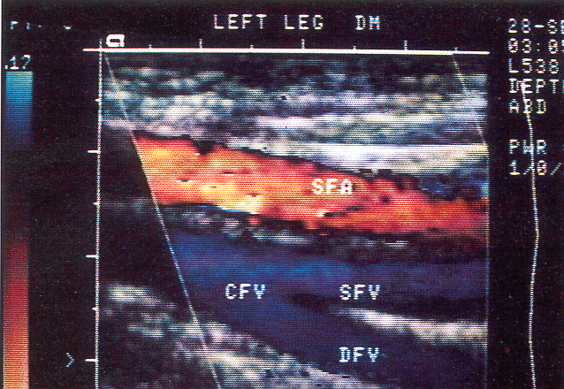
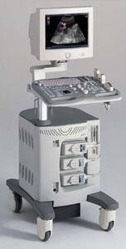
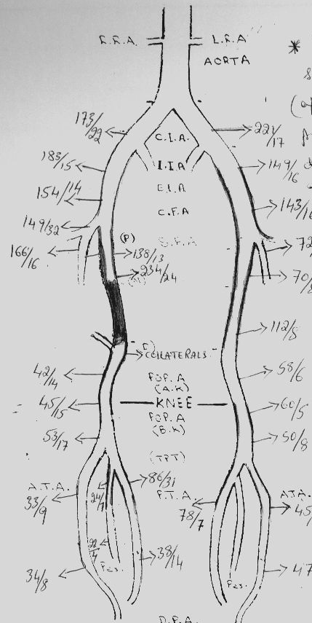
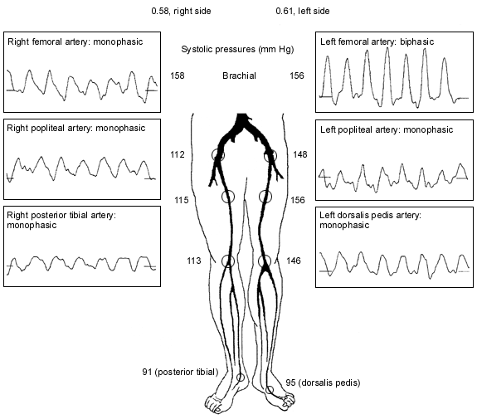
Arterial duplex
Notes:
*

Slide 19
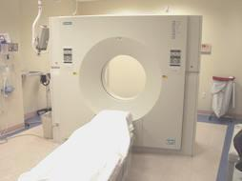
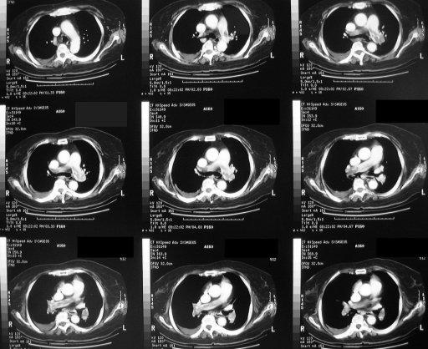
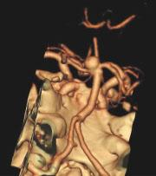
CTA
Notes:
*

Slide 20
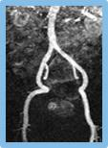
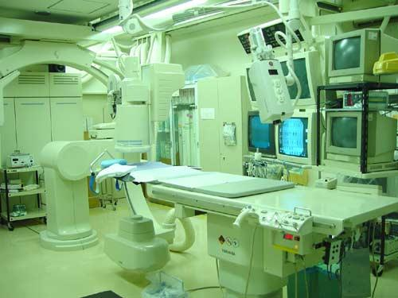
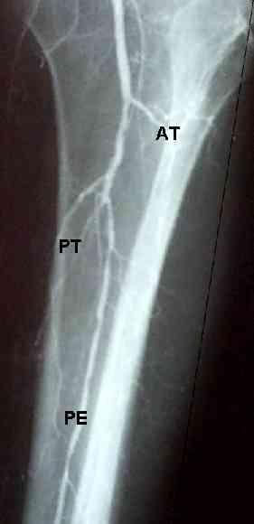
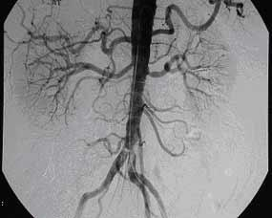
Angiogram
Notes:
*

Slide 21
What are the Goals of treating patients with PAD?
Relief symptoms
Improve quality of life
Limb salvage
Prolong survival
Notes:
*

Slide 22
Strategies in treating patients with PAD
Risk Factors Modification
Improve Lower Limb Circulation
Notes:
*

Slide 23
Risk Factors Modification
Diet and weight control
Exercise
Antiplatlets
Hypertension control
Diabetes control
Lipid control
Smoking Cessation
Notes:
*

Slide 24
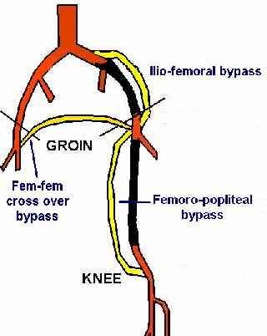
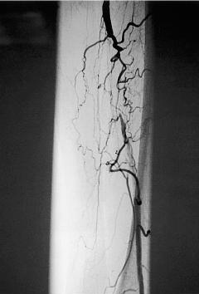
Strategies in treating patients with PAD
Improve Lower Limb Circulation
Conservative (Exercise Program)
Intervention ( Revascularization)
- Angioplasty +/- Stenting
- Surgical Bypass
Notes:
*

Slide 25
Percutanous Transluminal Angioplpasty PTA
Notes:
*

Slide 26
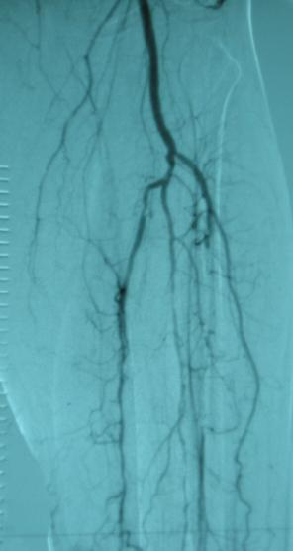
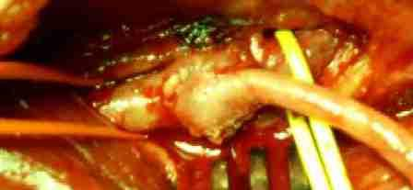
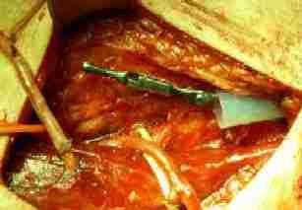
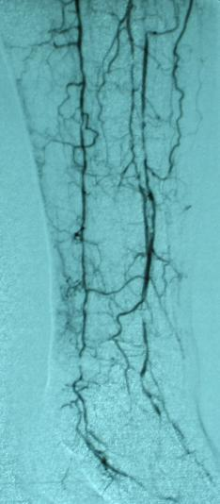
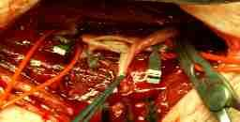
Surgical Bypass
Notes:
*

Slide 27
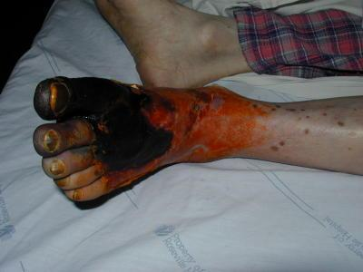
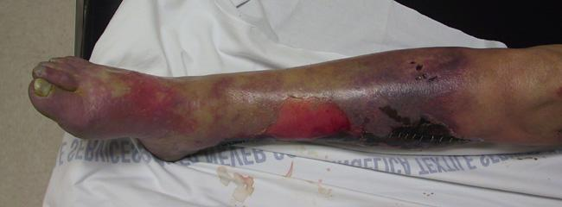
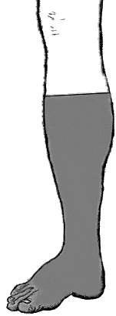
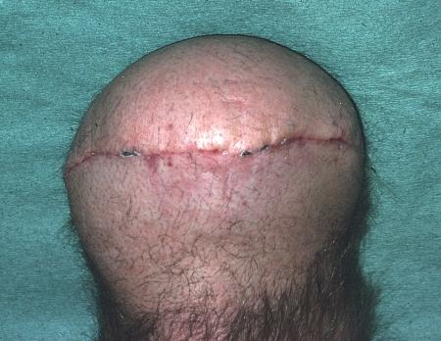
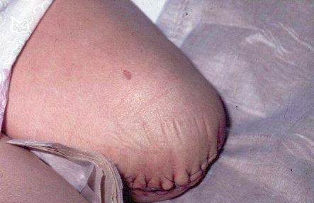
Last Strategy in treating patients with PAD
Major amputation
Primary vs Secondary
Minor vs BKA vs AKA
Notes:
*

Slide 28
NOW
Let’s Talk about Carotid Artery Disease
Notes:
*

Slide 29
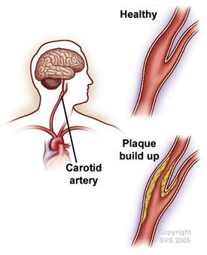
Why it is important to recognize patients with CAS?
Stroke is the third leading cause of death and a principal cause of long-term disability in much of the western countries
Notes:
*

Slide 30
How do patients with CAS present?
Symptomatic
Transient Ischemic Attacks (TIA)
Amurosis Fugax (Transient Visual Loss)
Stroke
Asymptomatic
Notes:
*

Slide 31
How do we diagnose CAS?
Symptomatic
History
Physical Examination
Non-invasive tests (arterial duplex,
CTA, MRA)
Invasive test (Conventional angiogram)
Asymptomatic
Carotid Bruit
Arterial duplex
Notes:
*

Slide 32
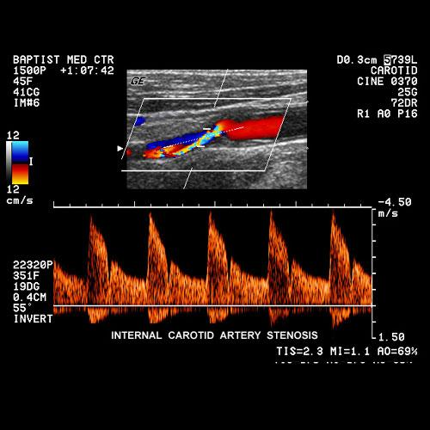
Arterial duplex
Stenosis is determined by measuring Velocities NOT anatomical diameter
Notes:
*

Slide 33
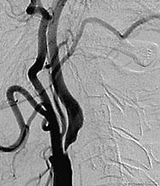
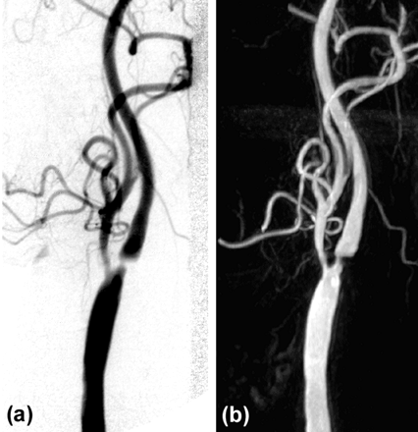
Angiogram
Notes:
*

Slide 34
What are the Goals of treating patients with CAD?
Prevent Stroke
Prolong survival
Notes:
*

Slide 35
Strategies in treating patients with CAD
Risk Factors Modification
Improve Brain Circulation
Notes:
*

Slide 36
Risk Factors Modification
Diet and weight control
Antiplatlets
Exercise
Hypertension control
Diabetes control
Lipid control
Smoking Cessation
Notes:
*

Slide 37
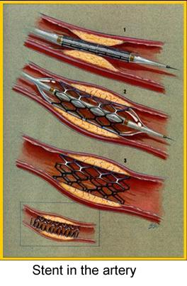
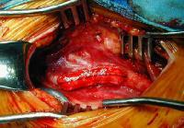
Strategies in treating patients with CAS
Improve Brain Circulation
Intervention ( Revascularization)
- Carotid Endarterectomy
- Angioplasty +/- Stenting
Notes:
*

Slide 38
What are the indications to intervene?
Symptomatic
> 70% stenosis- NACET
Decrease Stroke at 2 years from 26% to 9%
50-69% stenosis- marginal benefit, greater for male
Recovered Ischemic Stroke Patients
Asymptomatic
> 60% stenosis- ACAS
Decrease Stroke at 4 years from 11% to 5%
(should be done in high volume centers only)
Notes:
*

Slide 39
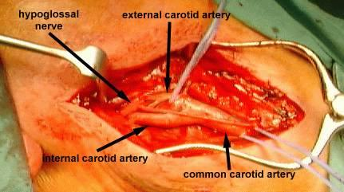
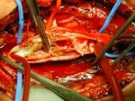
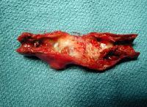
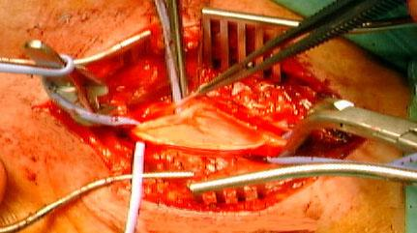
Carotid Endarterectomy: The Standard of Care
Notes:
*

Slide 40
Carotid Angioplasty and Stenting
This interventional procedure is currently under investigation
Relative Indications
Hostile Neck
Hostile Carotid Disease
As part of a Randomized Clinical Trial
Notes:
*

Slide 41
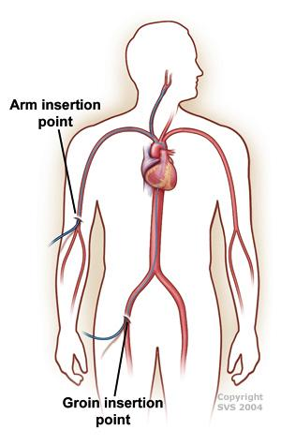
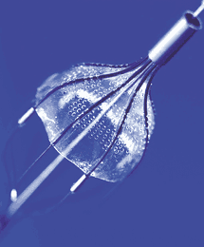
Carotid Angioplasty and Stenting
Notes:
*

Slide 42
Carotid Angioplasty and Stenting
Notes:
*

Slide 43
Acute Limb Ischemia
Notes:
*

Slide 44
What is an Acute Limb Ischemia?
Sudden decrease or worsening in the limb perfusion causing a potential threat to the limb viability resulting from a sudden obstruction of the arterial system
Notes:
*

Slide 45
What are the causes of acute arterial occlusion ?
Embolus
Thrombosis
Others
Trauma
Iatrogenic
Arterial dissection
Notes:
*

Slide 46
What is the possible source for an embolus?
Spontaneous (80%)
Cardiac source
arrhythmias, MI, prosthetic valve, endocarditis
Non-Cardiac source
Proximal AS plaque, Proximal Aneurysm, Paradoxical emboli
Iatrogenic (20%)
Angiographic manipulation
Surgical manipulation
Notes:
*

Slide 47
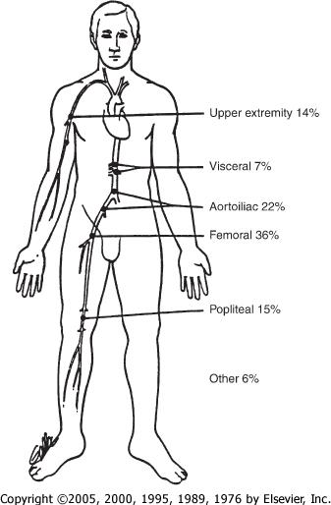
What are the common sites for embolus lodgment in the arterial tree?
Notes:
*

Slide 48
How do patients with acute limb ischemia present?
Sudden onset of diffuse and poorly localized leg pain
6 Ps
Paresthesias
Pain
Poikilothermia (coolness)
Pallor
Pulselessness
Paralysis
Notes:
*

Slide 49
Investigations
Acute Limb Ischemia is a
CLINICAL DIAGNOSIS
If time allows, especially if atherosclerotic thrombosis is suggested, preoperative angiography is often wise
Notes:
*

Slide 50
Goal of treating patients with Acute Limb Ischemia
Rapid restoration of adequate arterial perfusion without the development of morbid local or systemic complications
Notes:
*

Slide 51
Treatment
EMEGENCY (Golden time is 6 hours)
ABC
IV Heparin (anticoagulation)
Rapid surgical thromboembolectomy
+/ - surgical bypass
+/- thrombolytic therapy
+/- primary amputation
Notes:
*

Slide 52
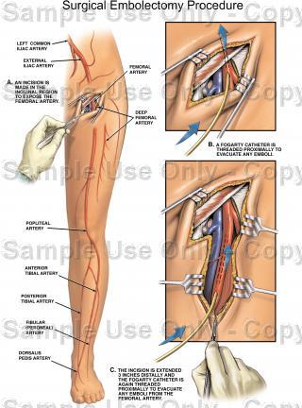
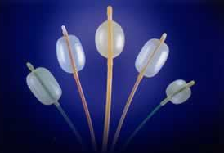
Surgical Thrmboemblectomy Procedure
Notes:
*

Slide 53
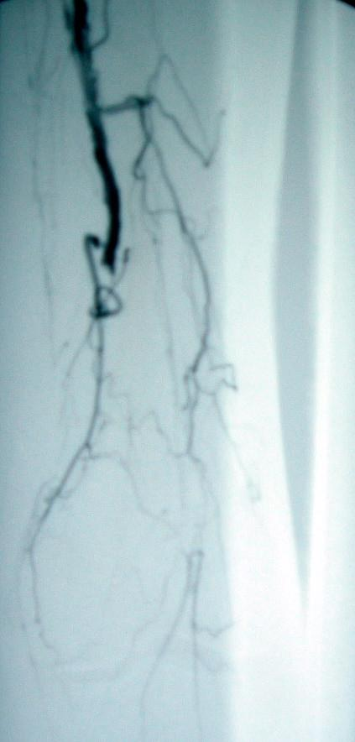
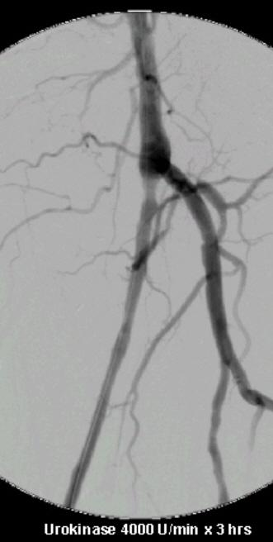
Thrombolysis
Notes:
*

Slide 54
What do we worry about after revascularization?
Reperfusion Injury
Local
Compartment Syndrome
Systemic
Hyperkalemia
Acidosis
Myoglobulinuria
Notes:
*

Slide 55
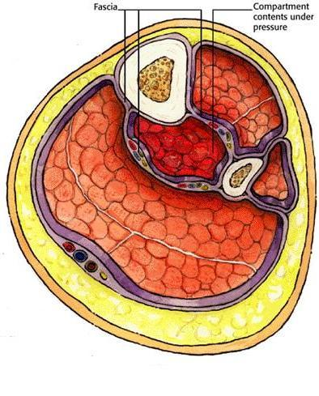
Compartment Syndrome
Notes:
*

Slide 56
Thank You
Notes:
*

