Slide 1
GU Oncology
Dr. Saleh Binsaleh
Associate Professor and Consultant Urologist

Slide 2
Contents
Renal Tumors
Bladder Tumors
Prostate Tumors
Testis Tumors
Adrenal Tumors

Slide 3
Renal Tumors

Slide 4
Renal Tumors
Benign tumours of the kidney are rare
All renal neoplasms should be regarded as potentially malignant
Renal cell carcinomas arise from the proximal tubule cells

Slide 5
Male : female ratio is approximately 2:1
Increased incidence seen in von Hippel-Lindau syndrome.
Pathologically may extend into renal vein and inferior vena cava
Blood born spread can result in 'cannon ball' pulmonary metastases
Notes:
VHL: The disease is caused by mutations of the VHL gene on the short arm of the third chromosome (3p26–p25).
Autosomal dominant. Predisposing to a variety of malignant and benign tumors: hemangioblastomas of the eye, brain, spinal cord, kidney (RCC, cysts), pancreas (cysts), and adrenal glands (pheochromocytomas), epididymis cystadenoma.

Slide 6
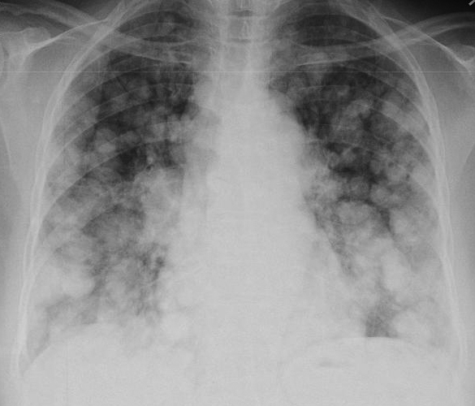
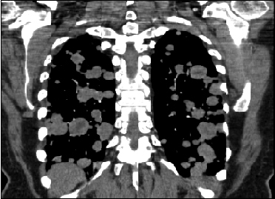
‘Cannon Ball' Pulmonary Metastases

Slide 7
Clinical features
10% present with classic trial of haematuria, loin pain and a mass.
Other presentations include ( Paraneoplastic Syndrome- PNS).
Pyrexia of unknown origin, hypertension, Stauffer's syndrome.
Polycythaemia due to erythropoietin production.
Hypercalcaemia due to production of a PTH-like hormone Can be treated medically.
Other PNS, Treatment usually nephrectomy.

Slide 8
Investigations
Diagnosis can often be confirmed by renal ultrasound
CT scanning allows assessment of renal vein and caval spread
Echocardiogram should be considered if clot in IVC extends above diaphragm

Slide 9
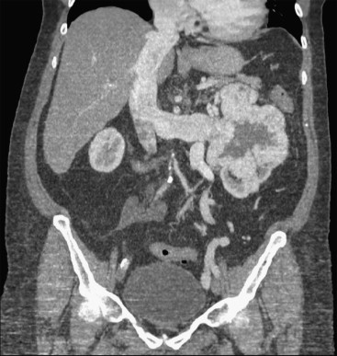
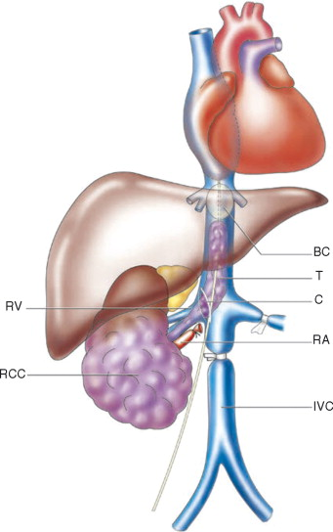
RCC with IVC thrombus

Slide 10
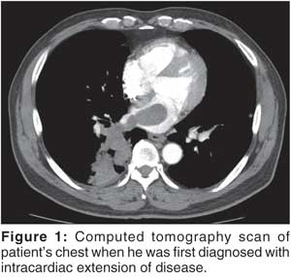
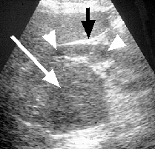

Slide 13
Management
Unless extensive metastatic disease it invariably involves surgery
Surgical option usually involves a radical nephrectomy
Kidney approached through either a transabdominal or loin incision
Renal vein ligated early to reduce tumor propagation
Kidney and adjacent tissue (adrenal, perinephric fat) excised

Slide 14
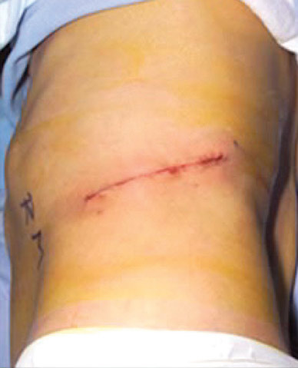
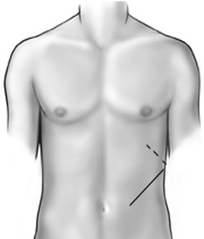
Open Radical Nephrectomy

Slide 15
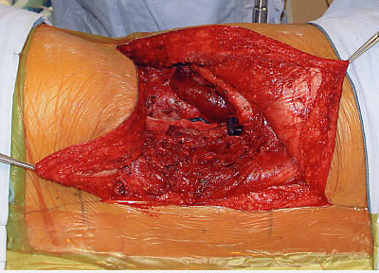
Open Radical Nephrectomy
Notes:
Thoraco-abdominal incision.

Slide 16
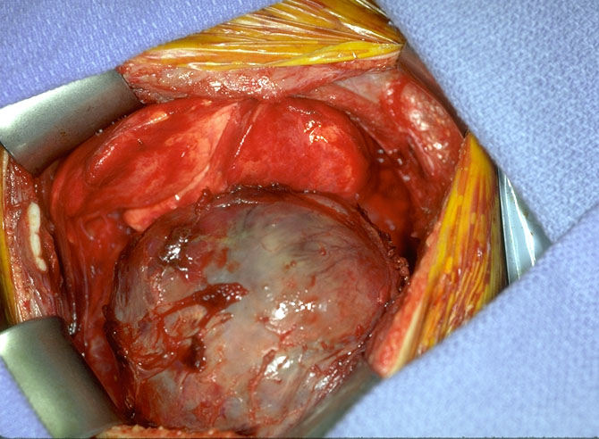

Slide 17
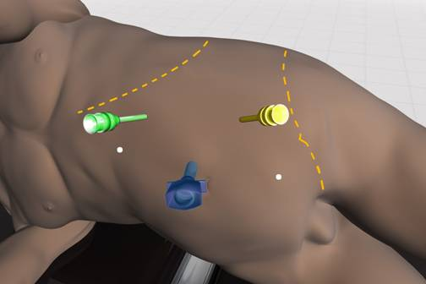
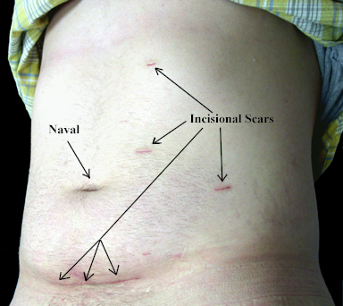
Laparoscopic Nephrectomy

Slide 18
Notes:
Clear cell renal cell carcinoma (CCRCC) is typically a solitary tumor. The tumor commonly presents as a bosselated, well-circumscribed mass with a capsule or pseudocapsule and a pushing margin. Occasionally, an infiltrative margin is seen. On cut section, CCRCC is typically a golden color because of the accumulation of lipid in the malignant cells, while areas of hemorrhage (brown), fibrosis (gray), necrosis, and cystic degeneration often give a variegated appearance.

Slide 20
Microscopic CRCC
Notes:
Typical histological appearance of clear cell renal cell carcinoma on hematoxylin and eosin stain, showing nests of epithelial cells with clear cytoplasm and a distinct cell membrane, separated by a delicate branching network of vascular tissue.

Slide 21
Metastasis Rx
Lymph node dissection of no proven benefit.
Solitary (e.g. lung metastases) can occasionally be resected.
Radiotherapy and chemotherapy have No role.
Immunotherapy can help (Performance status).

Slide 22
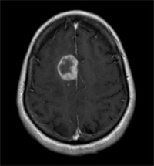

Slide 23
Bladder Tumors

Slide 24
Pathology
Of all bladder carcinomas:
90% are transitional cell carcinomas
5% are squamous carcinoma
2% are adenocarcinomas
TCCs should be regarded a 'field change' disease with a spectrum of aggression
80% of TCCs are superficial and well differentiated
Only 20% progress to muscle invasion
Associated with good prognosis
20% of TCCs are high-grade and muscle invasive
50% have muscle invasion at time of presentation
Associated with poor prognosis

Slide 25
Etiological factors
Occupational exposure
20% of transitional cell carcinomas are believed to result from occupational factors
Chemical implicated - aniline dyes, chlorinated hydrocarbons
Cigarette smoking
Analgesic abuse e.g. phenacitin
Pelvic irradiation - for carcinoma of the cervix
Schistosoma haematobium associated with increased risk of squamous carcinoma

Slide 26
Presentation
80% present with painless hematuria.
Also present with treatment-resistant infection or bladder irritability and sterile pyuria.

Slide 27
Investigation of Painless Haematuria
Urinalysis
Ultrasound - bladder and kidneys
KUB - to exclude urinary tract calcification
Cystoscopy
Urine Cytology
Consider IVU- CT scan if no pathology identified

Slide 28
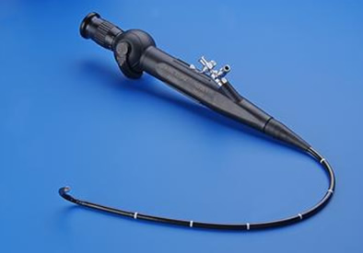
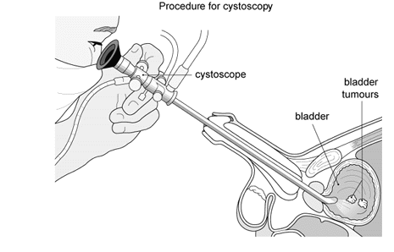

Slide 29
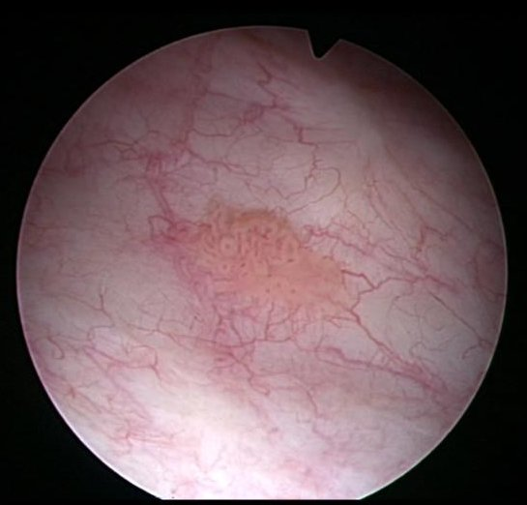
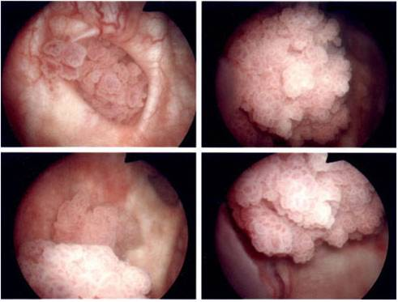
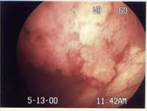

Slide 30
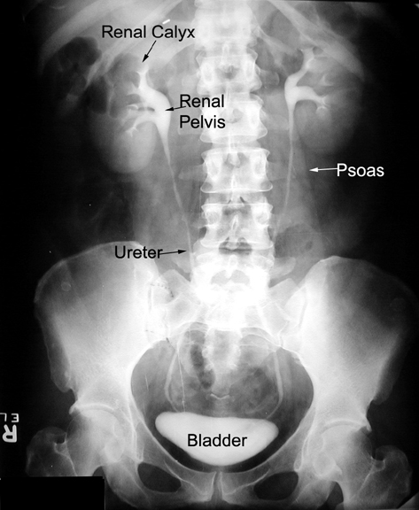
IVP

Slide 31
IVP

Slide 32
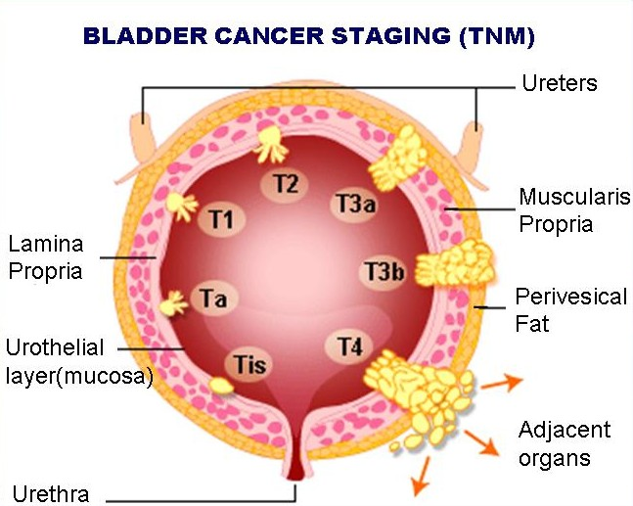

Slide 33
Pathological staging
Requires bladder muscle to be included in specimen
Staged according to depth of tumor invasion
- Tis In-situ disease
- Ta Epithelium only
- T1 Lamina propria invasion
- T2 Superficial muscle invasion
- T3a Deep muscle invasion
- T3b Perivesical fat invasion
- T4 Prostate or contiguous muscle

Slide 34
Grade of Tumor
G1 Well differentiated
G2 Moderately well differentiated
G3 Poorly differentiated

Slide 35
Carcinoma in-situ
Carcinoma-in-situ is an aggressive disease
Often associated with positive cytology
50% patients progress to muscle invasion
Consider immunotherapy
If fails patient may need radical cystectomy

Slide 36
Treatment of bladder carcinomas Superficial TCC
Requires transurethral resection and regular cystoscopic follow-up
Consider prophylactic chemotherapy if risk factor for recurrence or invasion (e.g. high grade)
Consider immunotherapy
BCG = attenuated strain of Mycobacterium bovis
Reduces risk of recurrence and progression
50-70% response rate recorded
Occasionally associated with development of systemic mycobacterial infection

Slide 37
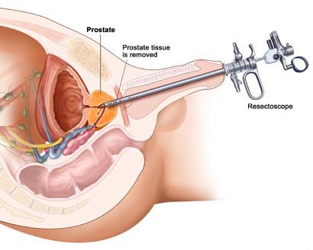
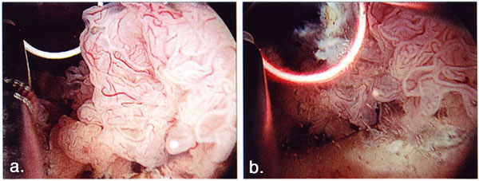
TURBT

Slide 38
Rx: Invasive TCC
Radical cystectomy has an operative mortality of about 5%
Urinary diversion achieved by:
Ileal conduit
Neo-bladder
Local recurrence rates after surgery are approximately 15% and after radiotherapy alone 50%
Pre-operative radiotherapy is no better than surgery alone
Adjuvant chemotherapy may have a role

Slide 39
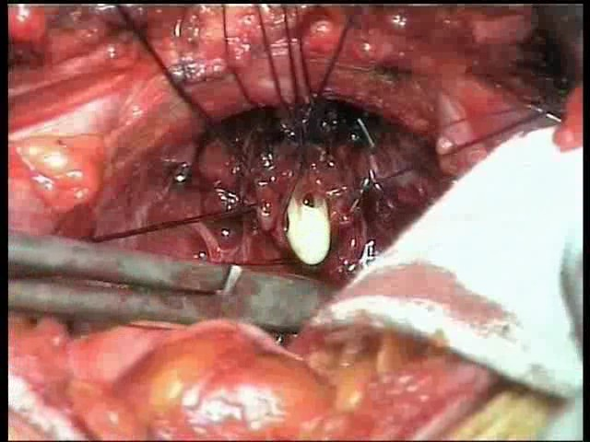

Slide 40
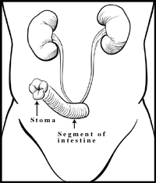
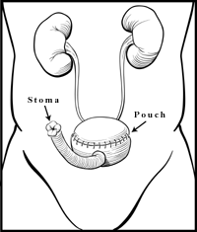
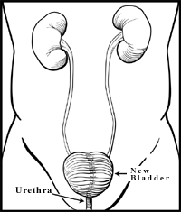
Types of Urinary Diversion
ILEAL CONDUIT
(incontinent diversion to skin)
CONTINENT CUTANEOUS RESERVOIR
(continent diversion to skin)
ORTHOTOPIC NEOBLADDER
(continent diversion to urethra)

Slide 41
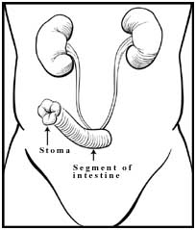
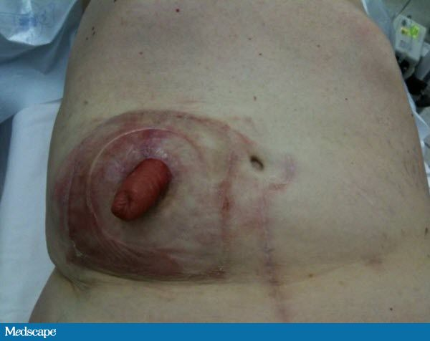

Slide 42
Prostate Tumors

Slide 43
Prostate cancer
Commonest malignancy of male urogenital tract
Rare before the age of 50 years
Found at post-mortem in 50% of men older than 80 years
5-10% of operation for benign disease reveal unsuspected prostate cancer

Slide 44
Pathology
The tumours are adenocarcinomas
Arise in the peripheral zone of the gland
Spread through capsule into perineural spaces, bladder neck, pelvic wall and rectum
Lymphatic spread is common
Haematogenous spread occurs to axial skeleton
Tumours are graded by Gleeson classification

Slide 45
Clinical features
Majority these days are picked up by screening
10% are incidental findings at TURP
Remainder present with bone pain, cord compression or leuco-erythroblastic anaemia
Renal failure can occur due to bilateral ureteric obstruction

Slide 46
Diagnosis
With locally advanced tumors diagnosis can be confirmed by rectal examination
Features include hard nodule or loss of central sulcus
Transrectal biopsy should be performed
Multi-parametric MRI maybe useful in the staging of the disease
Bone scanning may detect the presence of metastases
Unlikely to be abnormal if asymptomatic and PSA < 10 ng/ml

Slide 47
Serum prostate specific antigen (PSA)
Kallikrein-like protein produced by prostatic epithelial cells
4 ng/ml is the upper limit of normal
>10 ng/ml is highly suggestive of prostatic carcinoma
Can be significantly raised in BPH
Useful marker for monitoring response to treatment

Slide 50
Treatment
More men die with than from prostate cancer
Treatment depends on stage of disease, patient's age and general fitness
Treatment options are for:
Local disease
Observation
Radical radiotherapy
Radical prostatectomy
Locally advanced disease
Radical radiotherapy
Hormonal therapy
Metastatic disease
Hormonal therapy

Slide 51
Open

Slide 52
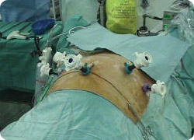
Laparoscopic

Slide 53
Robotic

Slide 55
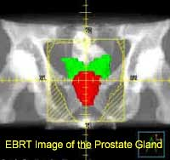
EBRT

Slide 56
EBRT

Slide 57
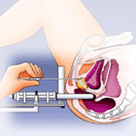
Brachytherapy

Slide 58
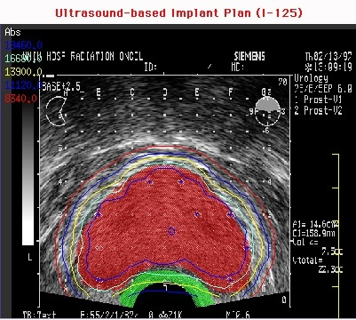
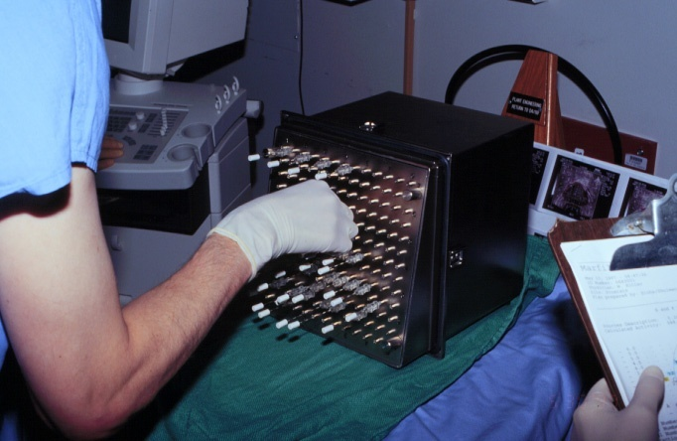

Slide 59
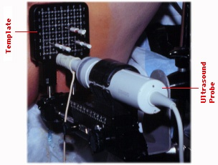
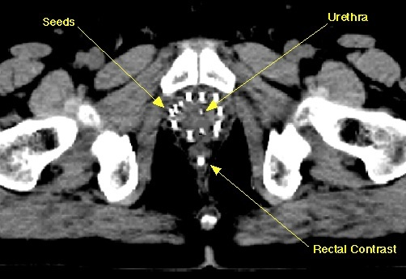

Slide 60
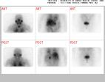

Slide 61
Hormonal therapy
80-90% of prostate cancers are androgen dependent for their growth
Hormonal therapy involves androgen depletion
Produces good palliation until tumours 'escape' from hormonal control
Androgen depletion can be achieved by:
Bilateral orchidectomy
LHRH agonists - goseraline
Anti-androgens - cyproterone acetate, flutamide, Biclutamide
Complete androgen blockade

Slide 62
Testicular Tumors

Slide 63
Testicular Tumors
Commonest presentation: testicular swelling on the side of the tumor.
Commonest malignancy in young men
Highest incidence in Caucasians in northern Europe and USA
Peak incidence for teratomas is 25 years and seminomas is 35 years
In those with disease localized to testis more than 95% 5 year survival possible
Risk factors include cryptorchidism, testicular and Klinefelter's syndrome

Slide 64
Classification
Seminomas (~50%)
None- Seminoma (~50%)
Teratomas
Yolk sac tumors
Embryonal
Mixed Germ cell tumor

Slide 65
Investigation
Diagnosis can often be confirmed by testicular ultrasound
Pathological diagnosis made by performing an inguinal orchidectomy
Disease can be staged by thoraco -abdominal CT scanning
Tumor markers are useful in staging and assessing response to treatment
Alpha-fetoprotein (alpha FP)
Produced by yolk sac elements
Not produced by seminomas
Beta-human chorionic gonadotrophin (beta HCG)
Produced by trophoblastic elements
Elevated levels seen in both teratomas and seminoma
LDH

Slide 66
Stage Definition
I Disease confined to testis
IM Rising post-orchidectomy tumour marker
II Abdominal lymphadenopathy
A < 2 cm B 2-5 cm C > 5 cm
III Supra-diaphragmatic disease

Slide 67
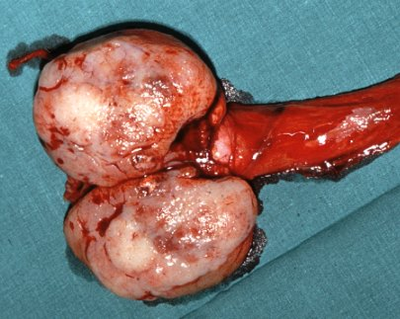
Seminomas

Slide 68
Seminomas
Seminomas are radiosensitive
The overall cure rate for all stages of seminoma is approximately 90%.
Stage I and II disease treated by inguinal orchidectomy plus
Radiotherapy to ipsilateral abdominal and pelvic nodes ('Dog leg') or
Surveillance
Stage IIC and above treated with chemotherapy

Slide 69
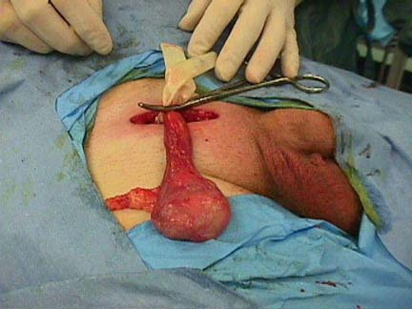
Radical Orchiectomy

Slide 70
None-Seminoma

Slide 71
None-Seminoma
None-Seminoma are not radiosensitive
Stage I disease treated by orchidectomy and surveillance Vs RPLVD Vs Chemo
Chemotherapy (BEP = Bleomycin, Etopiside, Cisplatin) given to:
Stage I patients who relapse
Metastatic disease at presentation

Slide 72
Questions

