Slide 1
Acetaminophen overdose
Hashim Bin Salleeh
Assistant Professor of Paediatrics
Consultant Paediatric Emergency Medicine
Department of Emergency Medicine
King Khalid University Hospital
King Saud University
hbinsalleeh@ksu.edu.sa
Notes:
acetyl-para-aminophenol
or APAP

Slide 2
Lets start with scenarios

Slide 3
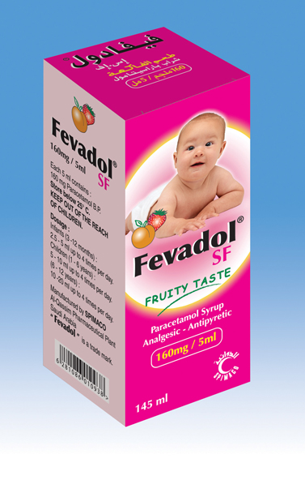
Problem # 1
A mother asked you about her 15 month old child accidentally took full bottle of Fevadol 60cc (160mg/5cc) 30 minutes ago. She described him to be well looking. What will be your advice?

Slide 4
Problem # 2
A mother brought her 4 M old son to ED with fever for 3 days duration
She was giving him Tempra 7ml every 4 h for the last 3 days
She found him today more lethargic, vomiting
Clinically, ill, slightly jaundiced, afebrile
CSF was obtained & was not suggestive of meningitis
Then mother asked why her son is yellow & if she can continue on Tempra or she should look for other medication for fever?

Slide 5
Problem # 3
19 y old girl brought to ED unconscious
Empty bottles of Tylenol, & Histop were found in her room
She was intubated & started on IVF
Laboratory investigations showed high acetaminophen level, PT, PTT, & LFT
Can we do something to help her?

Slide 6
Objectives
By the end of this lecture, students should be able to:
Know the potential toxic dose of APAP according to age
Identify symptoms and signs of APAP OD
Understand the pathophysiology of APAP OD
Know the antidote & mechanism of action

Slide 7
APAP
Acetaminophen has been approved for OTC use since 1960
1st cases of hepatic damage after APAP OD 1966
Excellent safety profile
Hepatotoxicity can occur with misuse and overdose

Slide 8
APAP
Therapeutic dose of acetaminophen
10-15 mg/kg/dose in children max 75mg/kg/day
325-1000 mg/dose every 4-6 hours in adults max 4g/day
Overdose can occur at any age
<1 year therapeutic misadventure
toddlers and young children Accidental poisoning
Older patients (e.g. teenagers and adults) intent to do self-harm

Slide 9
Toxic dose of APAP
Children:
< 12 months 150 mg/kg
1 – 6 y 200 mg/kg
1 – 6 y with risk factors 150 mg/kg
7 – 12 y 150 mg/kg
Youth & Adult
>6 g

Slide 10
Metabolic Pathways
Hepatic glucuronide conjugation(40-65%)
Hepatic sulfate conjugation(20-45%)
→ inactive metabolites excreted in the urine.
Excretion of unchanged APAP in the urine (5%).
Oxidation by P450 cytochromes (CYP 2E1, 1A2, and 3A4) to NAPQI (5-15%)
→ GSH combines with NAPQI
→ nontoxic cysteine/mercaptate conjugates
→ excreted in urine.
90%

Slide 11
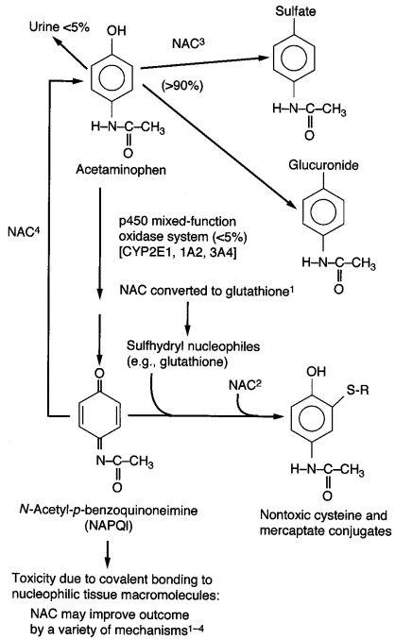

Slide 12
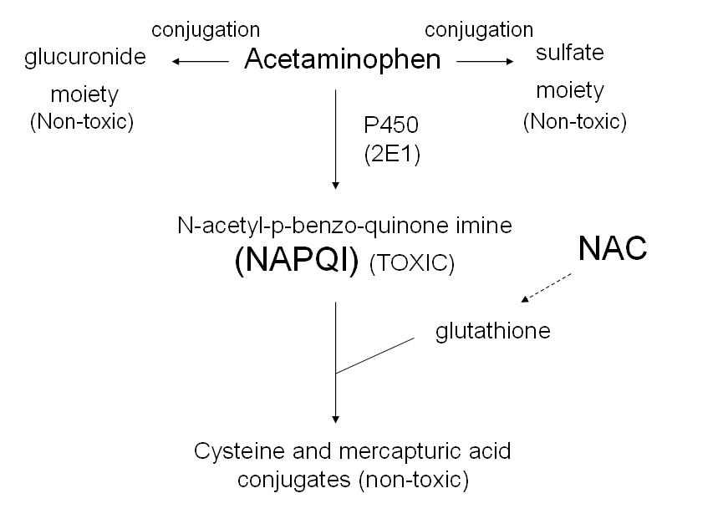

Slide 13
What happens in OD ?

Slide 14
Pathophysiology
Saturation of glucuronidation and sulfation pathways
Amount of APAP metabolized by p450 cytochromes to NAPQI increases
Normally NAPQI is detoxified by reduced GSH (glutathione) and thiol-containing substances
In OD: rate and quantity of NAPQI formation overwhelms GSH supply and regeneration:
→ elimination of NAPQI prolonged
→ free NAPQI binds critical cell proteins with sulfhydryl groups
→ cellular dysfunction and cell death.
Animal models: hepatotoxicity when GSH stores fall <30% of baseline

Slide 16
Factors which adversely affect APAP metabolism
Up regulation (i.e. induction) of CYP 2E1 enzyme activity
Decreased glutathione stores
Eating
NAC
Frequent dosing interval of APAP
Prolonged duration of excessive dosing
Notes:
smoking, barbituates, rifampin, carbamazepine, phenytoin, INH, + ethanol
use of APAP by alcoholics has not been associated with higher risk of liver injury in prospective trials

Slide 17
Clinical manifestation
I 0.5-24h n/v, anorexia, asymptomatic
II 24-48 h resolution of stage I sxs
RUQ pain, elevation of PTT, INR, bili + enzymes (at the latest by 36h)
III 48-96h coagulopathy, peaking of enzymes, acidosis, hypoglycemia, bleeding diathesis, jaundice, anuria, cerebral edema, coma. ARF in 25% of pts with hepatotoxicity
IV 4-14d resolution

Slide 18
Diagnosis
In the patient with a history of APAP overdose, a serum APAP level should be measured between 4 and 24 hours after ingestion
The value obtained should be evaluated according to the Rumack-Matthew nomogram for determining the risk of hepatotoxicity and the need for NAC therapy

Slide 19
Toxicological History
Often incomplete, unreliable or unobtainable
Sources – Patient, friends, family, EMS,or pill containers
PMHx, liver/renal disease, concurrent medications, previous overdoses, PΨHx, substance abuse
Notes:
Location may be important for environmental or occupational exposures

Slide 20
The 5W’s of toxicology
Who – pt’s age, weight, relation to others
What – name and dose of medication, coingestants and amount ingested
When – time of ingestion, single vs. multiple ingestions
Where – route of ingestion, geographical location
Why – intentional vs. unintentional

Slide 21
Management Guidelines
Airway
Breathing
Circulation
Decontamination
AC
Find antidote
NAC

Slide 22
NAC
Early → Prevents binding of NAPQI to hepatocytes
GSH precursor → increases GSH stores
Increases sulfation metabolism of APAP → less NAPQI formed
Reduces NAPQI back to APAP (at least in animal models)
Sulfur group of NAC binds and detoxifies NAPQI to cysteine and mercaptate conjugate (= GSH substitute)

Slide 24
NAC
Late (12-24h) → Modulates the inflammatory response
Antioxidant, free radical scavenger
Reservoir for thiol groups (i.e. GSH)
Impairs WBC migration and function → antiinflammatory
Positive inotropic and vasodilating effects (NO) → improves microcirculatory blood flow and O2 delivery to tissues
Decreases cerebral edema formation, prevents progression of hepatic encephalopathy and improves survival

Slide 25
NAC
NAC should optimally be given within 8 to 10 hours after ingestion
More delayed therapy is associated with a progressive increase in hepatic toxicity
some benefit may still be seen 24 hours or later after ingestion
Mortality is 37% in patients who received NAC 10-36 h after the overdose
Mortality is 58% in patients not given NAC

Slide 26
What is the Rumack-Matthew nomogram?

Slide 27
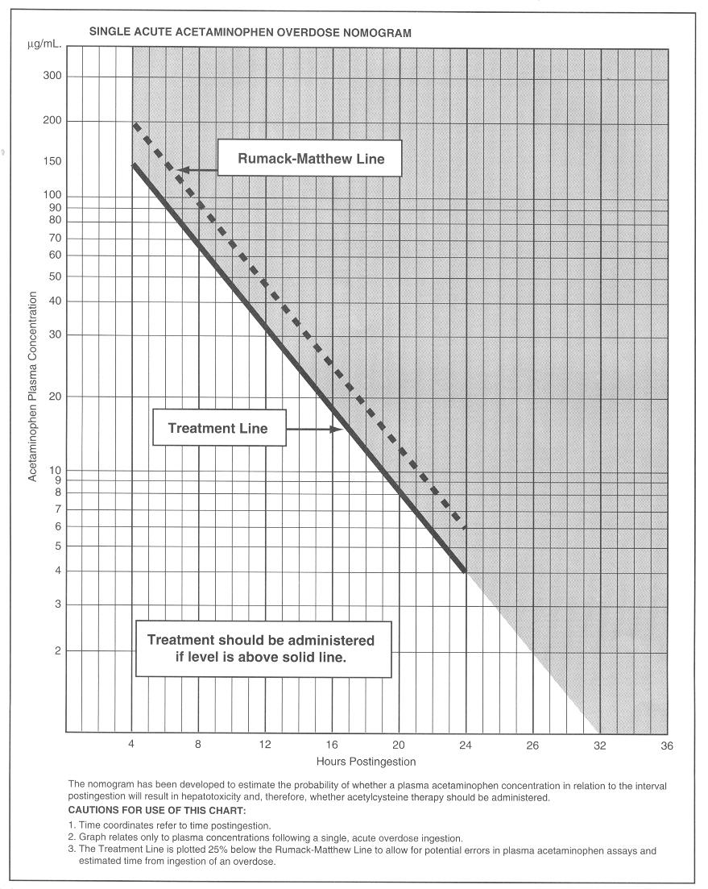

Slide 28
Rumack-Matthew nomogram
APAP level to predict which patients will develop an AST elevation >1000 IU/L with out antidotal treatment
Derived from acute ingestion of immediate release acetaminophen
Begins at 4 h post ingestion
Recommended line of treatment has been lowered by 25% to increase its sensitivity

Slide 29
What percent of pts whose APAP level falls above the upper line of the Rumack-Matthew normogram will develop hepatotoxicity? (defined as elevation of the plasma transaminases above 1,000 U/L)
60%

Slide 30
Which lab test is the most sensitive for early detection of hepatotoxicity.?
AST

Slide 31
When to give NAC?

Slide 32
Indication for NAC
APAP level above the treatment line
Hx of significant APAP ingestion presenting close to 8h (give while waiting for level)
All APAP ingestions who present late>24h with either detectable APAP or elevated transaminases
Chronic ingestions (>4g/day in adult, >120mg/d in child) with elevated transaminases
Hx of exposure and Fulminant Hepatic Failure

Slide 33
Poor prognostic indicators
pH <7.3 (2 days after OD, after fluids)
Hepatic encephalopathy
PT >1.8 times normal.
Serum creatinine >300mmol/L
Coagulation factor VIII/V ratio of >30

Slide 34
Indicators for transfer to transplant center
INR > 5
OR
any of the following complications:
ARF: creatinine >200 μmol/L
metabolic acidosis: pH <7.35 or bicarb <18 mEq/L
Hypotension
Encephalopathy
Hypoglycemia
A rising PT on the fourth day after overdose is the single best marker of a poor prognosis

Slide 35
Indicators for transplant
Arterial pH <7.3 at any time after FHF develops that fails to correct with colloid loading
OR
In patients with a normal arterial pH all 3 of the following:
PT >100 sec (without FFP or Vit K)
Creatinine >300 μmol/L
Grade III or grade IV hepatic encephalopathy
Makin AJ, Williams R: Acetaminophen-induced hepatotoxicity: Predisposing factors and treatments. Adv Intern Med 1997; 42:453
Lee WM: Acute liver failure. N Engl J Med 1993; 329:1862

Slide 36
NAC Protocol
Oral
loading dose of 140 mg/kg
followed by 17 doses, each at 70 mg/kg, given every 4 hours
The total treatment duration 72 hours.
IV
Loading dose: 150 mg/kg IV over 1 h
Dose 2: 50 mg/kg IV over 4 h
Dose 3: 100 mg/kg IV in 16 h

Slide 37
XR tablets
Several studies show that elimination of extended and immediate-release acetaminophen are nearly identical after 4 hours.
some case reports APAP levels falling above the treatment normogram line as late as 11-14 hours post ingestion of the extended-release preparation
Treatment guidelines almost the same

Slide 38
Back to the scenarios

Slide 39
Problem # 1
A mother asked you about her 15 month old child accidentally took full bottle of Fevadol 60cc (160mg/5cc) 30 minutes ago. She described him to be well looking. What will be your advice?

Slide 40
Problem # 2
A mother brought her 4 M old son to ED with fever for 3 days duration
She was giving him Tempra 7ml every 4 h for the last 3 days
She found him today more lethargic, vomiting
Clinically, ill, slightly jaundiced, afebrile
CSF was obtained & was not suggestive of meningitis
Then mother asked why her son is yellow & if she can continue on Tempra or she should look for other medication for fever?

Slide 41
Problem # 3
19 y old girl brought to ED unconscious
Empty bottles of Tylenol, & Histop were found in her room
She was intubated & started on IVF
Laboratory investigations showed high acetaminophen level, PT, PTT, & LFT
Can we do something to help her?

Slide 42
20 yr old pregnant girl ingested 20g of Tylenol in a suicidal gesture 36h ago because she found out it is too late for her to have an abortion. Her APAP is <10 and her AST is 90
How will you manage her medically?
She asks you whether her baby will have any defects?

Slide 43
Take home messages
APAP has excellent safety profile but hepatotoxicity can occur with misuse and overdose
Toxic dose in Peds is 150 to 200 mg /Kg
Toxic dose in Adult is >6 gm
NAPQI is the toxic metabolite of APAP
NAC should be given within 8 hours of ingestion with APAP @ toxic level on Rumack-Mathew nomogram

Slide 44
THANK YOU
QUESTIONS
hbinsalleeh@ksu.edu.sa

