Slide 1
SCREENING
RESEARCH PROJECT – I

Slide 2
Learning objectives
Define the term “screening”
Explain the concept of screening and the lead time
Explain the difference between “screening”, “case finding”, “periodic examination” and “diagnosis”
State the uses of screening programs
State the criteria of health problems amenable for screening
Outline the differences between screening and diagnostic test
Distinguish between “mass screening” and “high risk screening”
State the criteria of an ideal screening test

Slide 3
Performance objectives
Compute sensitivity, specificity and predictive values of a screening test
Evaluate the performance of a screening test

Slide 4
DEFINITION OF SCREENING
“Screening is defined as the search for unrecognized disease or defect by means of rapidly applied tools in apparently healthy individuals not seeking medical care”
Screening tools could be
Test consisting a series of questions
Instrument to measure a parameter
Medical examination
Radiological test
Laboratory test

Slide 5
OUTCOME OF SCREENING
Screened population
Positive
Likely to have the condition
Negative
Not likely to have the condition
Further evaluation
Discard

Slide 6
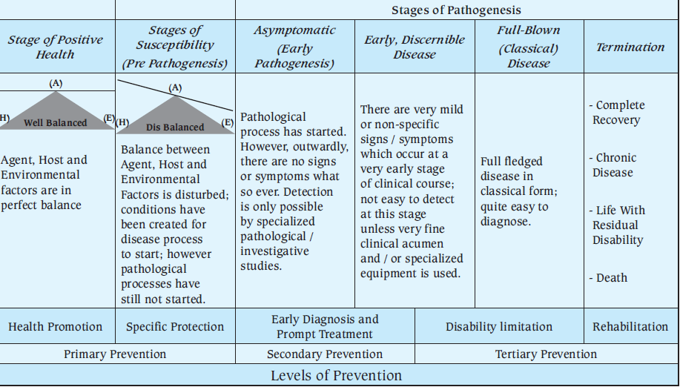
NATURAL HISTORY OF DISEASE AND LEVELS OF PREVENTION

Slide 7
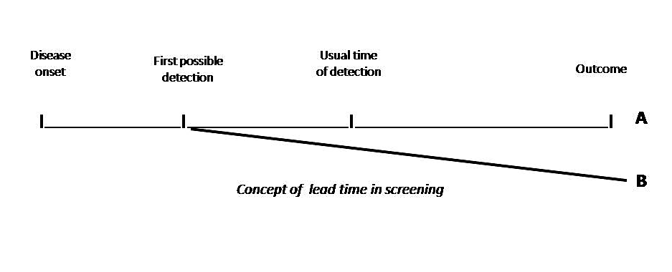
CONCEPT OF LEAD TIME

Slide 8
DIFFERENCE BETWEEN SCREENING AND
Periodic examination
Seeking of medical care at intervals to evaluate health status and to detect any health problem without the presence of any complaint. In periodic examination, different systems are looked at and a series of investigations are applied.
Case finding
The use of a clinical, laboratory or non laboratory test to detect disease in individuals seeking health care for other reasons. The aim of identifying diabetes among pregnant women is an example of case finding.
Diagnosis
A procedure to confirm or refute the existence of a disease or abnormality among those seeking medical care with a specific complaint. Achieved by obtaining medical history, clinical examination and the application of laboratory or non laboratory tests.

Slide 9
SCREENING & DIAGNOSTIC TEST
Screening tests |  | Diagnostic tests
Applied to apparently healthy or asymptomatic |  | Applied to those with specific complaint or suggestive signs or symptoms
Applied to a group of individuals |  | Applied to a single person
Results are based on one criterion |  | Results are based on the evaluation of a number of symptoms, signs and result of investigations
Results are not conclusive |  | Results are conclusive and final
Less accurate |  | More accurate
Less expensive |  | More expensive
Not a basis for treatment |  | Basis for treatment

Slide 10
USES OF SCREENING TESTS
Case detection; It is identification of unrecognized disease or defect that doesn’t arise from patients’ request
Control of diseases; This is with the purpose to prevent the transmission of the disease to healthy community members
Research purposes; initial screening is conducted to estimate the prevalence of a disease and subsequent screening will provide data on the incidence

Slide 11
TYPES OF SCREENING PROGRAMS
Mass screening; applied to the whole population or population subgroups as adults, school children, industrial’s workers irrespective of their risk.
High risk or selective screening; applied to a selective population subgroups who are at a high risk. Among high risk population, the disease is more likely to be prevalent and the screening will result in a better yield.

Slide 12
ELIGIBLE CONDITION FOR SCREENING
Major public health problem and/or have serious consequences
High prevalence among screened population
Have a detectable pre-clinical phase
Availability of test for detection in pre-clinical phase
Evidence that early detection reduces morbidity and mortality
Available facilities for the confirmation of the diagnosis
Agreed-on policy whom to treat as a patient
Available of effective treatment for the disease if identified
Expected benefits of early detection out-weight the risks and costs of screening

Slide 13
EXAMPLES OF SCREENING
Blood pressure for hypertension
Fasting blood sugar level for diabetes
Pap smear for cervical cancer
Mammogram for breast cancer
PSA (prostate specific antigen) for prostatic cancer
Elisa followed by RIBA (Recombinant ImmunoBlot Assay) for hepatitis C antibodies
Thyroid hormone from blood cord for hypothyroidism in newborn
Hip examination for congenital hip dislocation in the newborn
Notes:
RIBA = recombinant immunoblot assay

Slide 14
IDEAL SCREENING TOOL
Feasibility
Simple, inexpensive, capable of wide application
Acceptability
Acceptable by the people to whom it is intend to be applied
Reliability (precision)
Consistent results on repeated application on the same individual under same circumstances
Validity (accuracy)
Ability to distinguish between those who have and those who don’t have the disease as confirmed by a gold standard

Slide 15
VALIDITY
Validity of the test reflects its “accuracy” compared to a gold standard.
Validity has two components
Sensitivity: ability of the test to detect correctly those who truly have the condition (true positive)
Specificity: ability of the test to detect correctly those who truly don’t have the condition (true negative)

Slide 16
Screening test results | Gold standard |  | Total
 | Diseased | Not diseased
Positive | a | b | a+b
 | True positive | False positive
Negative | c | d | c+d
 | False negative | True negative
Total | a+c | b+d | a+b+c+d
Sensitivity: ability of the test to detect correctly those who truly have the condition (true positive)
Sensitivity= $\frac{a}{a+c}$
Specificity: ability of the test to detect correctly those who truly don’t have the condition (true negative)
Specificity = $\frac{d}{b+d}$

Slide 17
EXAMPLE
Test | Breast cancer |  |  | Total
 | Positive |  | Negative
Positive | 900 |  | 1980 | 2880
Negative | 100 |  | 97020 | 97120
Total | 1000 |  | 99000 | 100000
Sensitivity |  | (900/1000)x 100 = 90.00%
Specificity |  | (97020/99000) x 100 = 98.00%
Sensitivity:
the test was capable to identify correctly 90% of the those who have the condition
The false negative rate ($\frac{c }{a+c}$) is only 10%
Specificity:
the test was capable to identify correctly 98% of the those who don’t have the condition
The false positive rate ($\frac{b }{b+d}$) is only 10%

Slide 18
EXAMPLE
Test | Breast cancer |  |  | Total
 | Positive |  | Negative
Positive | 900 |  | 1980 | 2880
Negative | 100 |  | 97020 | 97120
Total | 1000 |  | 99000 | 100000
Sensitivity |  | (900/1000)x 100 = 90.00%
Specificity |  | (97020/99000) x 100 = 98.00%
Sensitivity:
A sensitive test will result in few false negative
Test with high sensitivity is preferable in screening
Specificity:
A specific test will result in few false positive
Test with high specificity is preferable for diagnosis

Slide 19
YIELD OF THE TEST
Yield of the test reflects the number of correctly unrecognized subjects with the condition who have been identified and brought into care
Yield of the test is measured by its predictive value
Predictive value positive (Pv_{+ve}) is the probability that a person positive by the test truly have the condition
Pv+ve= $\frac{a}{a+b}$
Predictive value positive (Pv_{-ve}) is the probability that a person negative by the test truly don’t have the condition
Pv-ve= $\frac{d}{c+d}$

Slide 20
Test | Breast cancer |  |  | Total
 | Positive |  | Negative
Positive | 900 |  | 1980 | 2880
Negative | 100 |  | 97020 | 97120
Total | 1000 |  | 99000 | 100000
Sensitivity |  | (900/1000)x 100 = 90.00%
Specificity |  | (97020/99000) x 100 = 98.00%
PV + ve |  | (900/2880) x 100 = 31.25%
PV – ve |  | (97020/97120) x 100 = 99.89%
Pv+ve:
Out of those who are positive by the test only 31.25% were found to have the condition
Pv-ve:
Out of those who are negative by the test, 99.89% were found to be free from the condition
EXAMPLE

Slide 21
Test | Breast cancer |  |  | Total
 | Positive |  | Negative
Positive | 900 |  | 1980 | 2880
Negative | 100 |  | 97020 | 97120
Total | 1000 |  | 99000 | 100000
Sensitivity |  | (900/1000)x 100 = 90.00%
Specificity |  | (97020/99000) x 100 = 98.00%
PV + ve |  | (900/2880) x 100 = 31.25%
PV – ve |  | (97020/97120) x 100 = 99.89%
EXAMPLE
Q: Is it a good test for screening?

Slide 22
Test | Breast cancer (Prevalence 1%) |  |  | Total |  | Test | Breast cancer (Prevalence 10%) |  |  | Total
 | Positive |  | Negative |  |  |  | Positive |  | Negative
Positive | 900 |  | 1980 | 2880 |  | Positive | 9000 |  | 4500 | 13500
Negative | 100 |  | 97020 | 97120 |  | Negative | 1000 |  | 85500 | 86500
Total | 1000 |  | 99000 | 100000 |  | Total | 10000 |  | 90000 | 100000
Sensitivity |  | (900/1000)x 100 = 90.00% |  |  |  | Sensitivity |  | (9000/10000) x 100 =90.00%
Specificity |  | (97020/99000) x 100 =98.00% |  |  |  | Specificity |  | (85500/90000) x 100 = 95.00%
PV + ve |  | (900/2880) x 100 = 31.25% |  |  |  | PV + ve |  | (9000/13500) x 100 = 66.67%
PV – ve |  | (97020/97120) x 100 = 99.89% |  |  |  | PV - ve |  | (85500/86500) x 100 = 98.84%
PREVALENCE & PREDICTIVE VALUE

Slide 23
YIELD OF THE TEST
Low predictive value positive of a test is a waste of resources; very few of those who tested positive will be found to have the condition
High predictive value positive is desirable in screening program; detecting and bringing into care subjects with the condition at a pre-clinical stage
Predictive value positive increases considerably with the increase in the prevalence of the condition among the screened population
In condition with relatively lower prevalence among the general population but higher prevalence among high risk population, it is recommended to avoid mass screening and to opt for “selective screening” of high risk population

Slide 24
PROBLEMS WITH FALSE RESULTS
False positive results are referred to as adverse effects or errors of screening
False positive result is not desirable
It is a waste of resources; incurring the cost of the screening and the confirmation of the diagnosis
Unnecessary exposure of subjects to the hazards of the tests
Emotional strain of being a probable case
False negative result is not desirable
Giving a false re-assurance that they are free from the condition

Slide 25
CORRECT RESULTS
True positive result is desirable
It is money well spent
Bringing subjects with the condition into care
Subjects who incurred the hazards of screening and confirmation of the diagnosis will benefit from therapeutic intervention
True negative result is desirable
Re-assurance that they are free from the condition

