Slide 1
General Principles of Prevention and control of communicable diseases
Dr. Abdulaziz Almezam
Dr. Salwa A. Tayel & Dr. Mohammad Afzal Mahmood
Department of Family & Community medicine
September-2013

Slide 2
OBJECTIVES OF THE LECTURE
By the end of this lecture you will be able to:
Identify measures for prevention and control of communicable diseases
Measures towards reservoir
Measures towards the MOT /environment
Measures to contacts and susceptible host
Identify the levels of prevention of diseases
2

Slide 3
Prevention
Actions aimed at eradicating, eliminating, or minimizing the impact of disease and disability, or if none of these is feasible, retarding the progress of disease and disability.
The concept of prevention is best defined in the context of levels of prevention; primary, secondary, and tertiary prevention.
(Oxford Dictionary 2008)

Slide 4
Control of disease
CONTROL: Disease incidence is reduced to a minimal level, acceptable at the level of country/region, at which the disease is no longer considered a public health problem, while infection may still occur.

Slide 5
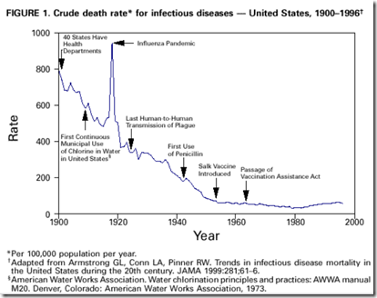
Control of disease

Slide 6
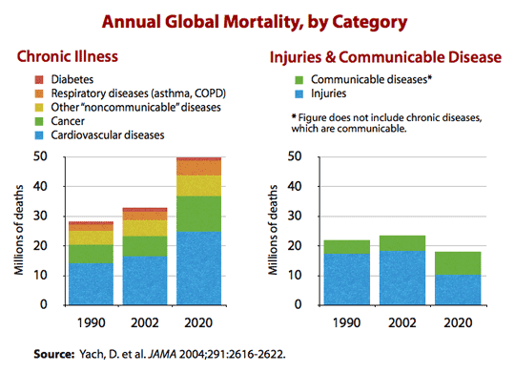
Control of disease

Slide 7
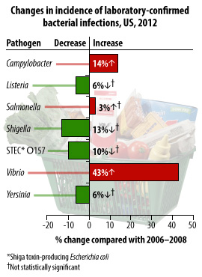
Control of disease

Slide 8
Elimination of disease
ELIMINATION: Reduction to zero of the incidence of a specified disease in a defined community or country or region as a result public health actions.
In 1988, polio paralyzed more than 350 000 people a year. Since that time, polio case numbers have decreased by more than 99% (with only 406 polio cases reported in 2013).

Slide 9
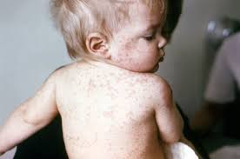
MeaslesCase

Slide 10
Measles Case

Slide 11
Eradication
It means worldwide disappearance of a disease i.e. (permanent reduction to zero level) :
The organism may be present only in laboratories, but there is no need for public health actions. e.g. smallpox since 1979.

Slide 12
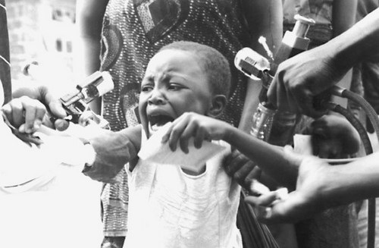
Polio Cases

Slide 13
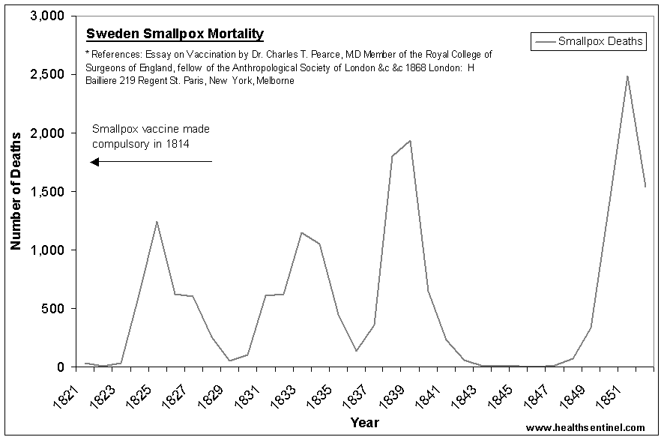
Polio Cases

Slide 14
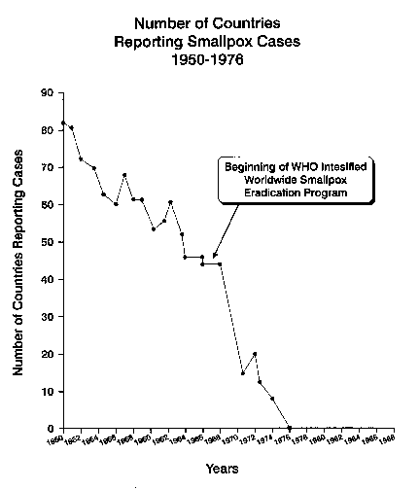
Polio Cases

Slide 15
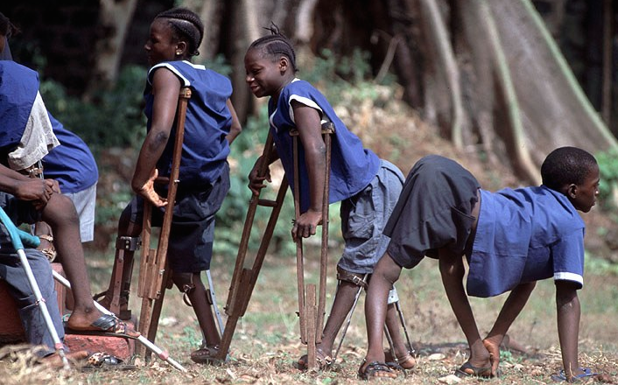
Polio Cases

Slide 16
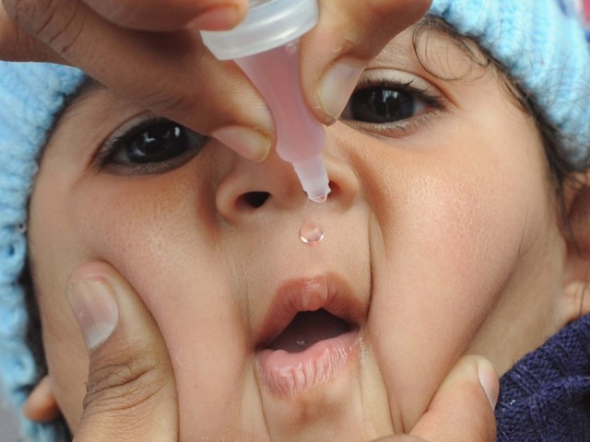
Polio Eradication Campaign

Slide 17
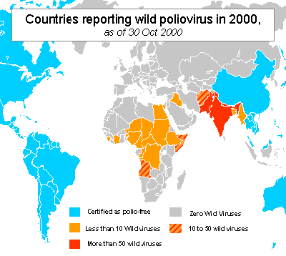
Countries reporting Poliovirus 2000

Slide 18
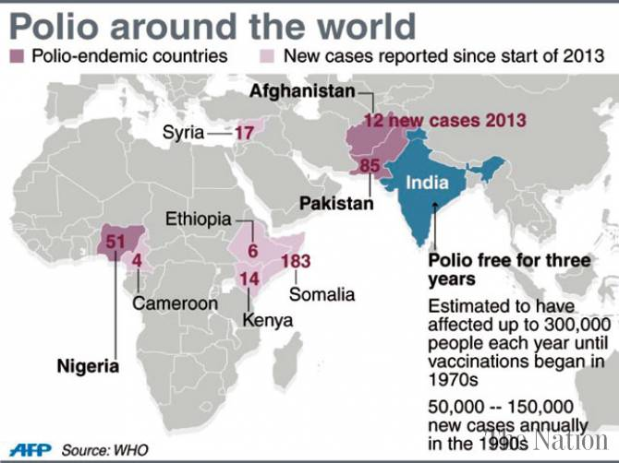
Global distribution of Polio

Slide 19
Cycle of infection and interventions applied at each link
The cycle of infection has three major links:
Reservoir& source
Mode of transmission
Susceptible Host
In general, control measures should be directed towards the link in the infection chain is most susceptible to interference.

Slide 20
Cycle of infection and interventions applied at each link
-Surveillance/quarantine
-Chemoprophylaxis
Sero-prophylaxis
Vaccination
-Isolation of cases
-Treatment
-Disinfection
-Control of carriers
-Control of animals
Reservoir& Source
Mode of transmission
Host
-Prevention of overcrowding
-Personal hygiene
-Vector control
-Environmental sanitation

Slide 21
Interventions to break the cycle of infection
Interventions to break the cycle of infection
The best control measures to the first link, the reservoir are:
Aim of control the reservoir or source of infection is to reduce the quantity of the agent by isolation, treatment of cases, control of carriers and animal reservoir
The best control measures to the second link, MOT are:
to interrupt the transmission from source of infection to the susceptible host.
Examples are: Vector control, Snail control and improvement of Environmental sanitation.
The best means of control to the third link (the host) are:
to improve the defense by making sure that people have adequate nutritional status, have no or few concomitant diseases that decrease the immunity, and by improving immunity through vaccination, chemoprophylaxis.

Slide 22
Measures towards Reservoir
Objective of control measures towards reservoir
Reduce quantity of agent (complete or partial reduction)
Reduce communicability
Measures towards cases
Measures towards carriers
Measures towards animal reservoir

Slide 23
Measures towards cases
Case finding (early detection/screening)
Reporting
Segregation /isolation of cases
Treatment of cases
Disinfection

Slide 24
Measures towards cases
Segregation/Isolation of cases
This means that the patient is isolated from the community in a fashion that prevents direct or indirect spread of infectious agents.
Isolation is usually done for a period which equals the “period of communicability” at a hospital (fever hospital) or at home. Ideally repeated negative sample are needed before his release.

Slide 25
Measures towards cases
Treatment of cases
Early diagnosis and prompt treatment of infections with appropriate regimens (e.g. antibiotics, antiviral or other chemotherapeutic agents) helps reducing communicability.

Slide 26
Measures towards cases
Disinfection
-Concurrent
-Terminal
Disinfection of the soiled articles by the patient discharges or excreta concurrently (during his presence as source of infection) and/or terminally (after his discharge from the hospital or death) helps in reduction of communicability.
Disinfection of contaminated objects with appropriate “enteric precautions,” “respiratory precautions,” “universal precautions”

Slide 27
Measures applied to carriers
Detection of carriers:
If they represent important reservoir of infection.
If they were suspected in a closed community, such as boarding schools, army barracks, food handling places,…..
Exclusion from work: in certain occupations for example;
food handler (e.g. Typhoid carrier) or a
teacher (e.g. Diphtheria carrier).
Treatment for the carrier state (when applicable).

Slide 28
Measures applied to animal reservoir
Inspection and slaughtering of infected animals (in bovine tuberculosis)
Testing and immunization of uninfected sheep, cattle (in brucellosis)
Careful husbandry and sterilization of animal products (in anthrax).
Extinction/Destruction of animal reservoir has been successful with diseases as rabies and bovine TB in several countries. Such procedure is only possible for domestic animals while it is difficult or almost impossible for wild animals (e.g. in jungle yellow fever,….)

Slide 29
Measures to Contacts/ susceptible Host
Surveillance/observation
Quarantine
Increasing resistance of susceptibles

Slide 30
Measures to Contacts/ susceptible Host
Surveillance means close medical supervision of the contacts, without restricting their movement, for the purpose of early detection of the disease in question.
Surveillance should be done for duration of the longest “incubation period” of the disease counted from date of last exposure.

Slide 31
Quarantine
Quarantine means separation (with restriction of the movement) in a specific place (quarantine) of apparently well persons or animals who have been exposed (contact) to a case of infectious disease.
Quarantine is done for the duration of the longest “incubation period” of the disease counted from date of last exposure. It allows early detection of the disease among these individuals.
This measure is applied for contacts of pneumonic plague and pneumonic anthrax.

Slide 32
Increasing resistance of susceptibles
Measures to improve the defense mechanism of the host by using:
Chemoprophylaxis,
Sero-prophylaxis,
Immunization (next lecture).

Slide 33
Increasing resistance of susceptibles
Chemoprophylaxis: The administration of a chemical, including antimicrobials, to prevent the development of an infection (if given before exposure)
or to slow progression of the disease to active clinically manifest disease (if given after exposure).

Slide 34
Increasing resistance of susceptibles
Chemoprophylaxis is used for travelers to endemic areas, occupationally exposed persons (e.g. Health Care Workers) and for contacts in closed communities as in camps, schools and institutions.
Examples:
Isoniazid (INH) for contacts of tuberculous cases.
Rifampicin for contacts of meningeococcal meningitis.
Chloroquine for travelers to malaria areas.

Slide 35
Increasing resistance of susceptibles
b) Sero-prophylaxis: prophylaxis using ready-made antibodies also known as passive immunization
(e.g. measles immunoglobulin and tetanus anti tetanic serum (ATS)
In case of measles, if it is given within the first three days of the incubation period, it prevents the attack and gives immunity for 4-5 weeks.
If administered from the 4th to the 10th day of IP, the subject gets a modified attack and permanent immunity.

Slide 36
Increasing resistance of susceptibles
c) Vaccination (Active immunization):
Protection of susceptible host from communicable diseases by the administration of a modified living infectious agent, killed organism, or inactive agent or part of the agent.

Slide 37
Measures towards the environment
Reduction of overcrowding (better housing conditions, proper ventilation)
Personal hygiene (cleanliness, hand washing, regular bathing)
Environmental sanitation: (e.g. sanitary sewage disposal, sanitary refuse disposal, safe water supply,…)

Slide 38
Measures towards the environment
Vector control (insecticides, indoor or aerial spraying, mosquito-nets,…..
National and international measures: which include different public health measures undertaken within and between countries in order to protect the individuals and communities from communicable diseases.

Slide 39
Cycle of infection and interventions applied at each link
-Surveillance/quarantine
-Chemoprophylaxis
Sero-prophylaxis
Vaccination
-Isolation of cases
-Treatment
-Disinfection
-Control of carriers
-Control of animals
Reservoir& Source
Mode of transmission
Host
-Prevention of overcrowding
-Personal hygiene
-Vector control
-Environmental sanitation

Slide 40
Choice of appropriate prevention & control measures
The choice of the control measure is disease dependent.
It depends upon the knowledge of:
Natural history, causation and dynamics of disease transmission
identification of risk factors and high risk groups
availability of tools of intervention (vaccine chemoprophylaxis or treatment,..)

Slide 41
Levels of Prevention
• Primary prevention => pre-event phase
• Secondary prevention => event phase
• Tertiary prevention => post-event phase
Health Promotion (1ry prevention)
Early detection & care (2ry prevention)
Rehabilitation (3ry prevention)

Slide 42
Natural History of Disease
Detectable subclinical disease
Susceptible Host
Subclinical Disease
Clinical Disease
Outcome:
Stage of Recovery, Complications, Disability, or Death
Diagnosis sought
Point of Exposure
Tertiary Prevention
Primary Prevention
Onset of symptoms
Secondary
Prevention
(Screening)

Slide 43
Actions taken prior to the onset of the disease which aim to remove the possibility that a disease will ever occur” It limits the incidence of diseases by preventing healthy people from developing disease. Primary Prevention activities can be directed at individuals or at the environment.
I- Primary Prevention:

Slide 44
At individual level
Measures to improve the general health of the individuals:
Health education efforts are directed at encouraging people to develop good health habits (Adequate nutrition, exercise) and to adopt hygienic practices (hand washing,….
Specific protective measures such as, chemoprophylaxis, sero-prophylaxis, vaccination

Slide 45
At environmental level
Environmental sanitation is used to provide an adequate sewage system, safe drinking water, clean air and proper ventilation.

Slide 46
It is the early detection and prompt treatment of a disease, thus hinder the progress of a disease and prevent complications. i.e. intervention in early pathogenesis phase. Measures of secondary prevention include: 1. Screening programs are used to detect diseases at early preclinical stages, when effective therapy may either cure the disease or limit its progression 2. Primary medical care: through early case finding at PHCC. It is the predominant form of secondary prevention.
II- Secondary Prevention:

Slide 47
III- Tertiary prevention:
Actions taken when the disease process has advanced beyond its early stages
i.e. intervention in late pathogenesis phase.
The aim of tertiary prevention is limitation of disability and rehabilitation from disease.
Tools for tertiary prevention include rehabilitation

Slide 48
Rehabilitation includes:
Medical rehabilitation – restoration of function or physical loss.
Educational rehabilitation change of educational methods.
Vocational (occupational) rehabilitation – restoration of the capacity to earn a livelihood.
Social rehabilitation: restoration of family and social relationships.
Psychological rehabilitation: restoration of personal confidence.

Slide 49
Examples of uses of levels of prevention
All three levels of prevention can be used to control a single disease process.
BCG Vaccination of newborns (primary prevention).
Screening and early treating a person with active tuberculosis (secondary prevention) may prevent transmission to another person (primary prevention).
In advanced cases of tuberculosis, occupational and social rehabilitation (tertiary prevention) by modification of working conditions may help to regain the capacity to earn his livelihood.

Slide 50
Reference books
Walter R Dowdle. The Principles of Disease Elimination and Eradication. December 31, 1999 / 48(SU01);23-7. Available at: http://www.cdc.gov/mmwr/preview/mmwrhtml/su48a7.htm
Heymann D. Control of communicable diseases manual. Washington DC: American Public Health Association, 2008.
Principles of Epidemiology in Public Health Practice. Third Edition. An Introduction to Applied Epidemiology and Biostatistics. Centers for Disease Control and Prevention (CDC)
Beaglehole R, Bonita R, Kjellstrom T. Basic epidemiology. 2nd edition. Geneva: World Health Organization, 2006

