Slide 1
TUTORIAL
SCREENING
Dr. Salwa Tayel, Dr. A. Almazam, Dr Afzal Mahmood
KSU, Department of Family & Community Medicine
(December, 2014)

Slide 2
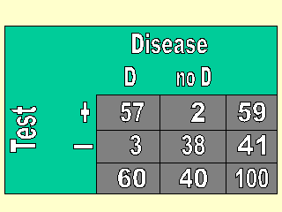
Calculating sensitivity and specificity of a screening test

Slide 3
Calculating sensitivity and specificity of a screening test
Sensitivity = 95%
Specificity =95%

Slide 4
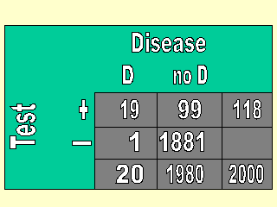
Calculating sensitivity and specificity of a screening test

Slide 5
Calculating sensitivity and specificity of a screening test
Sensitivity = [a/(a+c)] X 100 = 95%
What is the meaning of this result?
Specificity = [d/(b+d)] X 100 = 95%
What is the meaning of this result?

Slide 6
How to interpret results
Sensitivity: a / (a + c)
Sensitivity = 95%
i.e. Screening test will correctly identify 95% of all true cases.
Specificity: d / (b + d)
Specificity = 95%
i.e. Screening test will correctly classify 95% of all non-cases as being disease free.

Slide 7
Calculating PPV and NPV

Slide 8
Calculating PPV and NPV
P.P.V. = a/(a+b) = 19/(19+99) =16%
What is the meaning of this result?
N.P.V. = d/(c+d) = 1881/(1881+1)=99.99%
What is the meaning of this result?

Slide 9
How to interpret results
P.P.V. = a/(a+b) = 19/(19+99) =16%
Among persons who screen positive, 16% are found to have the disease.
N.P.V. = d/(c+d) = 1881/(1881+1)=99.99%
Among persons who screen negative, 99.9% are found to be disease free.

Slide 10
Calculating the PPV/NPV of a screening test

Slide 11
Calculating the PPV/NPV of a screening test
P.P.V. = 57/59=96.6%
N.P.V. = 38/41=93%

Slide 12
Comparison of mammography results with findings from surgical excisional biopsies in women without palpable breast masses
Total | Gold standard (Surgical biopsy) |  | Screening test (Mammography)
 | No cancer | Cancer
65 | 49 | 16 | Positive
935 | 931 | 4 | Negative
1000 | 980 | 20 | Total

Slide 13
Comparison of mammography results with findings from surgical excisional biopsies in women without palpable breast masses
Total | Gold standard (Surgical biopsy) |  | Screening test (Mammography)
 | No cancer | Cancer
TP+FP 65 | FP 49 | TP 16 | Positive
FN+TN 935 | TN 931 | FN 4 | Negative
1000 | FP+TN 980 | TP+FN 20 | Total

Slide 14
Calculate:
Sensitivity
Specificity
Positive Predictive Value
Negative Predictive Value
False Positive rate
False Negative rate
Disease prevalence

Slide 15
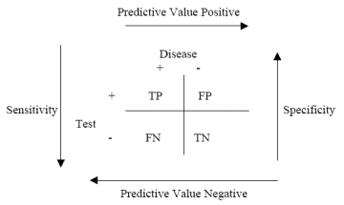
Following is a diagram that may help you to remember how to calculate sensitivity, specificity and the predictive values.

Slide 16
Calculations:
Sensitivity: 16/20*100 = 80%
Specificity: 931/980*100 = 95%
PPV: 16/65*100 = 24.6%
PNV: 931/935*100 = 99.6%
False Positive rate = 49/980*100 = 5%
False Negative rate = 4/20*100=20%
Disease prevalence 20/1000*100=2%

Slide 17
DISCUSSION
Effectiveness of the Screening Program
DISCUSS: The factors that influence effectiveness of Screening and Screening Programs

Slide 18
factors that influence effectiveness of Screening and Screening Programs
Accurate
Simple easy to implement Screening
Inexpensive
Acceptable to those who agree to be tested
Safe
The disease is of public health significance
High Prevalence (see the next slide for relationship between prevalence and predictive value of screening)
Significant in terms of morbidity, mortality, disability, cost to the community
Availability of effective treatment
Health system capable of providing services to all

Slide 19
Factors affecting the PPV/NPV of a screening test
Prevalence (%) Sensitivity Specificity PPV
0.1 90% 95% 1.8%
1.0 90% 95% 15.4%
5.0 90% 95% 48.6%
50.0 90% 95% 94.7%

