Slide 1
Clinical Decision Support
Nasriah Zakaria , Ph.D.
Assistant Professor Medical informatics and e-learning unit (MIELU)
College of Medicine, King Saud university
Notes:
CDSS can notify health care professionals of drug-drug interactions, contraindicated drugs, alternative medications, costs of interventions and abnormal laboratory results

Slide 2
What problem are you trying to solve?
Quality Assurance (immunization prior to discharge)
Safety (reduction of medication errors)
Regulatory (in compliance with standards)
Operational efficiencies (automatic requests for consultation)
Financial (reduce duplicate test ordering)
Notes:
CDS can help physician reach proper diagnoses, ask the right questions, and perform appropriate tests on the front end of the decision-making process--preventing errors of omission--as well as stop errors of commission on the back end, during treatment and procedures.

Slide 3
Management Information Systems
Chapter 12 Enhancing Decision Making
Systems for Decision Support
What have you learned so far?
Electronic Health Record
Medical Error and how to overcome ME
Functions of Health Information Technology:
Improve Clinical Outcomes/ Enhance Patient Care
Efficiency and Effectiveness
To improve decision making
Notes:
This slide describes the three main components of a DSS. It is important to note that, because of the need for analyzing and manipulating data, DSS typically operate with extracts or copies of production databases so that using the DSS does not interfere with critical operational systems.
CDS can help physician reach proper diagnoses, ask the right questions, and perform appropriate tests on the front end of the decision-making process--preventing errors of omission--as well as stop errors of commission on the back end, during treatment and procedures.

Slide 4
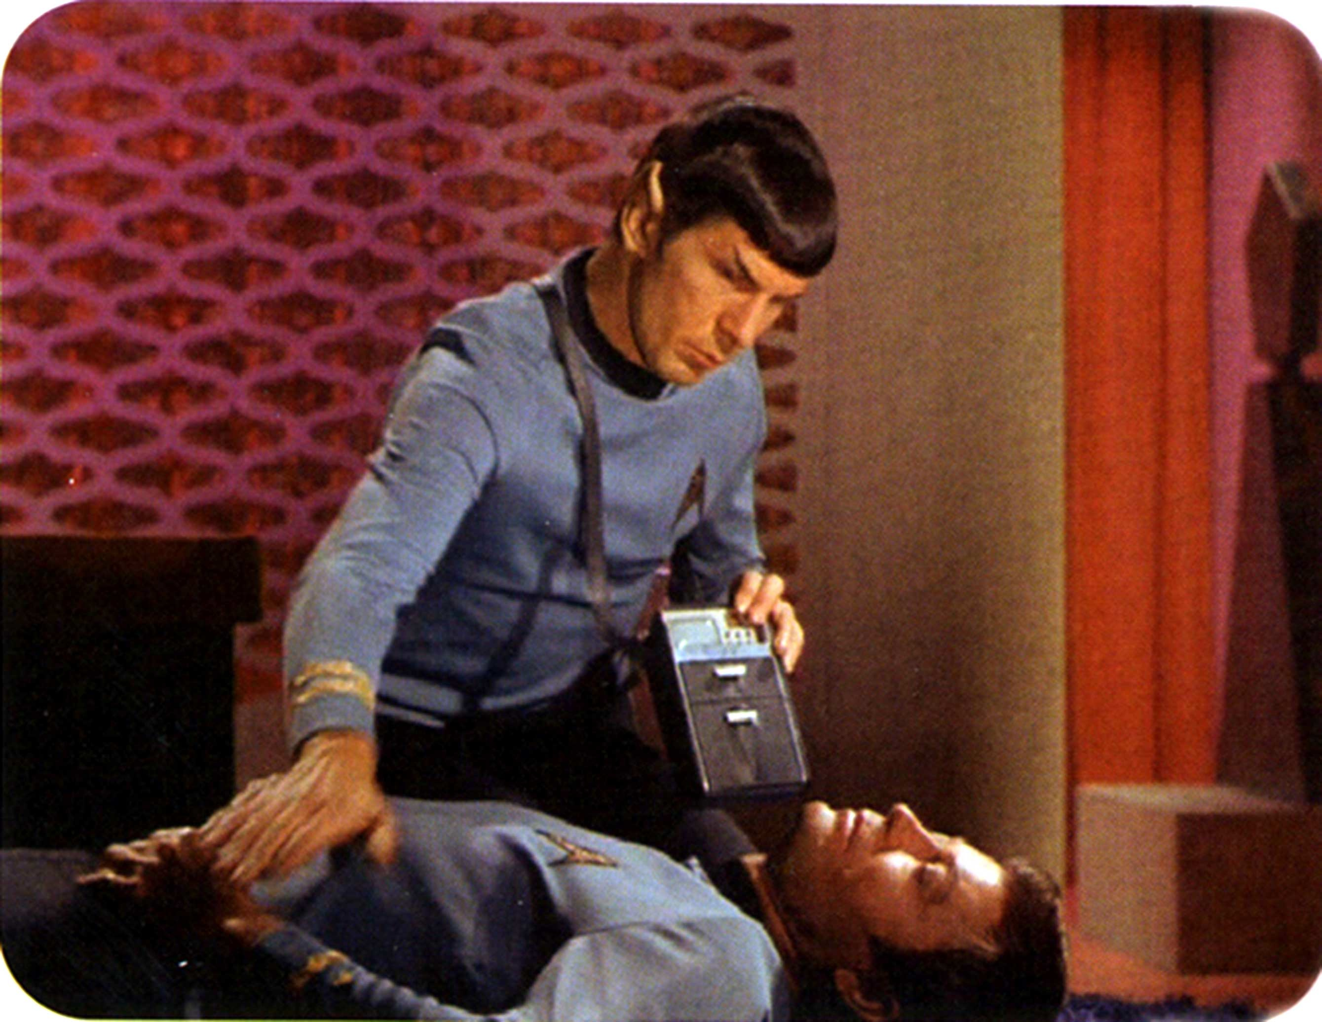
Star Trek & Diagnostic Device

Slide 5
Futuristic ….
In Star Trek- point diagnostic device to patients and device determine
What is the problem ?
How serious damage is?
In Star Trek- Diagnostic device is the “Clinical Decision Support”
Societal Concerns
Can computers replace doctors in making decisions?
What kinds of decisions can computers make?
How good will computers be?
What will the effects be on the practice of medicine, on medical education and on relationship among colleagues or between physicians and patients?
Notes:
قصة مدينة سلطان

Slide 6
Clinical Decision Support System (CDSS)
Definition:
Provide clinicians or patients with computer-generated clinical knowledge and patient-related information, intelligently filtered or presented at appropriate times, to enhance patient care” [1]
Notes:
Different vendors take different approaches to their CDS products, but they have one thing in common: a deep clinical knowledge base that helps promote patient safety.
CDS can help physician reach proper diagnoses, ask the right questions, and perform appropriate tests on the front end of the decision-making process--preventing errors of omission--as well as stop errors of commission on the back end, during treatment and procedures.

Slide 7
Elements of CDS [1]
Knowledge
Provide evidence to meet physician information needs
Meta-analysis of Randomized Controlled trials as evidences
Patient-specific Information
Medication List
Problem Lists
Lab results and other clinical data
Notes:
CDS can help physician reach proper diagnoses, ask the right questions, and perform appropriate tests on the front end of the decision-making process--preventing errors of omission--as well as stop errors of commission on the back end, during treatment and procedures.
http://www.informationweek.com/healthcare/clinical-information-systems/10-innovative-clinical-decision-support-programs/d/d-id/1101834?

Slide 8
Elements of CDS [1]
Filtered
Gathering and presenting pertinent data
Presented at appropriate time
Provider able and ready to act on the information
Enhance Patient Care
Error prevention
Quality improvement
Lab results and other clinical data
Notes:
قصة مدينة سلطان

Slide 9
MYCIN [2]
Gives ADVICE to clinicians
Used Artificial Intelligence
Production Rules– knowledge gathered from discussions among experts
Example:
Rule 507
Comprised of conditional statement (IF-THEN)
Notes:
MYCIN was an early expert system that used artificial intelligence to identify bacteria causing severe infections, such as bacteremia and meningitis, and to recommend antibiotics, with the dosage adjusted for patient's body weight —

Slide 10
Decision Making in Medicine [2]
Uncertainty
What is the diagnosis?
What should the intervention be?
What is the latest research that gives evidence the intervention really works?
Examples:
Should John gets another chemotherapy?
Should Mr. James undergo a third operation?
Should Mrs. Blackwood be given hepatitis B vaccination as an intervention?
Notes:
قصة مدينة سلطان

Slide 11
Why CDS?[1]
1. Questions
Unanswered Questions
Some doubts
Notes:
قصة مدينة سلطان

Slide 12
Why CDS?[1]
2. Information
Unmet information need
Cannot process information
Lack of time
Unsatisfied information need
Unrecognized information need
Notes:
قصة مدينة سلطان

Slide 13
Why CDS? [1]
3. Inquiry
Needs time
Resource Intensive (Evidence, Literature, Knowledge)
Solutions are needed…. CDS can help provide ALERTS and REMINDERS
To avoid errors and increase patient safety– new knowledge discovery – average 17 years to take evidence into clinical practice
CDS embedded in EMR to improve patient safety and reduce medical error
Notes:
قصة مدينة سلطان

Slide 14
Characterizing CDSS[1]
System Function
Mode of Giving Advice
Style of Communication
Underlying Decision Making Process

Slide 15
Evidence Based Medicine & CDSS [1]
“…use of current best evidence in making decisions ……..”[2, pg. 194]
Ideally:
EBM that uses Randomized Controlled Trial studies
High quality literature
Weaker forms:
Expert opinion
Interventions– are not based on FORMAL studies – found in BMJ
BMJ – one of the leading source of EBM studies
http://www.bmj.com/research

Slide 16
Constructing DSS[1]
Elicitation of Medical Knowledge
Reasoning and Representation
Validation of System Performance
Integration of DSS Tools
Notes:
Elicitation is a technique used to discreetly gather information. It is a conversation with a specific purpose: collect information that is not readily available and do so without raising suspicion that specific facts are being sought.

Slide 17
Types of CDSS [1]
Documentation Tool
* Provide complete documentation
*Well-designed order form
* Required fields & Proper information
* Reduce error of Omission by providing selection
* Provide coded data for CDSS
Notes:
error of omission. › a mistake that consists of not doing something you should have done,

Slide 18
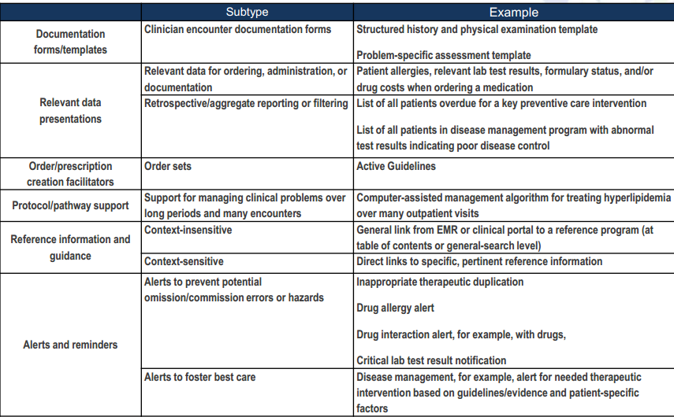
How Clinical Decision Support is implemented in an EHR
Notes:
Source:
http://www.healthteamworks.biz/pdf/ipip/learningcollaborative/october2010/saturday/presentations/22a.%20EHR%20Roundtable%20Already%20Installed%20EHR.pdf
error of omission. › a mistake that consists of not doing something you should have done,

Slide 19
Types of CDSS [1]
Types | Sub-types | Examples
1. Documentation Tool
 | 1.1 Patient Assessment Form | Pre-visit questionnaires
 | 1.2 Nursing Patient Assessment Form | Inpatient admission assessment

Slide 20
Types of CDSS [1]
Types | Sub-types | Examples
1. Documentation Tool
 | 1.3 Clinical Encounter Patient Form | Intelligent Referral Form
 | 1.4 Departmental/multidisciplinary clinical documentation forms | Emergency department documentation
 | 1.5 Data Flowsheets | Immunization flowsheet

Slide 21
Types of CDSS [1]
2) Relevant Data Presentation
Display relevant data –including costs
Pertinent Data are displayed
Complex Data – to show overall picture
To highlight needed ACTIONS

Slide 22
Types of CDSS [1]
Types | Sub-types | Examples
2. Relevant Data Presentation
 | 2.1 Relevant data for ordering | Display of relevant lab tests when ordering a medication
 | 2.2 Choice list | Suggest dose choice lists

Slide 23
Types of CDSS [1]
Types | Sub-types | Examples
2. Relevant Data Presentation
 | 2.3 Practice status display | ED tracking display
 | 2.4 Retrospective/aggregate reporting/filtering | Physician “report cards”
 | 2.5 Environment parameter report | Recent antibiotic sensitivities

Slide 24
Types of CDSS [1]
3) Order Creation Facilitators
Adherence to Standards (Guidelines)
Making the right things EASIEST TO DO
4) Protocol and Pathway Support
Provide support for multi-step care plan , protocol and pathway

Slide 25
Types of CDSS [1]
Types | Sub-types | Examples
3. Order Creation Facilitators
 | 3.1 Single-order completers-consequent orders | Prompt Order Consequent Order Suggestions
 | 3.2 Order sets | General Order Set Post Op Order Set
 | 3.3 Tools for complex ordering | Guided Dose Active Guidelines

Slide 26
Types of CDSS [1]
Types | Sub-types | Examples
4. Time-based checking & protocol/pathway support
 | 4.1 Stepwise processing of multi-step protocol | Tools for Monitoring and supporting patient clinical pathway
 | 4.2 Support for managing clinical problems | Computer assistant management

Slide 27
Types of CDSS [2]
5) Reference Information & Guidance
Address recognized needs from physicians & patients
“Infobuttons” – linked to references/standards
6)Reactive Alerts and Reminders
Data entry level
Immediate notification for errors and hazards
Lack of an order- reminder
Contradictions to a procedure

Slide 28
Types of CDSS [1]
Types | Sub-types | Examples
5. Reference Information and guidance
 | 5.1 Context-insensitive | General Link from EMR to a reference program
 | 5.2 Context-sensitive | Direct link to a specific reference program

Slide 29
Types of CDSS [1]
Types | Sub-types | Examples
6. Reactive Alerts & Reminders
 | Alerts to prevent potential errors | Drug Allergy Alerts Drug Interaction aler Under/Overdose Alert

Slide 30
Summary
CDS
Provide clinicians or patients with computer-generated clinical knowledge and patient-related information, intelligently filtered or presented at appropriate times, to enhance patient care” [1]
Notes:
قصة مدينة سلطان

Slide 31
References
[1] Carter, J.H. (2008) . Electronic Health Records, 2nd edition, American College of Medicine.
[2] Shortliffe, E.H., Cimino, J.J. (2006).Biomedical informatics: computer applications in health care and biomedicine, 3rd Edition, Springer.

