Slide 1
Acute Coronary Syndrome
Dr. Hussam F. Al-Faleh
Associate Professor of Cardiac Sciences

Slide 2
Why is this topic important ?

Slide 3
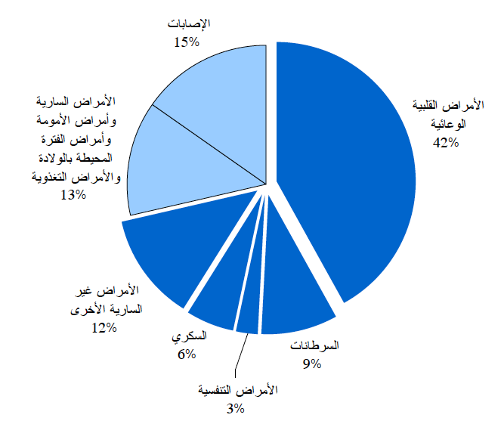

Slide 4
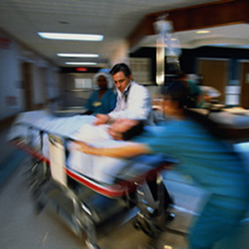
Almost 30% of ER admissions are cardiac

Slide 5

Exam questions !!

Slide 6
Objectives
Pathophysiology of ACS
Classification of ACS
Diagnostic workup
Initial management
Common complications of ACS

Slide 7
Resources
Davidson or Kumar
Lecture

Slide 8
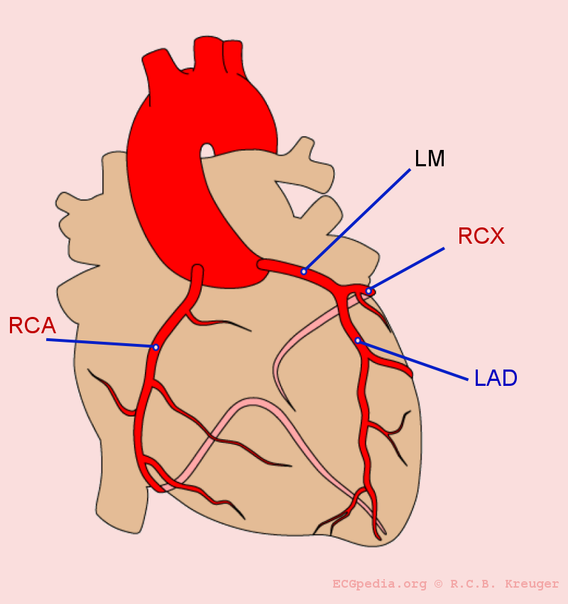
What are coronary arteries ??
LCX

Slide 9
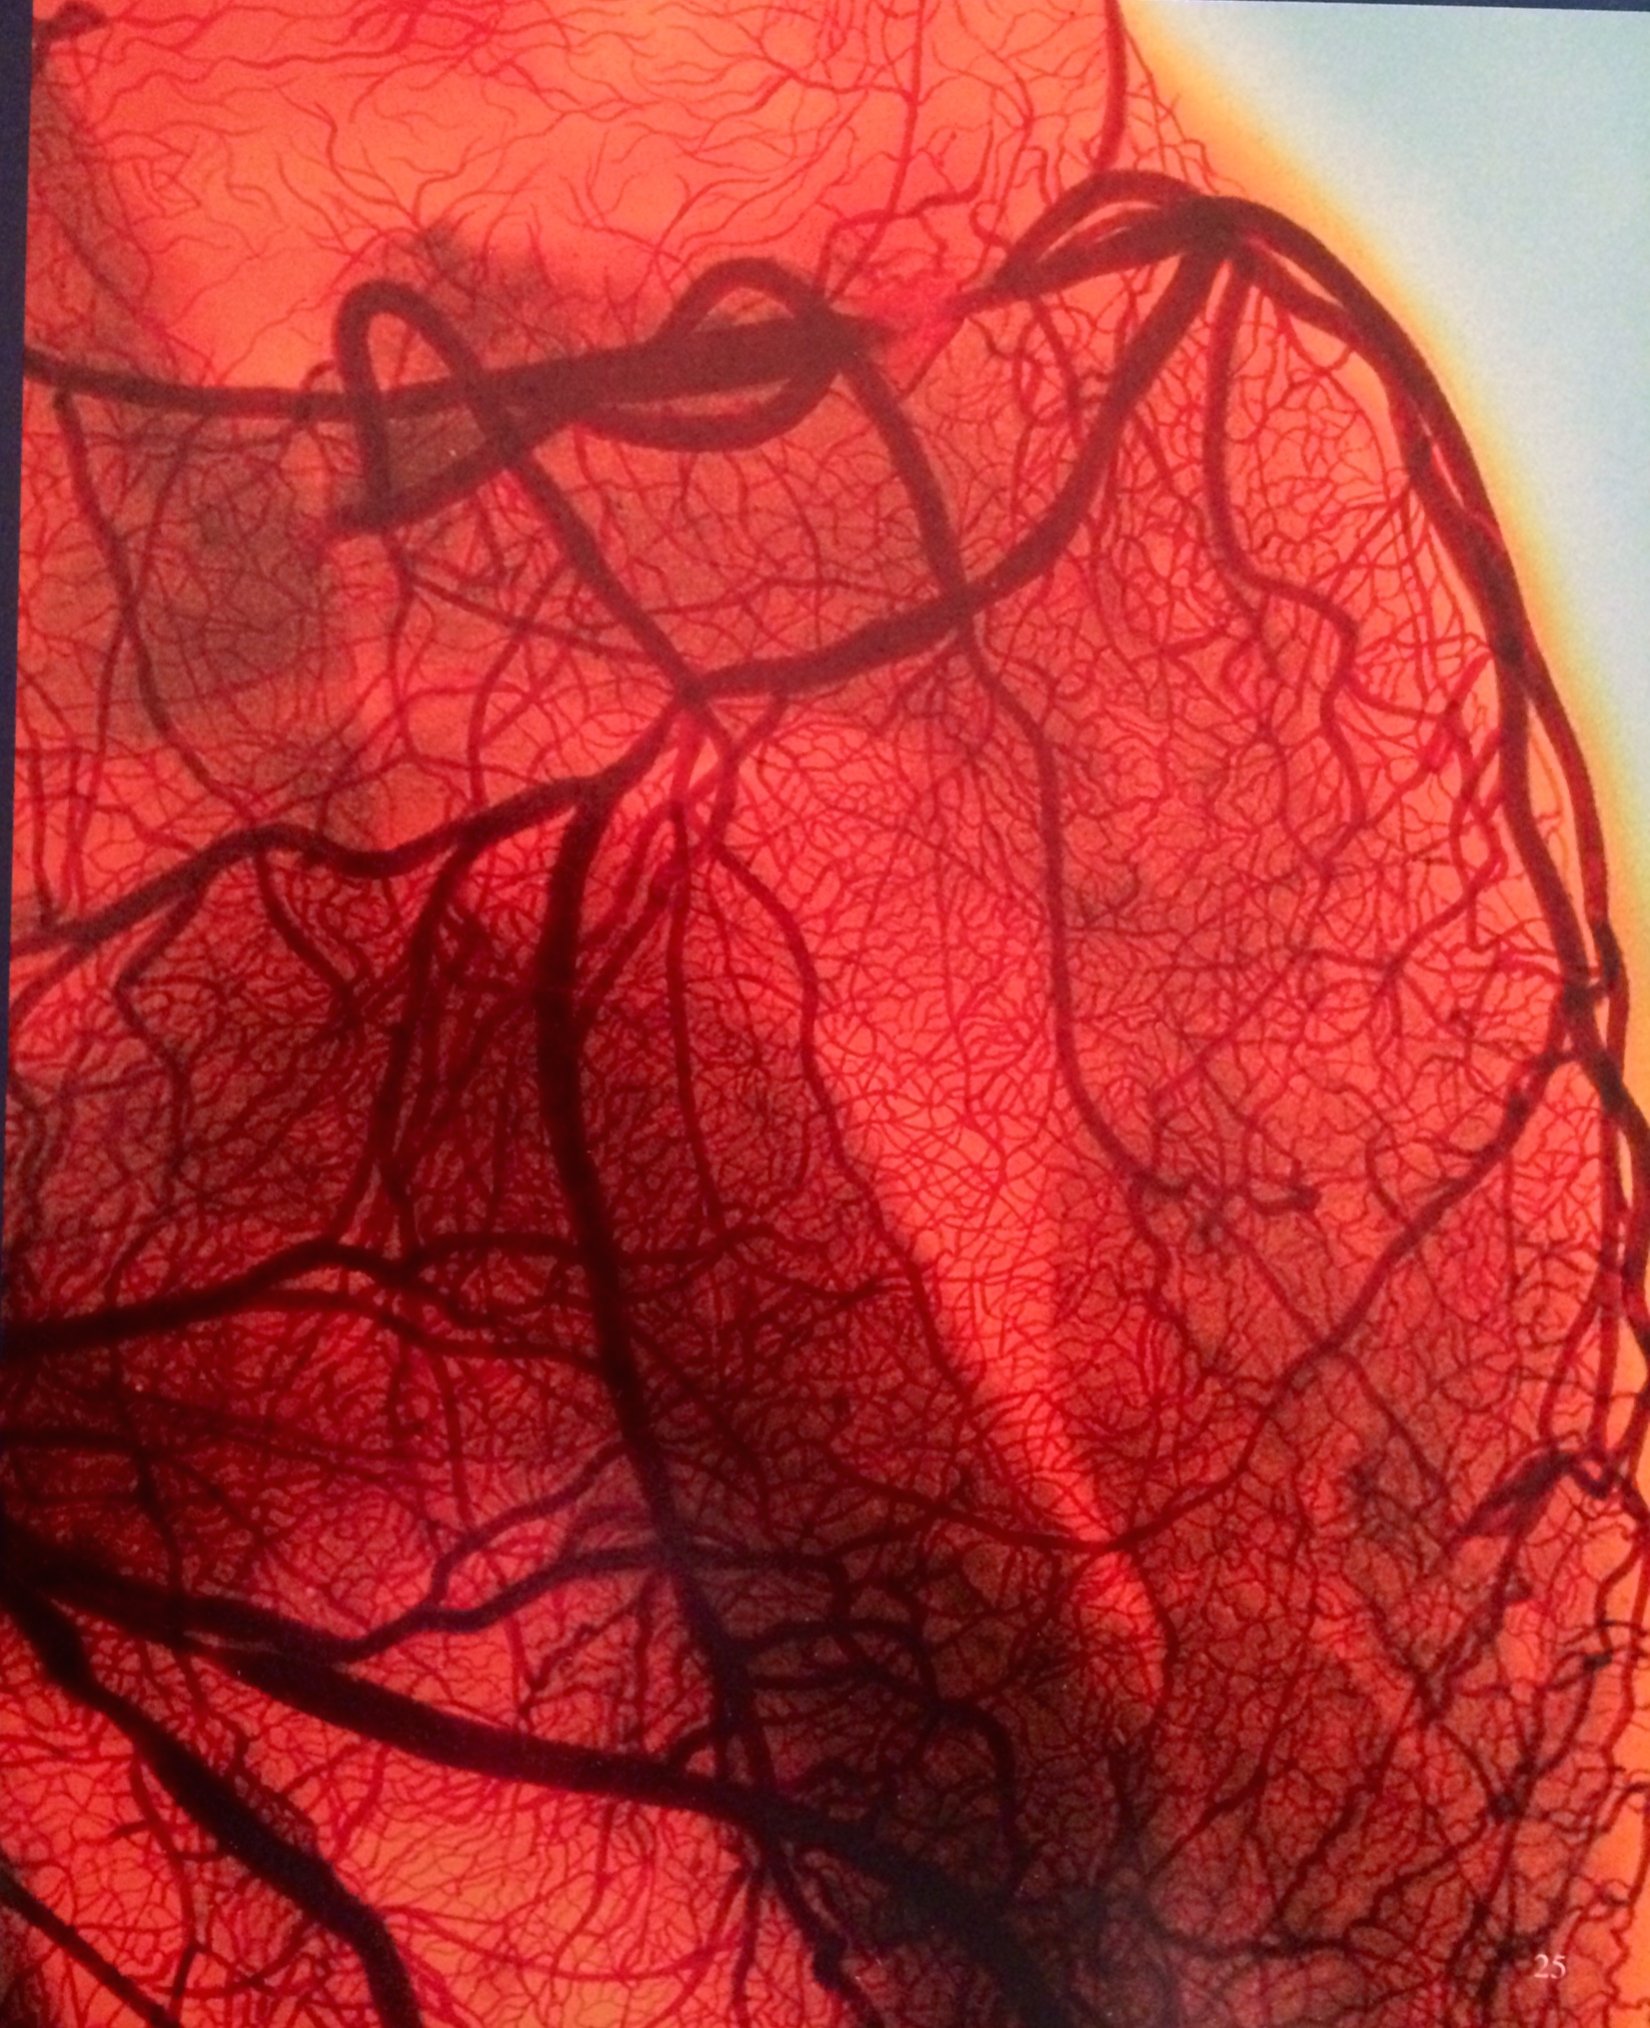

Slide 10
Clinical Scenario

Slide 11
Clinical scenario
Rashed, 60yr old man
Owns a business
Smoker
On a routine medical check up was found to have the following:

Slide 12

Rashed’s Profile
Physical Exam:
- BP of 150/90
( repeated 3 times)
Weight 90kg,Height 170 ( BMI=31)
Waist Circumference 115 cm
Lab investigations:
FBS = 9 mmol/l
TC = 6.0 mmol/l
LDL = 4.5 mmol/l
HDL = 0.7 mmol/l

Slide 13
He was counseled and told…
DM
Obese
Dyslipidemic
BP was high ( likely hypertensive if repeated on future occasions)
Strongly advised to change life style
Stop Smoking
Undergo another check up in 3 months times after dietary changes

Slide 14
What are the risk factors for CAD?

Slide 15
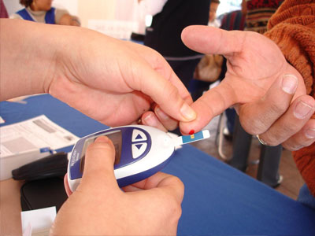
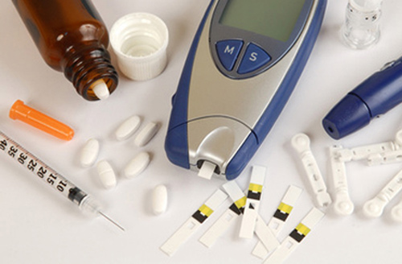
Diabetes Mellitus
One every 4 Saudis has DM

Slide 16
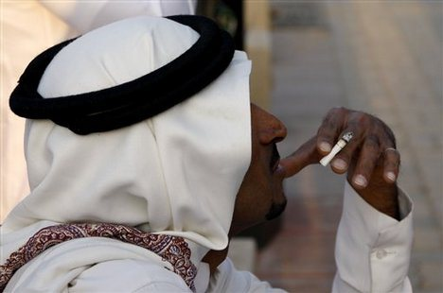
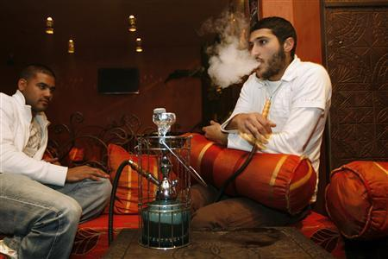
Smoking

Slide 17
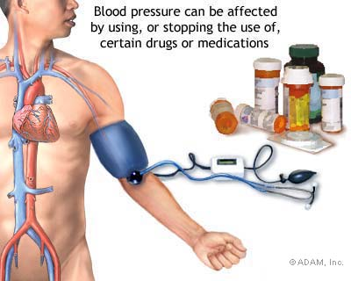
Hypertension

Slide 18
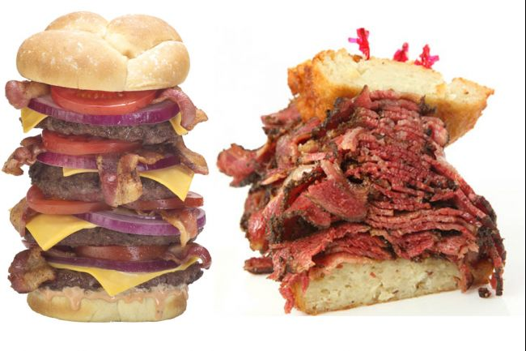
Hyperlipidemia

Slide 19
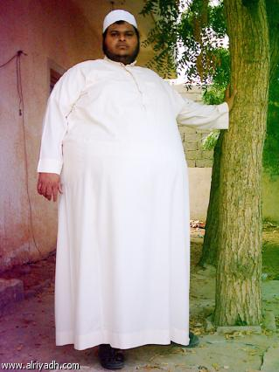
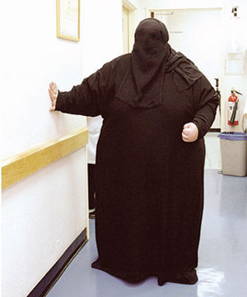
Obesity

Slide 20
Other Risk factors
Age : males ≥45, females ≥55
Gender (Male gender)
Family history of Premature CAD: males ≤55 females ≤65

Slide 21
Clinical scenario
Rashed, forgot or was careless !
3 yrs later, he started feeling occasional chest heaviness while rushing on the stairs. Radiated to both shoulders, and relived with rest.
He decided to go to his physician again….but after finishing off some business deals

Slide 22
What is happening with Rashed?

Slide 23
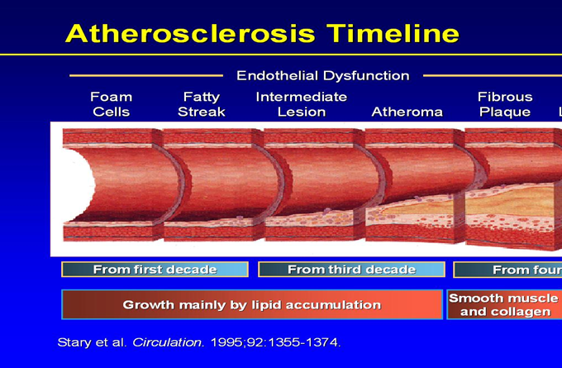
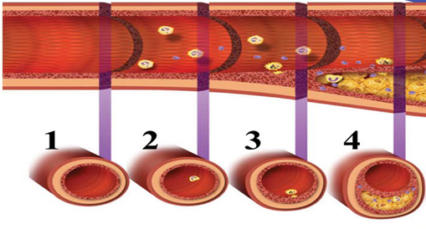

Slide 24
O2
Supply
Tissue
Demand

Slide 25
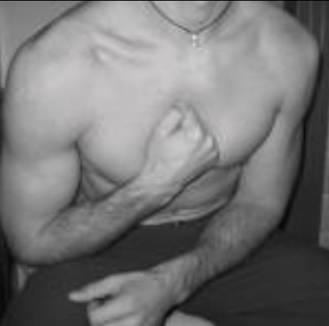
Back to Rashed
Delayed medical check up for 3 months!
Woke up at 5 AM with similar chest pain, however now at rest and severe.
Perfuse sweating and nausea
Called his son to take him to the ER
In ER
- HR 110bpm
- BP 180/100
- O2 Saturation 95% on RA
- PE was normal
Can you explain his clinical presentation?

Slide 26
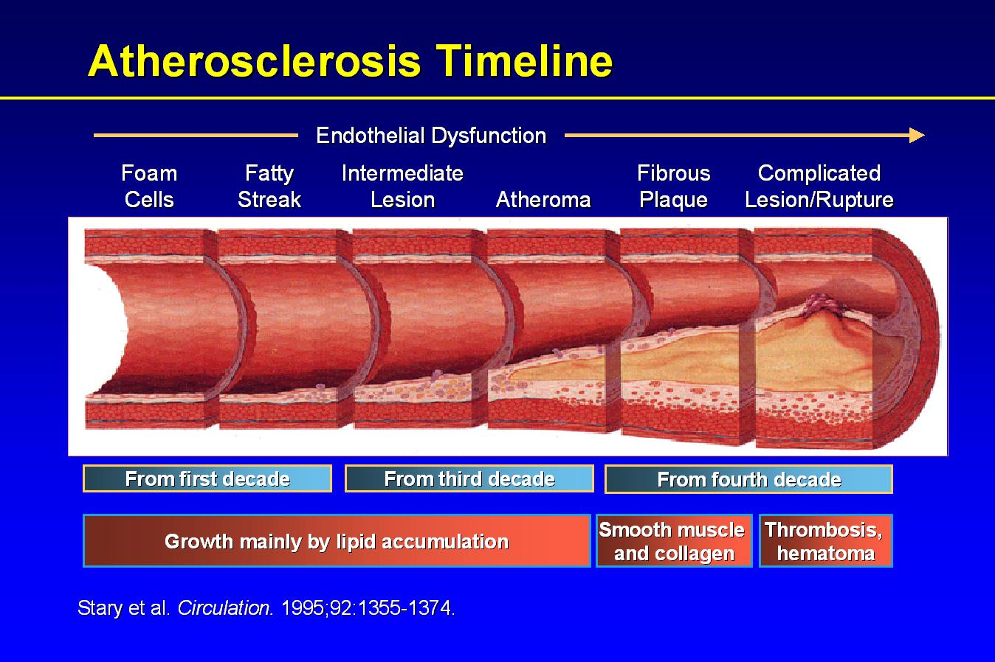
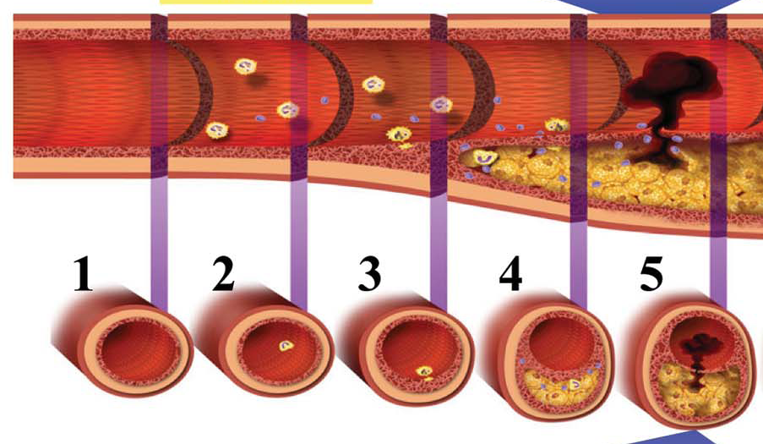

Slide 27


Slide 28
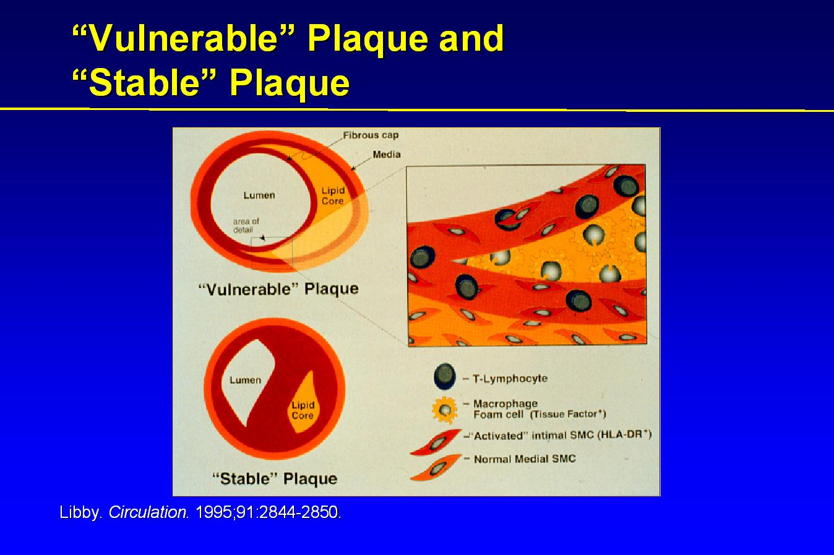
Secretion of
Matrex
metalloprotenases

Slide 29
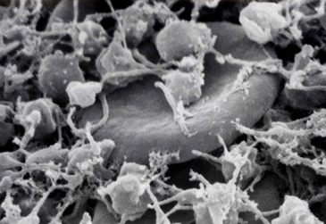

Slide 30
Investigations in the emergency room

Slide 31
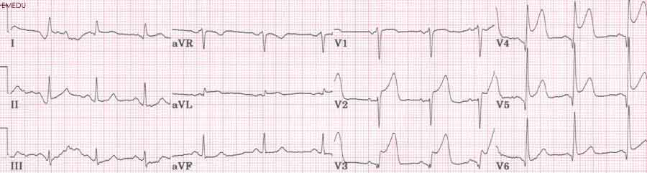
12 lead ECG

Slide 32
What is the diagnosis?

Slide 33
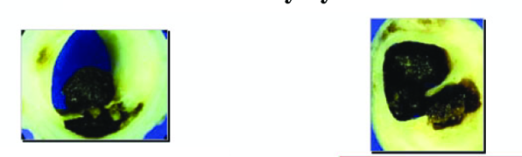


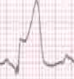

Acute Coronary Syndrome
OR
Unstable Angina
Non ST Elevation MI
(NSTEMI)
ST Elevation MI
(STEMI)
No Myocardial Necrosis
Myocardial Necrosis

Slide 34
What is Myocardial Infarction?

Slide 35
Third Universal Definition of MI
Typical rise in cardiac troponin T or I , CK-MB with at least one of the following:
1. Ischemic symptoms
2. Pathological Q wave on ECG
3. Ischemic ECG changes (e.g ST
elevation or depression, new LBBB)
4. Imaging evidence of new loss of
viable myocardium or a new WMA
5. Identification of an intracoronary thrombus by angiography or autopsy.
European Heart Journal , 2012

Slide 36
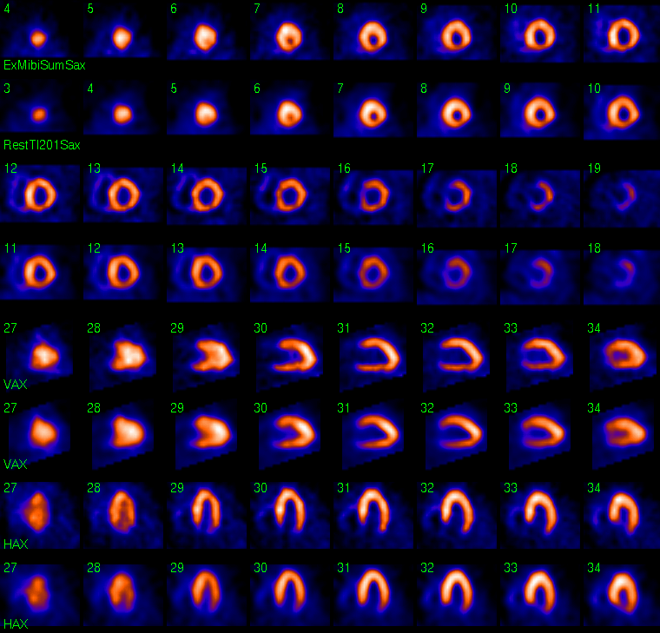
Nuclear imaging

Slide 37
Markers for Myocardial Necrosis

Slide 38
Biochemical markers
MI causes release of certain enzymes and proteins into the blood stream.
Creatin Kinase (CK) is released from multiple organs such as the myocardium , skeletal muscles, and the brain.
The Iso-form CK-MB, is cardio-specific
Starts to rise 4-6 hrs after onset of ischemia, then falls within 48-72hrs.

Slide 39
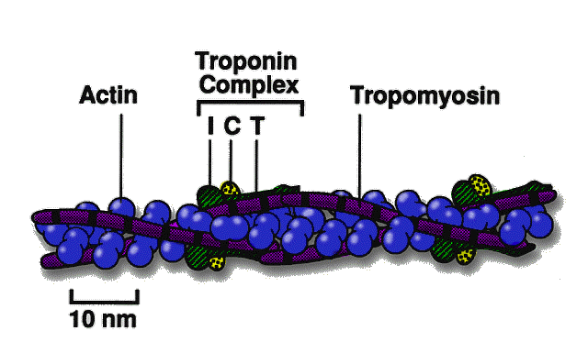
Biochemical markers
Cardiospecific proteins Troponin I, and T are the most sensitive & specific markers for myonecrosis.
Released with 4-6hrs, but can last upto 2 weeks.

Slide 40
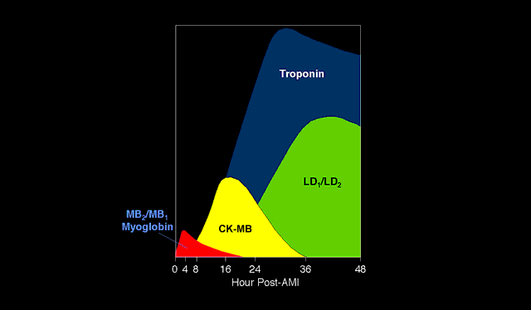
Relationship between onset of MI and
release of markers

Slide 41
Back to Rashed in ER
Management

Slide 42
Aims of therapy
Open Artery and Improve oxygen supply
1. Supplemental O2
2. Coronary vasodilators ( Nitroglycerine)
3. Antiplatelet agents
4. Reperfusion therapy
a. Fibrinolytic therapy
b. Primary Percutanous coronary intervention (PCI)
5. Antithrombotic agents

Slide 43
Aims of therapy
Reduce O2 demand
1. Beta blockers ( Propranolol, Metoprolol)
2. Analgesics ( Morphine)
Other medications
- ACE inhibitors( Enalapril, Lisinopril)
- Statin therapy

Slide 44
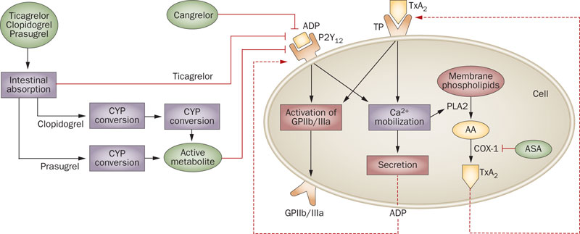
Antiplatelet Agents

Slide 45
Aspirin (ASA)
ASA is Chewable 160 to 325 mg at presentation, then 75 to 325 mg daily.

Slide 46
P2Y₁₂ inhibitors
More potent than ASA and is combined with ASA
Both agents are powerful adjuncts to reperfusion therapy
Examples:
1. Clopidogrel
2. Ticagrelor
3. Prasugrel

Slide 47
Reperfusion therapy

Slide 48
Fibrinolytics
ONLY USED FOR STEMI ( NOT NSTEMI)
Reduces short and long term mortality
Should be given during a 12hr window, and given ASAP.
2 types of fibrinolytics:
1. Non Fibrin specific ( Streptokinase)
2. Fibrin specific

Slide 49
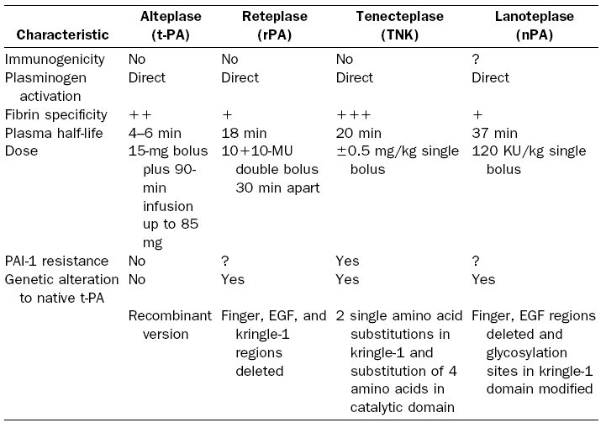
Fibrin specific agents

Slide 50
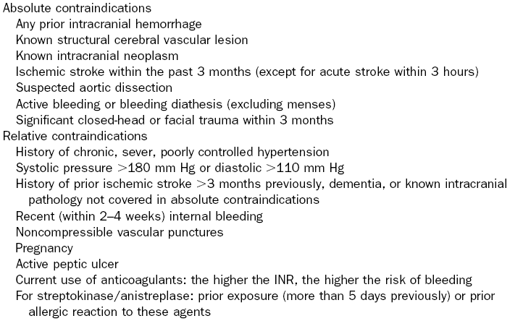

Slide 51
Primary PCI

Slide 52
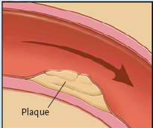
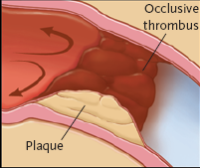
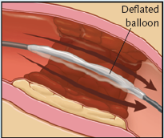
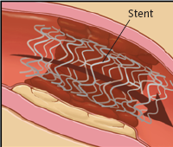
Adopted from N Eng J Med 2007

Slide 53
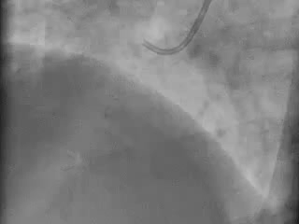

Slide 54
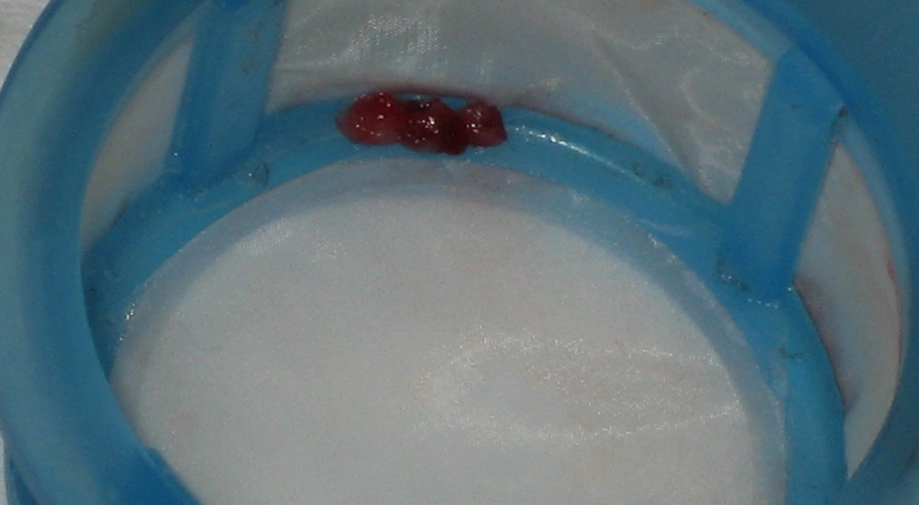
Thrombus aspiration

Slide 55
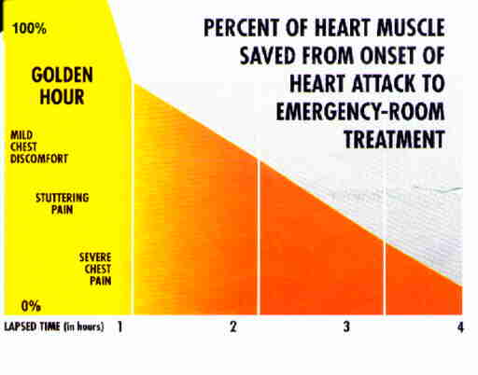

Slide 56
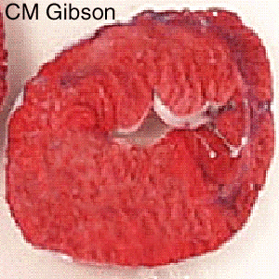
Myonecrosis based on duration of occlusion
Notes:
Years ago, Reimer and Jennings demonstrated that there is a wavefront of necrosis proceeding from the subendocardium to the subepicardium in a time dependent fashion. Recent data presented at the ACC from the DANAMI 2 trial raises questions as to the importance of restoring flow in a timely fashion given that patients transferred for primary PCI had good outcomes. This slide set reviews the strengths and weaknesses of the preliminary data from DANAMI 2.

Slide 57
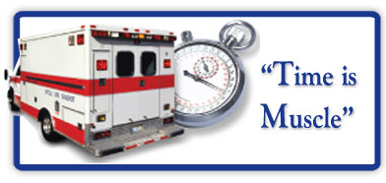

Door to needle time <30min
Door to balloon time <90min

Slide 58
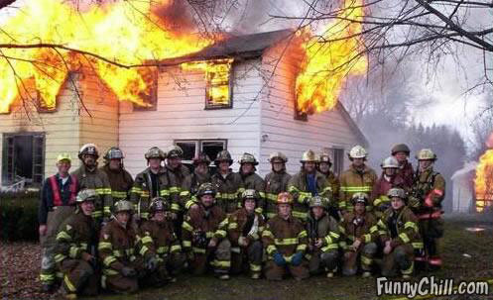

Slide 59
Antithrombotics

Slide 60
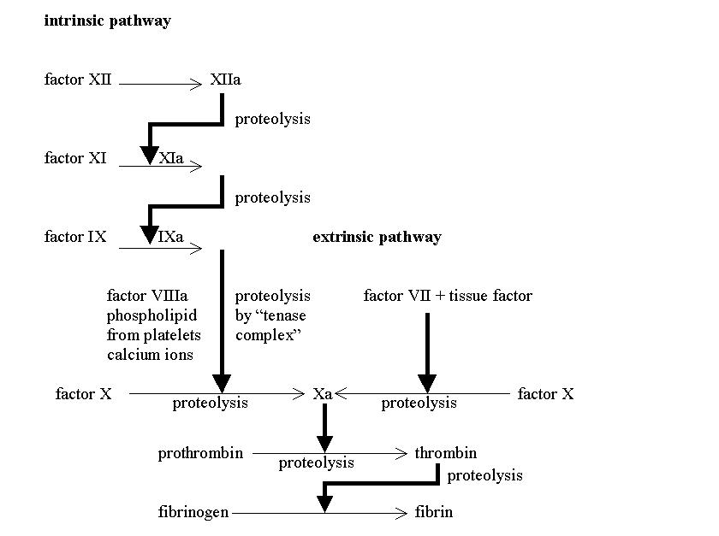
Heparin
Antithrombin III

Slide 61
Antithrombotics
Heparin
- Unfractionated
- Low molecular
Prevents further thrombosis and aids in insuring patency of the occluded artery.

Slide 62
Back to Rashed in ER
Was given chewable ASA
3 Sublingual Nitro tablets
He had no contraindications to fibrinolytic therapy
Just prior to receiving fibrinolytics , he lost consciousness ………

Slide 63
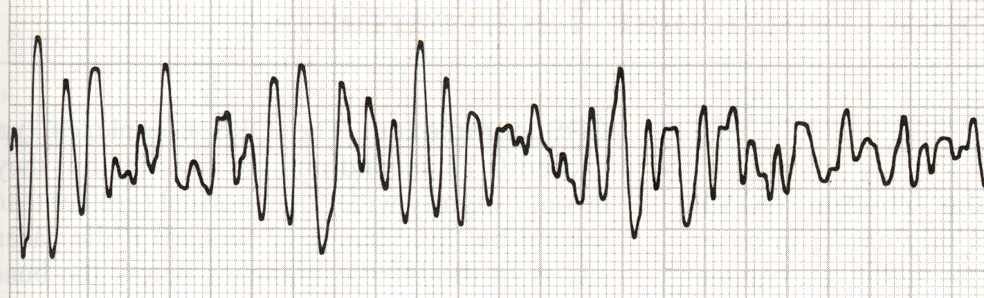
Ventricular Fibrillation

Slide 64
Defibrillator paddles immediately applied and 200J delivered managed to convert him to normal sinus rhythm
What other immediate complications may happen?

Slide 65
Complications of MI
Electrical ( Arrhythmia )
Heart failure (Pulmonary Edema)
Cardiogenic Shock
Mechanical complications ( usually occurs late after MI …days to weeks )

Slide 66
Summery
Plaque vulnerability is affected by an inflammatory process
Acute coronary syndromes is a spectrum and is classified according to markers of ST changes and Myocardial necrosis
In STEMI , time to reperfusion is critical in myocardial salvage ( time is muscle)

