Slide 1
Body Cations: K and Ca
Dr. Riyadh Al Sehli, MBBS, FRCPC
Transplant Nephrologist
Medicine 341
November 17, 2014

Slide 2
2 important Cations
Potassium [K]
Calcium [Ca]

Slide 3
K
Where does come form?
How much K do we eat every day?
How do we loose the K?
Where does K in the body live?
How does K move?
Is K important?
What keeps K in normal range ?
What happens if K level is abnormal?
What causes high K?
What causes low K ?

Slide 4
Where does K come form?
Depending on diet, the normal daily intake can vary
Fruits, potatoes, beans, and grains
High-fat diets usually contain low amounts of potassium
Average daily intake approximately 50 to 100 mmol

Slide 5
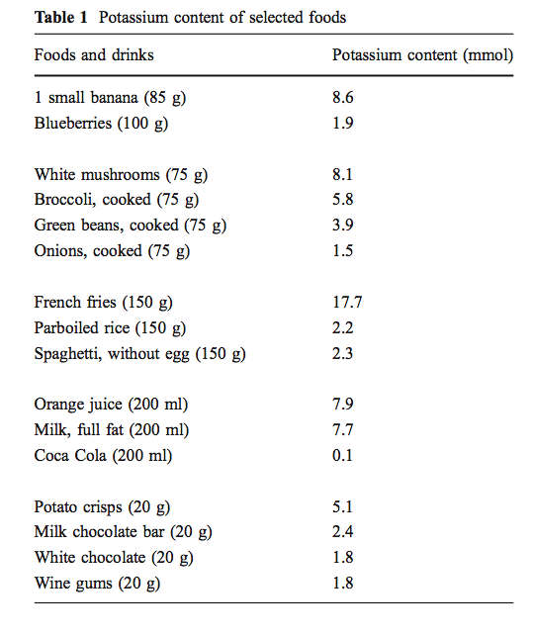
Pediatr Nephrol (2011) 26:377–384

Slide 6
How do we loose K ?
Renal clearance
primary mechanism
Very efficient until GFR < 30 ml/min
Intestinal excretion
Only handles 10 % of the daily K load
Efficiency can be enhanced in renal failure but it is variable form one person to another

Slide 7
Where does K live in the body live ?
Total body K is approximately 50 mmol/kg body weight
K is the most abundant intracellular cation (100- 150 mmol/l) ➔ 98 % of total body K
Extracellular K concentration (3.4 – 5.5 mmol/L) ➔ 2% of total body K

Slide 8
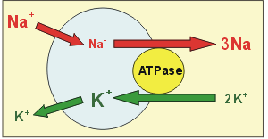
What keeps the IC K conc. high ?
Insulin , Beta agonists enhance the pump function
Beta Blockers inhibit the pump function
Cvphysiology.com

Slide 9
What keeps EC K low?
The Na/K ATPase pump
Renal clearance : requires normal GFR and normal aldosterone axis
Intestinal excretion

Slide 10
What happens when we eat K ?
Oral K intake is initially absorbed in the intestine and enters portal circulation
increased ECF K stimulates insulin release
insulin facilitates K entry into intracellular compartment by stimulating cell membrane Na/K ATPase pump
The transient rise in serum K stimulates renal and intestinal clearance of extra K

Slide 11
In order to Keep serum K in normal range, we need:
Normally functioning Na/K ATPase pump
intact renal response

Slide 12
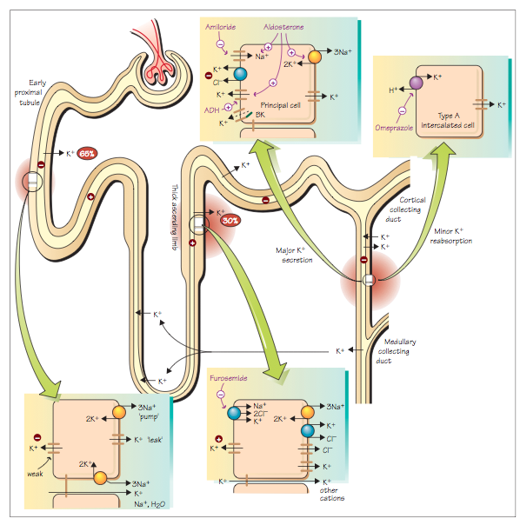
The Renal System at a Glance, 3e. By Chris O’Callaghan

Slide 13
Why is K important ?
Maintains electrical gradient across cell membranes i.e.
resting membrane potential essential for generation of action potential
Essential for intracellular metabolism e.g protein synthesis

Slide 14
What happens of K level is abnormal?
Skeletal muscle dysfunction: weakness and paralysis
Cardiac cell irritability: arrhythmia
Pediatr Nephrol (2011) 26:377–384

Slide 15
Hyperkalemia
[K]>5.5
NA/K ATPase dysfunction
-B blockers
-Digoxin
-⬇Insulin
Massive Cell breakdown
-Rhabdomyolysis
-Tumor lysis syndrome
Impaired Renal function
Aldosterone axis dysfunction
- Adrenal deffiency
-Aldosterone resistance

Slide 16
Can you eat too much K ?
If GFR is normal, renal clearance of K has a huge adaptive capacity
K intake is restricted only if:
GFR is reduced
existing aldosterone axis dysfunction
Na/K ATPase is not efficient ( blocked by drugs, Insulin ⬇ )

Slide 17
Hypokalemia
[K]<3.4
⬇Oral intake
- Malnutrition
-eating disorders
Rapid transcellular shift
-Insulin therapy
- Periodic paralysis
⬆Renal loss
-Diuretics
-too much aldosterone
⬆Intestinal loss
-Diarrhea
-Laxative abuse

Slide 18
How to raise K level?
Stop the loss
Replace lost K with K ( PO or IV if rapid correction is urgently needed)

Slide 19
How to lower K level ?
Reduce Cardiac muscle irritability withCa gluconate (only if EKG changes)
Push K into cells: Insulin , Beta agonists
Remove the K load
Through the kidney: diuretics, dialysis
Through the gut : Laxatives, K chelation(Ca resonium)

Slide 20
Calcium balance

Slide 21
Ca
Where does Ca come form?
How much Ca do we eat every day?
How do we loose the Ca?
Where does Ca in the body live?
How does Ca move?
Is Ca important?
What keeps Ca in normal range ?
What happens if Ca level is abnormal?
What causes high Ca?
What causes low Ca ?

Slide 22
Where does Ca come from?
Diet : 1000 – 1500 mg /day in average
Total body Ca = 1000 g

Slide 23
Where does Ca live ?
The vast majority of total body calcium (99%) is present in the skeleton
Non-bone calcium represents 1% of total body calcium
free ions (51%)
protein-bound complexes (40%)
ionic complexes (9%) [calcium phosphate, calcium carbonate, and calcium oxalate]
Non Ionized

Slide 24
Why Ca is important ?
Bone Ca
skeletal strength
dynamic store
Non-Bone Ca
extra- and intracellular signaling
nerve impulse transmission
muscle contraction

Slide 25
What keeps Ca in balance ?
Total intake
Rate of intestinal absorption
Intestinal excretion
Renal reabsorption
Renal excretion
Bone turnover
All these parameters are controlled by
1- PTH
2- Active Vitamin D
3-Serum Ionized Ca level

Slide 26
PTH is a hyper-calcemic hormone
⬆Release of Ca form bones (bone resorption)
⬆Renal absorption of Ca
Activates Vitamin D in the kidney

Slide 27
Active Vitamin D is also hyper-calcemic
⬆Intestinal absorption of Ca
⬆Bone resorption

Slide 28
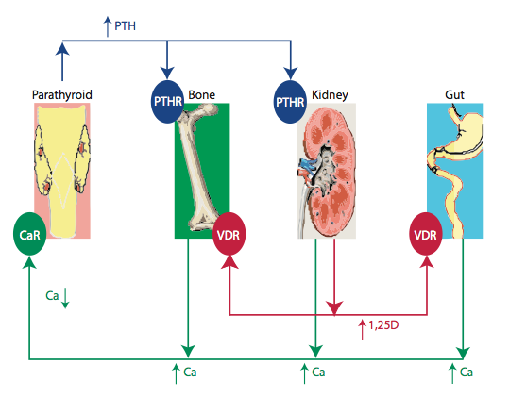
Clin J Am Soc Nephrol 5: S23–S30, 2010

Slide 29
What can go wrong ?
Oral intake
Intestinal absorption
Renal reabsorption
Renal excretion
Intestinal excretion
Bone turnover
PTH
Active Vitamin D

Slide 30
Hypercalcemia
⬆Intestinal absorprtion
- Increased intake
- Increased Vit D
⬆Renal reabsorprtion
- Hyperparathyroidism
-Thiazide diuretics
⬆Bone resorption
-Osteoclastic bone metastasis
-Immobilization
⬆PTH
-Primary hyperparathyroidism
-Multiple Endocrine Neoplasia
⬆Vit D
-Intoxication

Slide 31
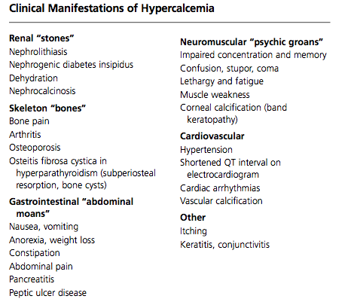
Am Fam Physician 2003;67:1959-66

Slide 32
Hypocalcemia
⬇Intestinal absorprtion
- Decreased intake
-malabsorption
-Small bowel reseciton
- Vit D defficiency
⬇Renal reabsorprtion
- hypoparathyroidism
-Loop diuretics
-Tubular defects
Bone remodling
-Osteoblastic bone metastasis
-Hungry bone syndrome
⬇PTH
- hypoparathyroidism
⬇Vit D
- Renal failure
-

Slide 33
Neuropsychiatric
Seizure
Neuromascular
Parasthesia
Autonomic
Biliary colic
Cardiovascular
Prolonged QT interval
Dementia
Extrapyramidal
Papillidema
Cataract
Spasm
Chvostek’s sign
Trousseau’s sign
Heart failure
Hypotension
Bronchospasm
Diaphoresis

Slide 34
Thank You

