Slide 1
Water & Sodium Disorders
(H₂O/Na⁺)
KSU-COM-Course 341
Safar 1436-November 2014
Ahmad Raed Tarakji, MD, MSPH, FRCPC, FACP, FASN, FNKF
Assistant Professor
Nephrology Unit, Department of Medicine
College of Medicine, King Saud University
Consultant Internist & Nephrologist
King Khalid University Hospital
King Saud University Medical City
Atarakji@ksu.edu.sa

Slide 2
Objectives
By the end of the lecture the student should be able to:
  Recognize the systems that control body Na and H₂O contents
  Understand the difference between body Na content (volume status) and serum Na concentration
  Recognize the different types of IV fluids used at bedside
  Know the workup for Hyponatremia
  Know how to calculate the water deficit in Hypernatremia

Slide 3
Structure
Composition of the fluid compartments
Mechanisms which regulate fluid and Sodium balance
Disorders of water balance
Disorders of Sodium balance

Slide 4
Homeostasis
A relative constancy in the internal environment of the body, naturally maintained by adaptive responses that promote cell function and survival

Slide 5
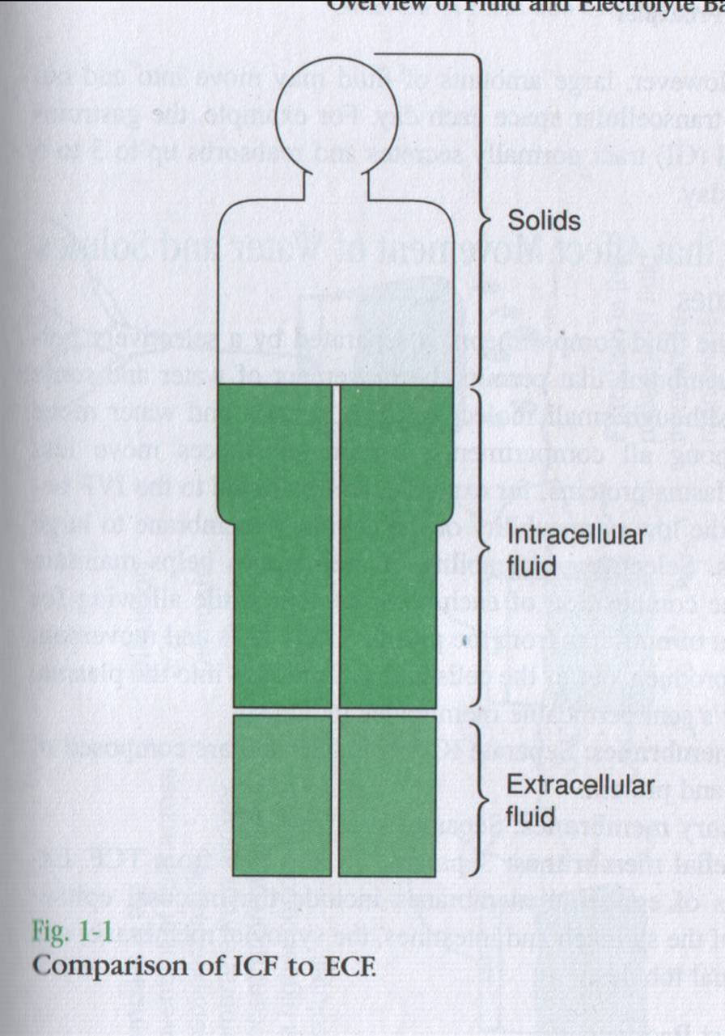
Total Body Fluid:

Slide 6
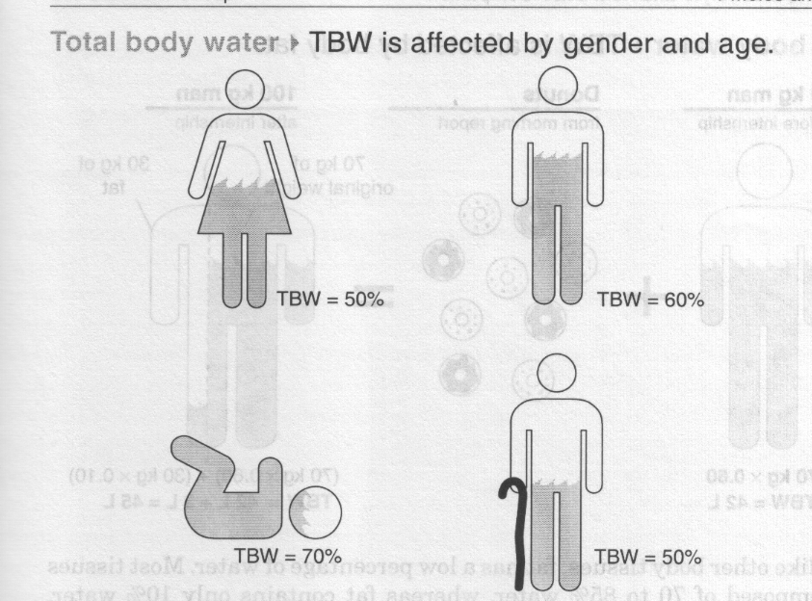

Slide 7
Body Fluid Compartments

Slide 8
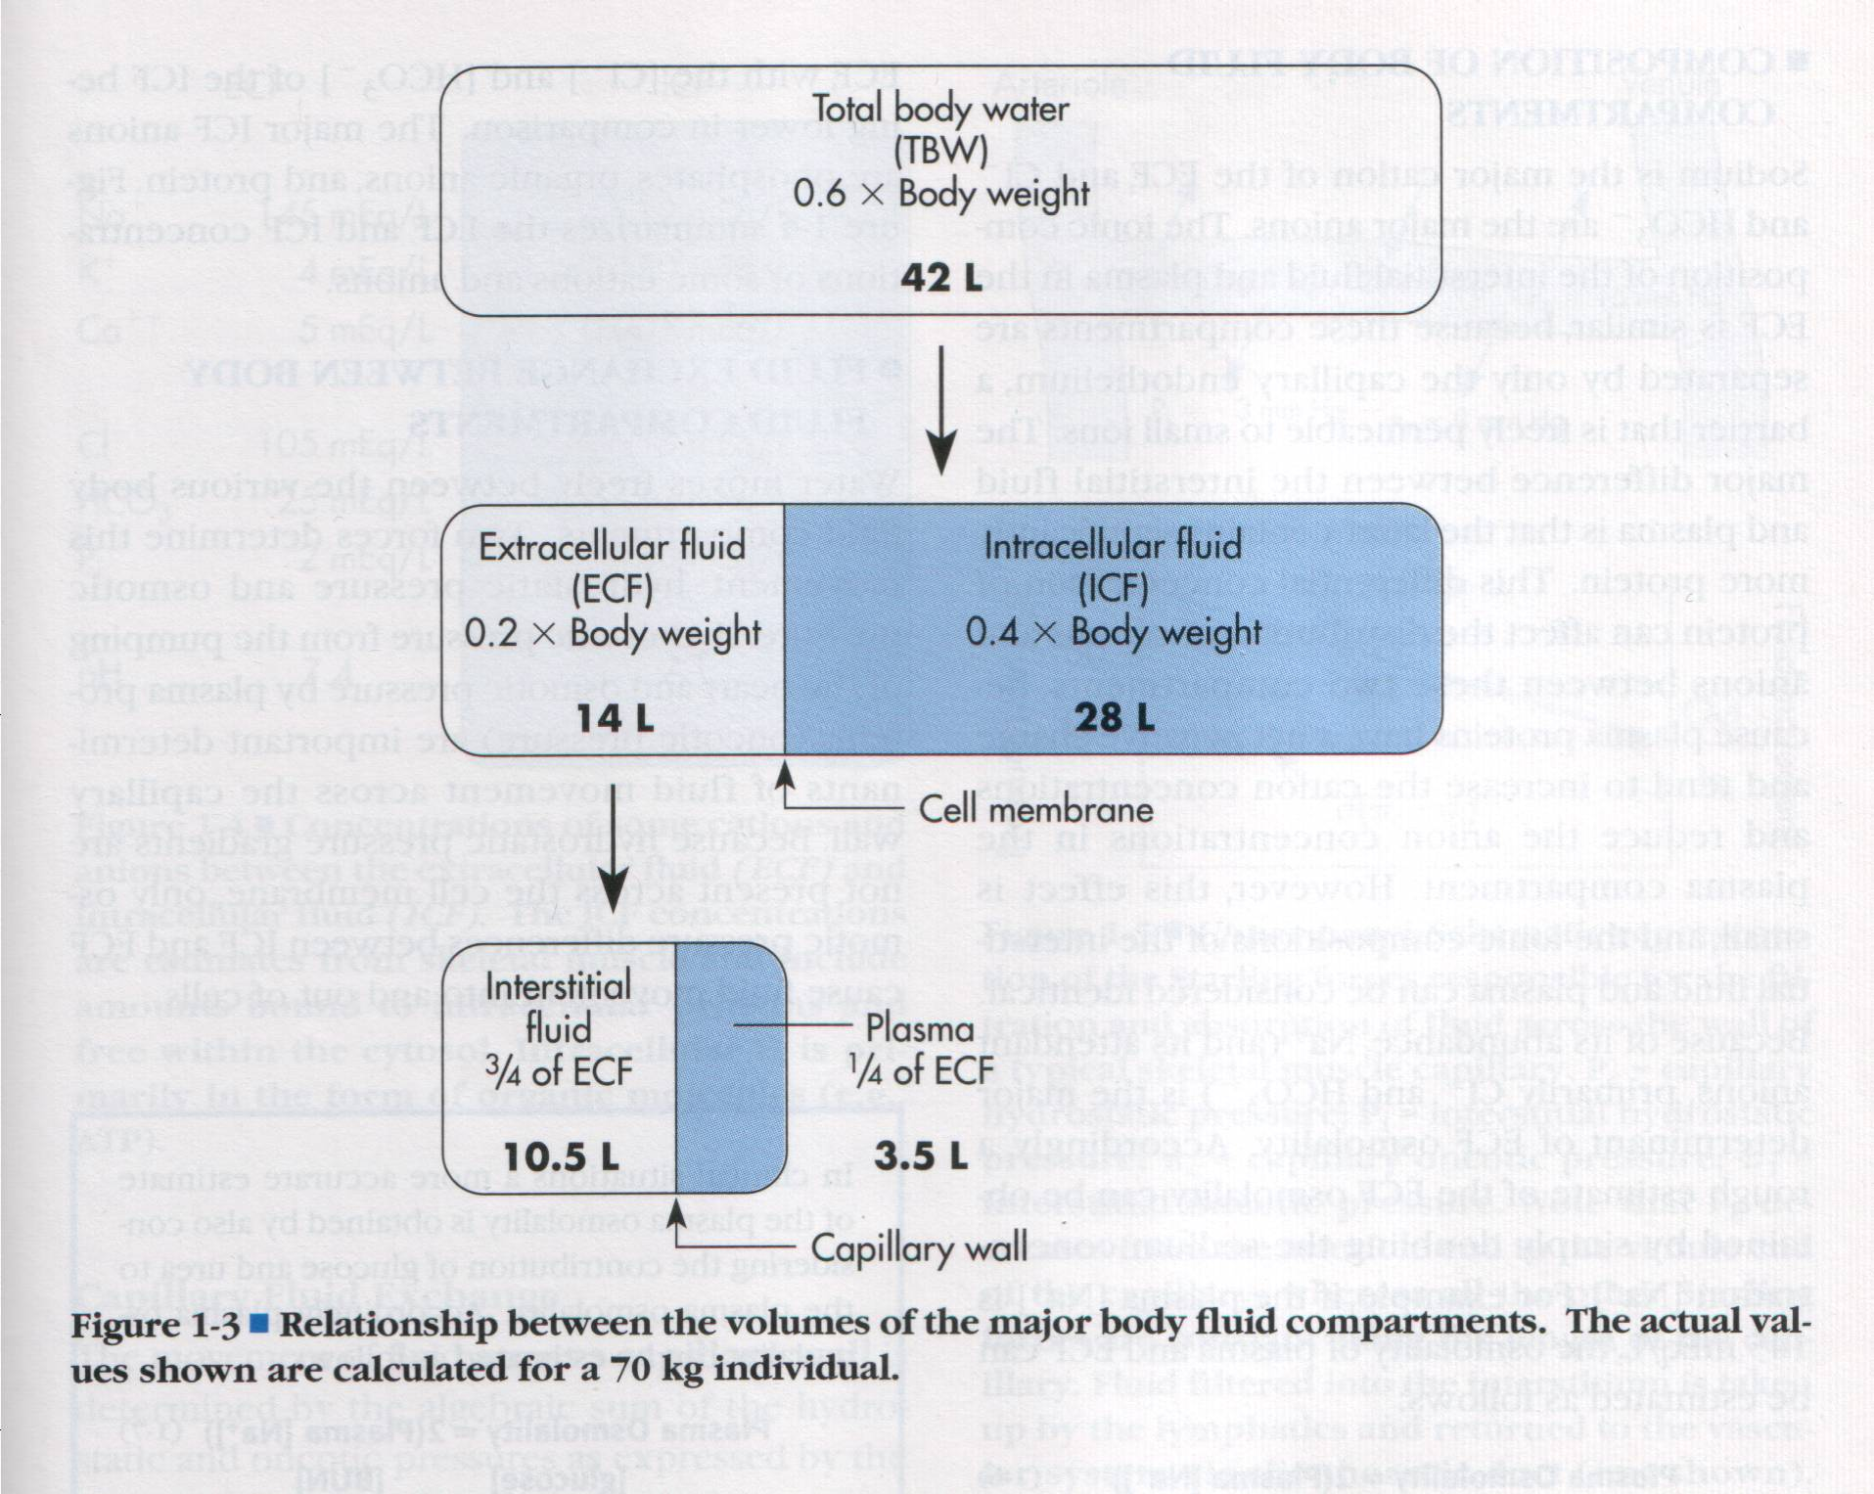

Slide 9
Body Fluid Compartments
Fluid compartments are separated by thin semi-permeable membranes with pores to allow fluid movement and molecules of a specific size to pass while preventing larger heavier molecules from passing
The bodies fluid is composed of water and dissolved substances known as solutes (electrolytes or non-electrolytes)
Electrolytes are substances dissolved in solutions and dissociated into particles called ions
  Cations: Positively charged ions
  Anions: Negatively charged ions

Slide 10
Definitions:
Osmosis: movement of water
Diffusion: movement of solutes
Filtration: movement of both solutes and water
Osmolality:
  Osmoles in solution: mOsm/kg water
  Calc Posm = (2 x serum Na⁺) + blood urea + glucose
  For Na+, K+ and Cl-: 1 mEq = 1 mOsm
  Normal osmolality of body fluids: 283-292 mOsm/kg water

Slide 11
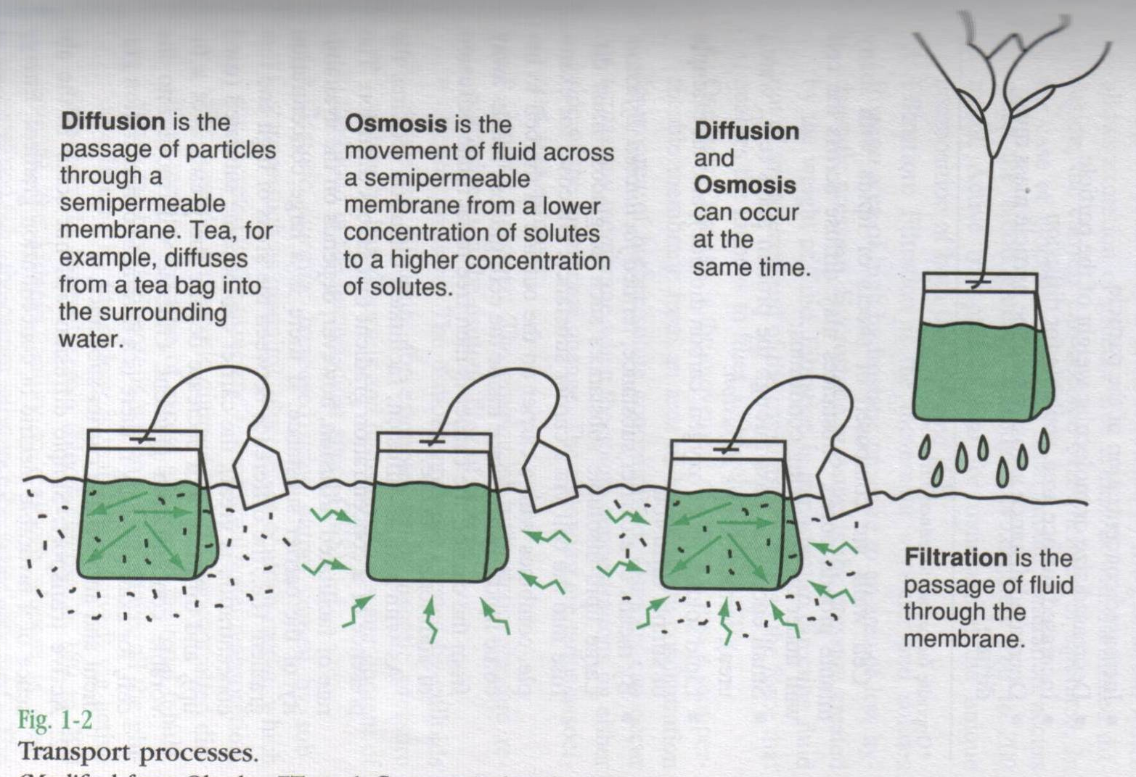

Slide 12
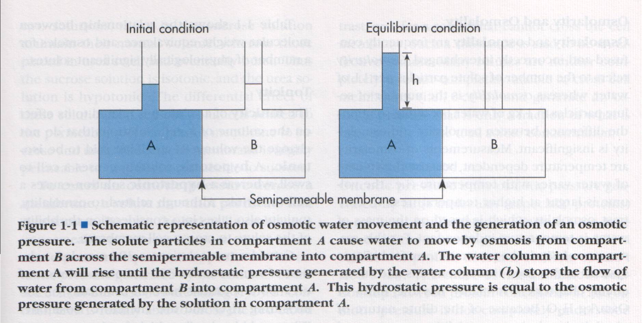

Slide 13
Body Fluid Compartments
ECF and ICF are in osmotic equilibrium
ICFosm = ECFosm = Posm
IV
ICF
ISF
Na⁺ 140
K⁺ 140

Slide 14
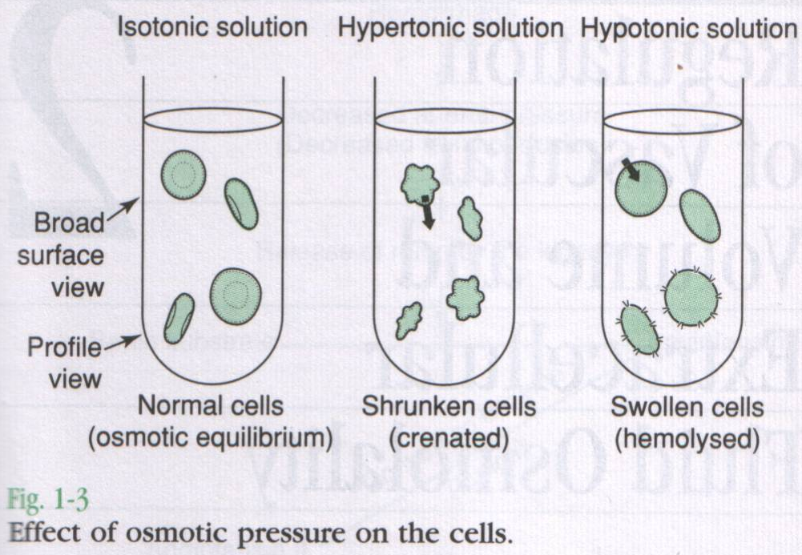

Slide 15
Regulation Mechanisms of Fluid and Electrolytes:
Regulation of osmolality and volume is achieved through thirst and the osmoreceptor-antidiuretic hormone system (vasopressin)
  Volume is more important than osmolality
The regulation of volume also occurs through neurological and renal mechanisms
  The stretch receptors (baroreceptors)
  The Renin-Angiotension-Aldosterone System
  The Natriuretic peptides
  Kinins & Prostaglandins

Slide 16
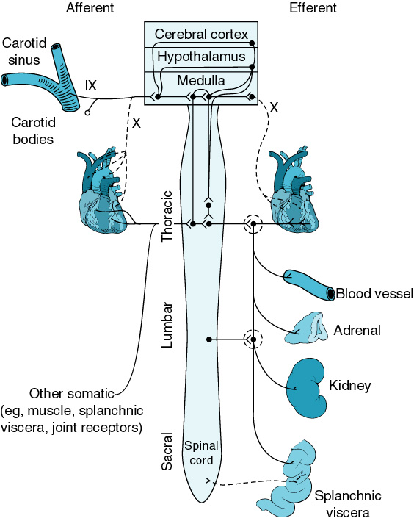

Slide 17
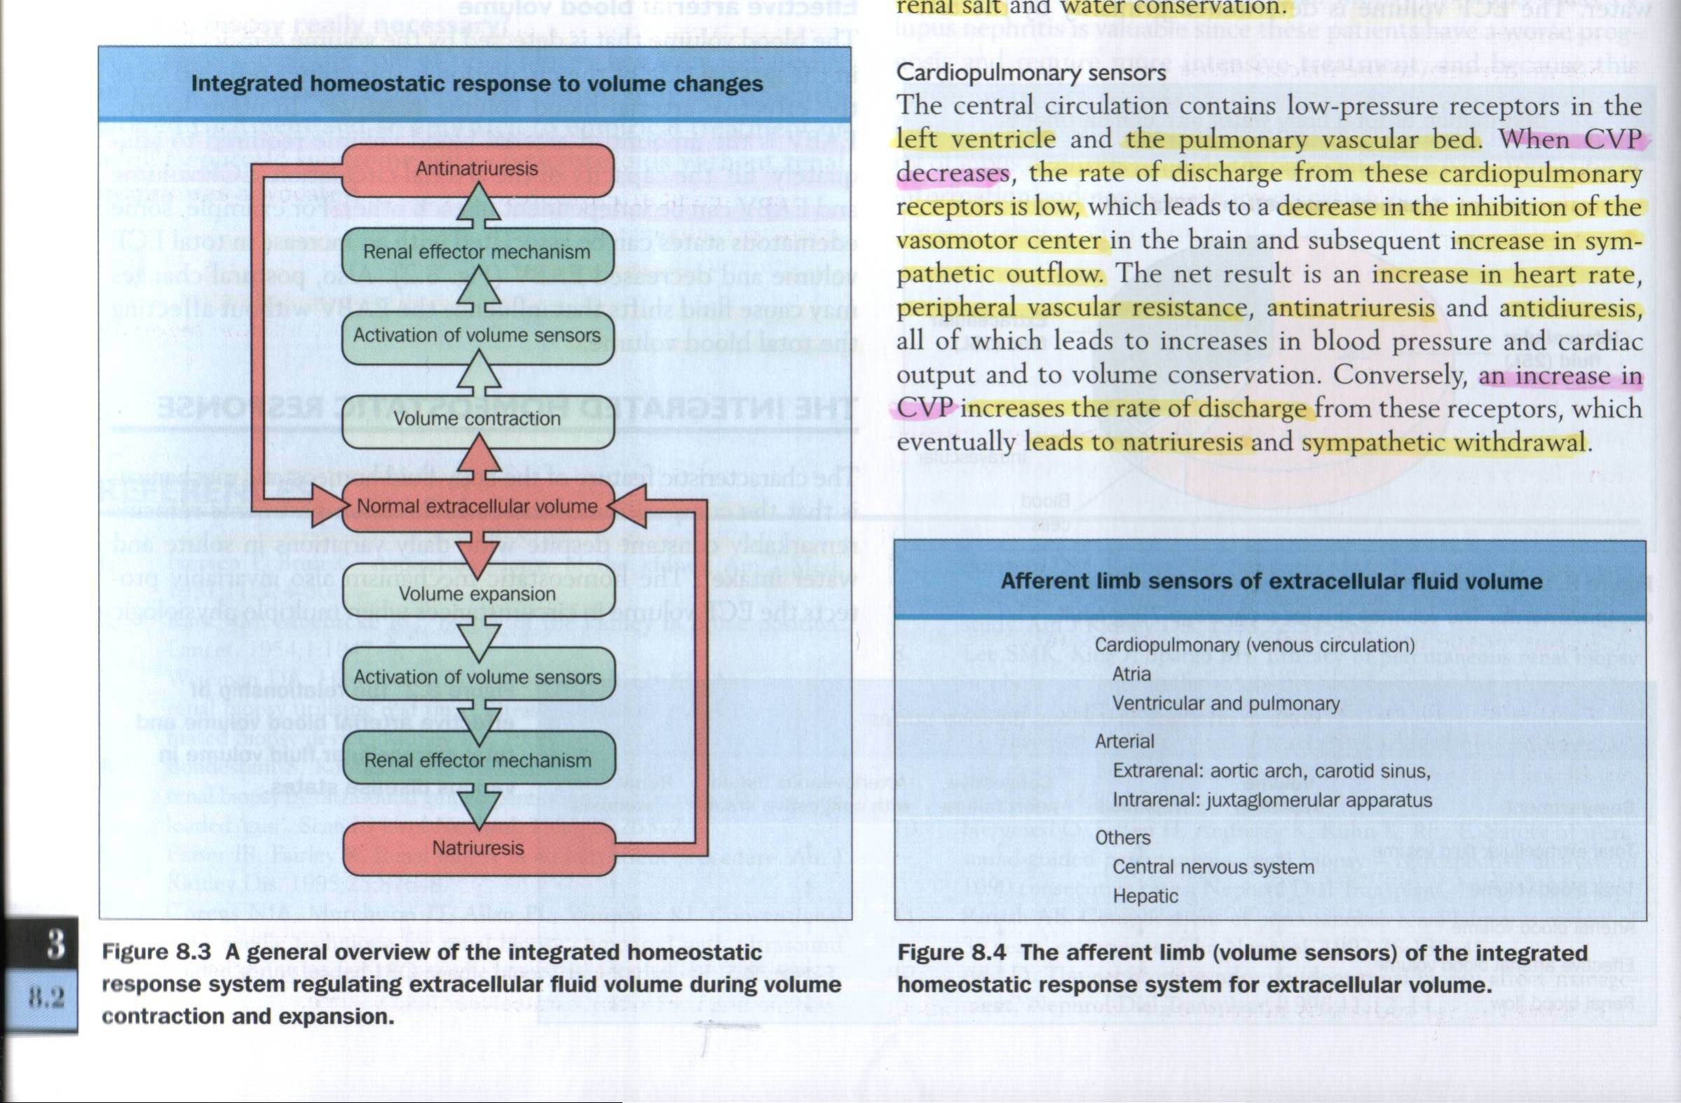

Slide 19
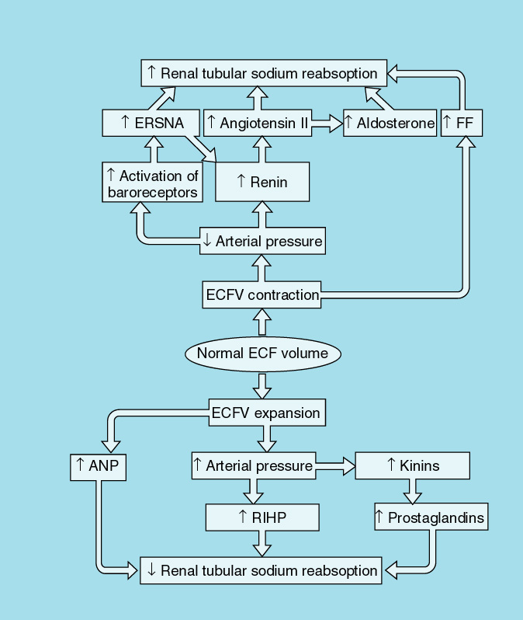

Slide 20
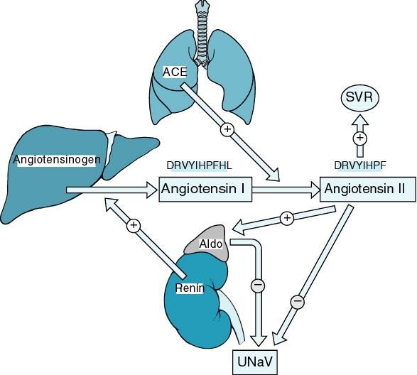

Slide 21
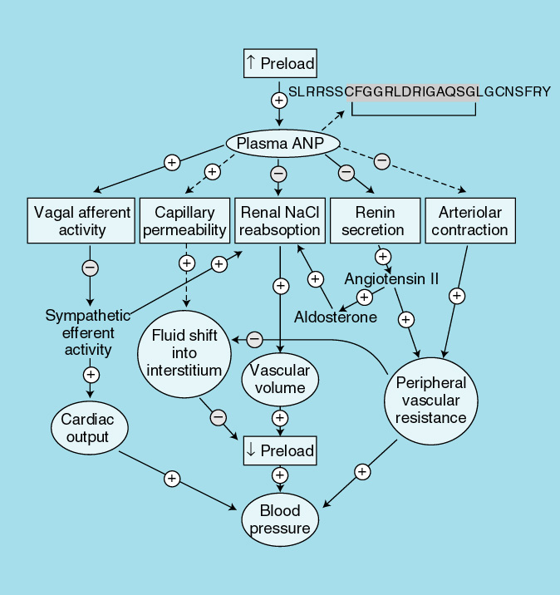

Slide 22
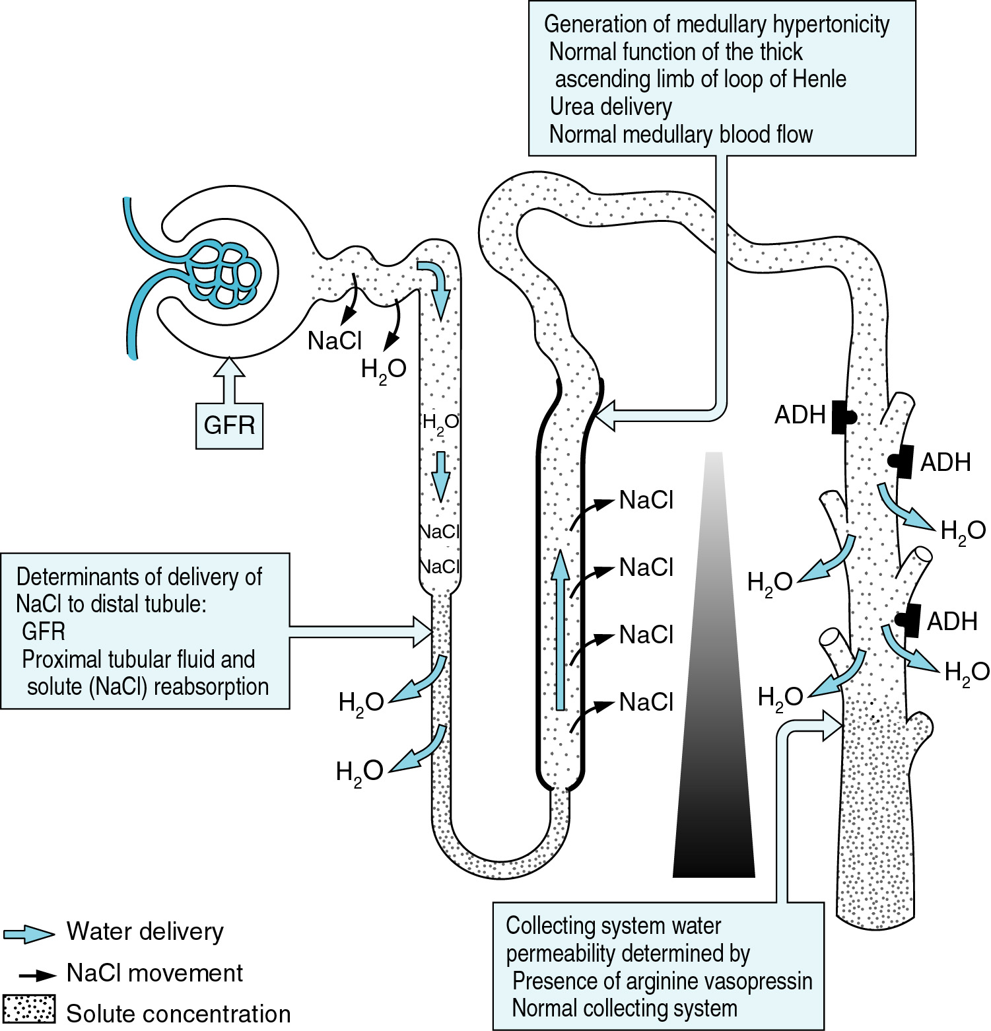

Slide 23
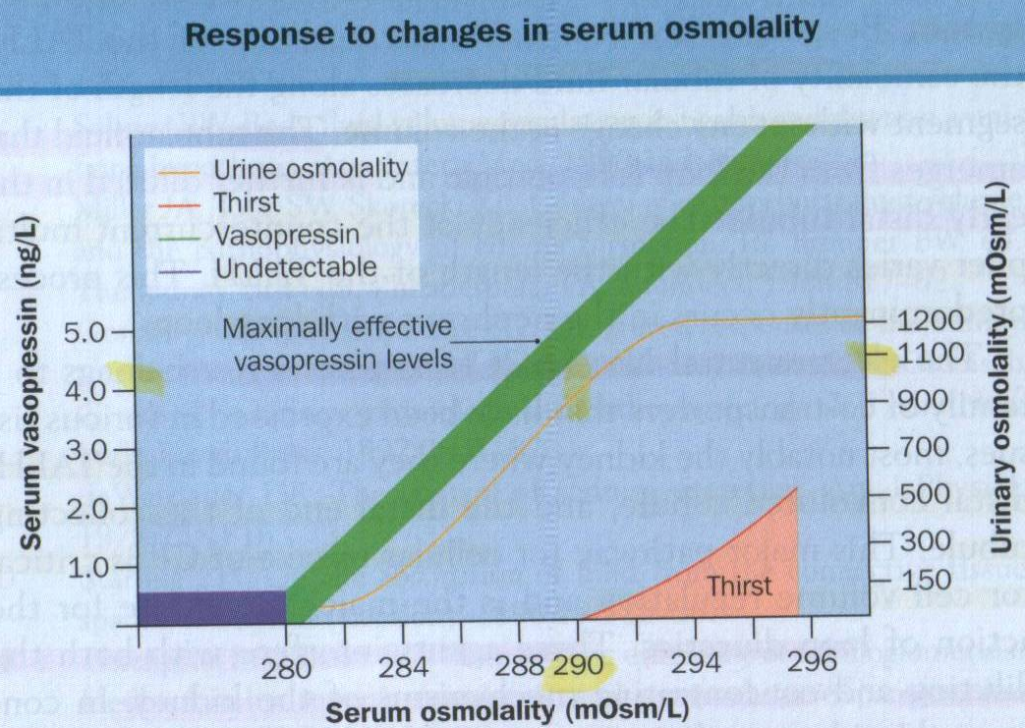

Slide 24
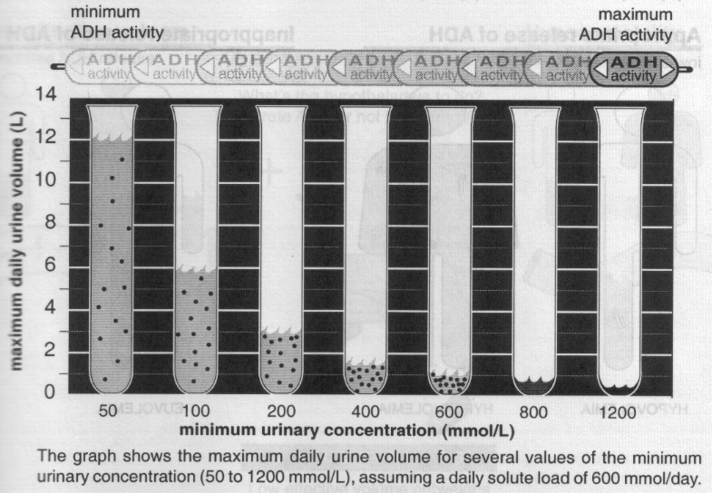
Urine Output & Daily Solute Load

Slide 25
The Linear Relationship Between Urine Specific Gravity and Uosm
Osmolality (mOsm/Kg H₂O) | SG
300 – 400 | 1.010
700 – 800 | 1.020
1000 – 1200 | 1.030
Plasma SG ~ 1.008

Slide 26
Effect of Hypovolemia on Osmoreceptor Gain

Slide 27
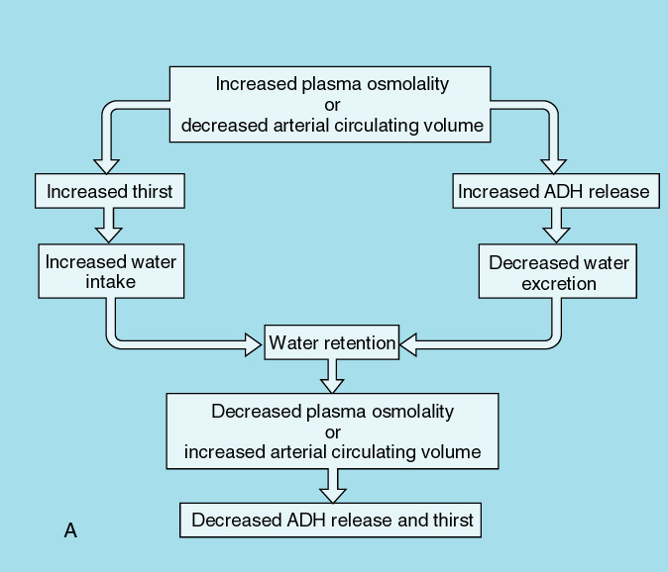

Slide 28
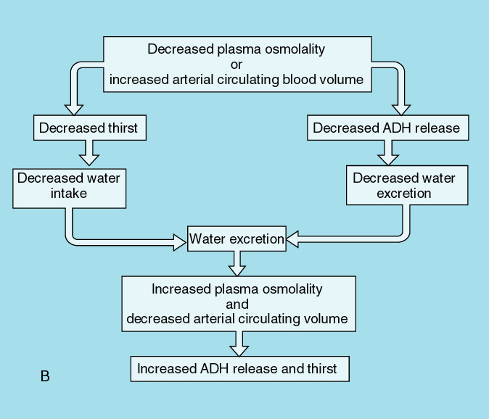

Slide 29
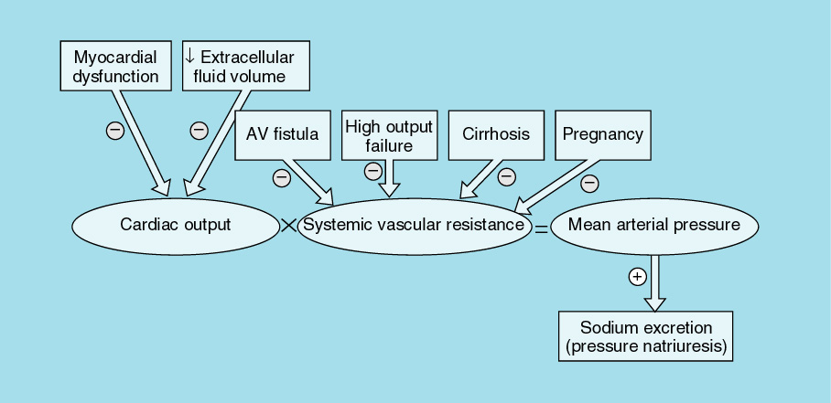

Slide 30
Effective Arterial Blood Volume (EABV):
Although the absolute volume of the intravascular space is an important component of circulatory “fullness”, the adequacy of the circulation (more commonly called the effective arterial blood volume or EABV) also is determined by cardiac output and systemic vascular resistance

Slide 31
Effective Arterial Blood Volume (EABV):
↓ EABV:
  ↑ CO
  ↑ SVR
  ↑ Renal Na retention
↑ EABV:
  ↓ CO
  ↓ SVR
  ↓ Renal Na retention

Slide 32
Effective Arterial Blood Volume (EABV):
EABV is the amount of arterial blood volume required to adequately ‘fill’ the capacity of the arterial circulation
ECF volume and EABV can be independent of each other
  Edematous states: increase in total ECF volume and decreased EABV
  Postural changes may cause shifts that influence the EABV without affecting the total blood volume

Slide 33
Effective Arterial Blood Volume (EABV):

Slide 34
Clinical features of Hypovolemia & Hypervolemia
 | Hypovolemia | Hypervolemia
Symptoms | Thirst | Ankle swelling
 | Dizziness on standing | Abdominal swelling
 | Weakness | Breathlessness
Signs | Low JVP | Raised JVP
 | Postural hypotension | Peripheral edema
 | Tachycardia | Pulmonary crepitations
 | Dry mouth | Pleural effusion
 | Reduced skin turgor | Ascites
 | Reduced urine output | Hypertension (sometimes)
 | Weight loss | Weight gain
 | Confusion, stupor

Slide 35
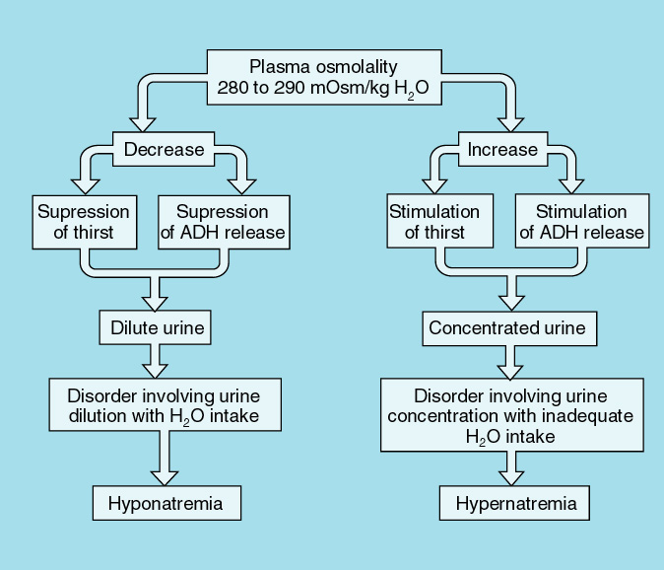

Slide 36
Sodium and Water:
ECF volume= absolute amounts of Sodium and water
Plasma Na⁺ = ratio between the amounts of Sodium and water (Concentration)
Hyponatremia = Water Excess
Hypernatremia = Water Deficit
Hypervolemia = Sodium Excess
  “Edema”
Hypovolemia = Sodium Deficit
  “Dehydration?”

Slide 37
Sodium and Water:
 | Hyponatremia (Water Excess) | Hypernatremia (Water Deficit)
Hypovolemia (Dehydration) (Sodium Deficit) | Hemorrhagic Shock with good oral water intake | Diarrhea in Children and Seniors
Hypervolemia (Edema) (Sodium Excess) | Advanced Congestive Heart Failure | Hemodialysis Patient after 3% Saline infusion

Slide 38
Tonicity
To compare the osmolality of a solution to that of another solution (body fluid compartments)
Used to compare the osmolality of intravenous solutions to that of the serum:
  ISOTONIC
  HYPOTONIC
  HYPERTONIC

Slide 39
Hypotonic | Isotonic | Hypertonic
Solutions have more water than solutes comparing to ECF | Solutions have the same solute concentration as the ECF | Solutions have more solutes than water comparing to ECF
Water will move from ECF into ICF | It will remain in the ECF | Water will move from ICF to ECF
Distilled Water 0.45% NaCl (1/2) 0.33% NaCl (1/3) | NS (0.9% NaCl) Ringers Lactate 2/3 DW-1/3 NS 5% Dextrose in Water (D5W) | 3% NaCl 10%-50% Dextrose D5W-1/2 NS D5NS Amino acid solution

Slide 40
Intravenous Solutions
Crystalloids vs Colloids
Crystalloids are intravenous solutions that contain solutes that readily cross the capillary membrane
  Dextrose and electrolyte solutions
Colloids are intravenous solutions that DO NOT readily cross the capillary membrane
  Blood, albumin, plasma

Slide 41
Solution | Gluc | Na⁺ | K⁺ | Ca⁺² | Cl⁻ | Lact | mOsm/L
D₅W | 50 | 0 | 0 | 0 | 0 | 0 | 278
D₁₀W | 100 | 0 | 0 | 0 | 0 | 0 | 556
NS | 0 | 154 | 0 | 0 | 154 | 0 | 308
½ NS | 0 | 77 | 0 | 0 | 77 | 0 | 154
D₅ NS | 50 | 154 | 0 | 0 | 154 | 0 | 293
D₅ ½ NS | 50 | 77 | 0 | 0 | 77 | 0 | 216
2/3-1/3 | 33 | 50 | 0 | 0 | 50 | 0 | 285
Ringer's Lactate | 0 | 130 | 4 | 3 | 109 | 28 | 274
Lytes: mEq/L
Gluc: g/L
D5W: 5 g dextrose/100 mL (50 g/L)
D10W: 10 g dextrose/100 mL (100 g/L)
NS (0.9% NS): 0.9 g NaCl/100 mL (9 g/L)
½ NS (0.45% NS): 0.45 g NaCl/100 mL (4.5 g/L)
2/3-1/3: 2/3 D5W (33 g/L) + 1/3 NS (0.33 g NaCl/100mL or 3.3 g NaCl/L)

Slide 42
Parental Fluid | ECF (1/3 TBW) |  | ICF (2/3 TBW)
 | IV (1/4 ECF) | ISF (3/4 ECF)
1000 ml D₅W | 80 ml | 250 ml | 670 ml
1000 ml NS | 250 ml | 750 ml | ---
Colloids (PRBC) | 300 ml | --- | ---
1000 ml ½ NS:
(500 ml NS) | 125 ml | 375 ml | ---
(500ml water) | 40 ml | 125 ml | 335 ml
Total | 165 ml | 500 ml | 335 ml
1000 ml D₅½NS | 165 ml | 500 ml | 335 ml
1000 ml D₁₀W | 80 ml | 250 ml | 670 ml
1000 ml D₅NS | 250 ml | 750 ml | ---

Slide 43
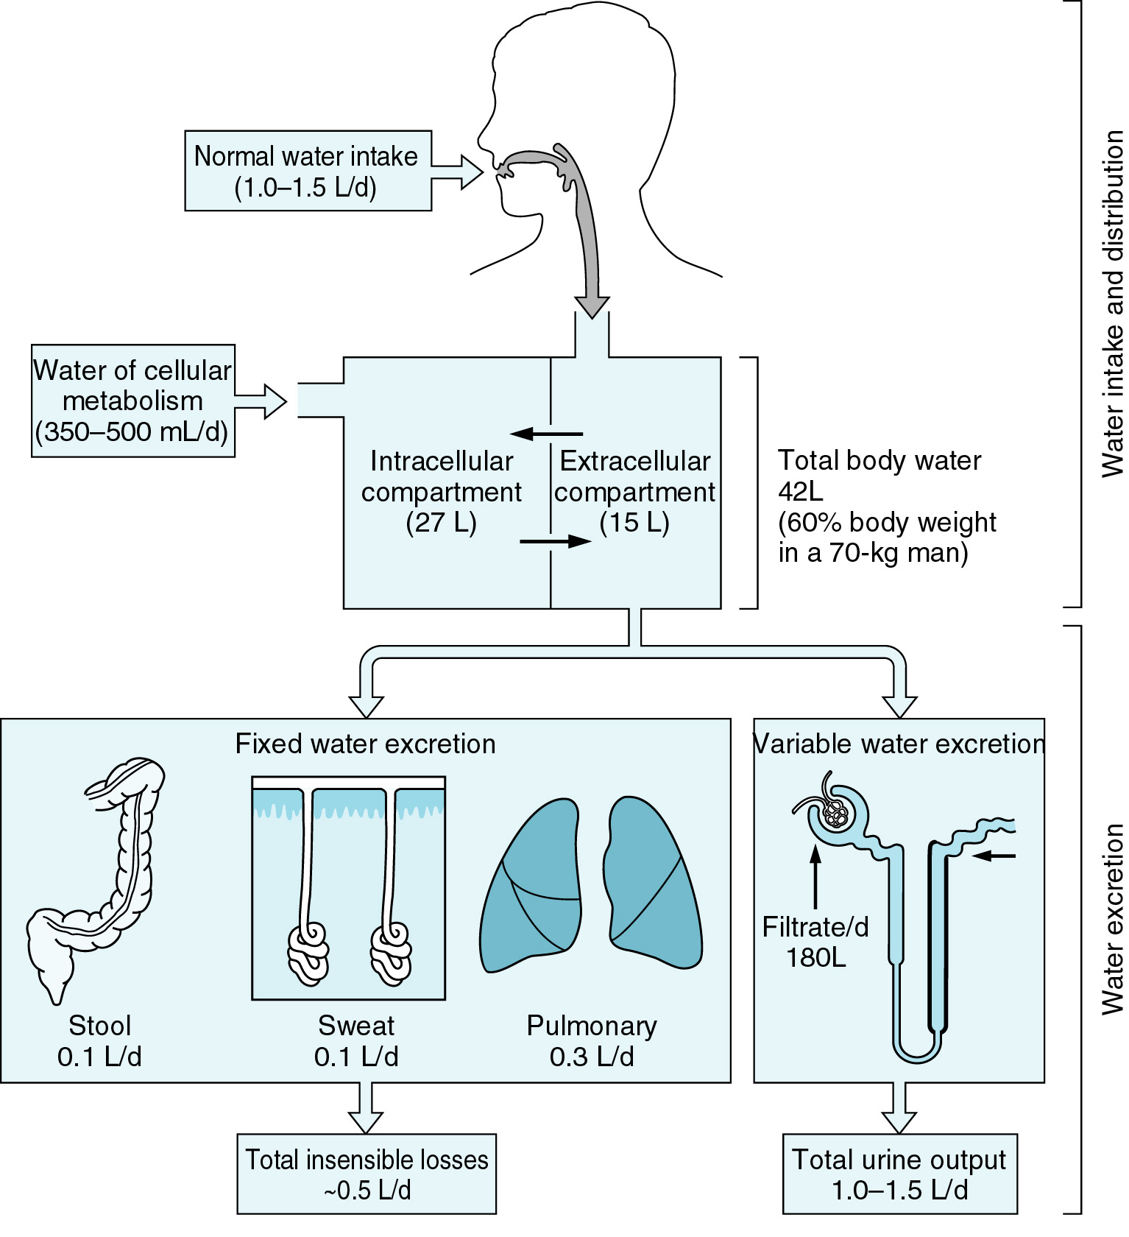

Slide 44
Basal Requirements:
Basal Water:
  1st 10 kg: 4 ml/kg/h +
  2nd 10 kg: 2 ml/kg/h +
  > 20 kg: 1 ml/kg/h
Insensible water loss:
  Stool, breath, sweat: 800 ml/d
  Increases by 100-150 ml/d for each degree above 37 C

Slide 45
Basal Requirements:
Electrolytes:
  Na: 50-150 mmol/d (NaCl)
  Cl: 50-150 mmol/d (NaCl)
  K: 20-60 mmol/d (KCl)
Carbohydrates:
  Dextrose: 100-150 g/d
  IV Dextrose minimizes protein catabolism and prevents ketoacidosis

Slide 46
Hyponatremia

Slide 47
Hyponatremia
  Normotonic or Isotonic Hyponatremia
    Factitious Hyponatremia
  Pseudohyponatremia
  Results from laboratory artifact due to high concentrations of proteins or lipids

Slide 48
Pseudohyponatremia:
Flame photometric or Indirect potentiometry measurement of PNa⁺
Normal Measured PNa⁺ = 153 mmol/L of Plasma Water
Normal Plasma Water Phase = 93% of One liter of Plasma
Reported Plasma Na⁺ = 153 x 0.93 = 142 mmol/L of Plasma

Slide 49
Hyponatremia
Hypertonic Hyponatremia
  Translocational Hyponatremia
  Results from non-Na osmoles in serum (often glucose or mannitol) drawing Na-free H₂O from cells
  [Na⁺] declines by ~2.4 mEq/L for each 100 mg/dL [5.5 mmol/L] increase in serum glucose
Spasovski et al. Clinical practice guideline on diagnosis and treatment of hyponatraemia. Nephrol Dial Transplant (2014) 0: 1–39

Slide 50
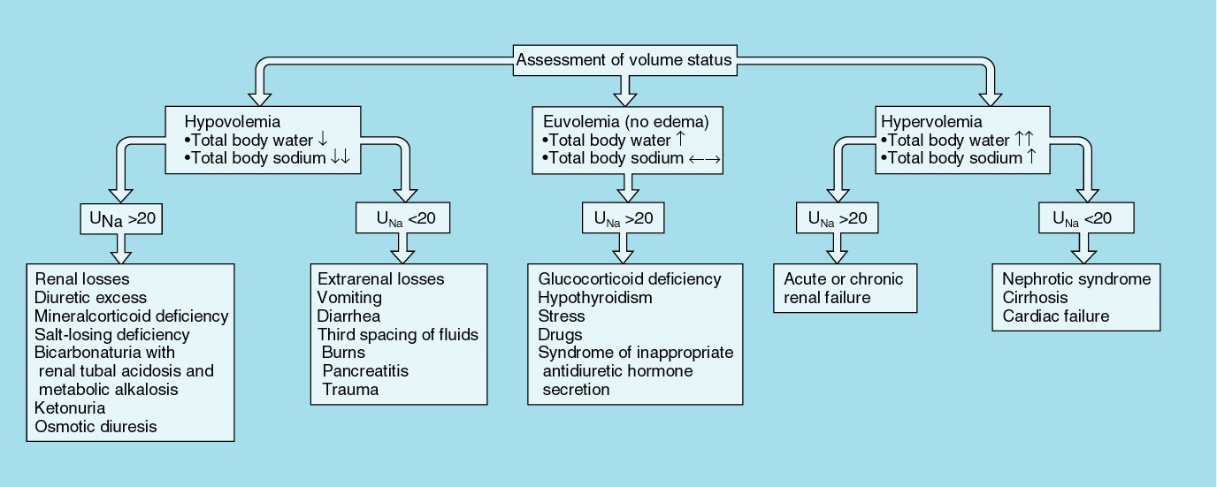
Hypotonic Hyponatremia: Causes

Slide 51
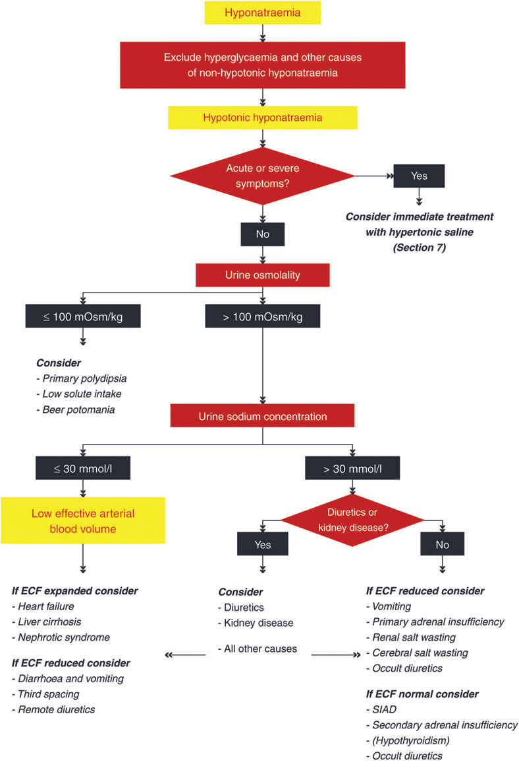

Slide 52
Classification of Symptoms of Hyponatremia
All symptoms that can be signs of cerebral edema should be considered as severe or moderate symptoms that can be caused by hyponatremia
Moderately Severe
  Nausea without vomiting
  Confusion
  Headache
Severe
  Vomiting
  Cardiorespiratory distress
  Abnormal and deep somnolence
  Seizures
  Coma (Glasgow Coma Scale ≤8)

Slide 53
Management of Hyponatremia:
Symptoms & Signs
  Volume Status
Serum:
  Osmolality
  TSH, FT4, Cortisol
  Albumin, Total Proteins
  Uric Acid
Urine:
  Electrolytes (Na/K/Cl/Urea/Creatinine)
  Osmolality
  Urinalysis
Rate of correction:
  0.5 mmol/L/h ~ 10-12 mmol/L/d

Slide 54
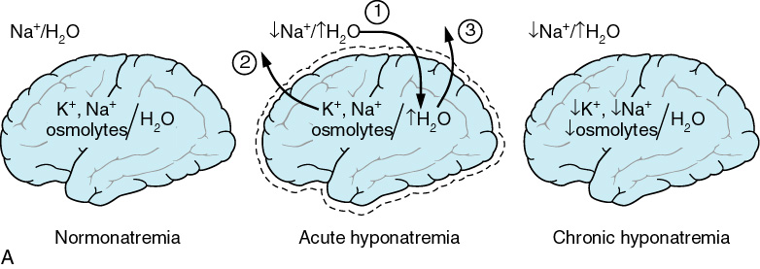

Slide 55
Diagnostic Criteria for SIADH
Essential criteria
  Effective serum osmolality <275 mOsm/kg
  Urine osmolality >100 mOsm/kg
  Clinical euvolemia
  Urine sodium concentration >30 mmol/l with normal dietary salt and water intake
  Absence of adrenal, thyroid, pituitary or renal insufficiency
  No recent use of diuretic agents

Slide 56
Diagnostic Criteria for SIADH
Supplemental criteria
  Serum uric acid <0.24 mmol/l (<4 mg/dl)
  Serum urea <3.6 mmol/l (<21.6 mg/dl)
  Failure to correct hyponatremia after 0.9% saline infusion
  Fractional sodium excretion >0.5%
  Fractional urea excretion >55%
  Fractional uric acid excretion >12%
  Correction of hyponatremia through fluid restriction

Slide 57
SIADH: “HIVE”
H: Hypoosmolar Hyponatremia (Posm <275 mOsm/Kg H₂O)
I: Inappropriate urine concentration (Uosm >100 mOsm/Kg H₂O)
V: Euvolemia, No diuretic use
E: Endocrine = normal Thyroid, adrenal and renal function
Hypouricemia (<238 mcmol/L) and low Urea (<3.5 mmol/L)

Slide 58
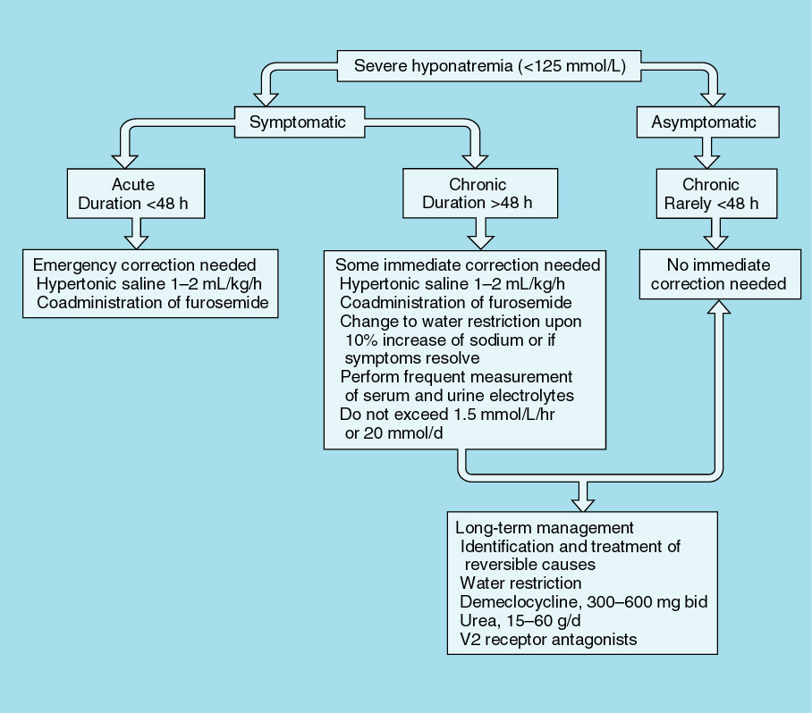
Hyponatremia: Treatment

Slide 59
Hypernatremia

Slide 60
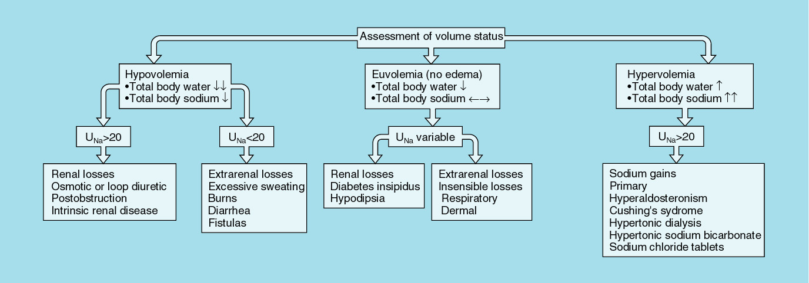
Hypernatremia: Causes

Slide 61
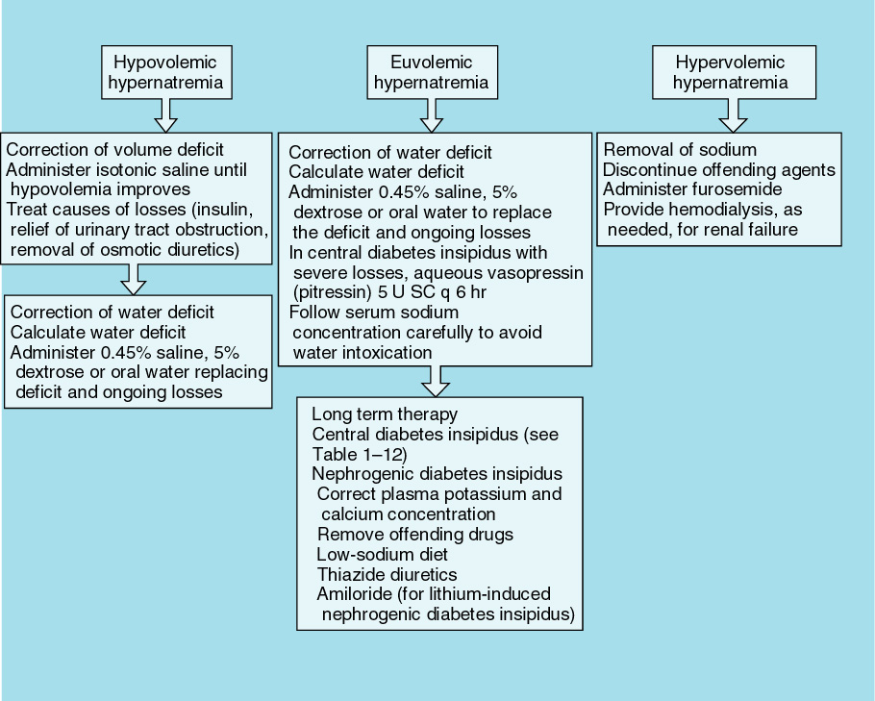
Hypernatremia: Treatment

Slide 62
Water Deficit Calculation:
Current Total Body Water = 0.6 x Current Body Weight
Current TBW x Current [Na⁺] = Target TBW x Target [Na⁺]
Target TBW – Current TBW = Water Deficit
Ongoing loss
IVF: type and rate
Reassessment

Slide 63
Questions????

