Slide 1
Heart Failure

Slide 2
Definition
Heart failure is a complex clinical syndrome
Can result from:
structural or functional cardiac disorder
impairs the ability of the ventricle to fill with or eject blood

Slide 3
Inability of the heart to pump blood at an output sufficient to meet the body’s demands

Slide 4
Characterized by:
signs and symptoms of intravascular and interstitial volume overload and/or
manifestations of inadequate tissue perfusion

Slide 5
Heart failure may result from an acute insult to cardiac function, such as a large myocardial infarction, valvular diseas, myocarditis, and cardiogenic shock
More commonly, from a chronic process

Slide 6
Common Causes
Coronary artery disease
Hypertension
Valvular heart disease
Dilated cardiomyopathy
Notes:
6

Slide 7
Nomenclature
Heart failure vs.
Cardiomyopathy
LV dysfunction
Pulmonary edema

Slide 8
Classification
Left vs. Right
Systolic vs. Diastolic
High output vs. low output

Slide 9
Heart Failure Syndrome
The initial manifestations of hemodynamic dysfunction are a reduction in stroke volume and a rise in ventricular filling pressures under conditions of increased systemic demand for blood flow
This stimulates a variety of interdependent compensatory responses involving the cardiovascular system, neurohormonal systems, and alterations in renal physiology

Slide 10
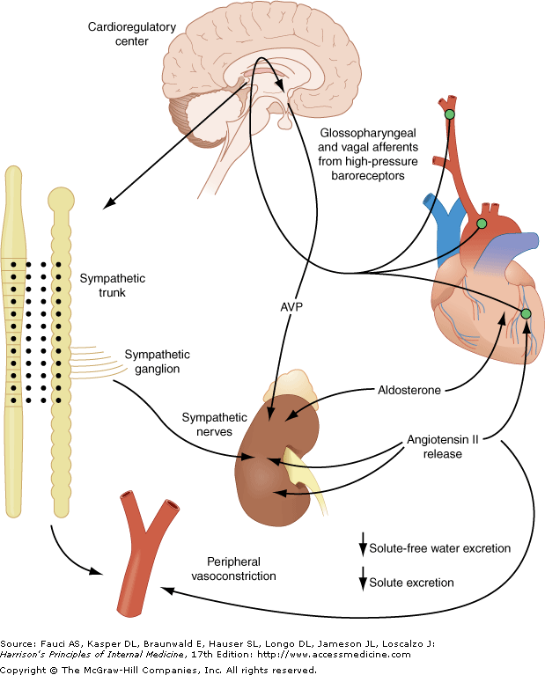

Slide 11
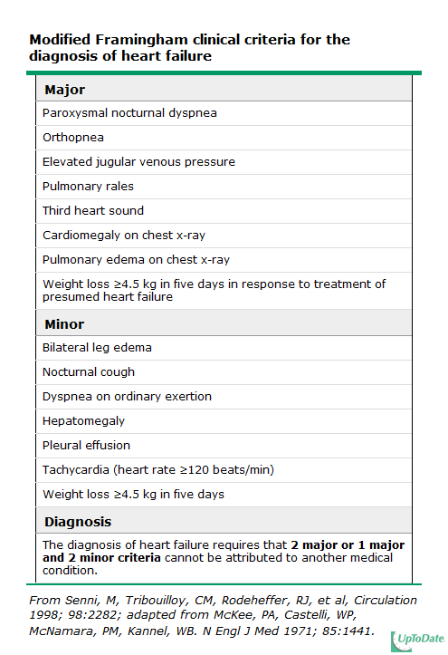
Notes:
11

Slide 12
FACTORS THAT MAY PRECIPITATE ACUTE DECOMPENSATION OF CHRONIC HEART FAILURE

Slide 13
 |  | Discontinuation of therapy (patient noncompliance or physician initiated)
 |  | Initiation of medications that worsen heart failure (calcium antagonists, β-blockers, nonsteroidal anti-inflammatory drugs, antiarrhythmic agents)
 |  | Iatrogenic volume overload (transfusion, fluid administration)
 |  | Dietary indiscretion
 |  | Pregnancy
 |  | Exposure to high altitude
 |  | Arrhythmias
 |  | Myocardial ischemia or infarction
 |  | Worsening hypertension
 |  | Worsening mitral or tricuspid regurgitation
 |  | Fever or infection
 |  | Anemia

Slide 14
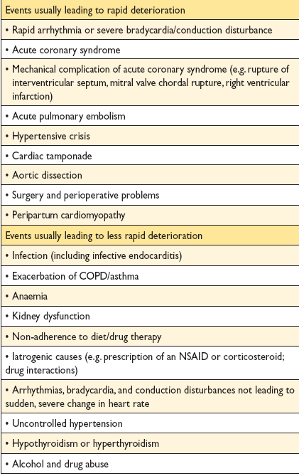

Slide 15
Evaluation

Slide 16
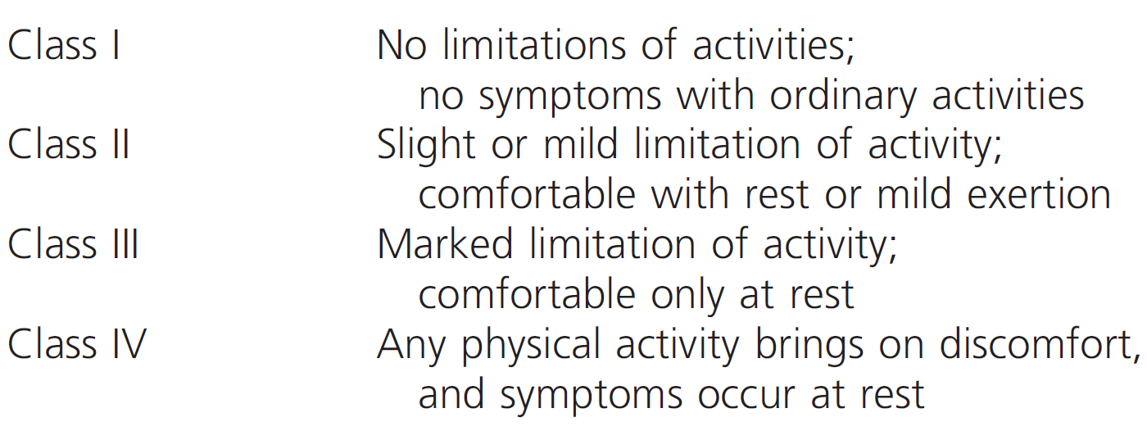
NYHA Classiffication
Notes:
16

Slide 17
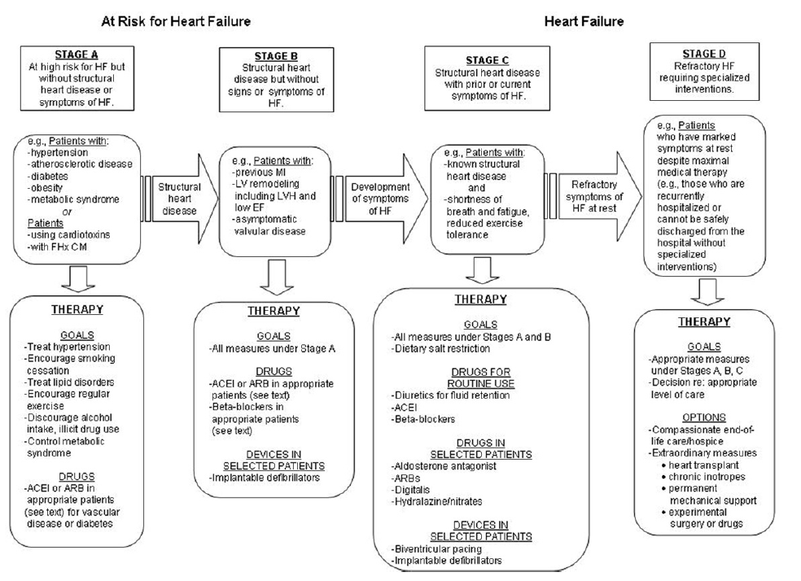
ACC/AHA
Notes:
17

Slide 18
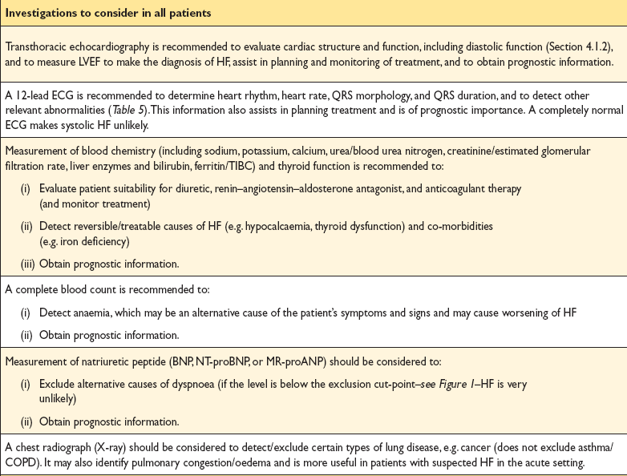

Slide 19
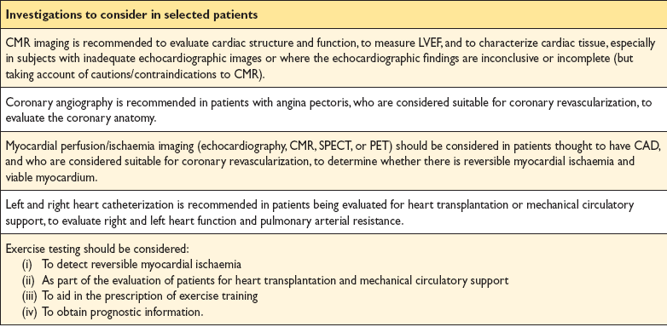

Slide 20
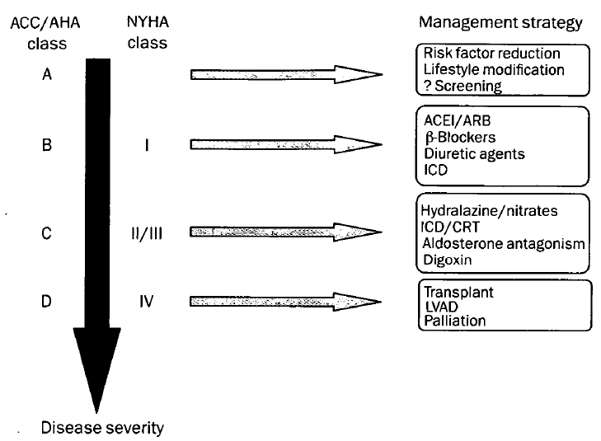
Therapy

Slide 21
56 Y/O gentleman
Diagnosed dilated cardiomyopathy
LVEF 25%
NYHA class II
O/E B/P 112/68 HR 82 bpm
JVP 7 cm water,
Soft S3 and grade 2 PSM
Chest clear,
No LL edema and warm extremities

Slide 22
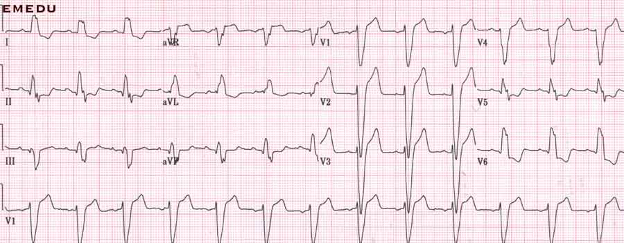

Slide 23
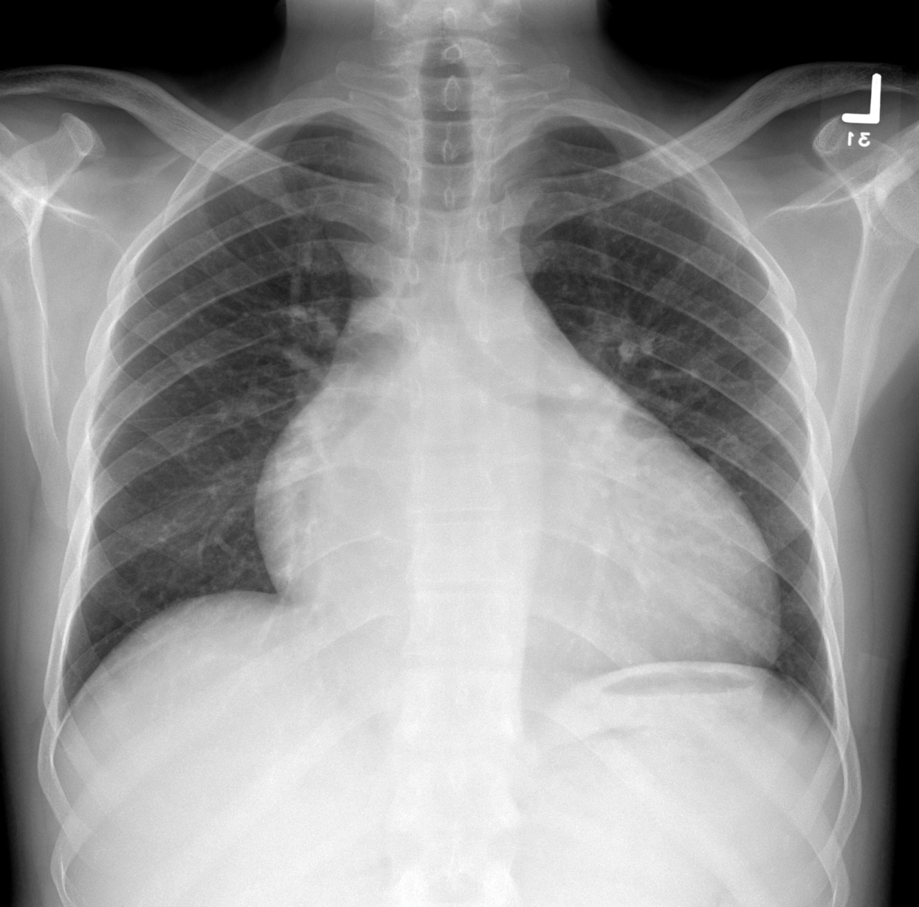

Slide 24
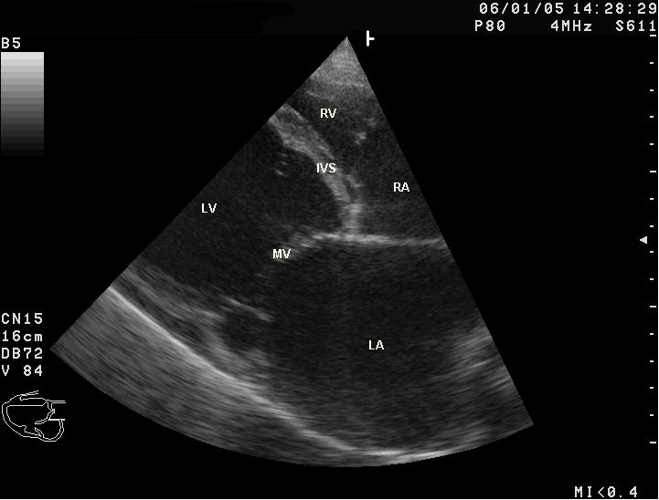

Slide 25
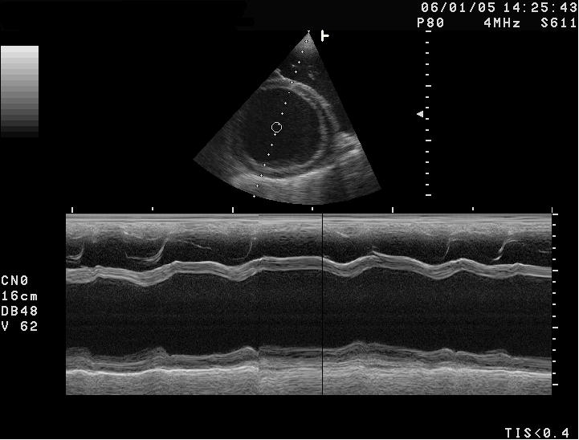

Slide 26
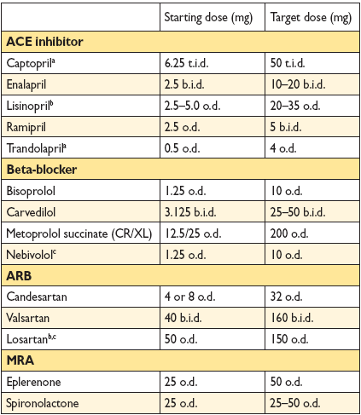

Slide 27
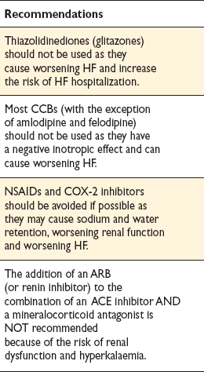
Treatments (or combinations of treatments) that may cause harm in patients with symptomatic (NYHA class
II–IV) systolic heart failure

Slide 30
Acute Heart Failure

Slide 31
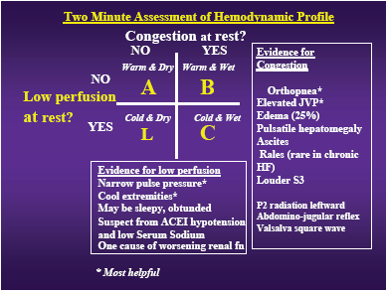
Notes:
31

Slide 32
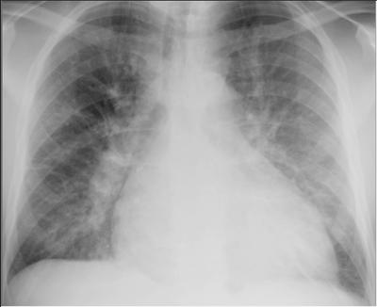

Slide 33
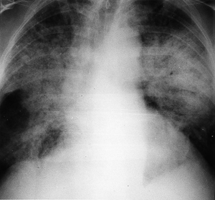

Slide 35
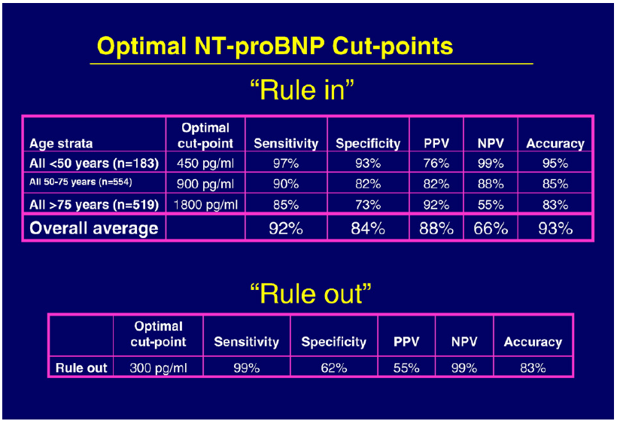

Slide 36
