Slide 1
Gastrointestinal Tract Radiological Anatomy ,Investigation
&
Diseases
Dr Sadeq Y. Alshami
Assistant Prof. & Interventionist Consultant
KSU & KKUH

Slide 2
OBJECTIVES
To know radiology modalities used in GI tract imaging.
To know advantages and disadvantages of each modality.
To know indications and contraindications of each modality.
To know the radiological anatomy of the GI tract.

Slide 6
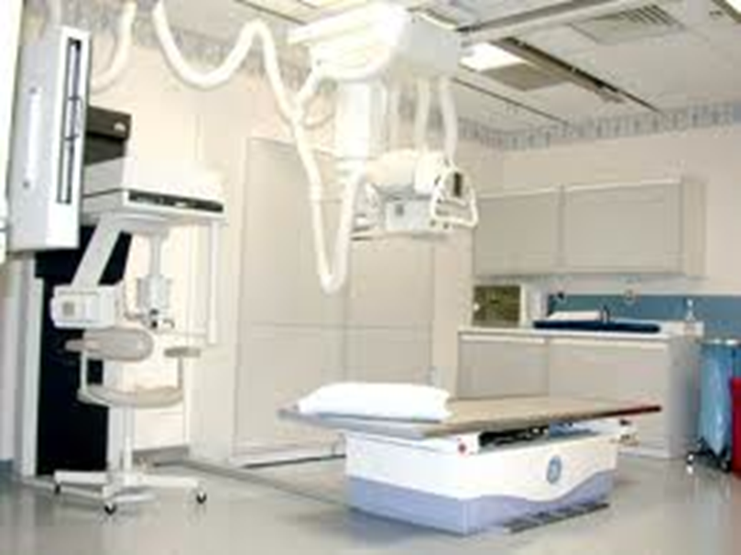
X-Ray

Slide 7
How To Assess The Film
Basic Details [name], [age] [sex]. [date] and appears well/poorly penetrated”
Establish the projection of the film (AP) and whether it is supine or erect.
check left and right
Check Bone, Soft tissue/Solid Organs, Calcification, Gas pattern & Artefacts

Slide 8
Abdominal x-ray
X-ray is a form of radiation, that are focused into a beam
X-ray can pass through most objects including the human body.
When X-rays strike a piece of photographic film, they make a picture.

Slide 9
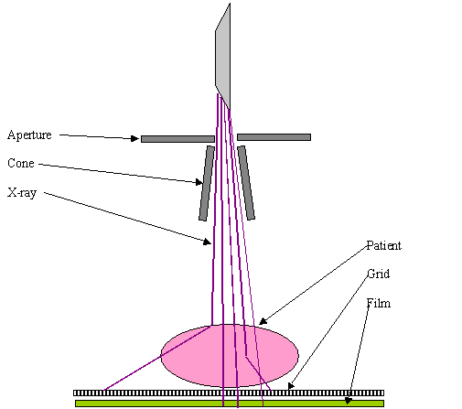

Slide 10
ABDOMINAL X-RAY
White ----- bone and calcification
Grey ------ soft tissue
Black ----- air

Slide 11
ADVANTAGES:
Widely available
Cheap
Excellent in diagnosing free air in the abdomen
Good in diagnosing bowel obstruction & stones/calcifications
DISADVANTAGES:
Radiation
Poor soft tissue details

Slide 12
INDICATIONS
Abdominal pain
Bowel obstruction
Stones
Masses
Trauma
Others, foreign body, supportive lines.. Etc
CONTRAINDICATIONS:
pregnancy

Slide 13
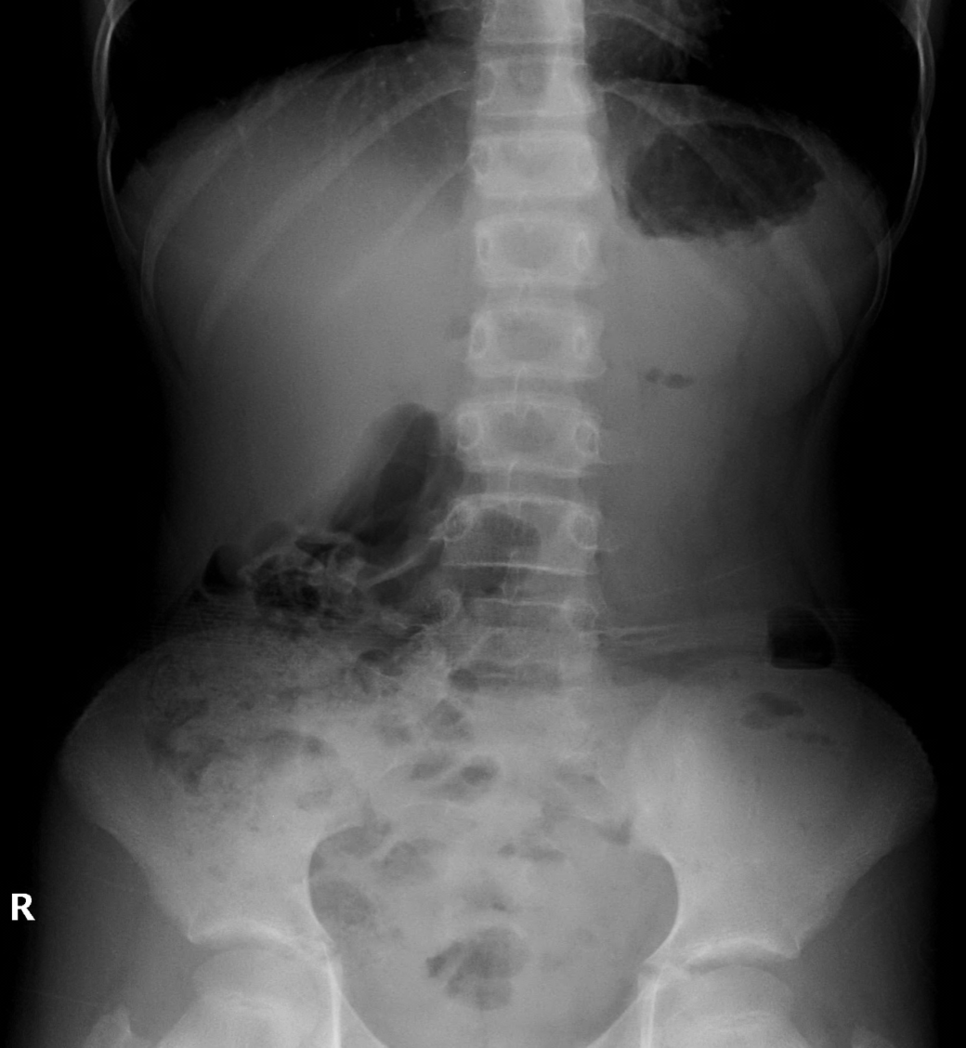
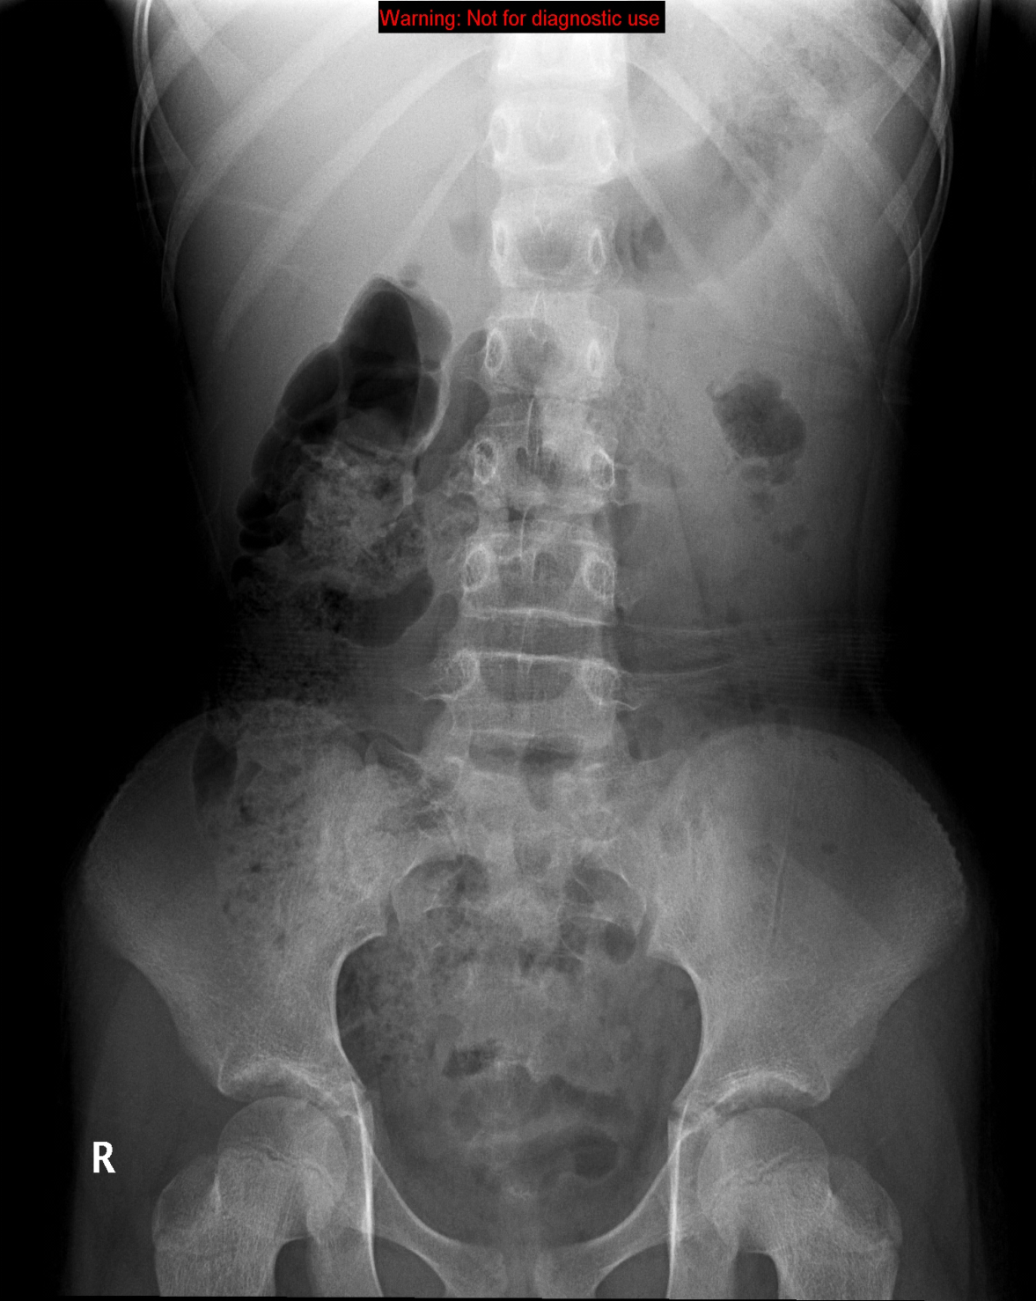
NORMAL ABDOMEN X-RAY
Standing
Supine

Slide 14
How To Assess The Film: Gas
Essentially you’re looking at the bowel here.
Before you start, check that there is gas under the diaphragm (if it is visible)
Look at small bowel and large bowel
SMALL BOWEL:
Because of peristalsis the outline of the gas in the normal small bowel is often broken up into many small pockets
It is generally central in the abdomen
Jejunum has ‘valvulae conniventes’, ileum is characteristically featureless
The calibre of the normal small bowel should not exceed 2.5–3 cm
If small bowel is not visible at all, it suggests that it is abnormal

Slide 15
How To Assess The Film: Gas
LARGE BOWEL:
The caecum therefore normally contains semifluid material containing multiple pockets of gas and, like much of the right side of the bowel, assumes a granular appearance on X-rays, creating mottled areas of gas seen best against the background of the iliac bone.
When visible the haustral folds of the colon may be seen, only partially visualised across part of the large bowel lumen.

Slide 16
STOMACH
SMALL BOWEL
LARGE BOWEL
RECTUM

Slide 17
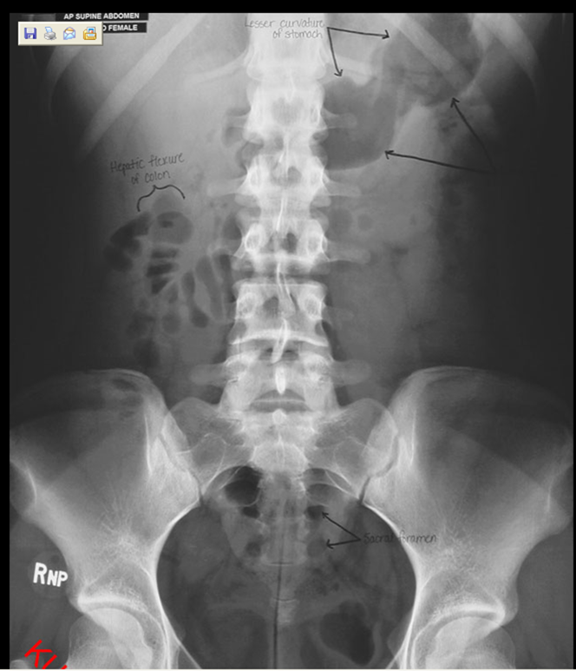
Abdomen X-ray

Slide 19
Abdomen X-ray

Slide 20
Abdomen X-ray

Slide 23
How To Assess The Film: Bone
Ribs, spine, sacrum, pelvis & hips
Bones may show evidence of malignant disease
Sacro-iliitis may be associated with intestinal problems such as Crohn’s disease
Excessively sclerotic bones may hint at other diseases e.g. Paget’s (which can present as abdominal pain) or GI ulcers (which are associated with sclerotic bone lesions)
Don’t forget to check the spine for conditions such as ank spondy

Slide 24
Abdomen X-ray

Slide 25
How To Assess The Film: Calcification
Calcification occurs in:
Calculi (look in kidney, ureters & bladder)
Phleboliths (usually within pelvis, look like silt)
Appendicoliths (caused by faeces in appendix, may suggest appendicitis)
Lymph nodes
Aortic calcification (aortic calcification is normal as age increases but you must check the aorta as asymmetry of the walls suggests aortic aneurysm)

Slide 26
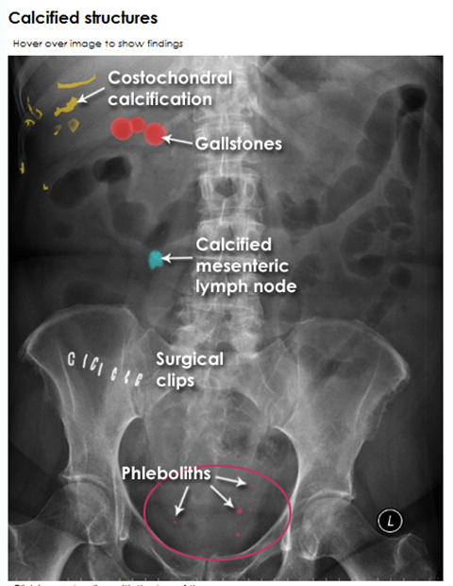
Abdomen X-ray

Slide 27
How To Assess The Film: Calcification

Slide 28
How To Assess The Film: Calcification
Calcified lymph nodes

Slide 29
How To Assess The Film: Calcification
Calcification of a normal aorta

Slide 30
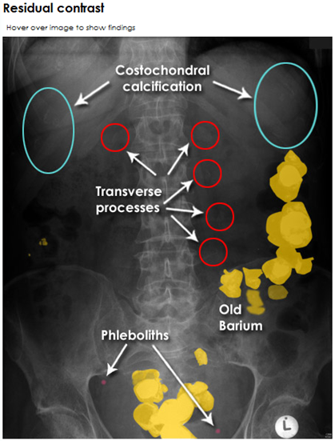
Abdomen X-ray

Slide 31
Abdomen X-ray

Slide 32
How To Assess The Film: Soft Tissue
Trace soft tissue outline for any clues as to pathology (e.g. obesity, trauma sites, abdo drains etc)
Also look for:
Psoas muscles
Kidneys (left is higher and slightly bigger than the right)
Liver (difficult to see but may be identifiable by lack of bowel in RUQ)
Spleen (difficult to see)
Bladder (visible if full, not always visible if empty) – a full bladder may hint that you are looking for an acute problem, rather than a chronic one
Uterus (causes a dent in the top of the bladder on IVU)

Slide 33
Soft tissues
2
1
3
4

Slide 34
Soft tissues
Liver
Spleen
Kidneys
Psoas muscles

Slide 35
Soft tissues
Liver
Spleen
Kidneys
Psoas muscles

Slide 36
Abdomen X-ray

Slide 37
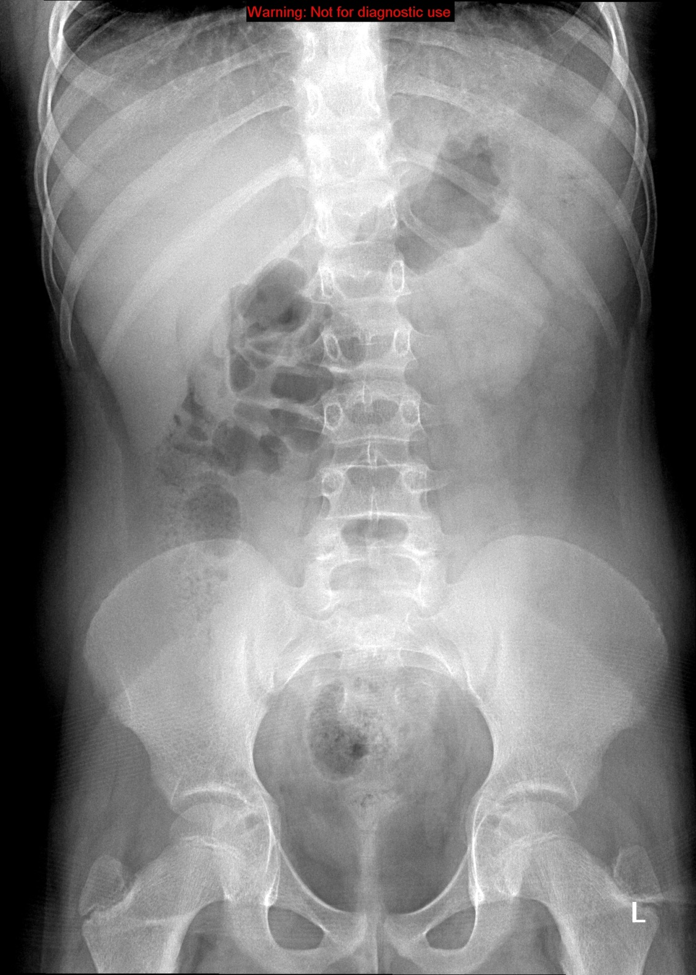
Liver
Spleen
Kidneys
Psoas muscles

Slide 38
Liver
Spleen
Kidney
Psoas muscles

Slide 39
Abdomen X-ray

Slide 40
Liver
Spleen
Kidneys
Psoas muscles

Slide 41
Abdomen X-ray

Slide 42
Abdomen X-ray

Slide 43
Abdomen X-ray

Slide 44
Abdominal X-Rays

Slide 49
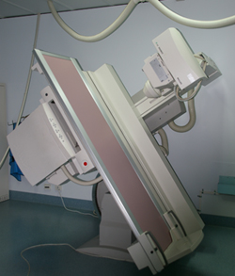
FLUOROSCOPY

Slide 50
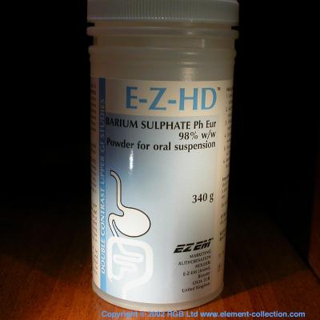
Fluoroscopy
+
ORAL
CONTRAST
X-RAY

Slide 51
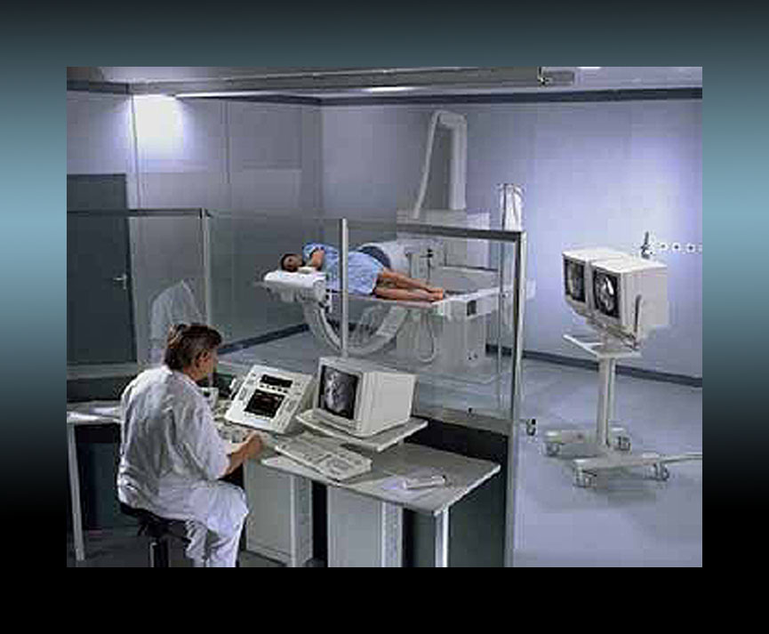
Upper gastrointestinal tract radiography, also called an upper GI, is an x-ray examination of the pharynx, esophagus, stomach and first part of the small intestine (also known as the duodenum) that uses a special form of x-ray called fluoroscopy and a contrast material called barium.

Slide 52
Barium swallow --------------> Esophagus
Barium meal ------------------> Stomach
Barium follow through -----> Small bowel
Barium enema ----------------> Large bowel

Slide 53
ADVANTAGES:
Available
Relatively cheap
Excellent in evaluation the bowel lumen and mucosa
DISADVANTAGES:
Radiation
Poor in evaluating extra luminal pathologies

Slide 54
INDICATIONS
Assessing the mucosal outline
Abdominal pain
Gastro esophageal reflux
Masses
Inflammatory bowel diseases
Post surgical, leak
CONTRAINDICATIONS:
Pregnancy
Bowel obstruction
Bowel perforation (with barium type of contrast)

Slide 55
Barium Swallow
Single contrast study, used manly to look at the oesophagus
Liquid barium is swallowed in an upright and prone position and radiographs are taken during the oesophageal phase of transit

Slide 56
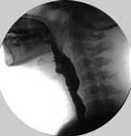
Barium Swallow, Single Contrast
Cricopharyngeus Muscle
At level of C5-C6,
Part of upper esophageal sphincter (UES)
Esophagus

Slide 57
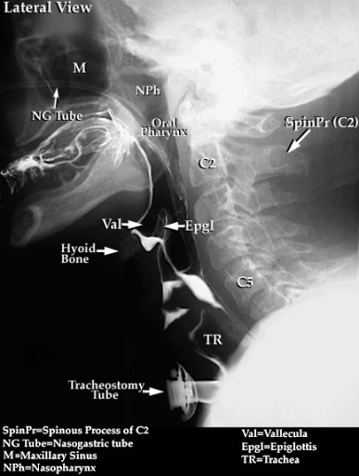
Barium Swallow, Single Contrast
Main Indication:
Dyshagia

Slide 58
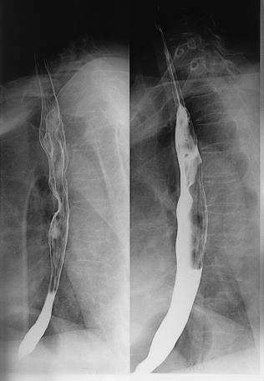
Barium Swallow, Double Contrast
Double Contrast
Identation of A.A
Indentation of L.main bronchus
Single Contrast

Slide 59
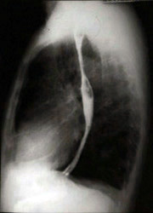
Barium Swallow, Single Contrast
Double Contrast
L.A.
Heart
L.V.

Slide 60
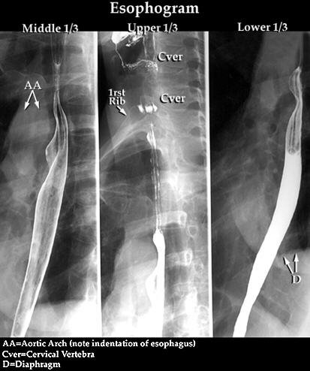
Barium Swallow, Double Contrast
Indentation of L.main bronchus
Double Contrast
Single Contrast

Slide 61
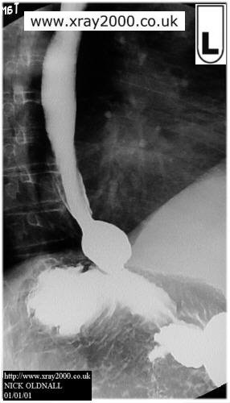
Barium Swallow, Single Contrast
Ampulla
Normal Varient
Fundus
Body

Slide 62
Barium Swallow, Single Contrast
Aortic Arch

Slide 63
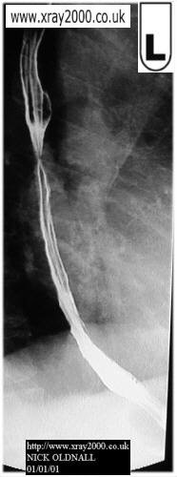
Barium Swallow, Double Contrast
Narrowing:
Could be peristalsis
So other shot is advised

Slide 64
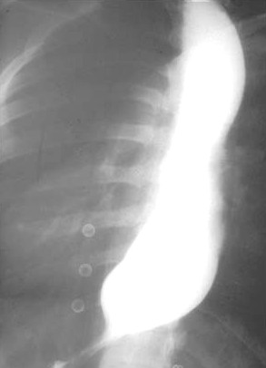
Barium Swallow, Single Contrast
Esophagus
Proximal
Dilatations
Narrowing (Stricture)
Bird Peak Sign
DDx: Achalasia

Slide 65
Lower Esophagus
Barium Swallow, Single Contrast
Benign Stricture:
The transitional Zone looks smooth and free of filling defects
Proximal
Dilatations
Distal Narrowing

Slide 66
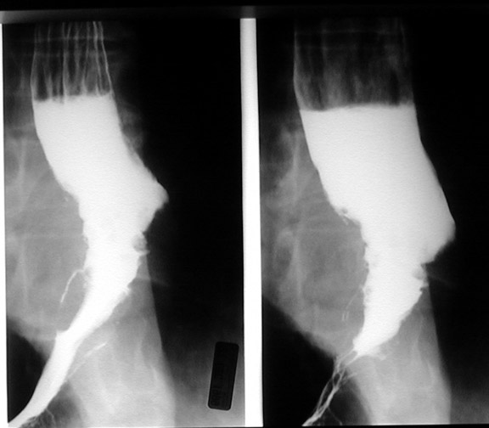
Barium Swallow, Single Contrast
Malignant Stricture:
The transitional Zone looks Irregular & ill defined
Presence of many filling defects
DDx:
Adeno CA
Sq. Cell CA
Filling Defect
It shows an irregularity that almost looks like an apple core lesion in the esophagus. This is typical in carcinoma of the esophagus

Slide 67
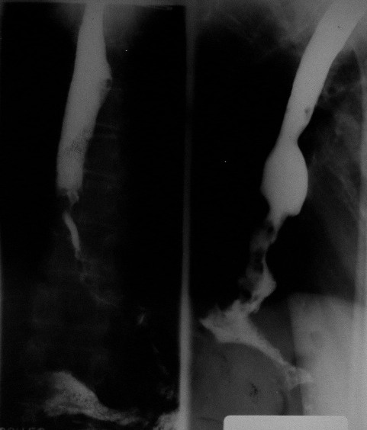
Barium Swallow, Single Contrast
(Oblique)
Filling Defect
Malignant Stricture
Long Irregular Narrowing
It shows an irregularity that almost looks like an apple core lesion in the esophagus. This is typical in carcinoma of the esophagus
Notes:
It shows an irregularity that almost looks like an apple core lesion in the esophagus. This is typical in carcinoma of the esophagus

Slide 68
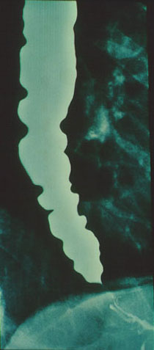
Barium Swallow, Single Contrast
(Oblique)
Irregular Wall & Dilatation:
Tertiary Contraction (Pathological non-propulsive Contraction)
Funnel Shape
(Achalasia)
Barium swallow in this patient with achalasia reveals a smooth distal tapering caused by the hypertensive lower esophageal sphincter that straddles the diaphragm, and multiple non-Peristaltic contractions throughout the body of the esophagus. This radiographic appearance sometimes has been called "vigorous achalasia". This term has little value, however, because recent studies suggest that patients with so-called vigorous achalasia cannot be distinguished clinically from non-vigorous achalasia.
Notes:
Barium swallow in this patient with achalasia reveals a smooth distal tapering caused by the hypertensive lower esophageal sphincter that straddles the diaphragm, and multiple non-Peristaltic contractions throughout the body of the esophagus. This radiographic appearance sometimes has been called "vigorous achalasia". This term has little value, however, because recent studies suggest that patients with so-called vigorous achalasia cannot be distinguished clinically from non-vigorous achalasia.

Slide 69
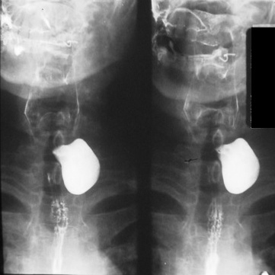
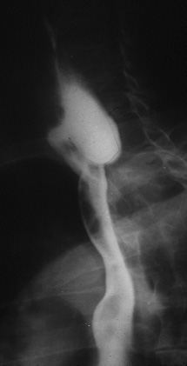
Barium Swallow, Single Contrast
(Oblique)
Well Defined Contrast Filled left cervical level sac
Pharyngeal Pouch
(Zenker's Diverticulum):
occurs in an area of anatomic weakness known as Killian's dehiscence

Slide 70
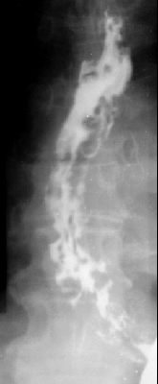
Barium Swallow, Single Contrast
Irregular Multiple Filling Defects
Differential Diagnosis Multiple Esophageal Filling Defects:
Fungal Infx
Polyps
Esophageal Varices (irregular)
Food Particles
Varices Barium swallow examination: AP view: Numerous rounded and elongated smooth-contoured filling defects are present in the inferior two thirds of the esophagus. The contour of the esophagus is irregular and spiculated.
Notes:
Varices Barium swallow examination: AP view: Numerous rounded and elongated smooth-contoured filling defects are present in the inferior two thirds of the esophagus. The contour of the esophagus is irregular and spiculated.

Slide 71
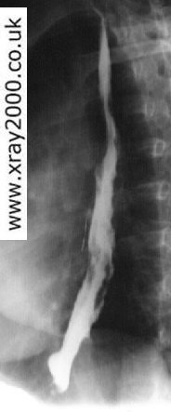
Barium Swallow, Single Contrast
Irregular Multiple Filling Defects
(Esophageal Varices)

Slide 72
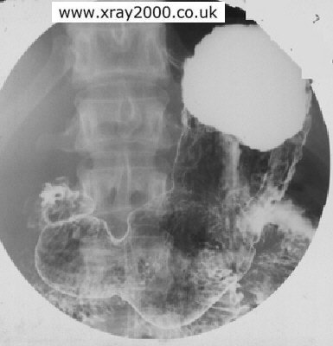
Barium Meal, Double Contrast
(Supine Position)
Supine Position:
Note Barium Distribution in the Fundus due to gravity
Angular Notch
Incisura Angularis
Antrum
Body

Slide 76
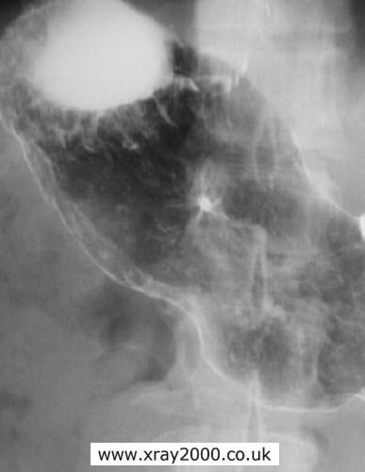
Barium Meal, Double Contrast
Contrast Filled Speculated Lesion
(Gastric Ulcer)

Slide 77
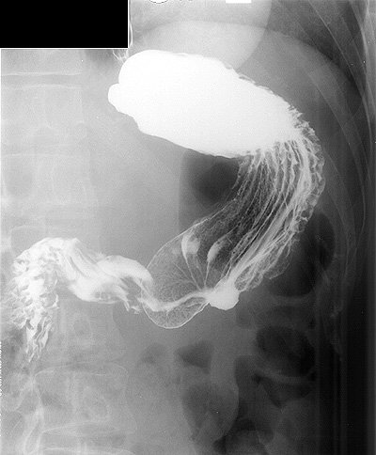
Barium Meal, Double Contrast
Rugae
Contrast Filled Outpouching at the Greater Curviture
(Malignant Gastric Ulcer)

Slide 78
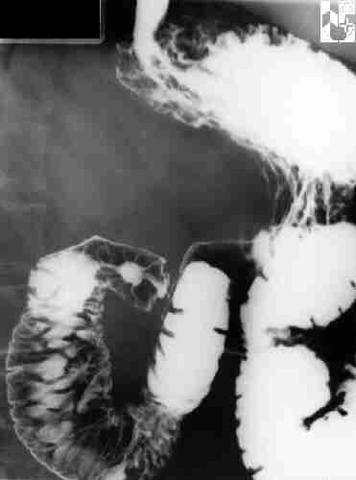
Barium Meal + Follow-Through
Contrast Filled Speculated Lesion
(Duodenal Ulcer)
1st Part of duodenum
2nd Part of duodenum
4th Part of duodenum
3rd Part of duodenum

Slide 79
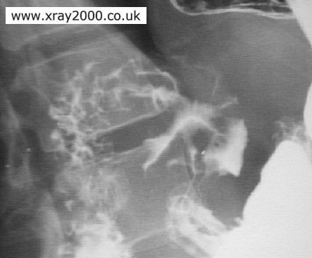
Barium Meal, Double Contrast
Speculated Mass
Ulcer
Pylorus
Stomach

Slide 80
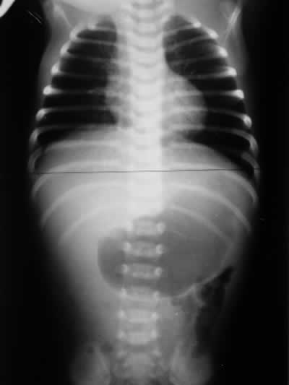
Barium Meal, Double Contrast
Distended Stomach
Single Bubble Sign
DDx: Gastric Output Obstruction (GOO)
(Pyloric Stenosis)
Gas in Descending Colon
(partial obstruction)

Slide 81
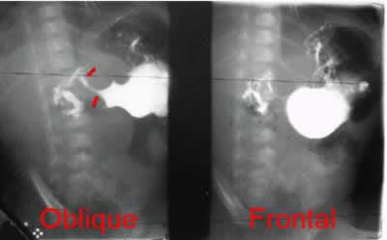
Barium Meal, Double Contrast
(Erect Position)
DDx:
Pyloric Stenosis
Mushroom’s Sign
(or apple core Sign)
String’s Sign
Shoulder’s Sign
For further information refer to “Pediatric Abdomen Radiology” Slides (37-46)

Slide 82
Barium Follow-Through
Used to examine duodenum, jejunum and ileum
Like a barium swallow but images taken every 20 minutes or so for 2-3 hours
Small bowel follow-through may reveal evidence of disorders such as Crohn's disease, Coeliac disease or small bowel tumours

Slide 84
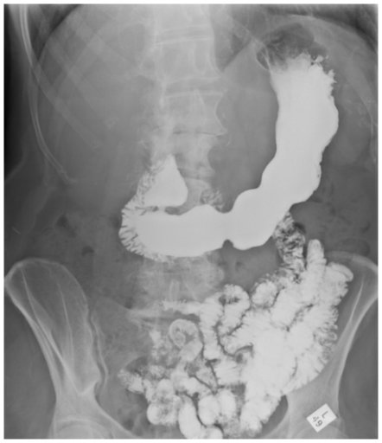
Barium Meal + Follow-Through
(Erect Position)
DJJ:
Normal Position= Left side
Barium Meal
Angular Notch
Incisura Angularis
Duodenal Cap
Pyloric Canal
2nd Part of Duodenum
3rd Part of Duodenum
Jejunum:
Plica Circularis on the outer border
Body
Antrum
Ileum
Barium
Follow-Through

Slide 85
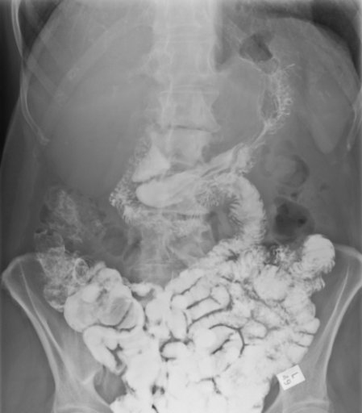
Barium Follow-Through to Cecum
(Erect Position)
DJJ:
Normal Position= Left side
2nd Part of Duodenum
3rd Part of Duodenum

Slide 86
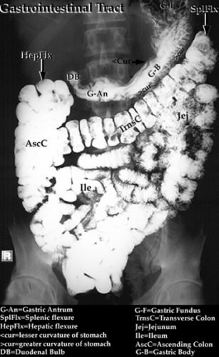
Barium Follow-through

Slide 87
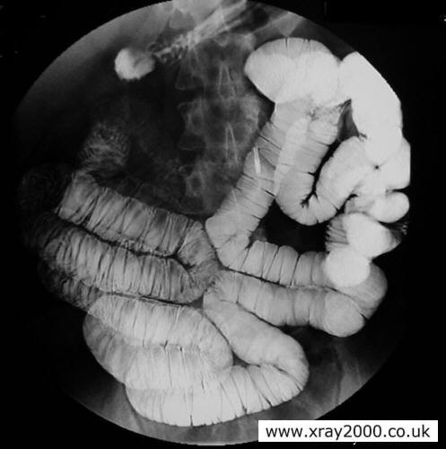
Small Bowel Enema
A Modified Follow-Through which is called Small Bowel Enema note that the bowel is more distended here
This procedure involves inserting a thin tube through the mouth, esophagus and past the stomach to inject barium, methylcellulose and water into the small bowel. This allows for better visualization of the small bowel than can be seen during a small bowel follow-through

Slide 88
Barium Enema
Single or double contrast study.
Double contrast means air fired up after barium – pictures may show coating on the outline of the bowel rather than a white bowel (right)
Patient has to have:
low residue diet for three days before the procedure
laxatives 24 hr before
bowel prep just before
Barium up the bum, patient has to move into different positions to coat to the whole colon. Often the table moves about to help the passage of barium. Serial X-rays are taken
Films can be small and only cover a small area of bowel
This is normal, despite the arrows!

Slide 89
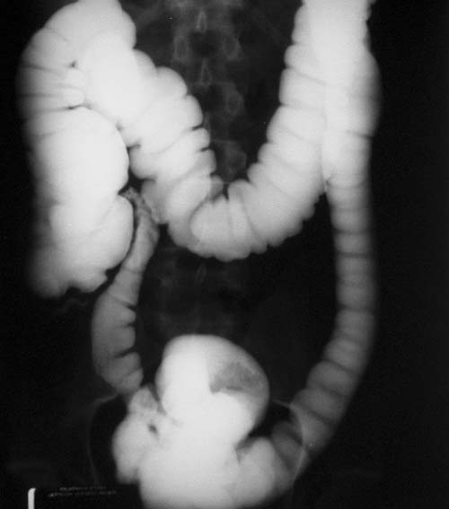
Barium Enema, Single Contrast
Transverse Colon
Ascending Colon
Descending Colon
Cecum
Terminal Ileum
Sigmoid

Slide 90
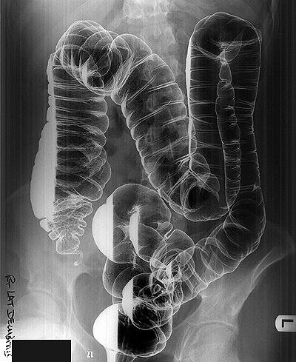
Barium Enema, Double Contrast
(Right Lateral Decubitus)
Hepatic Flexure
Note the effect of gravity

Slide 91
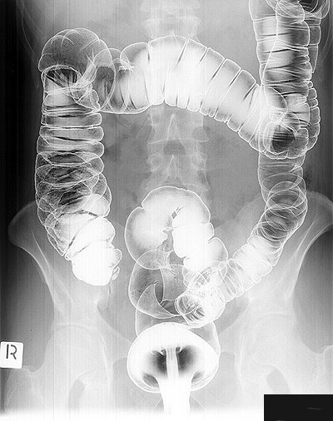
Barium Enema, Double Contrast
(Prone Position)
Note the Haustrations
If lost → UC (IBD)
Cecum

Slide 92
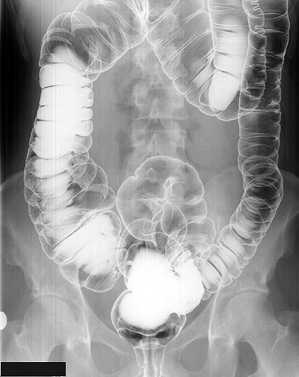
Barium Enema, Double Contrast
(Supine Position)
Rectum

Slide 94
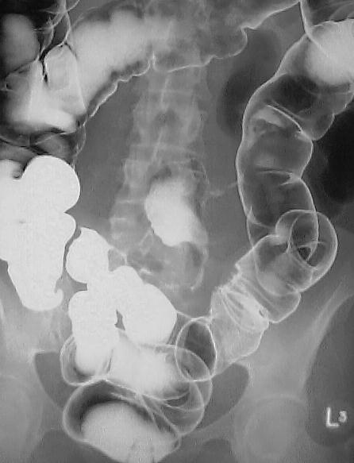
Barium Enema, Double Contrast
(Prone Position)
Normal Segments
Skip Lesions & lesions in Small intestines
DDx: Crohns’ Disease
Strictures in Small intestines
There is a short segment of abnormal descending colon with asymmetrical puckering of the mucosal surface, without stricturing.
Note also however that contrast has refluxed into the terminal ileum and small bowel, and there are several strictures present within it. One of these lies adjacent to the large bowel abnormality.
Notes:
There is a short segment of abnormal descending colon with asymmetrical puckering of the mucosal surface, without stricturing.
Note also however that contrast has refluxed into the terminal ileum and small bowel, and there are several strictures present within it. One of these lies adjacent to the large bowel abnormality.

Slide 95
Differential Diagnosis of Terminal Ileum Narrowing:
Tumor → Lymphoma
Iatrogenic → Adhesion
Inflammatory (IBD)
Cecum
There is smooth narrowing of the terminal ileum and an adjacent loop of more proximal ileum as it crosses to the right side of the pelvis. There is no visible mucosal fold thickening or ulceration.
Notes:
There is smooth narrowing of the terminal ileum and an adjacent loop of more proximal ileum as it crosses to the right side of the pelvis. There is no visible mucosal fold thickening or ulceration.

Slide 96
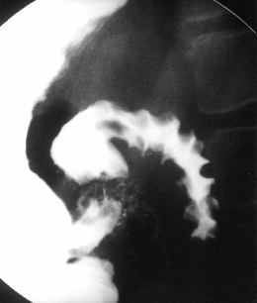
Barium Enema
Multiple Filling Defects
Cobble Stone appearance
DDx: Crohn’s Disease
Cecum
There is abnormal wall thickening, luminal narrowing, and cobblestoning involving a long segment of the distal ileum including the terminal ileum.
Notes:
There is abnormal wall thickening, luminal narrowing, and cobblestoning involving a long segment of the distal ileum including the terminal ileum.

Slide 97
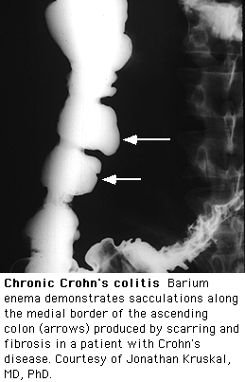
Barium Enema
Ascending colon
DDx: IBD
Pseudopolyps
Pseudodiverticulum

Slide 98
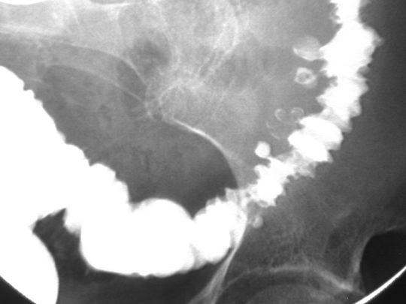
Barium Enema
Contrast Filled Sacs (outside the Lumen)
Diverticulosis in Descending & Sigmoid Colon

Slide 99
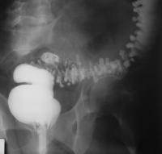
Barium Enema
Diverticulosis

Slide 100
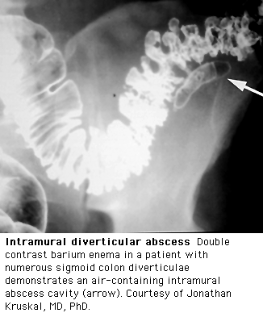
Barium Enema, Double Contrast

Slide 101
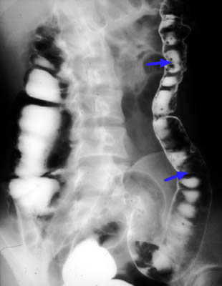
Barium Enema, Double Contrast
Multiple Small & Round Filling Defects
DDx: Multiple Polyps
Notes:
fpc

Slide 102
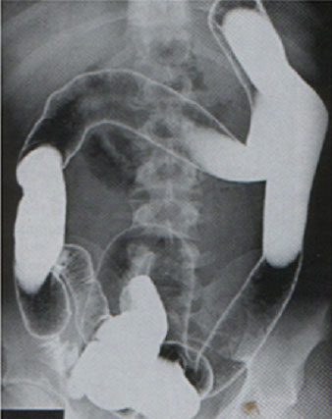
Barium Enema, Double Contrast
Loss of Haustrations
LEAD PIPE SIGN
DDx:
Ulcerative Colitis (Pancolitis)
Cecum
Terminal Ilium

Slide 103
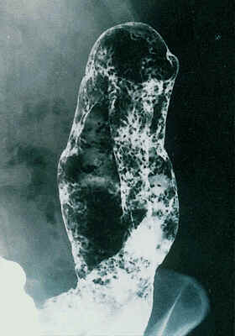
Barium Enema, Double Contrast
Loss of Haustrations
Splenic Flexure
Granular Mucosa
Multiple Filling Defects
DDx:
Ulcerative Colitis
Granular mucosa and complete absence of haustra which confirm total colitis. 2 short strictures are present in the descending colon, but there were no malignant features radiologically
Notes:
Granular mucosa and complete absence of haustra which confirm total colitis. 2 short strictures are present in the descending colon, but there were no malignant features radiologically

Slide 104
Barium Enema, Double Contrast
Ask the Doctor About these
Multiple Apple Core Sign
DDx:
Colon CA

Slide 105
Barium Enema
Stricture
Apple Core Sign
DDx:
Sigmoid Colon CA

Slide 106
Barium Enema
Apple Core Sign
DDx:
Colon CA

Slide 107
Barium Enema
A Sigmoid Stricture is always considered malignant until proven otherwise

Slide 108
Barium Enema, Double Contrast
A huge right indirect hernia in the scrotum

Slide 109
Barium Enema, Double Contrast
A huge mass that has displaced the intestines
(Spleen)
Notes:
splenomegaly

Slide 110
Barium Enema
Meconium
Filling defects & dilated Descending & Sigmoid Colon
Transition Zone
is the term applied to the region in which a marked change in caliber occurs, with the dilated, normal colon above and the narrowed, aganglionic colon below
According to the Transition Zone:
Rectum → Ultra Short
Rectosigmoid → Short
Transverse Colon → Long
Beginning of the Colon→ Total (microcolon)
DDx:
Hirschsprung disease (HD) which is more definitively diagnosed by means of contrast enema examination, which can show the presence of a transition zone, irregular contractions, mucosal irregularity, and delayed evacuation of contrast material, among other findings
Although the hallmark of the diagnosis is the presence of transition zone but it’s absence exclude the disease
For more info visit:
http://emedicine.medscape.com/article/409150-imaging

Slide 111
COMPUTED TOMOGRAPHY

Slide 112
CT scan

Slide 113
ADVANTAGES:
Available
Short scan time
Much more soft tissue and bone details
Excellent in diagnosing extra-luminal lesions
Excellent in diagnosing the cause of bowel obstruction
DISADVANTAGES:
Radiation
Some times need intra venous contrast (renal disease)
Relatively expensive

Slide 114
INDICATIONS
Abdominal pain
To look for bowel obstruction cause
To diagnose intra-abdominal masses
Trauma
CONTRAINDICATIONS:
Pregnancy
No IV contrast in renal failure
Unstable patients (severe trauma/ICU)

Slide 130
MRI

Slide 131
ADVANTAGES:
Relatively safe in pregnancy (no radiation)
Give much more soft tissue details
Excellent in diagnosing abdominal solid organ lesion: liver, spleen, kidneys
DISADVANTAGES:
Expensive
Long scanning time
Sensitive to motion

Slide 132
INDICATIONS
Abdominal solid organ masses
Inflammatory bowel disease
CONTRAINDICATIONS:
uncooperative patients
Early pregnancy (relative contraindication)
No IV contrast renal failure (relative contraindication)

Slide 134
CT scan
MRI

Slide 144
Angiography

Slide 151
Thank You

