Slide 1
RADIOLOGY
of
HEMATOPOIETIC DISORDERS
DR. SAJJAD HUSSAIN
ASSISTANT PROFESSOR & CONSULTANT
Department of Radiology and Medical Imaging
KING SAUD UNIVERSITY
KING KHALID UNIVERSITY HOSPITAL

Slide 2
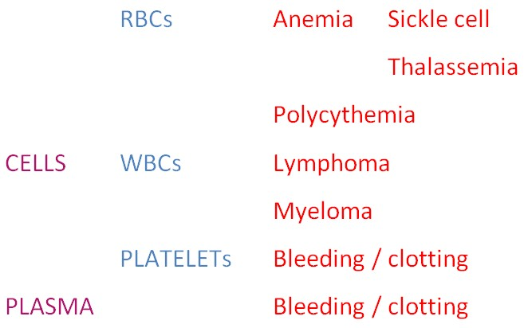

Slide 3
ANEMIA
Reactive increase
in red bone marrow
Expanded bone marrow in bones including long bones of hands, feet, limbs, skull
Decreased T1 MRI signal in vertebral body bone marrow than adjacent discs
Liver, Spleen, Lymph nodes, Thymus, Paraspinal areas with possible extension into spinal canal outside the dura,
Kidneys, Meninges, Skin
New marrow areas
in potential organs
Transfusions
Iron overload
Increased CT density (brightness) and changes in MRI signal of liver & spleen
SCA
Infections
Pneumonias, Osteomyelitis
Infarcts
Spleen, Kidneys, Brain, Bones

Slide 4
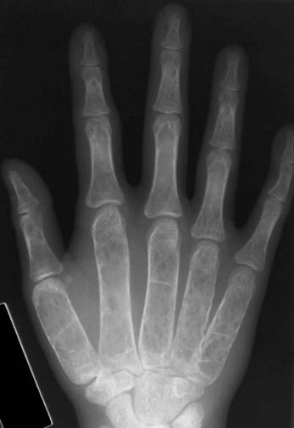
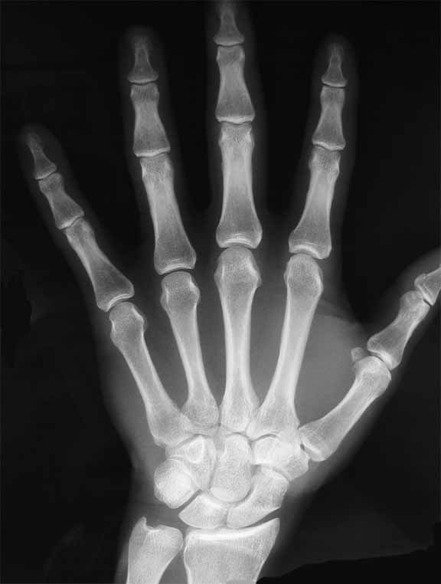
Thalassemia
Decreased bone density with coarse trabeculae
Wide medullary cavity with thin cortex
Normal for comparison

Slide 5
Severe chronic anemia
Normal for comparison

Slide 6
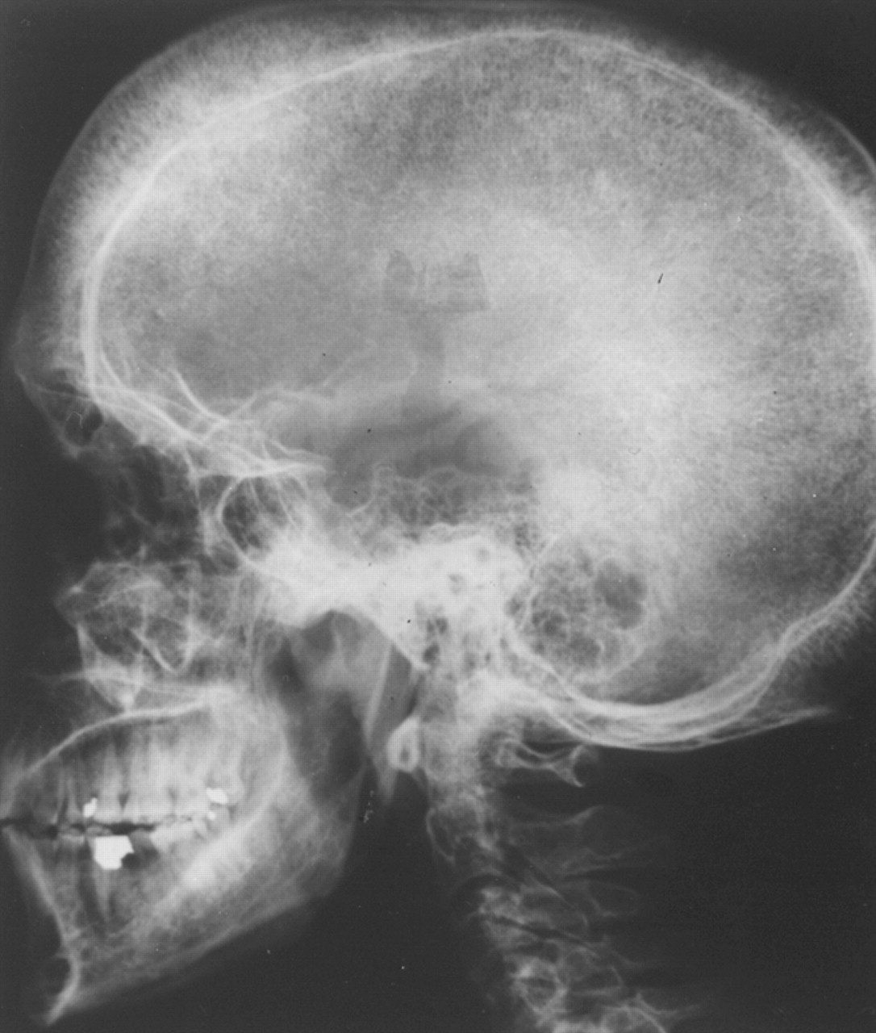
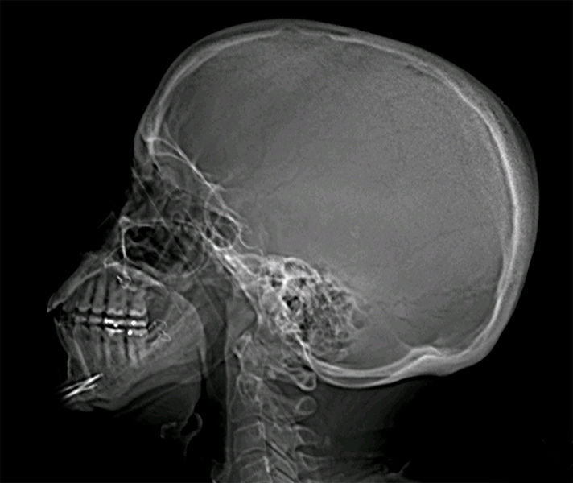
25-year-old man with β-thalassemia.
Lateral skull radiograph shows
expansion of diploic space with hair-on-end appearance
widened groove for middle meningeal artery
Spared occipital bone (arrow)
Normal for comparison
Georgiades C S et al. AJR 2002;179:1239-1243

Slide 7
Severe chronic anemia
Normal for comparison

Slide 8
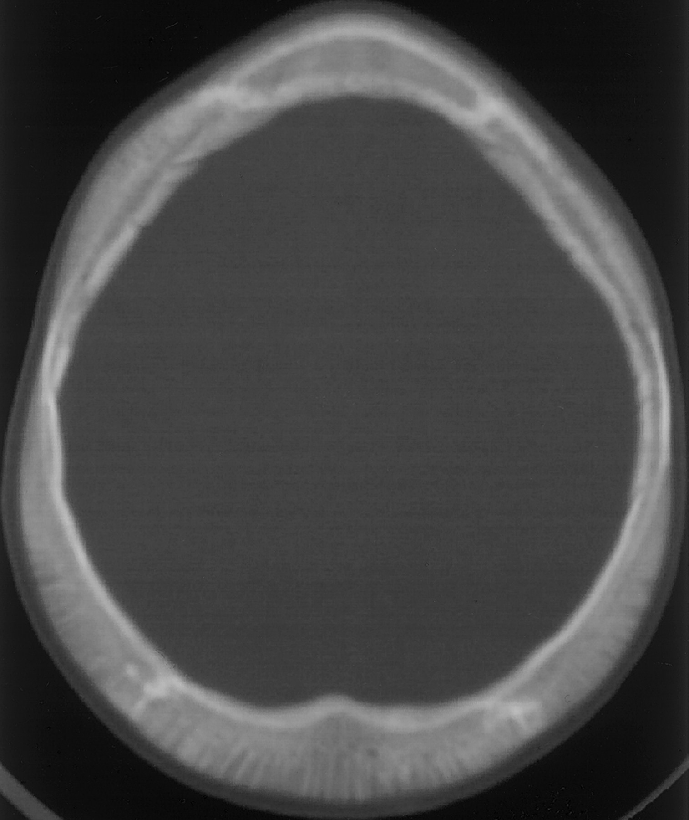
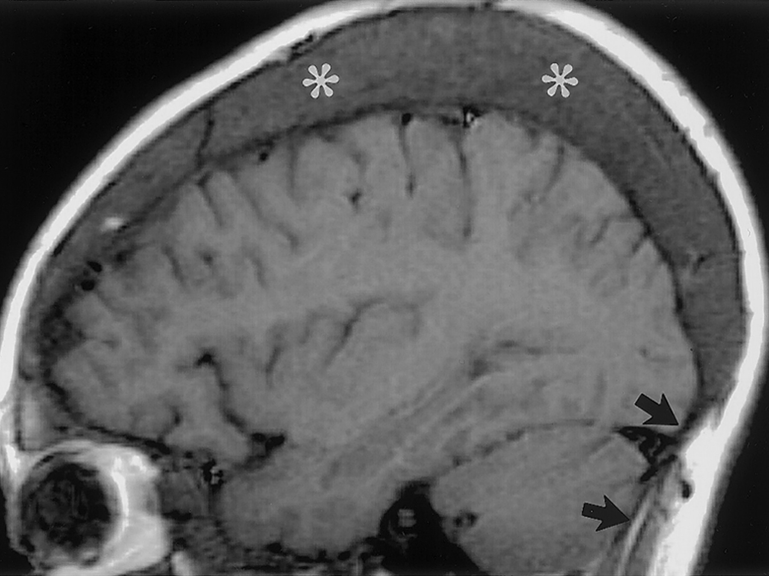
Axial CT image of upper skull (left) shows diploic space widening and trabecular prominence
Sagittal MRI of brain (right) shows diploic space widening representing red marrow (*). Note spared occipital bone (arrows), which has no marrow elements
Lonergan G J et al. Radiographics 2001;21:971-994

Slide 9
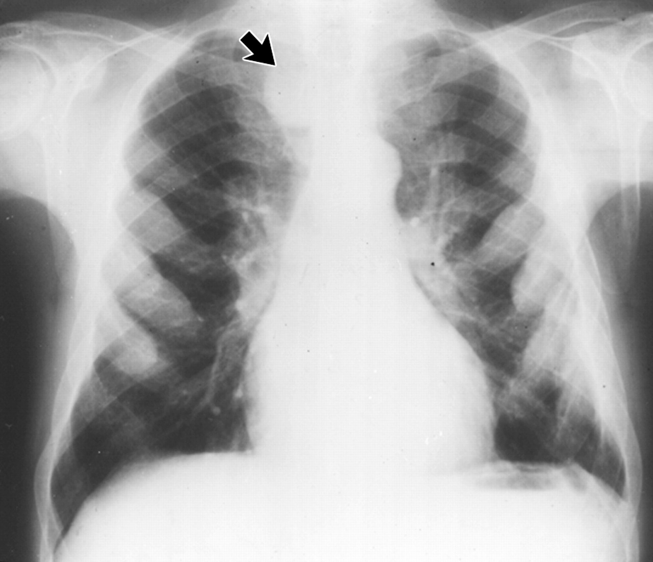
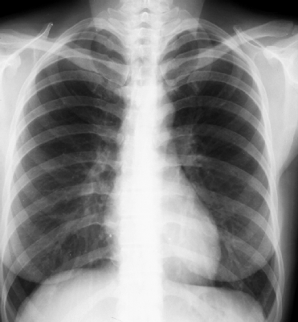
25-year-old man with β-thalassemia.
PA radiograph of chest (left) shows diffuse expansion of ribs and right upper paraspinal thoracic mass (arrow) compatible with extramedullary hemopoiesis.
β-thalassemia
Normal for comparison
Georgiades C S et al. AJR 2002;179:1239-1243

Slide 10
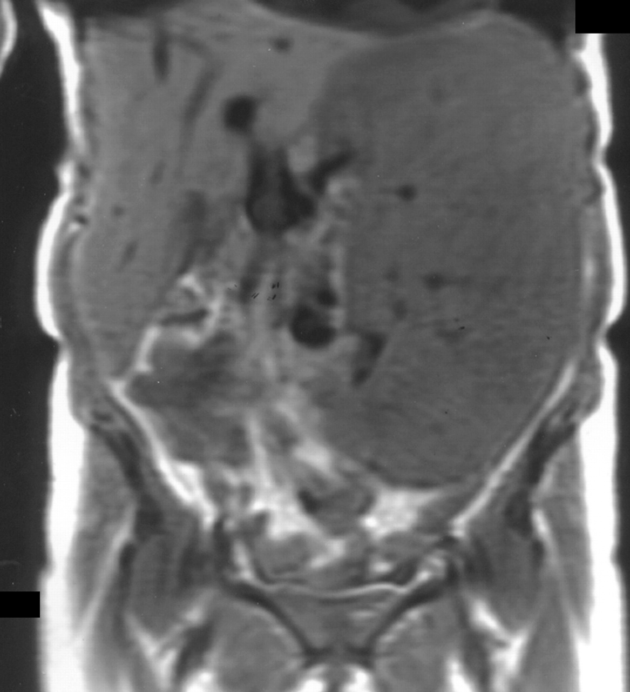
51-year-old woman with myelofibrosis.
Coronal T1-weighted MR image shows massively enlarged spleen
Splenic biopsy was followed by splenectomy
Pathologic examination revealed extramedullary hematopoiesis
Georgiades C S et al. AJR 2002;179:1239-1243

Slide 11
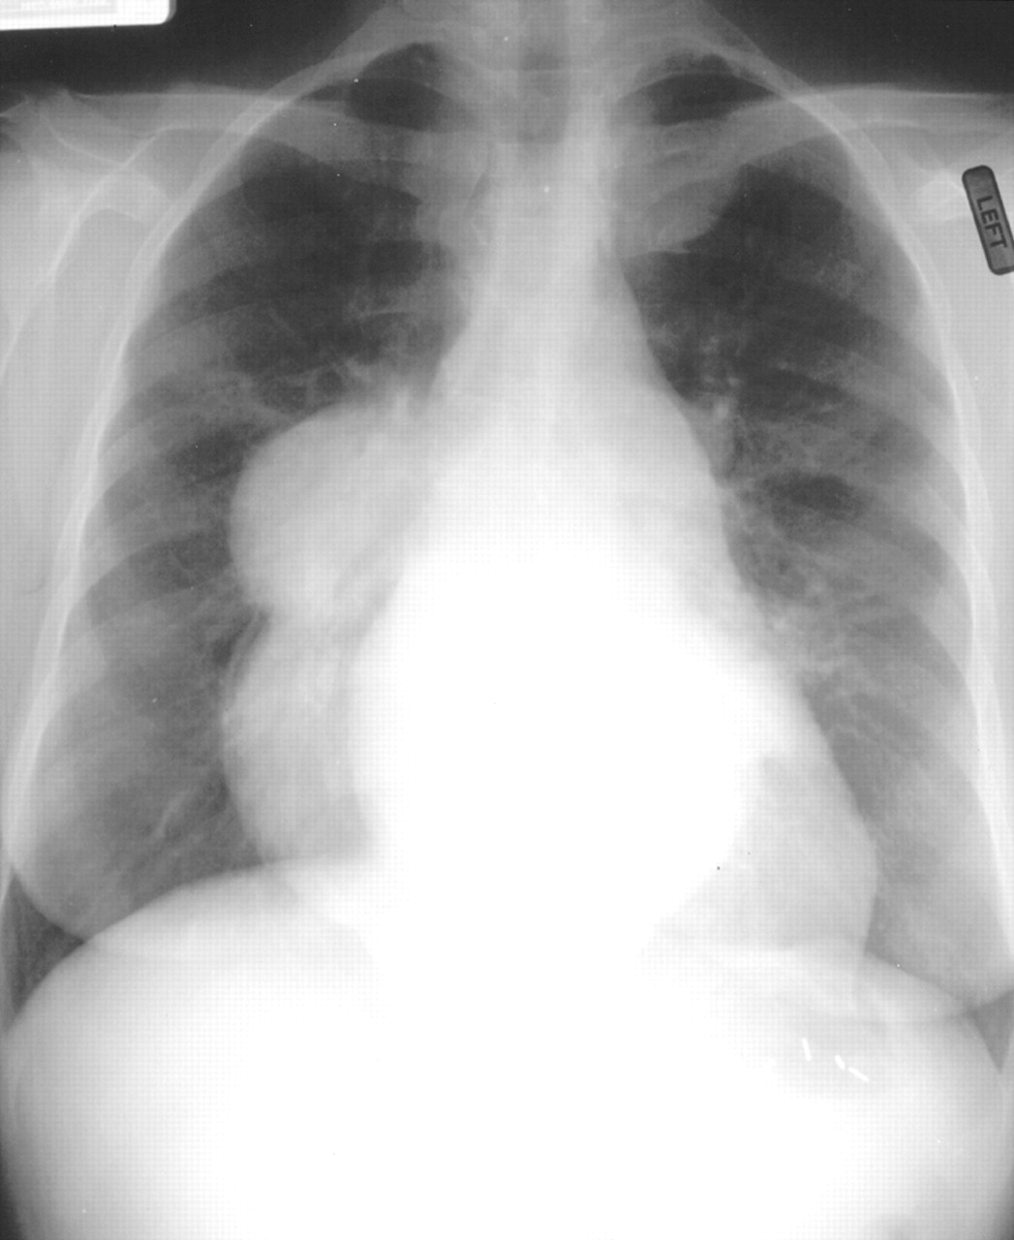
23-year-old woman with history of thalassemia and known extramedullary hemopoiesis
PA chest film shows well-marginated bilateral, paraspinal masses compatible with extramedullary hemopoietic tissue
Georgiades C S et al. AJR 2002;179:1239-1243

Slide 12
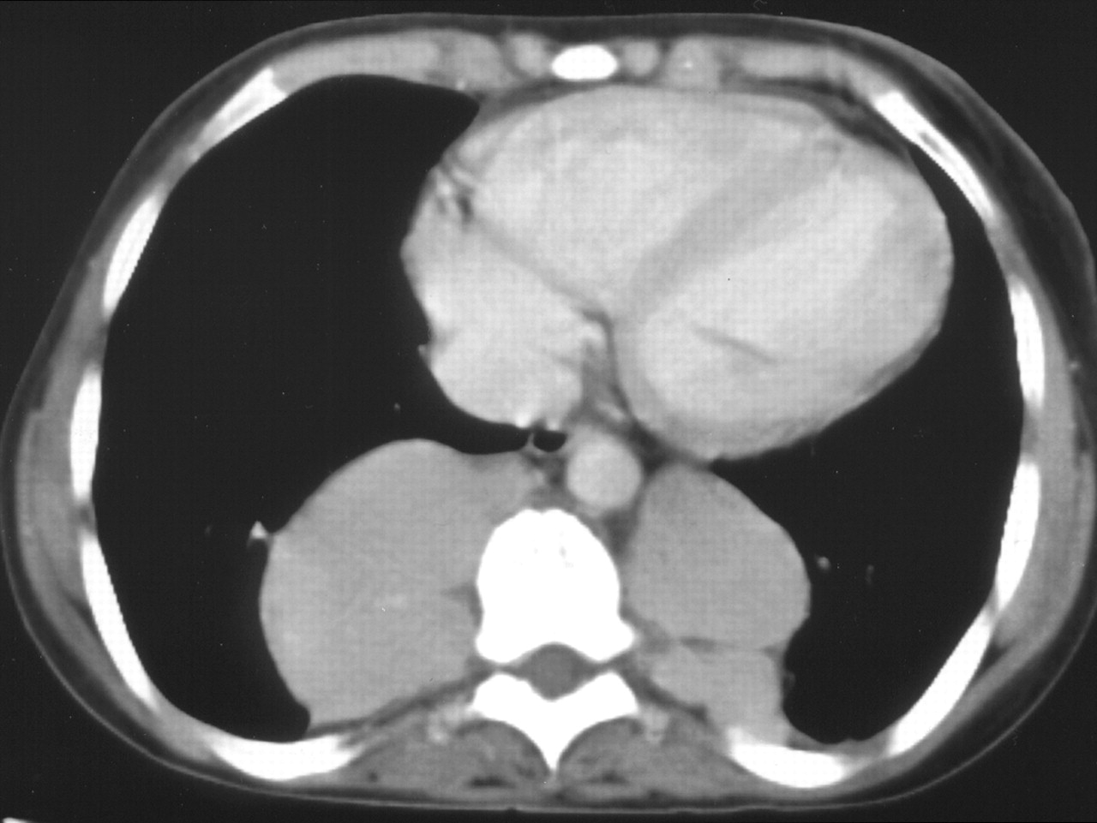
23-year-old woman with history of thalassemia and known extramedullary hemopoiesis. Axial contrast-enhanced CT scan through chest shows uniformly enhancing paraspinal hemopoietic masses with no bony erosion.
Georgiades C S et al. AJR 2002;179:1239-1243

Slide 13
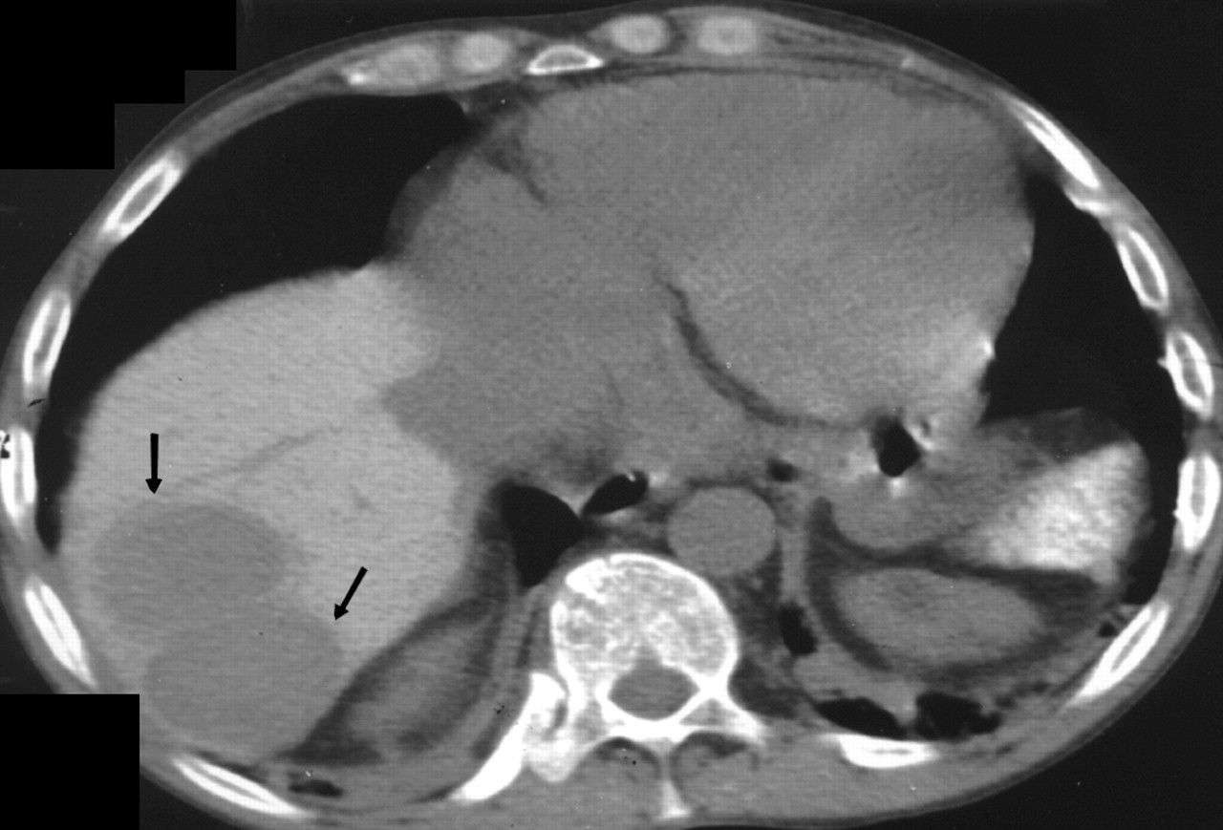
40-year-old man with sickle cell disease
Axial unenhanced CT scan at thoracoabdominal level reveals two uniformly low-attenuation (compared with liver parenchyma), well-marginated lesions (arrows)
Percutaneous biopsy showed extramedullary hemopoiesis
Georgiades C S et al. AJR 2002;179:1239-1243

Slide 14
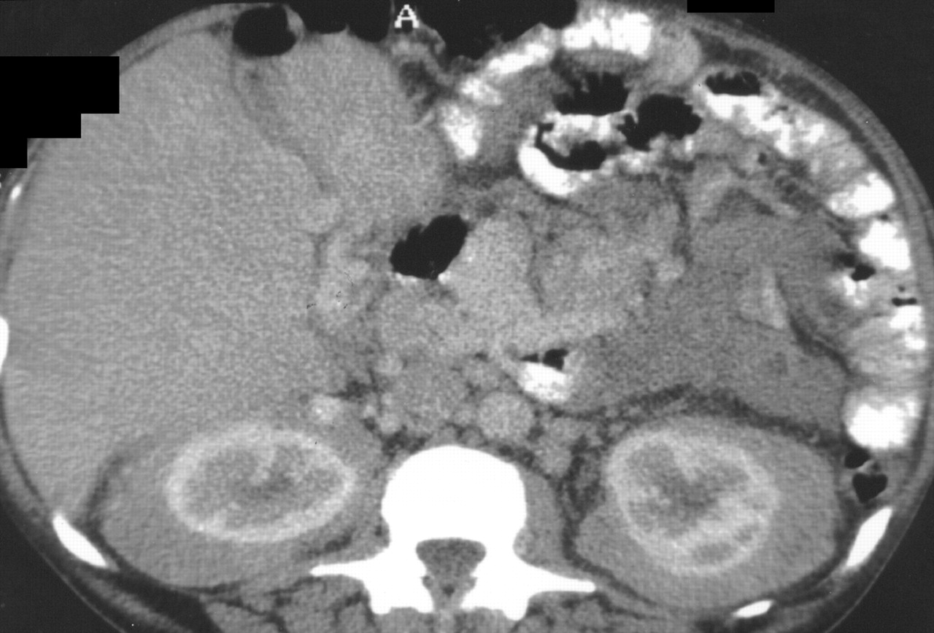
56-year-old man with myelofibrosis
Axial contrast-enhanced CT scan through kidneys reveals bilaterally symmetric enhancing perinephric masses. Biopsy showed extramedullary hematopoiesis
Georgiades C S et al. AJR 2002;179:1239-1243

Slide 15
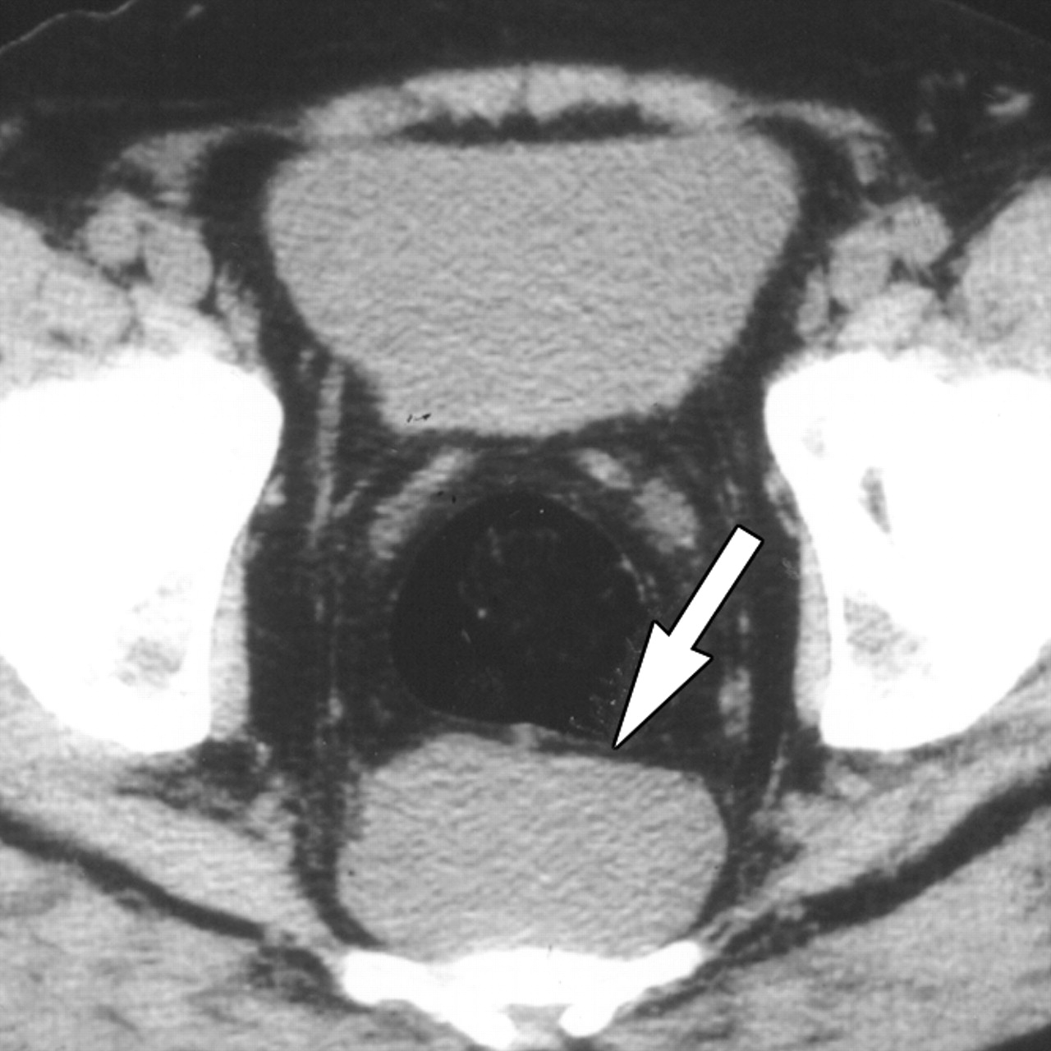
48-year-old man with hemolytic anemia and myelofibrosis
Axial CT scan through pelvis shows
well-marginated presacral soft-tissue mass (arrow) with no bony erosion
Biopsy showed extramedullary hematopoiesis
Georgiades C S et al. AJR 2002;179:1239-1243

Slide 16
Sickle cell disease may be manifested as
ANEMIA
growth failure, hyperkinetic heart failure
expansion of intramedullary hematopoiesis
Presence of extramedullary hematopoiesis
VASO-OCCLUSION
Infarcts in spleen, bone marrow, kidney,
bowel, brain, muscles
SUPERIMPOSED INFECTION
Pneumonia (Pneumococcus, H. influenzae,
Staph. aureus, Chlamydia, and Salmonella)
Osteomyelitis (Salmonella)
Lonergan G J et al. Radiographics 2001;21:971-994

Slide 17
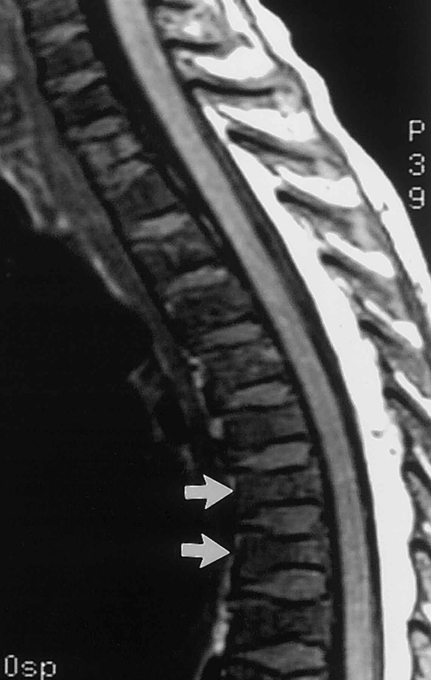
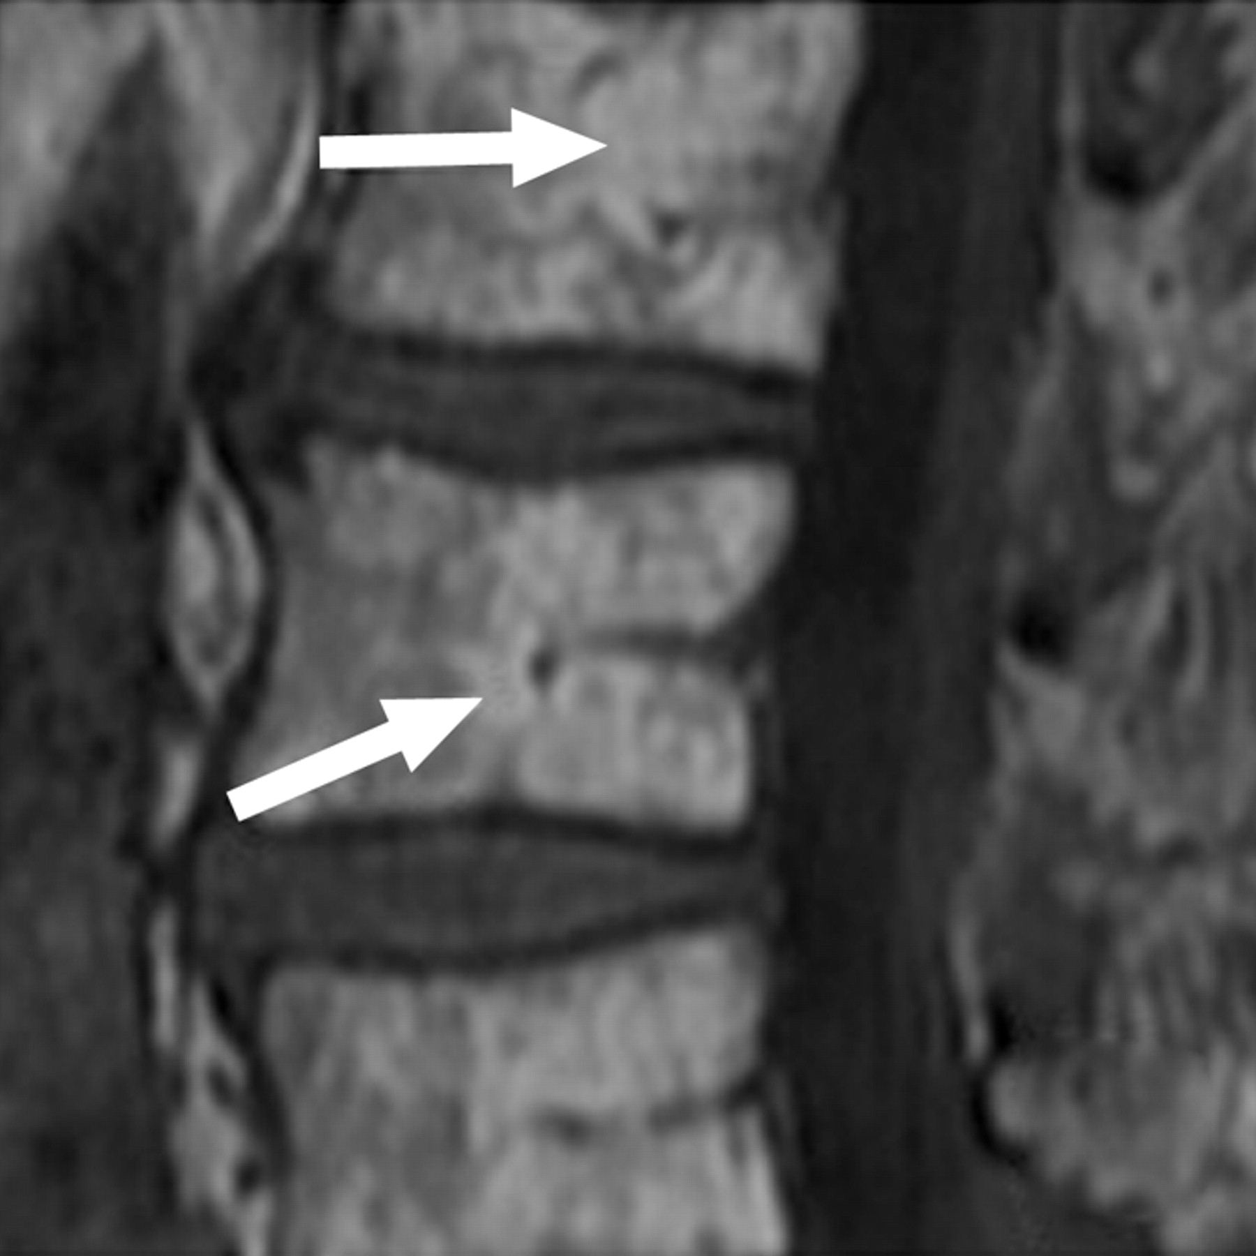
Red marrow in vertebral bodies in a 7-year-old girl with Sickle Cell Anemia.
Sagittal T1-weighted MRI of spine shows
Low signal intensity in vertebral bodies compared to discs
H-shaped vertebrae (arrows in right image) due to osteonecrosis of vertebral endplates
Normal for comparison
Lonergan G J et al. Radiographics 2001;21:971-994

Slide 18
Bone infarcts typically occur in the medullary cavities and epiphyses
Epiphyseal infarcts are frequently seen in the femoral and humeral heads, and more often bilateral than avascular necrosis due to other diseases
Lonergan G J et al. Radiographics 2001;21:971-994

Slide 19
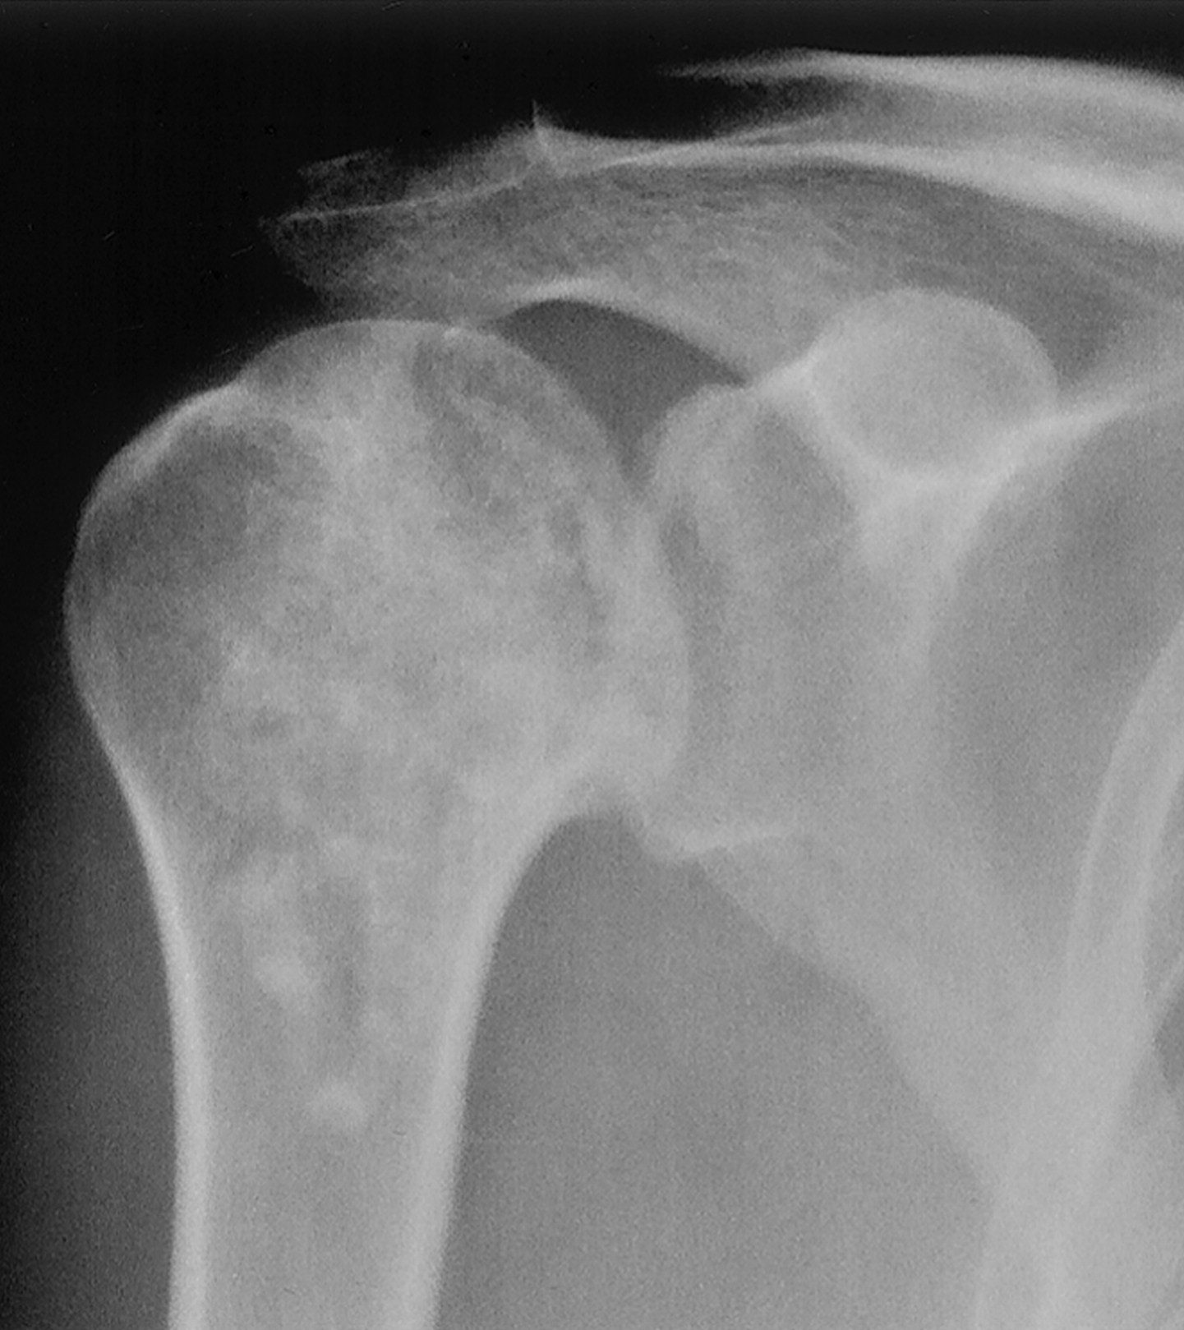
Medullary bone infarcts in SCA
Frontal radiograph of right shoulder in a 22-year-old patient shows an area of patchy sclerosis and radiolucency
Sickle cell anemia
Normal for comparison
Lonergan G J et al. Radiographics 2001;21:971-994

Slide 20
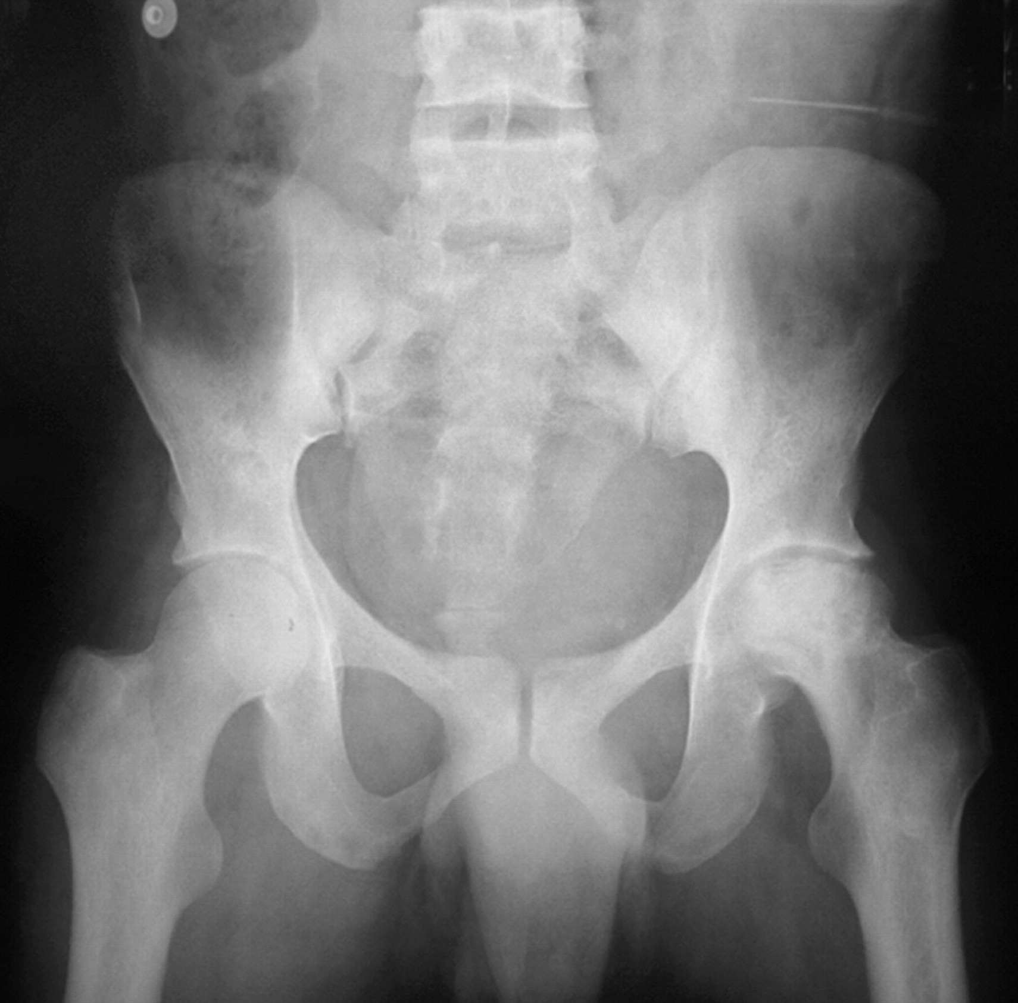
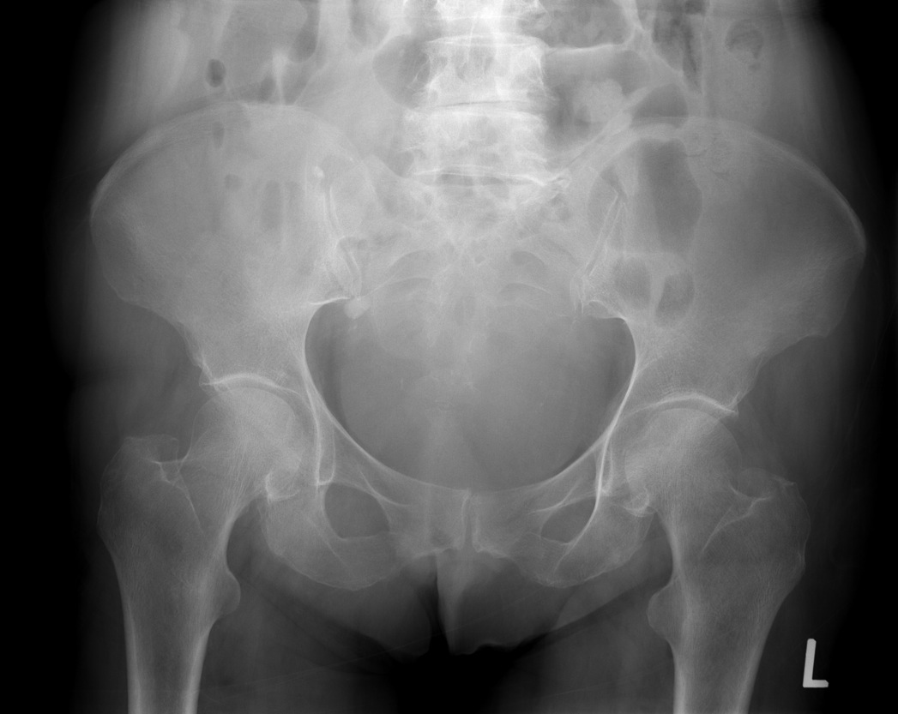
AP radiograph in a 44-year-old man shows advanced avascular necrosis in left hip and a normal right hip
Sickle cell anemia
Normal for comparison
Ejindu V C et al. Radiographics 2007;27:1005-1021

Slide 21
Sickle cell anemia
Normal for comparison

Slide 22
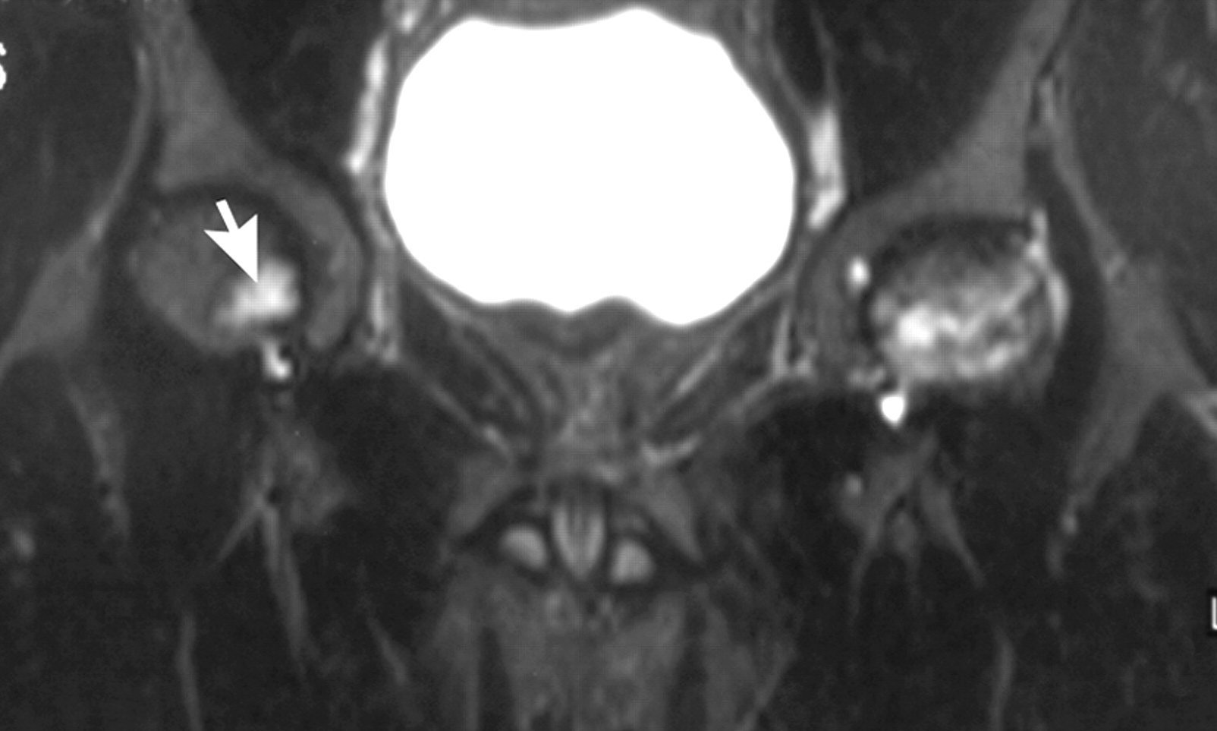
Coronal STIR MR image in the same patient shows stage 1 avascular necrosis in right hip (arrow) as well, in addition to advanced changes of avascular necrosis of left femoral head
Ejindu V C et al. Radiographics 2007;27:1005-1021

Slide 23
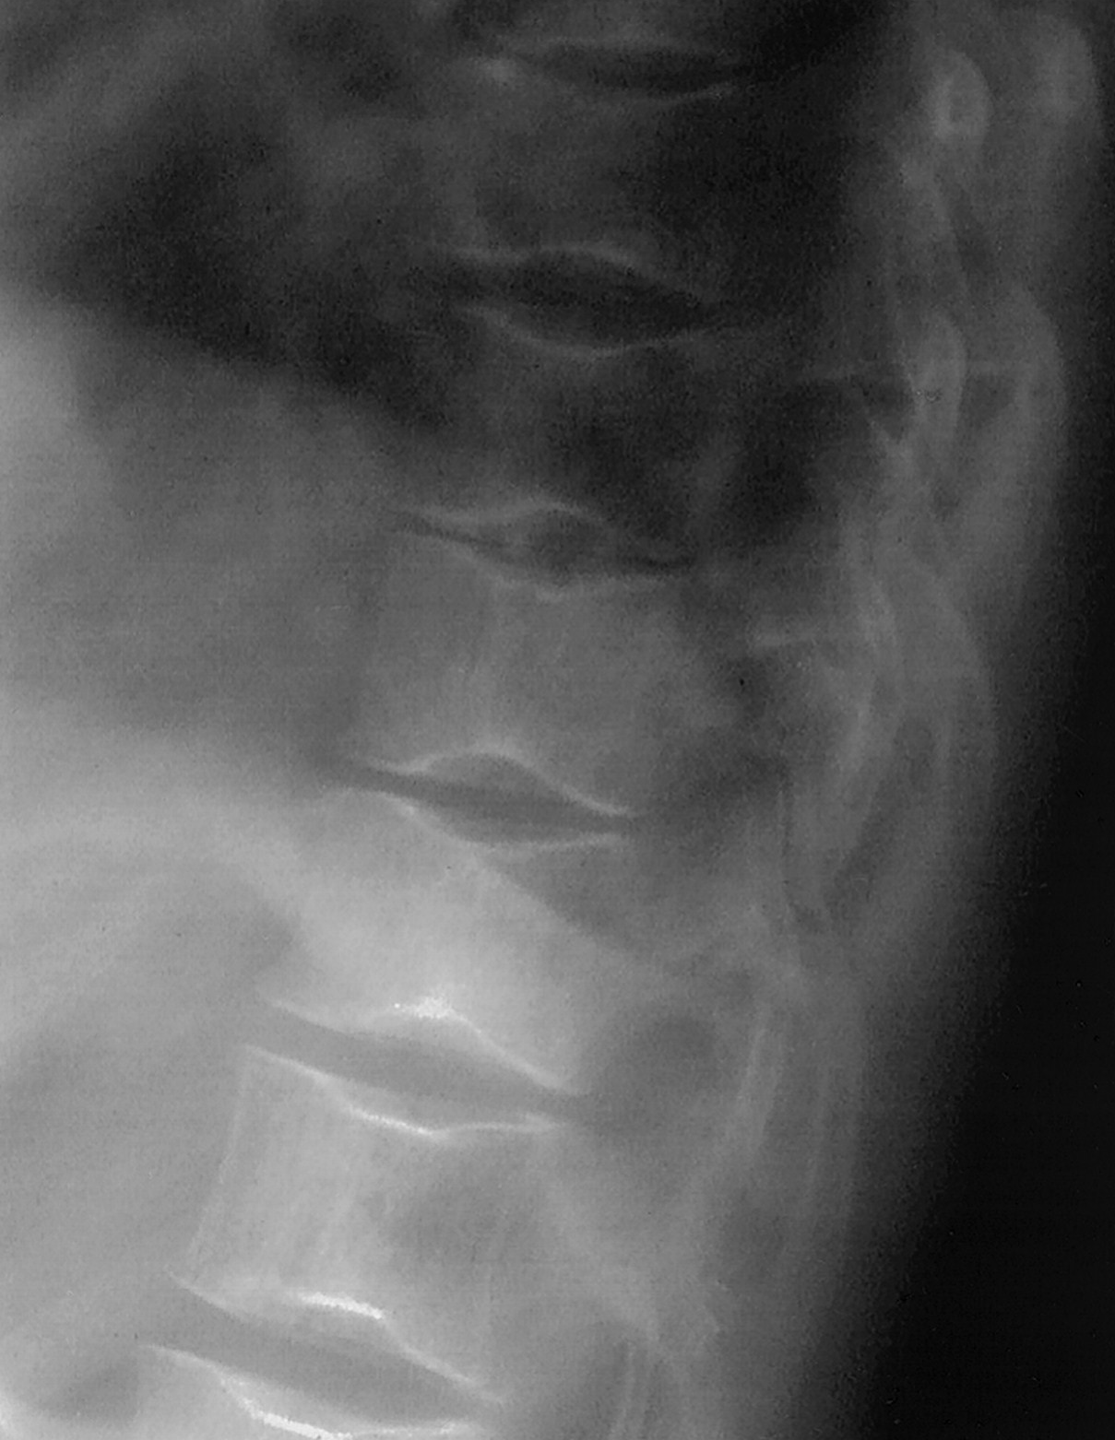
H-shaped vertebrae in a 15-year-old patient with SCA
Lateral radiograph of spine shows classic boxlike endplate depressions in middle portion (see the lowest vertebra shown) due to osteonecrosis of the vertebral endplates
Normal for comparison
Lonergan G J et al. Radiographics 2001;21:971-994

Slide 24
Red marrow vertebral bodies in a 7-year-old girl with SCA.
Sagittal T1-weighted MRI of spine shows low signal intensity in vertebral bodies compared to discs, and H-shaped vertebrae (arrows in right image) due to osteonecrosis of vertebral endplates
Normal for comparison
Lonergan G J et al. Radiographics 2001;21:971-994

Slide 25
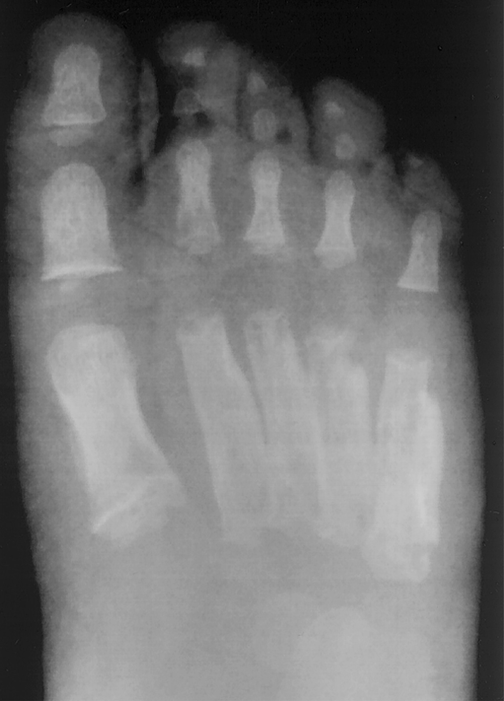
Hand-foot syndrome (dactylitis) in SCA
Frontal radiograph of right foot in a 3-year-old girl shows thick periostitis and subperiosteal new bone along the metatarsal shafts
Lonergan G J et al. Radiographics 2001;21:971-994

Slide 26
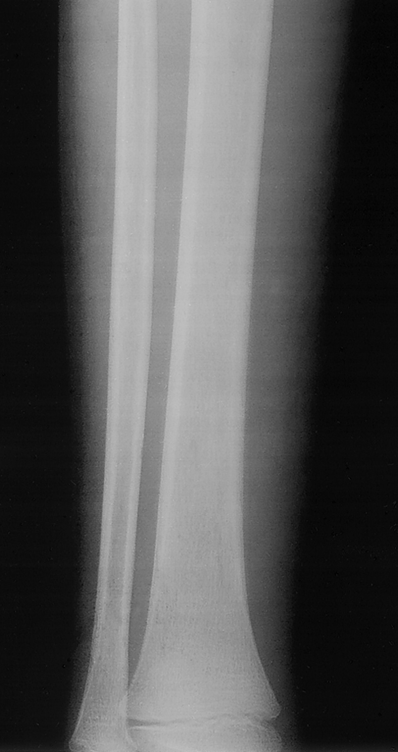
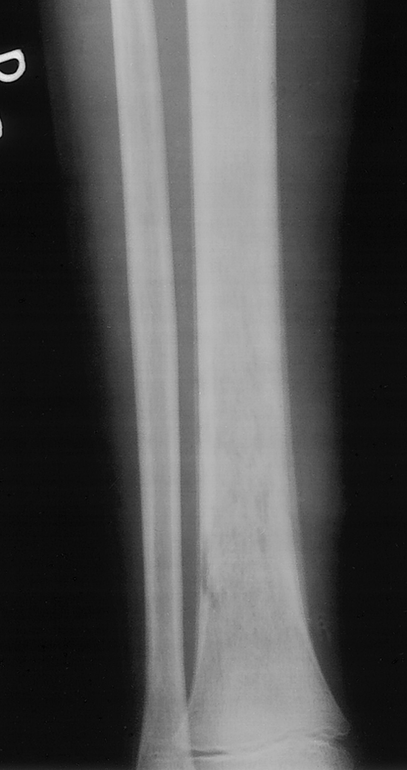
Salmonella osteomyelitis in a 10-year-old boy with SCA
Initial film (left) at onset of lower shin pain and fever is normal
Film 7 days later (right) shows mottled attenuation of lower tibial shaft and diffuse periostitis of the lower diaphysis
Lonergan G J et al. Radiographics 2001;21:971-994

Slide 28
Bone infarcts and osteomyelitis are difficult to differentiate on history, clinical examination and plain x-ray images but are very important to avoid complications of osteomyelitis
MRI findings of
Cortical defects in bone
Adjacent fluid collections in soft tissue Bone marrow enhancement
are highly suggestive of infection
Ultrasound guided aspiration of fluid collection around the involved bone can be confirmatory
Lonergan G J et al. Radiographics 2001;21:971-994

Slide 29
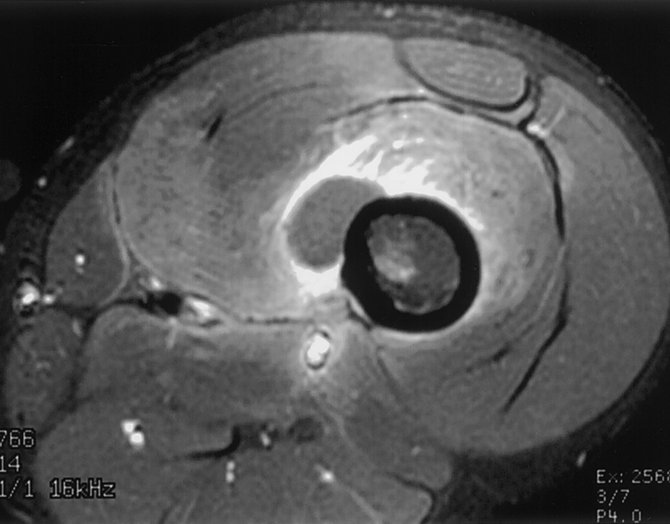
Osteomyelitis of femur in a 24-year-old patient with SCA
Axial T1-weighted MRI after contrast shows heterogeneous enhancement of marrow cavity, a rounded low-signal-intensity area adjacent to the shaft that is non-enhancing (fluid collection), and enhancement of the soft tissues around the shaft and of the adjacent musculature. Areas of enhancement are likely infected
Lonergan G J et al. Radiographics 2001;21:971-994

Slide 30
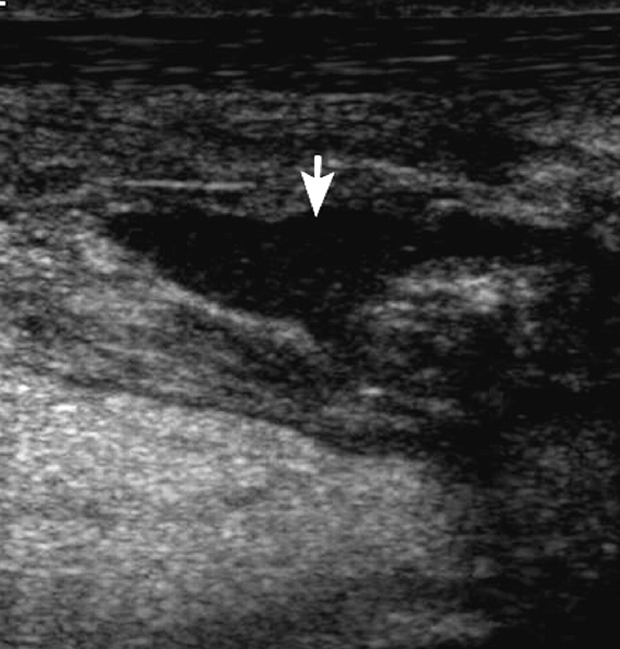
Soft-tissue infection in a 52-year-old man with homozygous sickle cell disease.
Longitudinal high-resolution ultrasound image of left ankle shows a hypoechoic (dark) fluid collection (arrow) deep to Achilles tendon. Thick pus was aspirated from this area under ultrasound guidance
Achilles tendon
Ejindu V C et al. Radiographics 2007;27:1005-1021

Slide 31
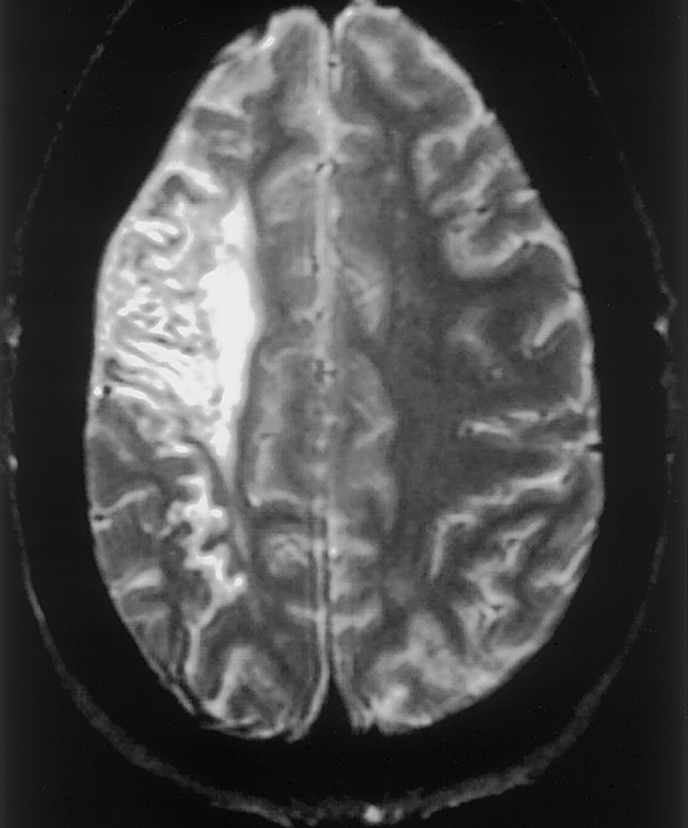
Chronic infarct in a 19-year-old patient with SCA and longstanding mild left sided weakness
Axial T2-weighted MRI shows an area of high signal intensity and enlargement of overlying CSF spaces, compatible with chronic infarction and atrophy
Lonergan G J et al. Radiographics 2001;21:971-994

Slide 32
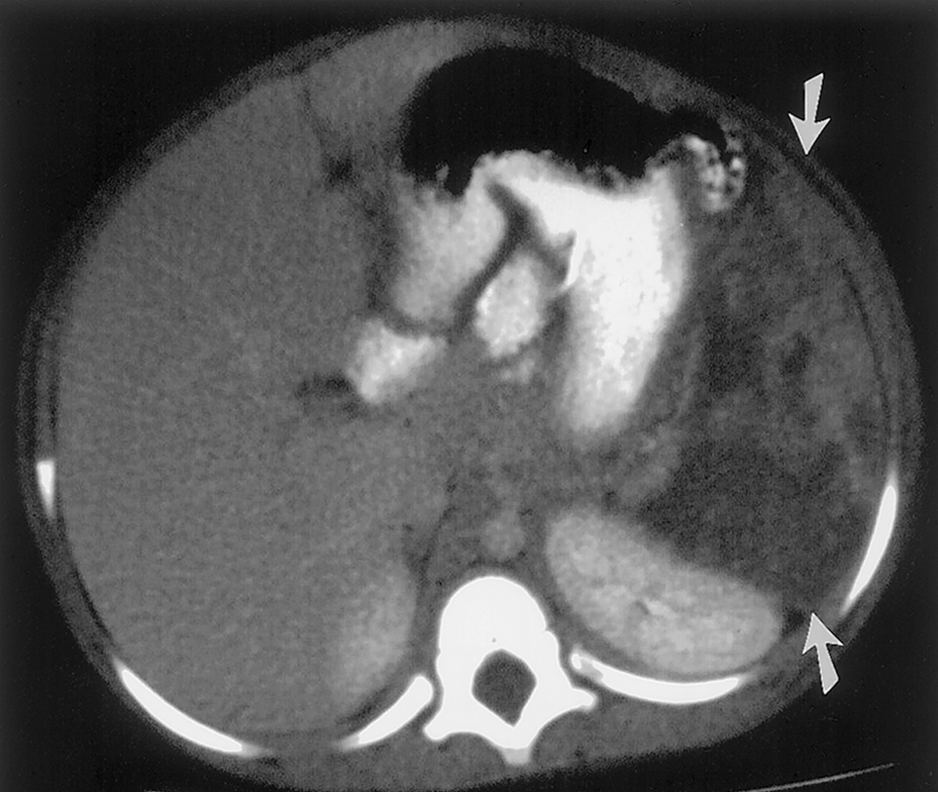
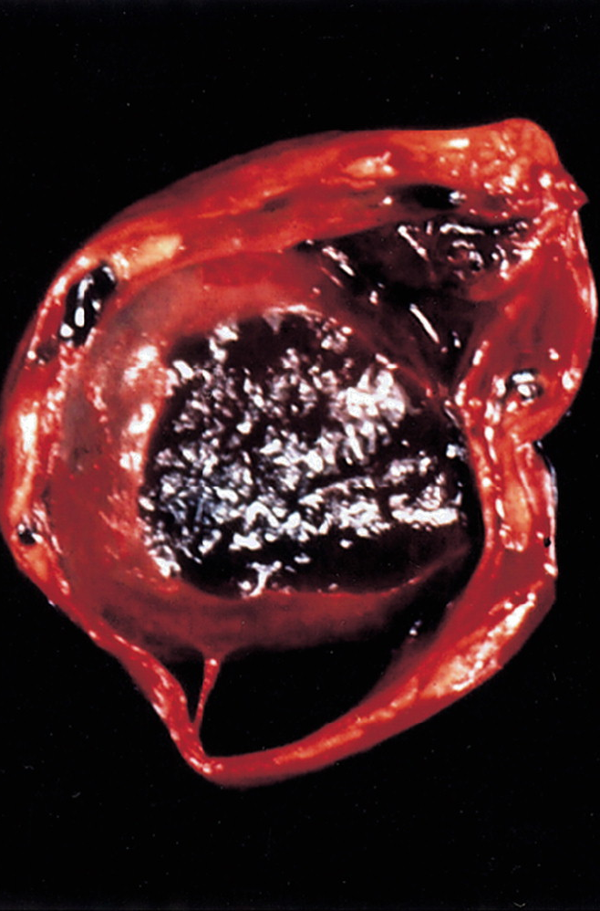
Sequestration syndrome with splenic infarction in SCA
Axial CT after contrast shows enlarged spleen that enhances heterogeneously and minimally with large non-enhancing areas (arrows)
Photograph of spleen in a different patient shows areas of congestion and central necrosis
Lonergan G J et al. Radiographics 2001;21:971-994

Slide 33
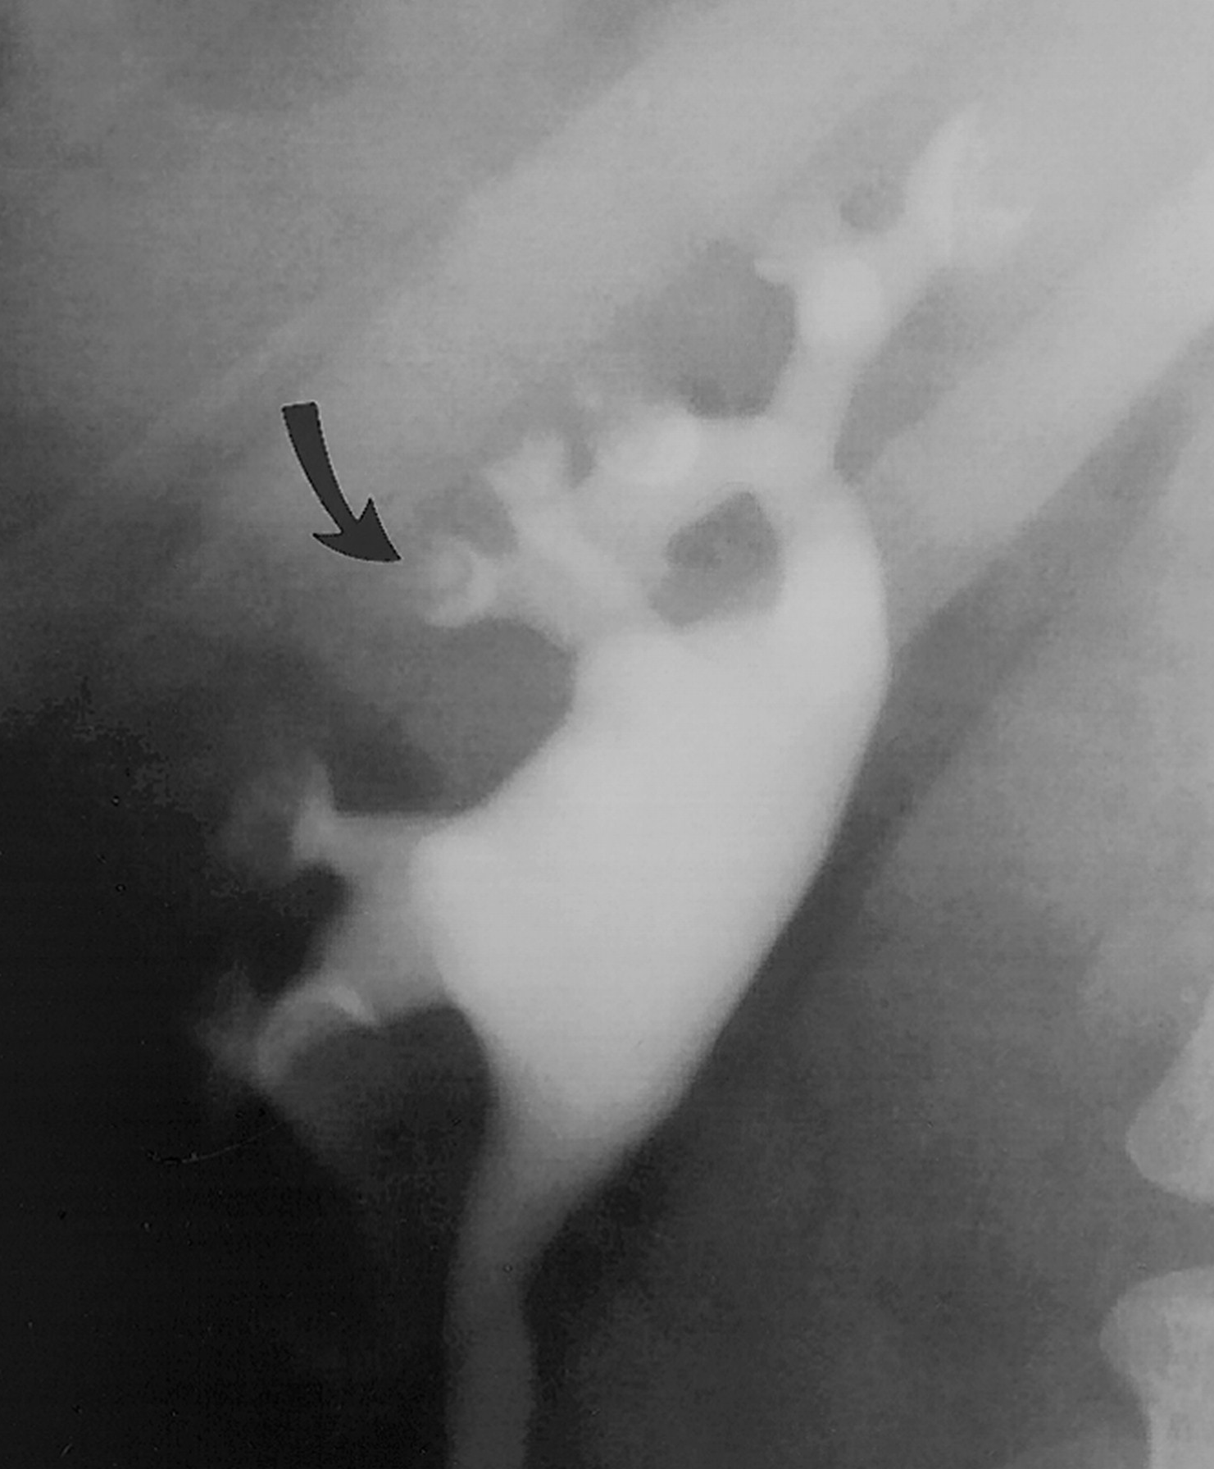
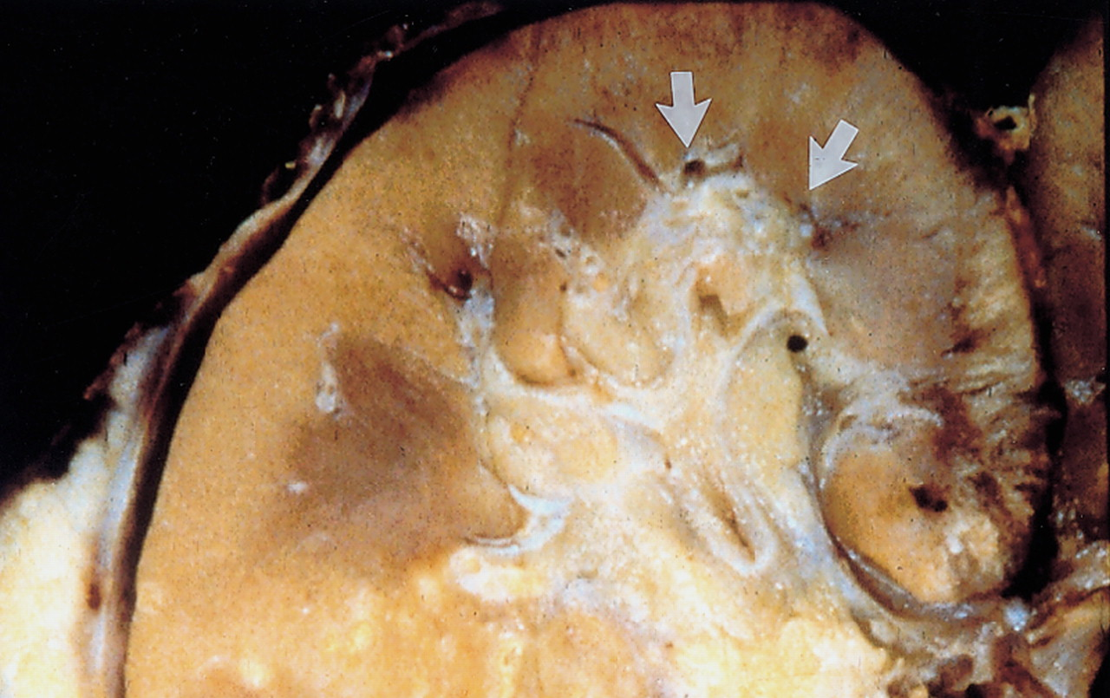
Papillary necrosis in SCA
Frontal view of kidney during excretory urography in a 32-year-old man with SCA shows a small, round collection of contrast material in a missing papillary tip (arrow)
Photograph of a kidney from a different patient shows loss of papillary tips in some upper pole pyramids (arrows).
Lonergan G J et al. Radiographics 2001;21:971-994

Slide 34
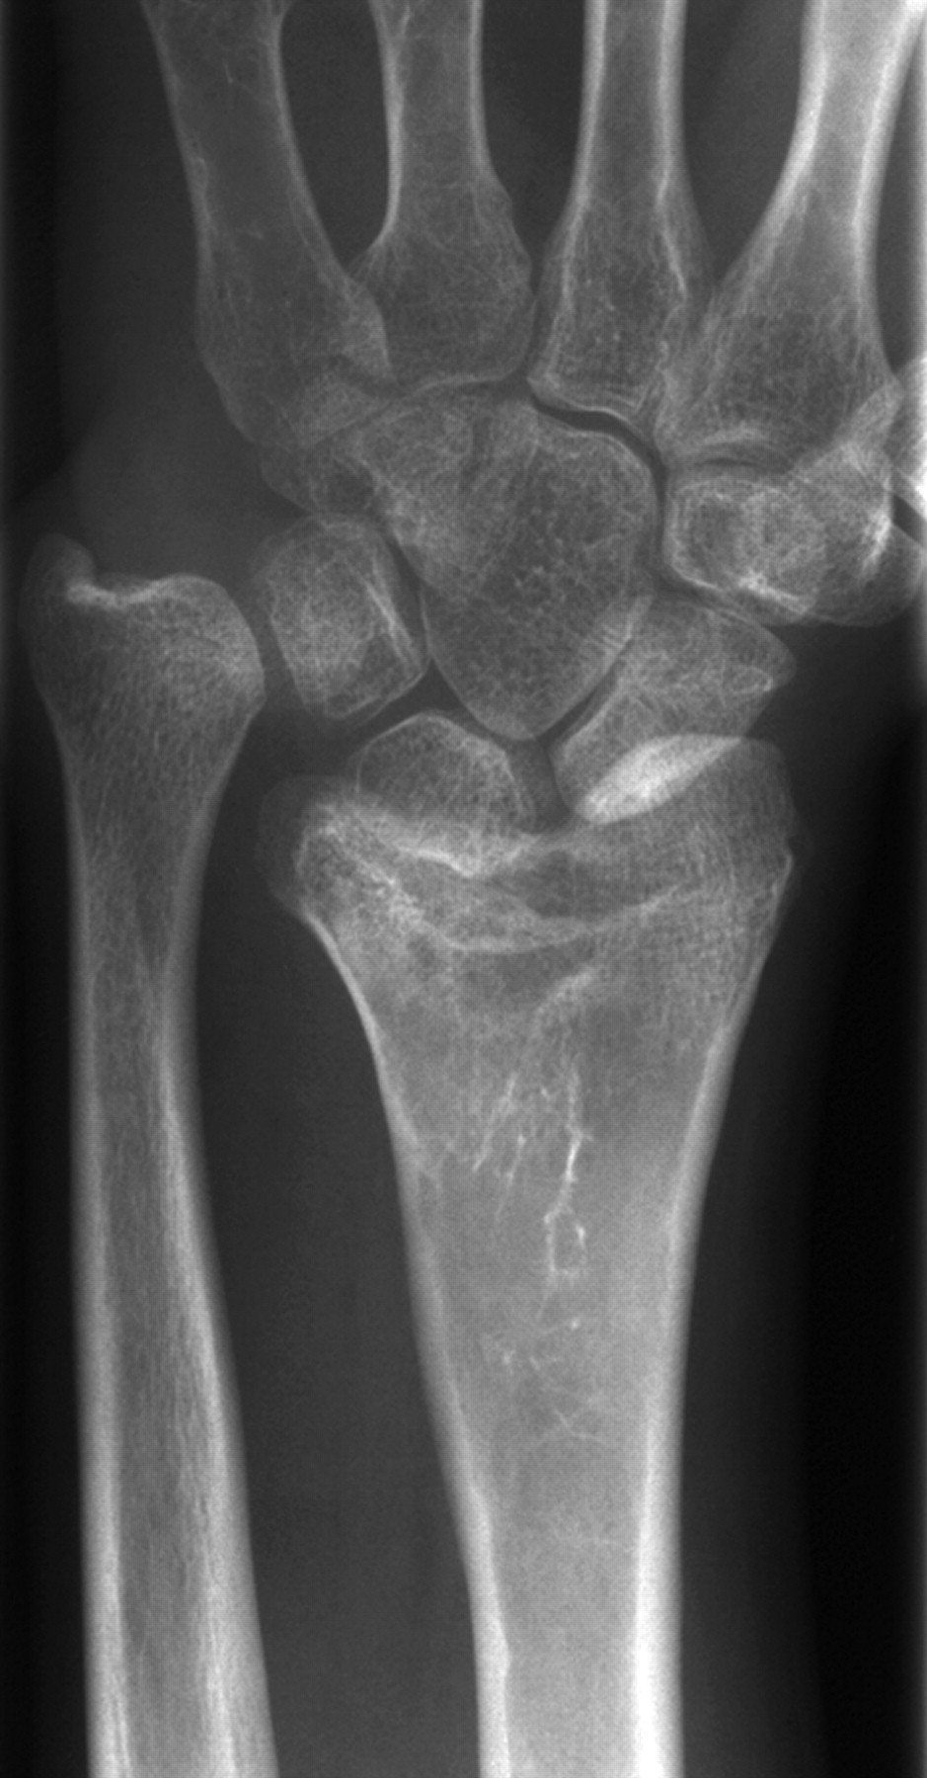
Growth disturbance in distal radius in a 12-year-old girl
Anteroposterior (AP) radiograph of left wrist shows epiphyseal shortening and a cup deformity of adjacent metaphysis.
Also changes of old bone infarct in distal radius.
Ejindu V C et al. Radiographics 2007;27:1005-1021

Slide 35
LYMPHOMA

Slide 36
Hodgkin’s Disease
Lymphocytic predominance
Mixed cellularity
Lymphocytic depletion
Nodular sclerosis - the most common
Non Hodgkin’s Lymphoma
Burkitt lymphoma (jaw and abdomen)
Burkitt-like lymphomas (abdomen and nodes)
Large B-cell lymphomas (abdomen and nodes)
Lymphoblastic lymphoma (Mediastinum, nodes, bone marrow)
Anaplastic large cell lymphoma (Nodes, skin, soft tissue, bone)
Other peripheral T-cell lymphomas
MALT lymphoma
Lymphoma can present as mass anywhere in the body
Toma P et al. Radiographics 2007;27:1335-1354

Slide 37
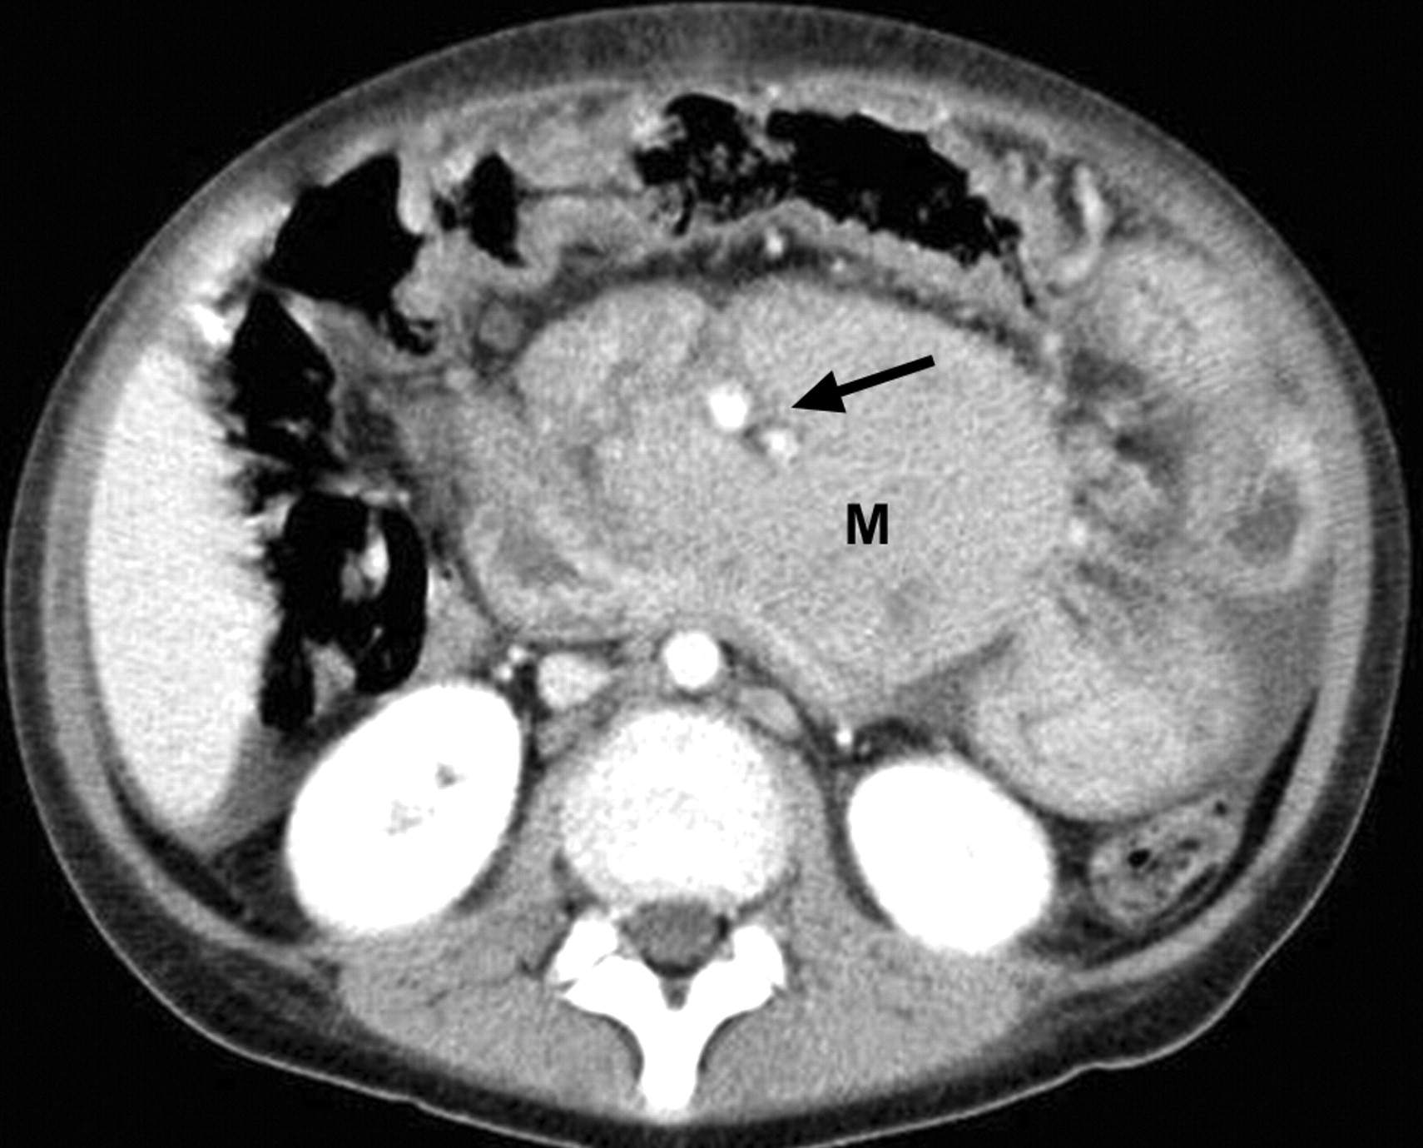
NHL in an 11-year-old boy.
Axial CT scan shows a large lymphomatous mass (M) encasing the mesenteric vessels (arrow)
Toma P et al. Radiographics 2007;27:1335-1354

Slide 38
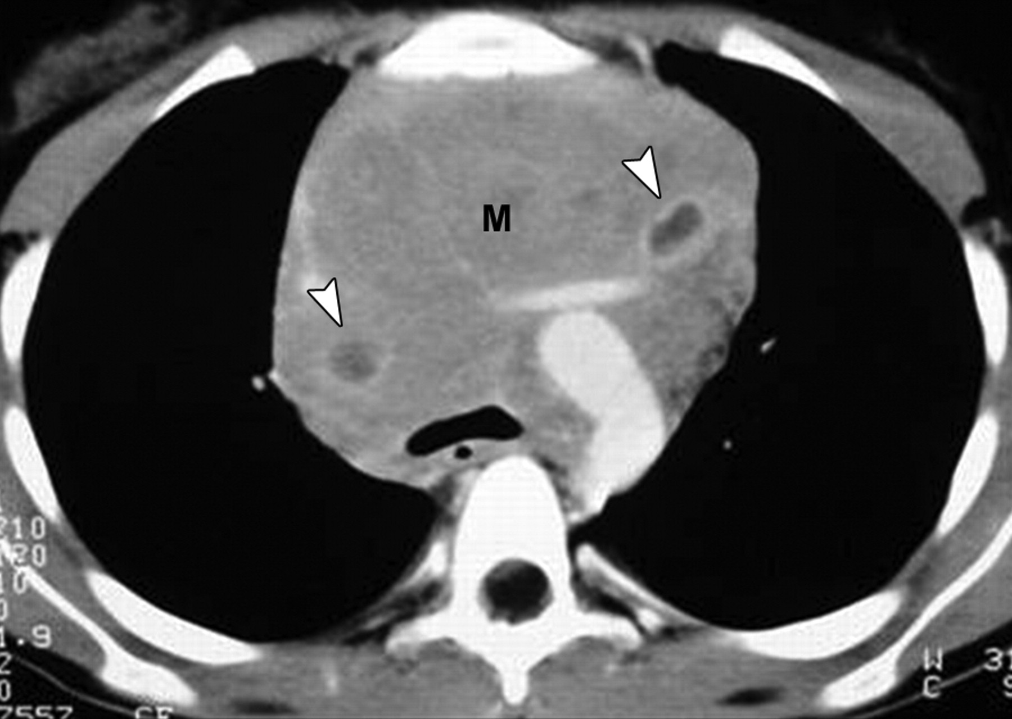
NHL in a 14-year-old boy. Contrast-enhanced CT scan shows a large anterior mediastinal mass (M) that originates from thymus. A few cysts with central low attenuation and a peripheral enhancing ring are present (arrowheads).
Toma P et al. Radiographics 2007;27:1335-1354

Slide 39
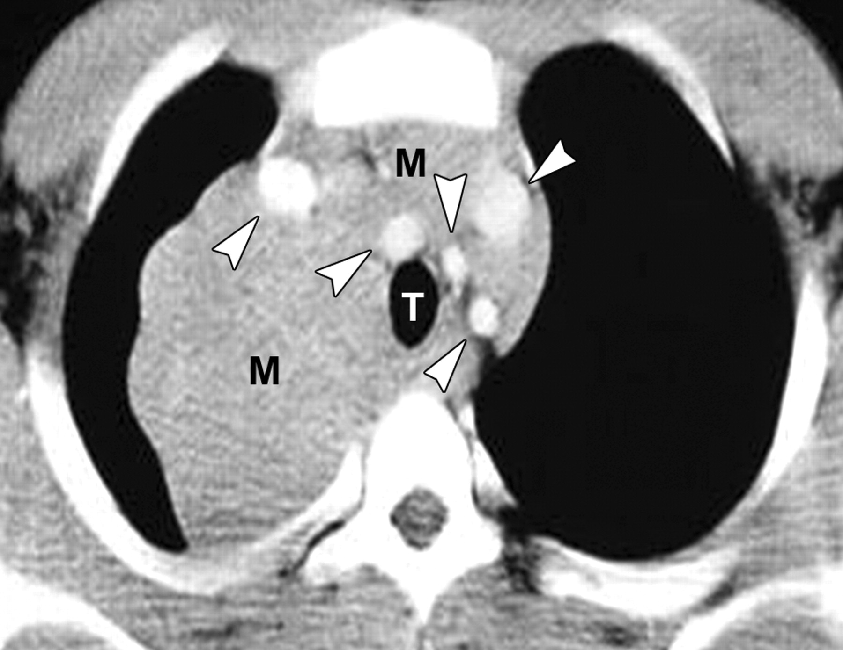
HD in a 17-year-old boy. Contrast-enhanced CT scan shows a large mediastinal mass (M). Trachea (T) is compressed, and great vessels (arrowheads) are displaced
Toma P et al. Radiographics 2007;27:1335-1354

Slide 40
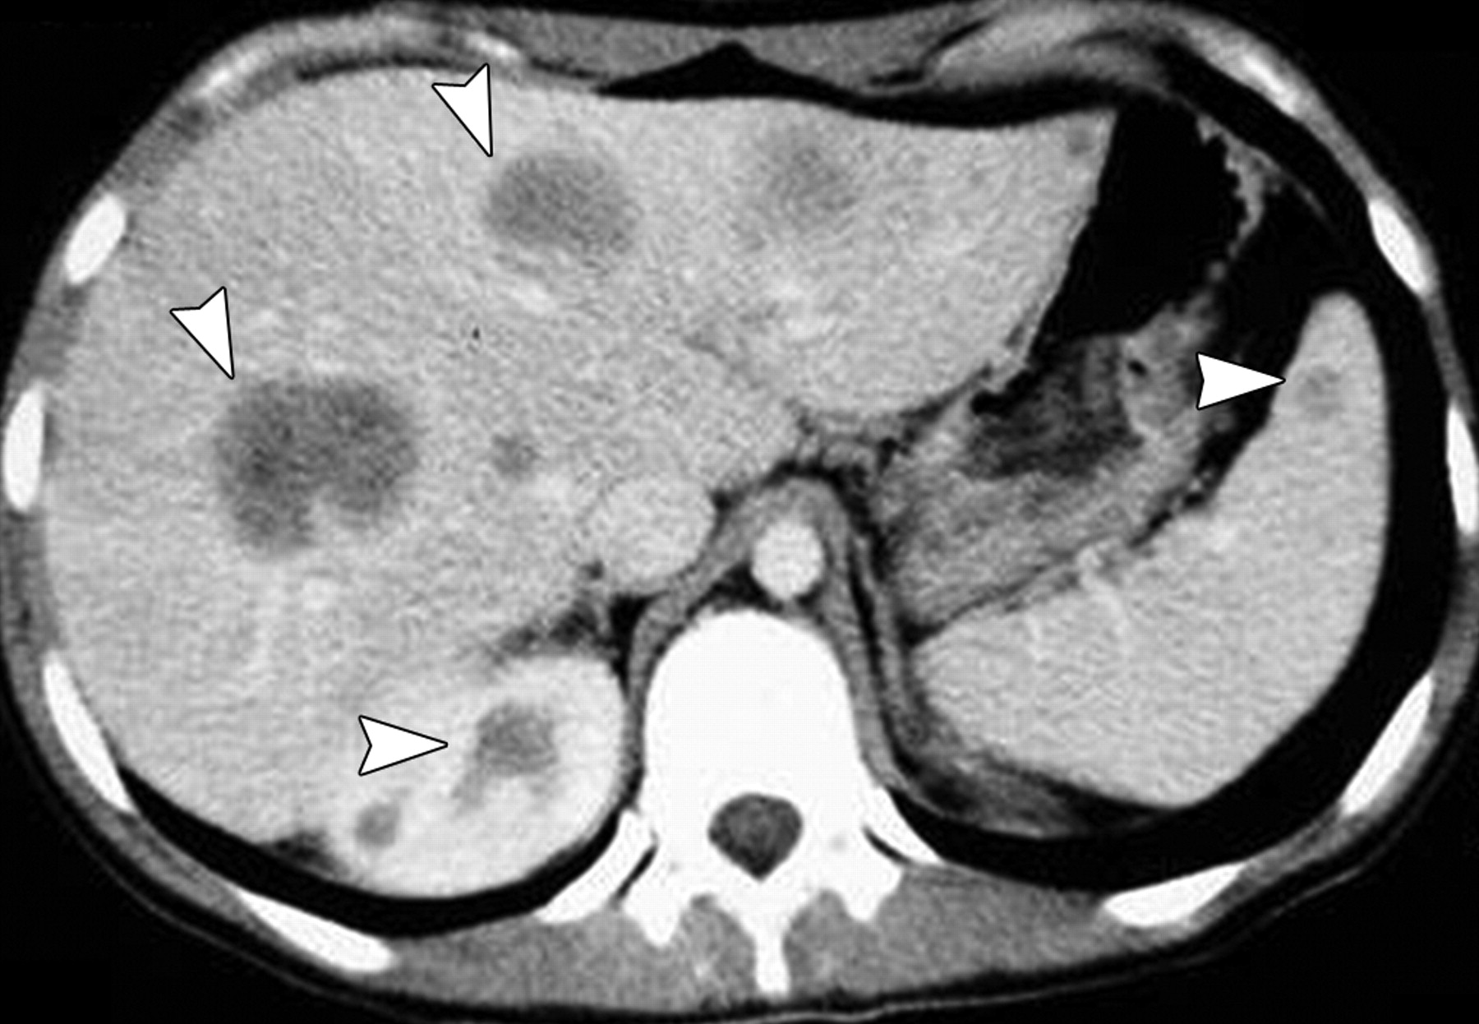
NHL in a 16-year-old girl. Contrast-enhanced CT scan shows low-density lesions (arrowheads) in both hepatic lobes, with small nodules in spleen and right kidney.
Toma P et al. Radiographics 2007;27:1335-1354

Slide 41
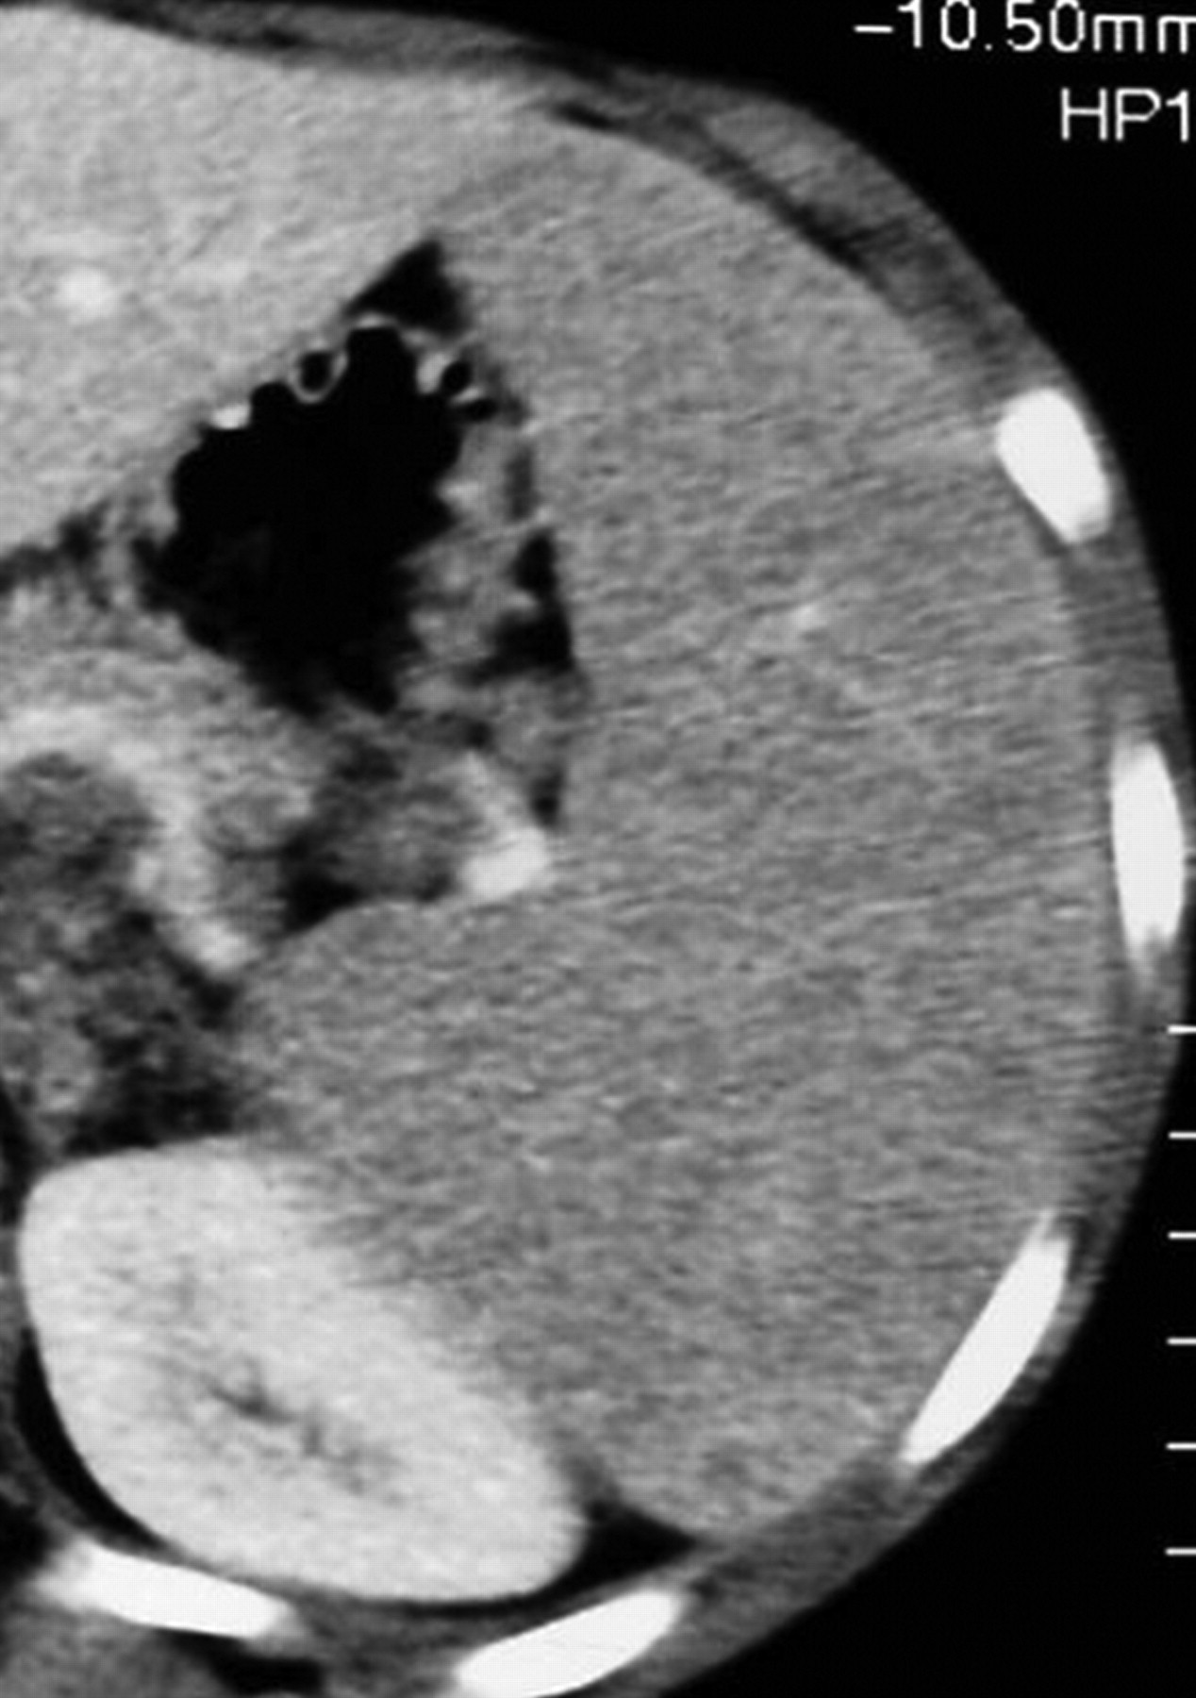
HD in a 12-year-old girl
Contrast-enhanced CT scan shows an enlarged spleen with a diffusely inhomogeneous appearance.
Toma P et al. Radiographics 2007;27:1335-1354

Slide 42
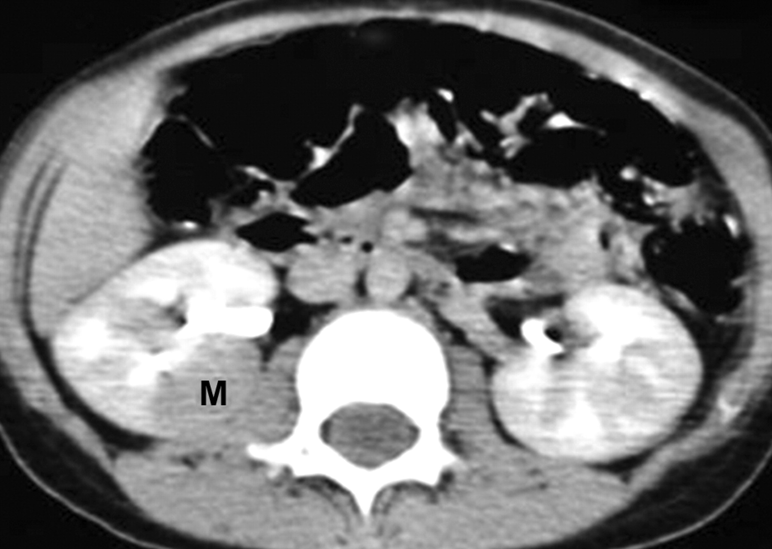
NHL in a 14-year-old boy. Contrast-enhanced CT scan shows single well-defined, hypoattenuating mass (M) in right kidney
Toma P et al. Radiographics 2007;27:1335-1354

Slide 43
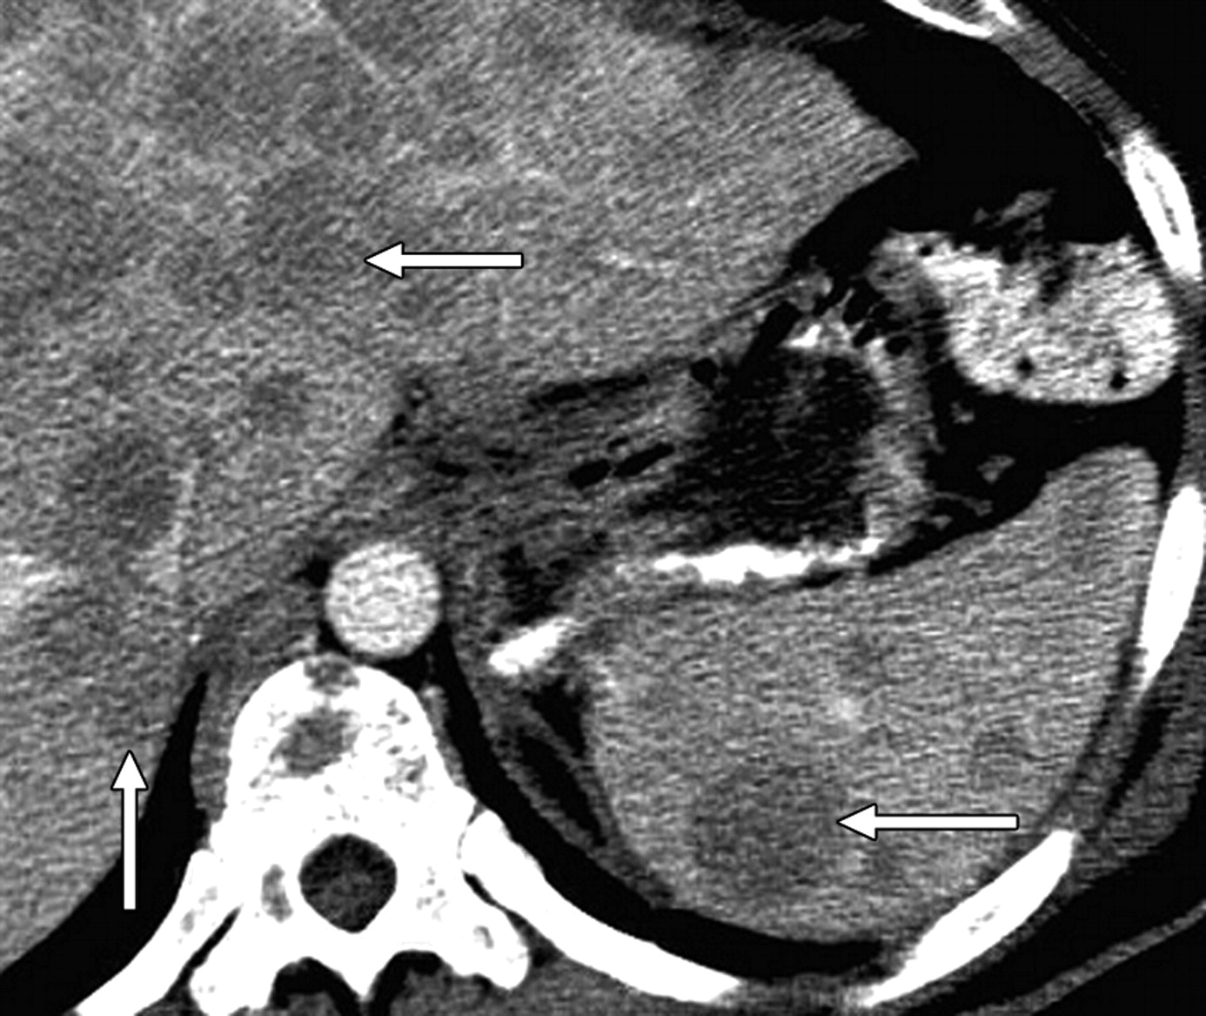
Diffuse hepatosplenic involvement in lymphoma
Axial CT scan shows multiple round, homogeneous, low density nodules (arrows) in liver and spleen
Leite N P et al. Radiographics 2007;27:1613-1634

Slide 44
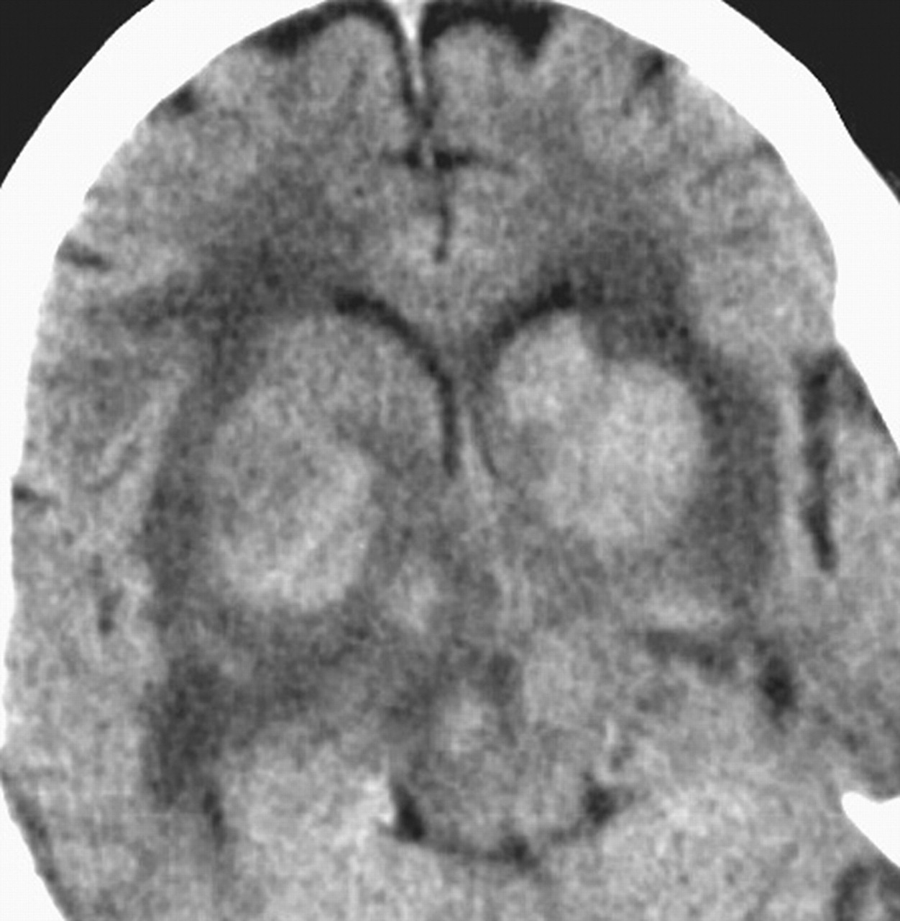
72-year-old immunocompetent woman with primary CNS non-Hodgkin's B-cell lymphoma
Unenhanced CT image shows classic hyperdense masses involving deep white and gray matter.
Slone H W et al. AJR 2005;184:1679-1685

Slide 45
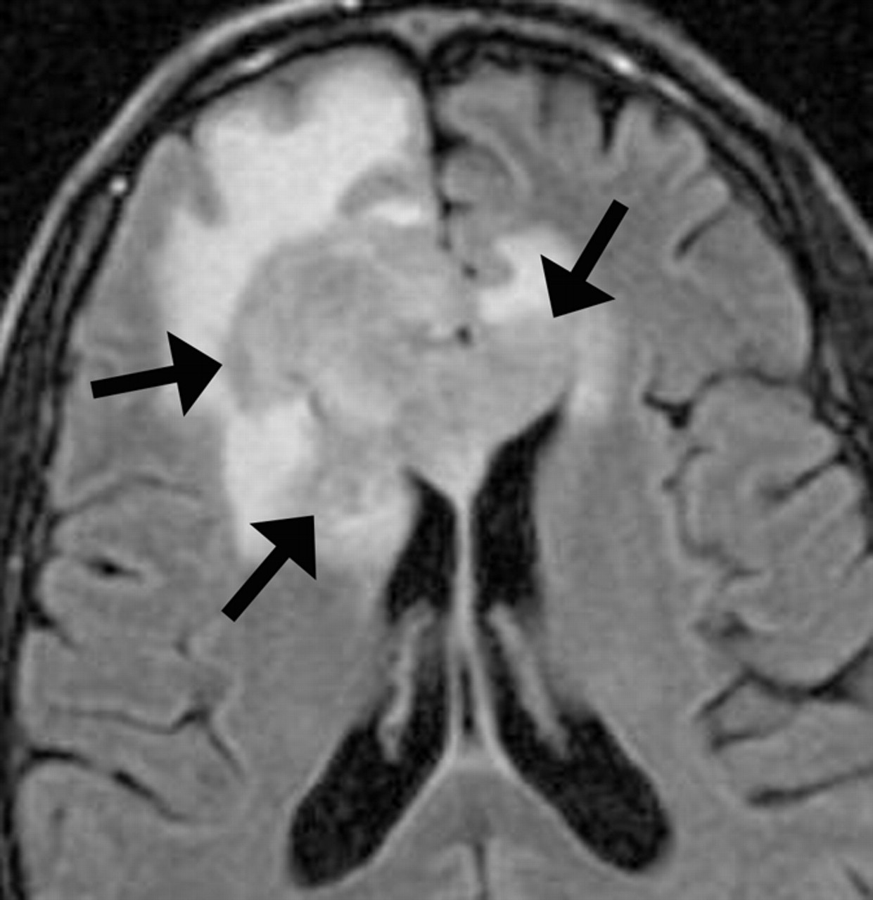
44-year-old HIV-positive woman with primary CNS non-Hodgkin's B-cell lymphoma
Axial FLAIR MRI shows lesion isointense to gray matter (arrows).
Slone H W et al. AJR 2005;184:1679-1685

Slide 46
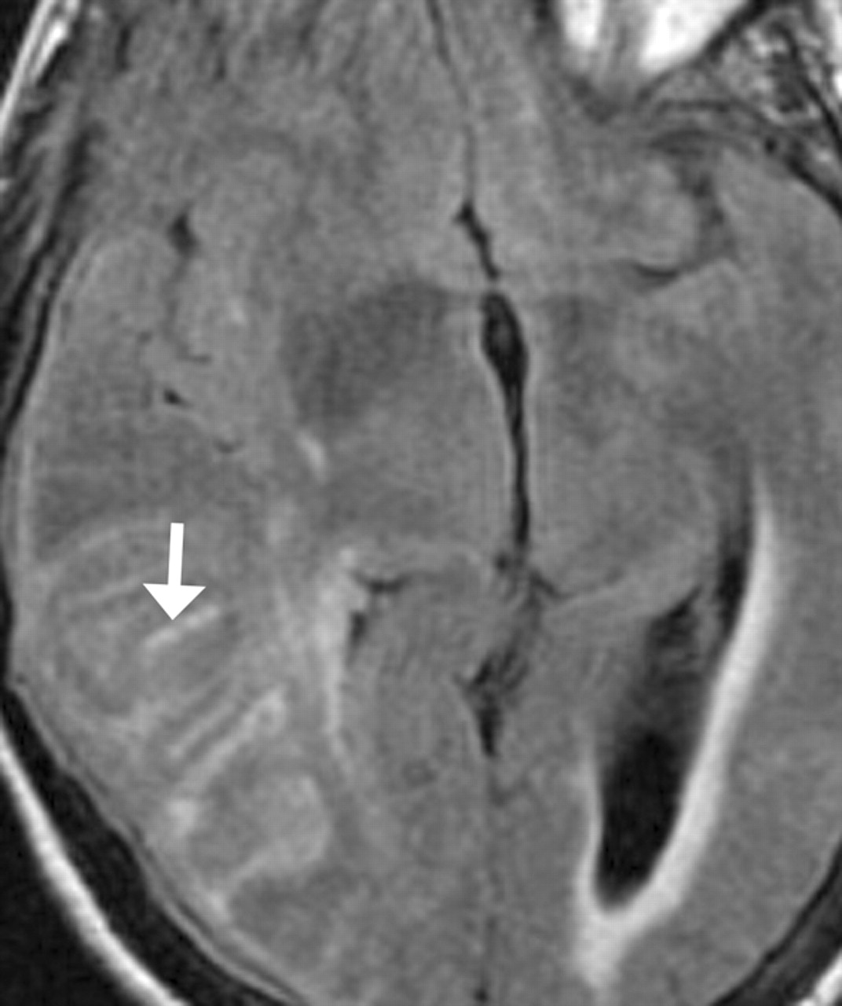
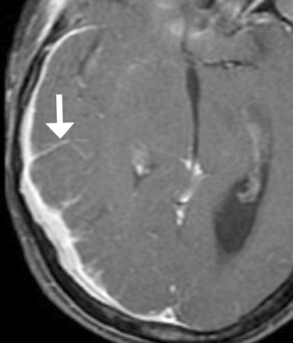
63-year-old woman with primary meningeal lymphoma
Axial FLAIR (left) and post contrast T1 weighted (right) MR images show hyperintensity and enhancement (arrows) involving sulci and leptomeninges
Slone H W et al. AJR 2005;184:1679-1685

Slide 47
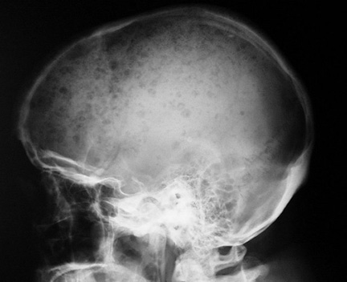
Lateral skull radiograph showing multiple very sharply outlined (punched out) lytic lesions of multiple myeloma

Slide 48
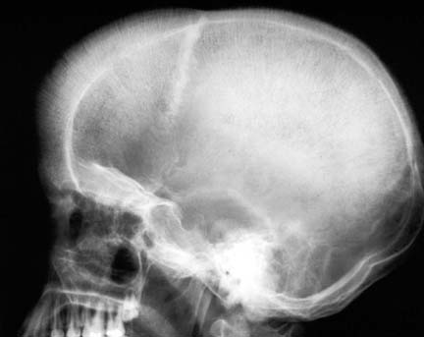
Findings shown here can be seen in
1. any severe chronic anemia
2. thalassemia
3. Sickle cell anemia
4. Lymphoma
5. Lymphoma

Slide 49
Findings shown here can be seen in
1. any severe chronic anemia
2. thalassemia
3. Sickle cell anemia
4. Lymphoma
5. Lymphoma

Slide 50
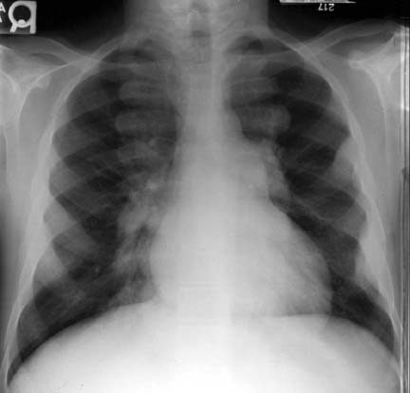
Findings shown here can be seen in
1. any severe chronic anemia
2. thalassemia
3. Sickle cell anemia
4. Lymphoma
5. Lymphoma

Slide 51
Findings shown here can be seen in
1. any severe chronic anemia
2. thalassemia
3. Sickle cell anemia
4. Lymphoma
5. Lymphoma

Slide 52
INTRA medullary hyperplasia can be seen in Thalassemia, Sickle cell anemia, Iron deficiency anemia, Any severe chronic anemia except bone marrow failure
Signs of INTRA medullary hyperplasia include
Expanded bone marrow in bones including long bones of hands, feet, limbs, skull
Decreased T1 MRI bone marrow signal than adjacent discs
EXTRA medullary hematopoiesis can be seen in ALL SEVERE CHRNIC ANEMIAS
Sites of EXTRA medullary hematopoiesis include Liver, Spleen, Paraspinal areas with possible extension into spinal canal outside the dura, Kidneys, Meninges, Skin, Lymph nodes, Thymus
EXTRA medullary hematopoiesis appears as homogeneous soft tissue masses on imaging
INFARCTS and INFECTIONS are additional findings in Sickle cell anemia
Bone infarct vs infection is important to diagnose early so that antibiotics can be started early to prevent complications. MRI with contrast and ultrasound /CT guided aspiration of fluid collections are very helpful if imaging is unable to differentiate these two
Multiple myeloma produces punched out lytic lesions in bones with background bone appearing normal. Opposite to bony metastases, myeloma more often involves intervertebral discs and mandible, and less often involves pedicles.
Lymphoma can produce a mass anywhere in the body. CT is often used to scan whole body to evaluate the disease extent (staging), and to do CT-guided biopsy to make tissue diagnosis if not already diagnosed. Rest is all by laboratory and clinical based.

Slide 53
THANKS

