Slide 1
Research Questions, Objectives & Hypotheses
Dr.Shaik Shaffi Ahamed
Associate Professor
Department of Family & Community Medicine

Slide 2
SESSION OBJECTIVES
Students will be able to
Learn formulation of research question
Differentiate between goals & objectives
Define the specific objectives in terms of the stated problem
Describe the study hypothesis

Slide 3
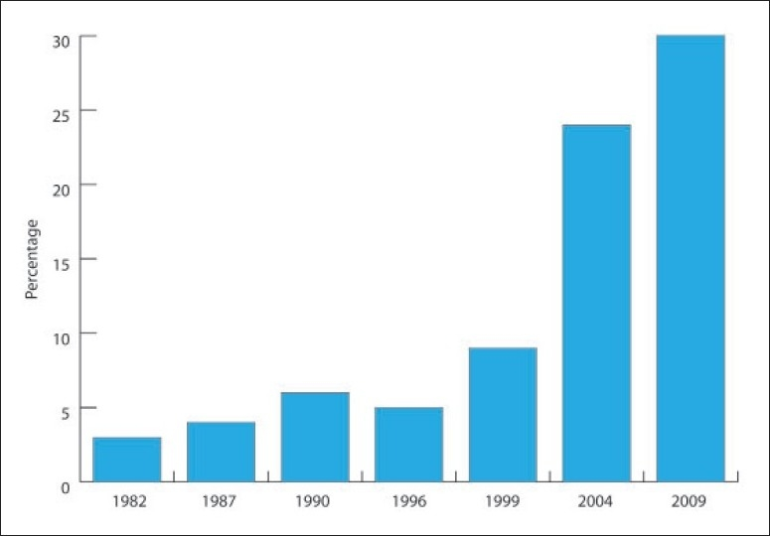
Ref: Prevalence of diabetes mellitus (DM) in a Saudi community.
Ann Saudi Med. 2011 Jan-Feb;31(1):19-23

Slide 4
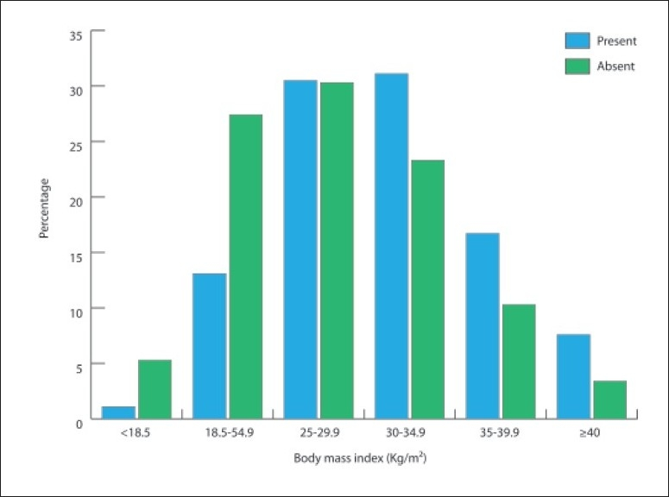
Prevalence of diabetes mellitus by age group in a Saudi community.
Ann Saudi Med. 2011 Jan-Feb;31(1):19-23

Slide 5
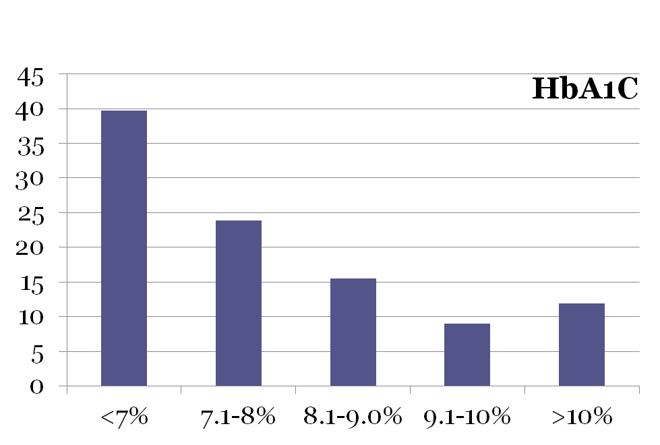
Glycemic control in diabetic patients KKUH January –December 2009 Al-Rowais NA Saudi Pharmaceutical Journal (2014) 22, 203-206
%
HbA1C < 7% is acceptable as adequate control

Slide 6
What research questions come to your mind?
Reduction in prevalence of DM?
Improvement in well controlled DM?
What other research questions can arise ?
All the stated responses will lead towards the goal of reducing the impact of DM in Saudi Arabia and each research question will be answered by stating clear objectives

Slide 7
Ask following questions initially
Do I have the time for this at this point during my course?
Is this really the burning topic for me?
Will this be worth it?
Is this a major and relevant public health problem or is it too esoteric?
Are my goals/objectives too big ? Am I covering too much?
Will available methods answer my questions?
What are the ethical and human subject issues here?

Slide 8
Research Question
A well-defined and specific research question is the key for making decisions about study design and population and subsequently what type of data will be collected and analyzed.

Slide 9
RESEARCH QUESTION
IT SHOULD BE A SINGLE SENTENCE IN THE FORM OF A QUESTION.
IT SHOULD BE CLEAR UNAMBIGUOUS AND SPECIFIC

Slide 10
How & from where to get ideas to formulate a Research Question ?
Be inspired by observing people & practices, by attending seminars, conferences, & symposia
Review local, national, and regional problems
Discuss, collaborate and get input from your colleagues
Read about the topic, reviews, & research done; to find out gaps in existing knowledge?

Slide 11
REQUIREMENTS
What are the items required to support feasibility of my research question ?
Your background knowledge reflects in the question
Background information (critical appraisal) stated in intro/background section

Slide 12
Subject knowledge
Familiarity with the subject helps define an appropriate research question for a study.
Questions arise out of a perceived knowledge deficit within a subject area or field of study. (pathways of current knowledge and uncertainty )
The challenge in developing an appropriate research question is in determining which uncertainties could or should be studied and also rationalizing the need for their investigation.

Slide 13
Types of Research Questions
Descriptive: describing a group, exploring
Relational: associations between two variables in a group
Comparable: associations between two or more variables in two or more groups (Causality / prediction / intervention)

Slide 14
RESEARCH QUESTIONS(examples)
What is the level of knowledge of “Biostatistics” among 3rd year medical students ?
Is drug “A” better than drug “B” in the management of hepatic failure in patients with Cirrosis?
Is alcoholism related to the development of Cirrosis liver?

Slide 15
Relational & Comparable
Is concentration of blood cholesterol directly related to dietary intake of saturated fat in Saudi population?
(hereditary?/ dietary/ metabolic ? Reasons in Saudi Population could differ from other settings)
Does daily saturated fat intake by persons with hypercholesterolemia differ from persons with normal cholesterol range in Saudi population ?
(physical activity is in the pathway?)

Slide 16
Evaluation of Research Question
How good and appropriate is the idea ?
Critique appropriateness of your Question
Merit of your question
Relationship of proposal to problem

Slide 17
GOOD RESEARCH QUESTION
Feasible:
Logical:
Novel:
Ethical:
Relevant:

Slide 18
FINER criteria: a good research question
F Feasible
• Adequate number of subjects • Adequate technical expertise
• Affordable in time and money • Manageable in scope
I Interesting
• Getting the answer intrigues investigator, peers & community
N Novel
• Confirms, refutes or extends previous findings
E Ethical
• Amenable to a study that institutional review board (IRB) will approve
R Relevant
• To scientific knowledge • To clinical and health policy
• To future research

Slide 19
Goals and Objectives
Goals
Objectives
=

Slide 20
Goals
It describes the aim of the work in broad terms ( over a longer time period)

Slide 21
Objectives
These are more specific and relate directly to research question. They may be divided into two types:
Primary objectives → (bound to be achieved)
Secondary objectives → (by the way)

Slide 22
Research Goal & Objectives
The goal (aim) and objectives must be stated at the very beginning of the study, since they will guide the investigator during the process of formulating research questions and hypothesis.
They will also help in the prioritization process.
They will enable the reader or consumer of the work to judge whether the investigator had achieved these objectives or not.

Slide 23
Research Objectives
The research objectives should be:
Closely related to the research question
Covering all aspects of the problem
Very specific
Ordered in a logical sequence
Stated in action verbs that could be evaluated e.g. to describe, to identify, to measure, to compare, etc.
Achievable, taking into consideration the available resources and time
Mutually exclusive, with no repetitions or overlaps

Slide 24
SMART Objectives
S Specific
M Measurable
A Achievable
R Relevant
T Time-bound

Slide 25
Research objectives
Properly formulated, specific objectives will facilitate the development of your research methodology and will help to orient the collection, analysis, interpretation and utilization of data.

Slide 26
Objective -examples
To study whether SNP markers are
associated with obesity and hypertension phenotypes.
To assess the general population knowledge & attitude towards Organ donation
To identify the risk factors for Type-II diabetes

Slide 27
Example
Goal: To reduce risk of cardiovascular diseases in Saudi population by developing evidence based
interventions
Question: Is dietary intake of saturated fats over the past xx weeks related to hypercholestrolemia in Saudi adult population ?
Question: Is dietary intake of saturated fats over a period of xx months is associated with risk of coronary heart disease in Saudi adult population

Slide 28
Example contd.
Specific Objective1: To determine the daily intake of saturated fats in the past 4 weeks in Saudi adults
Specific Objective 2: To determine the relationship of dietary intake of saturated fats and blood levels of low density lipoprotein (LDL) in Saudi adults
Specific Objective3: To determine the association of dietary intake of saturated fats and intimal thickness of coronary artery in Saudi adults

Slide 29
Research Hypothesis
“ Research hypothesis is a statement of the research question in a measurable form”

Slide 30
Research Hypothesis (cont.)
A hypothesis can be defined as a prediction or explanation of the relationship between one or more independent variables (PREDISPOSING/RISK FACTORS) and one dependent variable (OUTCOME/CONDITION/DISEASE)).
A hypothesis, in other words, translates the problem statement into a precise, clear prediction of expected outcomes.
It must be emphasized that hypotheses are not meant to be haphazard guesses, but should reflect the depth of knowledge, imagination and experience of the investigator.

Slide 31
Hypothesis formulation
This is based on existing knowledge, deriving it through critical reading of literature and facts
Descriptive:
It is hypothesized that average daily intake of saturated fat in Saudi adult population is more than 20% of the recommended intake when measured by xxx test and yyy standards to define dietary saturated fat intake.

Slide 32
Hypothesis formulation
Specific Objective: To determine the relationship of dietary intake of saturated fats and intimal thickness of coronary artery
Hypothesis
It is hypothesized that > 20% of recommended saturated fat intake in Saudi population will be associated with 50% increased intimal thickness of coronary artery when compared to the normal intimal thickness measured by XYZ

Slide 33
Hypothesis-examples
• We hypothesize that standard care plus new intervention
(additional drug) will be superior to standard care alone in
reducing CVD mortality among patients with preexisting
heart disease.
• We hypothesize that prophylaxis with inhaled
drug A will be superior to oral preparation of
drug B in preventing acute exacerbation of
reactive airway disease.
• We hypothesize that low birth weight is an
independent risk factor for type II diabetes.

Slide 34
Example 1: (KAP Study)
Area: Family medicine
Topic: communicable diseases- hepatitis
Goal: to contribute to the reduction of hepatitis in KSA through studying public perceptions about the disease
Objective: To assess the awareness, knowledge, and attitudes of the general public towards hepatitis in KSA.
Hypothesis: It is hypothesized that the awareness, knowledge and attitudes of the general public towards hepatitis in KSA is less than 50%.

Slide 35
Example 2: (Interventional Study)
Research area: cardiology
Research topic: ischemic heart disease (IHD)
Goal: to contribute to prevention of IHD
Research question: does hypocholesterolemic agent “A” decrease the risk of MI?
Primary objective: to determine the effect of reducing LDL on the occurrence of MI
Secondary objective: to describe the side effects of lowering LDL
Research hypothesis: the risk of MI among patients treated with hypocholesterolemic agent “A” is lower than the risk among patients not treated with hypocholesterolemic agents

Slide 36
Summary
Perform a systematic literature review to increase knowledge for the topic
Learn about current trends and technological advances on the topic.
Seek careful input from experts, mentors, colleagues and collaborators
Use the FINER criteria in the development of the research question.
Develop clear and well-defined objectives using SMART criteria
Ensure that the research question and objectives are answerable, feasible and relevant.
Develop the testable research hypotheses from the research question.

Slide 37
References
Stephen B Hulley. Designing Clinical Research. 3rd Edition . Wolters Kluwer Health Lippincott Williams and Wilkins 2007
Daniel P Schuster & William J Powers. Translational and Experimental Clinical Research. Introduction: Lippincott Williams and Wilkins 2005

