Slide 1
Cohort Studies
Dr. Amna Rehana Siddiqui & Prof Awatif Alam Prof Ashry Gad
Department of Family & Community Medicine
September 2014

Slide 2
Learning Objectives
To describe the types of Cohort Study designs with their advantages and disadvantages
Calculate and interpret
Risk : incidence in exposed and unexposed groups
Relative Risk as measure of Association
Attributable Risk as an estimate for prevention

Slide 3
Types of Study Designs
Design | Study Type
Case report | Observational - Descriptive
Case series | Observational - Descriptive
Cross sectional | Observational - Descriptive/Analytic
Case control | Observational - Analytic
Cohort | Observational - Analytic
Clinical trial | Experimental - Analytic

Slide 4
What is a risk ?
Risk is the possibility of harm
Risk is the likelihood of an individual developing a disease/problem
In epidemiology risk is the likelihood of an
individual in a defined population developing a
disease or other adverse health problem

Slide 5
What is a risk ?
A risk factor is a characteristic associated with disease.
Measure risk and investigate that how this compares with other populations (relative measures) who do not have the defined risk.
The association between risk of disease ( individual
and social characteristics ~ risk factors) is often the
starting point for causal analysis

Slide 6
Population at risk
All women
(age groups)
Total population
Population at risk
0-25
years
Men
Women
25-69
years
25-69
years
70+
years
Eg. Population at risk in a study of carcinoma of cervix

Slide 7
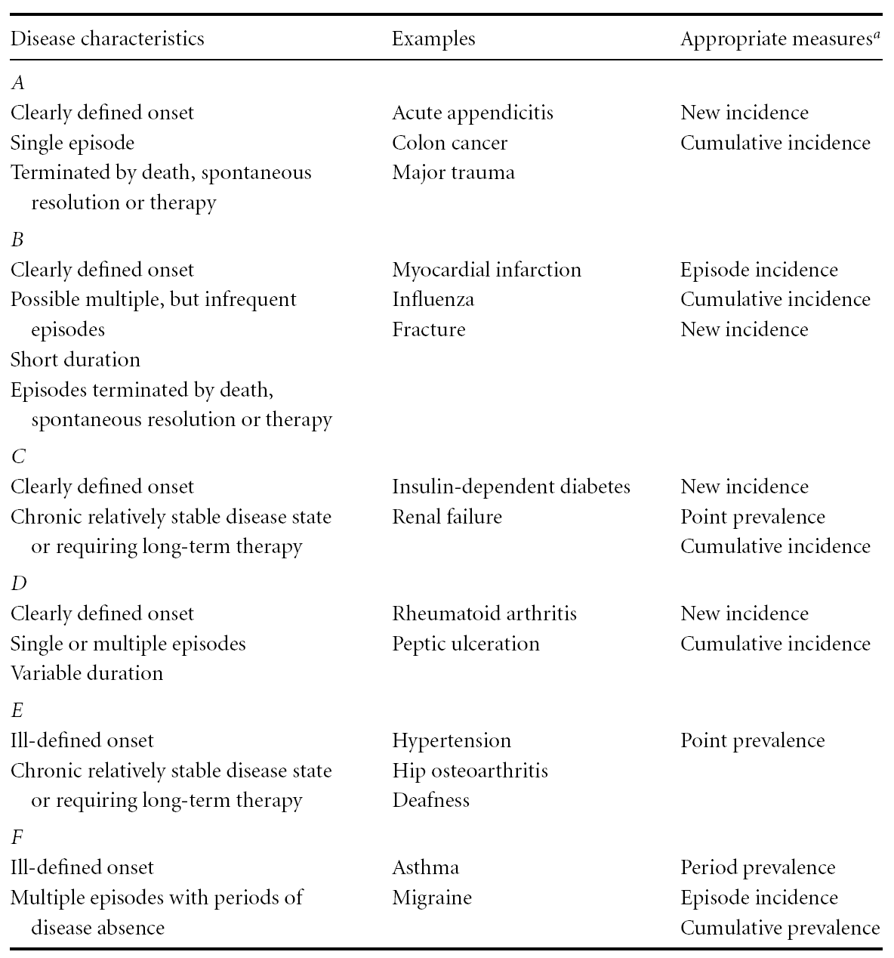
Appropriate Measure of Disease Occurrence

Slide 8
Basic Question in Analytic Epidemiology
Are exposure and disease linked?
Direction of inquiry in cohort study
E
D
Exposure
Risks e.g.
Tobacco chewing
Disease (outcome)
e.g. Myocardial
Infarction (MI)

Slide 9
Design of Cohort Studies What is a cohort ?
Cohort: group of individual with a common characteristic who are followed over a period of time e.g. A smoker’s cohort means all are smokers in that group
Selection of cohorts based on exposed and unexposed individuals to follow in specified time or until development of outcome (disease/death)

Slide 10
Cohort study design
A cohort, which is exposed to a suspected factor but not yet developed the disease, is observed and followed over time.
The incidence of the disease is measured directly in the two groups one exposed to a risk factor and other not exposed and then incidence rates are compared

Slide 11
Measuring occurrence of disease
Comparison of incidence proportion in both groups
Conceptually longitudinal to determine possible causal association between risk (exposure) and disease (outcome)

Slide 12
Design of a COHORT Study
EXPOSED
NOT EXPOSED
DEVELOP
DISEASE
DO NOT
DEVELOP DISEASE
DEVELOP
DISEASE
DO NOT
DEVELOP
DISEASE

Slide 13
Cohort Study (Prospective)
Disease occurs
Exposed
No disease
Disease occurs
Unexposed
No disease
2011 Present
Future time

Slide 14
Cohort Study (Retrospective)
Disease occurs
Exposed
No disease
Disease occurs
Unexposed
No disease
Examine exposure in medical records /census/available data
1995 Past
Present 2011

Slide 15
Defined population
2011 Current time
Data from 1995/
Retrospective
Prospective
NON-randomized
EXPOSED
NOT EXPOSED
Current time 2011
2025
DEVELOP
DISEASE
DO NOT
DEVELOP DISEASE
DEVELOP
DISEASE
DO NOT
DEVELOP
DISEASE
Designs of a COHORT Study

Slide 16
The Framingham Study
Began in 1948 for Cardiovascular disease
A small town 20 miles from Boston in Massachusetts, USA
Population under 30,000
Participants between 30-62 years of age
Follow up for 20 years
Sample size of 5000
Other famous cohorts include; British Physicians Cohort UK; Nurses Health Study USA,
Women Health Initiative (WHI), Study of women across the nation (SWAN) in USA

Slide 17
Framingham Study Exposures Outcome
Smoking
Obesity
Elevated blood pressure
Elevated Cholesterol levels
Physical activity
New Coronary events determined by
-Daily surveillance
-Examination / 2 years

Slide 18
Nurses Health Study
Nurses' Health Study, a large cohort study involving over121,700 women, who enrolled in 1976 from eleven states of USA; using a questionnaire in mail every two years to determine
Exposure
Biological
Demographic
Hormonal
Lifestyle
Nutritional and
Other risk factors.
Outcomes in
Chronic diseases,
Cancer in general
Cancers related to female reproductive tract

Slide 19
It is the best observational study design.
Why?
The investigator proceeds from “E to D” i.e. from cause to effect so he will not face a chicken egg dilemma and the temporal (time) sequence between E and D can be clearly established.
It uses a control group to accept or reject the hypothesis between E and D.

Slide 20
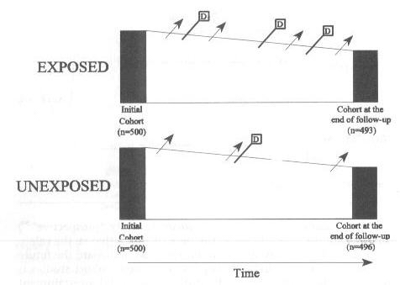
Measuring Association in a Cohort
Follow up in time of two groups defined by exposure status within a cohort or
Follow up of two cohorts defined by exposure
D=Death

Slide 21
Analysis:
The basic analysis involves:
Calculation of incidence rates among the exposed
Calculation of incidence rates among the non-exposed
Incidence rate is expressed per unit time as: xx/100/Time , xx/1000/Time , xx/10000/Time
or in person time denominator

Slide 22
Frame work of Analysis
Total | Outcome
 | Not diseased | Diseased
a + b c + d | b d | a c | Exposed Non-exposed
Incidence
(a/a+b)
(c/c+d )
Ascertain whether there is a significant statistical association between exposure and disease.
Calculate chi-square or Z- test.

Slide 23
Relative risk (RR)
Diseased Not diseased
Exposed a b
Unexposed c d
RR = Incidence in exposed = a/a+b
Incidence in unexposed c/c+d
If causal association what is expected ?
What does RR=1 means ?

Slide 24
Cohort Studies: Causal Association
Onset of study
Time
Eligible subjects
Disease
Exposed
No Disease
Disease
Unexposed
No Disease
Direction of inquiry

Slide 25
Interpretation of Relative Risk (RR)
RR=1: No association between exposure and disease
incidence rates are identical between groups
RR> 1: Positive association (increased risk in exposed)
exposed group has higher incidence than unexposed group
RR< 1: Negative association (protective effect in exposed)
unexposed group has higher incidence than exposed group

Slide 26
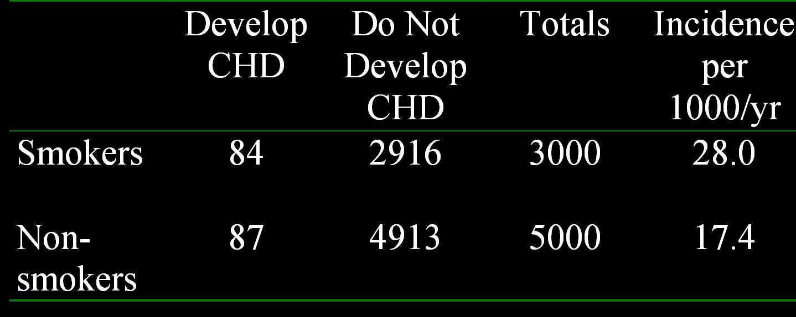
Example 1: Relative Risk Calculation
Incidence in smokers = 84/3000 = 28.0/1000/yr
Incidence in non-smokers = 87/5000 = 17.4/1000/yr
Relative risk = 28.0/17.4 = 1.61

Slide 27
Example 2: Consider smoking & Coronary heart disease (CHD)
in a population where we have data for exposure and outcome
CHD in
smokers
30%
CHD in
Non-smokers
15%
30/100 – 15/100 = 15/100 CHD risk is attributable to smoking
RR of CHD is twice more in smokers than in non smokers (0.30/0.15=2)

Slide 28
Attributable Risk (AR) and Attributable Risk Fraction (ARF)
The Incidence of disease in the Exposed population whose disease can be attributed to the exposure.
AR=I _{e} –I _{u}
The proportion (fraction) of disease in the exposed population whose disease can be attributed to the exposure.
AR= (I _{e} –I _{u} )/I _{e}
I=Incidence. e= exposed, u=unexposed

Slide 29
Attributable Risk
Attributable risk in exposed (Example 1)
= (28-17.4) / 1000 =10.6/1000
10.6 of the 28/1000 are attributable to smoking
Attributable risk % = (28-17.4) / 28
= 10.6/28
= 0.379 = 37.9% ~ 40%

Slide 30
Women Health Initiative Cohort
Exposure Heavy Physical Activity at age 35 years | Developed Cancer Breast | Did not develop Cancer Breast | Total | Incidence
Yes | a 687 | b 31107 | a+b | a/a+b
No | c 1032 | d 38475 | c+d | c/c+d
RR= Calculate Incidence in exposed / Incidence in unexposed

Slide 31
Women Health Initiative Cohort
Exposure Heavy Physical Activity at age 35 years | Developed Cancer Breast | Did not develop Cancer Breast | Total | Incidence
Yes | a 687 | b 31107 | a+b 31794 | a/a+b 0.021
No | c 1032 | d 38475 | c+d 39507 | c/c+d 0.026
RR= Calculate Incidence in exposed / Incidence in unexposed

Slide 32
Women Health Initiative Cohort
Exposure Heavy Physical Activity at age 35 years | Developed Cancer Breast | Did not develop Cancer Breast | Total | Incidence
No | a 1032 | b 38475 | a+b 39507 | a/a+b 0.026
Yes | c 687 | d 31107 | c+d 31794 | c/c+d 0.021
RR= 0.26/0.21 = 1.24
Note how exposure is defined/whether No/Yes to exercise; if yes what will be RR ? (Hint: it will be protective and less than 1)

Slide 33
Potential Biases in Cohort Studies
Non response
Loss to follow up with time
Measurement errors in exposure

Slide 34
Advantages of cohort studies:
Valuable in rare exposures.
Can study multiple outcomes of a single exposure / risk factor.
Exposure happened before outcome (Temporality)
Can calculate incidence rates.
Can quantify Risk, Relative risk, & Attributable Risk
Dose response ratio can be calculated between exposure and disease and other outcomes.
Low potential for bias than case-control study
Can establish a natural history of disease when not known

Slide 35
Disadvantages of cohort studies:
Attrition (loss to follow up) may affect validity of results.
Measurement errors, multiple interviews, tests
Involve a large sample
Inefficient for evaluation of rare diseases.
Takes a long time.
Expensive.

Slide 36
Summary
Cohort studies are observational in nature and are useful in comparing risks in subgroups of populations within a specific time frame
Availability of data from previous years can lead to less expensive estimates for Risk, RR, and AR, using a retrospective cohort study
Prospective Cohort studies are expensive in time and resources, in addition to estimates of Risk, RR and AR , provide a causal link between risk factors and disease/other outcomes e.g. cancer.

Slide 37
Reference book & page number for the lecture resource
Epidemiology by Leon Gordis. 3rd Edition.
Elselvier & Saunders 2004
-Chapter 9 Cohort studies: pages 149-158.
- Chapter 12 More on Risk : Estimating the Potential for prevention: pages 191-193

