Slide 1
Comparison of Male (between Group A & Group B)

Slide 4
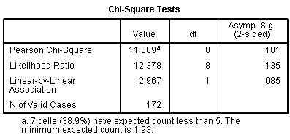

Slide 5
Comparison between male and female students

Slide 8
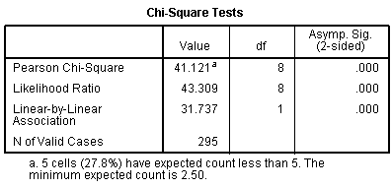

Slide 9
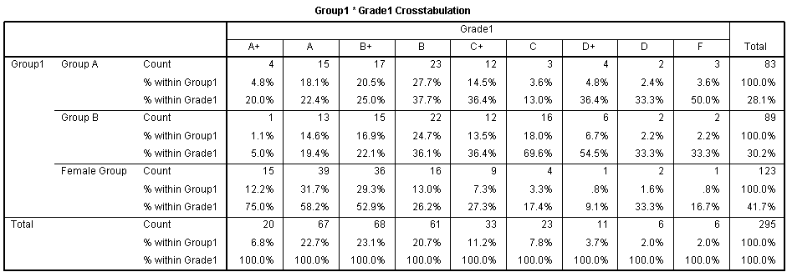

Slide 10
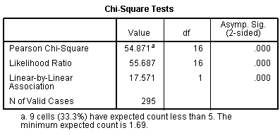

Slide 11
Comparison between Group-A male students and Female students

Slide 14
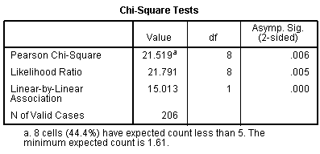

Slide 15
Comparison between Group-B male students and Female students

Slide 18
