Slide 1
Inflammatory Bowel Disease
An Introduction To

Slide 2
Inflammatory Bowel Disease
Outline
What is the Disease?
Epidemiology
Pathophysiology
Ulcerative Colitis
Crohn’s Disease

Slide 3
Inflammatory Bowel Disease
Two chronic diseases that cause ulceration & inflammation of the intestines
Ulcerative Colitis
Crohn's Disease.

Slide 4
Inflammatory Bowel Disease
Two chronic diseases that cause ulceration & inflammation of the intestines
They have some features in common but there are some important differences
20% of patients have clinical picture that falls in between (indeterminate colitis)

Slide 5
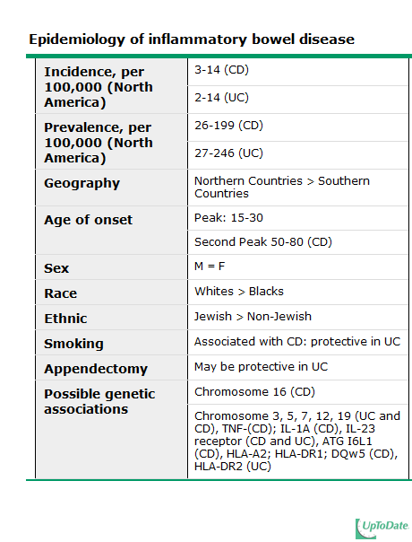
Epidemiology
Most numbers are North American
Increasingly diagnosed in Saudi Arabia

Slide 6
Pathophysiology
Unclear
A number of factors may be involved.
Host Factors
Environmental Factors

Slide 7
Pathophysiology
Host Factors
Genetics (Twins, Relatives, & children)
Obesity
Appendectomy

Slide 8
Pathophysiology
Environmental Factors
Smoking (Crohn’s Vs Ulcerative)
Infection
Oral Contraception

Slide 9
Pathophysiology
Current Theory:
There is a genetic defect that affects the immune system, so that it attacks the bowel wall in response to stimulation by an offending antigen, like a bacteria, a virus, or a protein in the food

Slide 10
Ulcerative Colitis
An inflammatory disease of the large intestine
Recurring Inflammation and ulceration of the mucosa of the large intestine
Almost always involve the rectum and extend proximally

Slide 11
Ulcerative Colitis
It extends in a continuous fashion
40-50% of patients have disease limited to the rectum and rectosigmoid
30-40% of patients have disease extending beyond the sigmoid
20% of patients have a total colitis

Slide 12
Ulcerative Colitis
Macroscopic Appearance
Erythematous mucosa, has a granular surface, looks like sand paper
In more severe diseases hemorrhagic, edematous and ulcerated
In fulminant disease a toxic colitis or a toxic megacolon may develop

Slide 13
Ulcerative Colitis

Slide 14
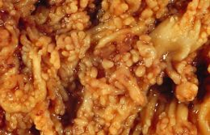
Ulcerative Colitis

Slide 15
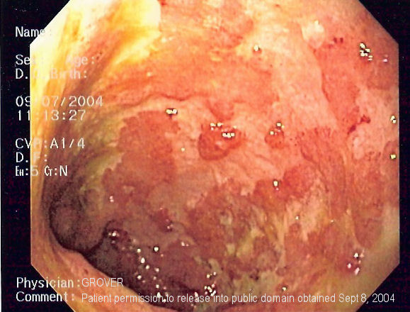
Ulcerative Colitis

Slide 16
Ulcerative Colitis
Microscopic Appearance
Crypt abscesses
Branching of crypts,
Atrophy of glands
Loss of mucin in goblet cells

Slide 17
Ulcerative Colitis Presentation
The major symptoms of UC are:
Diarrhea (4 to more than 10)
Rectal bleeding
Tenesmus & Passage of mucus
Crampy abdominal pain & Fever
Exam is often normal unless complications occur.

Slide 18
Ulcerative Colitis Complications
Hemorrhage
Toxic megacolon
Perforation
Stricture
Cancer

Slide 19
Ulcerative Colitis
Extra-intestinal manifestations
Uveitis and Episcleritis
Erythema Nodosum and Pyoderma Gangrenosum
Arthritis
Ankylosing Spondylitis
Sclerosing cholangitis

Slide 20
Ulcerative Colitis Treatment
Mainly medical treatment

Slide 21
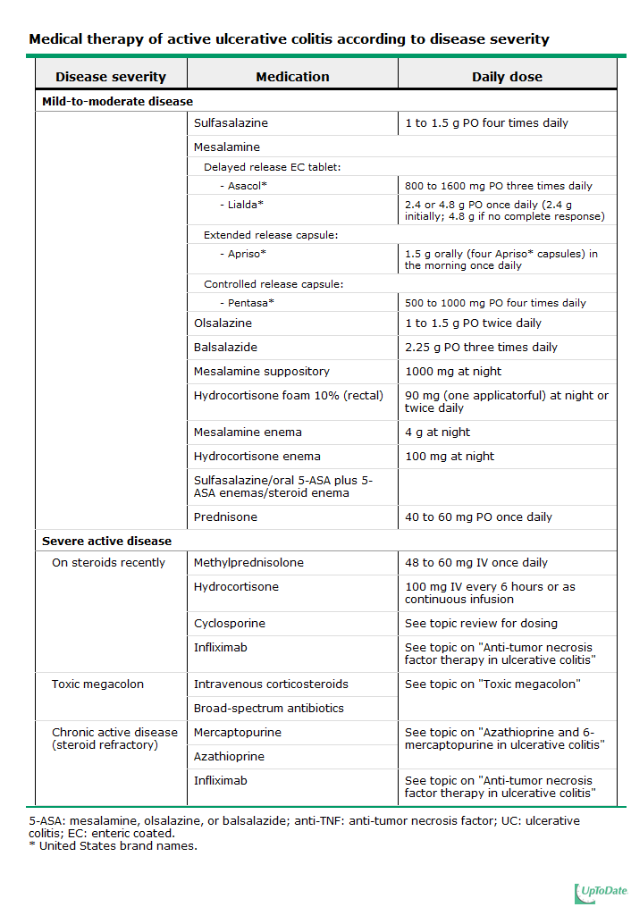

Slide 22
Ulcerative Colitis Treatment
Mainly medical treatment
Surgical treatment:
Failure of medical management
Treating complications
Prophylaxis for cancer
Cure after colectomy

Slide 23
Crohn’s Disease
An inflammatory disease that affects any part of the GI tract
Recurring transmural Inflammation of the bowel
About 80% have small bowel involvement, mostly the terminal ileum

Slide 24
Crohn’s Disease
Characterized by skip lesions
30-40% of patients have small bowel disease alone
40-55% of patients have both small and large intestines disease
15-25% of patients have colitis alone

Slide 25
Crohn’s Disease
Macroscopic Appearance
Mild disease has aphthus or small superfecial ulcers
In more severe diseases there is the characteristic cobblestone appearance
Thickening of the bowel wall with creaping fat

Slide 26
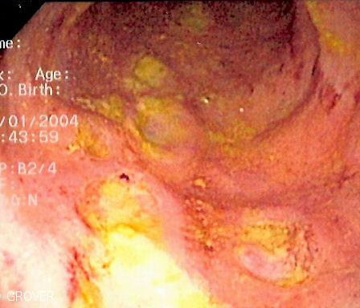
Crohn’s Disease

Slide 27
Crohn’s Disease

Slide 28
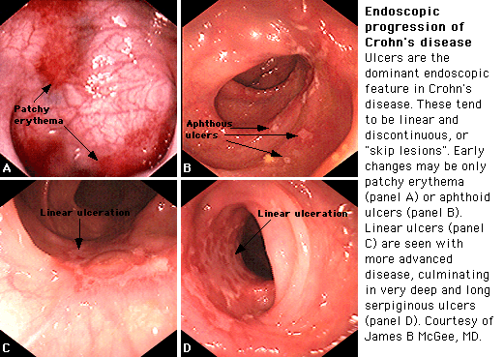

Slide 29
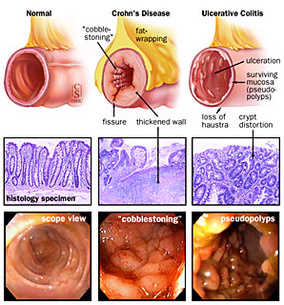
Inflammatory Bowel Disease

Slide 30
Crohn’s Disease
Microscopic Appearance
Transmural inflammation
Focal ulcerations
Acute and chronic inflammation
Granulomas may be noted in up to 30 percent of patients

Slide 31
Crohn’s Disease Presentation
The major presentations of CD are:
Crampy abdominal pain
Diarrhea
Weight loss
Colitis and Perianal disease
Dudenal Disease

Slide 32
Crohn’s Disease Complications
Phlegmons & abcesses
Fistulas
Stricture
Malabsorption
Perianal disease
Cancer risk

Slide 33
Crohn’s Disease
Extra-intestinal manifestations
Uveitis and Episcleritis
Erythema Nodosum and Pyoderma Gangrenosum
Sclerosing cholangitis
Renal stones
Gall stones
Amyloidosis

Slide 34
Crohn’s Disease Treatment
Mainly medical treatment:
Oral 5-aminosalicylates (sulfasalazine)
Antibiotics (Cipro, Metronidazole)
Glucocorticoids (Prednisone)
Immunomodulators (Azathioprine)
Biologic therapies (infliximab)

Slide 35
Crohn’s Disease Treatment
Mainly medical treatment
Surgical treatment:
Failure of medical management
Treating complications
Not a Cure

Slide 36
Inflammatory Bowel Disease
 | UC | Crohn’s disease
Blood in stool | Yes | Occasionally
Mucus | Yes | Occasionally
Systemic symptoms | Occasionally | Frequently
Pain | Occasionally | Frequently
Abdominal mass | Rarely | Yes
Perineal disease | No | Frequently

Slide 37
Inflammatory Bowel Disease
 | UC | Crohn’s disease
Fistulas | No | Yes
Small intestine obstruction | No | Frequently
Colonic obstruction | Rarely | Frequently
Response to antibiotic | No | Yes
Recurrence after surgery | No | Yes

Slide 38
Inflammatory Bowel Disease
 | UC | Crohn’s disease
Rectal sparing | Rarely | Frequently
Continuous disease | Yes | Occasionally
„cobblestoning” | No | Yes
Granuloma on biopsy | No | Occasionally

Slide 39
Inflammatory Bowel Disease
Questions?

