Slide 2
THIRD YEAR ORIENTATION
NADIA ALJOMAH
MOUDI ALDEGETHER

Slide 3
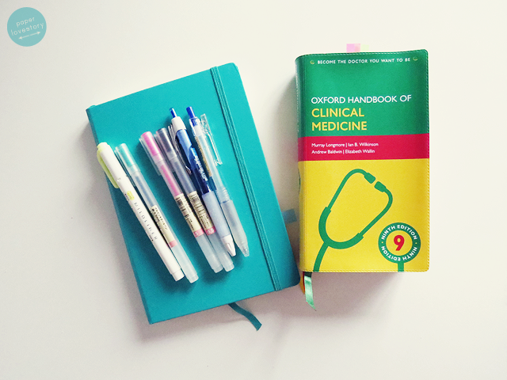
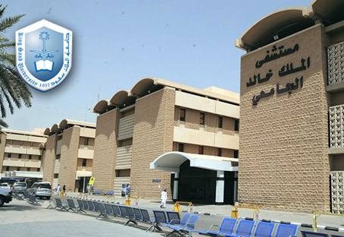
THIRD YEAR ?

Slide 4
You should find the answer on your own!
Do not listen to what others say.
Try it for yourself, then YOU decide
what is third year like...!

Slide 5
What’s different now?
Block system
basic sciences
clinical sciences
patients

Slide 6
3rd year
Both Terms
1st Term Only
2nd Term Only
General Surgery
Internal Medicine
Community Medicine
Radiology
Health Informatics
Research (lectures + exams)
Medical Ethics
Forensic Medicine & Toxicology

Slide 7
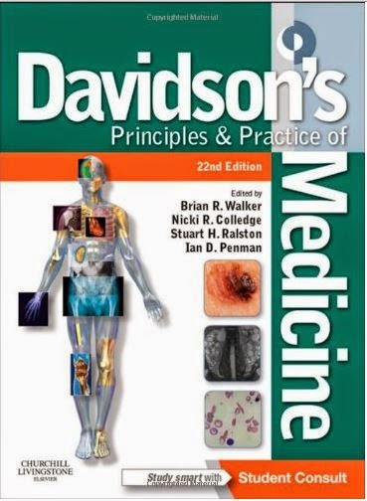
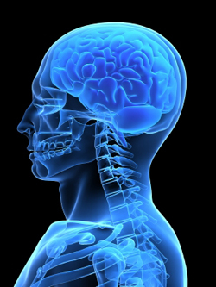
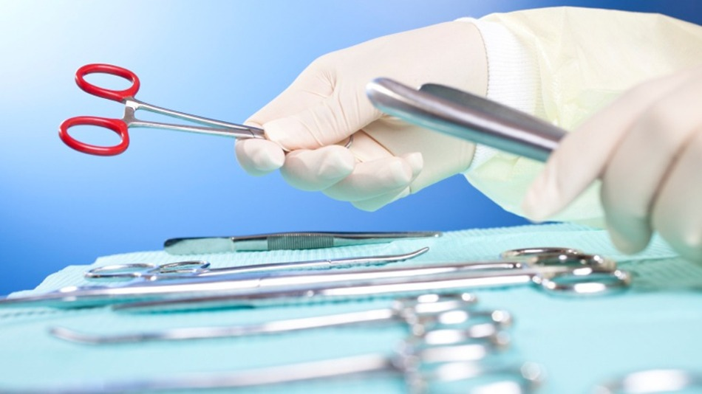
Subjects and references

Slide 8
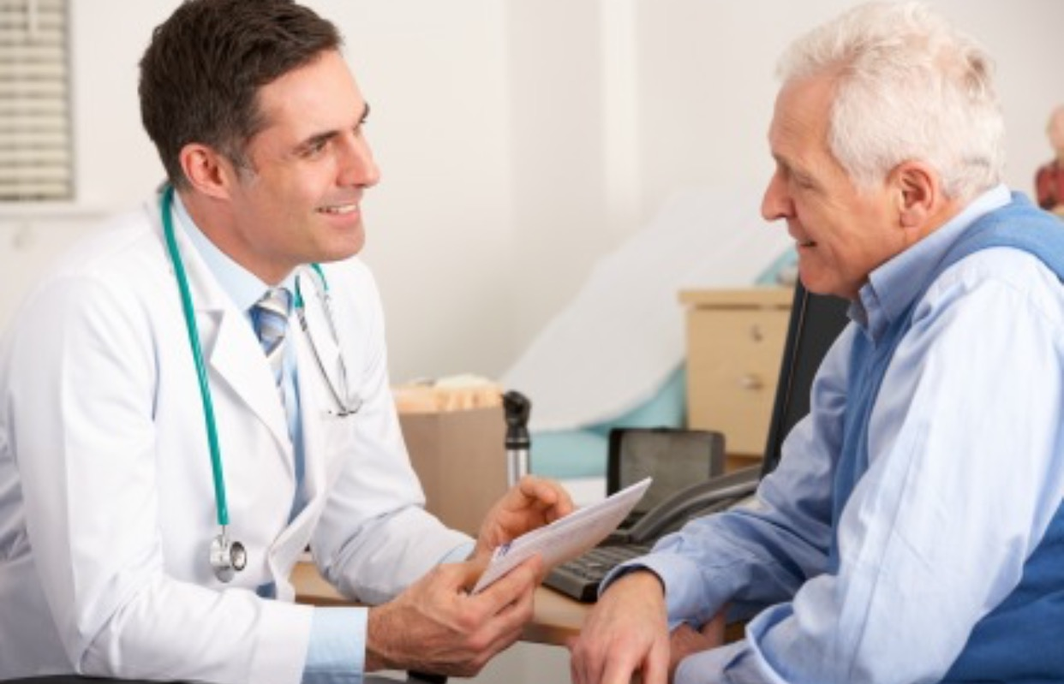
Internal Medicine
(MED 341)

Slide 9
Internal Medicine
(MED 341)
Credit hours : 10
Marks:
Written (MCQ)
Written (MCQ) exams
40 marks:
- Mid = 15
- Final = 25
OSCE exams
55 marks:
Mid OSCE = 25
Final OSCE = 30
Log book and DXR
5 marks

Slide 10
Important notes
lecture slides are not enough.
You may need more than one source. But not more than 3 eg : caplan videos , step up to medicine and slides Or Davidson's with caplan videos
Try to study the lectures in a clinical aspect (from a clinical point of view)
In order to answer the exam questions correctly you need to know the difference between the best initial diagnostic test and the most accurate diagnostic test , the best initial therapy and the most effective therapy and you need to know what is the next best step in
pretest Book is perfect to assess your knowledge of medicine

Slide 11
References
Recommended by department:
1-Kumar and Clark's Clinical Medicine
2-Davidson's Principles and Practice of Medicine
Recommended by students
Step-up to Medicine, By: Steven S. Agabegi, and Elizabeth D. Agabegi
Caplan videos
Danish
Review books :
Pretest

Slide 12
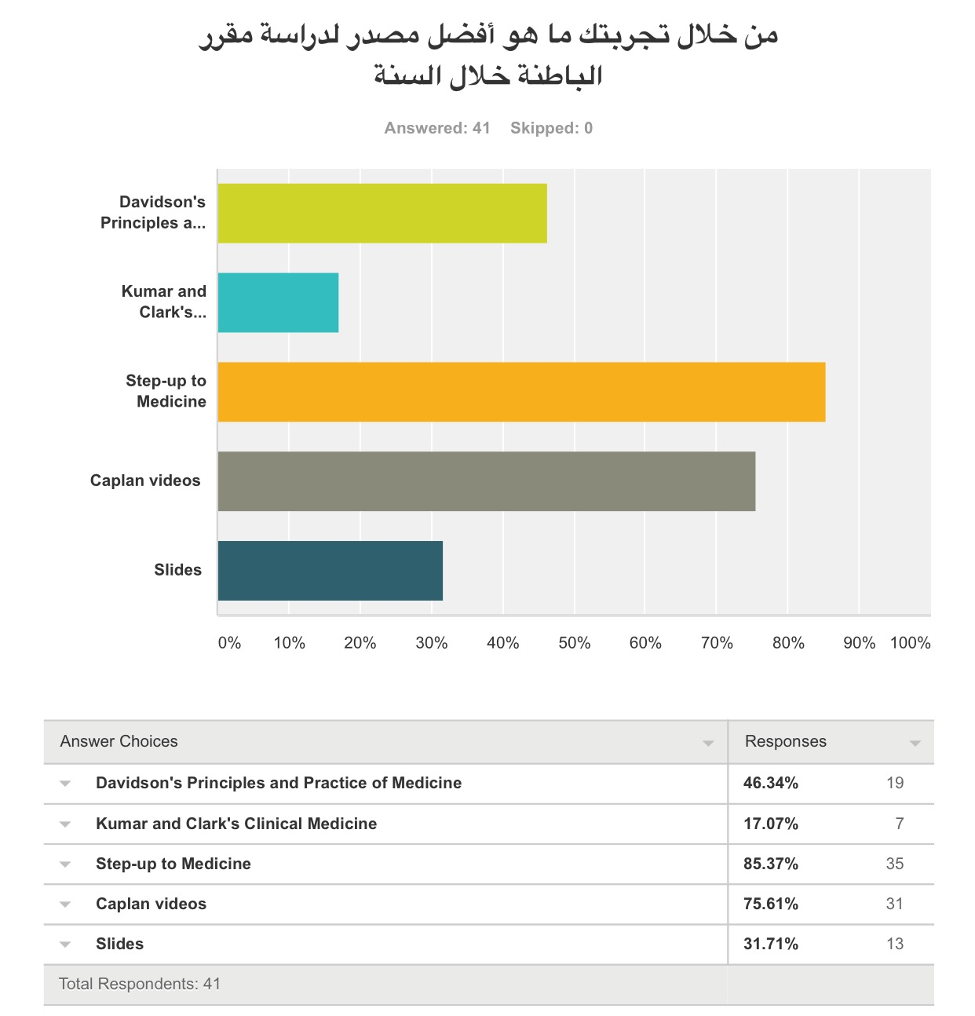

Slide 13
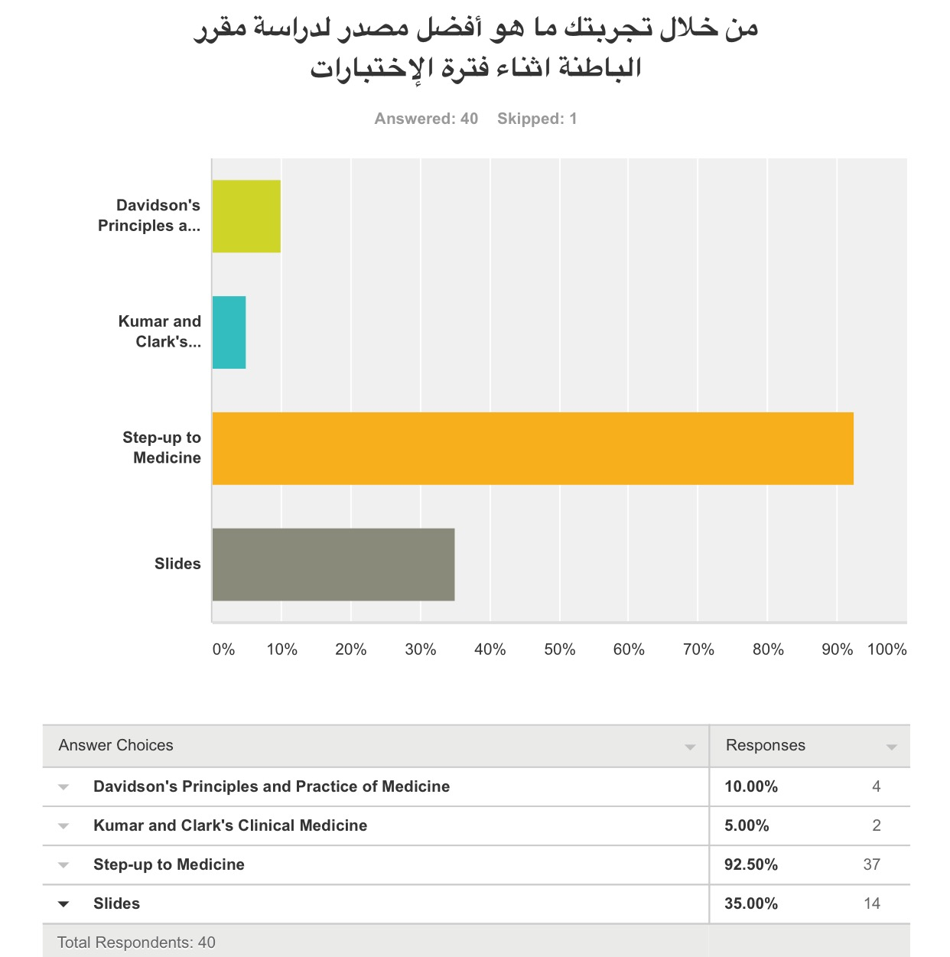

Slide 14
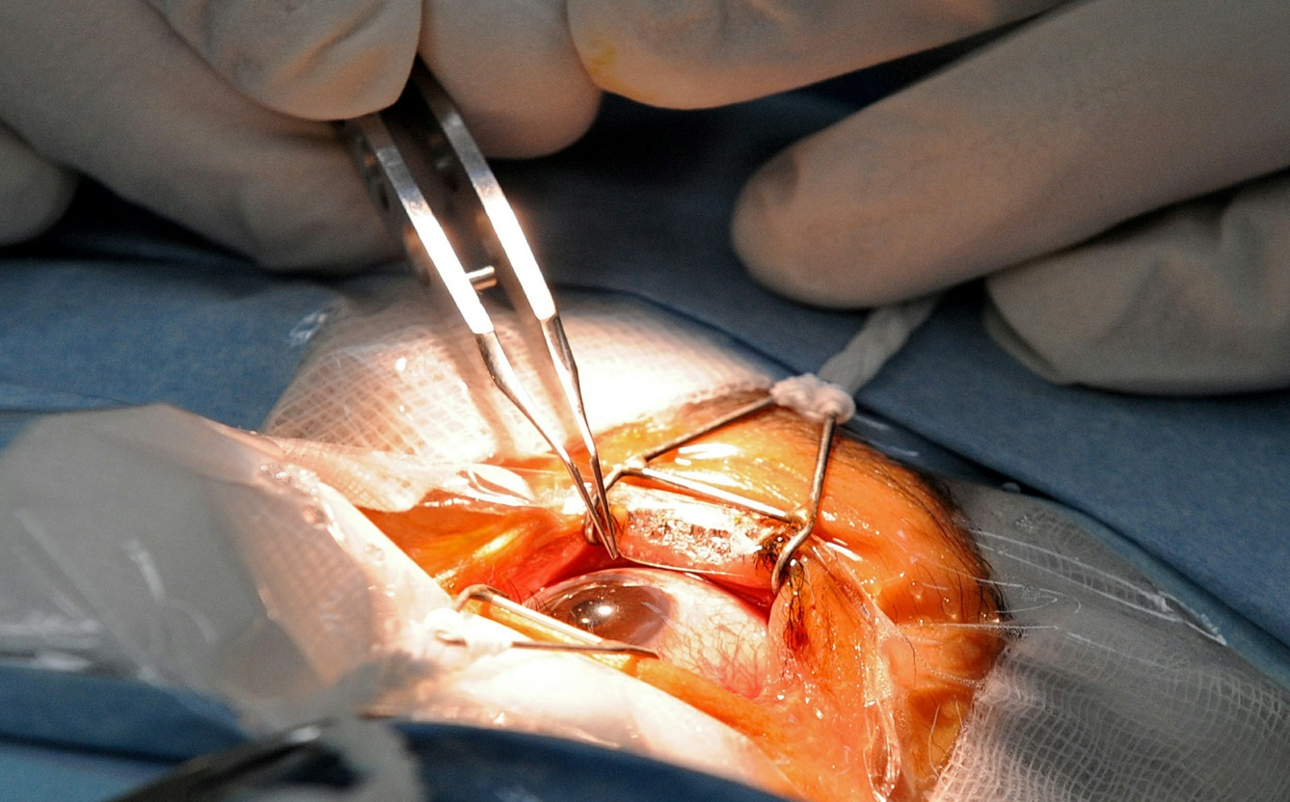
General Surgery
(SURG 351)

Slide 15
Credit hours : 8
Marks:
Written (MCQ)
exams
40 marks:
Mid = 20
Final = 20
OSCE exams
55 marks:
Mid OSCE = 15
Final OSCE = 40
Log book
5 marks

Slide 16
Notes:
It's very important to take notes during the lecture.
Focus on: when do we need to do a surgery? And when we do not?
- Try as much as you can to study the lectures in a clinical aspect (from a clinical point of view)

Slide 17
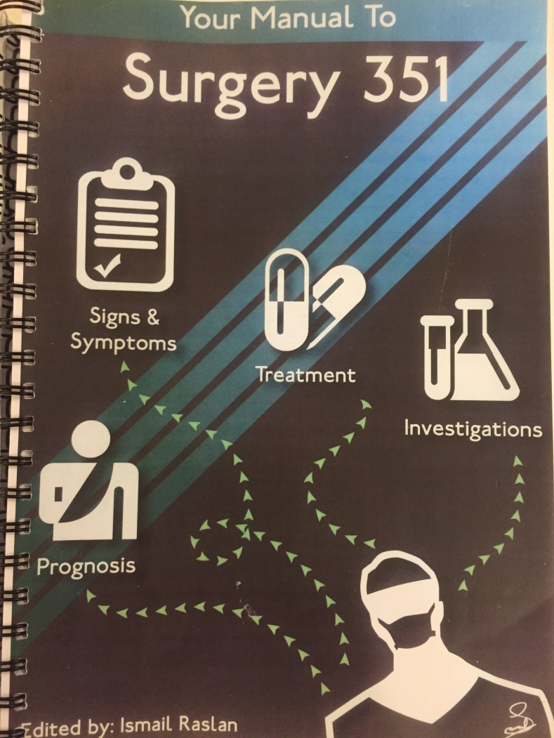
References
Raslan booklet "Your Manual to Surgery 351"
Doctors slides
Teams

Slide 18
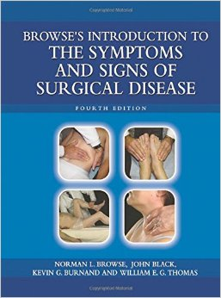
For history taking (optional):
The Patient History: Evidence-Based Approach (Lange Medical Books)
An Introduction to the symptoms and signs of surgical
disease by Norman Browse

Slide 19
Recommended by department:
- Clinical:
Churchill, pocketbook of differential diagnosis By: A. Raftery E. Lim, Edition 2011
Essential of General Surgery, Latest Edition by Peter Lawrence
- Theory:
Essential of Surgical Specialties, Latest Edition by Peter Lawrence

Slide 20
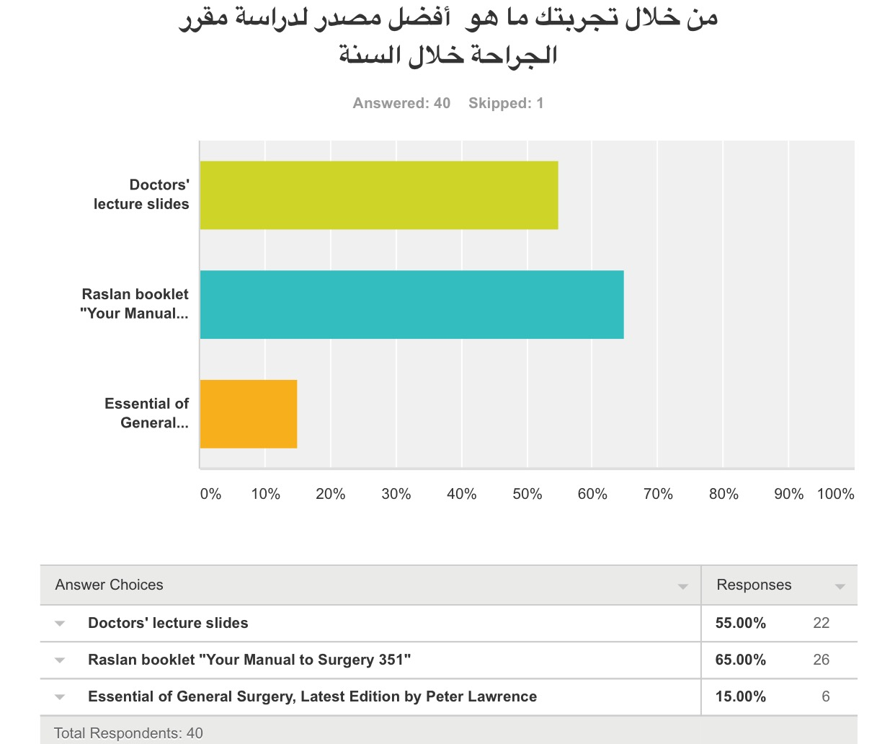

Slide 21
Community Medicine (CMED311)

Slide 22
Credit hours: 4
Marks :
Written (MCQ) exams 80 marks:
Mid = 40
Final = 40
Quizzes
10 marks
Assignment/s
10 marks
Note :
The seminar topics where included with us

Slide 23
References :
Doctors' lecture slides
For seminar topics: the material was the seminar reports that the students prepared, and the department had revised
Teamwork

Slide 24
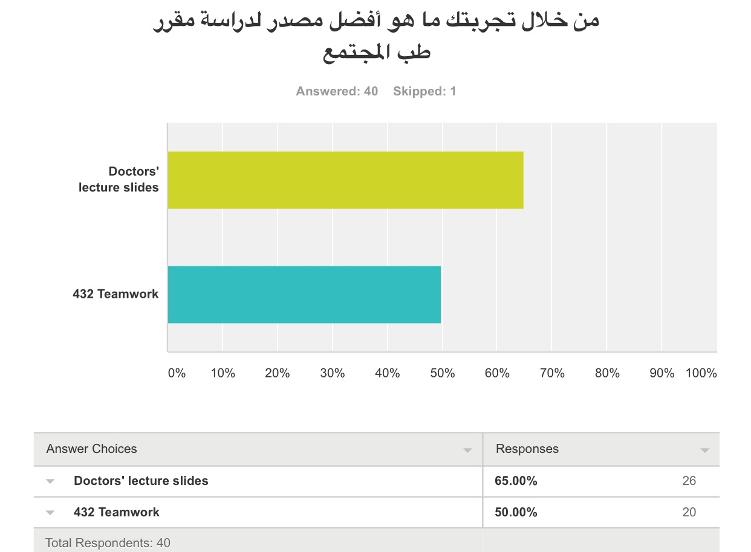

Slide 25
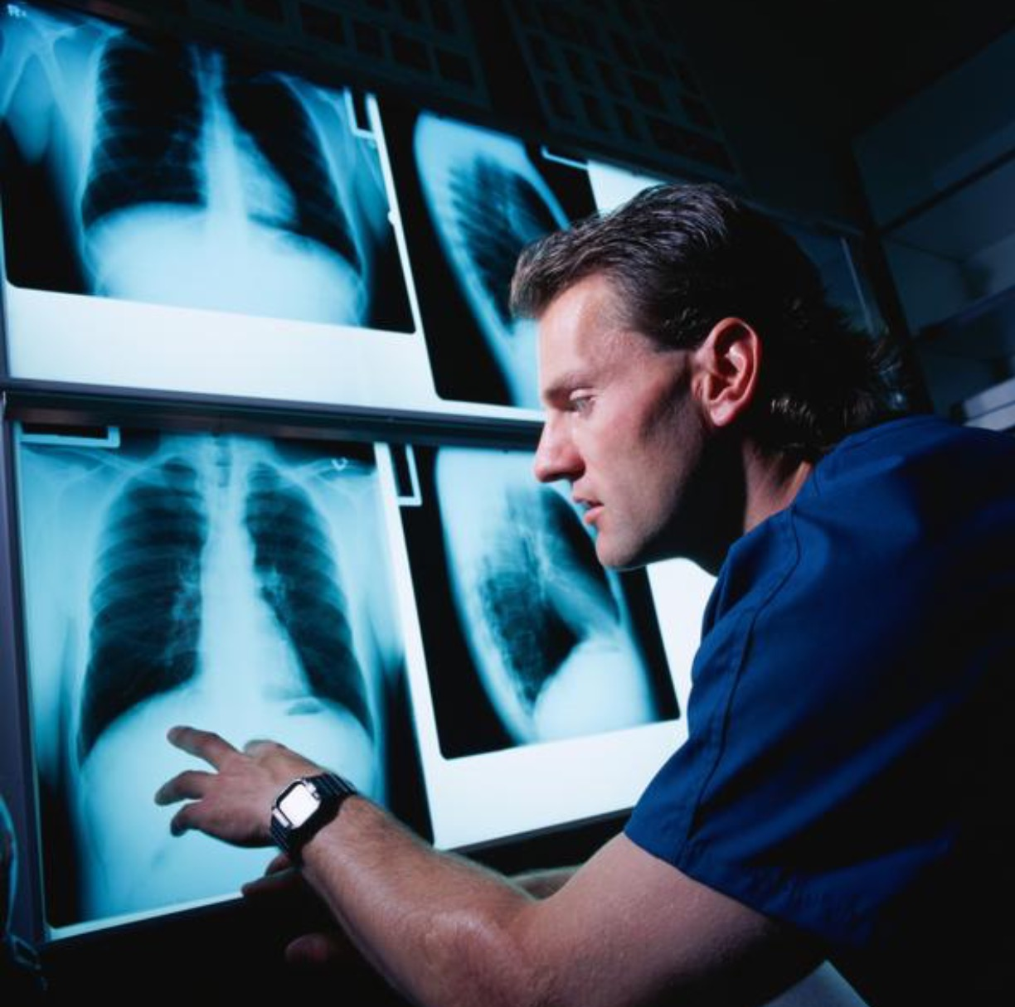
Medical Radiology and Body Imaging
(RAD 365)

Slide 26
Credit hours: 2
Marks :
Written (MCQ) exams 95 marks:
Mid = 35
Final = 60
Quizzes
5 marks:
(2.5 for 1 quiz in each term
Note :
The pictures in the exam, are the same as the slides

Slide 27
References
-Doctors' Lecture slides
-432 Teamwork
-431 Teamwork
Recommended book by department:
Diagnostic Imaging, By Andrea G. Rockall, Andrew Hatrick, Peter Armstrong, Martin L. Wastie

Slide 28
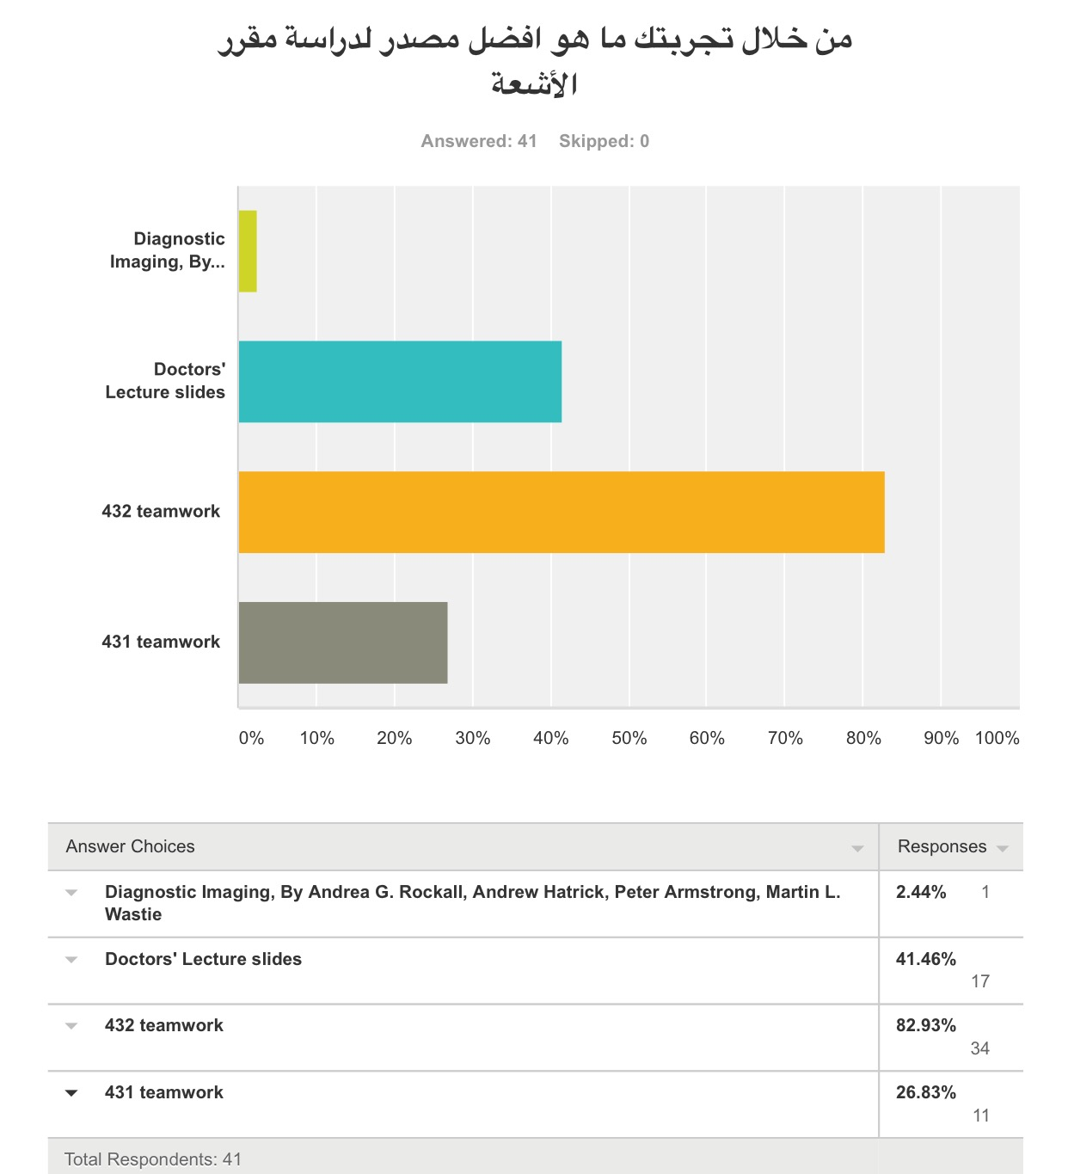

Slide 29
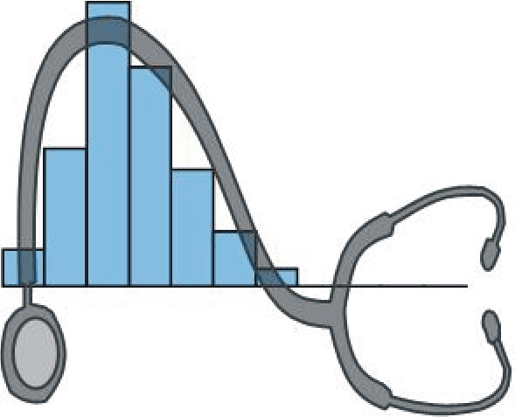
Research Methodology & Biostatistics
(CMED 305)

Slide 30
Credit hours: 6
Marks :
Written (MCQ) exams
40 marks:
- Mid = 15
- Final = 25
Supervisor’s evaluation
30 marks
Presentation + Final research report 10 marks
Quizzes 10 marks
Assignment/s 10 marks
Note :
Refer back to the "Research Course Orientation" slides, by 431

Slide 31
References
Doctors' lecture slides
Research Course Manual
(provided by the course organizer in the beginning of the year)
Suggested: youtube videos for the biostatistics part, for more understanding

Slide 32
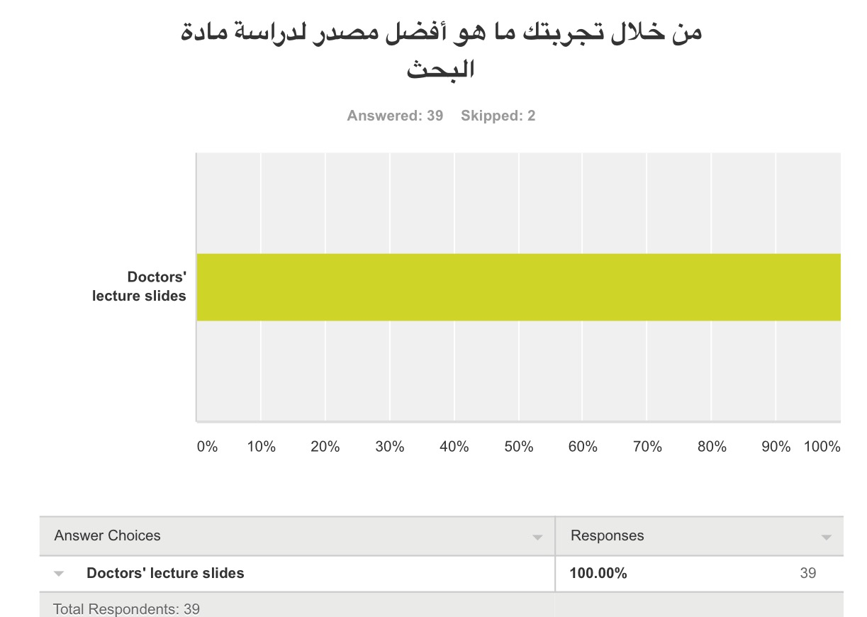

Slide 33
Health Informatics (CMED 301)

Slide 34
Credit hours:2
Marks :
Written (MCQ) exams 40 marks:
- Mid = 20
- Final = 20
CIS project 24 marks:
Letter to organization = 1
CIS progress reports = 3
CIS presentation = 10 ..... CIS report = 10
Discussions 16 marks:
4 discussions; 4 marks each
Online quiz 10 marks
Attendance 8 marks:
- Class = 2 ..... - DXR workshop = 2
- EBM workshop = 2 ..... - CIS day = 2
Analysis of case study (workshop activity)
1 mark
Certificate of completion (workshop homework)
1 mark :

Slide 35
References
-Doctors' lecture slides
-The internet

Slide 36
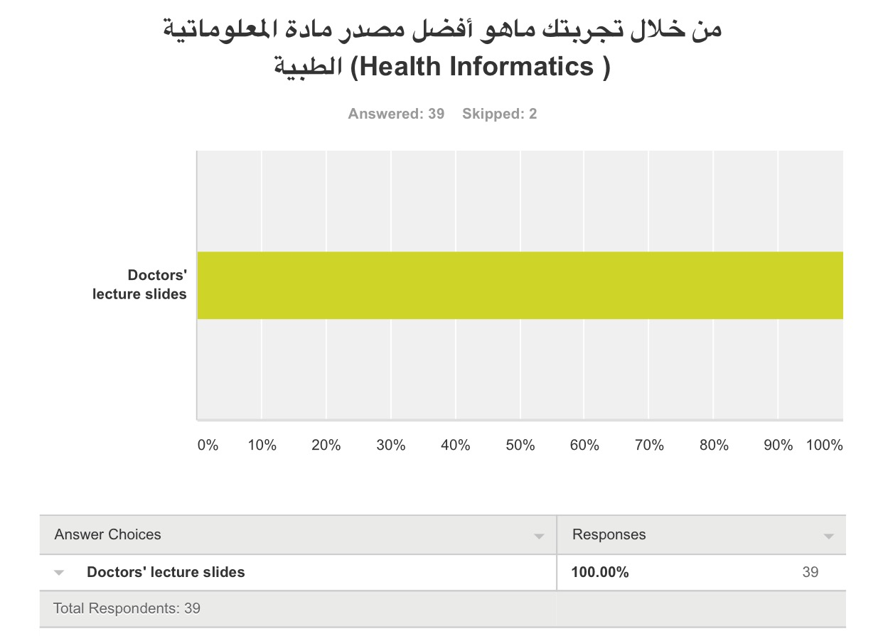

Slide 37
Medical Ethics
(CMED 395)

Slide 38
Credit hours : 3
Marks :
Written (MCQ) exams 40 marks:
- Mid = 20
Final = 20
Group Discussion/s 10 marks
Individual case discussion
(analyzing a given case
scenario) 20 marks
Writing an ethical case
scenario + presentation
30 marks:
- writing the case = 20
- presenting it = 10
Note :
Important to attend lectures because doctors discussed cases in class (and nothing was written in slides, references). There's also quizzes about the same lecture.
- Try to do the tasks early.

Slide 39
References
Doctors' lecture slides [uploaded to blackboard]
Booklet of Medical Ethics Course [also on blackboard]
If there were additional sources, they uploaded them on blackboard

Slide 40
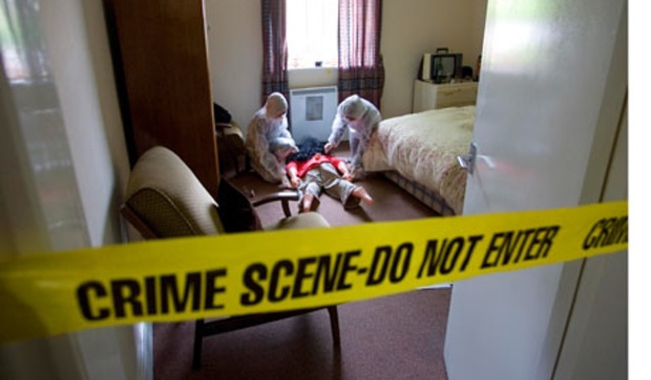
Forensic Medicine and Toxicology
(FORM 321)

Slide 41
Credit hours : 2
Marks :
Written (MCQ) exams 100 marks:
- Mid = 40
- Final = 60

Slide 42
References
-Doctors' lecture slides
-Doctors' notes during the lecture
-Caplan videos emergency medicine (toxicology)
Recommended book by department,
for forensic medicine:
-Simpson's Forensic Medicine, 13rd edition
for toxicology :
-Rosen's Toxicology

Slide 43
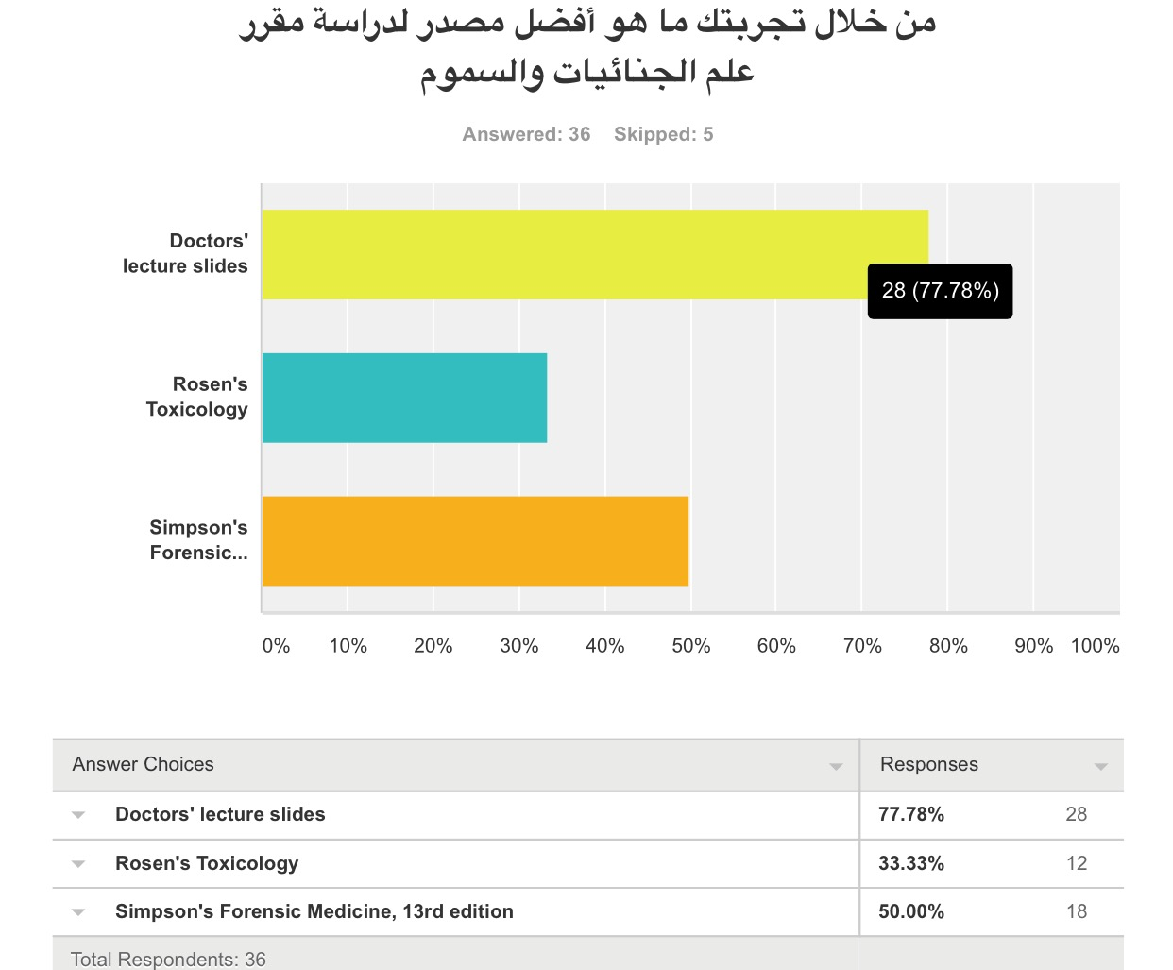

Slide 44
General notes for all subjects
Focus on clinical aspects
After studying, you may like to go through sample questions such as those in books (surgical recall, medical recall, USMLE books...etc)
In medicine and surgery, know the difference between: initial (first), most specific, and next investigation or treatment.

Slide 45
What is: BST (Bed-Side Teaching)? CBL (Case-Based Learning)? TBL (Task-Based Learning)?

Slide 46
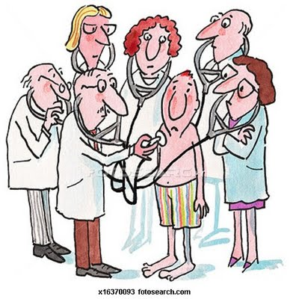
BST: Bed-Side Teaching

Slide 47
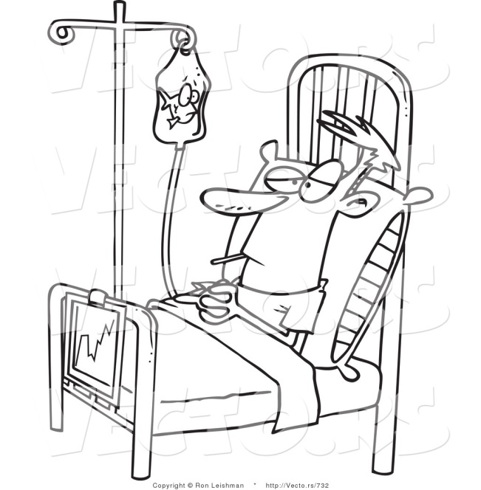
BST: Bed-Side Teaching
It’s in medicine + surgery
It is a 2-3 hours session with a doctor
The batch is divided into 10 sub-groups (F1, F2...F10)
Each subgroup has a leader (communicates with the doctor of the session and the girls of the group)
The session’s contents depend on the doctor (whether he/she prefers to just talk, or go to the patient, or wants you to take history first then come to him/her... Etc)

Slide 48
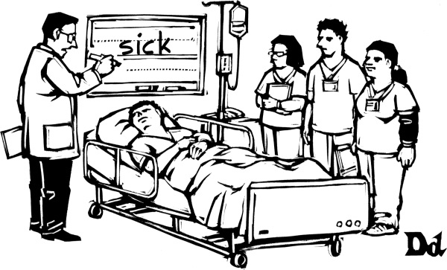
How to start a BST? What preparations are needed?
The subgroup leader must know which doctor will be giving the session (a schedule is provided from the department) + she must communicate with that doctor to make sure he/she knows about the session and did not forget (this is done usually by bleeping the doctor)
It’s preferable if the subgroup leader asks the doctor if he/she requests anything for the session
Eg: does he want you to take history of patients in the first hour of the session and then you meet with him? Or does he want you to come directly to meet him then he will take you to the patients? ... Etc + she must inform the girls
It is important to bring all your tools with you to the session (stethoscope, torch,……etc)
If the doctor asks you to take history, ask the doctor about the ward where you should take history from

Slide 49
How to bleep a doctor?
Use any phone in the hospital
Dial 2
After you hear the beep, dial the pager number
After you hear 2 beeps, dial the number of the phone you are calling from (you find it on the screen of the telephone, or written on a paper on it)
End the call... Then wait a few minutes until the phone rings!
Pick up the phone, tell the doctor:
Who you are (your name)
From which year
From which subgroup
If lost, ask for a nurse’s help if you’re in the ward:
“Hello sister, can you make a bleep for this number please?”

Slide 50
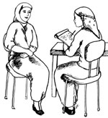
The doctor asked us to take history from a patient... What do I do?!
Know which ward/s the doctor wants you to take history from
Know if the doctor wants you to take history, physical
examination or both.
Know how many cases he/she wants
The subgroup leader has these choices
(after she asks her group about what they prefer):
Either to divide the group on patients (like 3 girls for each patient, or 6 girls for every ward), and they all go at the same time
Or, she divides the group into small groups, and in each session it is the turn of one of those groups to go.
Or any other idea that the groups agrees to
However, if the doctor asks that each girl takes history alone, she should... No divisions

Slide 51
Cont. The doctor asked us to take history from a patient... What do I do?!
When you go to the ward, go to the nurse station and ask her “where is the patient list?”. This usually has the names of patients, ages, their rooms, and their diagnosis.
Make sure to communicate with your colleagues and to know which patients you and they will be taking.

Slide 52
So you are in the ward, and you’ve chosen your patient... What to do now?
Go to the patient’s room
Knock the door, or open the curtains slowly
Greet them with a smile and say “assalamu alaykum”
Ask for their permission.

Slide 53
What to expect?
You might not find the patient (either in the bathroom, or out for a procedure) à find another patient
You might find the patient, but he/she’s asleep...
What to do? I honestly don’t know.
Some people might wake the patient up, and some might search for another patient. It’s up to you. I personally prefer not to wake them up.
The patient might refuse. If they refuse, thank them and leave.
Some patients might be hesitant... So try to add some words.
But if you tell the patient you will make it quick, please make it quick
(skip the systemic review... Although it is not advisable, unless the patient got bored or the patient is tired)

Slide 54
Cont. What to expect?
Some patients might talk a lot about something not important. What to do?
Try to ask them specific questions. Or interrupt them (politely) with a question that you haven’t asked before like: “so you said you had a surgery, in which hospital was it?”... Or: “Regarding your cough, how long did it last?”
Make sure that you don’t lose track of time during taking history
Do not worry, your first history will be the longest one.

Slide 55
The doctor cancelled the BST session... What to do?
First, the subgroup leader must inform the department’s secretary
You have these choices:
Divide your group into smaller numbers and go attend with other groups (after your subgroup leader takes permission from the other subgroup leader/s)
Reschedule the session:
Ask the doctor what other times are suitable
Find another doctor (from the same specialty) and reschedule the session in a suitable time
Ask a doctor if you can attend his/her clinics
Take history/physical examination from patients
Work on your research
Organize a group study (or study alone)
Go home [bad choice, unless you’re ill]

Slide 56
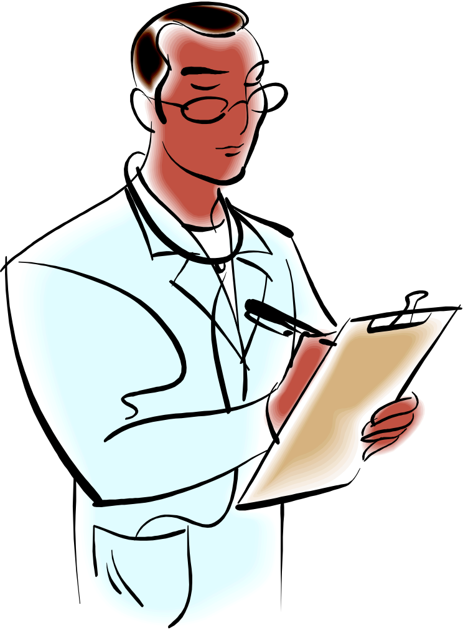
Tips for starting taking history
You might like to keep a specific notebook/papers/file... Etc for taking history
You can prepare the list of questions you need to ask, and take them with you to ask the patient. (or have them printed and take them with you)...
There are examples made by students from 431 and 432.
Practice makes perfect.
Try to practice it alone, or with one friend and let her evaluate you.
If you have spare time (e.g: at the end of the day), try to go and take history from a random patient.

Slide 57
Cont. Tips for starting taking history
Try to put a logical sequence for your questions (a sequence that makes sense to you), you may develop your own mnemonics or learn about mnemonics that are already there
Make sure you have some time left to organize your history notes before you present them in front of the doctor in the session
When you present history of a patient, it is better to it like a story.
You will notice that each doctor has his/her own way (sequence) in taking history. That’s completely normal
you might want to read from a book about taking history, such as:
“The Patient History: Evidence-Based Approach (Lange Medical Books)” and norman brows

Slide 58
CBL: Case-Based Learning

Slide 59
CBL: Case-Based Learning
It’s only in medicine
It is a 2-3 hours session with a doctor
The batch is divided the same as in BST (Bed-side)
The department will provide you before the session with the “case” you will be discussing.
Some doctors finish it quickly, others don’t.
It’s very similar to PBL (you have a case and discuss it with the doctor), except that here you have no learning issues to give a presentation about next session + you must have previous knowledge about the topic discussed in the case.

Slide 60
Cont. CBL: Case-Based Learning
How to prepare for CBL?
Take a look at the case a day before
You may do a quick reading about the topic (take a general idea. Some girls preferred to read from mini Oxford of medicine, but you can find your own sources)
The cases usually will be about something you’ve taken during this year, so if you study day by day, you may do well in the CBL session

Slide 61
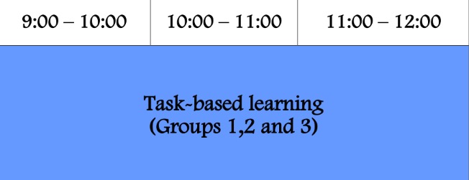
TBL

Slide 62
TBL
It is similar to bed side teaching but you attend in the medical education department Not in the wards .
you will learn how to examine or take history of a specific system e.g cardiac history and examination .
the attendance marks are under the logbooks' 5% .
The medical education secretary will send an email a day before the skills session, and she will send the distribution (which girls should attend the session)

Slide 63
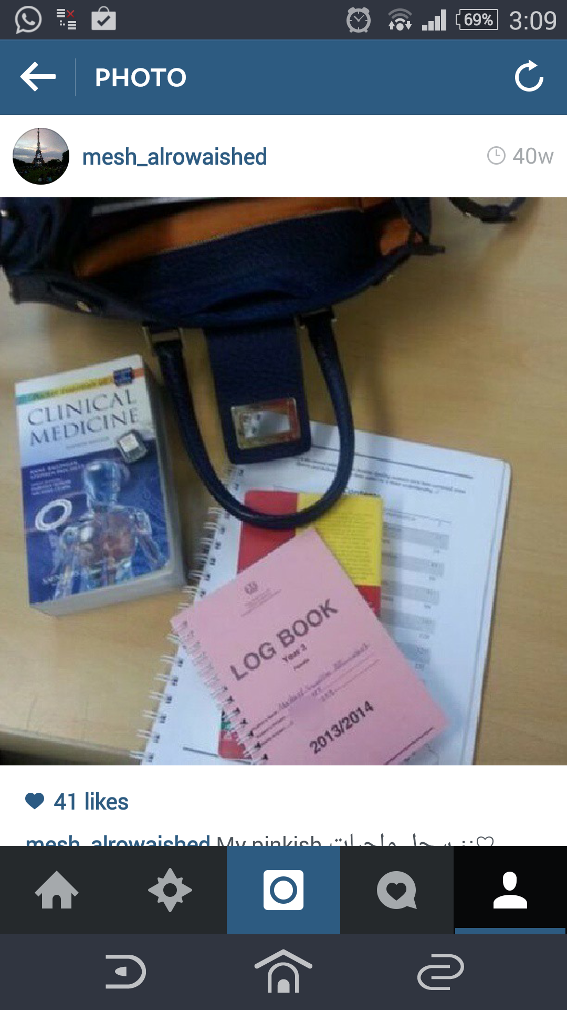
The Logbook? Credits for the pic: Meshael Alrowaished

Slide 64
The logbook?
It’s a small notebook
You keep it with you so the doctor signs it at the end of a session (it is proof of attendance)
Divided according to the themes of the year
Each theme has sections:
A section for medicine and surgery BST sessions
A section for CBL
A section for TBL
Divided to: DXR, clinical skills, ward (equal to self study)
The only thing to sign is the “clinical skills”... DXR and ward are not signed!
There are other things, the secretary told us to ignore them.
Make sure the doctor signs it, remind him/her at the end of the session before you leave

Slide 65
When do you take your logbook with you?
Bed-side teaching session (BST) for both surgery and medicine
CBL (for medicine)
When you have clinical skills:
Clinical skills
TBL clinical skills

Slide 66
We faced a problem: The year began and our logbooks were not handed to us yet
The best solution in this case is that the leader or subgroup leaders may contact the secretaries of medicine and surgery and see what the solution:
They might tell you to make an attendance sheet for that session (the students sign it, or just have their names), and the subgroup leader hands it to the secretary.
Or they might tell you to hand it in to the doctor of the session (and make sure you tell the doctor that the secretary had told you to do this)
In case you don’t know what to do, just make an attendance sheet and let the subgroup leader keep it.
Write the date + time of session + name of doctor on it

Slide 67
When we got our logbooks:
We wrote the date we’ve received them on the cover
On the missing fields (the ones we took before having the logbooks), we wrote “no logbook” or something like that

Slide 68
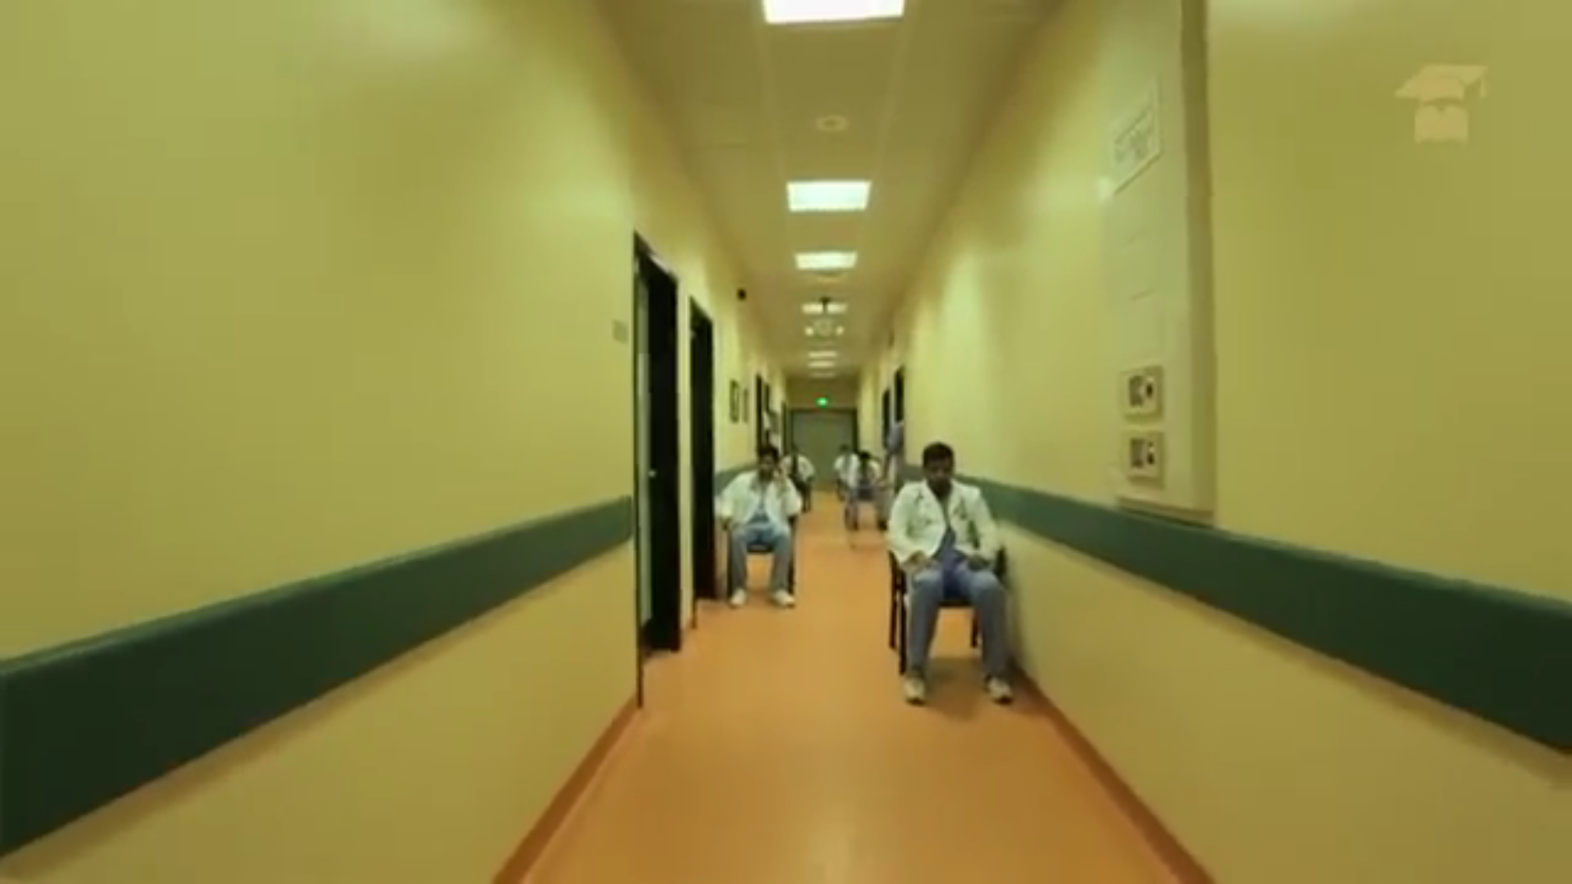
O S C E
(Objective Structured Clinical Examination)

Slide 69
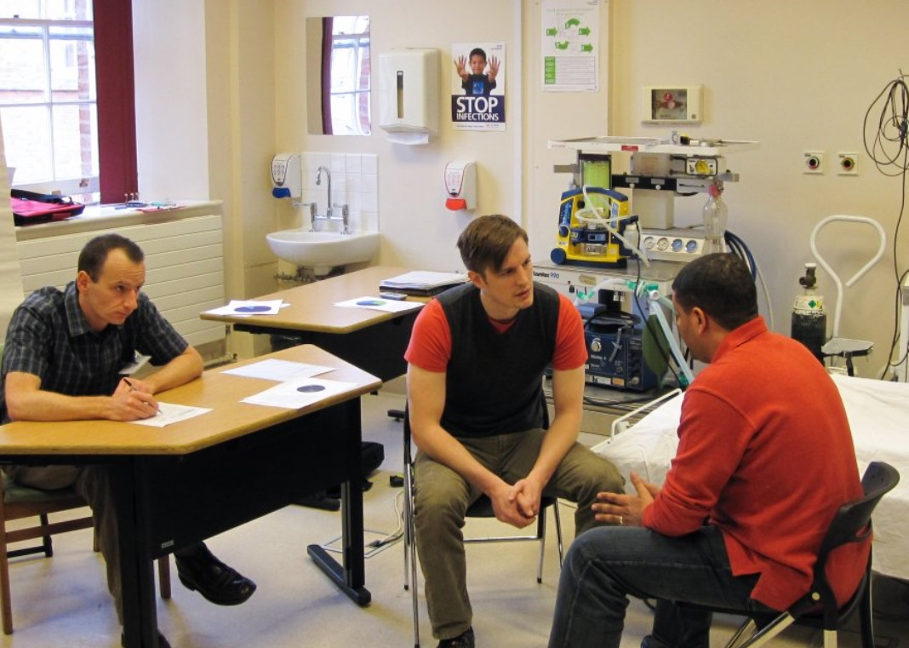
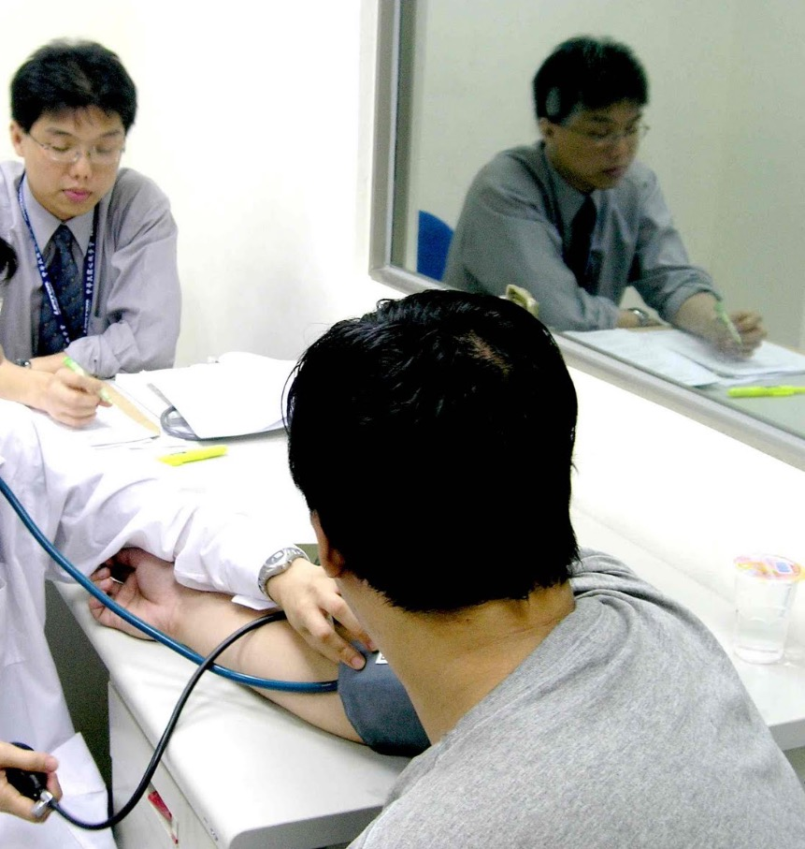
In every station you are required to do a task and the doctor will evaluate you and ask you some questions
Tasks could be:
Take history
Perform a physical examination on a simulated patient)
Perform a clinical skill (eg: insert IV cannula, take blood pressure... Etc)
You
The examiner
The patient

Slide 70
Resources
Internal medicine :
1-429 History Taking and Physical Examination 2013 (Updated 424 Dua'a Booklet) ملزمة دعاء البلوي
2-Clinical examination, by Nicholas Talley and Simon O’Connor
Pocket Talley
(pocket clinical examination, by Nicholas Talley and Simon O’Connor)
3-Bates' Guide to Physical Examination and History Taking
Book by Lynn S Bickley
4-Geeky medics (videos with details )
http://geekymedics.com/category/osce/cardio/( Only videos):
http://www.youtube.com/user/geekymedics123
Surgery :
1-Browse's Introduction to the Symptoms & Signs of Surgical Disease 4th Edition
2-Surgery booklet 428
3-Surgery booklet 424

Slide 71
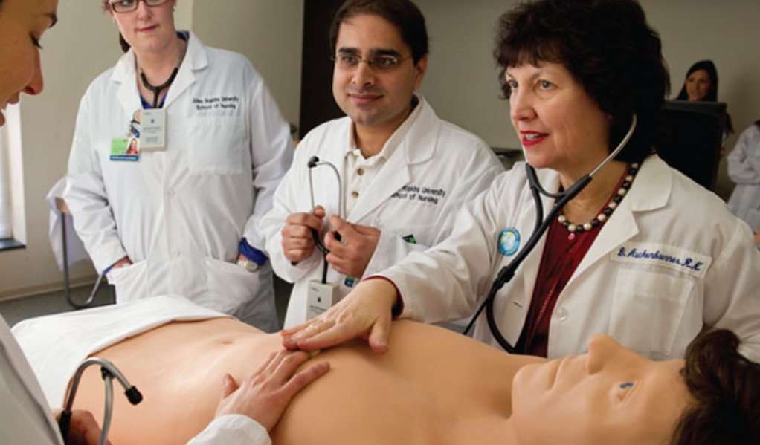
Practice !
“Tell me, and I will forget. Show me, and I may remember. Involve me, and I will understand." Confucius

Slide 72
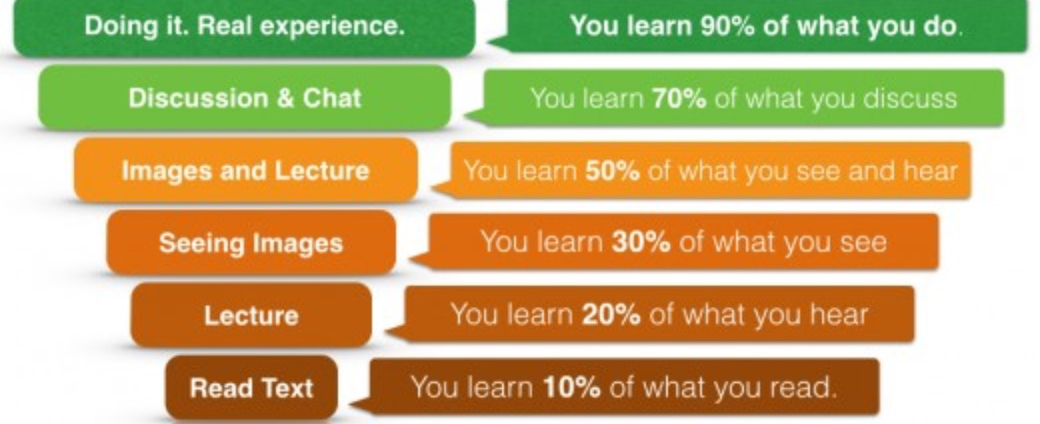
You must Prepare for the OSCEs from the beginning of the year
in the clinical sessions you must ask and practice don't be shy.
Group practice” is a good idea
As the saying goes, “practise makes perfect.” Medical students must practise in order to learn the skills they need to help people.
Finally ask the student council for a “mock OSCE"

Slide 73
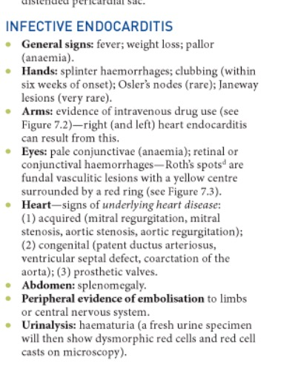
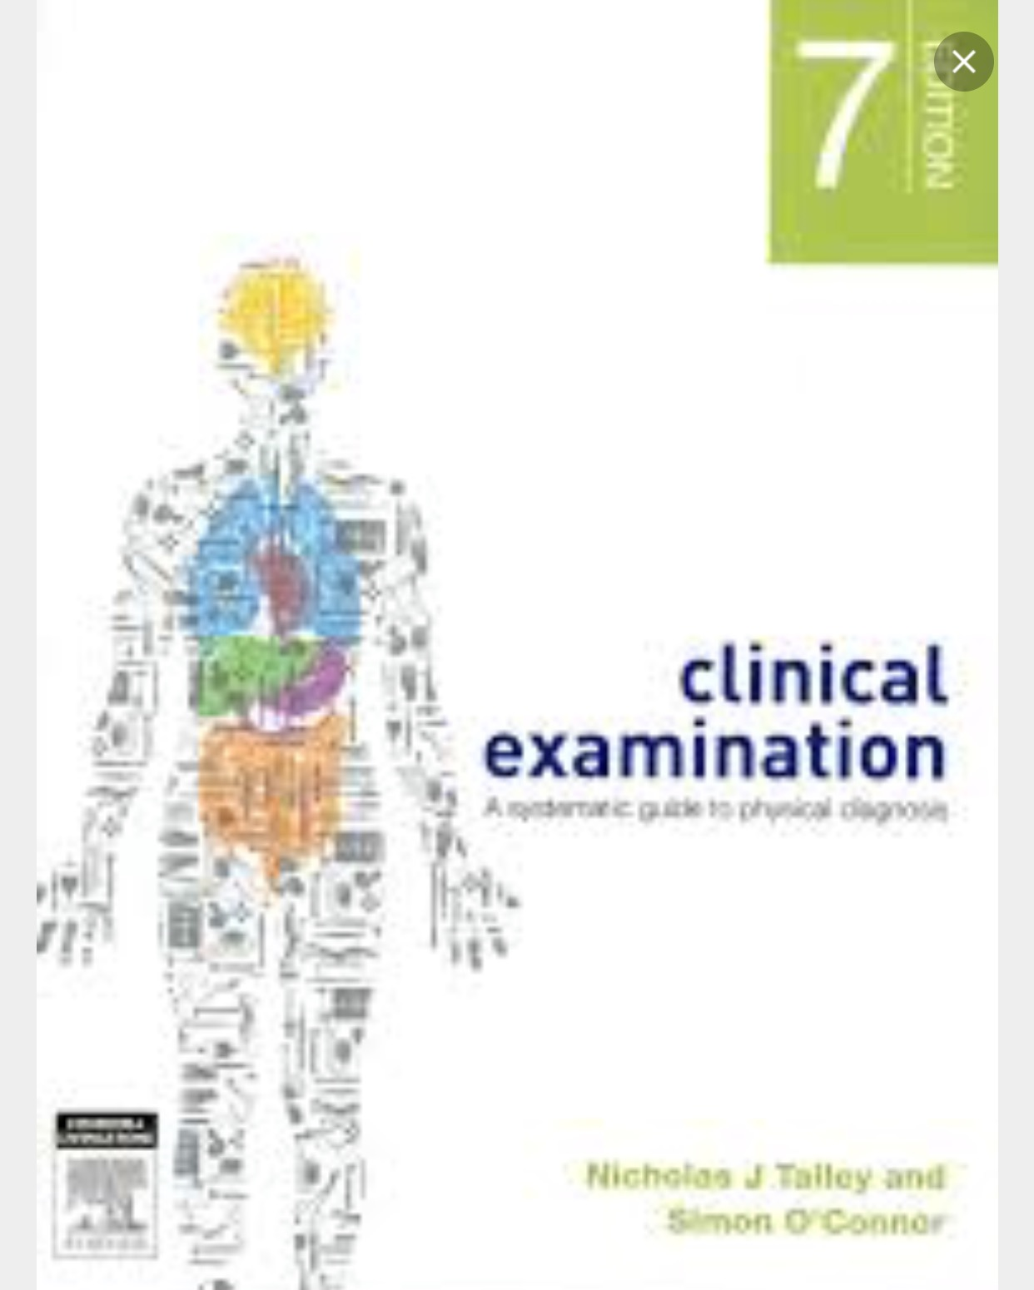
Medicine OSCE :
75/50% of the examination tasks could be systemic (eg : do abdominal examination )
But they asked us to examine a patient looking for signs of a disease (eg : examine this patient looking for signs of infective endocarditis , And the best way to prepare yourself for this is by studying the clinical correlation section in each chapter

Slide 74
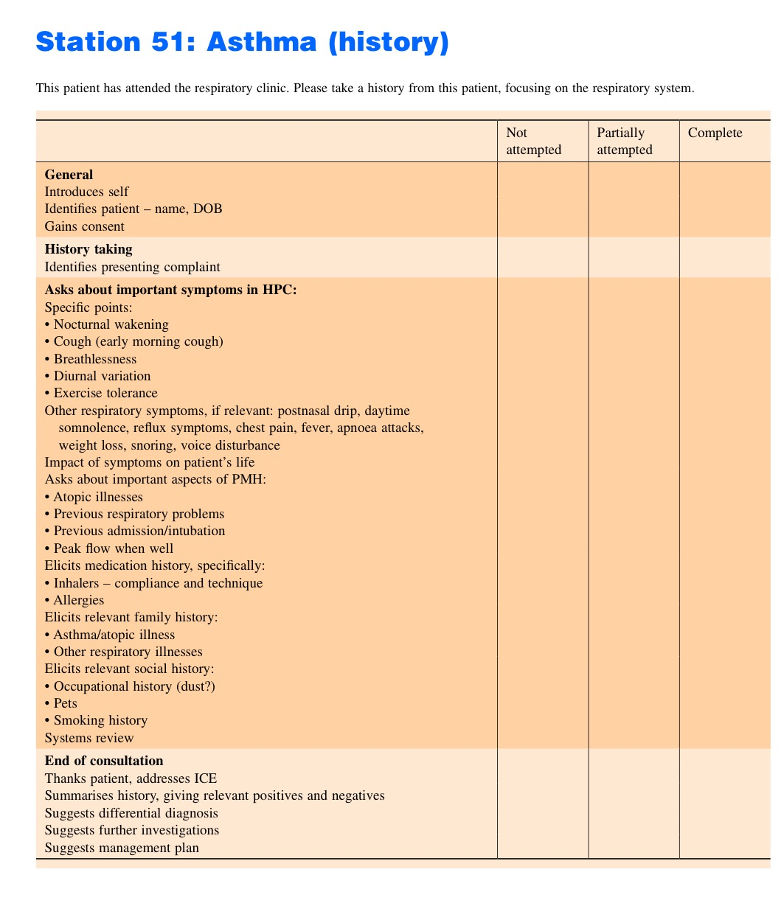
Helpful checklists website
http://www.wiley.com//legacy/wileychi/blundell/pdf.html

Slide 75
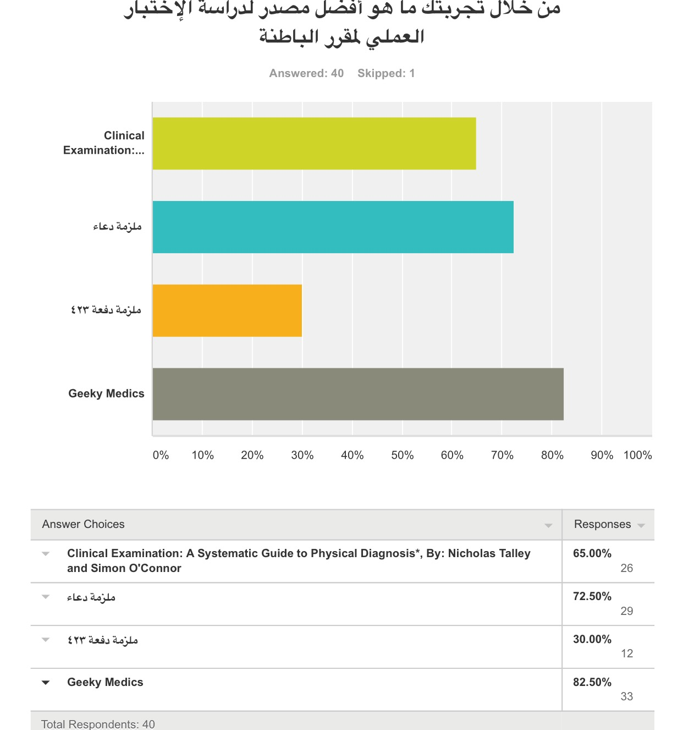

Slide 76
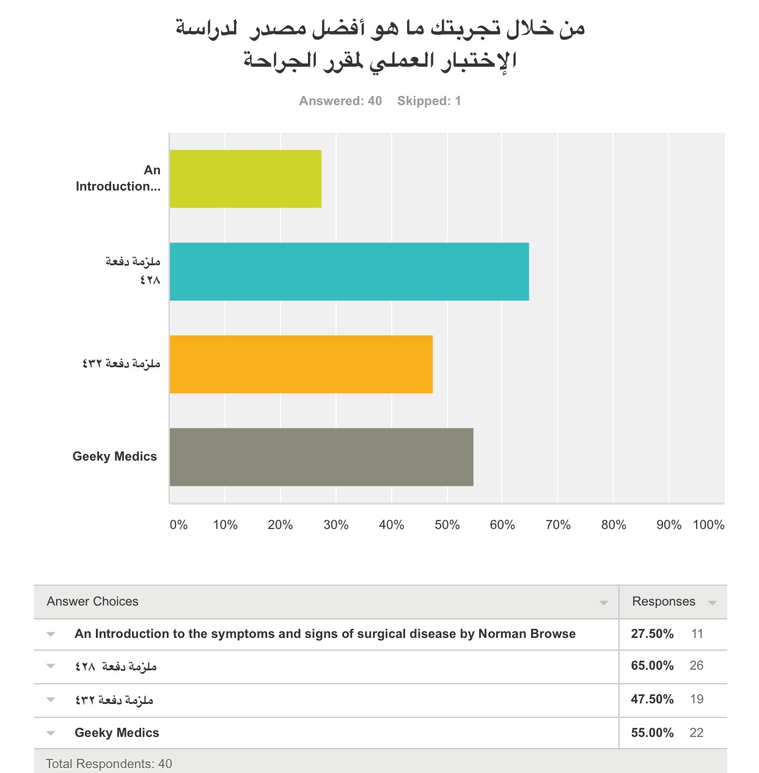

Slide 77
Dxr
It is a website that requires you to log in
In every theme, there are cases.
When you choose a case, you deal with it like a real patient:
Ask questions (to take history)
Do physical examination
Order appropriate investigations
Write down your hypotheses
Write down your diagnosis
Put a management plan for the patient
At the end, it grades your work.

Slide 78
Dxr
The link to DXR:
https://kingsaud.dxrclinician.com/
The following screenshots are put here just to give you an idea

Slide 79
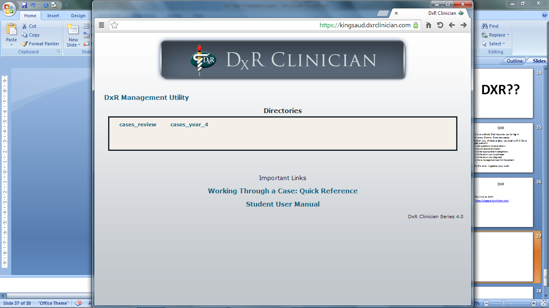
Here, they write the name of the theme and for what year

Slide 80
Then, you choose a patient

Slide 84
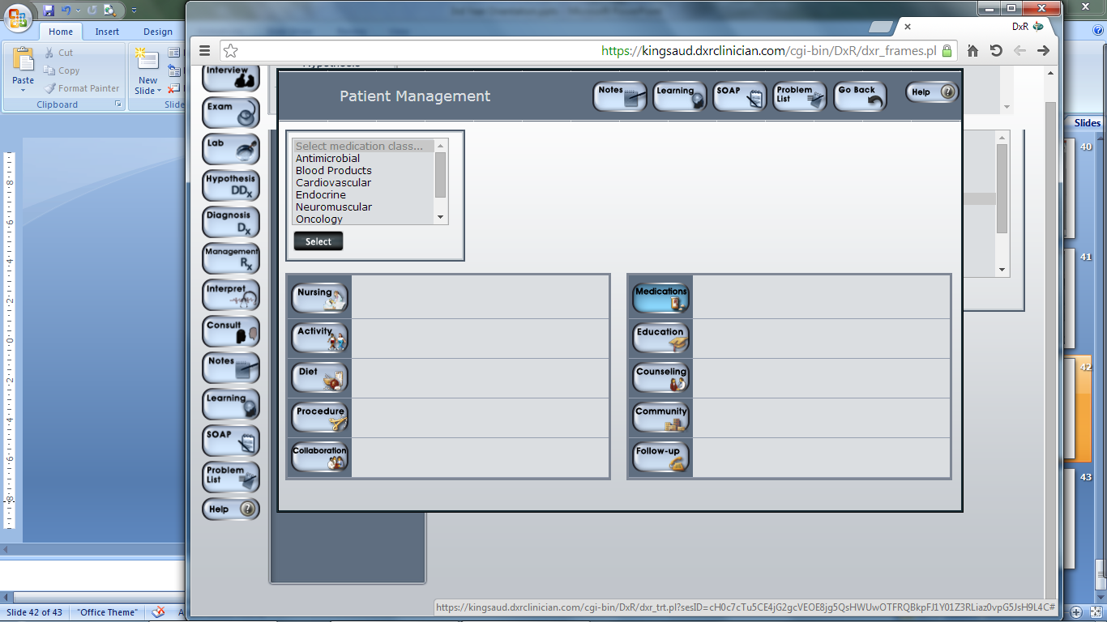

Slide 85
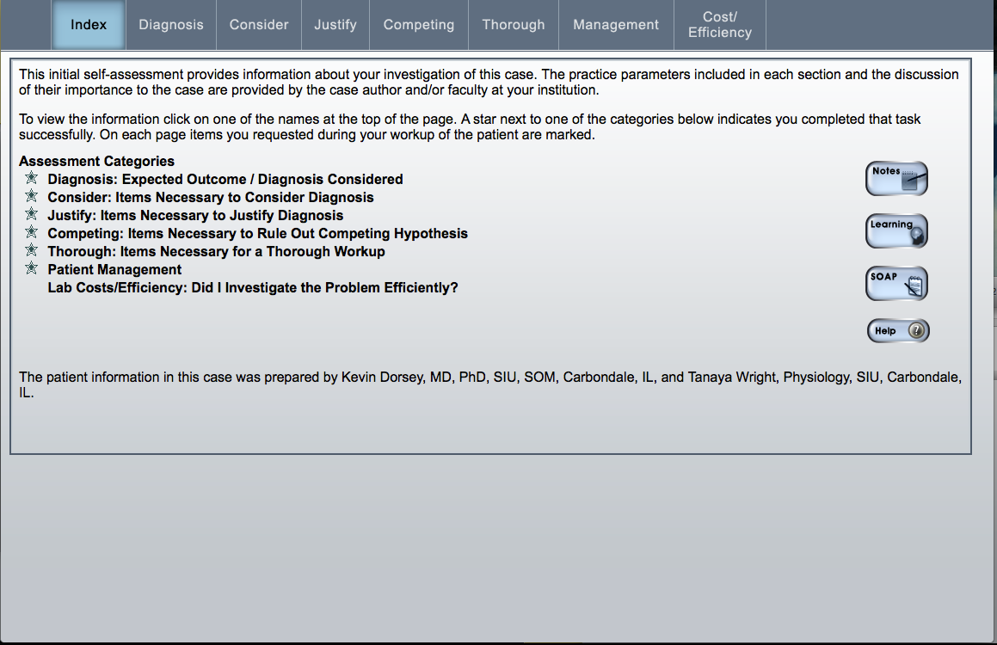

Slide 86
DXR Workshop
In the beginning of the year, the informatics department organized a workshop for “DXR”. We were divided into 2 groups (F1, F2):
in the 1st week F1 had the work shop
in the 2nd week F2 had the workshop
They taught us about the system and how to interact with it
They provided us with cases that are not graded (so we can practice how to use the system)
It is important to attend this workshop ( 2 marks ).

Slide 87
DXR throughout the year
Every theme had its DXR cases:
The cases became available once the new theme starts (according to the schedule)
The cases closed when the theme ended (last day of the theme, Thursdays)
A schedule was sent by the medical education department which contained how many cases we have to solve for every theme
(e.g: there are 6 cases in GI theme but we were only required to solve 4)
Both DXR + logbook account for 5 marks (out of total 100) in both surgery and medicine

Slide 88
DXR Tips
Try to finish them as soon as possible, don’t wait for the deadlines
Warning: Some patients have their bodies exposed (don’t solve DXR in front of non-medical people)

Slide 89
Special thanks to :
Samiha Aljetaily
Reem Alsalman
Tarfah Al-Obaidan
431
432

Slide 90
THANK YOU HAVE A GREAT THIRD YEAR

Slide 91
YOU can contact us anytime:
NADIA ALJOMAH:
432201030@STUDENT.KSU.EDU.SA
MOUDI ALDEGETHER
modi.satt@yahoo.com

