Slide 1
TRAVEL MEDICINE

Slide 2
Learning objectives
Define travel medicine and identify its components
Explain the importance of this branch of medicine in view of international travel
List the groups of travelers who are at a special risk
State the responsibilities of travelers to prevent ill-health
State the time and purpose of visiting a general practitioners by a potential traveler
List the risk associated with international travel and related health problems
Outline the specific preventive measures for international travelers in relation to the destination
Outline the health advice that should be provided to travelers

Slide 3
Definition of travel medicine
It is “The field of medicine concerned with the promotion of health … for the peoples, cultures and environment of regions being visited in addition to the prevention of disease or other adverse health outcomes in the international traveller .... It focuses primarily on pretravel preventive care”.
Source: “Committee to Advise on Tropical Medicine and Travel. Guidelines for the practice of travel medicine. An Advisory Committee Statement (ACS). Can Commun Dis Rep 2009;35(ACS-8):1-14”

Slide 4
Concerns
Growing volume of international travellers that reached 1 billion in 2010 and expected to reach 1.6 billion by 2020
International travel carries a risk for travelers, community of origin and community of destination
The risk for travelers includes diseases, injuries and death

Slide 5
Components of travel medicine
Medical evaluation Before travel and after return
Risk assessment Based on the health status of travelers, destination and timing, circumstances of travel
Preventive services Immunization and chemoprophylaxis
Travel advice Precautions that should be considered

Slide 6
CONSULTATION BEFORE DEPARTURE

Slide 7
Group of travelers at special risk
— Infants and young children
— Elderly
— Pregnant women
— Immuno-compromised
— Disabled
— Pre-existing medical conditions (diseases and surgery)

Slide 8
Evaluation of risk for traveler that are basis for action
— Mode of transport (air, sea)
— Destination(s)
— Security situations
— Duration and season of travel
— Purpose of travel
— Standards of accommodation and food hygiene
— Behavior of the traveller
— Underlying health of the traveller

Slide 9
Responsibilities of traveler
Decide on the travel destination and timing
Recognize and accept risk
Visit the general practitioner prior to traveling
Obtain travel insurance
Adhere to the preventive precautions
Carry medical kits and understand its use
Assume the responsibility of the health and safety of children
Respect people and culture in country of destination
Visit the general practitioner upon return

Slide 10
Responsibility of traveler: check status of destination
Warning level 1: Practice usual precautions
Presence of usual risk for infectious diseases as diarrheal diseases and malaria
Warning level 2: Practice enhanced precautions
Presence of MERS-CoV is Arabian Peninsula
Warning level 3: Avoid non-essential travel
Presence of outbreak (Ebola) and adverse security situation

Slide 11
Responsibility of traveler: consult general practitioner
Before departure
After arrival
Timing: 4 to 6 weeks
Purpose
Medical evaluation
Risk assessment
Receive preventive interventions
Travel advice
Have chronic diseases (cardiovascular disease, diabetes mellitus, respiratory disease, on anticoagulants)
Spent more than 3 months in a developing country
Received treatment for malaria while travelling
Exposed to a serious infectious disease while travelling
Experienced illness in the weeks following return (fever, persistent diarrhea, vomiting, jaundice, urinary disorders, skin disease or genital infection)

Slide 12
Responsibility of traveler: carry medical kits
Traveler’s medical kits
Usual medications in sufficient quantities
Essential medicine to meet common illnesses
Gastro-intestinal infections
Respiratory infection
First aid kits
Special items according to destination

Slide 13
Responsibility of traveler: issue travel insurance
Required in case of
Illness
Accident
Death
Covers
Changes to the itinerary
Emergency repatriation for health reasons
Medical care (illness and accidents)
Hospitalization
Repatriation of the body in case of death.

Slide 14
Risk factors and health problems facing international travelers
RISK
HEALTH PROBLEMS
Overcrowding
Low sanitation
Climatic change
Vector of diseases
Stray animals
Unsafe roads
Security problems
Aggravation of existing problem
Food and water borne infections
Air borne infections
Unintentional & Intentional Injuries
Vector borne diseases
Zoonotic diseases

Slide 15
Common diseases associated with international travel
Gastrointestinal
Traveler’s diarrhea
Typhoid fever
Hepatitis A
Cholera
Poliomyelitis
Respiratory diseases
Influenza
Meningitis
Mers-Cov
Tuberculosis
Vector borne diseases
Yellow fever
Malaria
Dengue fever
Leishmaniosis
Japanese encephalitis
Behavior related
Zoonotic diseases
Blood borne
Soil borne
Sexually transmitted diseases
Rabies
Hepatitis B
Tetanus

Slide 16
Unintentional and intentional injuries
Road traffic injuries
Inter-personal violence
Injury in recreational water
Animal bites (domestic and wild animals)

Slide 17
Preventive measures for common diseases among international travelers
Immunization or Chemoprophylaxis
and
General measures for the prevention of infectious diseases

Slide 18
Immunization for travelers
Timing 4 – 6 weeks before travel
(Accelerated schedule)
Type
Routine (Age-specific)
Recommended (Destination-specific)
Required (IHR)
Yellow fever
Meningococcal (Hajj)

Slide 19
Immunization for travelers
Weeks before travel
Departure
6
5
4
3
2
1
0
1st consultation
2nd consultation
Yellow fever
Meningococcal meningitis
Typhoid
Hepatitis A
Hepatitis B, A+B
Rabies
Japanese encephalitis
Diphtheria/tetanus
Measles
Poliomyelitis
Booster doses

Slide 20
Yellow fever vaccine
The vaccine
Live attenuated virus vaccine
Single subcutaneous injection
Immunity starts after 10 days
Valid for 10 years
Not recommended for
Infants < 9 months
Immune compromised patients
Pregnant women
Egg allergies
HIV-positive individuals

Slide 21
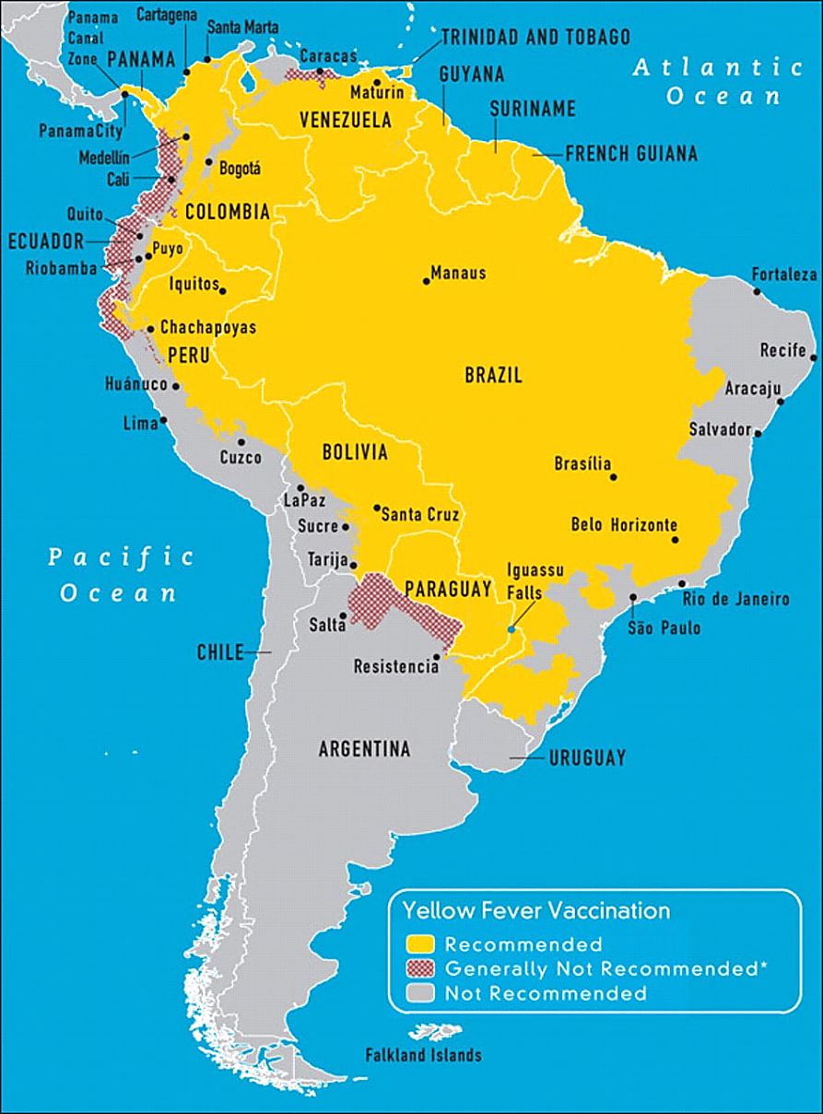
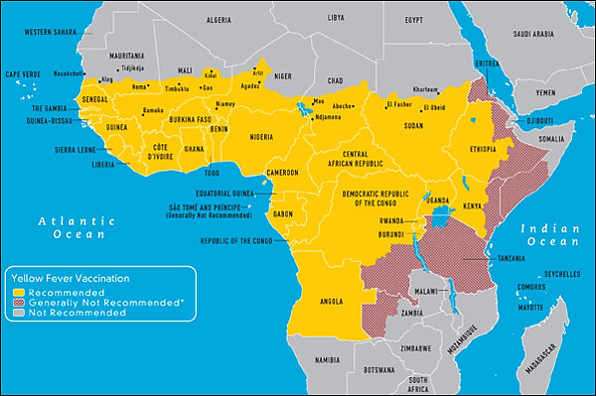
Yellow fever region
CDC, 2012

Slide 22
Meningococcal vaccine
The vaccine
Quadrivalent polysaccharide (MPSV4; A, C, Y, W-135)
Single dose subcutaneous injection for 55 years and older
OR/
Conjugated quadrivalent (MCV4) with diphtheria toxoid
Single intramuscular injection for 2 years – 55 years
Protection
Not effective for children below2 years
Protection is for 3–5 years in adults and older children
Required for entry to KSA for pilgrims in Hajj season
Recommended for travelers to sub-Saharan Africa (especially the dry season)

Slide 23
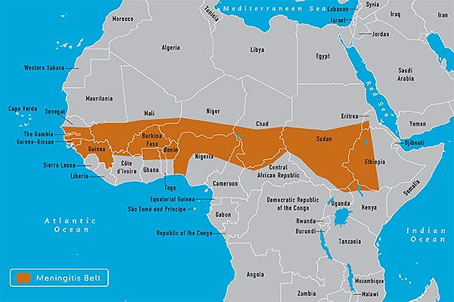
Meningitis region
CDC, 2012

Slide 24
Typhoid vaccine
The vaccine
Live attenuated (Ty21a)
Oral vaccine
Four doses (One capsule on alternating days not with antibiotics)
Schedule should be completed at least one week before traveling
Booster every 5 – 7 years
Vi capsular polysaccharide vaccine (ViCPS)
Single dose intramuscular injection
At least two weeks before traveling
Booster at 2 years intervals
Both vaccines are effective but differ in duration of immunity
Compliance may be a problem with oral vaccine
Recommended to travelers to developing countries

Slide 25
Hepatitis A
Endemic in many developing countries
Risk among travelers prior to wide spread immunization
3 – 6 per 1000 non-immunized travellers per month
Increases to 20 per 1000 among travellers who ventured off the usual tourist routes
Mortality is high among the elderly (1.2%) and pregnant women

Slide 26
Hepatitis A vaccine (concluded)
The vaccine
Two doses of inactivated parenteral vaccines (HAVRIX® or VAQTA®)
First dose: 70 – 85% develop antibodies within two weeks
Second dose: after12 to 18 months leading 100% sero-conversion
Protection
14 – 20 years in children
25 years among adults
Recommended
Travelers to the developing countries
2 years and older
Travelers in less than four weeks after the 1st dose should be administered immune globulin (0.02 mL/kg) at a different anatomic injection site**
A combined hepatitis A and hepatitis B vaccine is also available

Slide 27
Hepatitis B
At risk are those who
Workers in mid to high endemic areas for ≥ 6 months
Short term travelers
Medical relief workers
Receive medical care (injection, transfusion)
Engage in unprotected sex and parenteral drug abuse

Slide 28
Hepatitis B vaccine
The vaccine
Recombinant vaccine given by intramuscular injection
Monovalent including hepatitis B
Combined with hepatitis A (for those ≥ 18 years)
Regular schedule: 0-, 1-, and 6-month with no booster dose
Accelerated schedule for the combined vaccine only (FDA)
0-, 7-, and 21- days
Booster dose at 1 year
Recommended for travelers to endemic areas and travelers with special risk

Slide 29
Rabies vaccine
The vaccine
Human diploid cell vaccine (inactivated)
3 doses on 0, 7, and 21 or 28 (intramuscular)
Note:
Pre-exposure vaccine eliminates the need for rabies immune globulin (RIG) after exposure, but does not eliminate the need for additional post exposure rabies vaccinations.

Slide 30
Japanese encephalitis
The risk
Estimated risk in highly endemic areas during the transmission season can reach 1 per 5000 persons per month.
The disease
Mosquito borne viral disease
Present in most Asia and some parts of western pacific
Present in rural areas in rice and pig farms (pigs are not affected)
Case fatality may be as high as 30%
Severe neurologic sequelae occurs in 50% of survivors

Slide 31
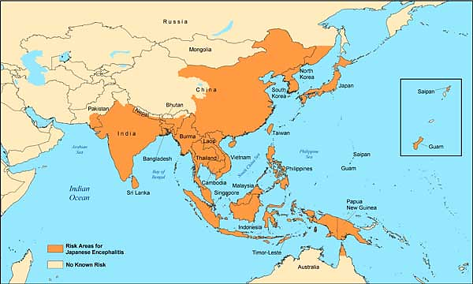
Japanese encephalitis
CDC, 2012

Slide 32
Japanese encephalitis vaccine
The vaccine
Two Inactivated vaccine; one prepared in brain mice and the other on cell culture
Intramuscular injection
Classic schedule of three doses: 0, 7 and 30 days
Accelerated schedule of two doses at 0 and 7 days (80% conversion)
The last dose should be at least 10 days before departure
Booster dose at 24 months if the risk continues
Vaccine should be given at least 10 days prior to departure because of the possible serious adverse reactions (generalized itching, respiratory distress, angioedema, and anaphylaxis) up to one week after vaccination and adequate immune response is not achieved for several days.

Slide 33
Other vaccines – influenza
The risk
Risk of exposure to the virus is throughout the year in tropical and subtropical areas
The attack rate is 1.2–2.8% in travelers of all age groups
The vaccine
Inactivated parenteral vaccine
live attenuated vaccine administered by nasal spray (for healthy persons 5–49 years)
Recommended to travelers to
tropics and subtropics at risk of serious related complications
Southern Hemisphere from April through September

Slide 34
Other vaccines - Tuberculosis
The vaccine
BCG vaccine
Live attenuated
Single intradermal injection
Recommended to long stay in developing countries
If not then
Baseline tuberculin before travel with a follow up every 1 year

Slide 35
Other vaccines - Cholera
Rare among European and North American travelers (0.2 per 100,000 travelers)
Rate among Japanese travelers was 13 per 100,000 returning from Indonesia in 1991
New vaccines
Live attenuated oral vaccine
Result in 60–80% protection for 6 to 12 months
Not effective against the new serotype O139 (spread rapidly through Asia in mid 90s)

Slide 36
Malaria chemoprophylaxis (cont.)
Proguanil (all areas)
1 – 2 days before departure, daily during the journey and 7 days after return
Doxycycline (all areas)
1 – 2 days before departure, daily during the journey and 4 weeks

Slide 37
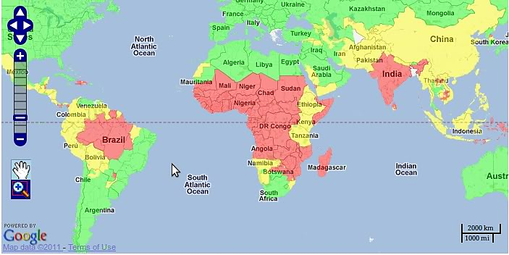
Malaria distribution
Red= malaria everywhere yellow=malaria in some provinces Green= not known

Slide 38
Malaria chemoprophylaxis (concluded)
Chloroquine (chloroquine sensitive areas)
1 – 2 weeks before departure, daily during the journey and 4 weeks after return
Primaquine (predominant vivax areas and ovale)
1 – 2 days before departure, daily during the journey and 7 days after return
Mefloquine (mefloquine sensitive areas)
2 weeks before departure, daily during the journey and 4 weeks after return
Notes:
For more information http://wwwnc.cdc.gov/travel/yellowbook/2014/chapter-3-infectious-diseases-related-to-travel/malaria#3939

Slide 39
Travel advice (cont.)
Maintain high level of personal hygiene
Wash hands with soap and water
Wear mask in overcrowded areas where respiratory infections are likely
Select food for safety
Drink bottled water and juice
Avoid insect bite; wear long sleeves, use repellants, sleep under net
Avoid close contact with stray and captivated animals
Seek immediate care in the event of animal bite

Slide 40
General measures to prevent road traffic injury
Obtain information on direction and road conditions; avoid unfamiliar roads
Check condition of rented car
Wear seat belt and follow speed limit
Avoid getting in an argument than may lead to physical violence
Avoid getting in verbal arguments that could lead to interpersonal violence
Avoid unfamiliar places, others home or hotel room until you know them well
Keep valuables out of sight (jewelry, cameras and large cash)
Don’t resist if stopped by armed robbers

