Slide 1
COMPUTERIZED PHYSICIAN ORDER ENTRY (CPOE)
Ahmed Albarrak
301 Medical Informatics
albarrak@ksu.edu.sa

Slide 2
Outline
Definition and context
Advantages of CPOE
Disadvantages of CPOE
Outcomes and examples
Same system other outcome

Slide 3
What is Computerized Physician Order Entry (CPOE)?
Ordering of tests, medications, and treatments for patient care using computers
Involves electronic communication of the orders
Often use rules-based methods for checking appropriateness of care
Notes:
CPOE is the ordering of tests and medications as well as other treatments for patient care using computers.
It often involves electronic communication of the orders as well as the use of rules-based methods for checking against drug references and other electronic information resources.
CPOE have automated rules engines or “if-then” logic statements that can lend physicians a powerful support element.
Based on data entered by the physician and pre-determined "if-then" logic statements, embedded decision support tools can remind doctors of certain risks or recommendations as the doctor’s orders interact with known patient information stored within the database.
More sophisticated systems may also include integration of lab results and the use of decision support.

Slide 4
Definitions
Information system—an arrangement of—
Data
Processes
People
Technology
interaction to collect, process, store, and provide the information needed to support the organization.

Slide 5
CPOE comprised physician order entry
CPOE is a solution to a current human system problem that focuses on achieving improved quality and safety for patients

Slide 6
CPOE, EHR and DSS
Documentation
Medication
DSS
EHR
Test reports (EKG, PFT)
Radiology, lab results
CPOE
Notes:
EHR - Repository of electronically maintained information about lifetime health status and health care which may include:
Orders via CPOE
Documentation (progress notes, office visits, consults)
eMAR (what medications were administered)
Radiology, lab, path results
Test reports (EKG, PFT, etc)
Clinical Decision Support (triggered in care of patient)

Slide 7
Technical Infrastructure
EHR
Drug information database
DSS
Others

Slide 8
Strategic Objectives
Endorsement of CPOE
Establish CPOE as an Institutional Commitment and Goal
Identify CPOE as a Quality and Safety Improvement Initiative

Slide 9
Example DSS in CPOE – medication prescription
Allergy
Age (check drug name and dose)
Duplicate drugs on active orders, not one-time
Severe drug interactions
Drug-drug, drug-food
Dose maximum
Drugs with opposite actions

Slide 10
CPOE—National Perspective
Why?
November 1999:
Report from the Institute of Medicine
To Err is Human: Building a Safer Health System
44,000-98,000 patient deaths/year in U.S. hospitals due to medical errors
Increased focus on patient safety and on quality of care
CPOE is viewed as an important tool to improve patient safety and quality of care delivered

Slide 11
Why?
11
“the science and technologies involved in healthcare -- the knowledge, skills, care interventions, devices and drugs – have advanced more rapidly than our ability to deliver them safely, effectively, and efficiently”
IOM. 2001. Crossing the Quality Chasm: A New Health System for the 21st Century.

Slide 12
Definitions
12
© 2008 Board of Trustees of U of IL
EMR (Electronic Medical Record) – the set of databases (lab, pharmacy, radiology, clinical notes, etc.) that contains the health information for patients within a given institution or organization
CDS (Clinical Decision Support) component - software that makes relevant information available for clinical decision-making (clinical data, references, clinical guidelines, situation-specific advice)
CPOE (Computerized Physician Order Entry) component – enables clinicians to enter orders (tests, meds, dietary, etc.)
CCR (Computerized Clinical Reminder) – just-in-time reminders at the point of care that reflect evidence-based medicine guidelines

Slide 13
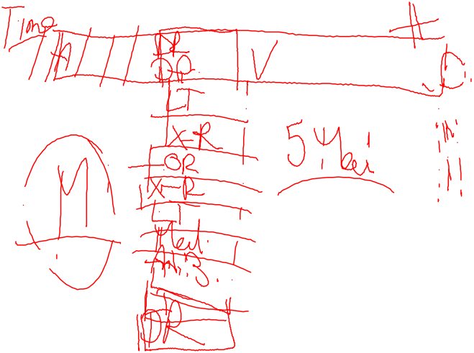

Slide 14
Medical Informatics tools can…
14
© 2008 Board of Trustees of U of IL
Improve communication
Make knowledge more readily accessible
Assist with calculations
Perform checks in real time
Assist with monitoring
Provide decision support
Require key pieces of information (dose, e.g.)

Slide 15
CPOE
CPOE is a computer application (function) that process physician orders
Meds
Laboratory Tests
Diagnostic Studies
Ancillary Support
Nursing Orders
Consults

Slide 16
CPOE—What It Does?
Provides Decision Support
Warns of Drug Interactions
Drug-Drug
Drug-Allergy
Drug-Food
Checks Dosing
Reduces Transcription Error
Reduces number of lost orders
Reduces duplicative diagnostic testing
Recommends cost effective, therapeutic alternatives

Slide 17
CPOE
17
© 2008 Board of Trustees of U of IL
In 2005, only 4% of hospitals in USA are in full compliance with CPOE; 17% have made good progress.
Government and larger teaching hospitals are more likely to have implemented CPOE.
Source: Cutler EM, Feldman NE, Hurwitz JR. US Adoption of Computerized Physician Order Entry Systems. Health Affairs 2005 Nov/Dec;24(6):1654 – 1655.

Slide 18
Example CPOE improves adherence to guideline
Teich JM et al. Arch Intern Med. 2000 Oct 9;160(18):2713-4.
Notes:
A time series analysis was performed at an urban academic medical center at which all adult inpatient orders are entered through a computerized system.
When physicians enter drug orders, the computer displays drug use guidelines, offers relevant alternatives,
and suggests appropriate doses and frequencies.

Slide 19
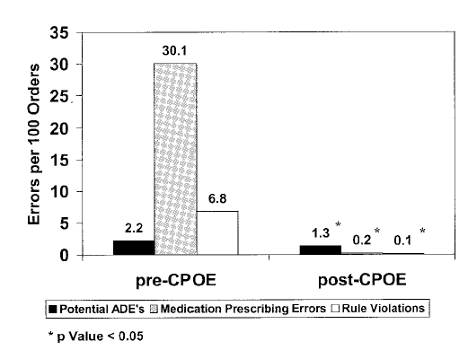
Example CPOE reduce errors
Potts studied ADE rates in 13,828 medication orders before/after CPOE implementation at Vanderbilt Children’s PICU:
Potts AL, Barr FE, et al. Pediatrics. 2004 Jan;113(1 Pt 1):59-63.

Slide 20
Example CPOE introduces errors
Brigham and Womens' Hospital, Boston introduced a CPOE
After implementation, the rate of intercepted Adverse Drug Events (ADE) doubled!
Reason: The system allowed to easily order much too large dosages of potassium chloride without clear indicating that it be given in divided doses.
Bates et al The impact of computerized physician order entry on medication error prevention. JAMIA 1999, 6(4), 313-21.
 | pre | period1 | period2 | period3
Potential ADEs/1000 pt-days | 15.8 | 31.3 | 59.4 | 0.5
Notes:
Period 1: 5 months after CPOE implem
Period 2: after implementing allergy guidelines
Period 3: after significant potassium chloride changes

Slide 21
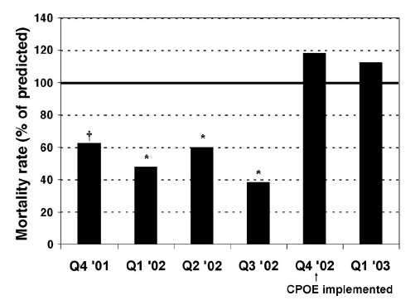
Example CPOE introduces errors
Association with increased PICU mortality:
2.8% 14 months before CPOE
6.4% 5 months after CPOE
Han YY, Carcillo JA, et al. Pediatrics. 2005 Dec;116(6):1506-12.
Notes:
Many of the implementation strategies used by CHP in their pediatric intensive care unit (PICU) have been previously identified as problematic including: (a) absence of critical care physician active and meaningful involvement in system design, decision support tools and implementation strategies; (b) use of an adult-based general medical ward platform not designed/redesigned for the organization’s needs or the requirements of critical care practitioners; (c) a training period for clinicians ending a full 3-months prior to implementation rather than using just-in-time training; (d) absence of order sets – widely regarded as the single most import factor for enabling physician work flow; and (e) adoption of a slow and inefficient platform with inadequate performance during peak periods (2,3). In addition, decisions to move from a decentralized to a centralized pharmacy and acceptance of a CPOE platform which did not allow simultaneous users to enter/review medications were counterintuitive in a busy critical care unit. Furthermore, it appears that computer terminals were not optimally placed or were immobile and insufficient in number to allow nurses to carry on their work at the bedside, thus interfering with patient care.

Slide 22
Example CPOE reduce costs
Brigham and Women’s Experience: Cost-Effective
Cost:
$3.7 million implementation
$ 600,000 to $1.1 million operational costs
Results:
Decreased drug costs
ADE cost is approximately $4,700
Kausal R et al. J Am Med Inform Assoc. 2006; 13(3): 365-7
Notes:
It took six years for BWH to realize a net benefit and over seven years for
BWH to realize an operating budget benefit from CPOE.

Slide 23
CPOE: Lessons From Other Institutions
Leadership
Physicians need to lead the effort as the primary users
However, CPOE is an interdisciplinary project that requires input and coordination with all clinical groups (nursing, PT/OT, Case Management, Pharmacy, Lab, Radiology, etc.) and I.T.
Commitment
CPOE affects the workflow and process of all caregivers and ancillary departments, not just physicians
Success requires commitment to change at all levels
Support
Responsiveness and Flexibility are key
Must be ongoing, not just at rollout

Slide 24
The Need for CPOE
Improved patient safety
Improved quality
Improved efficiency
Reducing operating costs

Slide 25
CPOE
25
© 2008 Board of Trustees of U of IL
Bobb A, et al. The epidemiology of prescribing errors: The potential impact of CPOE. Arch Intern Med 2004;164:785 – 792.
A CPOE with an advanced level of CDS is needed to prevent many of the prescribing errors with the greatest potential to lead to patient harm.
Basic = drug-allergy, drug-drug interaction & duplicate therapy checking, basic dosing guidance, formulary decision support
Advanced = dosing for renal insufficiency and geriatric patients, guidance for medication-related lab testing, drug-pregnancy and drug-disease contraindication checking

Slide 26
CPOE
26
© 2008 Board of Trustees of U of IL
Campbell EM, Sittig DF, Ash JS, Guappone KP, Dykstra RH. Types of unintended consequences related to CPOE. JAMIA 2006;13:547-556.
Ash JS, Sittig DF, Poon EG, Guappone K, Campbell E, Dykstra RH. The extent and importance of unintended consequences related to CPOE. JAMIA 2007;14:415 - 423.
More/new work for clinicians
Reduce redundancy in info collection, display relevant info in logical locations, reduce keyboarding
72% said it was a moderate to very important issue
Unfavorable workflow issues
Model clinical workflow wherever possible
87% said it was a moderate to very important issue
Never ending system demands
Reassess quality assurance measures and user retraining
82% said it was a moderate to very important issue

Slide 27
Reasons for CPOE
Order Communication
Clarity of Orders
Ease of Identifying the Ordering Physician
Standardization of Care
Clinically validated order sets for
Clinical diagnoses
Procedures
Situations (post-op order sets)
Alerts and Reminders (Real Time Decision Support)
Drug Safety Database (Conflict Checking)
Clinically validated rules

Slide 28
Patient Safety
Institute of Medicine
Report on medical errors released 1999
Estimated that between 44,000 and 98,000 hospital deaths/year are due to medical errors
Some question the accuracy of the estimates but has raised public awareness and concern
Top 10 Causes of Death 1998
Heart Disease 724,269
Cancer 538,947
Stroke 158,060
Lung Disease 114,381
Medical Errors 98,000*
Pneumonia 94,828
Diabetes 64,574
Motor Vehicle 41,826
Suicide 29,264
Kidney Disease 26,295
* Estimated

Slide 29
Medication Errors
Two recent Harvard studies found that physician ordering errors accounted for 56%-78% of all preventable Adverse Drug Events
Bates et al. JAMA 1997;277:307-311
Kaushal et al. JAMA 2001;285:2114-2120

Slide 30
Medication Errors
Physician drug ordering errors are most often due to one of two causes:
Lack of knowledge about the drug
Wrong dose
Wrong frequency
Drug-drug interaction
Incomplete patient information
Documented allergies
Recent lab results

Slide 31
CPOE Can Help Reduce Errors
Brigham and Women’s Hospital launched its first CPOE in 1993
Since then, they have documented a 54% reduction in serious medication errors
Resulted in 62% reduction in preventable ADE’s

Slide 32
Improved Efficiency
Maimonides Medical Center (Bronx, NY)
700 bed teaching hospital
After CPOE, found substantial reduction in order processing time
Physician order to receipt by pharmacy
3.4 hours 0.5 hours
Physician order to Delivery to Patient Care Area
4.6 hours 1.4 hours

Slide 33
Does CPOE Take More Time?
Time Spent/Patient Encounter—Duplicate Tasks Removed (minutes)
Time Spent/Patient Encounter (minutes)
36.3
34.2
35.1
34.2
6.2
6.9
6.2
5.7
Evidence shows that CPOE adds less than one minute to the time physicians spent writing orders and overall only added 1-2 minutes per patient encounter. As physicians gained experience with the system, the time for orders actually decreased.
(Overhage JM, et al J Am Med Informatics Associ 2001;8:361-371)

Slide 34
CPOE
The clinical benefits for improved patient care clearly outweigh the perceived concerns.

Slide 35
What Is Needed For Success?
Clinicians
End-users (clinicians) must be willing to champion the implementation of CPOE
Clinicians must be involved in design and implementation of the system
Clinicians must be flexible and willing to change workflow processes

Slide 36
What Is Needed For Success?
Information Technology (I.T. Department)
Ensure fast, reliable, and easily accessible system
Provide ongoing support
Train, educate users
Institution
Commitment to workflow changes

Slide 37
CPOE--Summary
CPOE is a key component to improve Patient Safety and Quality of Care
The focus needs to be on workflow and process of care changes that are necessary for optimal patient care—Not on implementing a new computer system
Commitment from clinicians to help with process design and implementation is critical for success.

Slide 38
CPOE--Summary
CPOE is process to improve patient care, not an I.T. project

Slide 39
Best luck with
Patients care

