Slide 1
DEMYELINATING DISEASES (MULTIPLE SCLEROSIS)
DR. Nuha Alkhawajah
Assistant Professor
Consultant Neurologist

Slide 2
MYELIN

Slide 3
MYELIN
A lipid dense layer that surrounds the axon of the neuron
Insulates the axon and allows continuous propagation of the electrical impulse
Schwann cells peripheral nervous system (PNS) neurons
Oligodendrocytes central nervous system (CNS).

Slide 4
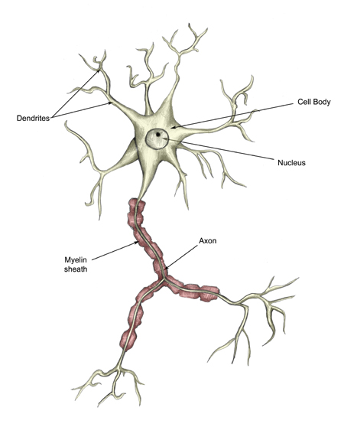
MYELIN

Slide 5
DEMYELINATING DISEASAES

Slide 6
DEMYELINATING DISEASAES
Damage of the myelin
PNS & CNS
Inherited or acquired
CNS: multiple sclerosis (MS), acute dissaminated encephalomyelitis (ADEM), neuromyelitis optica (NMO)
PNS: acute inflammatory demyelinating polyneuropathy (Guillain Barre syndrome), chronic inflammatory demyelinating polyneuropathy (CIDP).

Slide 7
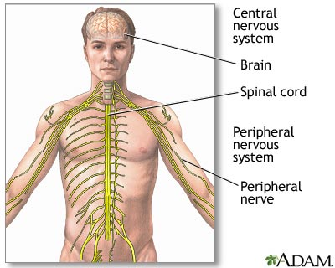
CNS & PNS

Slide 8
1-Multiple Sclerosis

Slide 9
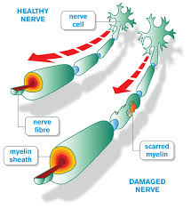
1-Multiple Sclerosis

Slide 11
MS Epidemiology
Among the most common neurological diseases in young adults
More common in females (1.5-2.5:1)
Mean age of presentation is 30 years

Slide 12
MS Epidemiology
More people with MS were born in May and fewer people were born in November.
First degree relatives are at 15-33 times greater risk.
More common in North America and Europe
Rare in the tropics

Slide 13
Environmental Risk Factors
Infections:
History of infectious mononucleosis (EBV) is associated with higher susceptibility to MS
Antibodies to EBV were higher in people who developed MS than in control samples.
HHV6: antibodies were three times higher in women with progressive MS.
Vitamin D:
sunlight may be protective (ultraviolet radiation or vitamin D)
sun exposure & serum vitamin D are inversely related to risk/prevalence of MS
vitamin D levels are inversely related to MS disease activity

Slide 14
Cont.
3. Smoking:
a higher risk of MS in ever-smokers than in never-smokers
smoking may also be a risk factor for disease progression
Dietary Salt
Obesity:
in adolescence or early adulthood is associated with increased risk for MS
leptin increases the proliferation of auto-aggressive cells responsible for myelin damage.

Slide 15
MS Pathology
Pathologic hallmark is focal demyelinated plaques
Variable degrees of inflammation, gliosis, and neuro-degeneration
Recurrent relapses lead to permanent myelin damage and oligodendrocytes loss

Slide 16
MS COURSE:
Relapsing remitting (RRMS)
Secondary progressive (SPMS)
Primary progressive (PPMS)
Relapsing progressive (RPMS)

Slide 17
MS COURSE:

Slide 18
أنواع التصلب المتعدد
الإنتكاسي
التقدمي الثانوي
التقدمي الإبتدائي
الإنتكاسي التقدمي

Slide 19
MS Course
Relapsing remitting (RRMS), secondary progressive (SPMS), primary progressive (PPMS) or relapsing progressive (RPMS) MS
80% of the patients will have a relapsing remitting course
50% of the RRMS will become secondary progressive

Slide 20
MS Symptoms

Slide 21
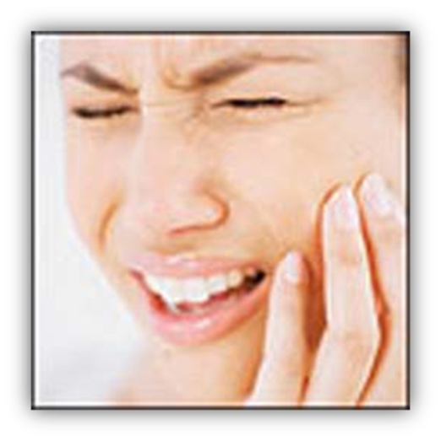
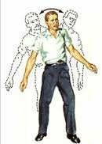
MS SYMPTOMS

Slide 22
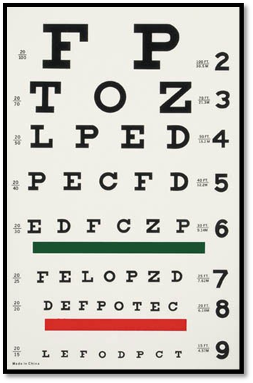
MS SYMPTOMS

Slide 23
OPTIC NEURITIS
Blurred vision
Pain exacerbated by eyes movement
Reduced perception of colors
Flashes of light on moving the eyes
Enlarged blind spot

Slide 24
BRAIN STEM RELATED MS SYMPTOMS

Slide 25
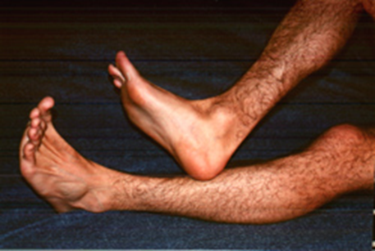
CEREBELLUM RELATED MS SYMPTOMS
A visual disturbance in which the object in the visual field appears to oscillate
Oscillopsia
Dysarthria
Imbalance

Slide 26
BRAIN AND SPINAL CORD MS SYMPTOMS
Electric like sensation induced by neck flexion
Cognitive dysfunction: memory, concentration, depression, processing speed
Weakness (monoparesis, paraparesis, quadriparesis)
Sensory loss/numbness/pain
Sphicteric dysfunction
Lhermitte’s sign??

Slide 27
Transverse myelitis
A general term that indicates inflammation of the spinal cord
Could be caused by MS, NMO, infections, connective tissue diseases…..
Spinal cord related motor, sensory &/or autonomic dysfunction
Sensory level
Unilateral or bilateral
CSF: increased WBC count and proteins

Slide 28
Uhthoff’s Phenomena
Neurological dysfunction
Stereotyped
Less than 24 h
Reversible
Related to fluctuations in axonal conduction properties due to increasing body temperature

Slide 29
MS Relapse or Attack
Patient-reported symptoms or objectively observed signs
Typical of CNS acute inflammatory demyelinating lesion
Lasting at least 24 hrs
No fever or infection

Slide 30
Diagnosing MS
McDonald diagnostic criteria:
Dissemination in time: history of at least two attacks
Dissemination in space: clinical evidence of involvement of two CNS sites OR of one lesion with reasonable historical evidence of another site being affected
History & Exam

Slide 31
Diagnosing MS
Clinically Isolated Syndrome

Slide 33
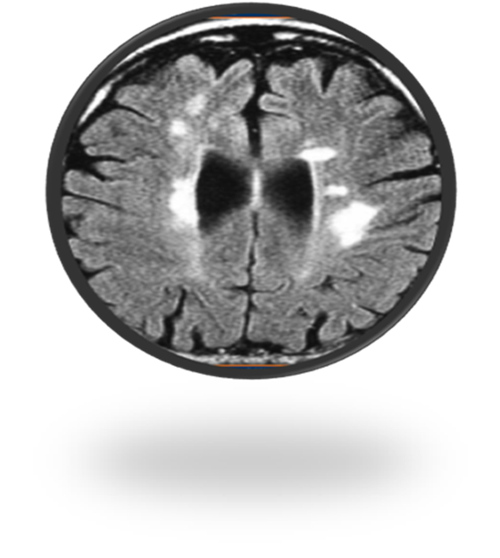
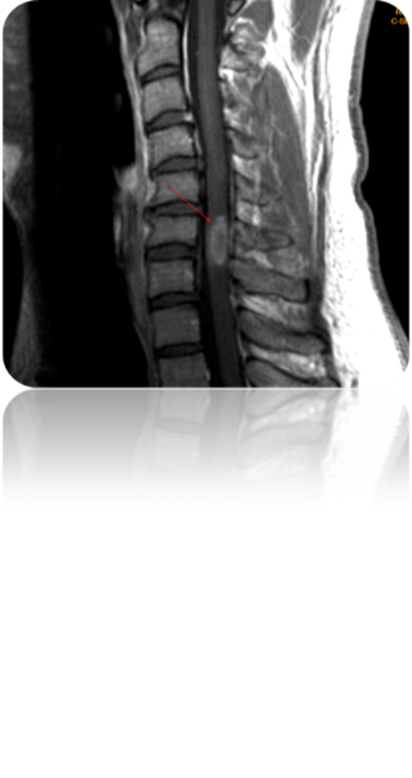
DIAGNOSIS OF MS
Imaging: MRI of the brain and spinal cord

Slide 34
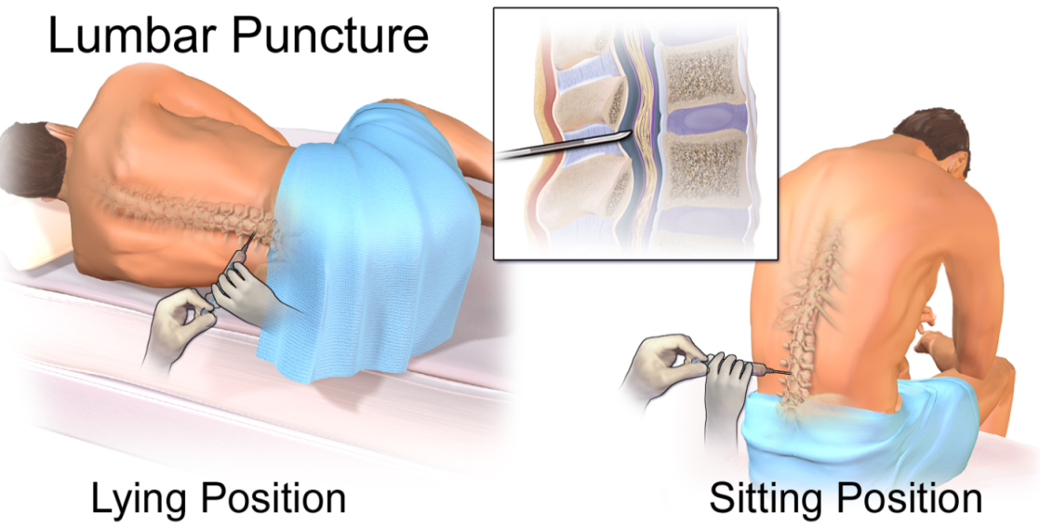
MS Diagnosis
Lumbar puncture: oligoclonal bands and IgG index
Image from Wikipedia

Slide 35
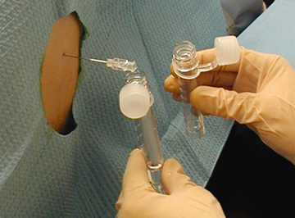
iik
Image from WISER

Slide 36
MS PROGNOSIS
Fifty percent of patients will require a cane 28 years after disease onset
Twenty five percent will require a wheelchair 44 years after disease onset

Slide 37
MS PROGNOSIS

Slide 38
MS PROGNOSIS

Slide 39
EXPANDED DISABILITY STATUS SCALE (EDSS)

Slide 40
MS Treatment
Acute treatment of relapses
Disease Modifying treatments

Slide 41
MS TREATMENT
Acute treatment of relapses
Steroids for 3-5 days
plasma exchange

Slide 42
MS TREATMENT
Disease Modifying treatments
Reduction of number of relapses per year
Reduction of number of new MRI lesions
Prolongation of time to development of secondary progressive disease
Reduction of long term disability

Slide 43
MS TREATMENT
1980’s: Steroids for relapses only
1990’s: Disease modifying therapies (interferon and copaxone)
2000’s: Mitoxantrone for aggressive MS and Natalizumab
2010’s: Oral medications now available (Fingolimod, teriflunomide, dimethylfumarate.. )

Slide 44
2-NEUROMYELITIS OPTICA

Slide 45
2-NEUROMYELITIS OPTICA
Also known as Devic’s disease
More common in females (9:1)
Mean age is 10 years later than MS
More common in Asian and African populations
Affects mainly the optic nerves and the spinal cord
More severe attacks than in MS

Slide 47
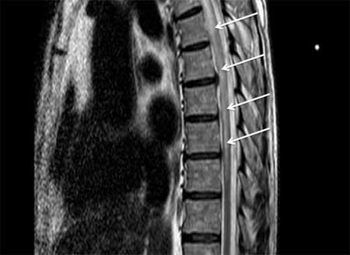

Slide 48
NMO Pathology
Astrocytopathy
Targets aquaporine 4 (a water channel) rich areas (aquaporine 4 abd in 70%)
Vasculocentric deposition of immunoglobulin and complement

Slide 49
NMO Treatment
Acute treatment of relapses
steroids or plasma exchange
Disease Modifying treatments
chronic immunosuppression with azathioprine, Rituximab, mycophenolate mofetil, cyclophosphamide….

Slide 50
NMO TREATMENT
MS treatment may worsen NMO

Slide 51
3-ADEM

Slide 52
3-ADEM
Acute disseminated encephalomyelitis
CNS inflammatory demyelinating disease
Frequently preceded by vaccination or infection
More common in children
Equal males to females ratio
Affects all ethnicities
Usually a monophasic illness (no relapses)

Slide 53
ADEM Pathology
Wide spread white and gray matter perivenous ‘‘sleeves’’ of inflammation and demyelination
Axons are relatively spared

Slide 54
ADEM
SYMPTOMS:
Encephalopathy (lethargy, stupor, coma)
multifocal neurological deficit (visual symptoms, ataxia, TM..)
May fluctuates over a 3 months period

Slide 56
ADEM TREATMENT
Acute treatment: Steroids, plasma exchange and intravenous immunoglobulins

Slide 57
SUMMARY
MS:
A demyelinating disease
Can affect any part of the CNS
A disease of young adults
More common in females
RR course is the most common initial course

Slide 58
SUMMARY
NMO
A demyelinating disease
Can affect any part of the CNS but mainly optic nerve and spinal cord
Older group in acomparison to MS
More in females
Relapsing course

Slide 59
SUMMARY
ADEM
ACUTE INFLAMMATORY DEMYELINATING DISEASE
MONOPHASIC
MORE COMMON IN CHILDREN
FOLLOWS INFECTION OR VACCINATION
ENCEPHALOPATHY IS A PREREQUISTE FOR THE DIAGNOSIS IN CHILDREN

Slide 60
MS vs NMO vs ADEM
 | MS | NMO | ADEM
AGE | 30 | 40 | 5-8
GENDER | females 1:1.5-2.5 | females 1:9 | Equal or males 1-1.3:1
ETHNICITY | NA and Europe | Asia | all
SYMPTOMS | CNS | CNS (ON AND TM) | CNS
COURSE | RR/progressive | Relapsing | Monophasic
TRANSVERSE MYELITIS | Yes <3 v. segments | Yes > 3 v. segment | Yes <3 v. segments
ACUTE TREATMENT | Streoids and PLEX | Streoids and PLEX | Streoids and PLEX
Disease Modifying treatment | Yes | Yes | No need

