Slide 1
Myopathy
Dr. Hana Albulaihe consultant Neurologist

Slide 2
MYOPATHY
MYO- is muscle , pathos is suffering in Greek.
Disorders in which there is a primary functional or structural impairment of skeletal muscle.

Slide 3
Approach to myopathy
The evaluation of the patient presenting with a complaint of “weakness” involves the following steps:
Distinguishing true muscle weakness from asthenia or motor impairment not due to loss of muscle power.
Localizing, within the neuromuscular system, the site of the lesion that is producing weakness.
Determining the cause of the lesion

Slide 4
Distinguishing between myopathy and non myopathic pain or weakness is the first step in evaluating patients with muscle-related complaints.
SOB, joint pain, fatigue, poor exercise tolerance or paresthesia, rather than a true muscle weakness.

Slide 5
Symptoms:
Positive symptoms:
Myalgia
Myotonia.
Cramps.
Contractures.
Myoglobinuria.

Slide 6
Negative symptoms:
Weakness.
Atrophy.
Exercise intolerance.
Periodic paralysis.

Slide 7
Weakness
Weakness is a cardinal symptom.
The distribution of weakness is variable and may change over time.
Complaints such as difficulty arising from a chair or low toilet, difficulty climbing stairs, a waddling gait, difficulty lifting objects over the head, combing hair or brushing teeth.
Distal weakness is less common.

Slide 8
Weakness
Patients with proximal leg weakness may rise from sitting on the floor by climbing up their legs with their hands. This is called “ Gower’s Sign”.

Slide 9
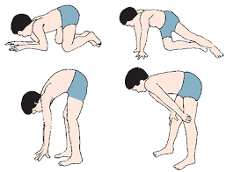

Slide 10
Weakness
Onset.
Course.
Limbs involved.
Muscle involved.
Progression.
Presence of sensory/ autonomic symptoms.

Slide 11
Weakness
Define pattern of weakness:
Proximal limb girdle.
Distal distribution.
Scapuloperoneal distribution.
Distal arm and proximal lower limb.
Associated symptoms: ptosis / ophthalmoplegia / cardiac/ respiratory.

Slide 12
Exercise intolerance
A less reliable negative symptom.
Often reflects the general level of conditioning and health.
In patients without any objective weakness, depression should be considered.

Slide 13
Exercise intolerance
Exclude certain metabolic myopathies or mitochondrial cytopathies.
Ask if it is elicited by brief or long term exercise (carbohydrates or lipid metabolism).

Slide 14
Myalgia
Infrequent symptom.
Orthopedic or rheumatologic conditions are more frequent causes.
Constant proximal muscle pain often accompanies inflammatory myopathies.
Episodic myalgias after exercise point to metabloic myopathies.
In patients with waxing and waning diffuse myalgias, anexity should be ruled out.

Slide 15
Cramps
Involuntary contractions of muscle that last for seconds to minutes.
Most are benign and occur predominantly in calves.
Risk factors are old age, dehydration, prolonged sitting, use of diuretics, hypothyrodism and DM.
They are most common in motor neuron disease and chronic neuropathies rather than myopathies.
Cramps are only common in metaboic.

Slide 16
Myotonia
Impaired relaxation after sustained voluntary contractions.
A painless phenomenon.
Commonly involves intrinisic hand muscles and eyelids.
It is due to repetitive depolarization of the muscle fibers.
It improves with repeated exercise.

Slide 17
Myotonia
Clinically myotonia can be seen by tapping the muscle ( percussion myotonia) or by voluntary contractions of muscle groups ( action myotonia).
Typical tests are squeezing the hand of the examiner or forceful closure of the eye.

Slide 18
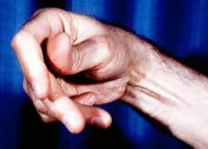

Slide 19
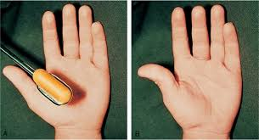

Slide 20
Myoglobinuria
Excess myoglobin in urine resulting in a cola colored urine.
It is an uncommon finding.
Severe and relatively acute muscle fiber damage.

Slide 21
Myoglobinuria
Causes:
Idiopathic.
strenuous exercise.
Drugs or toxin intake.
Infections.
Heat stroke.
In case of recurrent myoglobinuria, glycogenoses, lipid storage myopathies or central core disease with malignant hyperthermia should be ruled out.

Slide 22
Lab investigations:
*Muscle enzymes:
CK.
Aldolase.
LDH.
Aminotransferase.
*ANA, ENA antibodies( anti Ro/SSA, anti La/SSB, anti Sm, and anti RNP)

Slide 23
Lab investigations:
Myositis specific antibodies ( anti-histidyl-t-RNA aynthase anti Jo-1 ).
Genetic testing.

Slide 24
Electromyography:
Electrodiagnostic technique for evaluating and recording the electrical activity produced by skeletal muscles, the signals can be analyzed to detect abnormalities.

Slide 25
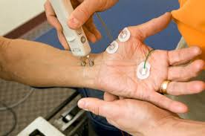
NCS

Slide 26
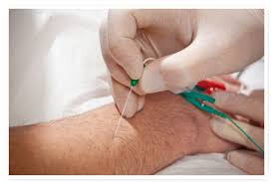
EMG

Slide 27
MRI
Muscle biopsy.

Slide 28
Classification

Slide 29
Congenital myopathies.
Muscular dystrophies.
Channelopathies.
Metabolic myopathies.
Mitochondrial myopathies.
Inflammatory myopathies.
Toxic, metabolic and infectious.

Slide 30
Congenital myopathies

Slide 31
Congenital myopathies
Clinical characteristics present from birth or prenatally.
Prenatal: decreased fetal movement.
Postnatal: hypotonia, poor respiratory effort, difficulty feeding, reduced muscle bulk, weakness.
First year and beyond: hypotonia, weakness, delayed milestones, failure to thrive, recurrent respiratory infections, flaccid speech.
Slow or non progressive course.

Slide 32
Congenital myopathies
Central core disease.
Multicore (minicore) disease.
Nemaline myopathy.
Myotubular (centronuclear) myopathy.
Myofibrillar myopathy.
Congenital fiber type disproportion.

Slide 33
Congenital myopathies
Managemet:
Genetic counseling.
Detection and treatment of orthopedic complication.
Prevention of complications ( general anaesthesia).

Slide 34
Malignant hyperthermia
Hypermetabolic crisis.
MH- susceptible individual is exposed to a volatile anaesthetic or succinylcholine.
Genetic skeletal muscle receptor abnormalities allowing excessive calcium accumulation in the presence of certain anaesthtic triggering agents.

Slide 35
Malignant hyperthermia
Symptoms:
Masseter spasm immediately following anaesthetic induction.
Hypercarbia.
Sinus tachycardia.
Generalized muscular rigidity.
Tachypnea.
Cyanosis.

Slide 36
MH
Rapidly increasing temperature is a later sign of MH and is typically absent when the diagnosis is initially suspected.
Sweating
Cola- colored urine.
Ventricular fibrillation.

Slide 37
Muscular dystrophies

Slide 38
MD
Inherited myopathies.
Variable age at onset.
Progressive degeneration of the muscles with connective tissue replacing muscle fibers.
Systemic involvement.

Slide 39
MD
Dystrophinopathies ( Duchenne and Beker).
Emery- Dreifuss muscular dystrophy.
Autosomal dominant dystrophies:
* fascioscapulohumeral MD.
* Oculopharyngeal MD.
* Congenital and proximal myotonic dystrophy.
Limb girdle MD.

Slide 40
Dystrophinopathies
X linked recessive disorders.
Duchenne and becker (DMD, BD).
Caused by mutation in the dystrophin gene.
Dystrophin provides mechanical reinforcement to the sacrolemma and stabilizes the glycoprotein complex.
Its absence causes digestion of the glycoprotein complex.
This initiates degeneration of the muscle fiber resulting in muscle weakness.

Slide 41
Duchenne MD (DMD)
Motor developmental delay.
Toe walking, as a compensation for the progressive weakness of the knee extensors.
Difficulty rising from sitting position.
Gower’s sign.
Lumber lordosis, waddling gait, pseudo-hypertrophy of the calves.
12 years: loss of ambulation, marked wasting of muscles, contractures, kypho-scoliosis, exaggerated lumber lordosis.
Death due to respiratory complication between 15-30 years.

Slide 42
DMD
Systemic involvement:
Cardiomyopathy: CHF and arrhythmias.
Malignant hyperthermia like reactions with rhabdomyolysis.
Intestinal pseudo-obstruction.
CNS involvement: mental retardation, learning disabilities.

Slide 43
DMD
Investigation:
CK is markedly elevated early in the disease.
Electromyography: myopathic potentials.
Muscle biopsy: necrosis, replacement with connective tissue and fibrosis, variation in muscle fiber size, absent dystrophin.

Slide 44
DMD
Management:
Early detection of systemic involvement:
Assessing for evidence of cardiac dysfunction and treatment accordingly.
Screening for orthopedic complications to maintain function and prevent contractures.
Dietary calcium and vitamin D supplementation, and yearly DXA scanning.
Weight and growth monitoring.
Avoidance of anaesthesia and sedation if possible.

Slide 45
DMD
Glucocorticoids are the mainstay.
Boys 5 years and older who are no longer gaining motor skills or whose motor skills are declining.
It increases strength, muscle and pulmonary functions.
Reduces cardiomyopathy and lower mortalitiy.
Has an anabolic action in contrast to its catabolic action on normal skeletal muscle in unaffected people.
Stabilizes sacrolemma.

Slide 46
DMD
Side effects:
Weight gain.
Cushinoid facial appearance, acne.
Short stature, compression fracture.
Delayed puberty.
Excessive hair growth.
Gastrointestinal bleeding.
Psychosis and behavioral changes.

Slide 47
Becker Dystrophy
Older age at onset.
Less severe symptoms.
Loss of ambulation is usually in the 4th decade.
Muscle biopsy shows decreased staining patterns rather than complete absence of dystrophin.

Slide 48
Myotonic dystrophy (MD)
The most prevalent inherited neuromuscular disease in adults.
Autosomal dominanat.
Age of onset average is 29 years.
Myotonia.
Weakness of the forearms and peroneal muscles.
Ptosis and weakness of other facial muscles.

Slide 49
MD
Frontal bolding.
Mild axonal neuropathy.
Heart involvement.
GIT dys-motility, constipation and diarrhea.
Cataract.
Endocrine abnormalities.
Low IQ.

Slide 50
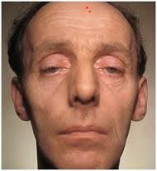

Slide 51
Inflammatory myopathies

Slide 52
Inflammatory myopathies
Polymyositis.
Dermatomyositis.
Inclusion body myositis.

Slide 53
PM and DM
Epidemiology:
The combined incidence is 2/ 100.000 annually.
Female to male ratio of 2:1.
DM affects children and adults.
PM affects mainly adults.
The peak incidence in adults occurs between the ages of 40-50.

Slide 54
PM and DM
Clinical features:
Multi-system disorders.
Sub-acute progressive proximal skeletal muscle weakness.
Mild myalgias and muscle tenderness.
Neck flexors are comonly involved.
Facial muscles are usually spared.

Slide 55
PM and DM
Dysphagia due to pharyngeal and upper esophageal muscles involvement (30%).
In advanced cases muscle wasting and hyporeflexia.
Respiratory muscles weakness.
Interstitial lung disease 10% (anti-tRNA synthetase or Jo-1).
Cardiac arrhythmias, bundle branch block and ST changes.

Slide 56
PM and DM
Polyarteritis.
Raynaud phenomenon.
Cutaneous manifestations in DM that precedes or accompany weakness.
Malignancy.

Slide 57
PM and DM
Malignancy:
Risk in DM is 30-40 % (ovarian and lung).
Risk in PM is 15% (non-hodgkin’s lymphoma and lung).

Slide 58
PM and DM
Cutaneous manifestation:
Gottron’s papules and the helitrope eruption are the hallmark and pathognomonic features.

Slide 59
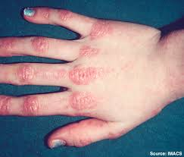

Slide 60
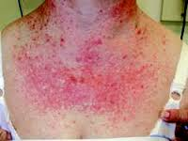

Slide 61
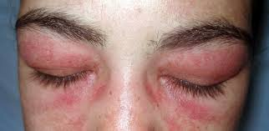

Slide 62
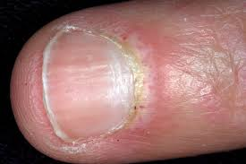

Slide 63
PM and DM
Generalized erythroderma.
Psoriasiform changes in scalp.
Calcinosis cutis.
Mechanic’s hands.

Slide 64
PM and DM
Diagnosis :
Elevated levels of muscle enzymes (CK, LDH, aldolase, AST, ALT)
Autoantibodies, ANA, in up to 80% of patients.
Antibodies associated with primary myositis syndromes: anti-Jo1 (20%), anti SRP (5%), anti-Mi2 (15-35%) of DM and 5-9% PM).
Antibodies associated overlap syndrome: anti-PM/Scl, anti-Ro, anti-La, anti U1 snRNP (SLE, systemic scleroderma, RA or mixed CTD), anti U2 snRNP (scleroderma).

Slide 65
PM and DM
Elevated levels of serum and urine myoglobin.
EMG.
MRI: inflammation, edema with active myosotis, fibrosis, and calcification.

Slide 66
DM
Muscle biopsy:
Perifasicular atrophy.
Microvascular injury and deposition of membrane attack complex, endothelial microtubular inclusions and hyperplasia.
Perimysial inflammatory cells.

Slide 67
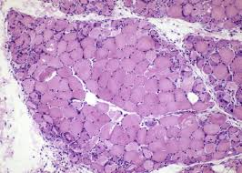

Slide 68
PM
Muscle biopsy:
Endomysial,permysial and perivascular inflammatory infiltrates.
Muscle destruction and regeneration, muscle fiber size variation.
No perifascicular atrophy, microvascular injury, endothelial hyperplasia and inclusions.

Slide 69
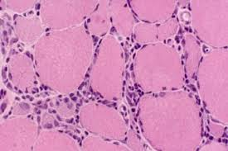
PM

Slide 70
PM and DM
TREATMENT:
Prednisone at 1mg/kg/day to be tapered slowly over 12 months.
Vitamin D and calcium supplements.
Glucocorticoids sparing agents: azathioprine and methotrexate.
Physiotherapy and occupational therapy.

Slide 71
PM and DM
Prevention of aspiration :swallowing assessment, elevation of the head of the bed, nasopharyngeal or gastric tube, semi thick diets.
Sun protection.

Slide 72
Inclusion body myositis
Epidemiology:
Adults older than 50 (third to fifth decade).
More common in men.
More common in whites.

Slide 73
IBM
CLINICAL FEATURES:
Proximal lower extremity weakness is usually the first sign.
Chronic slowly progressive symmetic myopathy.
Asymmetric weakness could occur.
Myalgia in 40%.
Wrist and finger flexors weakness, hip flexors and quadriceps muscles.
Mild facial weakness in 60 %
Esophageal dysmotility and dysphagia in 60%.

Slide 74
IBM
DIAGNOSIS:
Muscle enzymes are typically normal or mildly elevated, CK is less than 10 times normal.
Myositis-specific antibodies are typically absent.
EMG.
MRI

Slide 75
IBM
BIOPSY:
Endomysial inflammation 90%.
Basophilic rimmed vacuoles 70%.
Eosinophilic inclusions adjacent to the basophilic-rimmed vacuoles 50%
The definitive diagnostic feature is filamentous inclusions and vacuoles 90%.

Slide 76
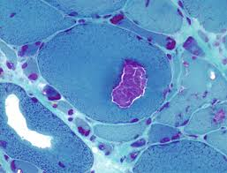

Slide 77
IBM
TREATMENT:
The response to therapy is generally poor.
Steroids and steroids sparing agents.
IVIG for dysphagia.
Physiotherapy and occupational therapy.

Slide 78
Toxic myopathies
Alcohol, cocaine.
Lipid lowering agents.
Steroids.
Antimalarials, antiretroviral.
Antipsychotic.
Chemotherapy.

Slide 79
Statin induced myopathy
The mechanism is not well understood.
Myalgia 2-11%
Myopathic weakness 2-11%
Myositis.
Myonecrosis 0.5%
Rhabdomyolysis 0.1%

Slide 80
SIM
PREVENTION:
Pravastatin and fluvastatin.
A baseline CK level prior to starting statin.
Patients should be alerted to report the new onset of myalgia and weakness.
Caution in patients with renal failure, hypothyroidism and liver failure.

Slide 81
conclusion
History and physical examination are of great important for differentiation of weakness due to myopathy from the other causes.
Myopathy could be inherited or acquired.
There is a wide variation in the age of onset of different types of myopathies but in all the cardinal symptom is weakness.
Screening for systemic involvement ( cardiac, pulmonary) early on diagnosis affect long term prognosis.

Slide 82
Thank you

