Slide 1
Hypercoagulable state
Dr farrukh shah
Haematology consultant

Slide 2
Aims and Objectives
Normal haemostasis
Aetiology of thrombosis: Virchow’s triad
Heritable thrombophilia
Deep vein thrombosis and pulmonary embolism
Principles of anticoagulation
Emergency reversal of anticoagulation

Slide 3
Normal Haemostasis
Blood vessels
Platelets
Naturally occurring inhibitors of coagulation
Coagulation factors
Fibrinolytic system

Slide 4
Blood vessels
Vascular smooth muscle arranged in circular fashion
Vascular collagen supports platelet adhesion and activates contact factors
Vascular endothelial cells play a key role in blood coagulation

Slide 5
Platelets
Extremely important in haemostasis
Aggregate to form temporary haemostatic plug
Capable of generating strong procoagulant activities to set off coagulation cascade

Slide 6
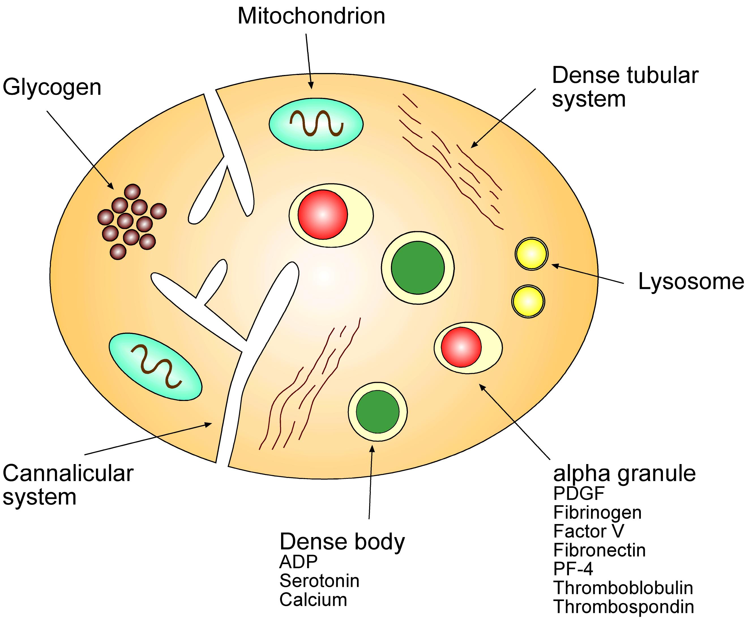
Platelet Ultrastructure

Slide 7
Natural inhibitors
Antithrombin
Protein C
Protein S
Proteins C and S are vitamin K dependent

Slide 8
Coagulation factors
Nearly all are synthesised by the liver
Circulate as inactive pro-forms
Activation usually involves cleaving off of peptide chains and unmasking of active site
Most require calcium to bind to substrates
II, VII, IX and X are vitamin K dependent

Slide 9
VIII
Activated Protein C
Protein S
V
Protein C +
thrombomodulin
antithrombin

Slide 10
Testing coagulation in vitro
Contact Factors
Tissue Factor
XI
IX
VIII
VII
INTRINSIC
Heparin
APPT
EXTRINSIC
Warfarin
PT(INR)
X
V
Ca²⁺
Prothrombin
Thrombin
Fibrinogen
Fibrin
TT
XIII
Insoluble fibrin clot

Slide 11
Virchow’s triad
Malignancy
Pregnancy and peripartum period
Oestrogen therapy
Inflammatory bowel disease
Sepsis
Thrombophilia
Venous disorders
Venous valvular damage
Trauma or surgery
Indwelling catheters
Hypercoagulable state
Endothelial injury
Circulatory stasis
Left ventricular dysfunction
Immobility or paralysis
Venous insufficiency or varicose veins
Venous obstruction from tumour, obesity or pregnancy
Virchow R, ed. Gesammelte Abhandlungun zur Wissenschaftichen Medicin. Von Meidinger Sohn, Frankfurt, 1856; Blann AD, Lip GYH. BMJ 2006;332:215–219; Geerts WH et al. Chest 2004;126:338S–400S; Bennet PC et al. Thromb Haemost 2009;101:1032–1040
Notes:
Virchow’s triad revisited
In 1856, Virchow postulated a triad of conditions that predispose to thrombus formation.¹
Virchow’s triad describes three abnormalities that promote thrombus formation:²
Abnormalities in the blood vessel wall (endothelial injury)
Abnormalities in blood flow (circulatory stasis)
Abnormalities in blood clotting components (hypercoagulable state).
Various risk factors contribute to a different extent to the development of VTE.
References
1. Virchow R, ed. Gesammelte Abhandlungun zur Wissenschaftichen Medicin. Von Meidinger Sohn, Frankfurt, 1856.
2. Blann AD, Lip GYH. BMJ 2006;332:215–219
3. Geerts WH et al. Chest 2004;126:338S–400S
4. Bennet PC et al. Thromb Haemost 2009;101:1032–1040

Slide 12
Thrombosis
Thrombosis is abnormal
A thrombus is a mass in the vascular lumen which is made up of fibrin and blood constituents
Proportions of red cells, white cells and platelets in the thrombus vary enormously
Venous thrombi - largely red cells
Arterial thrombi - largely platelets

Slide 14
Arterial thromboembolism
Almost invariably associated with atheromatous plaques
Platelets central to thrombus formation
Thrombi – platelet rich, pale, friable
Anti-platelet agents central to treatment

Slide 15
Main risk factors for arterial thromboembolism
Smoking
Hypertension
Hypercholesterolaemia
Diet
Diabetes mellitus
Personal or family history

Slide 16
Less common risk factors for arterial thromboembolism
Hyperhomocystinaemia
Anti-phospholipid syndrome
Raised fibrinogen
Raised factor VII
Raised factor VIII

Slide 17
Clinical syndromes of arterial thromboembolism
Unstable angina
Myocardial infarction
Transient ischaemic attack
Thrombotic stroke
Acute peripheral vascular occlusion

Slide 19
VTE is a major cause of death in Europe
600,000
Deaths resulting from VTE 543,454
Number of deaths per annum
500,000
400,000
300,000
Combined deaths 209,926
200,000
Transport accident
Prostate cancer
100,000
Breast cancer
0
AIDS
Cohen AT et al. Thromb Haemost 2007;98:756–764
Notes:
VTE is a major cause of death in Europe
A modified incidence model supported by other studies showed that VTE is a major cause of death in Europe.
These data are from the VITAE study, in which an epidemiological model was constructed to estimate the number of venous thromboembolic events in six EU countries; this figure was then scaled up to include the whole of the EU.
The total number of VTE-related deaths per year was easily more than double the combined number of deaths from some other common causes of death – road traffic accidents, prostate cancer, breast cancer and AIDS.
The authors concluded that these figures suggested that there was an urgent need for healthcare policy makers to review their national guidelines for VTE prophylaxis and to ensure that they are consistently implemented.
Reference
1. Cohen AT et al. Thromb Haemost 2007;98:756–764

Slide 20
Venous thrombosis
Stasis plays a bigger part
Thrombus red cell rich, platelet poor
Antiplatelet agents have limited role in treatment
Warfarin is commonest drug for long-term management

Slide 21
venous thrombosis
Frequent and important clinical problem
Annual incidence: DVT 0.5-1.2 per thousand
Annual incidence : PE 0.2-0.6 per thousand
Significant morbidity: DVT present in 70% of patients presenting with a proven PE
Silent PE present in 50% of patients with proximal DVT
Potential mortality: seen in up to 30% of post mortems
May involve unusual sites

Slide 22
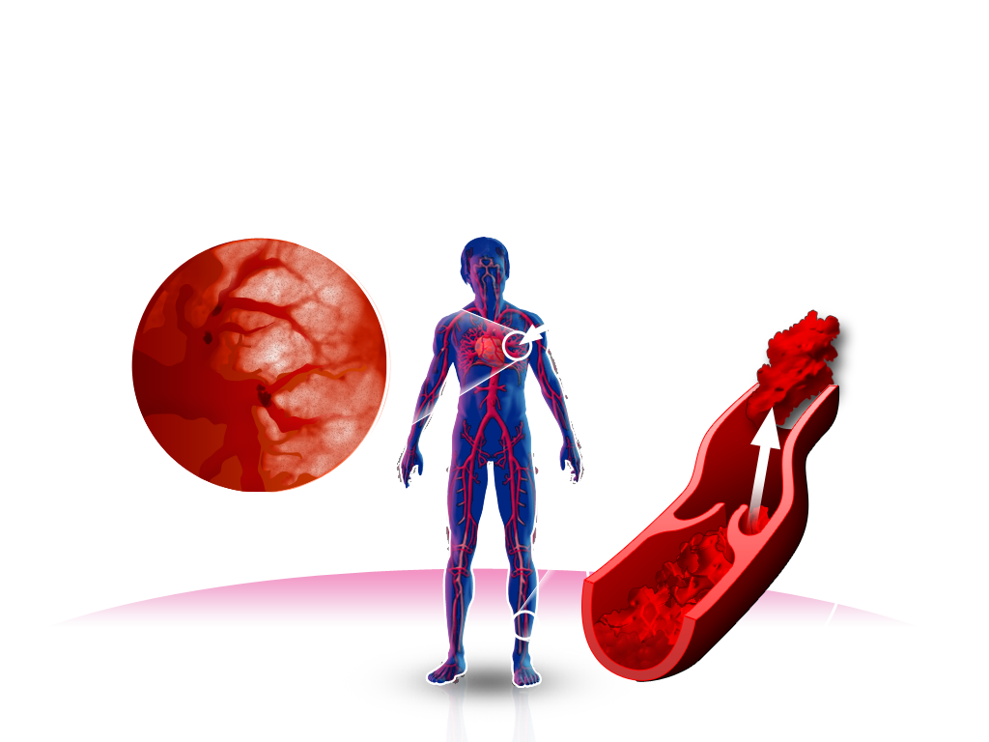
Venous Thromboembolism (VTE): Deep Vein Thrombosis (DVT) and Pulmonary Embolism (PE)
PE
PE occurs when parts of the clot detach and travel in the blood to block vessels in the lungs
Embolus
Migration
Thrombus
As the venous clot grows, it extends along the vein
Notes:
VTE: deep vein thrombosis and pulmonary embolism
DVT and PE are referred to collectively as VTE.
Thrombosis is the formation of a blood clot (thrombus) inside a blood vessel
DVT is the most common type of pathological obstruction, usually occurring in the deep veins of the leg
DVT can develop into a chronic condition in which damage to the valves in the veins results in swelling of the leg, pain and venous hypertension (known as PTS)
Embolism occurs when part or all of a thrombus breaks away from a blood vessel wall and this clot, now known as an embolus, enters the bloodstream. Emboli are potentially dangerous because they can occlude or obstruct blood vessels in vital organs
Patients with DVT are at risk of PE, which occurs when emboli travel through the heart and lodge in an artery in the lungs. If less than 50% of the pulmonary circulation is blocked, symptoms are generally limited to shortness of breath or are absent altogether
Very large emboli can cause a massive blockage of the pulmonary circulation, which may be fatal
Abbreviations
DVT, deep vein thrombosis; PE, pulmonary embolism; PTS, post-thrombotic syndrome

Slide 23
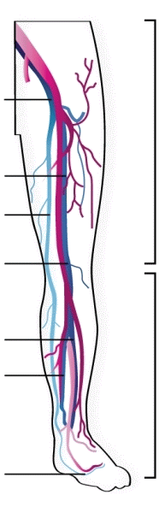
DVT
Definition: Formation of thrombi within the lumen of the vessels that make up the deep venous system
Distal vein thrombosis refers to DVT of the calves
Proximal vein thrombosis refers to DVT of the popliteal vein or the femoral vein. These thromboses are termed 'proximal' because they are closer to the heart
External iliac
Proximal
Deep femoral
Great saphenous
Popliteal
Anterior tibial
Posterior tibial
Distal
Dorsal venous arch
Notes:
Discuss significance of location

Slide 24
Risk factors for VTE
Exposing risk factors (acute conditions or trauma, surgery)
Predisposing risk factors
(patient characteristics)
History of VTE
Chronic heart failure
Advanced age
Varicose veins
Obesity
Immobility or paresis
Myeloproliferative disorders
Pregnancy/peripartum period
Inherited or acquired thrombophilia
Hormone therapies
Renal insufficiency
Surgery
Trauma
Acute medical illness
Acute heart failure*
Acute respiratory failure
Central venous catheterisation
Cancer
Inflammatory
diseases
Risk factors from Geerts WH et al. Chest 2004;126:338S–400S
*New York Heart Association classification III and IV
Notes:
Risk factors for VTE
Several factors contribute to an increased risk of VTE. These can be divided into exposing risk factors (i.e. some medical conditions, acute trauma and surgical intervention) and predisposing risk factors (i.e. a patient’s characteristics).
This slide shows the exposing and predisposing risk factors for VTE. Those in the middle can be both predisposing and exposing risk factors.
Many hospitalized patients have one or more of these risk factors; the risk is generally cumulative.
Reference
1. Geerts WH et al. Chest 2004;126:338S–400S

Slide 25
Provoked and unprovoked VTE
Transient/ reversible factors e.g. surgery or hospitalisation
Continuing/ irreversible factors e.g. cancer
No identifiable cause
Provoked VTE
Unprovoked (idiopathic) VTE
ACCP guidelines recommend at least 3 months’ VKA therapy after provoked VTE or longer after unprovoked (idiopathic) VTE
Kearon C et al. Chest 2008;133:454S–545S
Notes:
Provoked and unprovoked VTE
Provoked VTE can be attributed to either transient/reversible factors, such as surgery, trauma, immobilization, confinement to bed, lengthy travel, oestrogen therapy and pregnancy, or continuing/irreversible factors, such as cancer and the antiphospholipid syndrome.^{1,2}
Unprovoked or idiopathic VTE has no identifiable cause.
Abbreviations
ACCP, American College of Chest Physicians; VKA, vitamin K antagonist
References
1. Kearon C et al. Chest 2008;133:454S–545S

Slide 26
The risk of recurrent Venous Thromboembolism (VTE)
Events occurring subsequent to an acute episode are termed recurrent VTE, and their prevention is termed secondary prevention
Chance of recurrent VTE in first 3 months
<2%
47%
If adequate anticoagulant response is achieved¹ (2-4% in subsequent 3 months)
If proximal DVT inadequately treated¹
Overall incidence of recurrent VTE at 6 months is 7%, despite anticoagulant therapy
If treated with current therapies, most recurrent events can be avoided; however, when treatment stops, risk continues for recurrent events²
After a course of treatment, patients with unprovoked (idiopathic) VTE or persistent risk factors (e.g. cancer, prothrombotic biochemical abnormalities) have the highest risk of recurrent thrombosis² – 10% per patient-year
Line B. Semin Nucl Med;
Kearon C. Circulation 2003;
Agnelli G, Becattini C. J Thromb Thrombolysis 2008
Notes:
26
26
26
26
After an initial DVT, ~80% of the recurrences are DVTs³
After an initial PE, ~60% of the recurrences are PEs³
References
Line B. Semin Nucl Med. 2001;31:90–101
Agnelli G, Becattii C. J Thromb Thrombolysis 2008;25:37–44
Kearon C. Circulation 2003;107:I22–I30

Slide 27
Screening: Cancer
Do not routinely request CT chest abdomen pelvis as part of screening
Comprehensive medical review at diagnosis PR, thyroid exam, breast exam in women
Routine screening for occult malignancy, FBC, ESR, U&E, LFTs and in men PSA
Chest X ray in smokers
Ultra sound, if raised LFTs, of liver and abdomen
MRI

Slide 28
Screening: Inherited risk factors
Activated Protein C resistance – Factor V Leiden
Antithrombin deficiency
Protein C deficiency
Protein S deficiency
Prothrombin G20210A mutation
MTHFR mutation leading to homocystinuria
Dysfibrinogenaemia

Slide 29
Suspect thrombophilia if………
VTE before age 40-45 years
Arterial TE before age of 30 years
Thrombosis in unusual anatomical site
Recurrent venous thrombosis or thrombophlebitis
Clear family history of any of above
Recurrent miscarriages (ie 3 or more)

Slide 30
Investigation of thrombophilia
Detailed history
Was it a spontaneous thrombotic event?
Personal and family history
Use of the combined pill, HRT
Other factors associated with thrombosis
Physical examination
Laboratory tests – thrombophilia screen
Other appropriate tests (eg. imaging)

Slide 31
Screening: Thrombophilia (NICE 2012)
Do not offer testing to patients continuing anticoagulant treatment
Consider testing for hereditary thrombophilia in patients who have had unprovoked DVT or PE and who have a first degree relative who has had a DVT or PE if it is planned to stop anticoagulation treatment
Do not test patients with provoked DVT or PE

Slide 32
Lower Limb DVT
Commonest site of venous thrombosis
Subdivided into:
Proximal (above knee) - popliteal, femoral or iliac veins
Calf vein (below knee)
Proximal vein DVT of greater importance clinically
>90% of cases of acute PE due to emboli from proximal DVTs

Slide 33
Lower Limb DVT – Clinical features
Pain, swelling and redness of affected limb
Calf muscle induration and tenderness
Local increase in temperature
Unilateral oedema
Accentuation of venous pattern
FEATURES NOT ENTIRELY RELIABLE
Wells’ score is a validated system for estimating pre-test probability of DVT

Slide 34
Lower Limb DVT – Investigations
Clinical assessment – Wells’ score
Imaging – demonstration of thrombus
Demonstration of circulating fibrin degradation products – D-Dimers

Slide 35
NICE CG 144 PE Wells Score

Slide 36
DVT - Imaging
Compression ultrasound
Non-invasive
High sensitivity for proximal DVT
Less sensitive for distal DVT

Slide 37
Isolated calf vein DVT
If treatment considered, should give warfarin for 6-12 weeks
OR
Serial compression ultrasound over next 7-10 days and treat if has extended proximally

Slide 38
DVT – Use of D-Dimers
D-Dimers – breakdown product of cross-linked fibrin
Not specific for DVT
Raised in pregnancy, malignancy, post-operatively, soft tissue injury etc
Useful for its negative predictive value
Interpret with caution!

Slide 39
DVT – Management strategy
If likely delay in diagnosis:
Commence LMWH without delay
Perform diagnostic tests asap
Stop LMWH only if DVT ruled out
Otherwise switch to oral anticoagulation, LMWH and warfarin or NOACs

Slide 40
Management of proven DVT
Acute DVT can be managed on outpatient basis
Start with low molecular weight heparin:
heparin monitoring not required
can start warfarin at same time
complete switch to warfarin when target INR reached
Usual duration of warfarin therapy for first proximal DVT is 6 months
Usual INR target for first proximal DVT is 2.5
Alternatively start on Novel Oral Anticoagulants

Slide 41
Lower Limb DVT – Complications
Pulmonary Embolism – main complication
Post-thrombotic syndrome:
chronic pain
swelling
occasionally, venous ulceration of skin
Severe acute venous obstruction
Paradoxical embolism – rare

Slide 42
PE - clinical features
Massive PE:
Sudden severe breathlessness
Shock – hypotension, fast, small volume pulse
Cyanosis
Raised JVP

Slide 43
PE - clinical features
Non-massive PE:
Pleuritic chest pain, cough, dyspnoea, haemoptysis
Tachypnoea
Tachycardia
Signs of right ventricular failure
Symptoms or signs of DVT often absent

Slide 44
PE - Investigations
CXR - often normal
ECG - right ventricular strain
Arterial blood gases - reflect severity
V/Q scan - different levels of probability
CTPA – sensitive test
Echocardiography - massive PE
Pulmonary angiography - most accurate but invasive

Slide 45
PESI score-simplified score
Predicts 30-day outcome of patients with PE with fewer criteria than the original Pulmonary Embolism Severity Index.
parameter | score
Age above 80 years | +1
History of cancer | +1
History of COPD | +1
Heart rate >110 | +1
Systolic BP <100 mmHg | +1
Oxygen saturations <90% | +1
Total score
8.9% risk of death in the "High" risk group (>0 points)
1.1% risk of death in the "Low" risk group (0 points),
with 1.5% having recurrent thromboembolism or non-fatal bleeding

Slide 46
Management of PE
Non-massive PE: treatment is same as for DVT
Massive PE:
immediate threat to life
thrombolytic therapy may be life-saving
follow up with heparin and warfarin

Slide 47
Patient 1
Previously fit and well 32 year old lady
Actress
October 2012 noticed pain behind her right thigh whilst working. Progressive worsening
3 days later developed shortness of breath suddenly whilst walking up stairs.
Dizzy, feeling faint, for 15 minutes felt vision blurring and confused/muddled speech.
Thought it was an anxiety attack and went to bed hoping the symptoms would subside.
GP the next day!!

Slide 48
Wells’ pre-test probability score for DVT
NICE Clinical Guidance 144. Venous thromboembolic diseases: Appendix C.
http://guidance.nice.org.uk/CG144

Slide 49
On first assessment
PE Wells score
BP: 90/45
O2 Sats: 85%
HR 130
Grossly swollen right leg with livido reticularis
✔
✔
✔

Slide 50
PESI score-simplified score
parameter | score
Age above 80 years | 0
History of cancer | 0
History of COPD | 0
Heart rate >110 | 1
Systolic BP <100 mmHg | 1
Oxygen saturations <90% | 1
Total score | 3
8.9% risk of death in the "High" risk group (>0 points)
1.1% risk of death in the "Low" risk group (0 points),
with 1.5% having recurrent thromboembolism or non-fatal bleeding

Slide 52
Anticoagulation
To prevent initial thrombotic events - primary prevention
To treat established thrombosis or embolism - primary purpose is to prevent propagation of clot and embolism
To prevent further thrombosis or embolism of an initial event - secondary prevention

Slide 53
Anticoagulation
Intensity and duration of treatment depends on the clinical indication
The risk of major bleeding or death is not insignificant
Patient compliance is essential for success

Slide 54
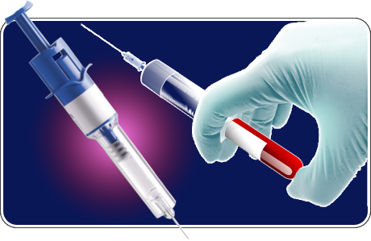
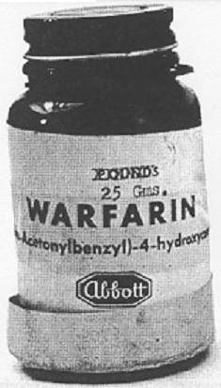
Overview of traditional anticoagulants
UFH
Parenteral administration
Monitoring and dose adjustment required
Risk of heparin-induced thrombocytopenia (HIT)
LMWH
Parenteral administration
Weight-adjusted dosing
Risk of heparin-induced thrombocytopenia (HIT)
Oral VKAs
Narrow therapeutic window
Interaction with food and drugs
Frequent monitoring and dose adjustment required
Hirsh J et al. Chest 2008;133;141S–159S;
Ansell J et al. Chest 2008;133;160S–198S
Notes:
References
1. Hirsh J et al. Chest 2008;133;141S–159S
2. Ansell J et al. Chest 2008;133;160S–198S

Slide 57
Heparin
Inactivates thrombin and factor Xa
Instantaneous action
Parenteral use only
Unfractionated form has very short half-life
Fractionated form (low molecular weight heparin) has much longer half-life
Does not cross the placenta
Monitored using the APTT (anti-Xa assay for LMWH)

Slide 58
Warfarin
Interferes with action of vitamin K
Oral use
Slow onset of action
Long half-life
Large number of drug and other interactions
Crosses the placenta
Teratogenic
Monitored by PT (INR)

Slide 59
Over-anticoagulation
Increased risk of severe or fatal bleed
GI tract and intracranial cavity are common sites
Essential questions:
is the patient bleeding?
how deranged are the clotting tests?
what has caused it?

Slide 60
Warfarin over-anticoagulation
Alcohol and other drug(s) are commonest causes
Antidotes to warfarin are vitamin K and fresh frozen plasma
FFP acts immediately; vitamin K takes 6 hours to kick in
Do NOT give more than 1-2 mg of vitamin K

Slide 61
Heparin over-anticoagulation
Antidote to conventional heparin is protamine sulphate
In practice, stopping the heparin infusion is all that is required
Low molecular weight heparins can be reversed with protamine sulphate but may need higher dose

Slide 62
Other therapies for venous thromboembolic disease
Thrombolysis – massive PE only
Inferior vena caval filter
When anticoagulation absolutely contraindicated
Recurrent VTE despite adequate anticoagulation
Patients with extremely limited pulmonary reserve who might not survive another PE
Not without complications

Slide 63
New anticoagulant drugs
Direct thrombin inhibitors: Dabigatran
Block both fibrin bound and circulating thrombin
Wider therapeutic indices
Faster onset of action
Less inter-patient variability
Monitoring not required

Slide 64
New anticoagulant drugs
Indirect Factor Xa inhibitors:
Fondaparinux
Selective inhibition of Factor Xa
Given once daily subcutaneously
No monitoring required because of limited inter-patient variability

Slide 65
New Anticoagulant drugs
direct Factor Xa inhibitors
Rivaroxaban, Apixaban and others
blocks a specific protein in the blood – Factor Xa – which is known to play a key role in the blood clotting cascade
Blocking Factor Xa prevents the generation of thrombin, thus preventing the formation of clots as fibrin is not produced
Notes:
65

