Slide 1
RADIOLOGY of SPINE DISEASES
Dr. Sajjad Hussain
Assistant Professor of Radiology
King Saud University
Consultant Radiologist
King Khalid University Hospital

Slide 2
Imaging Methods to Evaluate Spine
Plain X-Ray Films
Myelogram – injection of contrast medium in CSF followed by x-ray images. Rarely performed now-a-days
Computed Tomography (CT Scan)
Magnetic Resonance Imaging (MRI)
Discogram - injection of contrast medium in the disc followed by x-ray images
Spinal angiography – to evaluate arteries and veins
Ultrasound – more in children
Radionuclide Bone Scan – intravenous injection of radioactive material bound to phosphonates which deposit in bones, followed by images by gamma camera.
DEXA – radionuclide scan for bone density (osteoporosis)

Slide 3
X-RAYS (RADIOGRAPHS)
Often the first diagnostic imaging test, quick and cheap
Small dose of radiation to visualize the bony parts of the spine
Can detect
Spinal alignment and curvature
Spinal instability – with flexion and extension views
Congenital (birth) defects of spinal column
Fractures caused by trauma
Moderate osteoporosis (loss of calcium from the bone)
Infections
Tumors
May be taken in different positions (ie; bending forward and backward) to assess for instability

Slide 4
COMPUTERIZED TOMOGRAPHY (CT SCAN)
Uses radiation to obtain 2-D and 3-D images
Patients must lie still on a table that moves through a scanner
Cross-sectional images are obtained of the target areas
Much detailed information regarding bony and soft tissues
Better in visualizing
Degenerative or aging changes, Herniated discs
Spinal alignment
Fractures and fracture patterns
Congenital / childhood anomalies
Areas of narrowing in spinal canal through which spinal cord and spinal nerve roots pass
Poor in visualizing inner details of spinal cord
Entire spine can be imaged within a few minutes
A contrast material may be injected intravenously or intrathecally to make some areas clear

Slide 5
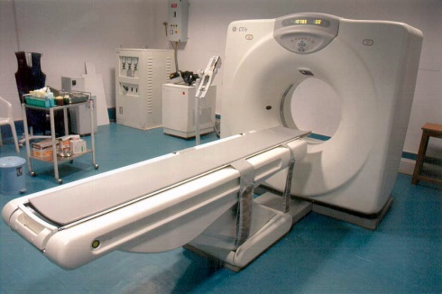

Slide 6
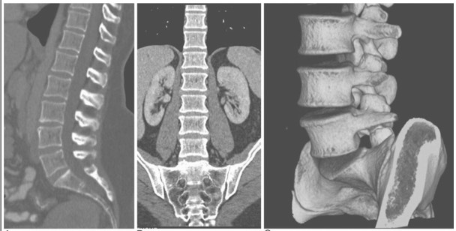

Slide 7
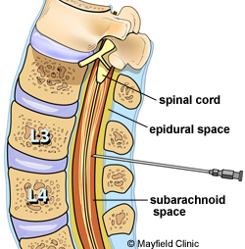
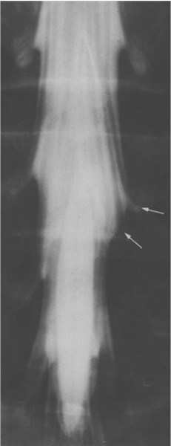
MYELOGRAM
A contrast material is injected into CSF to better identify areas where spinal cord or spinal nerves may be compressed
PROCEDURE:
Under local anesthesia, a needle is placed into lower lumbar spinal canal, and then CSF flow is confirmed. Contrast medium is then injected which mixes with CSF around spinal cord, making it visible on x-ray images
Often a CT scan is also performed after this
May be performed when MRI is contraindicated

Slide 8
Magnetic Resonance Imaging (MRI)
The gold standard of imaging for spinal disorders
Does not use ionizing radiation
Can identify abnormalities of bone, discs, muscles, ligaments and spinal cord
Intravenous contrast is sometimes administered to better visualize certain structures or abnormalities
Patient lies still in a tunnel like structure for about 25 minutes
Claustrophobic patients may need sedation, and children often need general anesthesia
Contraindications include
Implanted devices e.g. cardiac pacemakers and other electromagnetic devices
Certain metal clips and stimulators
Artificial joints and spinal hardware may still have MRI scans

Slide 9
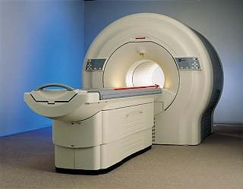
MRI SCANNER (closed type)

Slide 10
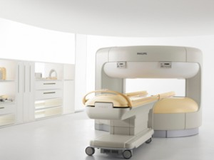
MRI SCANNER (open type)

Slide 11
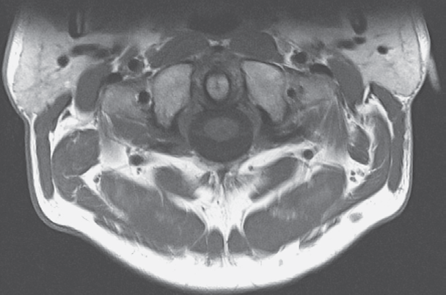
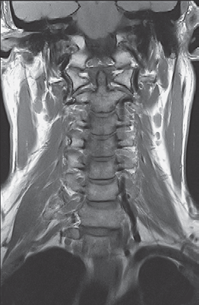
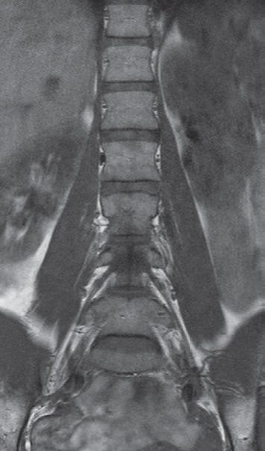
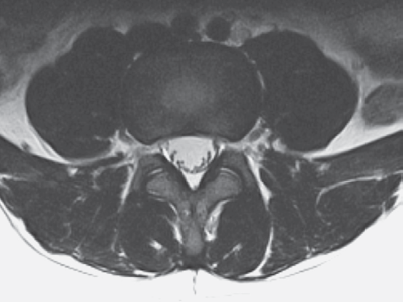
MR images are multi-planar

Slide 12
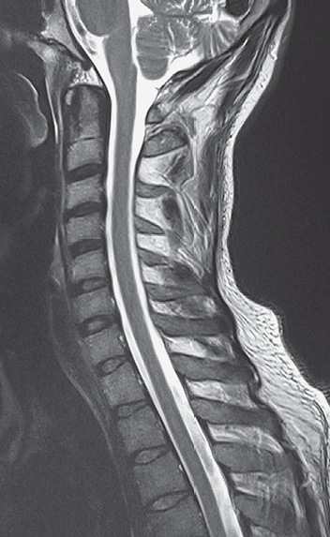
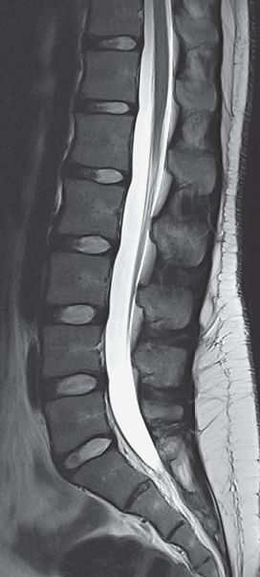
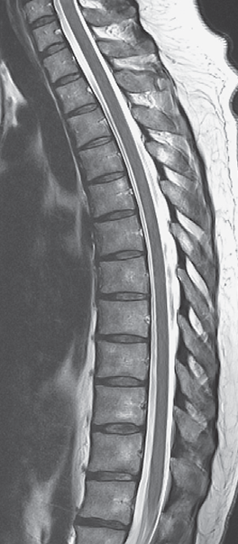
MR images are very high resolution

Slide 13
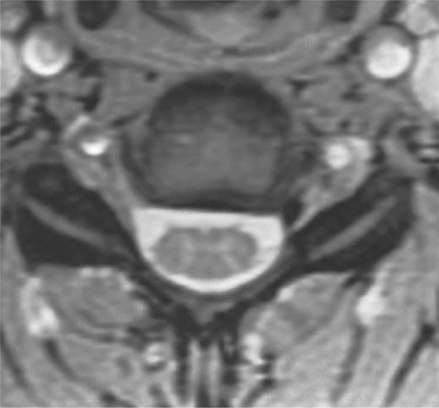
MR images are very high resolution

Slide 14
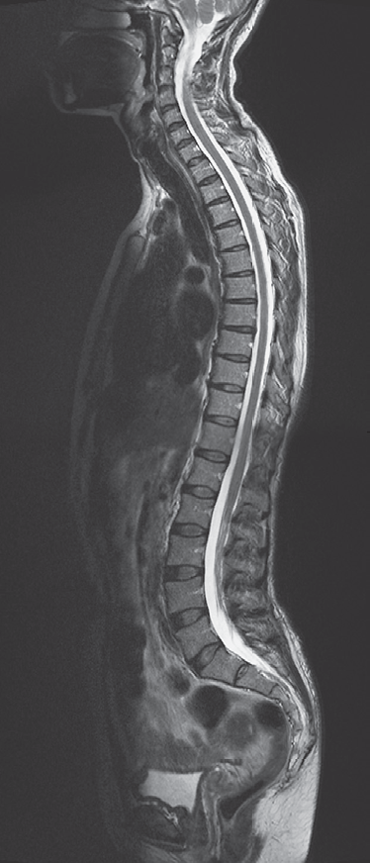
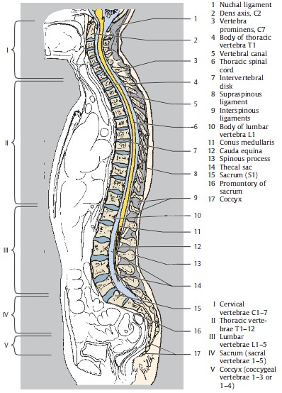

Slide 15
DISCOGRAM
Discs are the cushions between the vertebral bodies
While MRI and CT scans can provide structural information, discogram better identifies the relationship of disc to pain
PROCEDURE:
A needle is placed into center of the disc under fluoroscopy (continuous x-ray imaging)
A contrast material (dye) is injected
Radiologist then observes if patient experiences pain that is similar to his/her usual pain, and is increased by injecting contrast
X-rays (+ CT scan) are then done to see if dye stays within the center of the disc or leaks to outer border of the disc indicating a tear in annulus fibrosus of disc which can be a source of pain

Slide 16
Congenital Anomalies

Slide 17
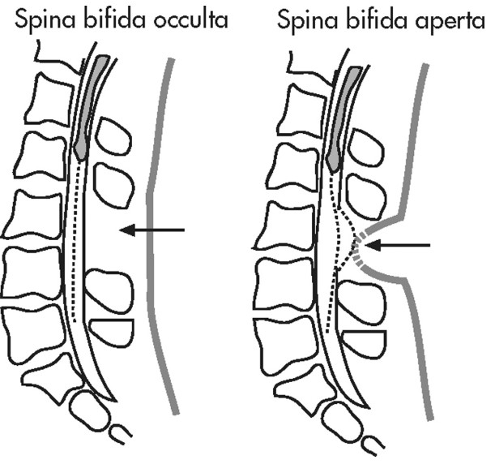
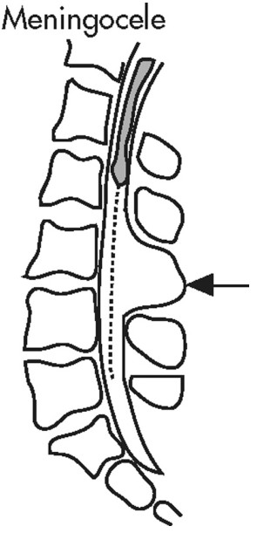
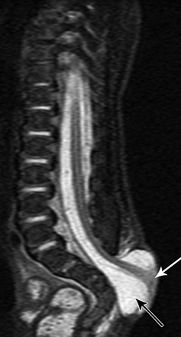
CONGENITAL ANOMALIES
Skin covered defects and Open skin defects
MRI is the best to assess the contents of the cavity, extent of abnormalities, and spinal cord.
CT shows bony structures the best and is often used before surgery

Slide 18
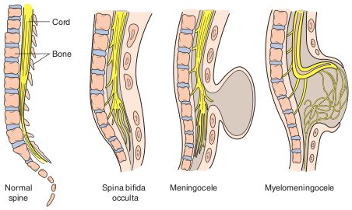

Slide 19
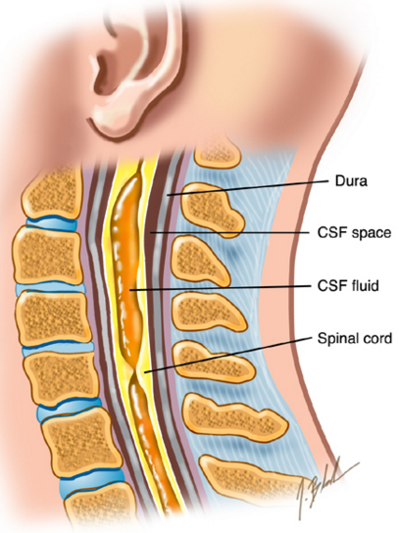

Slide 20
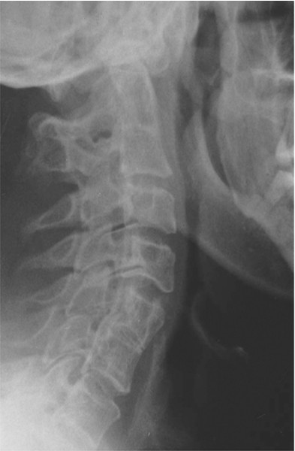
Multiple fusion abnormalities of vertebrae on plain film

Slide 21
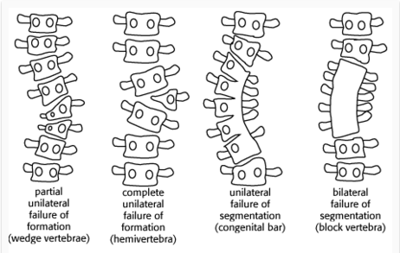

Slide 22
TRAUMA

Slide 23
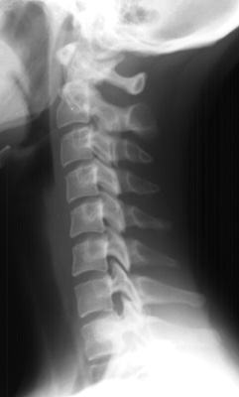
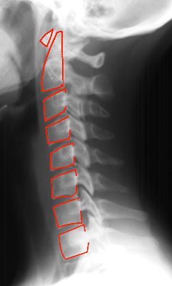
Plain film assessment of trauma – the first imaging method

Slide 24
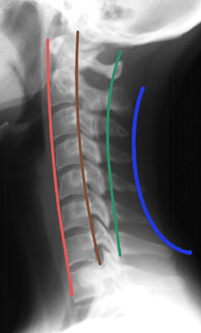
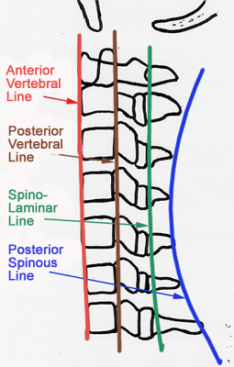
Alignment should be normal – check by drawing lines

Slide 25
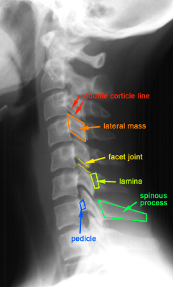

Slide 26
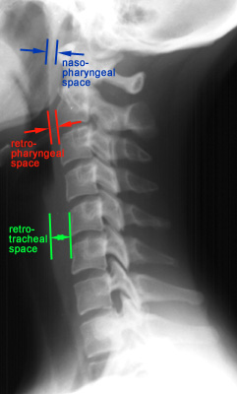

Slide 27
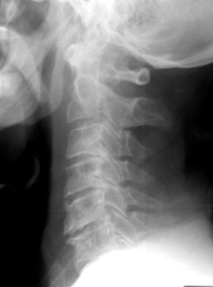
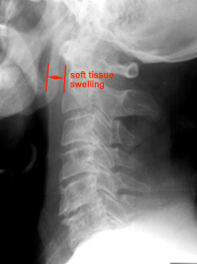
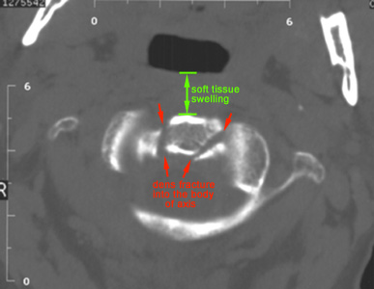
Soft tissue anterior to spine is very important

Slide 28
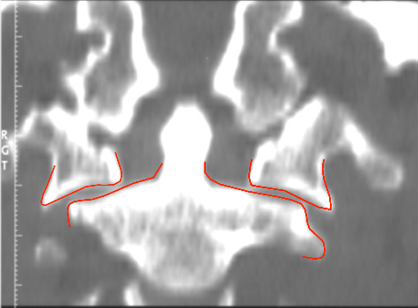
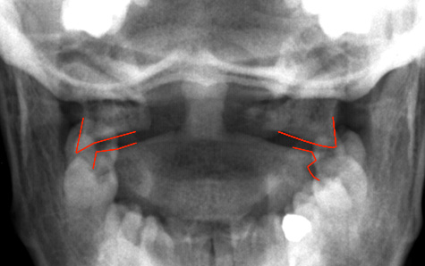
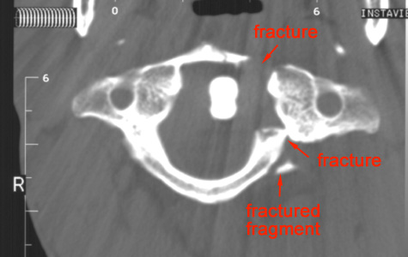
Jefferson Fracture
Lateral displacement of C1 in plain film (A)
Coronal reconstruction from a CT confirms the findings from the odontoid view
Axial CT clearly shows the location of the fractures of C1

Slide 29
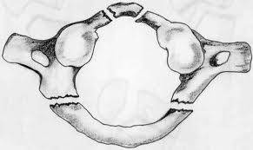
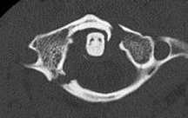
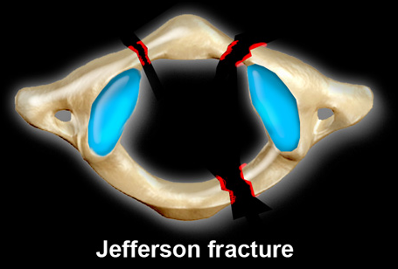
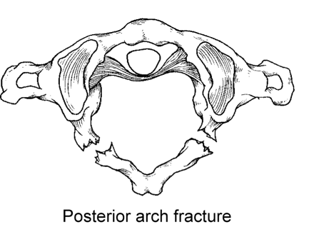

Slide 30
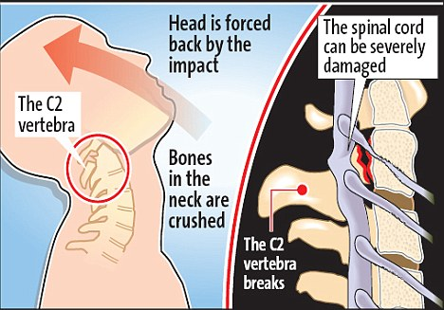
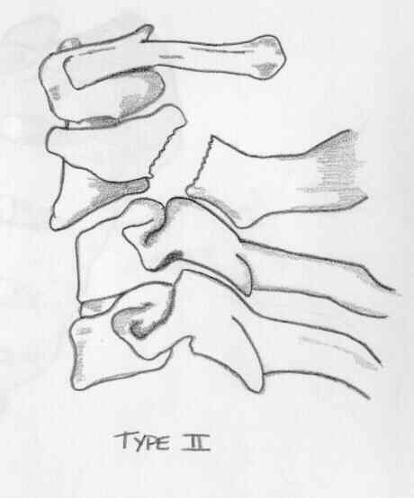
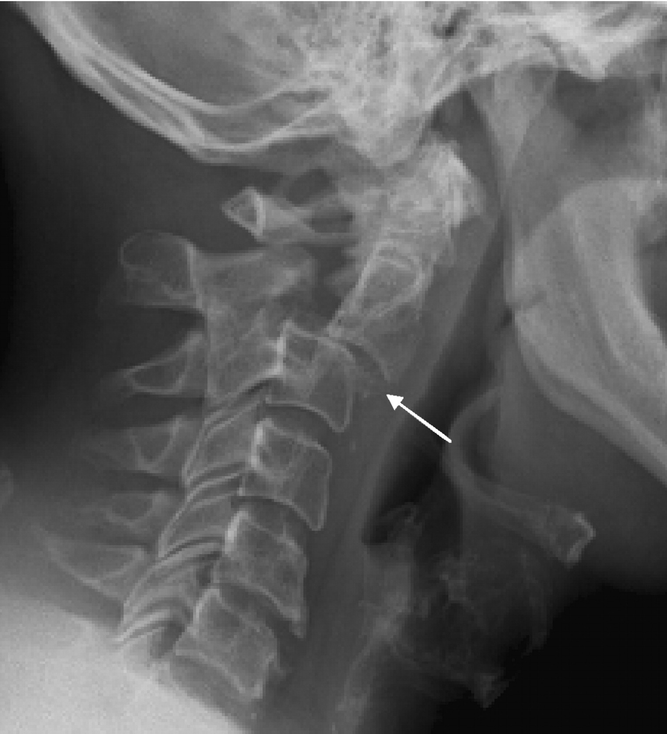

Slide 31
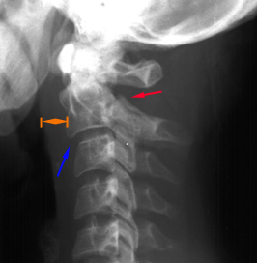
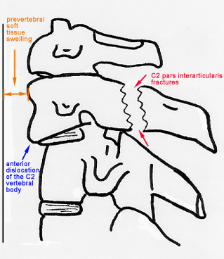
Hangman's Fracture
Fractures through the pars interaticularis of C2 resulting from hyperextension and distraction Hyperextension (e.g. hanging, chin hits dashboard in road accident) Radiographic features: (best seen on lateral view) 1. Prevertebral soft tissue swelling 2. Avulsion of anterior inferior corner of C2
associated with rupture of anterior longitudinal
ligament. 3. Anterior dislocation of C2 vertebral body 4. Bilateral C2 pars interarticularis fractures

Slide 32
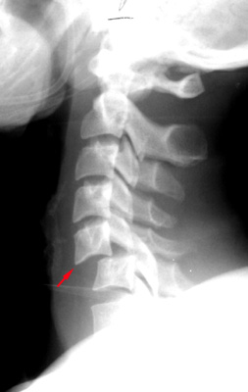
Bilateral Facet Dislocation
Complete anterior dislocation of vertebral body resulting from extreme hyperflexion injury
Associated with a very high risk of cord damage

Slide 33
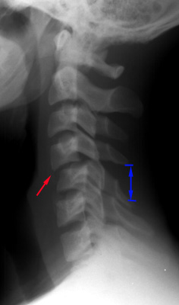
Unilateral Facet Dislocation
Facet joint dislocation and rupture of the apophyseal joint ligaments resulting from rotatory injury
Mechanism: simultaneous flexion and rotation

Slide 34
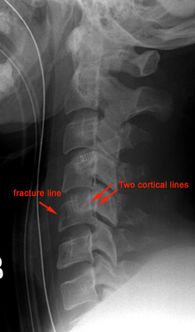
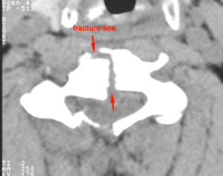
Burst Fracture
Results from axial compression
Injury to spinal cord is common due to displacement of posterior fragments
CT is required for all patient to evaluate extent of injury

Slide 35
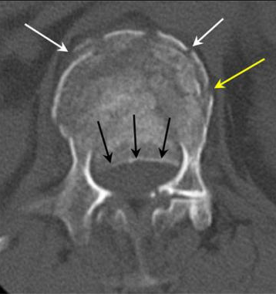

Slide 37
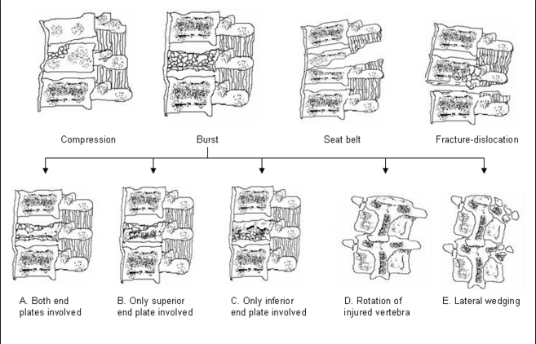

Slide 38
Further study about spine trauma
https://www2.aofoundation.org/wps/portal/!ut/p/a0/04_Sj9CPykssy0xPLMnMz0vMAfGjzOKN_A0M3D2DDbz9_UMMDRyDXQ3dw9wMDAzMjfULsh0VAbWjLW0!/?bone=Spine&segment=TraumaThoracolumbar&showPage=A&contentUrl=srg/popup/additional_material/53/D100-Classification.jsp

Slide 39
INFECTIONS

Slide 40
Discitis and Osteomyelitis
Usually the result of blood–borne agents
Especially from lung and urinary tract
Most common pathogen is staphylococcus, Streptococcus less common
Gram-negative rods in IV drug abusers or immunocompromised patients
E. Coli
Proteus
Non-pyogenic
Tuberculosis
Coccidioidomycosis
May occur after invasive procedure like Surgery, Discography, Myelography
In children, infection begins in vascularized disc
In adults, in anterior inferior corner of vertebral body with spread across disk to adjacent vertebral endplate
Site of involvement
L3/4
L4/5
Unusual above T9
Usually involvement of one disk space (occasionally 2)

Slide 41
Discitis and Osteomyelitis
IMAGING FINDINGS
PLAIN FILMS
Narrowing and destruction of an intervertebral disk
Earliest plain film sign
Indistinct adjacent endplates with destruction
Often associated with bony sclerosis of the two contiguous vertebral bodies
Paravertebral soft tissue mass
Endplate sclerosis (during healing phase beginning anywhere from 8 weeks to 8 months after onset)
Bone fusion after 6 months to 2 years
MRI
Bone marrow edema in infected vertebrae, discs and paraspinal soft tissues
Dark on T1 and bright on T2 images
Enhancement of inflammed tissues after contrast
Fluid collections (abscesses) are common

Slide 42
Discitis and Osteomyelitis
c

Slide 43
A. Sagittal T1 MRI shows decreased signal of vertebral bodies and disc with end plate destruction
B. Sagittal T2 MRI shows increased signal in corresponding areas with anterior subligamentous
abscess, epidural involvement and extension of inflammation in T6 with preserved endplate
C. Axial contrast-enhanced T1 MRI shows peripheral enhancement of paravertebral abscess and
marked enhancement of epidural tissues causing displacement of spinal cord
D. CT shows lytic lesion in vertebral body and paravertebral abscess with calcifications

Slide 44
TUMORS

Slide 46
AJNR

Slide 49
Infection
Trauma
Congenital

Slide 50
Infection
Trauma
Congenital

Slide 52
Infection Trauma Congenital

Slide 53
Infection Trauma Congenital

Slide 55
Infection Trauma Congenital

Slide 56
Infection Trauma Congenital

Slide 58
Flexion Extension Axial loading
Rotation Seat belt

Slide 59
Flexion Extension Axial loading
Rotation Seat belt

Slide 61
Flexion Extension Axial loading
Rotation Seat belt

Slide 62
Flexion Extension Axial loading
Rotation Seat belt
=
CHANCE fracture

Slide 65
Flexion Extension Axial loading
Rotation

Slide 66
Flexion Extension Axial loading
Rotation

Slide 68
Flexion Extension Axial loading
Rotation

Slide 69
Flexion +
lower neck muscle contraction

Slide 71
Flexion Extension Axial loading
Rotation

Slide 72
Flexion Extension Axial loading
Rotation

Slide 74
Flexion Extension Axial loading
Rotation

Slide 75
Flexion Extension Axial loading
Rotation

Slide 76
THANKS

