Slide 1
How to Write the Results and Discussion of your Study
Dr. Hayfaa A.A Wahbi
PhD, FRCOG, FRCS, Msc Ass. Rep,
Master Med.Edu
Associate Professor, Chair of Evidence Based Healthcare and Knowledge Translation

Slide 2
The Paper
Writing and editing the paper is the last step in the research process
The paper tells the story from study inception, through data collection, statistical analysis, findings and discussion
The process of writing the paper should be analogous to the research process—it requires attention to detail, time, and revision

Slide 3
The Results

Slide 4
Results
The heart of your paper
Write after figures and tables are constructed
Consider your data critically
Construct tables, figures and include them in outline
Write the results
+/- Use subheadings
Results determine
Whether you’ve answered your original question(s)
Your direction for future studies
Both of which belong in the discussion

Slide 5
Results uses the same order as Methods
Material & Methods
Study subjects
Study protocol
Calculations Statistical analysis
Results
Clinical characteristics
Systemic effects
Specific effects

Slide 6
Results
Short and to the point
important findings first
Present only data directly relevant to the study
Don’t repeat methods but you may remind the reader briefly how you measured something.

Slide 7
Results…con’t
Present absolute numbers and percentages so reviewers can judge the significance of the findings.
Statistical significance ≠ clinical significance

Slide 8
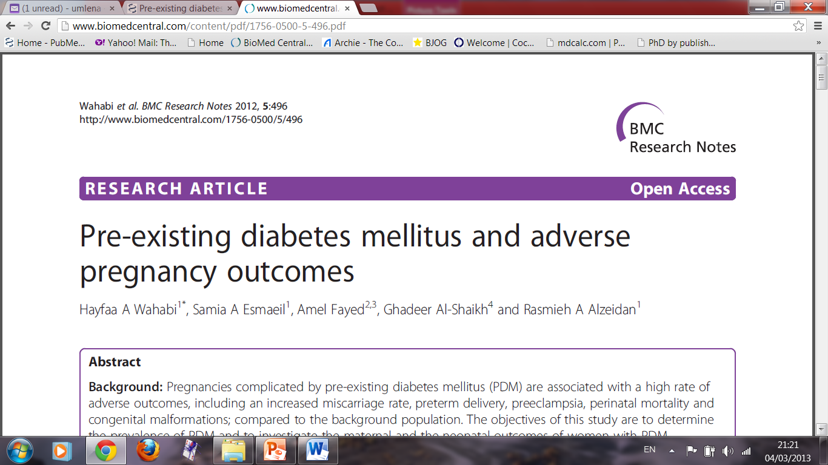

Slide 9
Results
There were 3273 deliveries during the study period of which 3157 met the inclusion criteria. Of the study population 116 (3.7%) women had pre-existing diabetes (PDM) and 569 had GDM (18.0%) while 2472 (78.3%) were not diabetic. For outcomes analysis, the 2472 non-diabetic women were compared to the 116 women in the PDM group.

Slide 10
Compared to the non-diabetic group the women with PDM were nearly threefold more likely to be delivered by emergency cesarean section (C/S), OR 2.67, 95% confidence intervals (CI) (1.63-4.32), P < 0.001, and more than six fold more likely to deliver by elective C/S, OR 6.73, 95% CI (3.99-11.31), P < 0.001 (Table 2). The neonates of the mothers with PDM were significantly heavier when compared to those of the non-diabetic mothers, P < 0.001; and the odds for macrosomia were increased to almost fourfold for the neonates of the PDM group OR 3.97, 95% CI (2.14-7.40), P < 0.001.

Slide 11
Although there was a threefold increase in the odds for low APGAR scores among the neonates of the mothers with PDM compared to non diabetics, OR 2.61, 95% CI (0.89- 7.05); the difference did not reach statistical significance, P = 0.057.
Similarly, despite the increase in frequency of intra-uterine fetal death (IUFD) among women with PDM compared to non-diabetic women, the difference did not reach statistical significance, P = 0.084; however the OR of 2.62, 95% CI (0.78-7.96) was consistent with more than twofold increase

Slide 12
Visual data
Type of visual | What it summarizes
Flow charts (algorithms) | Protocols
Tables | Complex data
Line graphs | Response to treatment
Bar graphs | Complex data to compare categories
Pie charts | Percentage of the whole
Diagrammatic illustrations | Simplify or enhance figures

Slide 13
Tables and Figures
Stand alone and tell a complete story
Unambiguous—immediately clear
Eliminate numerical data and long explanations in text
Figures display important trends, procedures, simplify detailed data, and show basic methodologies.

Slide 14
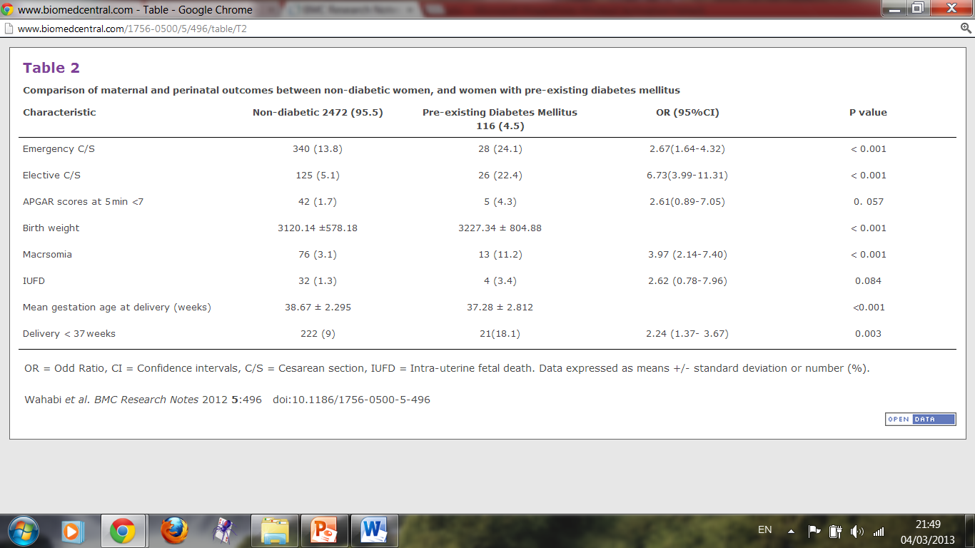

Slide 15
3200
Total number of delivery during the study period
2701
met the inclusion criteria
499
did not meet the inclusion criteria
45
Multiple pregnancies
96
Preexisting diabetes mellitus
198
delivery before completed 37 weeks gestation
160
not screened for gestational
diabetes
Figure 1:
Flow chart of the
Study population

Slide 17
Figure 1 Pathway for induction of labor in King Khalid University Hospital
IOL= Induction of labour, C/S= Cesarean section, PGE2 = Prostaglandin E2. CTG = Cardio-tocogram

Slide 18
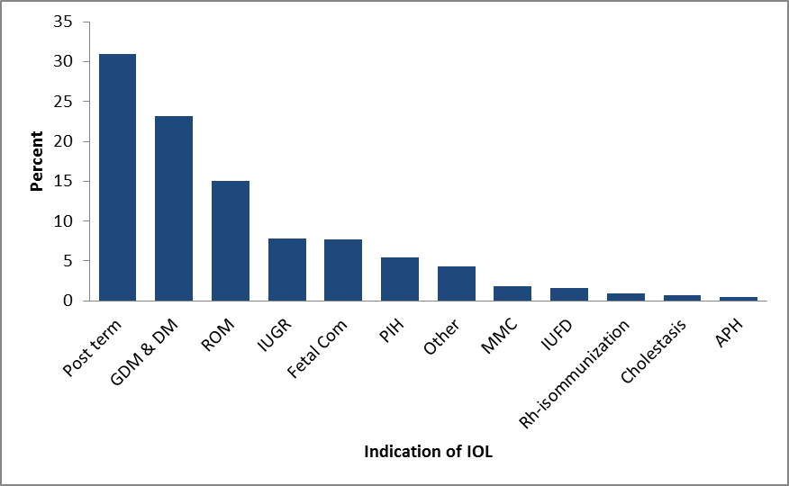
Figure 2 - Indications for induction of labor (IOL).
GDM = gestationaldiabetes, DM = diabetes mellitus, ROM = rupture of membranes, IUGR = intra-uterine growth restriction, Fetal com = fetal compromise, PIH = pregnancy induced hypertension, MMC = maternal medical condition, IUFD= intrauterine fetal death, ISO immunization = Rhesus

Slide 19
Results—Major Mistakes
Failure to provide all the data critical to answering the research question
Interpreting or commenting on results
“Six of the 20 patients required intubation, illustrating the seriousness of this problem” (belongs in Discussion)
“Over 40% of treated rats exhibited a decreased inflammatory response, an unexpected finding” (belongs in Discussion)

Slide 20
Results—Major Mistakes
Failure to adequately address statistical methods
Tables and figures inappropriate, unbalanced
Tables and figures poorly constructed

Slide 21
The Discussion

Slide 22
Discussion Construction
Summarize major findings—1st paragraph
Explain how your findings relate to those of others—what do they mean?
Clinical relevance of the findings?
Limitations and how this influenced your study?
How will you overcome these in the next studies?
Explain the implications of findings
What future direction(s) will you take?

Slide 23
Discussion what do your findings mean
Answers the question posed in Introduction
Explain the significance of your results
Explain the findings, relationships, and generalizations of your results
Explains how results support answers and how answers fit with existing knowledge on the topic
Has a beginning, middle, and end
Notes:
Answers your research question in the beginning, only those items that relate to the focus of your results

Slide 24
Part 1, Beginning present strongest evidence first
Begin with significance of your results
Never begin with background information
Never repeat information from Introduction
Never begin with historical overviews
This is what everyone is waiting for!
Notes:
Don’t begin with a historical review, don’t repeat results

Slide 25
Part 2, Middle interpret your results
Show how your results fit into the literature and how they support your answer
Give in descending order of importance
Compare your results with other studies, your work or others
Use one idea per paragraph

Slide 28
Discussion (Beginning)
The prevalence of PDM in this study is 3.7% which indicates a fivefold increase during the last 14 years based on earlier studies from Saudi Arabia [12,13].

Slide 29
Discussion (Middle)
This noticeable rise in the prevalence of PDM during pregnancy could be explained in part by the improved screening and detection of diabetes, however the main cause in our opinion is the increased prevalence of T2DM among adults in the Saudi population to an estimated range of 21 to 23% [14]. It is worth noting that the prevalence of 3.7% for PDM is very high compared to other regions of the world [6, 15-17}.

Slide 30
Discussion (Beginning)
We observed a threefold increase in the rate of APGAR scores less than 7 at 5 min of birth on the diabetic women compared to the non-diabetic

Slide 31
Discussion (Middle)
In a recent report low APGAR scores are predictors of long term neurological disabilities [20]. Such low scores in the diabetic cohort could be explained by the increase risk of birth asphyxia due to placental angiopathy [21].

Slide 32
Part 3, Ending be strong
Restate answer to question, and signal this ending
Mention possible applications, implications, or speculations
Pull out as a separate Conclusions section
Suggest future work if needed

Slide 33
Discussion (Ending)

Slide 35
Discussion (Ending)

Slide 36
Discussion (Ending)

Slide 37
Discussion (Ending)
References:
The references demonstrate that you understand how your findings relate to earlier reports.
Do not cite papers if you have only read the abstract
Format your references as required by the journal.
The soft wear Endnote® or Reference manager® should be used as it allow the change of style with little effort.

Slide 38
Discussion: Common Mistakes
Attempt to overly state the importance of the findings
Come to erroneous or unsupported conclusions
Uncritically accept statistical results
Also results in excessive length, a common problem
Authors should let the data speak for themselves

Slide 39
Discussion—Common Mistakes
Unwarranted speculations
Injecting peripheral issues
Not suggesting future directions for research

Slide 40
Authorship an ethical consideration
High
Included in acknowledgments | List as author
NOT included in acknowledgments: NOT listed as author | Included in acknowledgments
Involvement in Study
Low
Low
High
Involvement with Manuscript
Cramer and Rieger, 2001
Notes:
A
Many journals have specific definitions of authorship, defer to Uniform Requirements, authorships is determined by 3 qualifications: 1) conception and design of study, or analysis and interpretation of data; 2) drafting or critically revising manuscript; 3) approval of final version to be published

Slide 41
The international committee of medical journals editors
Why Authorship Matters: Credit, financial and academic implications and responsibility of contents
“Who Is an Author?
The ICMJE recommends that authorship be based on the following 4 criteria:
Substantial contributions to the conception or design of the work; or the acquisition, analysis, or interpretation of data for the work; AND
Drafting the work or revising it critically for important intellectual content; AND
Final approval of the version to be published; AND
Agreement to be accountable for all aspects of the work in ensuring that questions related to the accuracy or integrity of any part of the work are appropriately investigated and resolved.”
http://www.icmje.org/recommendations/browse/roles-and-responsibilities/defining-the-role-of-authors-and-contributors.html

