Slide 1
SCIENTIFIC WRITING
RESEARCH PROJECT – I

Slide 2
LEARNING OBJECTIVES
Identify the aspects of writing
Describe the structure of a scientific paper and reports
Explain the process of writing
State the value of developing an outline
State the elements that should be present in the title
State the components of the abstract
State the questions that should be answered by the introduction
State the components of the methods section
Describe the results section
State the link between the discussion and results
Identify persons that should be acknowledged
Know the style of writing the list of reference
Recognize the style of a scientific writing

Slide 3
PERFORNANCE OBJECTIVE
Writing scientific papers and reports

Slide 4
ASPECTS OF WRITING
Content
Organization
Presentation of tables and figures
Language and grammar
Writing style

Slide 5
KNOW THE STRUCTURE OF A PAER
Title
Authors name and affiliation
Abstract
Introduction/Background
Methods
Results
Discussion
Acknowledgment
References (Bibliography)

Slide 6
WRITING PROCESS
Prewriting:
Taking notes, put ideas on paper, generate sentences and paragraphs while keeping the type of reader in mind
Writing:
Start at any point you feel it is easier to start with. No need to complete the whole section before moving to another one but you may move between sections

Slide 7
WRITING PROCESS
Revision:
Going back again and again to refine the writing by working on the content then the structure of sentences, then style.
Editing:
Review for grammatical errors and usage errors.
Proofread:
Print and read your report again.

Slide 8
PAPER OUTLINE
Value of the Outline
Facilitate writing
Organize ideas
Ensure logic sequence of ideas and arguments
Show the relation between ideas
Eliminate overlap between sections
Reflect the flow of each section

Slide 9
TITLE
Written the last though it appears the first
Reflects the content of the paper
Used for indexing and retrieving of the article

Slide 10
WRITING THE TITLE (cont.)
Short
Include key words
“A retrospective study of the rate of depression among the elderly attending primary health care centers in the area of Jizan in KSA”

Slide 11
WRITING THE TITLE (concluded)
Short
Include key words
“Depression among the elderly attending primary health care centers in Jizan, KSA”

Slide 12
ABSTRACT
Selective summary of the article
Structured abstract is the norm
Abstract include
Background, rationale and aim
Methods
Main findings
Conclusion

Slide 13
WRITING THE ABSTRACT
Purpose for the study
Approach taken to realize the purpose
Major findings of the study
Relationship between these findings and the field
Why you did it?
How you did it?
What you found?
What does it mean?

Slide 14
INTRODUCTION
Two or more paragraphs
Starts with general then to more specific
Several ideas are presented and linked
The ideas presented lead to purpose of the study

Slide 15
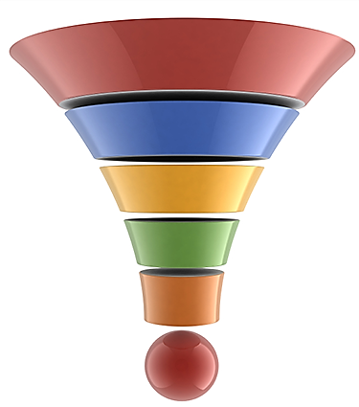
FLOW OF INTRODUCTION
General
Specific

Slide 16
WRITING THE INTRODUCTION
These are the questions for
which you should provide an answer
Background What is known?
Gaps in literature What is not known?
The research question What will be answered?
Relevance to field How it may be useful?

Slide 17
WRITING THE METHODS
What type of research design has been adopted?
Where and when the study has been conducted?
Who have been studied?
How many have been studied? And why?
How those studied were identified and recruited?
What was the intervention (if any; with reference to a protocol)?
How data were collected?
How data were analyzed?

Slide 18
EXAMPLE OF THE METHODS
A [type of study] was conducted
In [place] between [time]
Targeting [target population]
The estimated sample size was [number] considering the following assumption [….]
The [type of sampling] was used to select participants
The intervention consisted of [describe] following the procedure describe by [make reference to the source]
Data were collected using a questionnaire [describe] and medical examination including [describe]. Blood samples were collected [describe] and analyzed [for]
Data were analyzed using [program]. The [types] tests were applied. Significance was judged at [%] level.

Slide 19
NOT ACCEPTABLE WRITING OF METHODS
Narrative style is not accepted
Participants were directed to the interview room. There the nurse read to them the informed consent and asked them to sign it. After that participants were interviewed by the nurse which took 15 minutes. At the end of the interview the nurse asked them to wait for the physician for medical examination. After examination, participants went to lab to give 5 ml of blood.

Slide 20
RESULTS
It is the answer to the research question
Provide the new information that will fill the gap of knowledge
Presented results are those pertinent to the research question and the hypothesis under study

Slide 21
RESULTS COMPONENTS
Report of the findings
Tables and graphs
Statistical results
No interpretation (only facts)
Complement each other

Slide 22
WRITING THE REPORT OF THE FINDINGS
The text is a summary of the results (presented in tables and figures or not)
The text is written while having the discussion in mind
The text should be concise to summarize the findings but informative
Each paragraph should include a “theme” and the opening sentence refers to this theme
Focus on results that will be addressed in the discussion (even if not significant statistically)
Make reference to the tables and graphs (table1and figure 1)

Slide 23
POOR REPORT OF THE FINDINGS
Multinomial logistic regressions were performed for each of the four forms of bullying as; physical, verbal, relational, others and total. In each of the four multinomial logistic regressions, the bullying classification was the outcome variable, with non-involved as the reference category, and with area, gender and grade variables as predictors. The odds ratios and their corresponding 95% confidence intervals from the multivariate analyses are reported in Table 4.
Paragraph that tells nothing

Slide 24
TABLES AND FIGURES
It is a summary of the findings not for presentation of raw data
Avoid duplication of information in tables and graphs
Table and graphs should be complete and informative without the need to refer to the text: number, title, footnote and content
Pay attention to the decimals associated with percent, mean, standard deviation, OR and CI
Each table and graph should be presented in a separate page and not wrapped between text

Slide 25
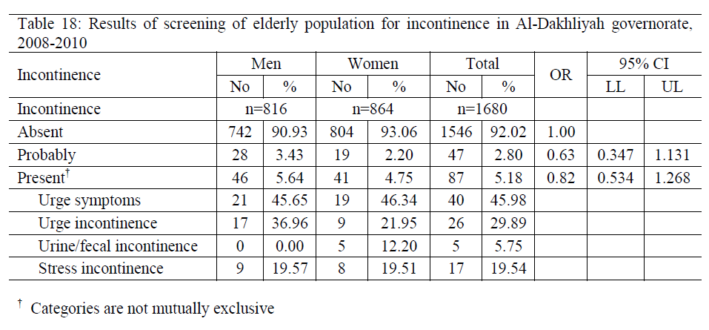
EXAMPLE OF A TABLE
Risk of incontinence among [..] by sex in Al-Dakhliyah [..]

Slide 26
Rate of dementia among elderly people in relation to age
EXAMPLE OF GRAPH
OR= 1.95; 95% CI= 1.51, 2.53
OR= 2.77; 95% CI= 1.90, 4.03
Age (years)
Legend
Title

Slide 27
DISCUSSION
It is about interpretation of the results [why] in view of others’ results and how they are going to be used [significance and implication]
It makes use of others’ findings (primary articles) to support the idea or the argument
Ends by a conclusion within the scope of the work
Includes limitations as constraints of the current study, reasons for negative [or positive] unexpected findings, unanswered questions
Includes recommendations for future research in specific areas and the reason for this recommendation

Slide 28
DISCUSSION
Avoid
Restating the results
Telling the reader your findings are comparable [to whom] and different [from whom] then [period] but explaining the significance of differences and similarities
Overgeneralization

Slide 29
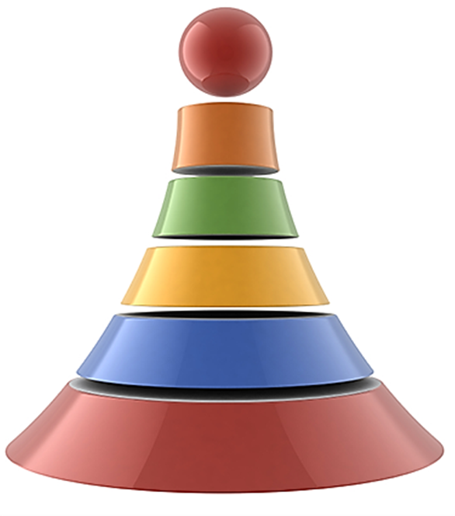
DISCUSSION
Interpretation of data
In relation to objectives
Interpreting others findings
End by the concepts used
In the introduction

Slide 30
REFERENCES
List of sources cited in introduction & discussion
Usually other journal articles
Previous studies in same field
Citation styles differ depending on Journal (Vancouver or APA style)

Slide 31
REFERENCES
Herbst AL, Ulfelder H, Poskanzer DC. Adenocarcinoma of the vagina.: Association of maternal stilbestrol therapy with tumor appearancce in young women. New England Journal of Medicine 1971;284(16):878-81.
Author name
Article’s title
Journal name
Volume Number
Issue Number
Pages

Slide 32
ACKNOWLEDGMENT
Thanking individuals or agencies (funding)
Thanking for special contribution
Individuals acknowledged are not the authors
Acknowledgment for specific contribution not on emotional basis

Slide 33
YOUR WRITING STYLE IS EQUALLY IMPORTANT AS THE SCIENCE INCLUDED IN THE PAPER

Slide 34
YOUR WRITING STYLE IS EQUALLY IMPORTANT AS THE SCIENCE INCLUDED IN THE PAPER
Poor writing
Poor communication of science

Slide 35
Write short sentences
Use a spell checkers
Use non-sexist language and third person language
Keep the past tense except for the discussion use the present tense
Use an active voice [with exceptions]
Avoid “difficult” words
Avoid the use of indefinite “this”
Avoid “Jargon” by using precise words
Use thesaurus for synonyms
Avoid empty sentences and empty paragraph
Omit unnecessary words [really, very, highly, clearly]

Slide 36
The interview was completed by participants in 15 minutes
Participants completed the interview in 15 minutes
USE ACTIVE VOICE

Slide 37
Not necessary to mention the actor: E.g. A self administered questionnaire was designed for data collection.
The person acted upon is more important: E.g. 100 child died as a result of an attack of an armed gang on a school bus.
USE OF PASSIVE VOICE

Slide 38
The reason for the high rate of diarrhea is because of the low level of hygiene
The reason for the high rate of diarrhea is the low level of hygiene
ELIMINATE UNNECESSARY WORDS

Slide 39
A small number of patients refused testing
Blood pressure reached high levels.
1% of the patients refused testing.
Blood pressure exceeded 170/110
USE PRECISE WORDS

Slide 40
ABBREVIATION
Don’t use abbreviation unless the term is repeated three times (PLWHA)
The term should appear complete when used for the first time followed by its abbreviation between brackets
Use the abbreviation when the term is used afterwards
Thesis and report should include a list of abbreviation

Slide 41
A well-written scientific paper
Explains the motives for doing the research, the methods used, its execution, and the implication of the results
Its is concise and informative
Its style is simple and clear
Its purpose is to inform readers and to document a particular approach to investigate the issue and to an answer the research question.

