Slide 1
PLAGIARISM
Randa M. Youssef
Professor of Community Medicine
Family and Community Medicine Dept.
King Saud University

Slide 2
Learning objectives
Define the term “plagiarism”
Explain the intention behind plagiarism: why it is done?
State the types of plagiarism
Identify what is considered plagiarism by type
Describe the overlap between plagiarism and copyright infringement
Recognize the seriousness of plagiarism
Believe that plagiarism will be discovered
Illustrate with examples the methods of avoiding plagiarism
Explain how to check own work for plagiarism

Slide 3
Performance objectives
1. Demonstrate an understanding of plagiarism
2. Adopt methods of avoiding plagiarism
3. Check your own work for plagiarism before submission

Slide 4
Definition
“The practice of taking someone else’s work or ideas and passing them off as one’s own” (Oxford dictionary)
More elaboration on the definition
Use without quoting, attribution, or citation
Extend to use of “words” without “paraphrasing”

Slide 5
Definition
“The practice of taking someone else’s work or ideas and passing them off as one’s own”
Synonyms
Copying
Stealing
Piracy
Appropriation
Infringement of copyright ©
Source: Oxford dictionary

Slide 6
Unintentional
Plagiarizing others’ work out of lack of knowledge of proper citation, quoting and paraphrasing
Deliberate
Plagiarizing others’ work with full knowledge that the act is an act of plagiarism

Slide 7
Types
Reproducing (cloning): Generating a copy of someone else work from A to Z
Ctrl-C followed by Ctrl-V: Copy and paste a significant part (4 to 6 successive words in text) of someone else work without change
Find then Replace: Replacing certain words with synonyms while maintaining the original content
Mixing and combining: Paraphrasing and integration in own work
Recycling: Plagiarism of own previous work
www.plagiarism.org

Slide 8
Types
Hybrid: Combine with perfection cited sources with copied work
Mash up: mixing copied materials from different sources
404-Error: Use citation of non-existing work
Aggregator: Proper citation but paper doesn’t contain original work
Re-tweet: Proper citation but relies too closely on the original paper
www.plagiarism.org

Slide 9
Plagiarism is considered when
Failure to use quotations
Not making reference to the source (citation)
Paraphrasing too closely

Slide 10
Identifying plagiarism
Knowledge of previous writing
Higher level of writing
Use of uncommon or unfamiliar terms or words
Obvious difference in style or terminology between paragraphs and sections (inconsistencies)
Use of specific software to detect plagiarism

Slide 11
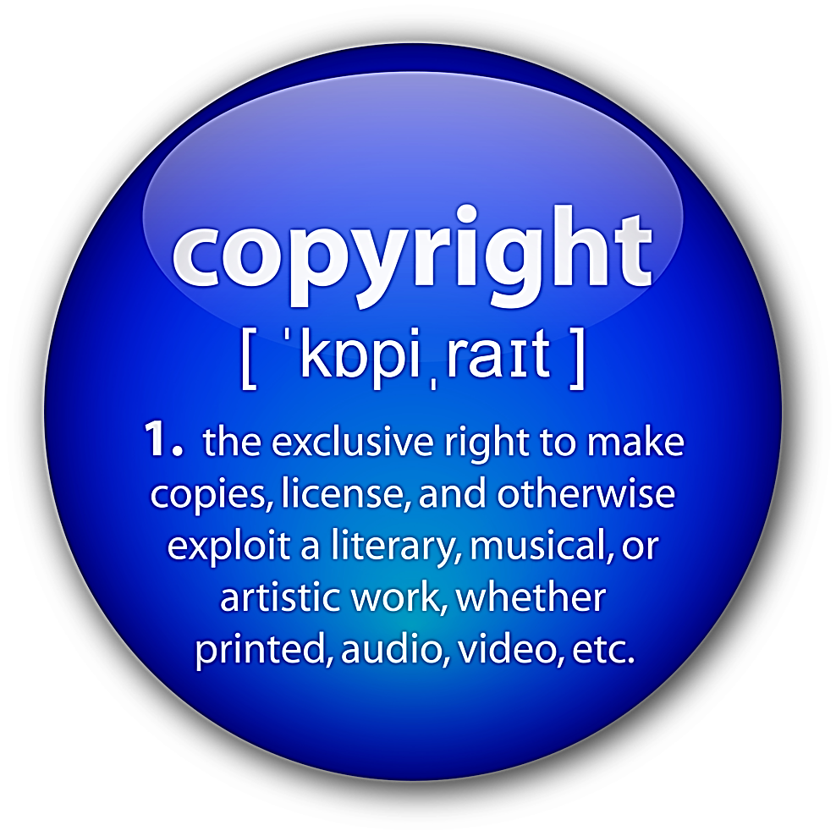
Source: Legal dictionary

Slide 12
“Fair use” is the use of a limited proportion of copyrighted materials for education and research purpose unless otherwise is indicated by the owner of the work. It is determined by
Purpose of use: non-profit
Nature of work used: published
Portion of the work used: not essential or relatively small
Effect of use on author: not violating owner’s profit

Slide 13
Copyright © infringement is “the act of violating the copyright owner’s exclusive right through unauthorized or prohibited use of copyrighted material. A copyright owner’s right is an exclusive one and is granted under the federal Copyright Act”.
Source: Legal dictionary

Slide 14
Plagiarism
(morale issue)
© infringement
(legal issue)
Taken without permission and pass it as self
Incorporating others work in own without attribution either unintentionally of deliberately
Incorporating others work in own without legal clearance

Slide 15
Plagiarism is an offense with adverse effects on
Reputation of the institution
Reputation and career of the person who plagiarize

Slide 16
General rules to avoid plagiarism
Don’t copy others’ work (hard copies or internet)
Think and decide on what ideas you will put on your assignment
Identify what is YOURS and what is not and maintain sources
Get counseling from your supervisor on writing especially when you are doubting plagiarism

Slide 17
Use proper citation
Make reference to the source from which the information have been obtained
No citation is required for “common knowledge” as: Sanitation of the environment will prevent a wide range of diseases.

Slide 18
Use quotation to convey the statement of others
Put the sentence extracted from others between quotation marks and attribute it to the original author
Original….Fifty years ago today was a tipping point in recognizing and reversing the deadly epidemic caused by smoking….
Or
Quoting: In his speech, Dr. Frieden said “Fifty years ago today was a tipping point in recognizing and reversing the deadly epidemic caused by smoking” [citation]

Slide 19
Paraphrase
Write the sentence in your own words and in your own style not only changing key words with synonyms.
Original….Fifty years ago today was a tipping point in recognizing and reversing the deadly epidemic caused by smoking….
Paraphrasing: The consequences of tobacco use and interventions to reverse the trend of the epidemic have been recognized 50 years ago [citation]

Slide 20
Effective paraphrase
Read the original passage until you understand its full meaning.
Set the original aside, and use your own words to reflect what you have understood
Check your interpretation with the original to make sure that your version conveyed the original information.
Use quotation marks to a unique word or series used as they are
Provide a citation for the source of the original passage

Slide 21
Summarize
Extract the main idea and summarize it in few words using your own words
Original: Bulman et al (2013) wrote in the results section “Overall, our ﬁndings suggest some participants were screened for HIV without their consent, and without understanding the rationale for this procedure. Additionally, no participants remember being told they had the right to refuse testing. Finally some participants felt they were treated paternalistically when they attempted to ask questions about HIV screening. These situations all occurred in a location where opt-out HIV screening was policy.”

Slide 22
Summarize
Extract the main idea and summarize it in few words using your own words
Original: Bulman et al (2013) wrote in the results section “Overall, our ﬁndings suggest some participants were screened for HIV without their consent, and without understanding the rationale for this procedure. Additionally, no participants remember being told they had the right to refuse testing. Finally some participants felt they were treated paternalistically when they attempted to ask questions about HIV screening. These situations all occurred in a location where opt-out HIV screening was policy.”
Summarized: Previous study (Bulman et al, 2013) cautioned that the “opt-out” approach for HIV screening of pregnant women may raise ethical concerns if women’s informed consent is violated .

Slide 23
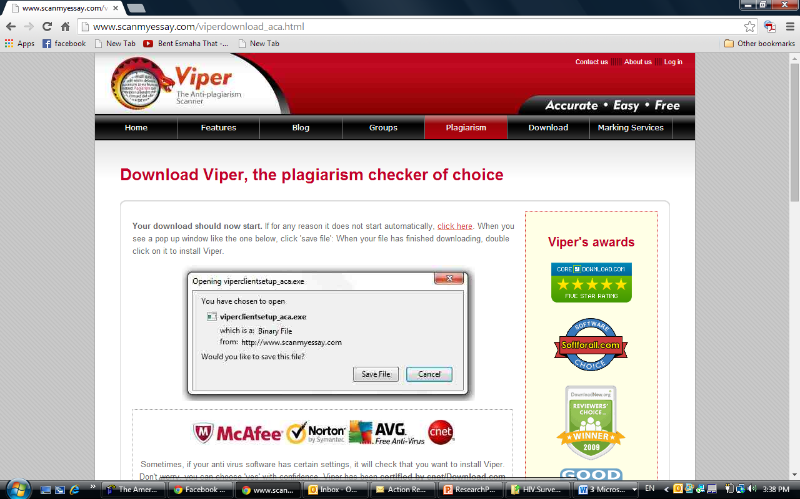
http://www.scanmyessay.com/viperdownload_aca.html

Slide 24
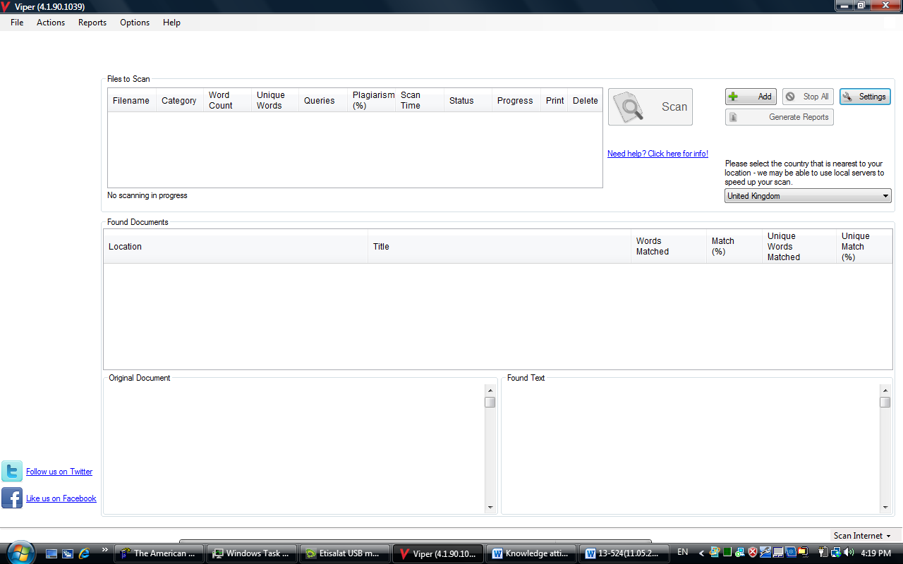

Slide 25
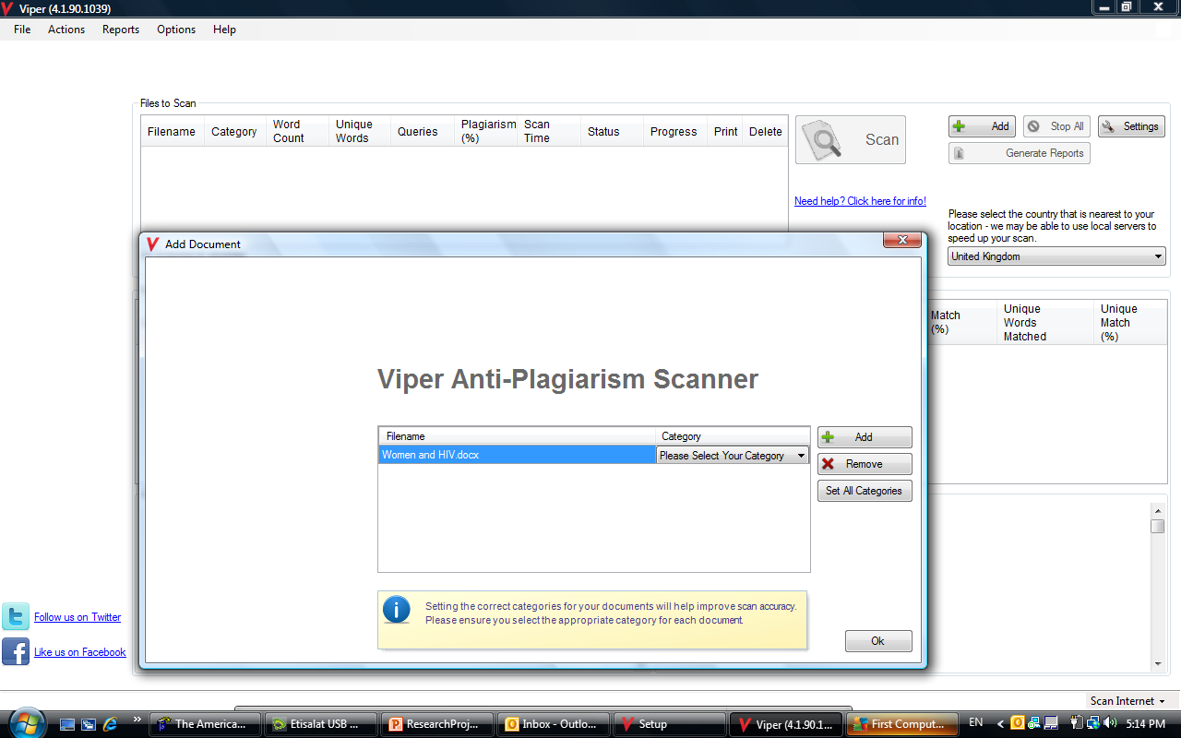

Slide 26
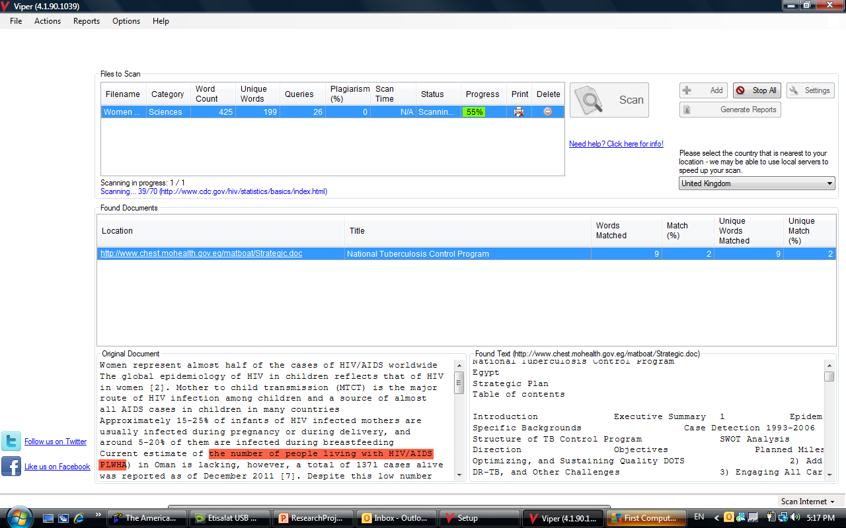

Slide 27
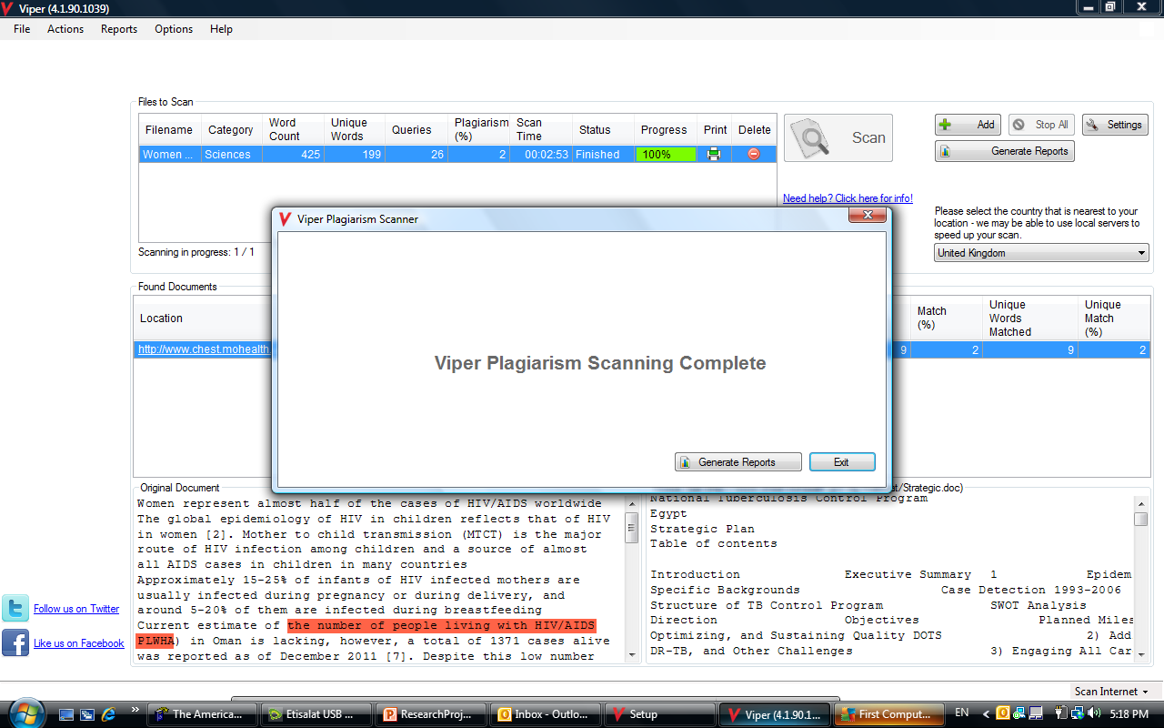

Slide 28
