Slide 1
ATHEROSCLEROSIS
PAD,CAROTID STENOSIS,
ACUTE LIMB ISCHEMIA
Dr.Elham Khoujah
Cosultant vascular/Endovascular surgeon.

Slide 2
ATHEROSCLEROSIS PATHOPHYSIOLOGY
Definition..
A process of progressive thickening and hardening of the walls of medium-sized and large arteries as a result of fat deposits on their inner lining.
Heamodynamic facts..
The endothelial cells that line blood vessels provide an active, dynamic interface between the blood stream and the arterial wall.
provide a semi-permeable barrier that regulates the exchange of fluid, nutrients, gases, and waste between the blood and tissues.
provide unique surface that generally allows the cellular elements of blood to flow with adhering to the vessel lining .

Slide 3
ATHEROSCLEROSIS PATHOPHYSIOLOGY cont.
Endothelial cells also regulate constriction and relaxation of vessels by releasing vasodilatory molecules (e.g., nitric oxide (NO) and prostacyclin (PGI₂) and vasoconstrictive molecules (endothelin and angiotensin-II).
When injury occurs, endothelial cells secrete cytokines that trigger and maintain an inflammatory response.

Slide 4
ATHEROSCLEROSIS PATHOPHYSIOLOGY cont.
RISK FACTORS OF ENDOTHELIAL INJURIES..
Physical injury or stress as a result of direct trauma or hypertension .
Turbulent blood flow, for example, where arteries branch.
Circulation of reactive oxygen species (free radicals), e.g., from smoking or air pollutants.
Hyperlipidemia (high blood concentrations of LDL or VLDL).
Chronically elevated blood glucose levels.
Homocysteinemia, which results from an inherited metabolic defect that leads to very high levels of the homocysteine, a metabolite of methionine; high concentrations are toxic to the endothelium.

Slide 5
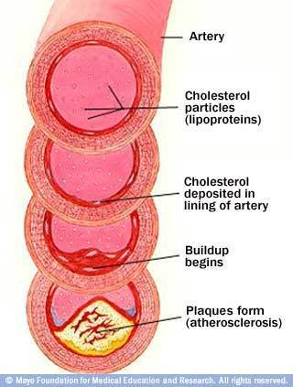
ATHEROSCLEROSIS PATHOPHYSIOLOGY cont.
Atherosclerosis is a disease process which is triggered by sometimes subtle physical or chemical insults to the endothelial cell layer of arteries.

Slide 6
(1) TOXIC INSULT
(modified LPL,heamodynamic insults,
infecious agents,oxidative stress)
(3) INFLAMATORY RESPONS
(adhesion to endothelium,migration to subendothelium,
release of cytokines,platlet activation)
(2) ENDOTHELIAL DYSFUNCTION
(increase adherence,permeability,hypercoagulability, (8) THROMBUS FORMATION
expression of adhesion molecules,release of chemokines) (rupture of fibrous cap or ulceration of plaque,
continuing influx&activation of macrophages)
(5)
(4) FOAM CELL FORMATION (6) INTERMEDIATE LESION (7) FIBROUS PLAQUE
(engulfing of LDL by macrophages) (layers of macrophages & (progression of intermediate lesion with
FATTY STREAKS smooth muscle cells) fibrous cap formation,mixture of inflamatory
(aggregation of lipid-rich macrophages & smooth muscle cells,intra. & extracellular
& T-lymphocytes) lipid,increase matrix proteins & necrotic
cellular debris)

Slide 7
PERIPHERAL ARTERIAL DISEASE sequence of atherosclerosis of peripheral vessels excluding the carotids and coronaries..
Presentation..
acute chronic
embolic thrombotic traumatic claudication critical limb ischemia

Slide 8
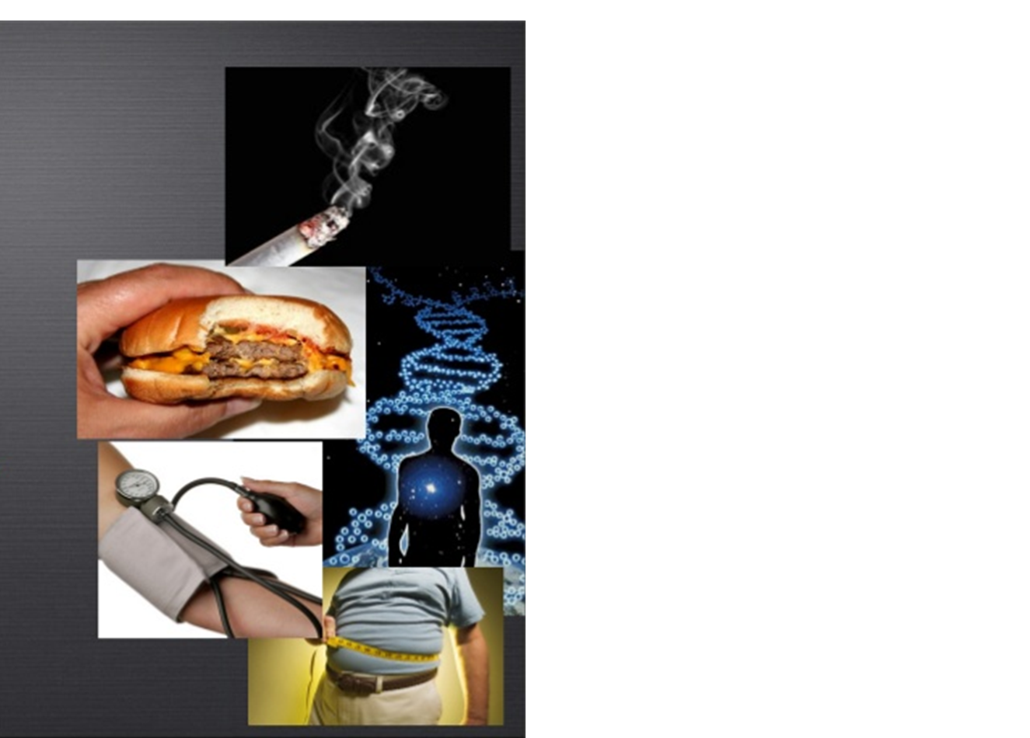
PERIPHERAL ARTERIAL DISEASE
Risk Factors..
Hypertension.
Diabetes.
Hyperlipidemia.
Smoking.
Familial tendency.
Obesity.
Gender.

Slide 9
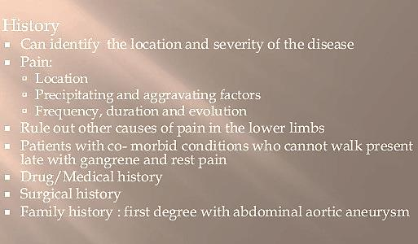
PERIPHERAL ARTERIAL DISEASE

Slide 10
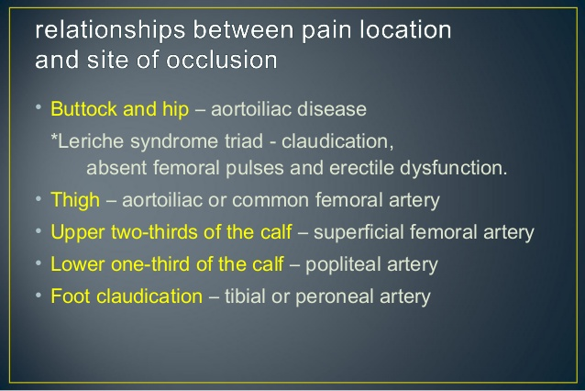
PERIPHERAL ARTERIAL DISEASE

Slide 11
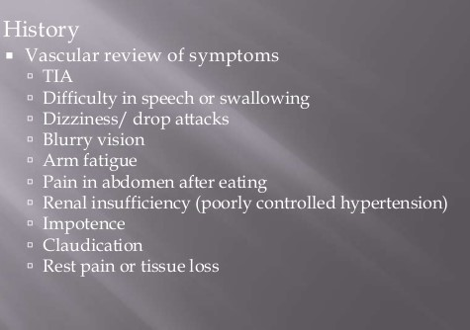
PERIPHERAL ARTERIAL DISEASE

Slide 12
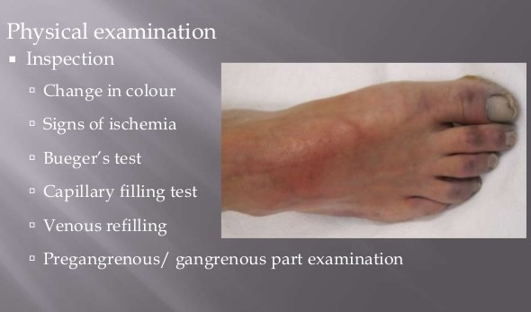
PERIPHERAL ARTERIAL DISEASE

Slide 13
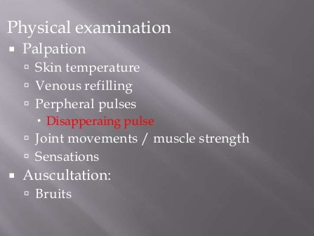
PERIPHERAL ARTERIAL DISEASE

Slide 14
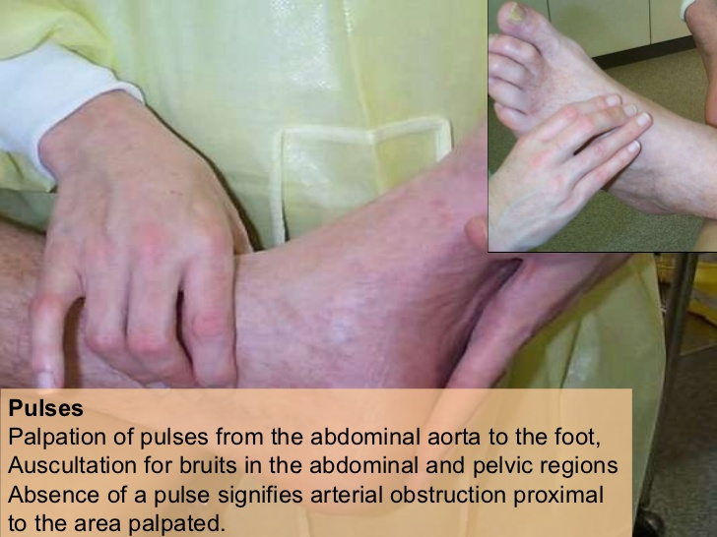
PERIPHERAL ARTERIAL DISEASE

Slide 15
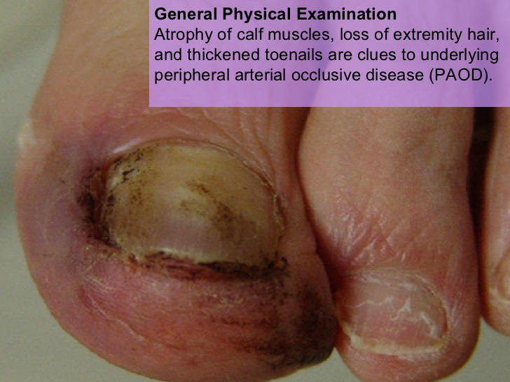
PERIPHERAL ARTERIAL DISEASE

Slide 16
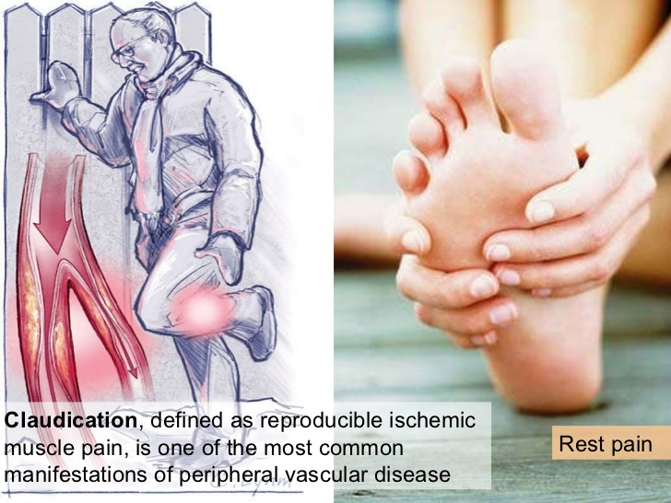
PERIPHERAL ARTERIAL DISEASE

Slide 17
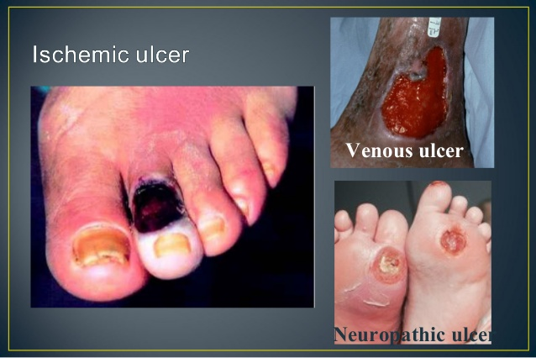
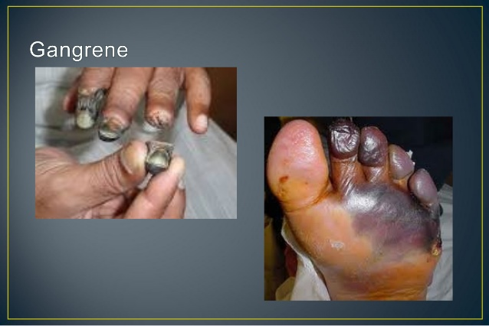
PERIPHERAL ARTERIAL DISEASE

Slide 18
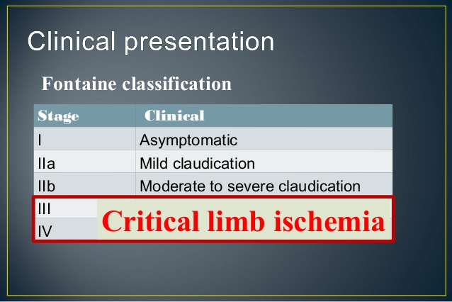
PERIPHERAL ARTERIAL DISEASE

Slide 19
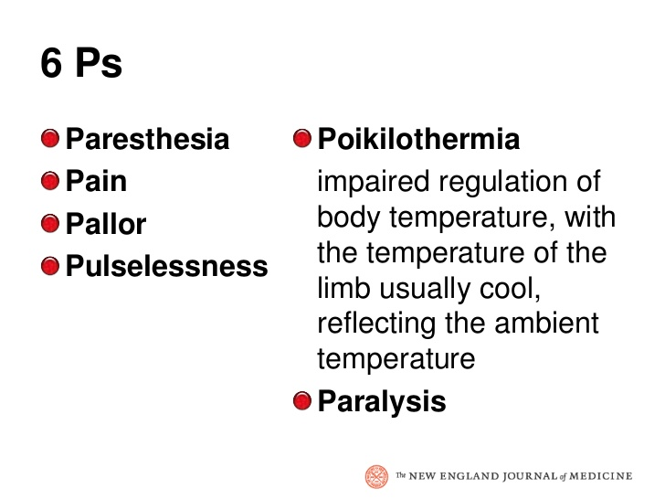
PERIPHERAL ARTERIAL DISEASE

Slide 20
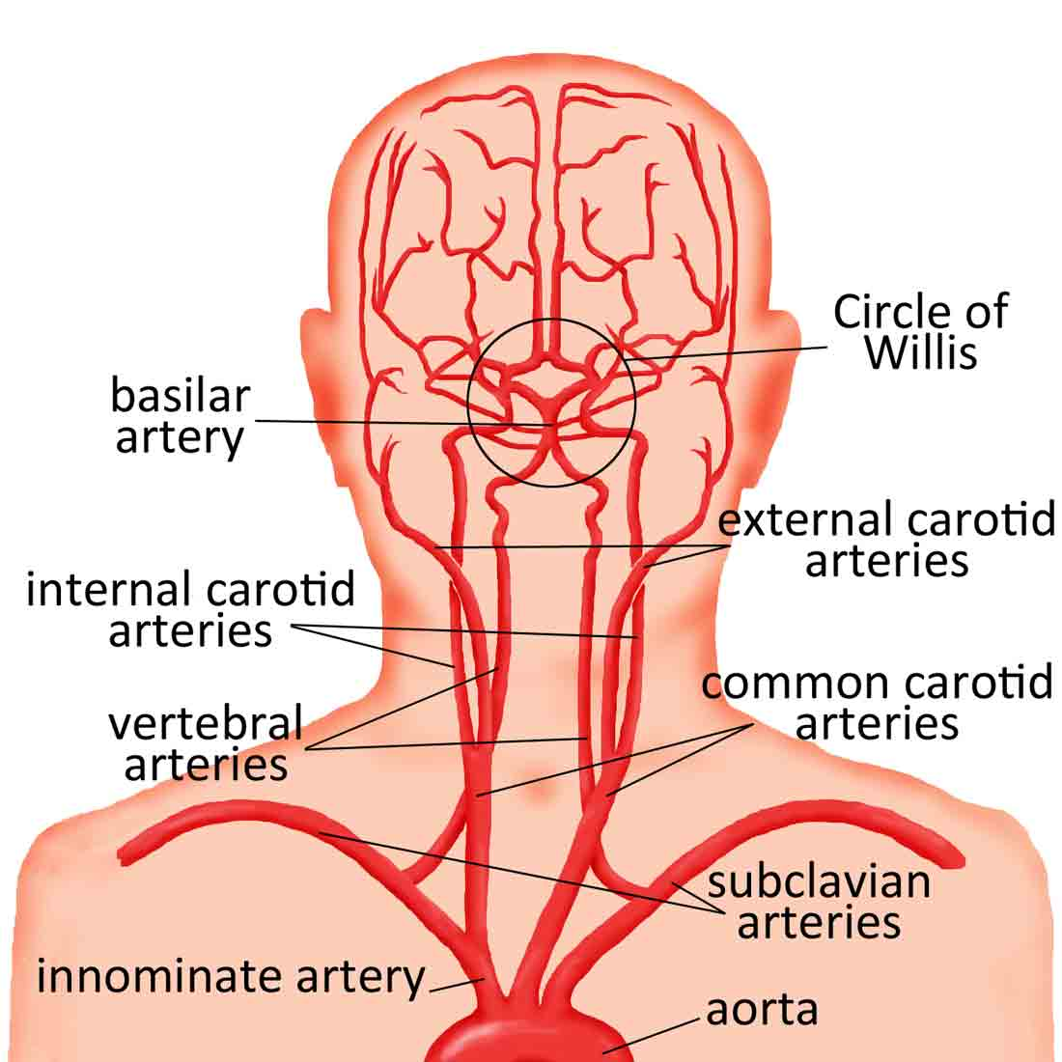
CAROTID ARTERY DISEASE

Slide 21
CAROTID ARTERY DISEASE
Risk factors..
History..
Symptoms & signs..

