Slide 1
Inguinoscrotal Conditions
In Infants and Children
Abdulrahman M Alzahem, MD, MS, FRCSC, FRACS
Associate Professor & Consultant
Division of Pediatric Surgery
Faculty of Medicine & KSUMC

Slide 2
Inguinoscrotal Pathology
Inguinal Hernia
Hydrocele
Undescended Testis
Acute Scrotum

Slide 3
Groin Hernias – Embryology & Anatomy
The processus vaginalis is present in the developing fetus at 12 weeks in utero
The processus is a peritoneal diverticulum that extends through the external inguinal ring
As the testis descends at the 7th to 8th months, a portion of the processus attaches to the testis, as it exits the abdomen and is dragged into the scrotum with the testis

Slide 4
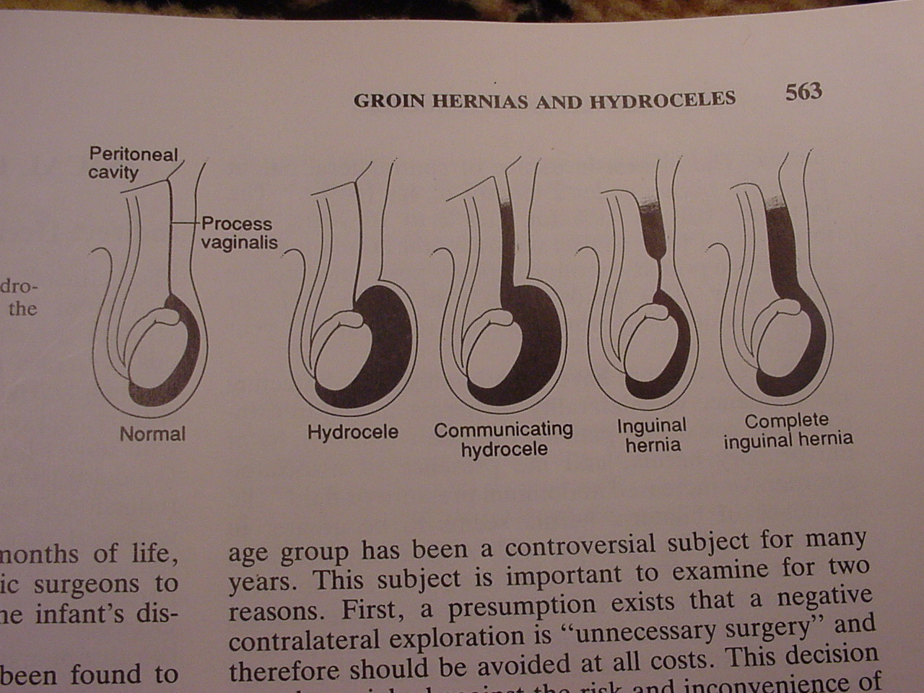

Slide 5
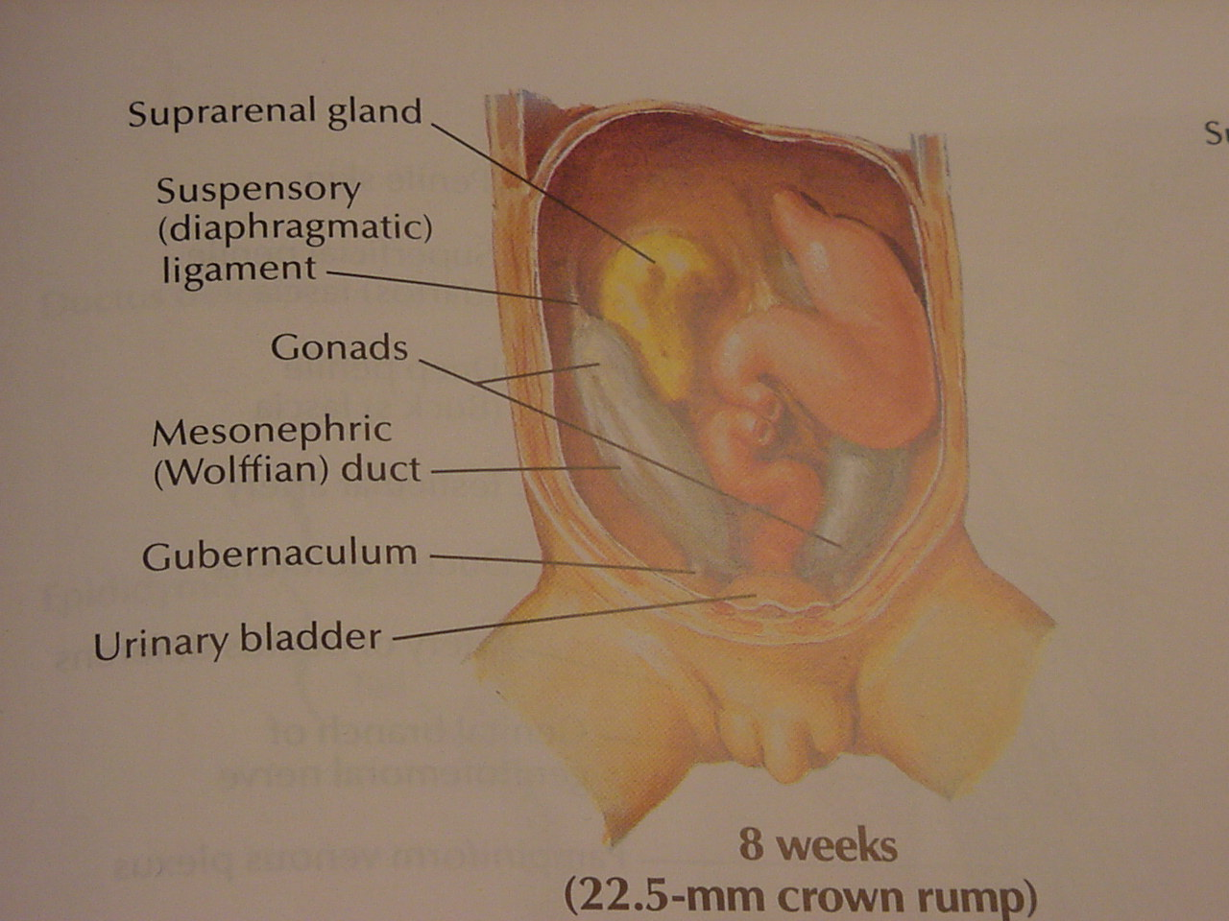

Slide 6
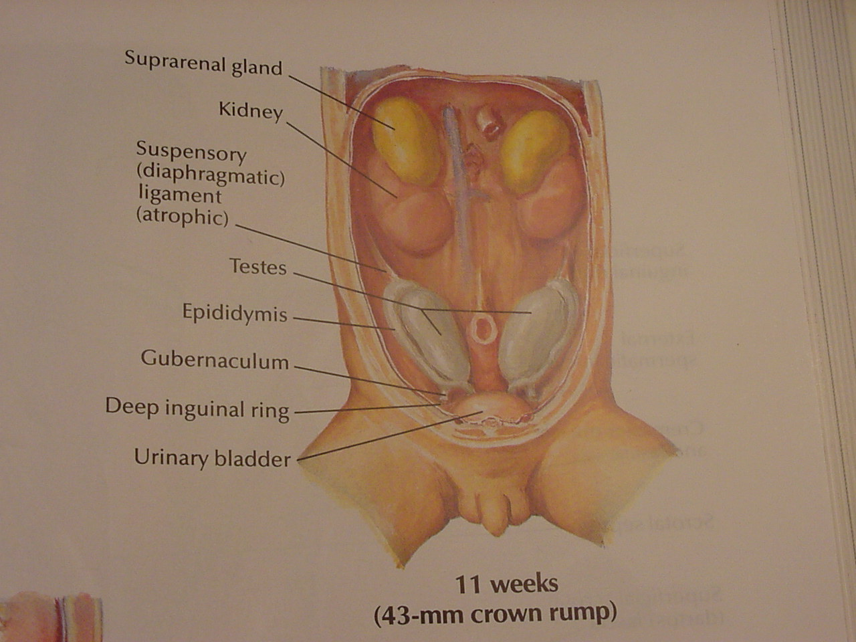

Slide 7
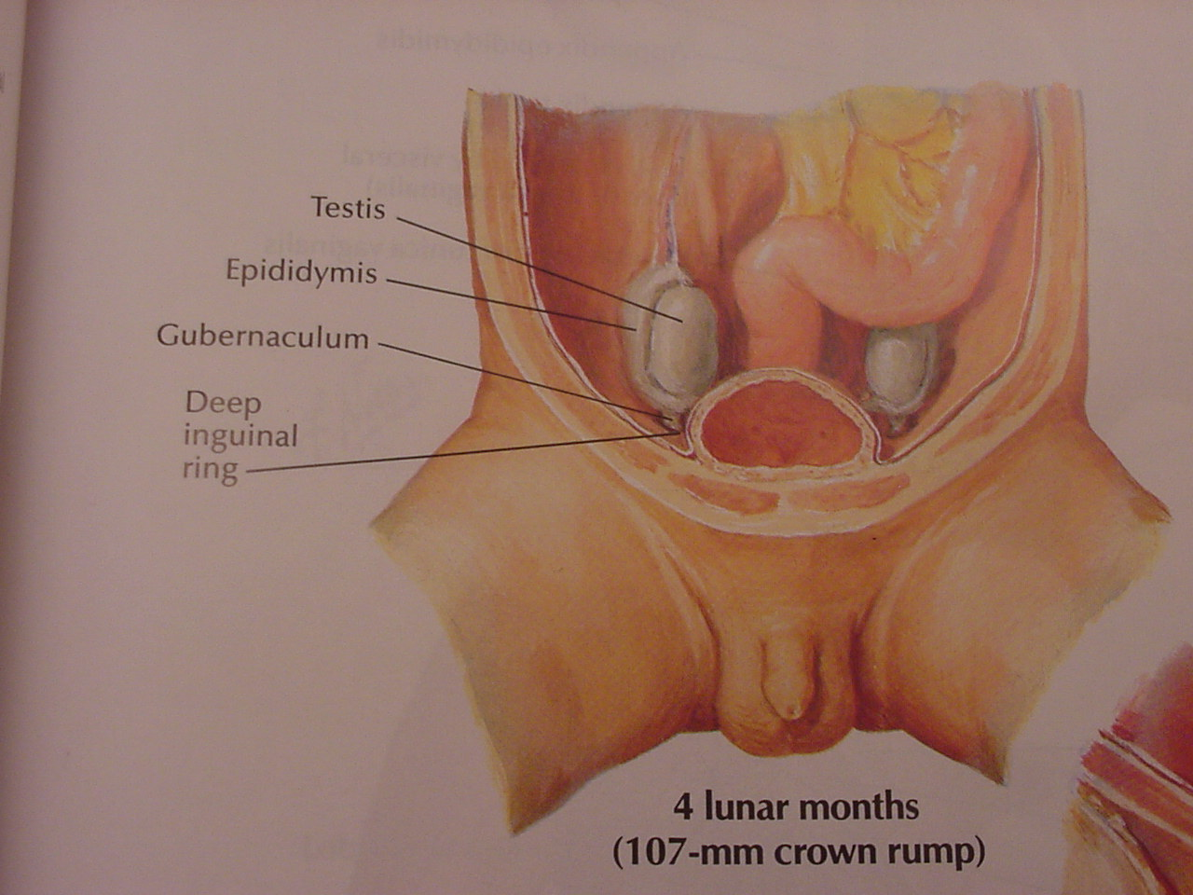

Slide 8
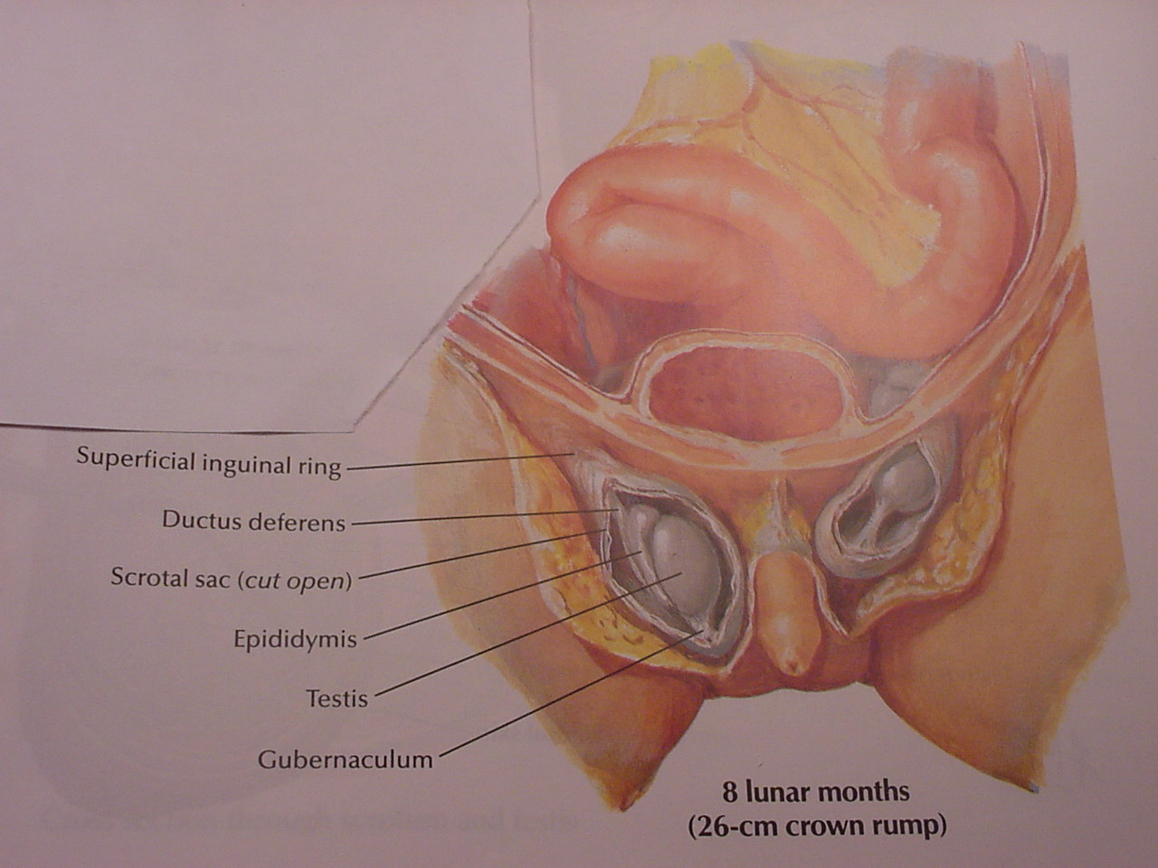

Slide 9
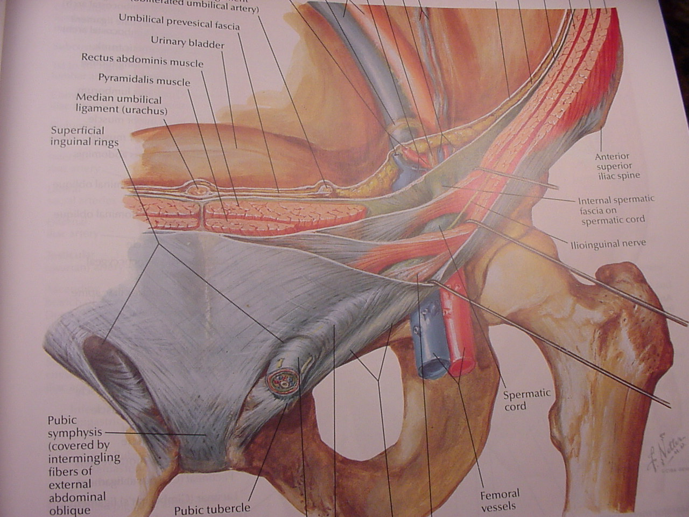

Slide 10
Inguinal Hernia
Congenital (PPV)
Prevalence (1-5% boys)
Premature (35%)
Male/Female (9:1)
Indirect (99%)
R > L
Inguinal hernia? Or Hydrocele?

Slide 11
Associated Conditions – Inguinal Hernia
Cystic Fibrosis
Connective tissue disorders
Ehlers-Danlos syndrome
Hunter-Hurler syndrome
Developmental dysplasia of the hip (DDH)
Chronic peritoneal dialysis
Preterm infants with intraventricular hemorrhage
Myelomeningocele with VP-shunt
Undescended testis

Slide 12
Inguinal Hernia
History
Intermittent groin swelling
Asymptomatic until get complicated
In girls, lump in upper part of labia majora
Examination
Examine the testes
Reducibility
Thickened spermatic cord*

Slide 13
Complicated Inguinal Hernia
Incarcerated hernia:
- Irreducible swelling
- No evidence of bowel obstruction or strangulation
Obstructed hernia:
- Irreducible swelling
- Symptoms and signs of bowel obstruction (bilious vomiting, abdominal distention, constipation)
Strangulated hernia:
- Irreducible swelling
- Symptoms and signs of strangulation (severe groin pain, fever, tachycardia, skin discoloration of the groin)

Slide 14
Inguinal Hernia
Management:
Herniotomy (as soon as it is feasible)
Incarcerated hernia
+/-Sedation and analgesia
Manual Reduction
Urgent herniotomy
Strangulated hernia Emergent herniotomy +/- bowel resection

Slide 15
Inguinal Hernia and Hydrocele

Slide 16
Hydrocele
History:
Scrotal swelling
Asymptomatic
1% over one year of age
Examination:
Get above the swelling
Not reducible (most accurate)
Transilluminates
Management:
Surgery not advised < 2 years of age
Ligation of PPV

Slide 17
Descent of Testis – 2 Phases
10-15th week: the gubernaculum enlarges to anchor the testis near the inguinal region as the embryo enlarges
28-35th week: the gubernaculum migrates out of the inguinal canal across the pubic region and into the scrotum
The processus vaginalis develops as a peritoneal diverticulum within the elongating gubernaculum, creating an intraperitoneal space into which the testis can descend

Slide 18
Undescended Testis
Palpable 80%
Definitions:
True undescended testis
Ectopic
Retractile
Incidence:
At birth: 3-4%
At one year: 1%
Pre-term: 30%
Non palpable 20%

Slide 19
Undescended Testis
Diagnosis:
Parents/Doctors
Clinical features
Empty scrotum
Palpable or not
Milk it down to scrotum
Imaging? (limited role)
Laparoscopy
Diagnostic
Therapeutic

Slide 20
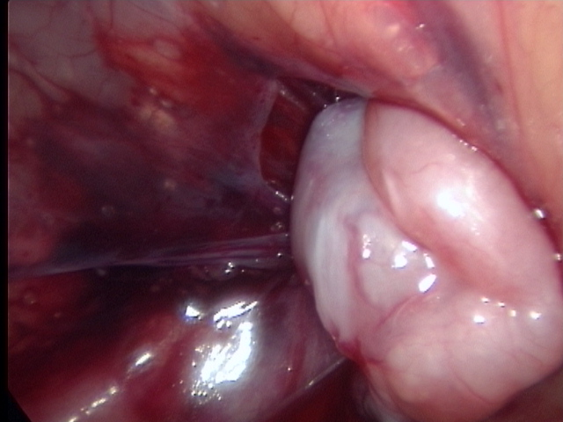
Undescended Testis
Indications:
Abnormal fertility
Testicular tumor
Cosmetic/Social
Trauma/Torsion
Treatment (6 months):
Palpable - open orchiopexy
Nonpalpable -
Laparoscopy assisted orchiopexy
Two stages Fowler-Stephens orchiopexy

Slide 21
Acute Scrotum
Introduction:
Acutely painful +/- swollen +/- red scrotum
Pediatric surgical emergency!!!
Causes:
Testicular Torsion
Torsion of Appendage(s) (prepubertal*)
Epididymo-orchitis (postpubertal*)
Idiopathic Scrotal Edema
Other conditions e.g. Incarcerated hernia, Acute hydrocele, HSP, Trauma

Slide 22
Testicular Torsion
Introduction:
Incidence: 1:4000
Two peaks: peripubertal and perinatal
Symptoms:
Lower abdominal pain and vomiting
Hemiscrotal pain
Swollen → red hemiscrotum
Signs:
Tender
Cremasteric reflex- absent (most specific)
Lies higher than contralateral testis
Horizontal in position

Slide 23
Duration of Torsion and Testicular Salvage
Duration of Torsion (Hours) | Testicular Salvage (%)
< 6 | 85-97
6-12 | 55-85
12-24 | 20-80
>24 | <10

Slide 24
Testicular Torsion
Investigations:
Color Doppler US
Radionuclide Scan
Management:
Timing is critical 4 - 6 hours
Exploration if any doubt
Untwist (open book) and assess viability
Fix the other side
If more than 12 hours, it is likely to be non-viable and may need orchiectomy

Slide 25
Testicular Appendages

Slide 26
Torsion of Appendage(s)
Introduction:
Embryological remnants of the mesonephric and mullerian duct system occur as tiny (2-10mm long) appendages of testis
Appendix testis (hydatid of Morgagni), appendix epididymis …etc
Peak age: 10-12 yrs
Presentation:
pain – more gradual onset
Blue dot sign
Swollen → red hemiscrotum
Color Doppler scan
Management: Conservative or operative if torsion cannot be excluded

Slide 27
Idiopathic Scrotal Edema
Introduction:
Cause?
Peak age: 4-5 yrs
Presentation:
Swollen, red scrotum
Minimal pain
Management:
Conservative, self limiting within 1-2 days

Slide 28
Any questions?

