Slide 1
Peripheral nerve injuries
M M Al-Qattan

Slide 2
Brachial plexus injury
Closed injuries (difficult delivery, RTA): the level of injury is at the roots
3 types:
A-Erb: C5,6,7
B- klumpke: C8, T1
C- Total: all roots
note:phrenic nerve palsy (C4) may occur with A&C;Horner syndrome(loss of ipsilateral facial sympathetics coming from T1,leading to ptosis meiosis and anhydrosis)may occur with B&C

Slide 3
Examination of the brachial plexus roots: myotomes and dermatomes
Myotomes:
C5: shoulder abduction and external ortation
C6: elbow flexion
C7: wrist extension
C8 :making a fist
T1: hand intrinsics

Slide 4
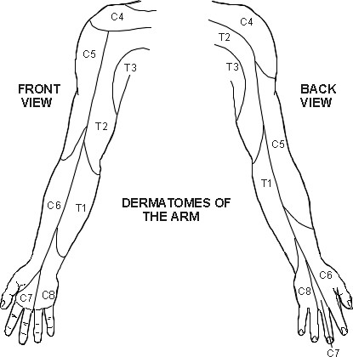
Dermatomes (note middle finger by the middle root=C7)

Slide 5
Erb palsy : C5,6,7: Waiter tip posture

Slide 6
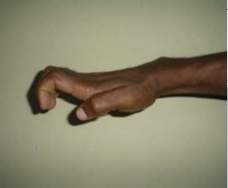
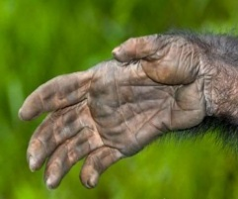
Klumpke palsy: Ape hand (no hand intrinsics leading to clawing of all fingers)

Slide 7
Isolated axillary nerve injury
Causes: shoulder surgery/trauma
Motor exam: loss of Deltoid (can not fully abduct the shoulder)
Sensory exam: loss of sensation over the deltoid muscle

Slide 8
Isolated musculocutaneous nerve injury
Causes: usually stab wounds near the axilla
Motor exam: loss of biceps (elbow flexion)
Sensory exam: loss of sensation along the distribution of the lateral cutaneous nerve of the forearm (i.e. the lateral forearm)

Slide 9
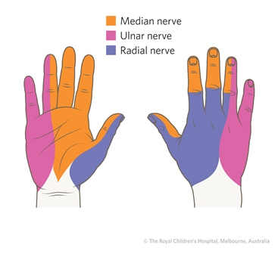
Sensation in the hand

Slide 10
Radial nerve palsy
Anatomy: the nerve supplies the triceps in the upper arm
Then goes in the spiral groove of the humerus
Then supplies the wrist extensors at the elbow level
Then divides into 2 branches: pure sensory (superficial radial nerve) and pure motor (posterior interosseous nerve) which supplies thumb extension and finger extension at the MP joints

Slide 11
Saturday night palsy
Cause: drunk falling asleep on the edge of a chair compresses the radial nerve in the axilla
Motor: loss of EXTENSION at the: elbow,wrist, thumb, and fingers
Sensory: lost in the hand (see diagram)

Slide 12
Fracture humerus at the spiral groove
Motor: normal triceps but a DROP WRIST (no wrist extension) and no thumb/finger extension
Sensory: lost in the hand (see diagram)

Slide 13
Isolated posterior interosseous nerve injury
Cause: radial head fracture, radial head excision
Motor: can extend the elbow and wrist; but can not extend the thumb or fingers
NO SENSORY LOSS (pure motor nerve)

Slide 14
Median and ulnar nerve injuries
Anatomy: the volar forearm muscles
A- superficial group : flexor carpi radialis, flexor carpi ulnaris, flexor digitorum superficialis, pronator teres: all by Median n. except FCU
B- Deep group: flexor pollicis longus, flexor digitorum profundus, pronator quadratus: all by the anterior interosseous nerve (branch of Median n) except the ulnar half of FDP (to ring and little fingers)

Slide 15
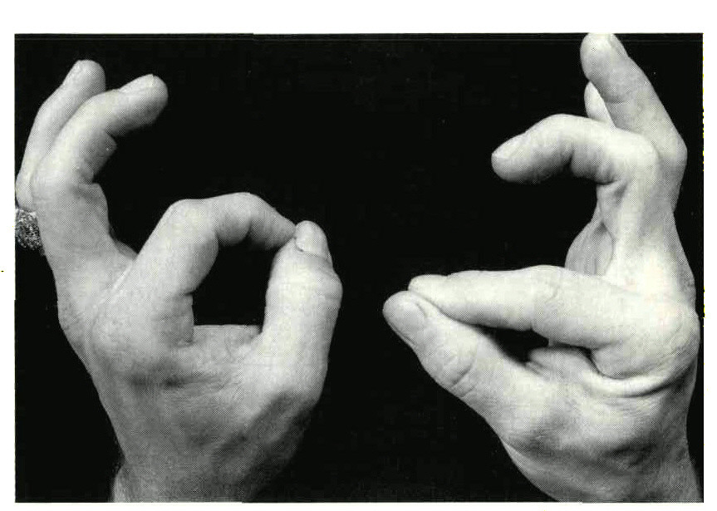
Anterior interosseous nerve palsy
Cause: supracondylar fractures
Motor: lost FPL, and FDP of the index and middle fingers…..Hence, can not make a perfect “O”= the “O” sign
NO SENSORY LOSS
(pure motor nerve)

Slide 16
Median and ulnar nerves and hand intrinsics
Thenar muscles: thumb adduction and opposition
Hypothenar muscles : little finger abduction and opposition
Lumbricals and interosseous muscles:
A-both participate in simultaneous MPJ flexion and IPJ extension (anti-claw)
B-interosseous muscles are responsible for finger abduction/adduction (except for little finger abduction)
Note: All are supplied by the ulnar n. except thumb opposition and the radial 2 lumbricals which are supplied by the Median n.

Slide 17
Injury of median nerve at the wrist
Cause: laceration, carpal tunnel syndrome
Motor: only loss of thumb opposition.
The loss of radial 2 lumbricals does not cause clawing because the interosseous muscles are intact
Sensory loss: see diagram

Slide 18
Injury of ulnar nerve at the wrist
Cause: lacerations
Motor loss:
A- loss of thumb adduction (Froment sign)
B- loss of hypothenars(loss of little finger abduction and opposition)
C-loss of finger abduction/adduction
D- ulnar claw hand
Note: no claw in the index or middle fingers because the radial 2 lumbricals are intact

Slide 19
Lower limb nerve injuries
Femoral nerve injury : loss of sensation in the anterior and medial thigh and loss of quadriceps (knee extension)
Common peroneal nerve injury (at fibular head): loss of sensation in lateral leg and dorsum of foot, and loss peroneus muscles and loss of toe extension and ankle extension (foot drop)
Posterior tibial nerve injury: loss of sensation in the sole of the foot and loss of flexion of the toes/ankle

