Slide 1
SUPERFASCIAL LUMPS
SKIN&SUBCUTANEOUS
TUMOURS\ CYSTS
Dr. Mohammad Al-Akeely
Associate Professor
Department of Surgery

Slide 2
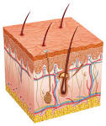
Skin anatomy
Epidermis: openings of glands
Papillary dermis: basal cell layer
Dermis : contains sweat & sebaceous glands

Slide 3
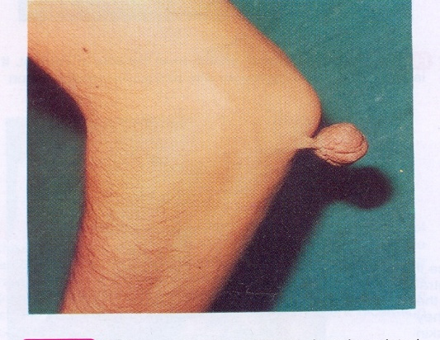
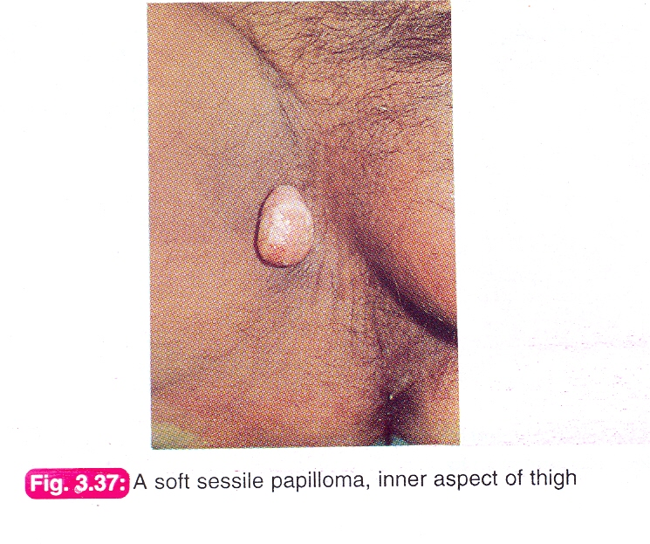
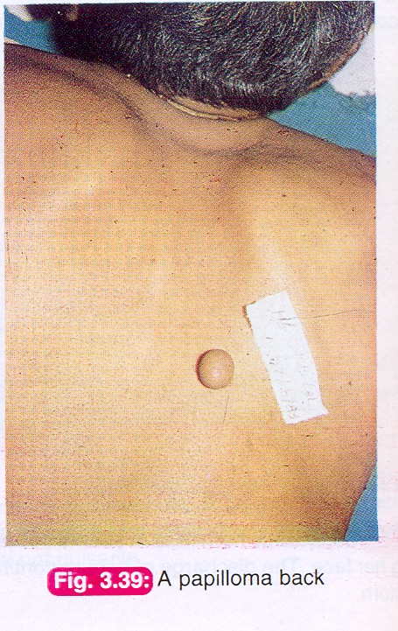
Benign skin tumours
papilloma(wart):
.Finger like projection of all skin layers
.usually infective ( papilloma virus)
.pedunculated or sessile
Rx : .Cauterization (small or multiple)
.Excision (large)

Slide 4
SCAR
Fibrous tissue proliferation following :
. trauma
.surgery
.infection
.It is usually flat.

Slide 5
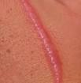
Hyper trophic scar
Excessive fibrous tissue in a scar
.. confined to the scar
. no neovascularization
.wound infection is an important factor
.clinically it is a raised , non tender swelling with no itching
.it may regress gradually in six months
. does not usually recur after excision

Slide 6
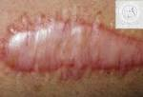
Hyper trophic scars:

Slide 7
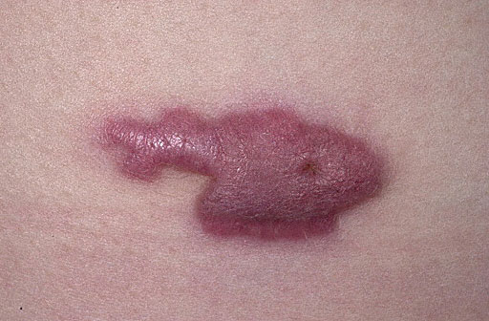
Keloid
Excessive fibrous and collagen tissue with neovascular proliferation in a scar which usually extends beyond the original scar.

Slide 8
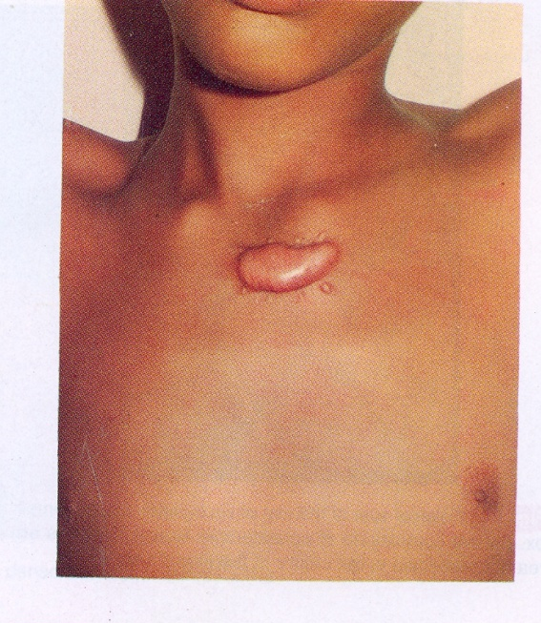
Keloid continue
initially raised , pink , tender , itchy and may ulcerate.
more common in dark skinned people
progressive v.s. non progressive
aquired v/s spontaneous
Rx
.Injection ( hyaluronidase , steroides etc.)
.Excision & grafting

Slide 9
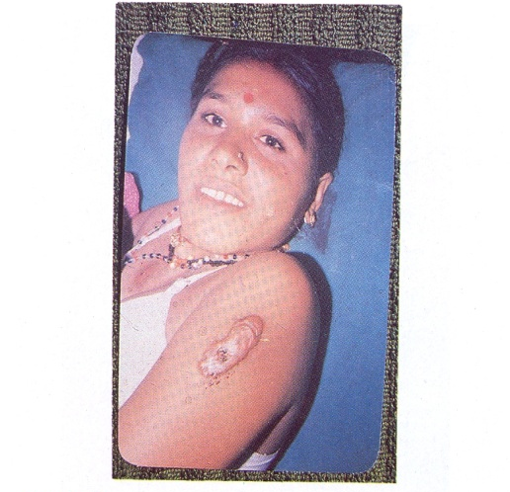
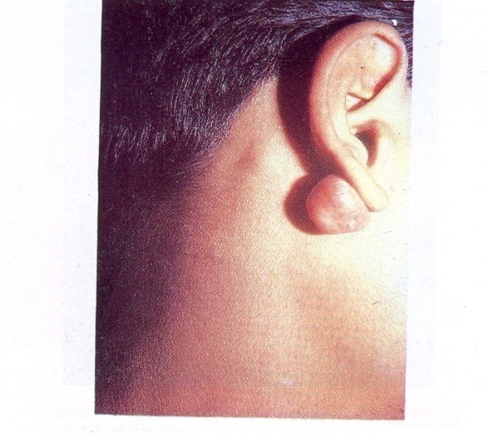

Slide 10
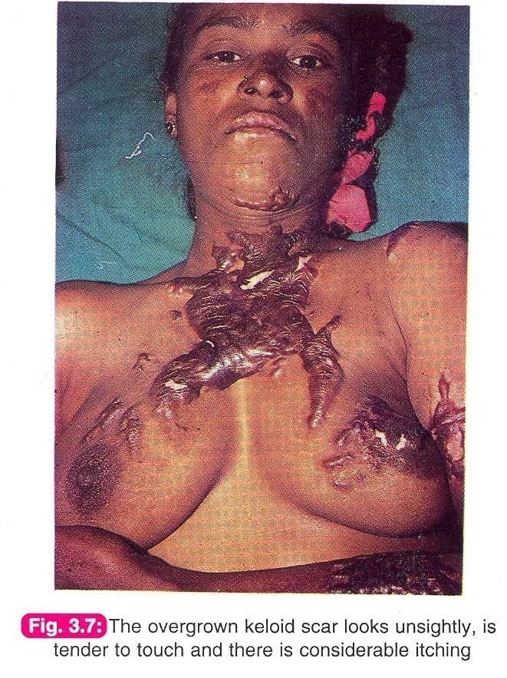
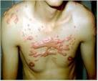

Slide 11
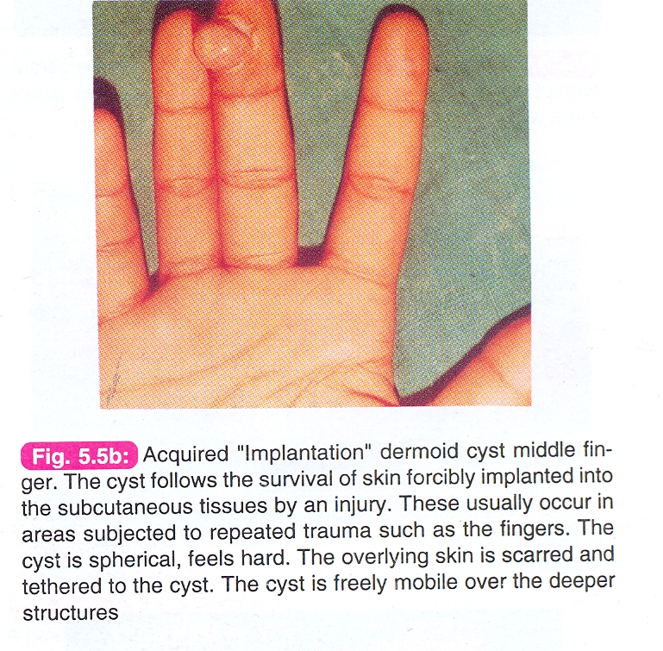
Pyogenic granuloma
. Excessive granulation tissue growth in ulcers.
. Firm, bright , red selling that bleeds on touch.
. recurrent bleeding when exposed to Trauma.
Rx : cauterization v.s excision .

Slide 15
Haemangioma
It is a developmental malformation of blood vessels rather than a tumour.
Types: capillary , cavernous ,arterial.
It commonly occurs in skin & sub cutaneous tissue
but other organs ( e.g lips , tongue ,liver ,brain) may be affected.

Slide 16
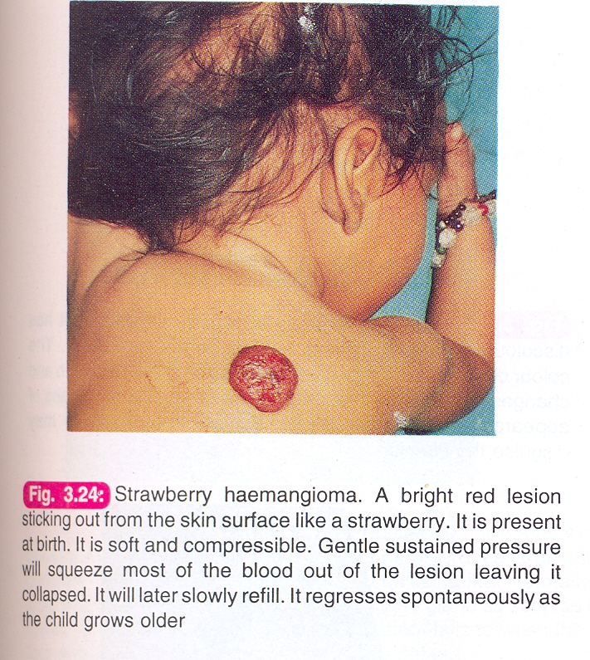
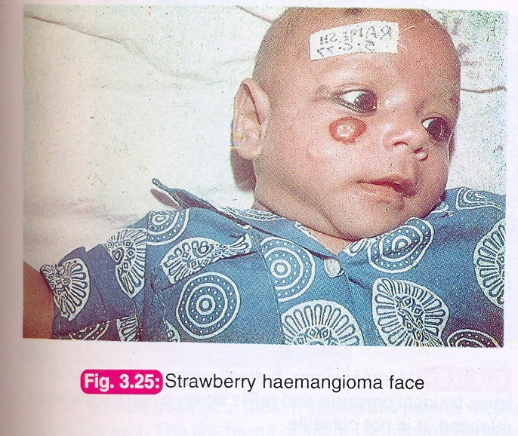
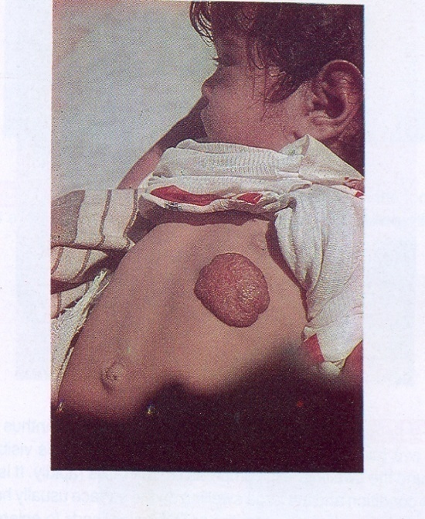

Slide 17
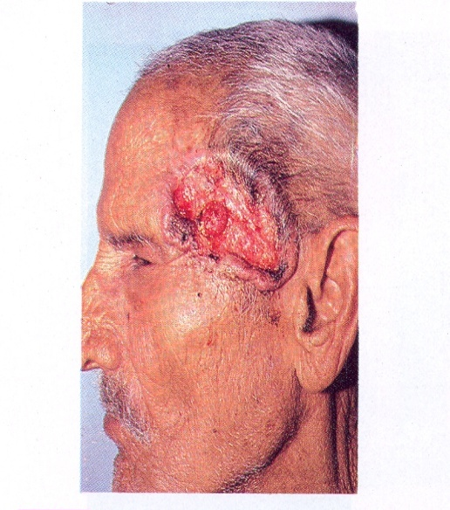
Malignant skin tumors
Basal cell carcinoma (BCC) :
.Ulcerated tumor of basal cell layer of skin.
. Middle aged white tropical males (Australia).
. common in face.
. low grade and slowly growing tumor (years).
Clinically:
. Rolled-in edges (inverted ) with attempts of
healing .
. floor shows an un healthy granulation with a scab.
.The base is indurated and may be fixed to bone.
. spreads locally ( usually no L.N metastases).
Rx : radio therapy & surgery

Slide 18
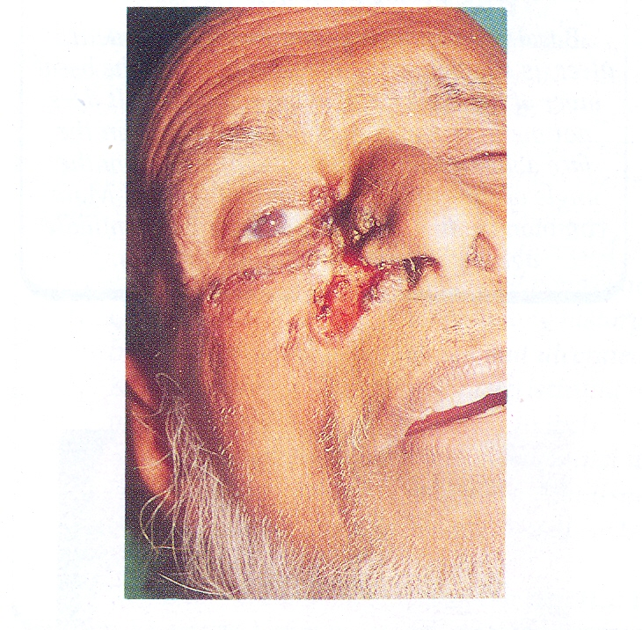

Slide 19
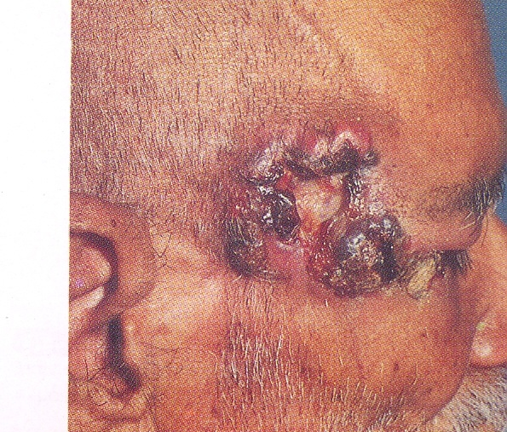

Slide 20
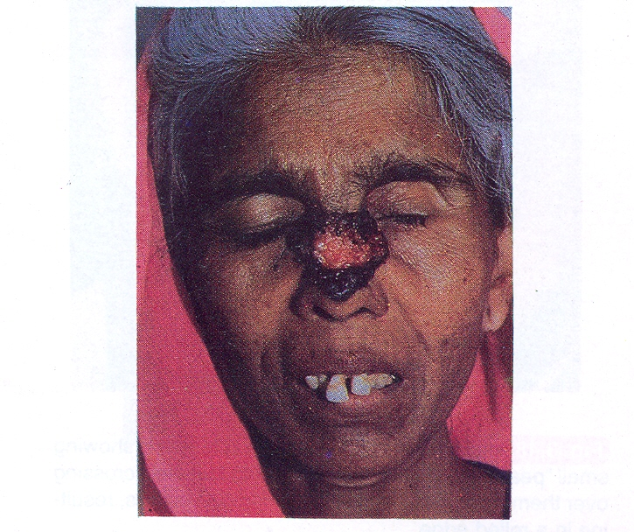

Slide 21
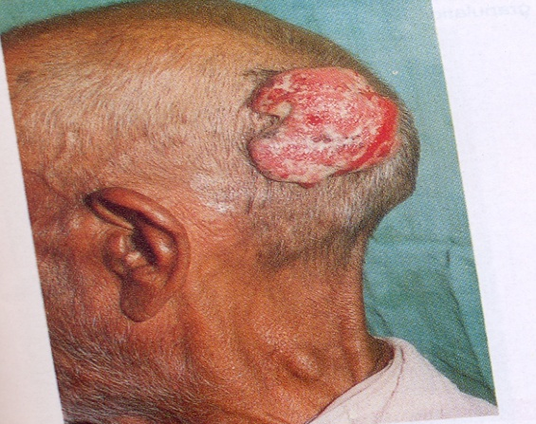
Squamous cell carcinoma (Epithelioma)
.Arise from squamous cell layer of skin or mucus membrane.
.It may arise from metaplasia of columnar epithelium
due to chronic irritation ( gall bladder, bronchus, stomach .etc.)
.It can ocure any where in the body, M>F .
.More malignant and rapidly growing than BCC.
.Edges are rolled out ( everted )
Spreads :
locally , L.N ,and blood
Rx:
Radiotherapy & Surgery

Slide 22
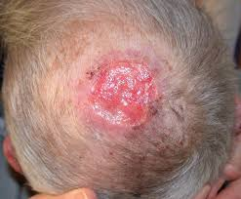
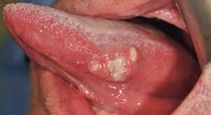

Slide 23
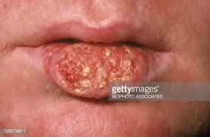

Slide 24
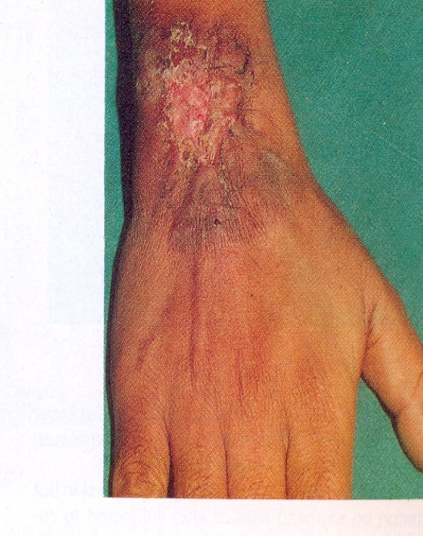
Marjolin ulcer
It is a low grade squamous cell carcinoma arising
in chronically inflamed ulcers or scars.
Rx:
Radiotherapy & Surgery

Slide 25
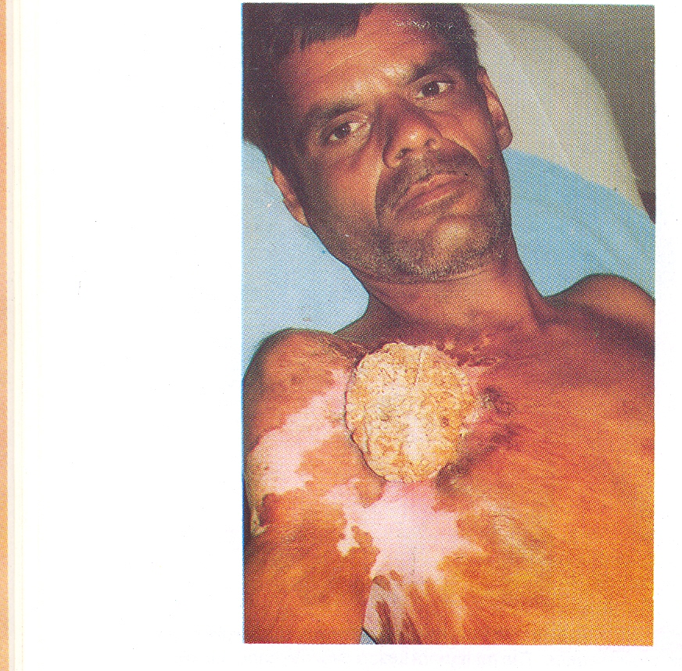

Slide 26
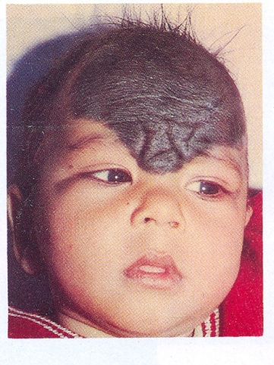
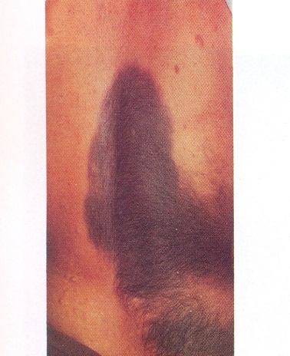
Naevus ( mole)
.A localized cutaneous malformations.
.Includes moles & birth marks.
.They may present at birth ,or even later.
Types:
junctional , intradermal , compound, blue naevus , juvenile and freckle .

Slide 27
Naevus cont;
Evidences of malignant change :
(very important )
.Increase in size
.change to irregular edge
.change in thickness
.change in colour
.change in surrounding tissue
.symptoms e.g: itching, bleeding discharge
.lymphadenopathy
.microscopic evidence

Slide 28
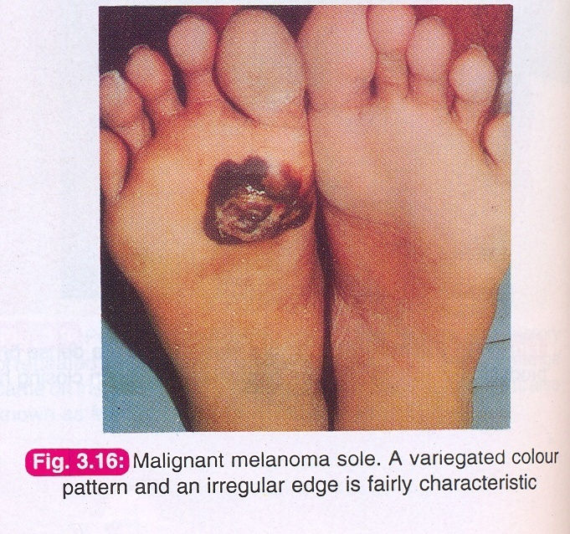
Malignant Melanoma
It is rare but most rapidly infiltrating skin tumor
De-novo ( 10 %) , Pre-existing naevus (90 %).
Metastasis :
Local & satellite nodules.
Lymphatic.
Blood ( liver, lung, bone etc;.

Slide 29
MELANOMA

Slide 31
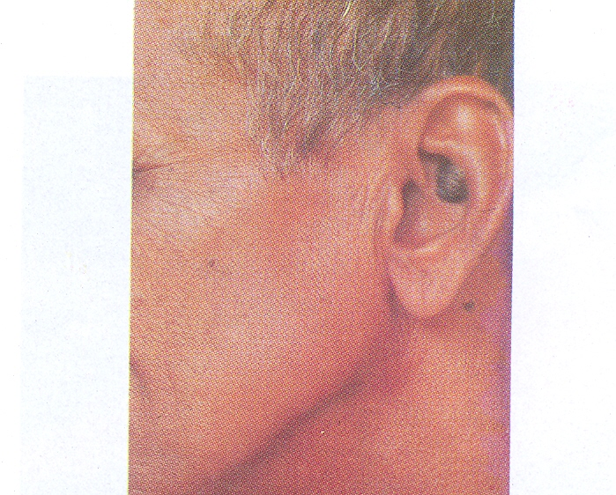

Slide 32
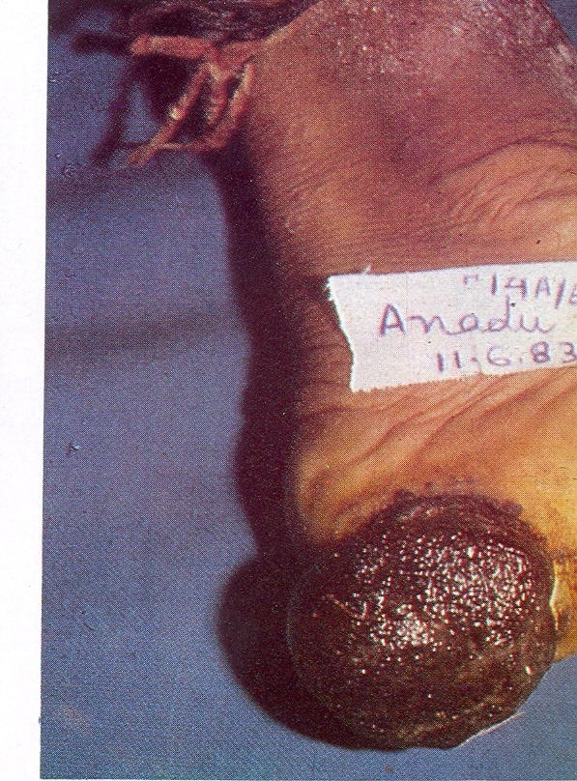

Slide 33
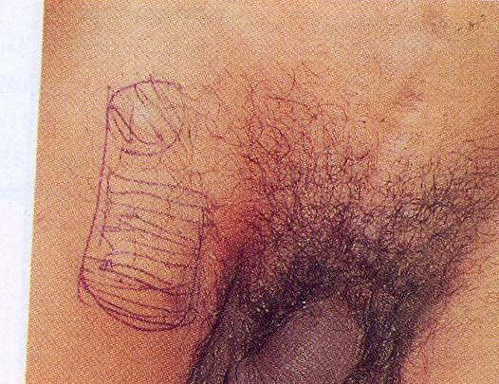

Slide 34
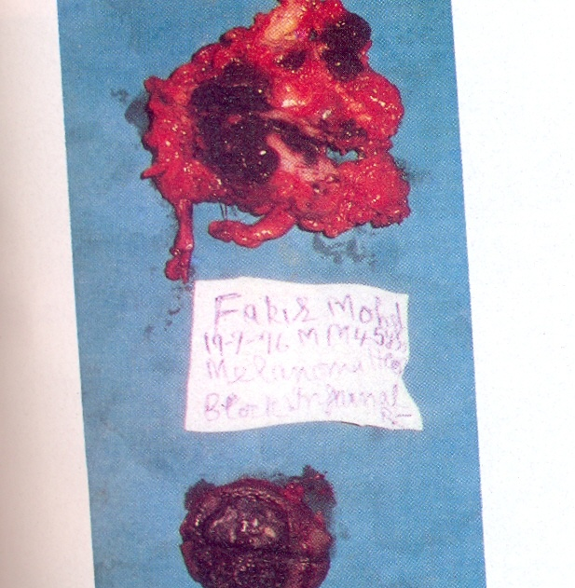

Slide 35
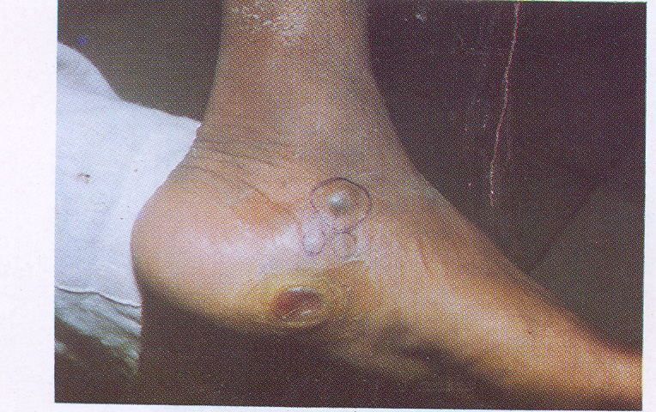
Satellite nodule

Slide 36
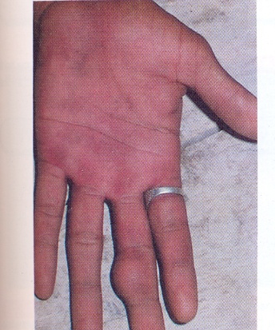
Skin Cysts
Implantation Dermoid :
.It is a post traumatic dermoid.
.Commonly in fingers and hands of farmers & taylors.
.Tense , may be hard tender swelling.
.Attached to skin which may be scarred
.Contains desquamated epithelial cells.
.pain and ulceration may occur following repeated trauma
RX:
Excision is curative.

Slide 39
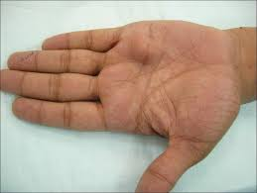

Slide 40
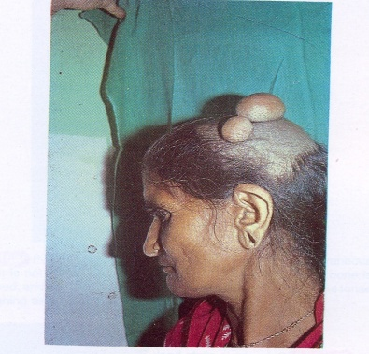
Sebaceous Cyst
It is a retention cyst due to blockage of its duct.
Lined by squamous epithelium and contains sebum
and desq. Epithelium.
Commonly in scalp , Face , scrotum and vulva
( never in palm & sole).
Clinically:
Spherical, cystic or tense swelling , attached to skin with punctum that may discharge sebum upon squeezing.
NB :Indentation and fluctuation tests may be positive .But
transillumination test is negative.
.

Slide 41
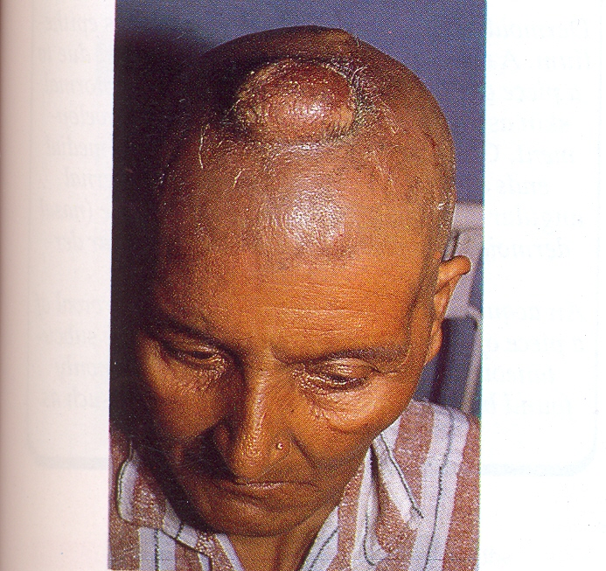

Slide 42
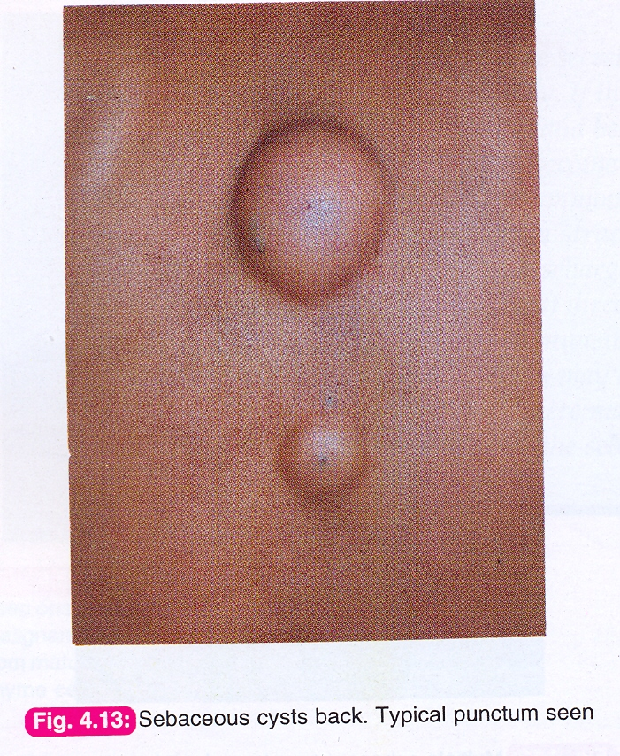

Slide 43
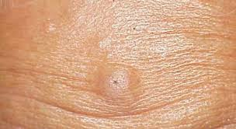

Slide 44
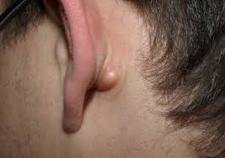

Slide 45
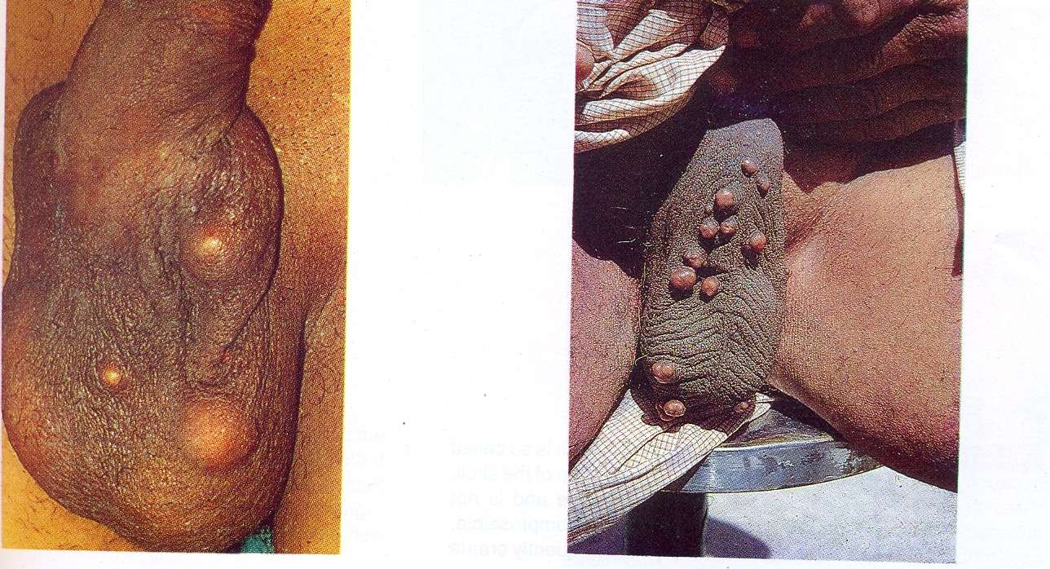

Slide 46
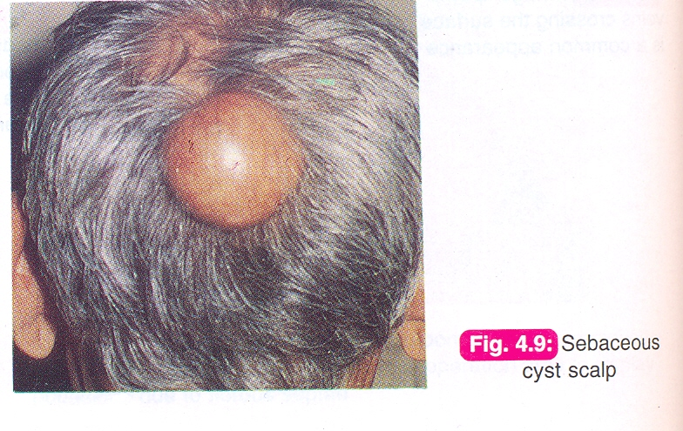
Seb. Cyst cont;
Complications:
Cosmotic.
Infection.
Ulceration.
Cock peculiar tumour. ( granuloma due to ulceration)
Sebaceous horn .(inspessated secreted sebum )
Rx :
.Excision: for un infected cyst .
.Incision & drainage: followed by excision for infected cyst.

Slide 47
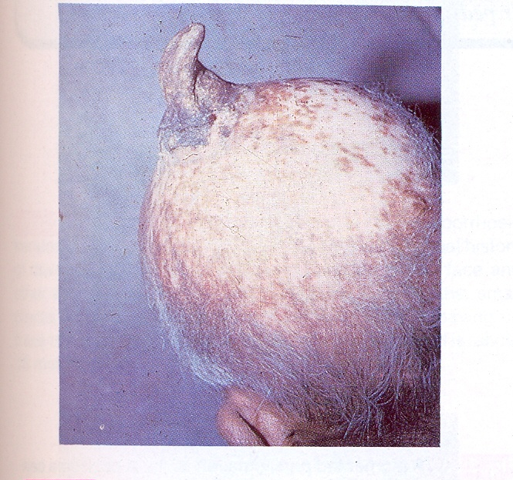
sebasceous horn

Slide 48
Infected sebasceous cyst.

Slide 49
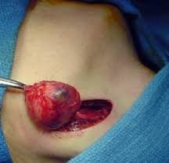
Sebasceous cyst excision

Slide 50
Subcutaneous Lumps
Cystic swellings:
Congenital Aquired
----------------- ………….
dermoid cyst abcess
cystic hygroma parasetic
haemangioma haematoma
Solid swellings:
commonly benign:
shwanoma , neurofibroma ,lipoma
( rarely malignant)

Slide 51
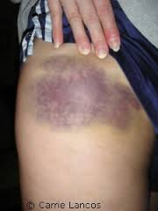
Traumatic haematoma

Slide 52
Dermoid cyst
Clinically four varaieties:
1.Sequestration dermoid.
2.Implantation dermoid.
3.Tubulo-dermoid.
4.Terato-dermoid.

Slide 53
Sequestration dermoid
.It is a true congenital cyst .
Ectodermal tissue burried in mesoderm forming a cyst lined by squamous epithelum and contains paste-like material.
.Common at lines of Embryonic fusion sites:
. Midline: neck & root of nose.
. Scalp.
. Inner or outer angles of eyes.

Slide 54
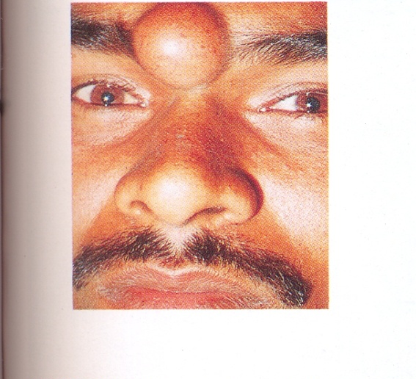
Sequestration dermoid cont;
Clinical features:
Painless, spherical,cystic mass.
Appears in childhood or adults.
Smooth surface.
Not attached to skin cf. seb. cyst
No punctum cf. seb. cyst.
Not compressible cf. meningocele.
Bone indentation (scalp)
Transillumination test - ve .
.

Slide 55
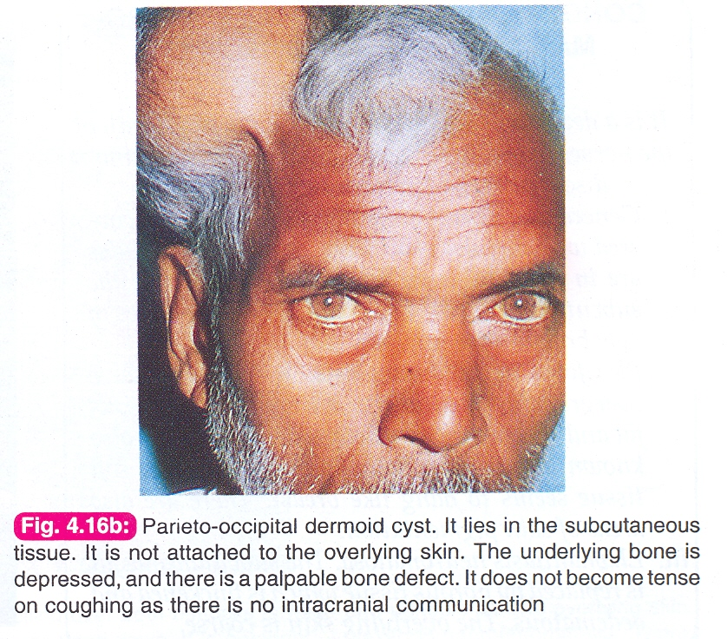
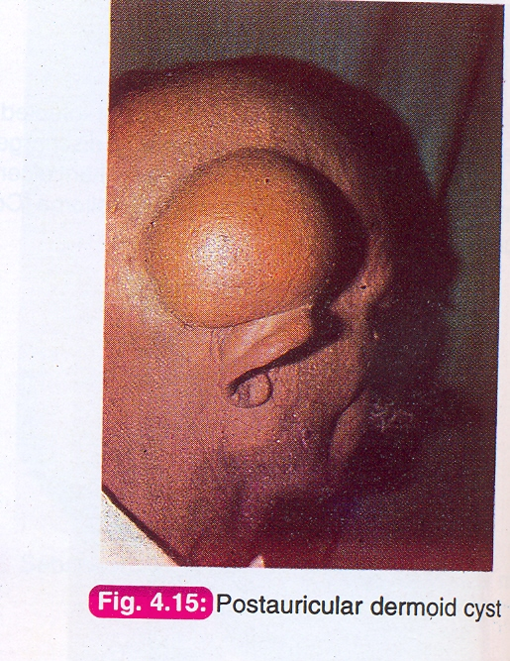
Occipital dermoid

Slide 56
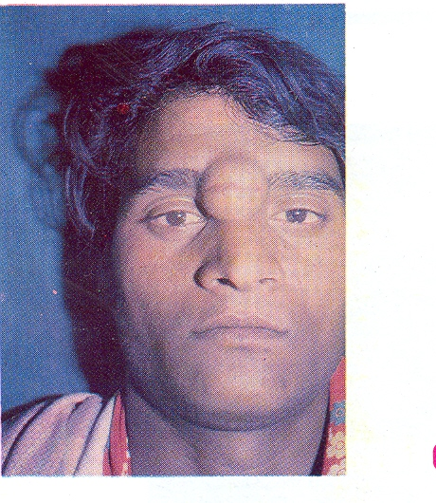
nasal root dermoid

Slide 57
nasal root dermoid

Slide 58
fore head dermoid

Slide 59
External angular dermoid

Slide 60
External angular dermoid

Slide 61
internal angular dermoid

Slide 62
Submental dermoid

Slide 63
complications: infection

Slide 64
Tubulo-dermoid
Cystic swelling arising from the non-obliterated part of congenital duct or tube which fills up by secretions of lining epith.
Examples
Thyroglossal cyst (remnant of thyroglossl duct).
Post-anal dermoid (remnant of neuro-enteric canal).
Epindymal cys tin brain (rem. of neuro-ectoderm canal).

Slide 65
Teratomatous dermoid
Cystic swelling arising from the totipotent cells with ectodermal preponderance.
Ovary ;Ovarian cyst.
Testes :Teratoma
Mediastinum.
ReteroperItoneum.
Pre-sacral area
They usually contain derivatives of mesoderm
(cartilage, bone, hair, cheesy material).

Slide 66
Cystic hygroma
A congenital malformation affecting lymphatic channels.
.appears early, multilocular,filled with clear fluid ( transillumination + ve ).
.lined by columnar epith.
.Common in : neck, axila, groin, medistinum and tongue.

Slide 69
Branchial cyst
A congenital cyst in persistent cervical sinus
Below angle of mandible, behined mid s.mastoid.m
Tense,distinct edges, +ve fluctuation and –ve transillumination.
Contains cholestrol crystals ( diagnostic ).
Differential diagnosis:
cold abscess, dermoid cyst , plunging rannula, cystic hygroma,
carotid body tumour, lymph node, sub.mand.salivary gland.

Slide 71
Ganglion
It a cystic swelling of synovial membrane of tendon or capsule in small joints.
. myxomatous degeneration.
. may be communacating.
Common sites
. dorsum of wrist
. dorsum of foot and ankle.
.palmar aspect of wrist & fingers.

Slide 74
Ganglion cont;
Clinically:
Slowly growing lump.
Common in females.
Spherical, firm, cystic swelling.
Mobile across tendon axis but limited along longitudinal axis.
Rx:
Asymptomatic: re-assurance.
Symptomatic: aspiration or excision.

Slide 75
transillumination test

Slide 76
aspiration of ganglion

Slide 77
excision of ganglion

Slide 78
Lipoma
It is a benign tumor of adipose tissue.
The most common benign tumor in subcutaneous tissue.
Common in trunk, neck and limbs.
Encapsulated v.s. diffuse.
May be mixed e.g: fibrolipoma , neurolipoma , haemangio-lipoma.
Dercums disease ( multiple lipomatosis ).

Slide 79
lipoma cont,
clinical features:
Painless , soft and lobulated lump.
Well defined edges and skin is free.
Slipping sign positive.
Freely mobile.
Fluctuation test is negative.
Trans illumination test is negative.

Slide 80
Lipoma cont,
Complication
necrosis, calcification, haemorrhage, infection ,and rarely malignancy.
Treatment:
Small asymptomatic – re-assurance
Symptomatic :
- surgical excision
- liposuction

Slide 87
multiple lipomatoses

Slide 88
ulcerated lipoma

Slide 89
Gluteal liposarcpma

Slide 90
Liposarcoma

Slide 91
NEUROFIBROMA
Tumour of nerve connective tissue ( not neurons)
Types:
Localised or solitary NF.
Generalized ( Von-Recklinghausen”s disease)
Plexiform NF
Elephantiasis NF
Cutaneous NF

Slide 92
Neurofibroma cont;
Clinical features of N.F:
Encapsulated, rounded or elliptical swelling.
Smooth, firm with well defined edges.
Tenderness and parasthesia may be present.
Mobility may be deminished along nerve-axis.
Rx:
excision

Slide 93
Multiple neurofibromatosis ( V-R disease)
Inherited as an autosomal dominant disease.
More common in males.
Multiple tumors- with Cafe-au-leit spots.
Peripheral and cranial nerves may be affected.
May be associated with other tumors (eg, endocrine).

Slide 98
Examples of exam cases :

Slide 99
A 25 years old patient presented to the surgical clinic complaining of a painless swelling at the front of the left thigh for 3 years and no other swellings . Examination revealed a spherical, soft,lobulated, non tender lump which is freely mobile in subcutaneous tissue.
The most likely diagnosis is:
a. lipoma
b. sebasceous cyst
c. fibroma
d.branchial cyst

Slide 100
A 25 years old patient presented to the surgical clinic complaining of a painless swelling at the front of the left thigh for 3 years and no other swellings . Examination revealed a spherical, soft,lobulated, non tender lump which is freely mobile in subcutaneous tissue.
The most likely diagnosis is:
a. lipoma
b. sebasceous cyst
c. fibroma
d. branchial cyst

Slide 101
.
A 16 years old girl presented to the clinic with a 2cm painless, cystic
swelling lateral to the left eyebrow.
it was first noticed 5 years ago and was gradually increasing in size.
The most likely diagnosis is?
a.Haemangioma.
b. Abscess.
c. External angular dermoid.
d. Ganglion

Slide 102
.
A 16 years old girl presented to the clinic with a 2cm painless, cystic swelling
lateral to the left eyebrow.
it was first noticed 5 years ago and was gradually increasing in size.
The most likely diagnosis is?
a.Haemangioma.
b. Abscess.
c. External angular dermoid.
d. Ganglion

