Slide 1
Common Neck swellings
Dr Mohammad AlShehri, Can. Board, FACS, D Med Edu.
Professor of Surgery

Slide 2
Agenda
Thyroid
Parathyroid
Thyroglossal cyst
Others

Slide 3
Thyroid

Slide 4
Case 1
Fatima is a 30-year old Saudi lady that presented to the Outpatient clinic, complaining of a swelling in the midline of her neck that she had for 2 months.

Slide 5
Case 1
What could this be?
Is it a thyroid swelling?

Slide 6
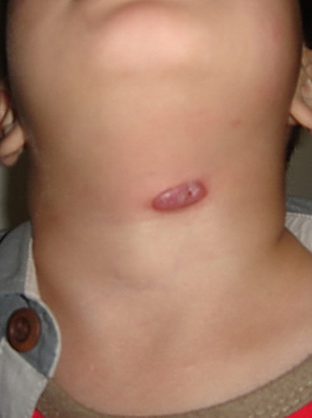
Movement with swallowing
Thyroid
Thyroglossal cyst

Slide 7
Case 1
What could this be?
Is it a thyroid swelling?
If it is a thyroid swelling, what could be the cause of this swelling?

Slide 8
Thyroid cyst
Multinodular goiter
Inflammatory
Benign tumor
malignancy

Slide 9
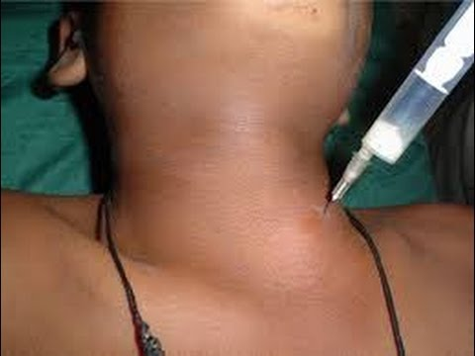
Thyroid cyst

Slide 10
Multinodular Goiter

Slide 11
Malignant tumors of the Thyroid

Slide 12
Characteristics
Painless enlarging nodule
Lymphadenopathy
Hoarseness of voice
Dysphagia
Function is usually normal

Slide 13
Thyroid Malignancy
85% | Papillary
10% | Follicular
< 5% | Lymphoma
 | Medullary
1% | Undifferentiated

Slide 14
Papillary Carcinoma
Commonest
Painless nodule
Young age
Spreads to lymphatics
Mets to lung & bone
Good prognosis

Slide 15
Follicular Carcinoma
Older patients than papillary
Mets by blood to lung & bone
Takes radio-nuclear iodine

Slide 16
Lymphoma
Usually diagnosed by pathology
Treat as lymphoma any where

Slide 17
Medullary Carcinoma
From C-cells
MEN 2 syndrome
Bad prognosis

Slide 18
Undifferentiated
Elderly patients
Locally invasive
Worst prognosis

Slide 19
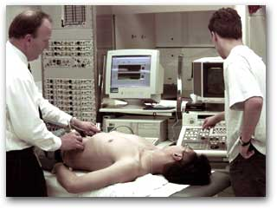
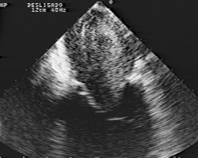

Slide 21
Case 2
Ahmed ( age 28 years) came to the Outpatient clinic complaining of nervousness, palpitations, sweating, and weight loss. Clinical examination revealed the presence of a goitre.

Slide 22
Graves disease
Toxic multinodular goiter
Toxic follicular adenoma
Others

Slide 23
Management
Medical
Radio-nuclear iodine
Surgery

Slide 24
Parathyroids

Slide 25
40 y old lady
# Lt humerous
Lt Ureteric stone removed 6 y back
Rt Ureteric stone removed 3 y back
Non functioning Lt kidney
S Ca 11.2mg/dl P 2.2mg/ dl

Slide 26
Clinical presentation
In the west 60 - 70% detected by routine screening.
Many are asymptomatic

Slide 27
Statistics from Western countries indicate a 0.1-0.5% prevalence rate for PHP.
No evidence for geographical variation

Slide 28
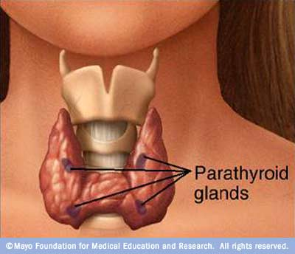

Slide 29
Physiology
Parathormone hormone
Vitamin D
ca

Slide 30
84% | Adenoma
15% | Hyperplasia
1% | Carcinoma

Slide 32
Clinical manifestations
Renal stones
Bone and joint pains
Abdominal groans
Psychic moans
Fatigue overtones

Slide 33
No symptoms
Mild symptoms
Renal symptoms
Bone symptoms

Slide 34
Commonest cause of Hpercalcaemia in society
Uncommon in children
2-3 times in females

Slide 35
Investigations
Serum Calcium
PTH
Serum Phosphate
Chloride

Slide 38
Management
All symptomatic patients should be treated
Asymptomatic ??
Ca Increased +++
Bone density Decreased +++

Slide 39
Conclusions
PHP is a very underdiagnosed disease in Saudi Arabia.
Patients are not diagnosed early
Complications could be serious and these are avoidable.

Slide 40
Recommendations
The medical community needs to be more aware of the disease.
Specifically the diagnosis should be considered in patients with
bilateral or recurrent renal stones
patients with suggestive radiological bone changes
and naturally in patients with high serum calcium level

Slide 42
Thyroglossal Cyst

Slide 43
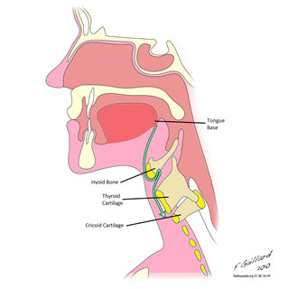

Slide 44
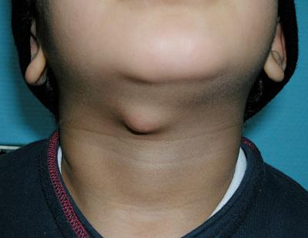

Slide 45
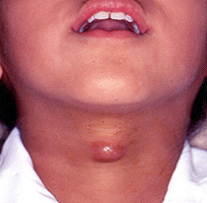

Slide 46
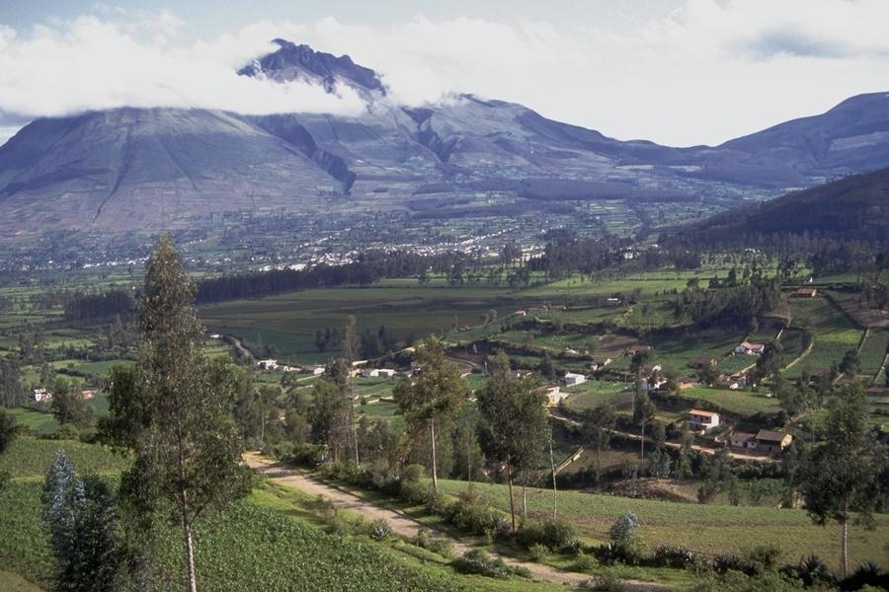
Than you
myshehri@ksu.edu.sa
@myshehri

Slide 47
Hyperthyroidism
Nervousness
Wt loss + Increased appetite
Heat intolerance
Sweating
Muscular weakness
Menstrual irregularities

Slide 48
Hyperthyroidism
Goiter
Tachycardia +/-Arrhythmias
Warm moist skin
Bruit & thrill
Eye signs

Slide 49
Laboratory
Increases T4, T3
Decreased TSH

