Slide 1
Poison Information Center Brief Review
Drug & Poison Information Center (DPIC)
King Saud University Medical City (KSUMC)
Nora A. Kalagi, Msc. Pharm
Lecturer of clinical pharmacy
DPIC clinical Pharmacist
Nakalagi@ksu.edu.sa

Slide 2
Outlines
Toxicological Terms
Poison versus Adverse Drug Reaction
Sources of Poisons
Poison Information Center
Handling Poison Calls
Resources of Poison Information
Drug & Poison Information Center in KSUMC: Years of Experience

Slide 3
Terms in Toxicology
Poison
Harm from any substance
Toxin
Harm from natural substance
Adverse Drug Reaction (ADR)
Noxious & unintended response from a drug

Slide 4
Poison versus ADR
Poisoning
ADR
Poisoning when an error was made in drug prescription or in the administration of the drug
When the drug was correctly prescribed and properly administered

Slide 5
Types of Poison
Prescription drug
Over The Counter drugs (OTC)
Herbal medications or preparations
Household chemicals
Industrial chemicals

Slide 6
Poison Can be…..
Unintentional Poisoning
Drug overdoses
Drug abuse
Misreading of product labels
Children
Intentional Poisoning
Suicide
Murder

Slide 7
Prevalence WHO numbers in 2014
Unintentional: 79.4%
Intentional: 16.7%
adverse reactions: 2.4%
Children < 6 years: 48%
unintentional: 99%
Adults: 38%
unintentional: 61%
Teens: 7%
unintentional: 37%
Notes:
http://www.poison.org/poison-statistics-national
Across all ages, 79.4% of poison exposures reported to U.S. poison centers in 2014 were unintentional, 16.7% were intentional, and 2.4% were adverse reactions. In children younger than 6 years, 99% of exposures are unintentional, compared to only 37% of teen exposures and 61% of adult exposures.
Children younger than 6 years comprise nearly half of poison exposures (48%), followed by adults (38%), then teens (7%).

Slide 8
Poison Information Center
Provision of toxicological information and advice
Management of poisoning cases
Provision of laboratory analytical services
Research, and education in the prevention and treatment of poisoning
Toxicovigilance activities

Slide 9
Toxicovigilance activities
Toxicovigilance is the active process of identifying and evaluating the toxic risks existing in a community, and evaluating the measures taken to reduce or eliminate them.
It involves the analysis of poisons center enquiries to identify whether there are specific circumstances or agents giving rise to poisoning, or certain populations suffering a higher incidence of poisoning.

Slide 10
Poison Information Center
Developing plans for, and responding to, chemical disasters
Monitoring the adverse effects of drugs
Handling problems of substance abuse

Slide 11
Poison Information Center
Staff
Pharmacists
Access
Phone calls (ideally 24 hours)
Written enquiries
Face-to-face
Use
Public
Healthcare professionals
Emergency services, government ministries, regulatory agencies

Slide 12
Poison Information Center
Documentation
Standardized way to reports
Follow up cases
Future improvement
Need for treatment protocols & guidelines
Notes:
The details of each enquiry are documented in a standardized way and can be processed and analyzed to generate a range of reports.
Some poisons information services actively follow up cases to find out the evolution and outcome of exposures.
This process yields data that can be used to improve the advice given in the future.

Slide 13
Poison Information Center – Phone Protocol for Handling Poison Calls
Analyzing a Poison Situation
I .Initial Assessment
II. History
III. Assessment
V. Follow-up
IV. Treatment Plan

Slide 14
Poison Information Center – Phone Protocol for Handling Poison Calls
Initial Assessment
Substance involved
Are symptoms present?
What has been done ?
History
Basic information
Substance
Amount
Symptoms

Slide 15
Poison Information Center – Phone Protocol for Handling Poison Calls
Assessment
Toxicity of substance
Circumstances of exposure
Competency of caller
Treatment Plan
No treatment necessary
First aid & observe at home
Refer to MD or ER

Slide 16
Poison Information Center – Phone Protocol for Handling Poison Calls
Follow-up
Has the victim remained asymptomatic ?
Were instructions followed ?
Was the treatment effective ?
Poison prevention teaching
Referral

Slide 17
Resources for Poison Information
Primary resources:
Journals, Reviews
Secondary resources
Iowa system, Pubmed
Tertiary resources:
Text books:
Clinical Toxicology
Poisondex
Notes:
Talk briefly about each one

Slide 18
Resources for Poison Information
The American Association of Poison Control Centers (AAPC)
Management of Poisoning - A handbook for health care workers By World Health Organization
TOXNET From the National Library of Medicine in the U.S., this site is a collection of of databases on toxicology, hazardous chemicals, and related areas.
Notes:
Talk briefly about each one

Slide 19
Resources for Poison Information
Toxic Exposure Treatment Guides IPCS International Programme on Chemical Safety
AACT - American Academy of Clinical Toxicology An organization uniting scientists and clinicians in the advancement of research, education, prevention and treatment of diseases caused by chemicals, drugs and toxins
Notes:
Talk briefly about each one

Slide 20
The American Association of Poison Control Centers (AAPC)

Slide 21
The American Association of Poison Control Centers (AAPC)
Non-profit, national organization
Founded in 1958
Represents the poison control centers of the United States
Poison prevention and treatment

Slide 22
Poison Centers in KSA
Notes:
What is NDPIC ?

Slide 23
Drug and Poison Information Centers in Saudi Arabia

Slide 24
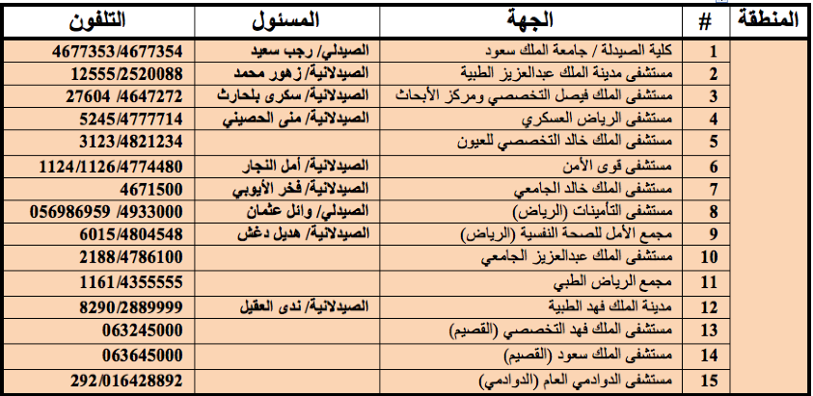
DPICs in KSA

Slide 25
DPICs in KSA

Slide 26
DPICs in KSA

Slide 27
Drug & Poison Information Center in KSUMC Years of Experience

Slide 28
DPIC in KSUMC
Established in October 1983
Primary goal: offer expert advice from well-trained clinical pharmacists in the management of poisoning cases throughout the KSA
Operated by Clinical Pharmacists
24 hours service

Slide 29
DPIC in KSUMC - Clinical Pharmacist Role in Poising Management
Identification of the poison
Pharmacokinetic / Toxokinetic
Antidotes dosing
Patient treatment plans & Monitoring outcomes
Improving health care & Lay public awareness

Slide 30
DPIC in KSUMC – Years of Experience
between October 1986 and October 1996

Slide 31
DPIC in KSUMC – Years of Experience

Slide 32
DPIC in KSUMC – Years of Experience

Slide 33
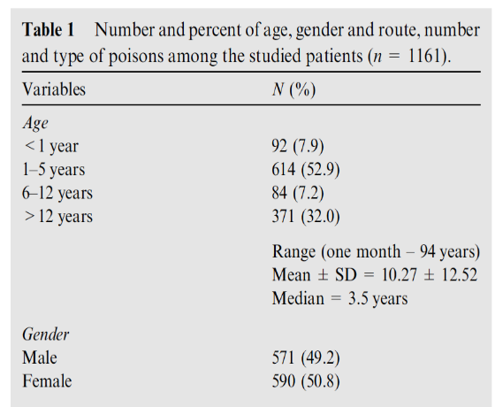
DPIC in KSUMC – Years of Experience

Slide 34
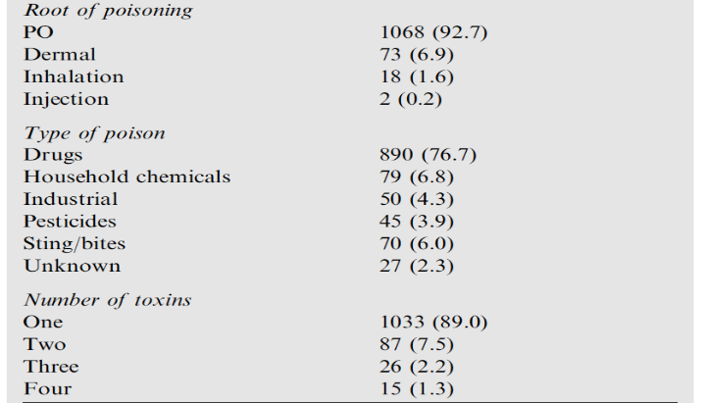
DPIC in KSUMC – Years of Experience

Slide 35
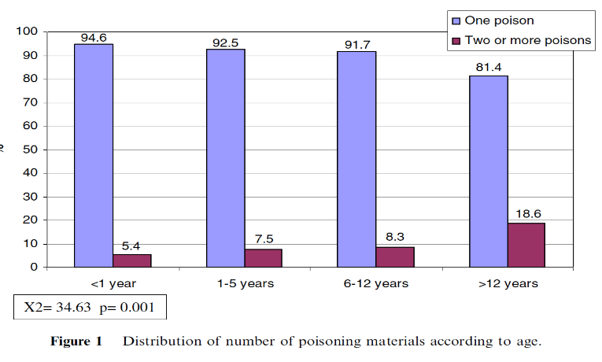
DPIC in KSUMC – Years of Experience

Slide 36
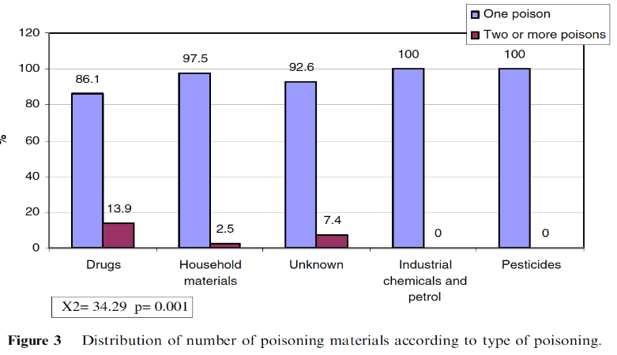
DPIC in KSUMC – Years of Experience

Slide 37
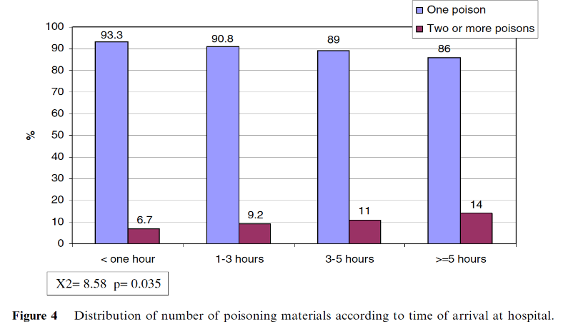
DPIC in KSUMC – Years of Experience

Slide 38
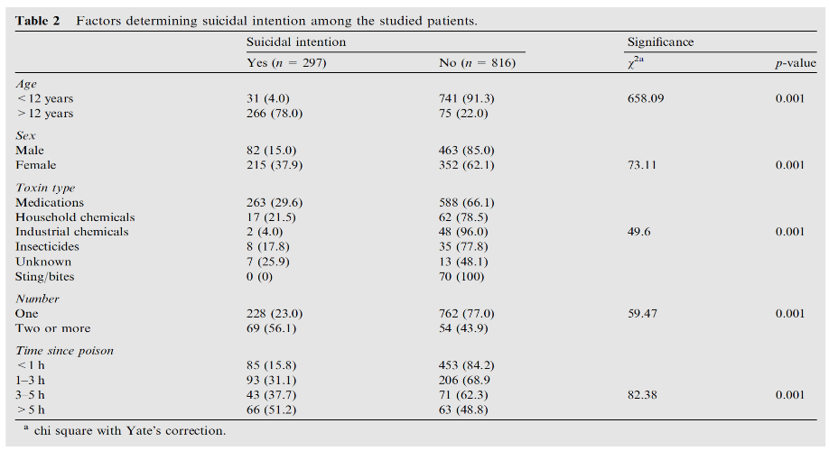
DPIC in KSUMC – Years of Experience

Slide 40
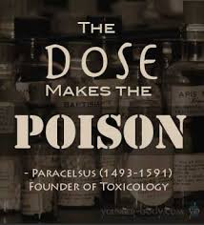
Any Question ???

