Slide 1
Infographics
Dr.Ibrahim Gosadi
Community Medicine Course

Slide 2
Alternative experience
Replacing production of 10 pages reports as done in past year.
Infographics are frequently used to display health education messages in an attractive and informing way.
It is a good way to combine statistics, graphics, designs, and written short information

Slide 3
Examples

Slide 7
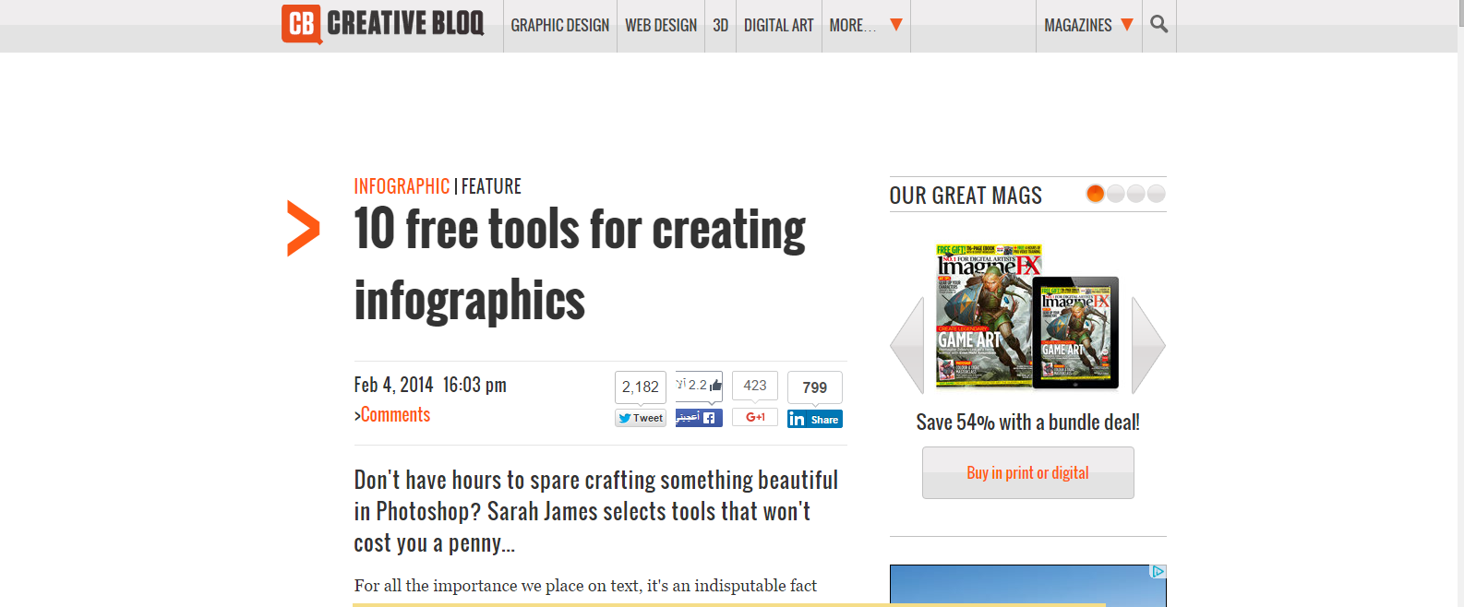
http://www.creativebloq.com/infographic/tools-2131971

Slide 8
http://piktochart.com/

Slide 9
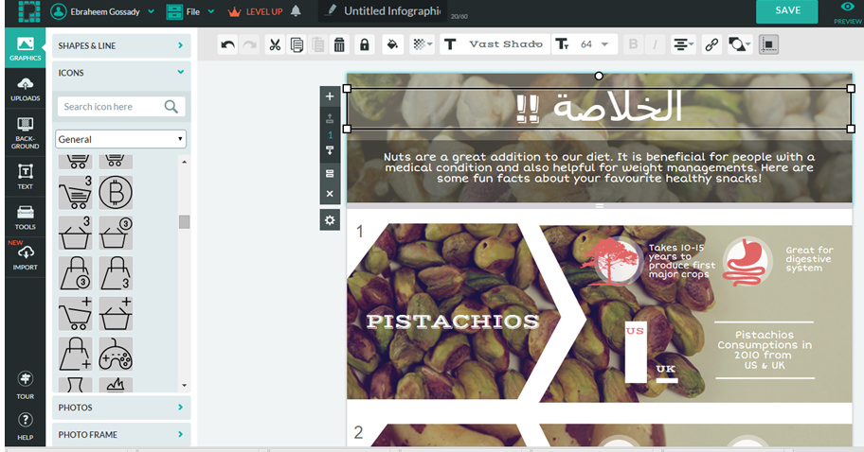
You can type in Arabic

Slide 10
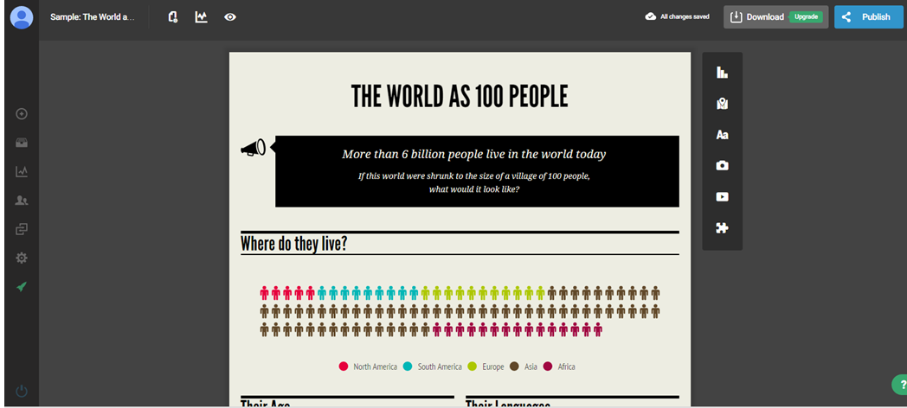
https://infogr.am/app/#/library

Slide 11
You can use different charts

Slide 12
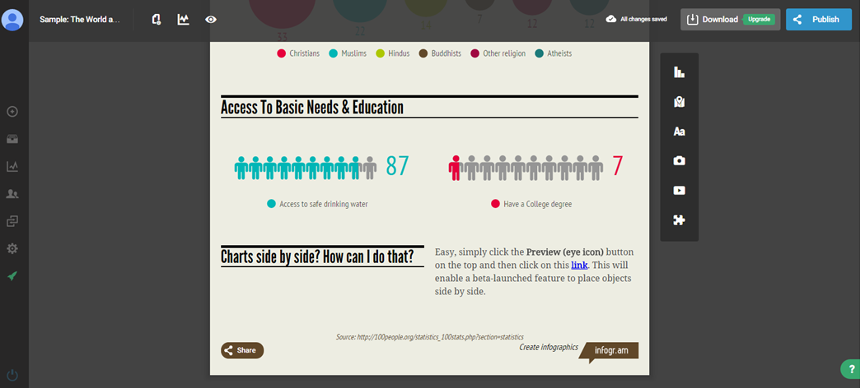
Manipulate colours and add text

Slide 13
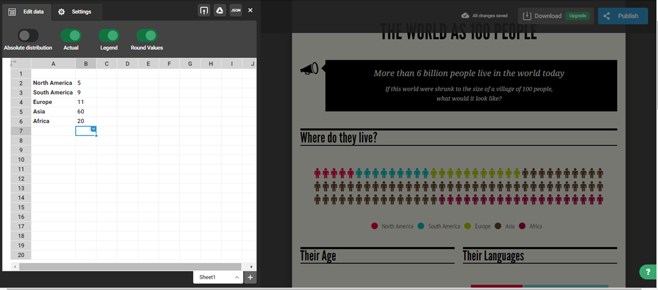
Easy manipulation of numbers

Slide 14
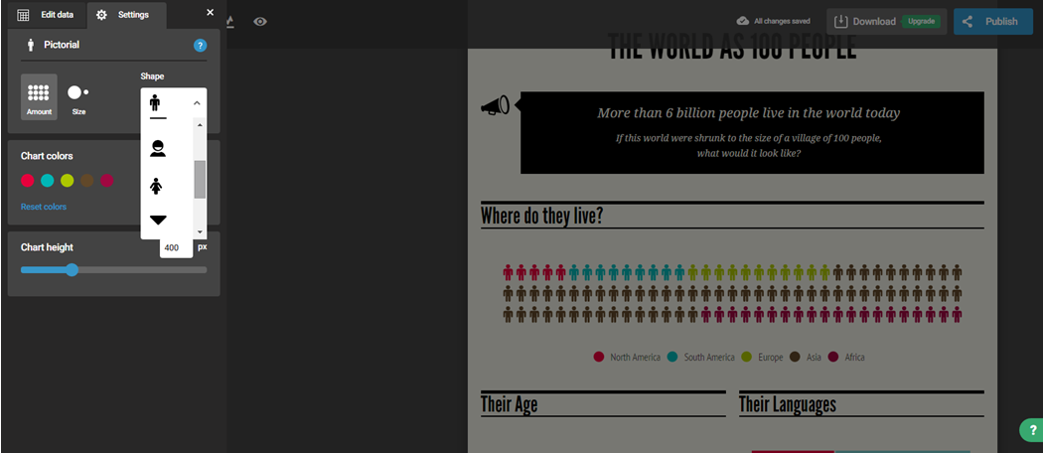
Easy selection of shapes in an extensive library

Slide 15
Infographics in COMM 311
It should be made as a single poster similar to the examples given in the beginning.
It should be made in ARABIC as excellent infographs can be shared in the university hospitals or relevant websites indicating the names of the producing students.
It is a way of an evaluating students throughout the COMM 311 course (5 marks).
The infographics topic should be a summary of most important information presented in the seminar and are worth sharing with the community .

Slide 16
Evaluation
Mid-term Exam 40%
Final Examination 40 %
Quizzes 10 %
Seminar presentation 5%
Seminar Report 5%
One page Infograph summarizing the seminar presentation

Slide 17
Infographics in COMM 311
For more information, simply write to the course coordinator:
Dr.Ibrahim Gosadi
Gossady@hotmail.com

