Slide 1
Epidemiology of pulmonary tuberculosis

Slide 2
LEARNIN G OBJECTIVES
State criteria of diagnosis of pulmonary tuberculosis
Describe trend & state reasons for resurgence of tuberculosis
List population subgroups at risk of tuberculosis
Draw the cycle of infection of pulmonary tuberculosis
Outline the procedures of diagnosis of tuberculosis with emphasis on the limitation of each procedure
Describe measures for the prevention and control
Describe the Directly Observed Therapy short course for the treatment of pulmonary tuberculosis

Slide 3
PERFORMANCE OBJECTIVE
To decide on the best measures for the control of pulmonary tuberculosis and to prevent its spread to susceptible population

Slide 4
PULMONARY TUBERCULOSIS
Respiratory tract infection
Caused by M. Tuberculosis

Slide 5
PULMONARY TUBERCULOSIS
Suspected cases present with
Cough & expectoration for 3 weeks
Low grade fever
Night sweating
Loss of weight

Slide 6
PULMONARY TUBERCULOSIS
SMEAR POSITIVE
SMEAR NEGATIVE
2 Positive sputum smears OR,
1 Positive sputum smear + positive radiology OR,
1 Positive sputum smear + positive culture
3 Negative sputum smears + Suggestive symptoms
+ Positive radiology
+ Decision to treat as TB
OR,
Culture positive but negative sputum smear

Slide 7
PULMONARY TUBERCULOSIS
INFECTION
Primary First exposure
Post primary Reactivation/re-infection
DISEASE
Active tuberculosis Disease process
Latent tuberculosis No disease yet

Slide 8
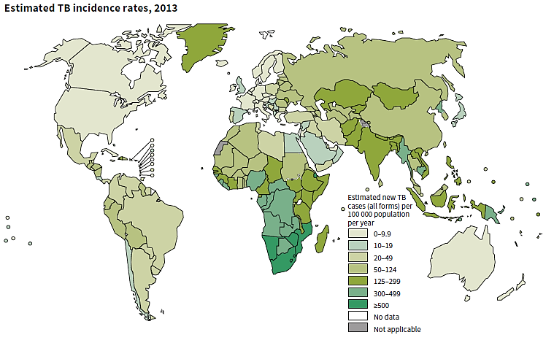
Global Tuberculosis Report – WHO, 2014

Slide 9
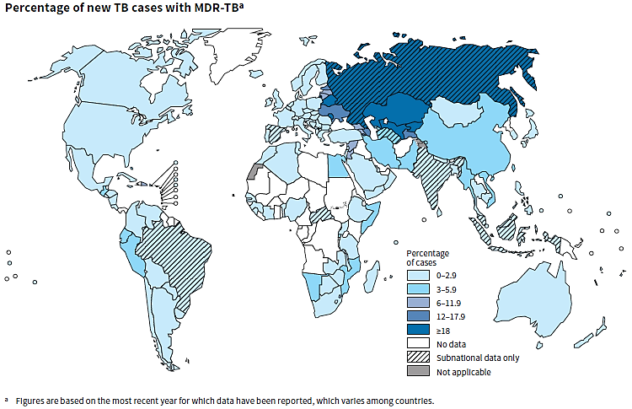
Global Tuberculosis Report – WHO, 2014

Slide 10
PULMONARY TUBERCULOSIS IN SAUDI ARABIA
64,345 reported cases; 48% non-Saudis for 2000 – 2013
Annual incidence rate (2013)
Between 14 to 17 per 100,000 populations
Between 8.6 and 12.2 per 100,000 Saudi population

Slide 11
RESSUREGENCE OF TUBERCULOSIS
Deterioration of the living conditions
Appearance of strains of M. tuberculosis resistant to anti-tuberculosis drugs.
HIV/AIDS pandemic
Resurging diseases are Infectious diseases which its incidence has increased in the past two decades or threaten to increase in the near future after a considerable period of decline.

Slide 12
MAJOR RISK FACTORS OF PULMONARY TUBERCULOSIS
Social factors: Unfavorable social conditions
Pre-pathogenic conditions: HIV/AIDS, diabetes
Occupation: Exposure & working conditions
Habit: Smoking

Slide 13
PROGRESS
Annual slow decline in the rates of tuberculosis
An estimated of 37 million lives saved between 2000 and 2013 as a result of effective diagnosis and treatment.

Slide 14
CYCLE OF INFECTION OF PULMONARY TUBERCULOSIS
Agent: Mycobacterium tuberculosis
Reservoir
Man in the form of a case
Transmission:
Contact: Direct, indirect& droplet
Air borne: droplet nuclei & dust transmission
Susceptible host:
Low standard of livings, malnutrition, alcoholism, HIV/AIDS
Portal of entry (inlet):
Respiratory tract
Incubation period=4-12 weeks
Portal of exit: Respiratory tract
Source of infection: Sputum and
contaminated articles, dust

Slide 15
DIAGNOSIS OF TUBERCULOSIS
Non specific symptoms and signs (mimic chest infection)
Delay consultation + Delay diagnosis

Slide 16
DIAGNOSIS OF PULMONARY TUBERCULOSIS
Tuberculin skin test (Mantoux technique)
Chest radiography
Microscopic examination of sputum specimen
Culture of sputum specimen

Slide 17
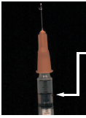
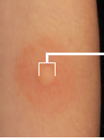
TUBERCULIN SKIN TEST
0.1 ml PPD
(1)
Erythema
Edema
Induration
(2)
(3)
(4)

Slide 18
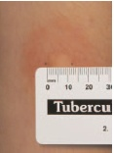
TUBERCULIN SKIN TEST
Report induration size in mm
Induration = Previous exposure to M. protein
Size
10 + mm = positive
5 - <10 mm = positive in immune compromised
≥ 15 mm = suggestive of infection rather than BCG
Induration

Slide 19
Contact of a case
Tuberculin negative
Tuberculin positive
Repeat tuberculin
Chest radiography
Tuberculin negative
Tuberculin positive
X-ray negative
X-ray positive
BCG vaccine
Chemoprophylaxis
Treatment
TUBERCULIN TESTING IN MANAGING CONTACTS

Slide 20
CHEST RADIOGRAPHY
Chest radiography findings
Enlarged mediastinal LN
Consolidation (area of opacity)
Cavitations (dark area)
Negative (not uncommon)

Slide 21
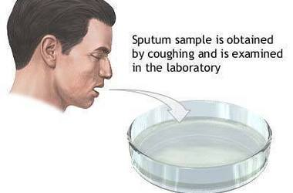
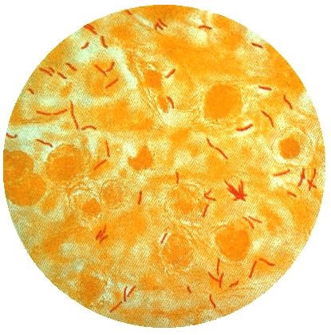
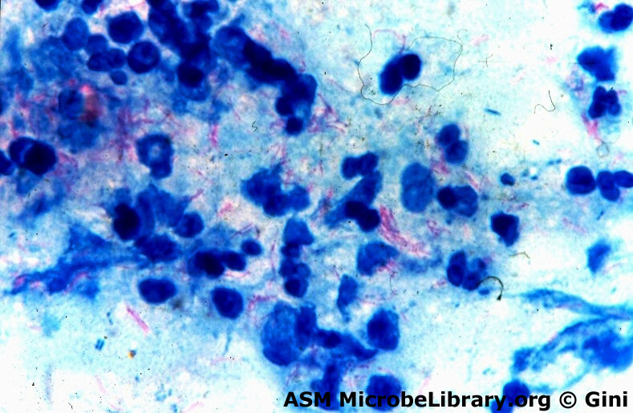
SPUTUM SMEAR & CULTURE
Collection
Microscopy
Culture

Slide 22
Agent
Reservoir
Transmission
Susceptible host
Protection
Identify & treat
Contact
Air borne
Minimize exposure
PREVENTION AND CONTROL OF RIs

Slide 23
PREVENTION & CONTROL OF RIs
Minimize exposure
Protection of susceptible
Identification and treatment
Isolation of case
(respiratory precautions)
Concurrent disinfection (patients’ items)
Ventilation exposure to sunlight
Cleaning floor with disinfectant
BCG vaccine: Live attenuated vaccine, 0.1ml IM injection in the left deltoid within 40 days of birth
Improve nutrition status
Anti-tuberculosis drugs
Control transmission
Increase host resistance
Eliminate reservoir

Slide 24
DIRECTLY OBSERVED THERAPY SHORT COURSE (DOTS)
2 months
4 months
Initial phase
Maintenance phase
(2 HRZE)
Isoniazid (H)
Rifampicin (R)
Pyrazinamide (Z)
Ethambutol (E)
(4 HR) daily or (4 HR)_{3 (three times per week)}
Isoniazid (H)
Rifampicin (R)
First line medications

Slide 25
DIRECTLY OBSERVED THERAPY SHORT COURSE (DOTS)
Strategy to improve compliance
Fixed Dose Combination therapy (FDC) - ALL IN ONE tablet
2 months
4 months
Initial phase
Maintenance phase
(2 HRZE)
Isoniazid (H)
Rifampicin (R)
Pyrazinamide (Z)
Ethambutol (E)
(4 HR) daily or (4 HR)_{3 (three times per week)}
Isoniazid (H)
Rifampicin (R)
First line medications

