Slide 1
Principles of Immunization
Ashry Gad Mohamed & Dr. Salwa Tayel
Family & Community Department

Slide 2
Objectives of the session
By the end of the session the students should be able to;
Mention the types of acquired immunity
List important immunizable diseases
Describe the compulsory childhood vaccination schedule practiced in KSA
Define the Cold Chain and its importance.

Slide 3
What is immunity?
Immunity is the ability of the human body to tolerate the presence of material indigenous to the body (“self”), and to eliminate foreign (“nonself”) material.
It provides protection from infectious disease, since most microbes are identified as foreign by the immune system.

Slide 4
Immunity to a microbe is usually indicated by the presence of antibody to that organism. Immunity is generally specific to a single organism or group of closely related organisms.
Immunity may be active or passive .

Slide 5
Active Immunity
Protection produced by the person’s own immune system
Often lifetime
Passive Immunity
Protection transferred from another animal or human
Effective protection that wanes with time

Slide 6
Antigen
A live (e.g., viruses and bacteria) or inactivated substance capable of producing an immune response
Antibody
Protein molecules (immunoglobulins) produced by B lymphocytes to help eliminate an antigen
It may be also by specific cells, including T-lymphocytes (also known as cell-mediated immunity) whose purpose is to facilitate the elimination of foreign substances.

Slide 7
The most effective immune responses are generally produced in response to a live antigen.
Some proteins, such as hepatitis B surface antigen, are easily recognized by the immune system.
Other material, such as polysaccharide (long chains of sugar molecules that make up the cell wall of certain bacteria) are less effective antigens, and the immune response may not provide as good protection.

Slide 8
Sources of Passive Immunity
Many types of blood or blood products
Homologous pooled human antibody (immune globulin)
Homologous human hyperimmune globulin
Heterologous hyperimmune serum (antitoxin)

Slide 9
Homologous pooled human antibody
known as immune globulin.
It is produced by combining (pooling) the IgG antibody fraction from thousands of adult donors.
Because it comes from many different donors, it contains antibody to many different antigens.
It is used primarily for postexposure prophylaxis for hepatitis A and measles and treatment of certain congenital immunoglobulin deficiencies.

Slide 10
Homologous human hyperimmune globulins
Antibody products that contain high titers of specific antibody.
These products are made from the donated plasma of humans with high levels of the antibody of interest.
However, since hyperimmune globulins are from humans, they also contain other antibodies in lesser quantities.
Hyperimmune globulins are used for postexposure prophylaxis for several diseases, including hepatitis B, rabies, tetanus, and varicella.

Slide 11
Heterologous hyperimmune serum
Known as antitoxin.
This product is produced in animals, usually horses (equine), and contains antibodies against only one antigen.
Antitoxin is available for treatment of botulism and diphtheria. A problem with this product is serum sickness, an immune reaction to the horse protein

Slide 12
Monoclonal antibody
Produced from a single clone of B cells, so these products contain antibody to only one antigen or closely related group of antigens.
Monoclonal antibody products have many applications including:
1. Diagnosis of certain types of cancer (colorectal, prostate, ovarian, breast).
2. Treatment of cancer (B-cell chronic lymphocytic leukemia, non-Hodgkin lymphoma).
3. Prevention of transplant rejection.
4. Treatment of autoimmune diseases (Crohn’s disease, rheumatoid arthritis) and infectious diseases e.g. respiratory syncytial virus (RSV).

Slide 13
Active Immunity
Immune system produces antigen-specific humoral and cellular immunity.
Lasts for many years, often lifetime .
Sources
infection with disease-causing form of organism
vaccination .
The persistence of protection for many years after the infection is known as immunologic memory.

Slide 14
Principles of Vaccination
Many factors may influence the immune response to vaccination.
Presence of maternal antibody.
Nature and dose of antigen.
Route of administration.
Presence of an adjuvant (e.g., aluminum-containing material added to improve the immunogenicity of the vaccine).
Host factors such as age, nutritional factors, genetics, and coexisting disease, may also affect the response.

Slide 15
Classification of Vaccines
1. Live Attenuated Vaccines
Attenuated (weakened) form of the “wild” virus or bacterium
Must replicate to produce an immune response.
Immune response virtually identical to natural infection.
Usually produce immunity with one dose except those administered orally .
Severe reactions possible

Slide 16
Interference from circulating antibody
Fragile – must be stored and handled carefully .
a. Viral: measles, mumps, rubella, varicella, zoster, yellow fever, rotavirus, intranasal influenza, oral polio.
b. Bacterial: BCG, oral typhoid

Slide 17
2. Inactivated Vaccines
Cannot replicate
Less affected by circulating antibody than live vaccines
Always require multiple doses
Immune response mostly humoral
Antibody titer diminish with time
May require periodic supplemental booster doses.
Whole-cell vaccines viral: polio, hepatitis A, rabies, influenza rabies. Inactivated whole virus influenza vaccine.
Whole inactivated bacterial vaccines (pertussis, typhoid, cholera, and plague).

Slide 18
Fractional protein-based :Protein-based vaccines include toxoids (inactivated bacterial toxin).
Subunit or subvirion products e.g. hepatitis B, influenza, acellular pertussis, human papillomavirus, anthrax.
Polysaccharide-based pure : pure cell wall polysaccharide from bacteria. pneumococcal disease, meningococcal disease, and Salmonella Typhi. A pure polysaccharide vaccine for Haemophilus influenzae type b (Hib).
Conjugate : polysaccharide that is chemically linked to a protein. This linkage makes the polysaccharide a more potent vaccine e.g.
Haemophilus influenzae type b (Hib), pneumococcal, meningococcal

Slide 19
Pure polysaccharide
Cannot replicate
Less affected by circulating antibody than live vaccines.
Always require multiple doses.
Immune response mostly humoral.
Antibody titer diminish with time.
May require periodic supplemental booster doses.
Polysaccharide vaccines, are not consistently immunogenic in children younger than 2 years of age. Young children do not respond consistently to polysaccharide antigens, probably because of immaturity of the immune system.

Slide 20
3. Recombinant Vaccines
Genetic engineering technology.
Viral: hepatitis B, human papillomavirus, influenza (one brand), live attenuated influenza.
Bacterial: Salmonella Typhi (Ty21a).

Slide 21
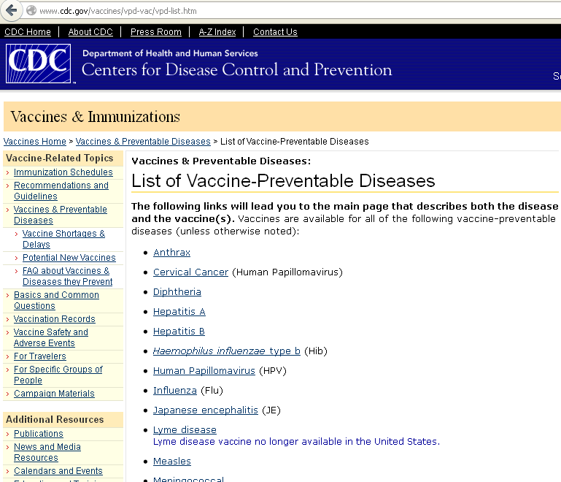

Slide 22
Childhood Immunization Schedule in KSA - 2013
Age: | Vaccines:
At birth | BCG / Hepatitis B
2 Months | IPV /DTaP / Hepatitis B/ Hib/Pneumococcal Conjugate (PCV)/Rota
4 Months | IPV /DTaP / Hepatitis B/ Hib/Pneumococcal Conjugate (PCV)/Rota
6 Months | OPV/IPV /DTaP/ Hepatitis B/ Hib/Pneumococcal Conjugate (PCV)
9 Months | Measles / Meningococcal Conjugate quadrivalent (MCV4)
12 Months | OPV/ MMR/ Pneumococcal Conjugate (PCV)/Meningococcal Conjugate quadrivalent (MCV4)
18 Months | OPV/DTaP/Hib/ MMR/ Varicella/ Hepatitis A
24 Months | Hepatitis A
First class Primary School age | OPV/ DTaP(Td) / MMR/Varicella

Slide 23
Doses & Routes of administration
Vaccine | Dose | Route
BCG | 0.05 ml | ID or SC (left arm)
DPT | 0.5 ml | IM (right or left side of thigh)
Hepatitis B (HBV) | 0.5 ml | IM
Haemophilus Influenza b (Hib) | 0.5 ml | IM
MMR | 0.5 ml | SC
OPV | 2 drops | Oral
BCG = Bacillus Calmette – Guerin vaccine (tuberculosis).
DPT = Diphtheria, pertussis and tetanus vaccine.
MMR = Live measles, mumps and rubella viruses in a combined vaccine.
OPV = Oral Poliovirus vaccines containing attenuated poliovirus types 1,2 and 3
Intradermal = ID Subcutaneous= SC Intramuscular= IM

Slide 24
Factors influencing recommendations concerning the age of vaccination
Age-specific risks of diseases
Age-specific risks of complications
Ability of persons of a given age to respond to the vaccine(s)
Potential interference with the immune response by passively transferred maternal antibody (e.g., measles vaccine)

Slide 25
Active immunization for adult females
MMR vaccine is given in adolescence before or after marriage, but not during pregnancy and has to be before 3 months of conception
Tetanus toxoid in pregnancy to prevent tetanus neonatorum in the newborn. In the first pregnancy on the third month and after 1 month. The third dose in the second pregnancy, and the fourth on the third pregnancy with a maximum of 5 doses.
If 10 years elapse, and then pregnancy occurs, the doses are given from the start
Live attenuated vaccines should not be given during pregnancy.

Slide 26
Vaccination for special occupations
Health care worker: hepatitis B, influenza, MMR, polio
Public safety personnel (police, fire fighters) and staff of institutions for the developmentally disabled: hepatitis B, influenza
Vetenerarians and animal handlers: rabies, plague and anthrax
Sewage workers: DT, hepatitis A, polio, TAB (Typhoid vaccine)
Food handlers: TAB
Military troops and camp dwellers: pneumococcal, meningococcal, influenza, BCG (for non reactors), tetanus

Slide 27
Invalid Contraindications to Vaccination
Mild illness
Mild/moderate local reaction or fever following prior dose
Antibiotic therapy
Disease exposure or convalescence
Pregnancy in the household
Premature birth
Breast feeding
Allergies to products not in vaccine
Family history not related to immuno-suppression

Slide 28
Vaccine potency
All vaccines are thermo-sensitive and need to be properly stored and distributed within an efficient cold chain system

Slide 29
The cold chain system
Refers to the system (personnel, equipment & procedure) used for keeping and distributing vaccines in good condition.
When implemented properly, can help overcome the challenge of the delivery of quality vaccines.
Can enhance the on-going quality, safety and efficacy of an immunization programme.

Slide 30
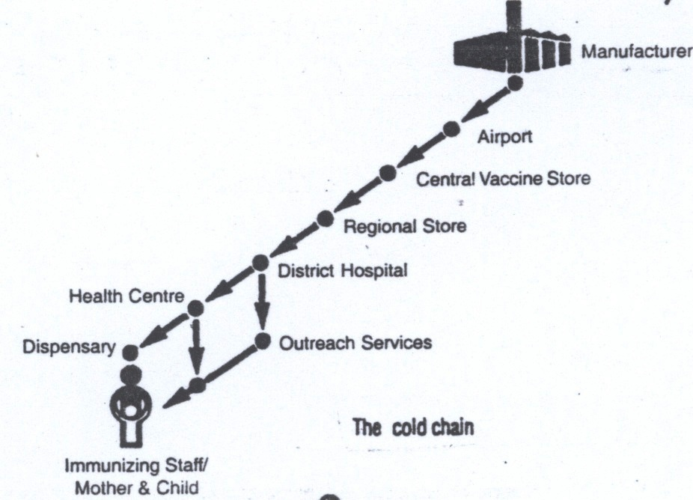

Slide 31
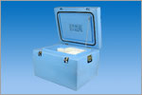
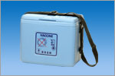
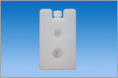
Examples of Cold Chain Instruments

Slide 32
Guidelines for Maintaining and Managing the Vaccine Cold Chain
http://www.cdc.gov/mmwr/preview/mmwrhtml/mm5242a6.htm#tab1

Slide 33
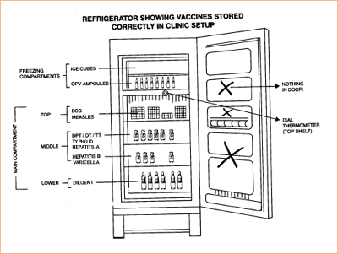
The proper temperature to keep vaccines at the health center level is (+2 to +8)

Slide 34
Heat Sensitivity of vaccines
Live oral polio vaccine (OPV)
BCG (Lyophilized) *
Measles (Lyophilized) *
Rubella and Mumps (Lyophilized)
Adsorbed Diphtheria-Pertussis-Tetanus vaccine (DPT)
Adsorbed Diphtheria-Tetanus vaccine (DT, Td)
Tetanus Toxoid (TT)
Hepatitis A
Hepatitis B
* Note: These vaccines become much more heat sensitive after they have been reconstituted with diluents.
Most sensitive
Least sensitive
Notes:
All vaccines are thermo-sensitive and need to be properly stored and distributed within an efficient cold chain system.
The stability of vaccines varies considerably (Galazka et al. 1998):
Diphtheria and tetanus toxoids and hepatitis B vaccine showing the highest thermostability,
Freeze-dried measles, yellow fever and BCG vaccines occupying the middle position and
Oral poliomyelitis vaccine being the most fragile.

Slide 35
Thank you

