Slide 1
Course Orientation
1436-2015

Slide 2
Who are we?
Medical Informatics and e-learning Unit (MIELU)
Dr. Amr Jamal (amrjamal@ksu.edu.sa)
Professor Ahmed Albarrak (albarrak@ksu.edu.sa)
Dr. Nasriah Zakaria (nzakaria@ksu.edu.sa)
Notes:
It would be good to make this two points:
Faculty-
Support staff (fatimah, ayah and khlod- also put how they will support student i.e their role . Email and contact)

Slide 3
Guest Speakers
Dr. Osama Swailem
King Faisal Specialist and Research Center
Dr. Anila Jahangiri
Jahangiri Consulting
Notes:
It would be good to make this two points:
Faculty-
Support staff (fatimah, ayah and khlod- also put how they will support student i.e their role . Email and contact)

Slide 4
MIELU staff
Grades and Attendance
Dr. Mohamad Al kheraiji (kheraiji@hotmail.com)- Male
Technical
Khulood Alghamdi (kmalghamdi@ksu.edu.sa)
Heba Rammal (hrammal@ksu.edu.sa)
Asrar Ansari (aaansari@KSU.EDU.SA)
Bashaier Al Yousefi (balyousefi@ksu.edu.sa)
Notes:
It would be good to make this two points:
Faculty-
Support staff (fatimah, ayah and khlod- also put how they will support student i.e their role . Email and contact)

Slide 5
Health/Medical/Biomedical Informatics
The science of health/clinical/bio/medical data/information/knowledge is
Acquired/Collected
Manipulated
Classified
Organized
Retrieved
Stored

Slide 6
Medical Informatics
This course is designed to provide 3rd year students with knowledge and skills about Medical Informatics.
Students will learn how data, information and knowledge is created, managed and processed using Information and Communication Technology.
This course will also introduce the students to electronic health record, computerized physician order entry, imaging, and Internet health applications.

Slide 7
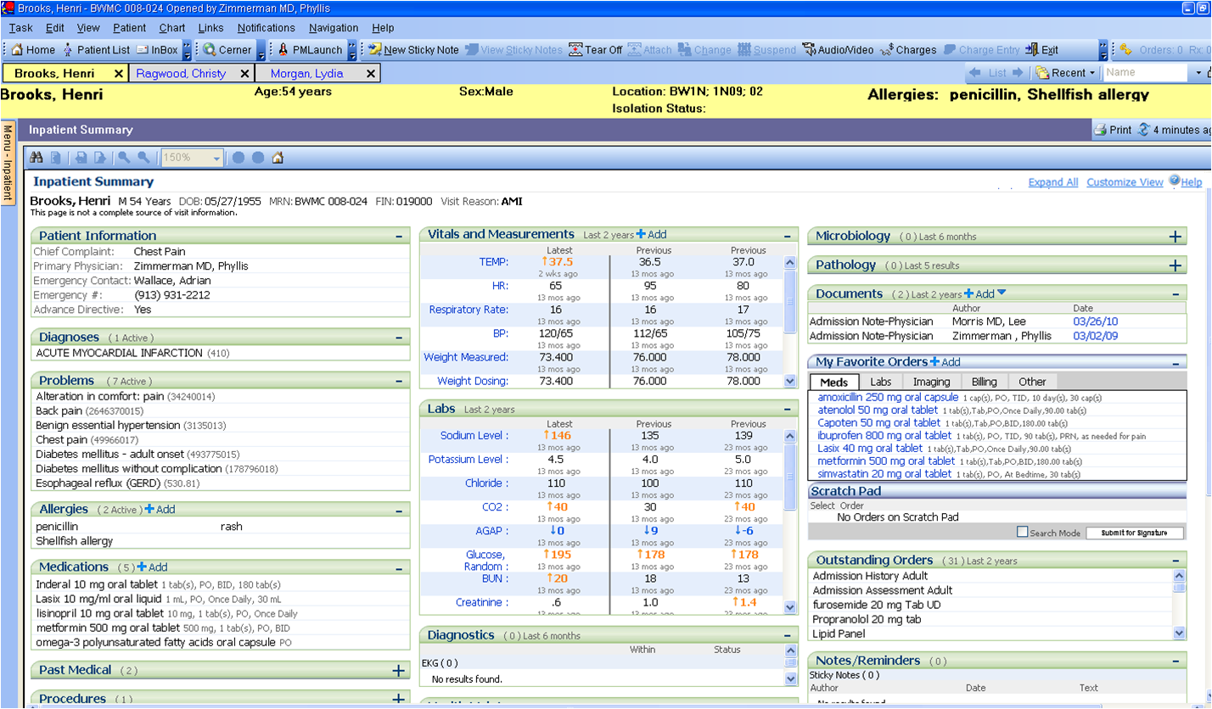
Notes:
More related to dental
A screen shot of an EHR would be nice

Slide 8
Learning Objectives (LO)
At the end of the course, students will be able :
LO1: To understand the current trends in medical informatics as they apply to the healthcare field and the health profession
LO2: To increase awareness of the ways in which information technology is used in health-related situations
LO3: To explore computer applications in health education, practice, administration and health research. Identify various types of information systems used within healthcare institutions.

Slide 9
Learning Objectives
LO4: To explore computer applications in health education, practice, administration and health research.
LO5:To identify various types of information systems used within various units in healthcare institutions
LO6:To conduct online search in healthcare literature as educational resources

Slide 10
Learning Objectives | Topics Covered | Assessments
LO1 | All topics esp Consumer Health Informatics, Telehealth | Quiz, Midterm, Finals
LO2 | Workshops, EHR, DSS, Telehealth, CPOE | Quiz, Midterm, Final, Workshop
LO3 | EHR, DSS, Telehealth, CPOE | Quiz, Midterm, Final
LO4 | CIS field visit, Ethics | CIS field visit report
LO5 | Clinical Informatics as A Career for Physician, Ethics | Quiz, Midterm, Final
LO6 | Tutorials & Workshops | Tutorials & Workshops

Slide 11
 | Assessment task | Proportion of Total Assessment
1 | Tutorial ( 9 tutorials) | 2%
2 | Workshop: Medical Search, Design Apps, EBM, CIS | 8%
3 | Midterm | 20%
4 | Online quiz | 10%
5 | Final examination | 40%
6 | Site Visit- Presentation and Report | 20%
 |  | 100%

Slide 12
Tutorial Participation (2%)
1. There will be 9 tutorials this year
2. Each group will be responsible 1-2 tutorials
3. Tutorials will include discussion, case study, system review, demonstration etc.
4. Designated group will present the outcome of tutorial
5. All groups must attend and participate in discussion or Q& A

Slide 13
Example
Week | Topic | Activities | # OF GROUPS
1 | Introduction to Medical Informatics (Tutorial) | Find one scientist who contribute in Health Informatics and present his/her major contributions | 2 groups
3 | Clinical Data and Databases (Tutorial) | Review Electronic Health Record- review different types of data What kind of errors can occur during data entry? How will this affect the quality of data? | 1-2 groups
4 | EHR (Tutorial) | Review Systmone (TPP) Practice Fusion Discuss if Electronic Health Record should provide social networking feature to allow collaboration among medical workers. What are the pros and the cons? | 2 groups

Slide 14
Workshop Participation(8%)
1. There will be 4 Workshops this year
2. Workshop will be 2-3 hours long
3. All groups members must participate actively

Slide 15
Use of Computer and Web
Blackboard
Search Engine
Googledoc, SlideShare, Dropbox
Notes:
I moved this slide to be before Blackboard

Slide 16
Blackboard- Learning Management System
www.lms.ksu.edu.sa
Logging In
Course name
Download lecture slides/View lecture slides
Announcements
Online Quiz
Upload report

Slide 17
Resources
Notes from lecture
Readings from textbook
Shortliffe, E., Cimino, J. (2014).Biomedical Informatics: Computer Applications in Healthcare and Biomedicine, 4th Edition, Springer
Readings from selected papers
Discussion with faculty members/KKUH staff

Slide 18
Attendance
Class Attendance
Please come within 10 minutes of the class
10% missing- 1st warning letter
20% missing- 2nd warning letter
25%- will be barred from taking the final examination
Workshop & Tutorial participation
Active Participation
Reminder: Never SIGN on behalf of your friends. Your integrity is our PRIORITY!

Slide 19
Course Policy
i. Lecture Hours
Attend class regularly
Pay attention
Questions are welcomed
Respect each other
ii. Tutorial and Workshop Hours
Be prepared
Avoid flaming and arguing without basis
Open discussion
Discussion within given topics
Other issues can be brought up outside classroom

Slide 20
Course Policy
iii. Grades
Follow grading criteria (available on Blackboard)
Re-grading can only be done by submitting written requests and within one week after grade is announced.
Always check Grade Center from time to time and contact us if there’s any error as soon as possible

Slide 21
Clinical Information
System Site Visit
To visit ONE clinical information system used in a healthcare organization/center/wards.
Examples
Electronic Health Record,
Radiology Information System
Computerized Physician Order Entry
PACS

Slide 22
Clinical Information
System Site Visit
CIS Milestone
Week 2: Announcement of the Project
Week 5: Select system & write letter to organization
Week 7-10: Visit Organisation (choose one convenient date)
Week11-15: Prepare CIS Site Visit Report
Week 22: CIS Presentation Day
Week 24: Submit Report

Slide 23
Stay Connected
Twitter
@MIELU_KSU
Facebook:
https://www.facebook.com/Ksumielu
Notes:
As you said add a slide to explain the absenteeism rate and policy (add it before plagiarism)

Slide 24
Thank You
nzakaria@ksu.edu.sa
albarrak@ksu.edu.sa
amrjamal@ksu.edu.sa
Notes:
As you said add a slide to explain the absenteeism rate and policy (add it before plagiarism)

