Slide 1
Glomerular diseases
MED 341
Nov 2, 2015

Slide 2
Objectives
1- To understand the pathophysiology of primary Glomerular Diseases.
2- To correlate the clinical findings with the underlying renal pathology.
3- To recognize the important features of Nephrotic syndrome.
4- Learn the most common causes of NS in adults.
5- To recognize the most important Glomerular diseases that cause Nephritic pattern ( Glomerulonephritis).

Slide 3
Renal cortex is the most important functional part of the kidney, because it has the Glomeruli
Nephron (zoom)

Slide 4
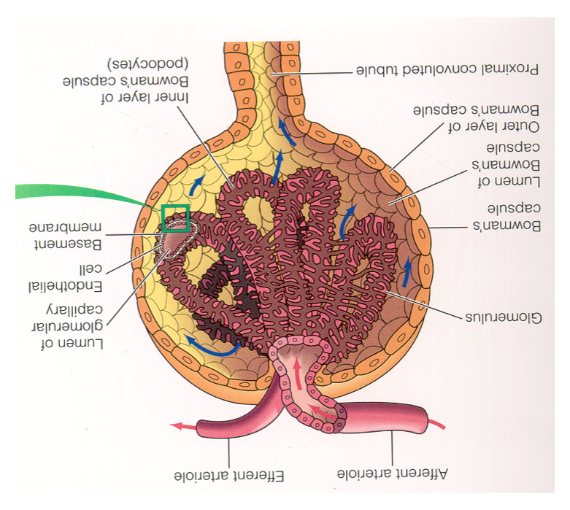
The Nephron
Proximal
tubule
G
L
O
M
E
R
U
L
U
S

Slide 6
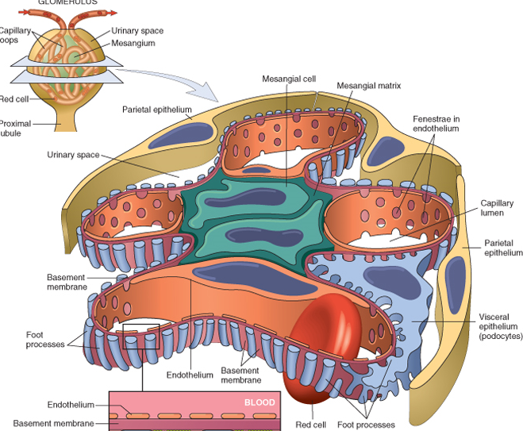

Slide 7
Microscopy
Light Microscope 2000x
EM 10,000,000

Slide 8
The Glomerular Capillary wall has 3 layers, through which filtration occurs
2
3
1

Slide 9
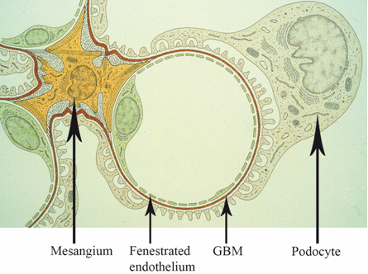
Normal Capillary Loop ( Electron Microscopy)

Slide 10
Normal Glomerular structure is needed to:
Keep the glomerular filtration normal, thus maintains normal kidney function.
keeps the urine volume maintained; so preventing fluid retention in the body which causes edema and high blood pressure.
Prevents the blood components (cells, proteins) from leaving the blood stream and appearing in the urine.

Slide 11
Normal versus disrupted G. capillary wall

Slide 12
So normal urine will have:
NO PROTEIN.
NO RED BLOOD CELLS ( Accept: <2 RBCs/High power field)
NO HEME.
NO CELLULAR CASTS.
No fat
No sugar

Slide 13
How glomerular diseases start?
Here we are talking about primary glomerular diseases that are mostly caused by immune system dysfunction.
Auto-antibodies targeting glomerular structure or immune-complexes (antigen-antibody) depositing and traumatizing the glomerular components.
Notes:
A lot of times the exact cause is not really clear, but the result of the damage in the glomerulus is telling how immune system is playing an important rule.

Slide 14
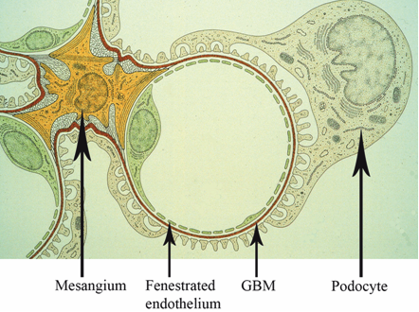

Slide 15
How glomerular diseases start?
Most important to recognize:
The manifestations of a glomerular disease are usually indicative of which components of glomerular capillary wall was affected at the most.
if Podocytes are the main target of the disease process >>>> mainly proteinuria ( at large amount) will manifest; thus Nephrotic Syndrome will be the main finding.
if endothelial cells and GBM are affected>>>> mainly hematuria and abnormal renal function will manifest because of disruption in glomerular filtration wall; thus Nephritic pattern of renal disease will manifest.
Proteinuria is always present in this kind of Glom injury as well.

Slide 16
Another important things to remember;
>> Glomerular diseases are named based on their histo-pathological characteristics seen under the microscope
>> So, almost always a kidney biopsy is needed to diagnose any suspected primary glomerular disease

Slide 17
But to make things easier, we can put Glomerular diseases in two main clinical categories (clinical i.e. the symptoms, signs and laboratory abnormalities)
>>> Nephrotic ( due to Podocytes dysfunction, so heavy proteinuria will be present)
>>> Nephritic ( due to glomerular capillaries inflammation; so hematuria, impaired renal function and variable amount of proteinuria will be present)

Slide 18
Nephrotic Syndrome (NS)
Podocytes abnormality is the primary finding in NS.
Podocytes will sustain a structural dysfunction; making them lose their Foot-processes.
This will lead to significant amount of protein appearing in the urine (Proteinuria).

Slide 20
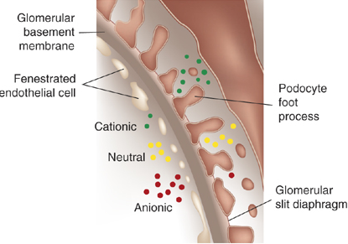
(Anionic)
(Albumin)

Slide 21
Nephrotic Syndrome
It refers to a constellation of clinical and laboratory features of renal disease:
Hypoalbuminemia (serum Albumin <30 g/L) Normal serum Alb: 35-55g/L
Heavy proteinuria ( > 3.5 g/24 hours of urine collection)
Peripheral or generalized edema
Hyperlipidemia

Slide 22
Complications of Nephrotic Syndrome
Infections & sepsis.
Thrombosis.
Acute kidney injury.
ESRD if heavy proteinuria not going into remission

Slide 23
Proteinuria
How many milligrams of proteins are normally secreted in the urine per-day?
< 150 mg/day of all kinds of proteins.
Including on average 4-7mg/day of Albumin that are secreted in the urine.

Slide 24
Urine Analysis in Nephrotic Syndrome
Heavy protein (Proteinuria) or called Nephrotic range proteinuria (>3.5 g/24h urine)
No RBCs ( some times few are occasionally seen)
No RBCs casts
Lots of fat (Lipiduria)( Fatty casts, oval fat bodies & fat droplets)
No WBCs ( few may be seen)

Slide 25
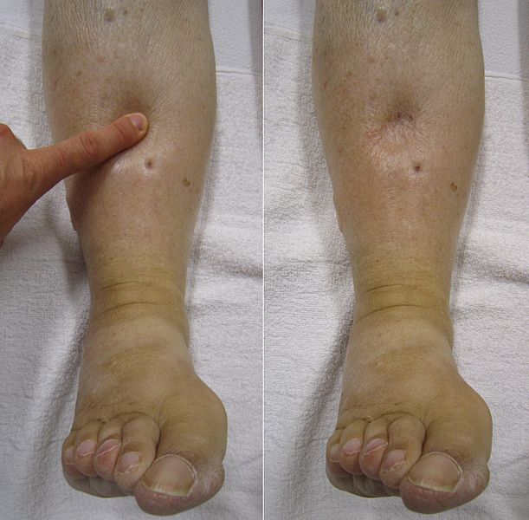
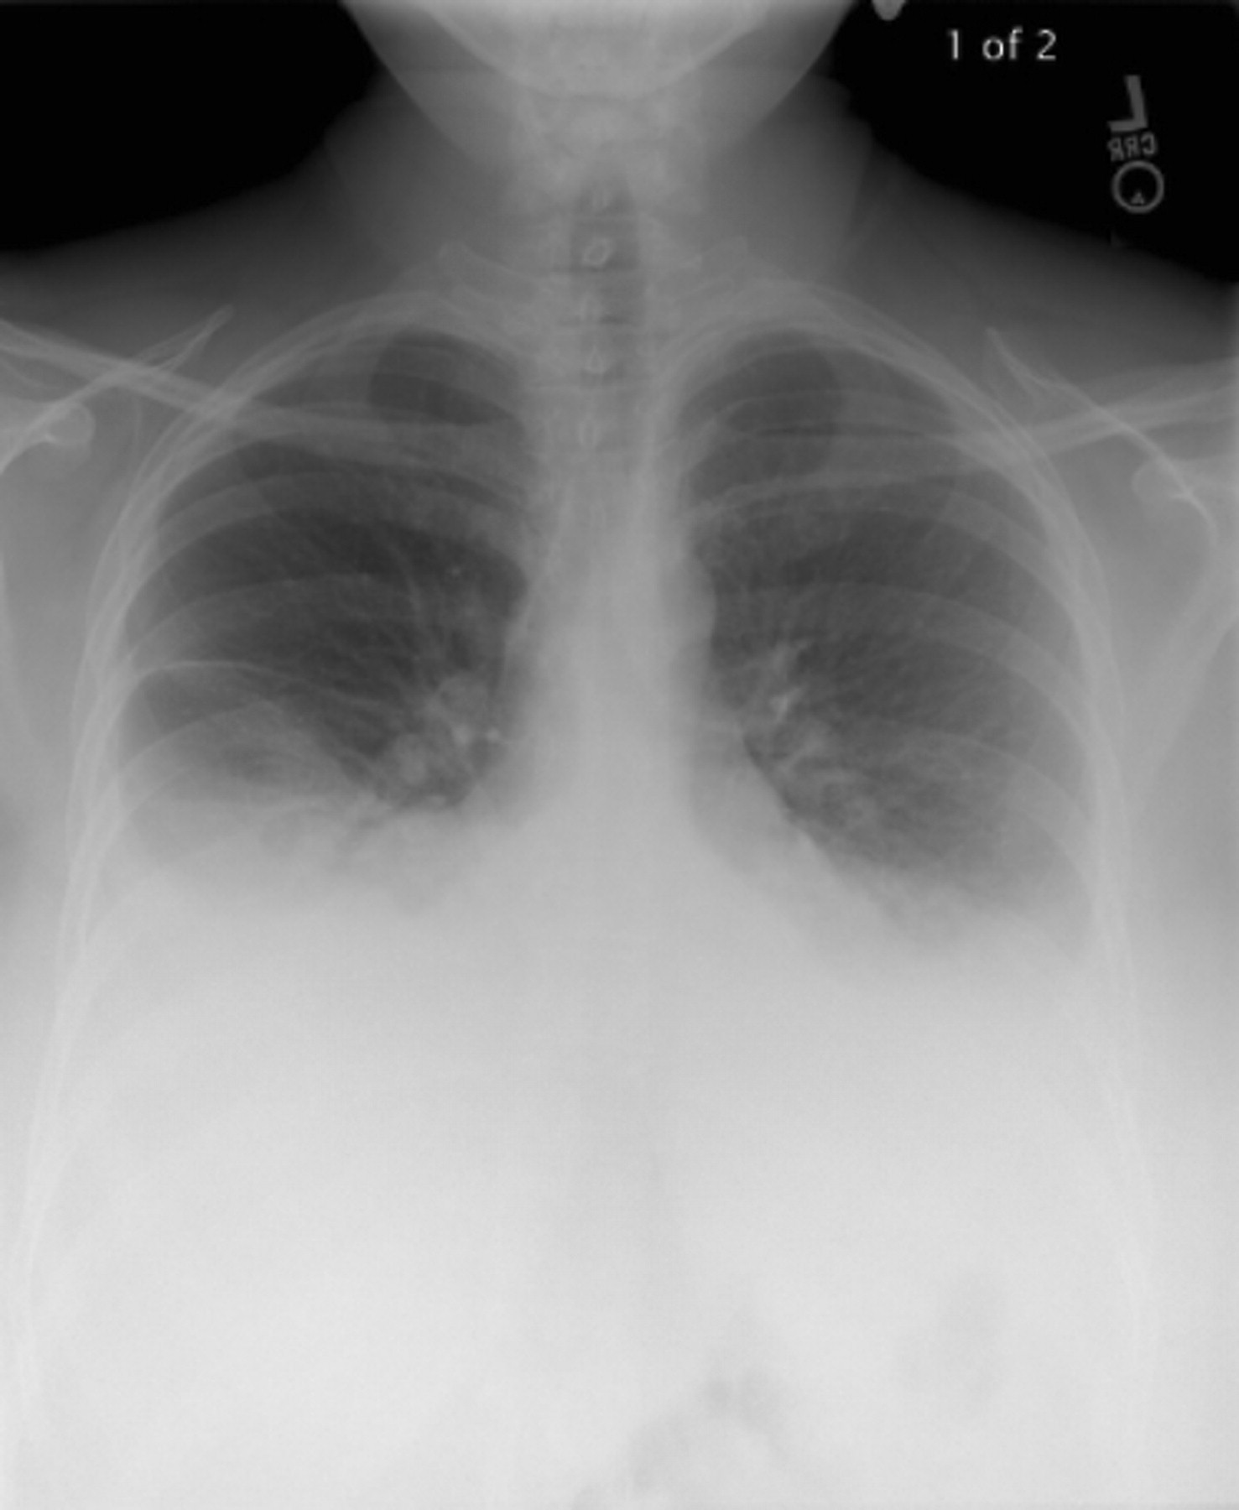
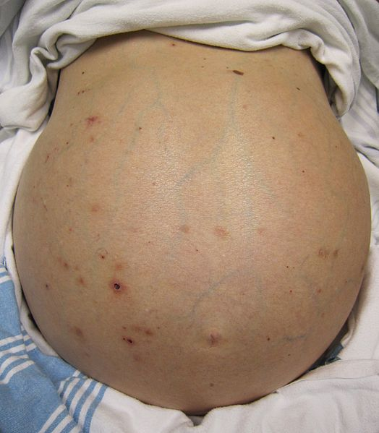
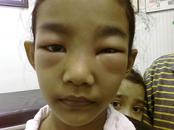
Clinical Presentation
Edema due to:
1- Low serum Albumin (Low oncotic pressure)
2- Increase Renal sodium retention
Because of uncontrolled activation of the epithelial sodium
channels (ENaC channels in the renal tubules)

Slide 26
Clinical Presentation
Patients also get:
Fatigue
Frothy urine (froth persists for long time after voiding)
Anorexia
Nausea & vomiting
Abdominal pain
Weight gain due to fluid retention
Shortness of breath if having pleural effusion
Signs & symptoms of DVT, PE

Slide 27
Glomerular Diseases present as Nephrotic Syndrome
1-Focal Segmental GlomeruloSclerosis (FSGS)
2- Minimal Change Disease (MCD)
3- Membranous Nephropathy (MN)

Slide 28
Focal Segmental GlomeruloSclerosis (FSGS)
The primary variant on light microscopy:
Focal: some glomeruli are affected by sclerosis (the rest of them look normal)
Segmental: sclerosis only involves a segment of each glomerulus that is affected.
But most important; all glomeruli (the affected by sclerosis and not affected one ) will have a diffuse foot processes effacement (thus Nephrotic syndrome appears)

Slide 29
Focal Segmental GlomeruloSclerosis (FSGS)
A common cause of Nephrotic syndrome in adults.
Causes 12 – 35 % of the cases in adults.

Slide 30
Focal Segmental GlomeruloSclerosis (FSGS)
Normal
FSGS

Slide 31
Focal Segmental GlomeruloSclerosis (FSGS)
Normal
FSGS, like minimal change disease, diffuse foot process effacement but with segmental sclerosis

Slide 32
Focal Segmental GlomeruloSclerosis (FSGS)
Can be:
Primary FSGS:
Has sudden onset of heavy proteinuria and other manifestations of nephrotic syndrome.
Usually treated with corticosteroids and other immunosuppressing medications.

Slide 33
Focal Segmental GlomeruloSclerosis (FSGS)
Or can be
Secondary FSGS:
-Proteinuria is less heavy than other causes of nephrotic syndrome.
-Serum Albumin is not very low like the primary type.
-Renal impairment is commonly seen with the secondary FSGS and this is not a good prognostic sign

Slide 34
Focal Segmental GlomeruloSclerosis (FSGS)
Possible causes of Secondary FSGS:
Massive obesity
Nephron loss ( > 75% of renal mass) e.g renal agenesis
Reflux nephropathy
Healing of prior GN (IgA, Lupus etc)
Anabolic steroid abuse
Severe preeclampsia
Drugs: Interferon, Pamidronate, Heroin
Infections: HIV

Slide 35
Focal Segmental GlomeruloSclerosis (FSGS)
Immunosuppressive therapy is indicated in most patients with primary FSGS
First line: corticosteroids
Second line: cyclosporine or tacrolimus
Secondary FSGS: not typically treated with Immunosuppression, treat the primary cause and add supportive measures to protect the kidneys, e.g. keeping blood pressure well controlled with ACEi.

Slide 36
Minimal Change Disease (MCD)
Called minimal because:
light microscopy: is typically showing normal glomeruli
So called: nil disease.
BUT:
electron microscopy: shows diffuse effacement of the epithelial cells’ foot processes only.
So the most important difference between MCD and the FSGS is the presence of glomerular sclerosis in FSGS
Here no sclerosis.

Slide 37
Cont. Minimal Change Disease (MCD)
Normal Glomerulus
MCD, basically no abnormality is seen on light microscopy

Slide 38
Cont. Minimal Change Disease (MCD)
Normal Glomerulus
MCD, EM shows the diffuse foot process effacement

Slide 39
Cont. Minimal Change Disease (MCD)
It is the main cause of Nephrotic syndrome in children:
- 90 % of cases in children < 10 years old
> 50 % of cases in older children
In children; typically is corticosteroid responsive in > 90%, thus kidney biopsy is commonly not done and treatment is given empirically for such cases.
It causes 10-25 % of Nephrotic syndrome in adults

Slide 40
Cont. Minimal Change Disease (MCD)
Can be :
Primary (Idiopathic)
or
Secondary:
Drugs ( NSAIDs, Lithium, Sulfasalazine, Pamidronate, D-penicillamine, some antibiotics)
Neoplasm ( Hodgkin Lymphoma, non-Hodgkin lymphoma, and leukemia)
Infections ( TB, syphilis )
Allergy

Slide 41
Cont. Minimal Change Disease (MCD)
Clinical presentation:
Typically has a sudden onset Edema
BP may be normal or slightly elevated
Heavy proteinuria (Nephrotic range)
Lipiduria
Hypoalbuminmia (usually very low serum Albumin)
Hyperlipidemia
Creatinine is always within the normal range or slightly elevated and normalizes with remission

Slide 42
Cont. Minimal Change Disease (MCD)
Diagnosis:
Must do kidney biopsy in adult patients with this presentation
Diffuse effacement of foot process.
Treatment:
First line: Corticosteroids, given x 3-4 months then taper over 6 months
Second line: oral Cyclophosphamide, Cyclosporin

Slide 43
Membranous Nephropathy (MN)
Most common cause of nephrotic syndrome in adults (15% and 33%)
Mostly secondary in children (hepatitis B antigenemia)
Presentation: slowly developing nephrotic syndrome

Slide 44
Membranous Nephropathy (MN)
Normal
MN
Diffuse thickening of the glomerular capillary wall throughout all glomeruli (IgG and C3 deposition)

Slide 45
Membranous Nephropathy (MN)
Normal
MN

Slide 46
Membranous Nephropathy (MN)
Etiology:
Primary (Idiopathic)
In approximately 75% of cases in adults.

Slide 47
Membranous Nephropathy (MN)
Secondary: causes of MN:
Systemic lupus erythematosus (SLE)
Class V Lupus Nephritis (10-20%)
Drugs: penicillamine, gold, high dose Captopril, and NSAIDs, Anti-TNF.
Infections: Hepatitis B, Hepatitis C, syphilis
Malignancy: solid tumors prostate, lung, or GI track

Slide 48
Membranous Nephropathy (MN)
Treatment of Primary MN
Corticosteroids plus
Cyclophosphamide or cyclosporine
May be Rituximab
Secondary MN
- Mainly target the primary disease that caused MN, and treat the Nephrotic syndrome manifestations.

Slide 49
Other important secondary causes of Nephrotic syndrome in adults:
Diabetes Mellitus
Amyloidosis
IgA Nephropathy
MPGN

Slide 50
Nephritic Glomerular diseases
When we say Nephritic; it means a clinical pattern of presentation for a group of GNs, and not a syndrome like what we saw in Nephrotic causes.
The Nephritic pattern is always indicative of underlying inflammatory process in the glomeruli; causing inflammatory modulators attraction, cellular proliferation and eventually glomerular permanent dysfunction if left untreated.
The GLomerular mesangium, endothelium and GBM components of the Glomerulus are likely going to be targeted because of their proximity to blood circulation.

Slide 52
Normal Glom.
Glom. with proliferative (inflammatory) GN

Slide 53
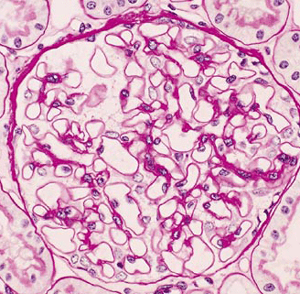
Crescentic GN; is a very bad GN!!!!
Normal Glom.
Glom. with Crescent
Indicates severe inflammation & worse outcome if not treated rapidly

Slide 55
Nephritic urine analysis shows:
Red Blood Cells (RBCs)
RBCs casts, or cellular casts
Dysmorphic RBCs (RBCs lose their smooth surface passing through the cracks)
Protein (at variable amount from mgs to grams per day)
Those are called Active Urinary Sediments
( Active = is indicative of underlying glomerular inflammatory process; requiring urgent medical attention)

Slide 56
RBCs cast formed by naturally occurring Tamm-Horsfall mucoprotein in the distal tubules & collecting ducts when they become loaded with RBCs coming from the inflamed Glomerulus (due to GN)

Slide 57
The Nephron
Proximal
tubule
G
L
O
M
E
R
U
L
U
S

Slide 58
Nephritic clinical manifestations:
AKI (Acute Kidney Injury) =Acute Renal impairment or Failure= elevated Creatinine)
Decreased Urine output
Edema
High Blood Pressure
May have other manifestations of systemic vasculitis since some GN types are actually vasculitis (e.g. skin rash, pulmonary hemorrhage, etc)
Positive immune markers: ANA, Anti-DNA, low complements, +ve ANCA (depends on the cause)

Slide 59
Nephritic Glomerular diseases
Here; they are called GN=Glomerulonephritis
Renal Diseases that can present with Nephritic picture:
IgA Nephropathy / HSP (Henoch-Schönlein purpura)
Post streptococcal glomerulonephritis (PSGN)
Lupus Nephritis
Anti-GBM (Goodasture’s disease)
ANCA vasculitis ( e.g. Wegner’s Granulomatosis)
Membranoproliferative GN (MPGN)

Slide 60
IgA Nephropathy
Most common type of Primary GN in developed countries
Can present as dark urine (hematuria) 1-3 days after upper respiratory tract infection. (< one week of URT infection)
A lot of times it gets picked up incidentally by finding abnormal urine analysis (Hematuria+/- Proteinuria) done for other reasons with no symptoms.
It has a chronic course that can progress to ESRD.
Needs kidney biopsy to reach the diagnosis.
The diagnosis is made by finding abnormal deposition of Ig A immunoglobulin in the Glomeruli, it elicit a local inflammatory response in the Glom mesangium (mesangial expansion)

Slide 61
It is thought to be secondary to altered mucosal immunity that leads to excessive IgA synthesis followed by deposition in the gloms.
There is really no effective immunosuppressing therapy except in severe cases where it can be tried.
Most important treatment is to control the blood pressure which also decreases the proteinuria.
HSP (Henoch-Schönlein purpura) is a systemic vasculitis caused by immune deposition of IgA in different organs; typically skin, bowel and kidneys.

Slide 62
IgA
IgA Nephropathy
Normal Glomerulus
IgA IF

Slide 63
Post streptococcal glomerulonephritis (PSGN)
Typically caused by throat infection with Gram positive cocci (Group A beta-hemolytic Streptococcus (GAS).
But also can be caused by Staphylococcus soft tissue or bone infection in adults.
Bacterial Antigen cross react with Glom antigens, or may be an immune-complex (Antigen-antibody) response that is responsible.
Patients present with frank hematuria usually after one week and up to 3 weeks from the start of infection.
Serum will show positive Antistreptolysin (ASO) titer.
Low C3, Normal or slightly low C4 in the serum.
May have positive throat culture.
Children have better and faster recovery than adults.
Treatment is usually supportive= wait and see.

Slide 64
Lupus Nephritis
LUPUS: The Disease with a Thousand Faces
Kidneys can be affected by SLE like other organs.
The degree of involvement can be mild (or even not visible to the physician) to a very severe one causing ESRD in few months.
Most important in dealing with these cases is having high suspicion of its presence and to start immediate workup & referral for diagnosis and treatment.

Slide 65
Lupus Nephritis
Kidney biopsy is mandatory to make the diagnosis.
Low complements (C3, C4) level along with the positive Lupus markers, abnormal urine analysis & abnormal renal function should make you think of its presence.
Lupus Nephritis treatment depends on the findings in renal biopsy.
It usually involves high degree of immunosuppressing medications.

Slide 66
ANCA vasculitis
Autoimmune disease that involves the presence of Neutrophils adhesion enhancing molecule called
ANCA=Anti-neutrophil cytoplasmic antibody
Two types of ANCA:
1- C-ANCA= Cytoplasmic type, more commonly causing Granulomatous Polyangiitis= old name Wegner’s Granulomatosis ( so a granuloma forming disease)
Angiitis: means small vessels vasculitis
2- P-ANCA= Perinuclear type, more commonly associated with Microscopic Polyangiitis & Churg-Strauss syndrome

Slide 67
ANCA vasculitis
Upper airways and lung involvement is common and patients can present with renal and pulmonary manifestations (GN + Pulmonary hemorrhage: hemoptysis)
Diagnosis is made by kidney biopsy and positive ANCA titer in the serum.
It is usually an aggressive disease that should be treated with potent immunosuppressing medications. (high dose corticosteroids & cyclophosphamide).

Slide 68
Anti-GBM antibody disease (Anti Glom Basement Membrane)
Due to autoantibody against (alpha-3 chain) of type IV Collagen that is found in Glomerular & alveolar basement membrane.
So the manifestations will be:
1- GN (can be the only presenting finding) &
2- Pulmonary hemorrhage (if with GN; is called Goodpasture’s disease)
3- positive test for Anti-GBM antibodies in the serum
4- Kidney biopsy shows the diagnostic Immunofluorescence pattern : Linear stain of IgG and C3

Slide 69
Linear Anti-GBM staining by Immunofluorescence is a Diagnostic test

Slide 70
Anti-GBM
Treatment is always started immediately to remove the antibodies by Plasmapheresis and preventing further antibodies production by giving heavy immunosuppression that includes corticosteroids and cyclophosphamide.

Slide 71
Membranoproliferative GN (MPGN)
It is a pathological description & has multiple causes.
It may present with Nephritic picture or Nephrotic syndrome
The primary (idiopathic) MPGN is mainly seen in children.
The secondary type is seen in adults due to:
Hepatitis B and C
Endocarditis
Lupus and Sjogren’s syndrome
Cancer
Complement deficiency

