Slide 1
Inflammatory Bowel Disease
Othman alharbi, FRCPC

Slide 2
Inflammatory bowel disease (IBD) is comprised of two major disorders:
  Ulcerative colitis (UC).
  Crohn's disease (CD).
These disorders have both distinct and overlapping pathologic and clinical characteristics.

Slide 3
Epidemiology
IBD is more common in the West, but the incidence is increasing in the developing countries including Saudi Arabia.
IBD can present at any age:
  The peak :15 - 30 years.
  A second peak 50

Slide 4
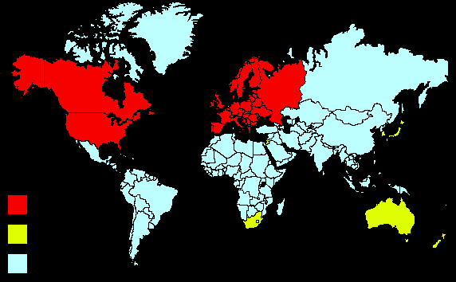
Inflammatory bowel disease (IBD) is comprised of two major disorders:
  Ulcerative colitis (UC)
  Crohn's disease (CD).
These disorders have distinct pathologic and clinical characteristics, but their pathogenesis remains poorly understood
High
Medium
Low
Notes:
Inflammatory bowel disease (IBD) is comprised of two major disorders: ulcerative colitis (UC) and Crohn's disease (CD).

Slide 5
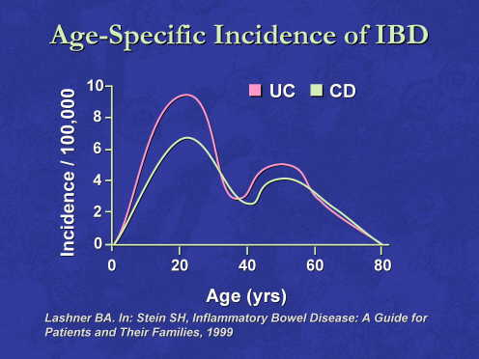

Slide 6
HOST FACTORS
  Genetic factors: NOD2/CARD15
ENVIRONMENTAL FACTORS
  Smoking:
  Appendectomy: protect UC
Diet

Slide 7
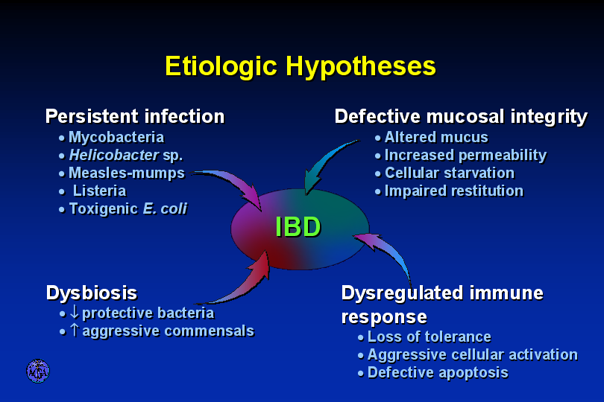

Slide 8
Ulcerative colitis
Ulcerative colitis is characterized by recurring episodes of inflammation limited to the mucosal layer of the colon.
Start rectum then extend proximally.

Slide 9
Ulcerative proctitis :rectum.
Ulcerative proctosigmoiditis :rectum and sigmoid colon.
Left-sided colitis: disease that extends beyond the rectum and as far proximally as the splenic flexure.
Extensive colitis :beyond the splenic flexure.
Pancolitis: whole colon

Slide 10
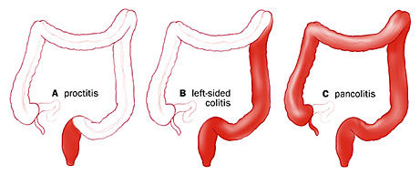

Slide 11
40-50% of patients have disease limited to the rectum and rectosigmoid
30-40% of patients have disease extending beyond the sigmoid
20% of patients have pancolitis

Slide 12
The major symptoms of UC are:
- diarrhea
- rectal bleeding
- tenesmus
- passage of mucus
- crampy abdominal pain

Slide 13
Patients with proctitis usually pass fresh blood or blood-stained mucus either mixed with stool or streaked onto the surface of normal or hard stool
When the disease extends beyond the rectum, blood is usually mixed with stool or grossly bloody diarrhea may be noted
When the disease is severe, patients pass a liquid stool containing blood, pus, fecal matter
Other symptoms in moderate to severe disease include: anorexia, nausea, vomitting, fever, weight loss

Slide 14
DIAGNOSIS —
  No single modalities is enough for Diagnosis.
  Combination of Clinical picture, laboratory, Endoscopy, pathology.

Slide 15
Colonoscopy
The vascular markings are lost, petechiae, exudates, touch friability, and frank hemorrhage may be present.
Colonic involvement is continuous in ulcerative colitis, in contrast to the patchy nature of Crohn's disease.

Slide 16
Pathology:
  crypt abscesses.
  chronic changes including branching of crypts, atrophy of glands, and loss of mucin in goblet cells

Slide 17
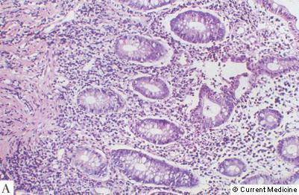
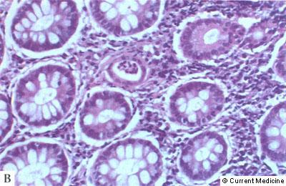
UC

Slide 18
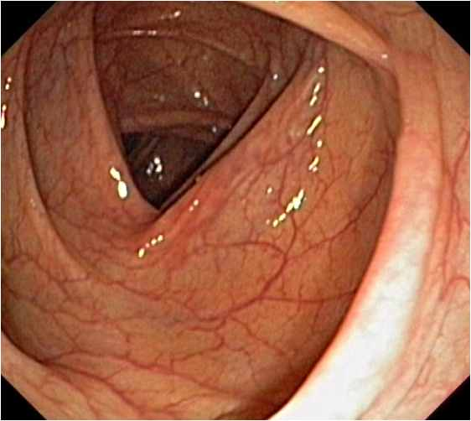
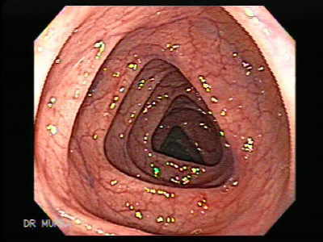
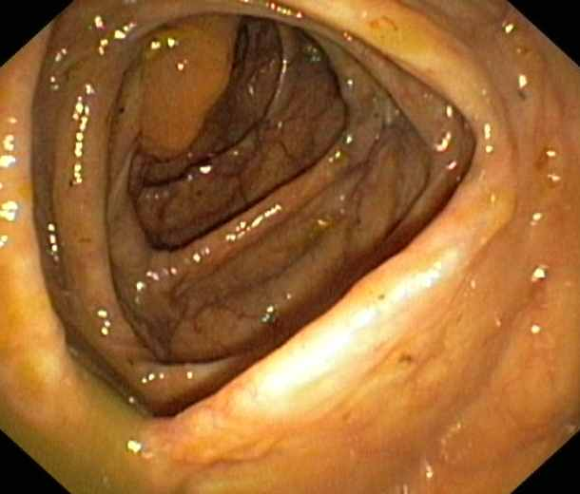
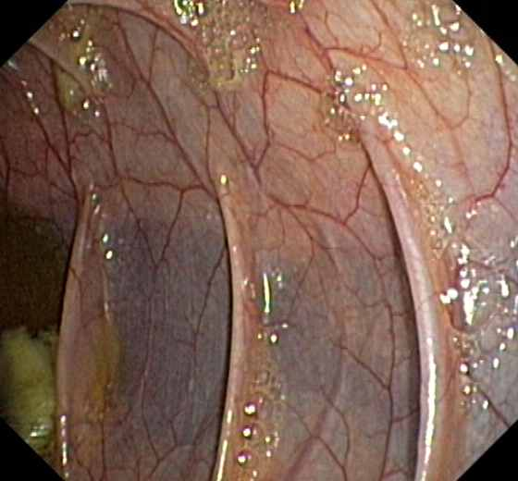

Slide 19
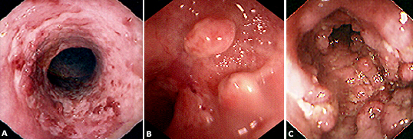

Slide 20
Ulcerative colitis - complication
Hemorrhage
Perforation
Toxic megacolon (transverse colon with a diameter of more than 5,0 cm to 6,0 cm with loss of haustration)
Colon cancer

Slide 21
managements
Goals of therapy
  Induce and maintain remission.
  Ameliorate symptoms
  Improve pts quality of life
  Adequate nutrition
  Prevent complication of both the disease and medications

Slide 22
managements
Role out infection
5 ASA therapy:
  Oral
  Rectal
Corticosteroids:
  Systemic: Prednisolone
  Local acting: enema.
Immunomodulators :
  Azithyoprine
  Methotrexate
Anti TNF therapy

Slide 23
Surgery:
  Severe attacks that fail to respond to medical therapy.
  Complications of a severe attack (e.g., perforation, acute dilatation).
  Chronic continuous disease with an impaired quality of life.
  Dysplasia or carcinoma.

Slide 24
CD
Crohn's disease (CD) is a disorder of uncertain etiology that is characterized by transmural inflammation of the gastrointestinal tract.
CD may involve the entire gastrointestinal tract from mouth to the perianal area.
  80% Small bowel.
  50 % ileocolitis.
  20 % colon.
  30% perianal disease.
  UGI < 5 %

Slide 25
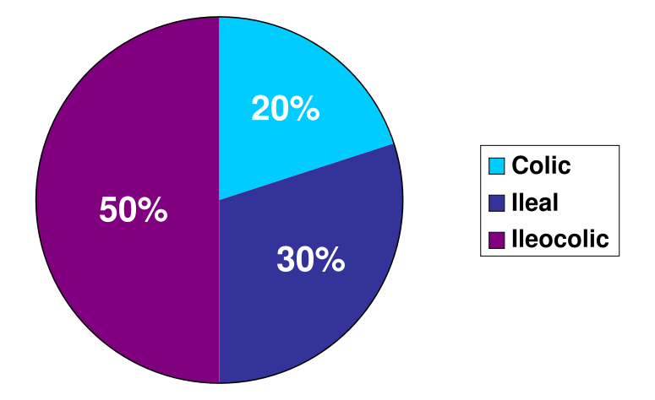

Slide 26
CLINICAL MANIFESTATIONS
Fatigue.
Diarrhea.
Abdominal pain.
Weight loss.
Fever.

Slide 27
Phlegmon/abscess :
  walled off inflammatory mass without bacterial infection
Fistulas :
  Fistulas are tracts or communications that connect two epithelial-lined organs.
    Enterovesical
    Enterocutaneous
    Enteroenteric
    enterovaginal
Perianal disease

Slide 28
Severe oral involvement
  aphthous ulcers.
Esophageal involvement
  odynophagia and dysphagia.
Gastroduodenal CD
  upper abdominal pain and symptoms of gastric outlet obstruction.
Gallstones

Slide 29
Extraintestinal manifestations
CD and ulcerative colitis share a number of extraintestinal manifestations
Arthritis
Eye involvement –uveitis, iritis, and episcleritis
Skin disorders.
Others:
  Primary sclerosing cholangitis, Venous and arterial thromboembolism ,Renal stones ,Bone loss and osteoporosis ,Vitamin B12 deficiency
Notes:
These manifestations, which tend to be more frequent with colonic involvement, include:
Arthritis – Primarily involving large joints in approximately 20 percent of patients without synovial destruction, arthritis is the most common extraintestinal manifestation. Central or axial arthritis, such as sacroiliitis, or ankylosing spondylitis, may also occur. An undifferentiated spondyloarthropathy or ankylosing spondylitis may be the presenting manifestation of CD. (See "Arthritis associated with gastrointestinal disease".)
Eye involvement – Eye manifestations in approximately 5 percent of patients include uveitis, iritis, and episcleritis (picture 1A-B). (See "Skin and eye manifestations of inflammatory bowel disease".)
Skin disorders – Dermatologic manifestations occur in approximately 10 percent of patients and include erythema nodosum and pyoderma gangrenosum (picture 2A-C).
Primary sclerosing cholangitis – This typically presents in approximately 5 percent of patients with an elevation in the serum alkaline phosphatase or gamma glutamyl transpeptidase (GGT) concentration. (See "Clinical manifestations and diagnosis of primary sclerosing cholangitis".)
Secondary amyloidosis is very rare but may lead to renal failure and other organ system involvement [8]. (See "Causes and diagnosis of secondary (AA) amyloidosis and relation to rheumatic diseases".)
Venous and arterial thromboembolism resulting from hypercoagulability (table 2) [9-14]. (See "Overview of the medical management of severe or refractory Crohn's disease in adults", section on 'Venous thromboembolism'.)
Renal stones – Calcium oxalate and uric acid kidney stones can result from steatorrhea and diarrhea [15]. Uric acid stones can result from dehydration and metabolic acidosis. (See "Risk factors for calcium stones in adults" and "Uric acid nephrolithiasis".)
Bone loss and osteoporosis may result related to glucocorticoid use and impaired vitamin D and calcium absorption [16,17]. (See "Metabolic bone disease in inflammatory bowel disease".)
Vitamin B12 deficiency – A clinical picture of pernicious anemia can result from severe ileal disease since vitamin B12 is absorbed in the distal 50 to 60 cm of ileum [18]. (See "Diagnosis and treatment of vitamin B12 and folic acid deficiency".)

Slide 30
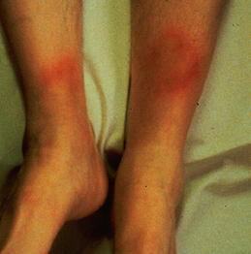
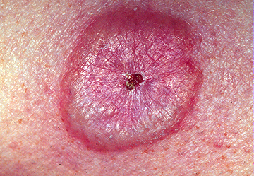

Slide 31
DIAGNOSIS
The diagnosis of CD is usually established with endoscopic findings or imaging studies in a patient with a compatible clinical history.

Slide 32
Colonoscopy:
  Endoscopic features include focal ulcerations adjacent to areas of normal appearing mucosa along with polypoid mucosal changes that give a cobblestone
Wireless capsule endoscopy

Slide 34
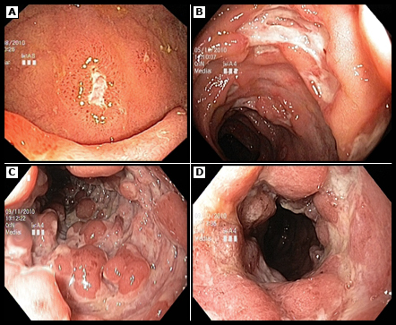

Slide 35
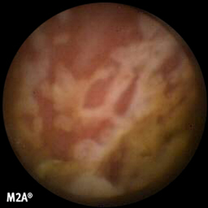

Wireless capsule endoscopy

Slide 36
Imaging studies
  small bowel follow through (SBFT)
  computed tomography: CTS or CT enterography
  Magnetic resonance imaging (MRI) or MR enterography

Slide 37
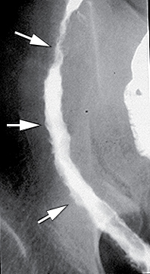

Slide 38
Serologic markers
  Inflamatory marker : ERS, CRP
  Antibody tests :
    Antineutrophil cytoplasmic antibodies (pANCA)
    Anti-Saccharomyces cerevisiae antibodies (ASCA)
  Stool markers — fecal calprotectin

Slide 39
Goals of therapy
  Induce and maintain remission.
  Ameliorate symptoms
  Improve pts quality of life
  Adequate nutrition
  Prevent complication of both the disease and medications

Slide 40
Management
Role out infection
Corticosteroids:
  Systemic: Prednisolone
  Local acting: Budosonide.
Immunomodulators :
  azithyoprine
  Methotrexate

Slide 41
Anti TNF therapy
Surgery
  Obstruction, severe perianal disease unresponsive to medical therapy, difficult fistulas, major bleeding, severe disability

Slide 42
Distinguishing characteristics of CD and UC
UC | CD | Feature
colon | SB or colon | Location
Continuous | Skip lesions | Anatomic distribution
Involved in >90% | Rectal spare | Rectal involvement
Universal | Only 25% | Gross bleeding
Rare | 1/3 | Peri-anal disease
No | Yes | Fistulization
No | 30% | Granulomas

Slide 43
Endoscopic features of CD and UC
UC | CD | Feature
Continuous | Discontinuous | Mucosal involvement
Rare | Common | Aphthous ulcers
Abnormal | Relatively normal | Surrounding mucosa
Rare | Common | Longitudinal ulcer
No | In severe cases | Cobble stoning
Common | Uncommon | Mucosal friability
distorted | Normal | Vascular pattern

Slide 44
Pathologic features of CD and UC
UC | CD | Feature
Uncommon | Yes | Transmural inflammation
No | 30% | Granulomas
Rare | Common | Fissures
No | Common | Fibrosis
Uncommon | Common | Submucosal inflammation

Slide 45
Thank You

