Slide 1
ACUTE VIRAL HEPATITIS
CLINICAL PRESENTATION.
DIGNOSIS.
EPEDEMOLOGY OF VIRAL HEPATITIS INFECTION A,B,C IN KSA.
MANAGEMENT.

Slide 3
Diagnosis of hepatitis
Patient history
Physical examination
Liver function tests
Serologic tests

Slide 4
Symptoms and Signs
Pre-icteric phase
Anorexia
Fatigue
Nausea
Vomiting
Arthralgia
Myalgia
Headache
Photophobia
Pharangitis

Slide 5
Icteric phase::
Enlarged liver
Tender upper quadrant
Discomfort
Splenomegaly (10-20%)
General adenopathy
Post-icteric phase

Slide 6
Lab Findings
L FT increase >5-10 times of normal
Markers of hepatitis B or C or A might be positive

Slide 7
Case report.
5/5/15Ahamed ,45y.teacher,living in HEIL. abdominal discomfort, nausea, lose of appetit,coloration of urine.
Exam. Marked jaundice
PRURITUS.

Slide 8
Lab. result
5/5/15 :
ALT 1081U/L(21-72)
AST 625 U/L (17-59)
ALKALINE PHOSPHATASE 204.0 U/L.
total BIL.2.8MG/DL (0.0-1.4)
ALB.3.2.6 g/l(3.5-5.0)
INR (NORMAL)

Slide 9
Lab. result
12/5/15 :
ALT 2638U/L(21-72)
AST 1071 U/L (17-59)
ALKALINE PHOSPHATASE 200.0 U/L.
YGT 493,0U/L
BIL.7.1MG/DL (0.0-1.4)
ALB.4.6 g/l(3.5-5.0)
INR (NORMAL)

Slide 10
DD:
Infectious Mononucleosis
Drug Induced Hepatitis
Chronic Hepatitis.
Alcohol Hepatitis
Cholecystitis, Cholelithiasis
6-Auto-immun hepatitis

Slide 11
MARKERS OF VIRAL HEPATITIS
HBV MARKERS
HCV MARKERS
HAV MARKERS

Slide 12
Lab. result
28/5/15 :ALT 176 U/L(21-72)
ALT 544 U/L (17-59)
ALKALINE PHOSPHATASE 170 U/L.
YGT 152U/L(15.0-73)
BIL.13 MG/DL (0.0-1.4)
ALB.4.7 g/l(3.5-5.0)
PT

Slide 13
Lab. result
23/7/15 :ALT 51 U/L(21-72)
AST 41 U/L (17-59)
ALKALINE PHOSPHATASE 141 U/L.
YGT 329U/L(15.0-73)
BIL.1.9 MG/DL (0.0-1.4)
ALB.4.7 g/l(3.5-5.0)
PT

Slide 14
Lab. result
21/10/15 :ALT 37 U/L(21-72)
AST 37 U/L (17-59)
ALKALINE PHOSPHATASE 90 U/L.
YGT 107U/L(15.0-73)
BIL.1.2 MG/DL (0.0-1.4)
ALB.4.7 g/l(3.5-5.0)
PT

Slide 15
Hepatitis B Markers
anti-HBc→ exposure (IgM = acute)
HBsAg → infection (carrier)
anti-HBs → immunity
HBeAg → viral replication
anti-HBe → seroconversion
HBV-DNA → viral replication:

Slide 16
Hepatitis C Markers
ANTI -HCV
PCR-RNA HCV

Slide 17
Hepatitis A Markers
HAV igM
HAV igG

Slide 18
Hepatitis E Markers
HEV igM
HEV igG
HEV RNA PCR

Slide 19
AUTOIMMUN HEPATITIS MARKERS
ANA
ANTI MITOCHONDRIAL AB
ANTI SMOOTH MUSCLES ABS.

Slide 20
AUTOIMMUN HEPATITIS MARKERS
ANA)
ANTI MITOCHONDRIAL
ANTI SMOOTH MUSCLES ABS

Slide 21
Hepatitis B Markers
anti-HBc→ exposure (IgM = acute)
HBsAg → infection (carrier): POSITIVE.
anti-HBs → immunity
HBeAg → viral replication:POSITIVE
anti-HBe → seroconversion
HBV-DNA → viral replication:NEG. on 25/10/15.

Slide 22
FINAL DIAGNOSIS
ACUTE VIRAL HEPATITS B

Slide 23
MANAGMENT

Slide 24


Slide 25
INCIDENCE OF ACUTE HEPATITIS IN 5 HEPATOLOGY CLINICS IN KSA 2013
Causes of Hepatitis | HAV | HBV | HCV | AIH | DILI
KKUH | 7 | 3 | 1 | 11 | ?
NGH | 10 | 5 | 2 | 8 | 8
AMC | 1 | 0 | 0 | 3 | 3
KFH | 1 | 2 | 0 | 3 | ?
DAMMAM UN. | 2 | 1 | 0 | 1 | 5
TOTAL | 21 | 11 | 4 | 26 | 16

Slide 26
Complications
1.Chronic hepatitis → cirrhosis- HCC
2.Fulmnant hepatitis

Slide 27
FULMINANT HEPATITIS
Definition: Hepatic Failure Within 8 Weeks Of Onset Of Illness.
Manifestation: Encephalopathy and Prolonged PT
Histopathology: Massive Hepatic Necrosis.

Slide 29
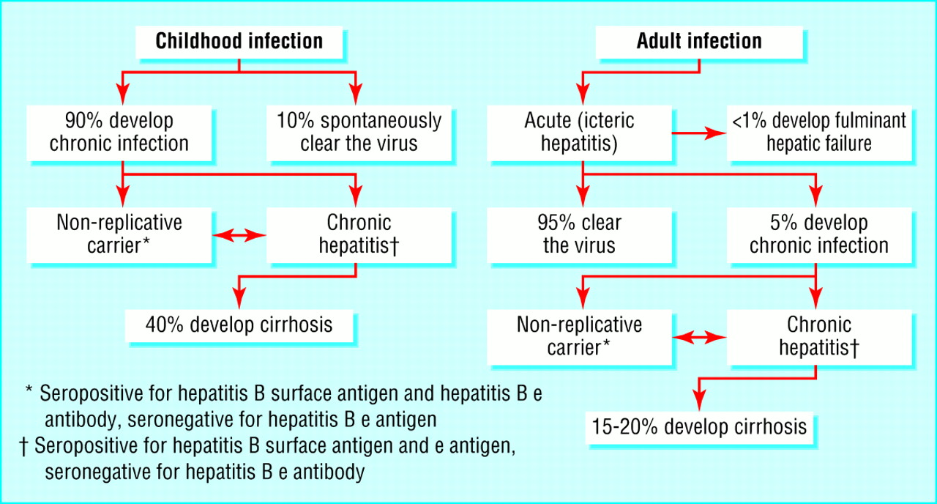
Natural History
  Gow, BMJ 2001

Slide 32
Possible transmission route of HBV in KSA
1-Horisontal transmission (person to person) is the main transmission route
2-Perintal transmission (positive HBSAG mothers) especially if they are HBEAG positive
3- Heterosexual transmission
4-Illegal injection drug use
5- Contaminated equipment used for therapeutic injections and other health care related procedures
6- Folk medicine practice
7-Blood and blood products transfusion without prior screening

Slide 33
HBV INFECTION before and after vaccination program

Slide 34
OVERALL PREVALENCE OF HBsAg AMONG SAUDIS IN THE 80’S ACCORDING TO REGIONS
Positivity (%)
Al-Faleh. Annals of Saudi Medicine, 1988

Slide 35

PREVALENCE OF HBeAg AMONG HBsAg POSITIVE SAUDIS PREGNANT WOMEN (n = 20920)
Al-Faleh, Annals of Saudi Medicine, 1988

Slide 36
FREQUENCY OF HBeAg AMONG HBsAg POSITIVE SAUDI CHILDREN (n=307)
Al-Faleh et al. Journal of Infection, 1992

Slide 37
PREVENTION STRATEGIES OF MINISTRY OF HEALTH IN KSA
Introducing HBV vaccine in EPI program; and
Mandatory screening of blood donors and expatriates.
Vaccination of risk groups.
Health education especially among medical personnel.

Slide 38
History of HBV infection control in KSA
1989
1990
1990-
until now
1990-
until now
Vaccination of
All infants
At birth
Vaccination of
all children
at school entry
vaccination of
All risk groups
mandatory
Screening of all
Expatriates coming
To work in KSA
Notes:
38

Slide 39
THE CURRENT EPI IN THE KINGDOM OF SAUDI ARABIA
At birth BCG + HB1
At 6 weeks DPT1 + OPV1 Hb2
At 3 months DPT2 + OPV2
At 5 months DPT3 + OPV3
At 5months Measles HB3
At 12 months MMR
At 18 months (DPT + OPV) Booster 1
At 4-6 years (DPT + OPV) Booster 2

Slide 40
COMPARISON OF PREVALENCE OF HBsAg AMONG SAUDI CHILDREN IN 1989 (n=4575) AND 1997 (n=5355) – ACCORDING TO AGE
Al Faleh, J Infect 1999

Slide 41
COMPARISON OF PREVALENCE OF HBsAg AMONG SAUDI CHILDREN IN 1989 (n=4575) AND 1997 (n=5355) – ACCORDING TO REGION
Al Faleh, J Infect 1999

Slide 42
Prevalence Of HBsAg Among Saudi Population Before & After Vaccination over 18 y
Before
After
Age
numbers
1-10yr
4575
1-2yr
637
1-12yr
3666
16-18yr
1365
Notes:
42

Slide 43
Long Term Seroconversion Rate Over 18 Years (Anti-HBS)
*
**
***
Age
N
1-2yr
637
1-12yr
3666
16-18yr
1365
* Al Faleh et al Annals of Saudi meds 1993
** Al Faleh et al Journal of infection 1999
*** AlFaleh et al journal of infection2008
Notes:
43

Slide 44
Long-Term protection of HB- vaccine over 18 years ( anti-HBS>10IU/L)(n=1355)
Age
Region
1-2yr
5
1-8yr
13
16-18yr
3
AL Faleh et al, J Infection 2008

Slide 45
CHANGING PATTERNS OF HBsAg POSITIVITY AMONG BLOOD DONORS IN MOH,CENTRAL BLOOD BANK 1994-2005

Slide 46
PREVALENCE OF HBsAg POSITIVITY AMONG BLOOD DONORS IN KKUH FROM 1987 TO 2008

Slide 47
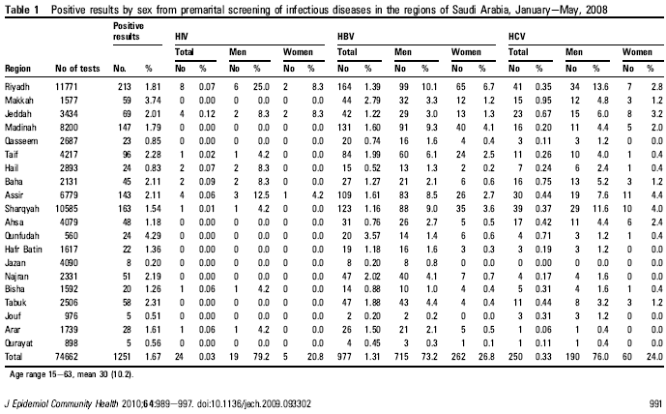

Slide 48
برنامج الزواج الصحيPRI-MARITALSCREENING
التهاب الكبد ب وج 1429-1435هـ HBV,HCV INFECTION FROM2009-2014
عدد المتقدمين NR.OF SCREENDS | HIV | الكبد ج HCV | الكبد ب HBV
2.131.018 | 512 | 5388 | 24103
 | 0.02 % | 0.3% | 1%

Slide 49
عدد حالات التهاب الكبد ب وج1429-1435هـ
NR.OF POSITIVE HBV&HCV CASES(2009-2014)
HCV=RED

Slide 50
HCV INFECTION

Slide 56
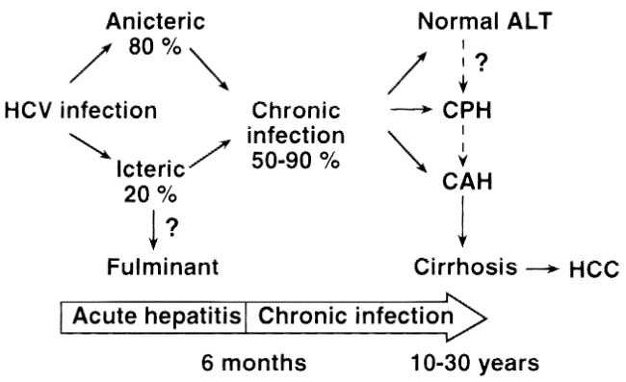
Natural history
Marcellin, J Hepat 1999

Slide 57
Overall prevalence rate of HCV infection in KSA among children and adolescent during the last 18 yrs.
1989 |  | 1997 |  | 2008
No. of children | Positive (%) | No. of children | Positive (%) | No. of students | Positive (%)
4496 | 39* (0.87%) | 5350 | 2** (0.04%) | 1357 | (5)3 0.22%
Diagnostic test only by 1^{st-}generation EIA kit. |  | Diagnostic test by 3rd-generation EIA kit and confirmatory test by RIBA kit. |  | Diagnostic test by PCR for anti- HCV Positive cases.
* ALFaleh et al. Hepatology 1991
** ALFaleh Ann Saudi Med. 2003
Notes:
57

Slide 58
Prevalence of HCV Positivity Among Different Saudi population
Type of patient | number | Prevalence(%)
Children from 1-18y | 3854 | 0.1
Pregnant women | 3127 | 0.7
Hemodialysis patients | 29054 | 55.8
Drug addicts | 9137 | 14
Shobokshi et al , SMJ 2003

Slide 59
Prevention Of HCV Transmission
Avoiding shared use of Razors or brushes and any item that pierces the skin.
Strict adherence of the universal precautions in health facilities.
Educating and training of HCW’s to the proper use of standard precautions
Folk medicine?!

Slide 60
HAV INFECTION

Slide 61
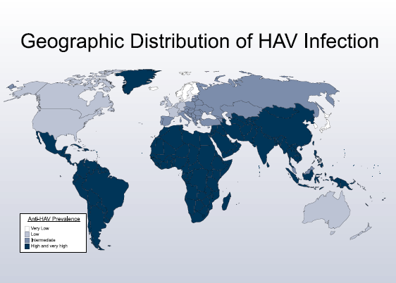

Slide 62
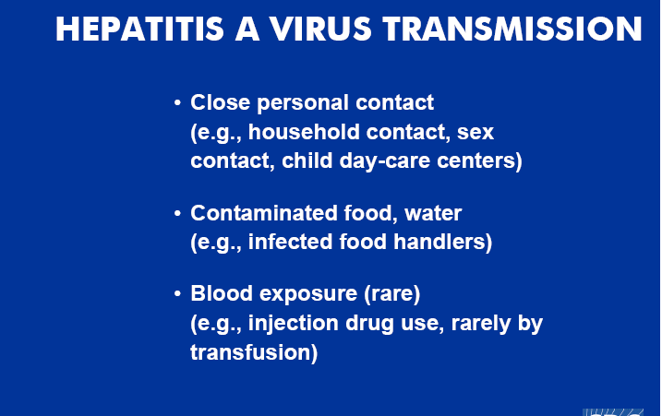

Slide 63
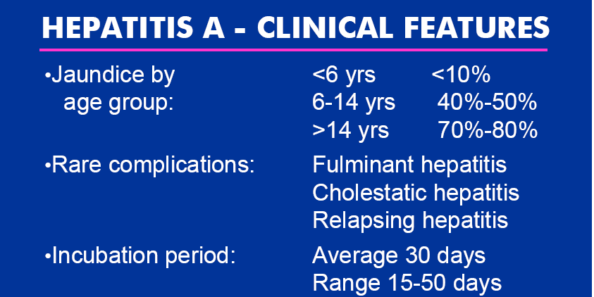

Slide 64
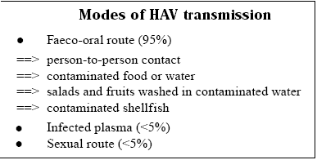

Slide 65
COMPARISON OF PREVALENCE OF ANTI-HAV AMONG SAUDI CHILDREN IN 1989 (n=4375) AND 1997 (n=5255) – ACCORDING TO AGE
Al-Faleh et al. Saudi Med. J, 1999
Notes:
1

Slide 66
COMPARISON OF PREVALENCE OF ANTI-HAV AMONG SAUDI CHILDREN IN 1989 (n=4375) AND 1997 (n=5255) – ACCORDING TO REGION
Notes:
1

Slide 67
PREVALENCE OF ANTI-HAV IN SAUDI CHILDREN IN 1997 ACCORDING TO SEX

Slide 68
PREVALENCE OF ANTI-HAV IN SAUDI CHILDREN IN 1997 ACCORDING TO LOCATION

Slide 69
AGE SPECIFIC PREVALENCE OF ANTI-HAV IN SAUDIS FROM RIYADH, CENTRAL REGION
Age (Years) | 1986 |  | 1994 |  | P
 | No. Positive/ No. Tested | % | No. Positive/ No. Tested | %
1 – 9 | 103/194 | 53.0 | 81/210 | 38.6 | 3.4 x 10.3
10 – 19 | 164/193 | 85.0 | 110/180 | 61.1 | 1 x 10.4
20 – 30 | 182/200 | 91.0 | 188/240 | 78.3 | 3 x 10.4
Total | 449/587 | 76.5 | 379/630 | 60.2 | 1 x 10.4
Arif et al. Saudi J Gastroenterology, 1995

Slide 70
Changing pattern of Hepatitis A prevalence within the Saudi population over 18 yrs
*
**
***
Age
Region
1-10 YRS
13
1-12 yrs
13
16-18 yrs
3
*AlRashed R. Ann SM 1997
** AlFaleh et al SMJ 1999
*** AlFaleh et al WJG 2008
Notes:
70

Slide 71
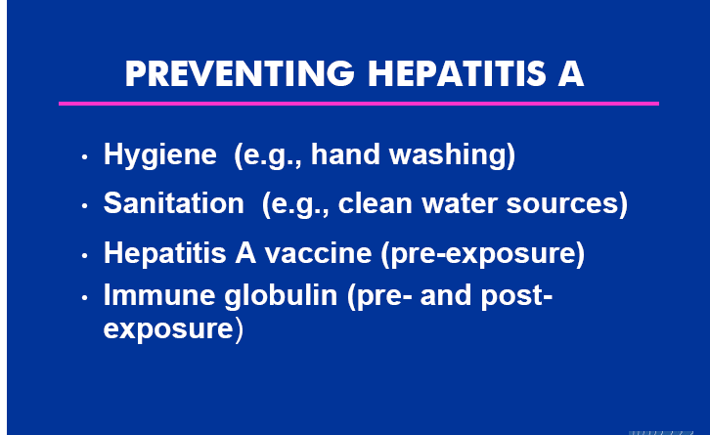

Slide 72
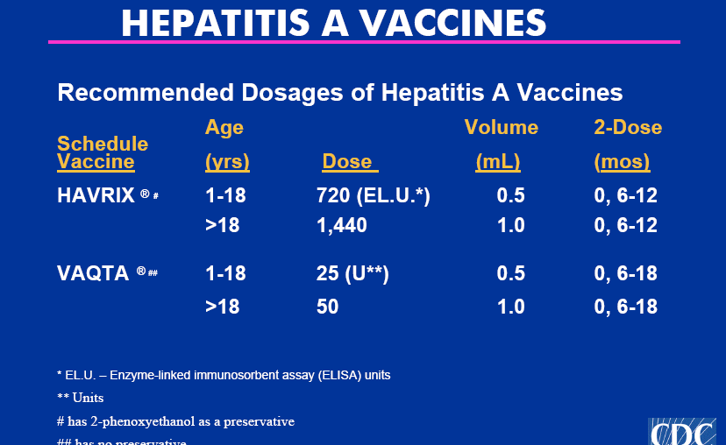

Slide 73
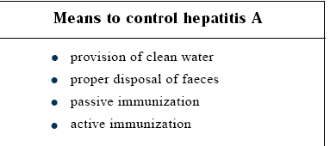

Slide 74
THANK YOU

