Slide 1
Chronic diarrhea and malabsorption
Dr Khalid Alswat, MD, MRCP, FACP
Associate Professor of medicine, consultant gastroenterologist

Slide 2
Objectives
To recognize the definition and different classifications of chronic diarrhea
To understand the mechanism of chronic diarrhea
To learn systematic approach of patient with chronic diarrhea
To understand the different mechanisms and causes of malabsorption
To be able to recognize the clinical manifestation of malabsorption and approach to patient with malabsorption

Slide 3
Case#1
Sarah is 22 Y F c/o non bloody diarrhea for 7 months
6-10 times/ Day
Mild LIF pain
Weight loss 10 kg ( 49 kg -> 39)
O/E cachexia, LIF tenderness ( mild)
Lab ( low hb 8 , low mcv) High ESR and CRP
What is the most likely next STEP?

Slide 4
case#2
Ahmed is 18 years old with fatigue, abdominal bloating and diarrhea for 3 months. Itchy skin rash
Unremarkable physical examination, except pallor and skin rash over thighs
Has low Hb ( low mcv)
Serology : anti TTG ab positive
Most likely diagnosis and second step?

Slide 5
Case #3
Nada is 27 years old F, with intermittent diffuse abd pain and diarrhea for 3 years.
No blood in stool
Diarrhea is triggered by fatty food, no nocturnal diarrhea
Symptoms improved with defecation.
Symptoms free for weeks
Weight and appetite stable
Examination: N
CBC, ESR: N
Most apropriate next step and diagnosis?

Slide 6
Definitions
Diarrhea: decrease in fecal consistency (weight of stool and frequency are not reliable)
Chronic diarrhea: > 4 weeks
Diarrhea is a symptom, not a disease and may occur in many different conditions.
Malabsorption: abnormality in absorption of food nutrients across the gastrointestinal (GI) tract.

Slide 7
Diarrhea
Acute diarrhea is a common and usually transient, self-limited, Infection related
Chromic diarrhea: usually requires work up, non-infectious cause.

Slide 8
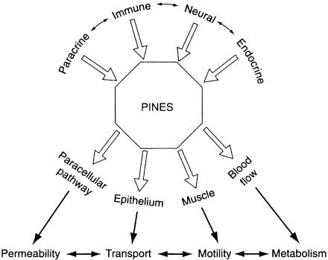
Mechanism of diarrhea
Change in:
Absorption
Secretion
Motility of the gut
->in response to various etiology

Slide 9
Classifications
Time course (acute vs. chronic)
Volume (large vs. small)
Pathophysiology (secretory vs. osmotic)
Stool characteristics (watery vs. fatty vs. inflammatory).
Epidemiology (epidemic vs. travel-related vs. immunosuppression-related)

Slide 11
Other classification
Fatty diarrhea
Inflammatory diarrhea

Slide 12
Common causes of diarrhea
Developing countries
Developed countries
Chronic bacterial
Mycobacterial
Parasitic infections
Then
Functional disorders,
Malabsorption
Inflammatory bowel disease
Irritable bowel syndrome (IBS)
Inflammatory bowel disease (IBD)
Malabsorption syndromes (such as lactose intolerance and celiac disease)
Chronic infections (particularly in patients who are immunocompromised)

Slide 13
Chronic diarrhea and malabsorption
Dr Khalid Alswat, MD, MRCP, FACP
Associate Professor of medicine, consultant gastroenterologist

Slide 14
Approach to patient with diarrhea
History
Physical examination
Investigations
Laboratory tests
Radiology
Endoscopy
Management

Slide 15
History
Main Symptom | Consistency or frequency of stools, the presence of urgency or fecal soiling)
Duration | Acute or chronic ( weeks)
Stool characteristics | Greasy stools that float and are malodorous may suggest fat malabsorption while the presence of visible blood may suggest inflammatory bowel disease
Volume of the diarrhea | voluminous watery diarrhea is more likely to be due to a disorder in the small bowel while small-volume frequent diarrhea is more likely to be due to disorders of the colon
Specific food | Fatty , diary, allergy to certain food
Change with fasting or night | Secretory , IBS

Slide 16
History …
Specific food | Fatty , diary, allergy to certain food
Associated symptoms | ABD PAIN, Weight loss, appetite change Extra-intestinal manifestation ( rash, arthritis. Mouth ulcers etc..)
History of travel | Travelers diarrhea, parasitic etc…
Drug hx | Antibiotic use, others
F Hx | Of GI illnesses
Systemic review | e.g endocrine causes , thyroid, DM, Addison

Slide 17
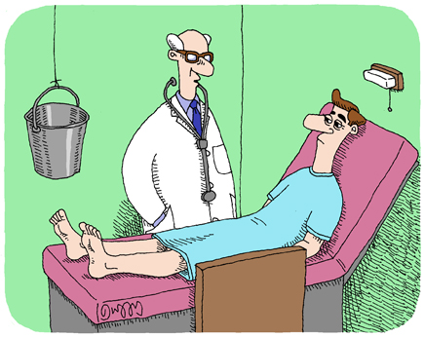
Physical examination
Rarely provides a specific diagnosis.
Findings suggestive of IBD (eg, mouth ulcers, a skin rash, episcleritis, an anal fissure or fistula, the presence of visible or occult blood on digital examination, abdominal masses or abdominal pain)
Evidence of malabsorption (wasting, physical signs of anemia, scars indicating prior abdominal surgery)
Lymphadenopathy (possibly suggesting, lymphoma, HIV infection)
Palpation of the thyroid and examination for exophthalmos and lid retraction may provide support for a diagnosis of hyperthyroidism

Slide 18
Investigations are GUIDED BY Hx and Ph Exam (essentials)
CBC
ESR
Electrolytes
Total protein and albumin
TFT
Stool : occult blood, C/S, ova and parasites, C-D toxin (if hx suggestive)

Slide 19
Specific investigations
The history and physical examination may point toward a specific diagnosis for which testing may be indicated

Slide 20
Malabsorption

Slide 21
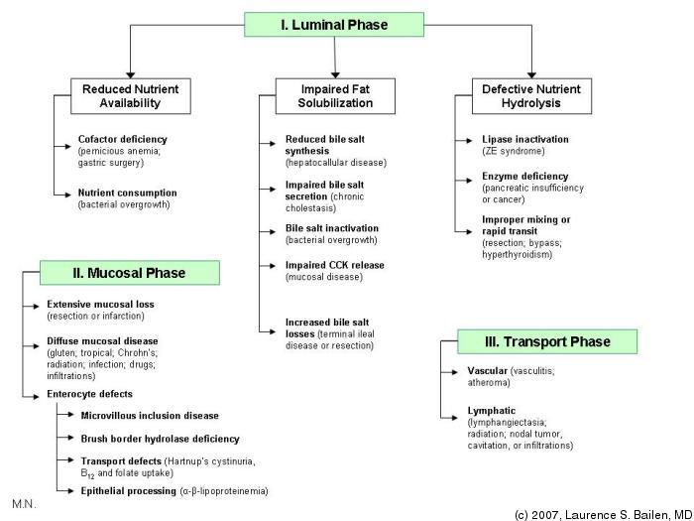

Slide 22
Clinical features
Depend upon the cause and severity of the disease
Malabsorption may either be global or partial (isolated).
Global malabsorption: results from diseases associated with either diffuse mucosal involvement or a reduced absorptive surface
An example is celiac disease in which diffuse mucosal disease can lead to impaired absorption of almost all nutrients
Partial or isolated malabsorption: results from diseases that interfere with the absorption of specific nutrients.
Defective cobalamin absorption, for example, can be seen in patients with pernicious anemia or those with disease (or resection) of the terminal ileum such as patients with Crohn's disease.

Slide 23
Signs and symptoms of malabsorption
Malabsorption of | Clinical features | Laboratory findings
Calories | Weight loss with normal appetite
Fat | Pale and voluminous stool, diarrhea without flatulence, steatorrhea | Stool fat >6 g/day
Protein | Edema, muscle atrophy, amenorrhea | Hypoalbuminemia, hypoproteinemia
Carbohydrates | Watery diarrhea, flatulence, acidic stool pH, milk intolerance, stool osmotic gap | Increased breath hydrogen
Vitamin B12 | Anemia, subacute combined degeneration of the spinal cord (early symptoms are paresthesias and ataxia associated with loss of vibration and position sense) | Macrocytic anemia, vitamin B12 decreased, abnormal Schilling test, serum methylmalonic acid and homocysteine increased

Slide 24
Signs and symptoms of malabsorption….
Malabsorption of | Clinical features | Laboratory findings
Folic acid | Anemia | Macrocytic anemia, serum and RBC folate decreased, serum homocysteine increased
Vitamin B, general | Cheilosis, painless glossitis, acrodermatitis, angular stomatitis
Iron | Microcytic anemia, glossitis, pagophagia | Serum iron and ferritin decreased, total iron binding capacity increased
Calcium and vitamin D | Paresthesia, tetany, pathologic fractures due to osteomalacia, positive Chvostek and Trousseau signs | Hypocalcemia, serum alkaline phosphatase increased, abnormal bone densitometry
Vitamin A | Follicular hyperkeratosis, night blindness | Serum retinol decreased
Vitamin K | Hematoma, bleeding disorders | Prolonged prothrombin time, vitamin K-dependent coagulation factors decreased

Slide 25
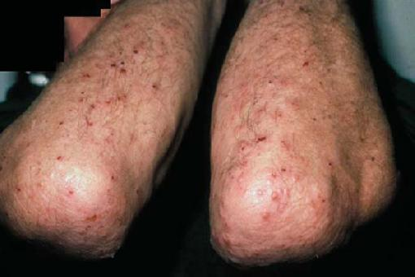
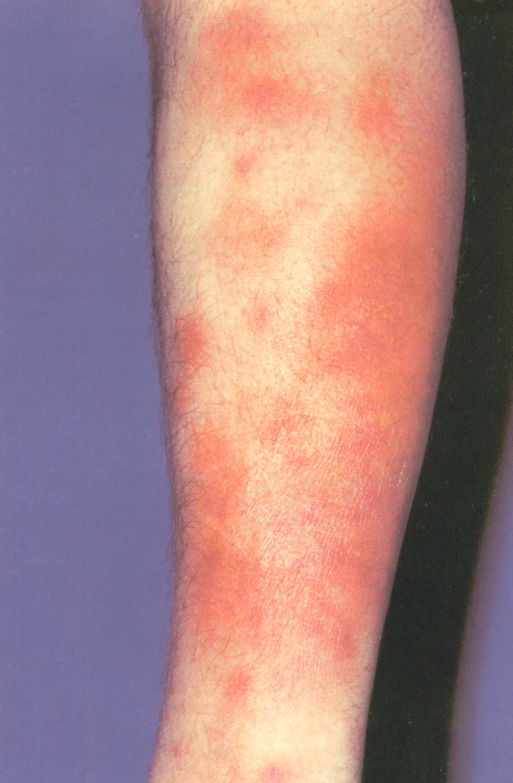
Example of Manifestations associated with celiac disease
Dermatological manifestations
Pale skin
Neurological examination
Motor weakness, peripheral neuropathy, or ataxia may be present.
The Chvosteks sign or the Trousseau sign may be evident due to hypocalcemia .

Slide 26
Investigation for malabsorption
Investigations for nutrients deficiency
Specific investigations to define the etiology and severity

Slide 27
Examples of investigations
Common lab: CBC , ESR, CRP, PT, INR, LFT
Serology: Anti TTG ( anti endomysial ab)
Endoscopy
Imaging

Slide 28
Serology
No specific serology tests for all causes of malabsorption
Serum Anti-TTG and antiendomysial antibodies can be used to help diagnose celiac sprue.
Determination of fecal elastase and chymotrypsin can be used to try to distinguish between pancreatic causes and intestinal causes of malabsorption.

Slide 29
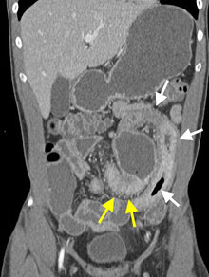
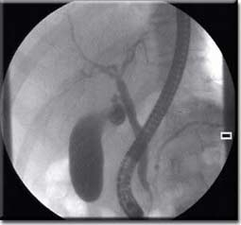
Iamging
Small bowel barium studies .
Strictures
Mucosal changes
Diverticula
CT scan of the abdomen
Strictures
Mucosal changes
Diverticula
Wall thickness
Massesss, lymph nodes
ERCP: pancreatitis (duct changes) ,
biliary doseases

Slide 30
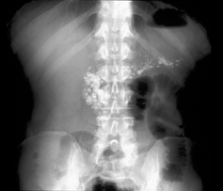
Imaging Studies
Plain abdominal x-ray film: Pancreatic calcifications are indicative of chronic pancreatitis.

Slide 31
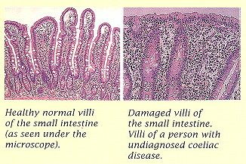
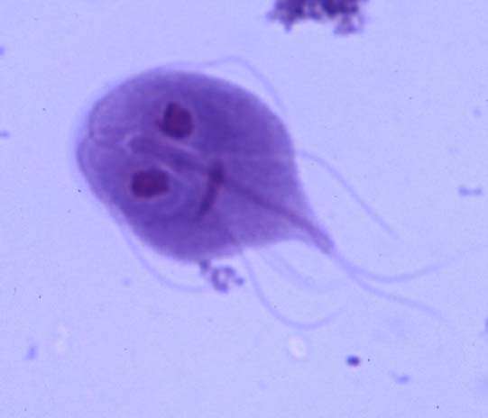
Endoscopy
Upper endoscopy with small bowel mucosal biopsy…. Examples
Celiac sprue
Giardiasis
Crohn disease
Whipple disease
Amyloidosis
Lymphoma.
Lower GI endoscopy: colonic and terminal ileal pathology ( e.g Chrons disease)

Slide 32
Treatment
Treatment of causative diseases
A gluten-free diet helps treat celiac disease.
Similarly, a lactose-free diet
Protease and lipase supplements are the therapy for pancreatic insufficiency.
Antibiotics are the therapy for bacterial overgrowth.
Corticosteroids, anti-inflammatory agents, such as mesalamine, and other therapies are used to treat CD

Slide 33
Nutritional support
Supplementing various minerals calcium, magnesium, iron, and vitamins
Caloric and protein replacement also is essential.
Medium-chain triglycerides can be used for lymphatic obstruction .
In severe intestinal disease, such as massive resection and extensive regional enteritis, parenteral nutrition may become necessary

Slide 34
Thank You
Additional essential reading…..

Slide 35
Secretory DIARRHEA CLUES: Large volume ( >1 L/d); little change with fasting; normal or low stool osmotic gap
Bacterial toxins
Inflammatory bowel disease
Crohn's disease
Ulcerative colitis
Microscopic colitis
Collagenous colitis
Lymphocytic colitis
Vasculitis
Endocrinopathies
Addison's disease
Carcinoid syndrome
Hyperthyroidism
Medullary carcinoma of the thyroid
Pheochromocytoma
Gastrinoma, Somatostatinoma , VIPoma
Disordered motility
Diabetic autonomic neuropathy
Irritable bowel syndrome
Postsympathectomy diarrhea
Postvagotomy diarrhea
Ileal bile acid malabsorption
Laxative abuse (stimulant laxatives)
Medications and toxins
Neoplasia
Colon carcinoma
Lymphoma
Villous adenoma in rectum
Congenital syndromes (e.g., congenital chloridorrhea)
Idiopathic

Slide 36
OSMOTIC DIARRHEA CLUES: Stool volume decreases with fasting increased stool osmotic gap

Slide 37
INFLAMMATORY DIARRHEA
Inflammatory bowel disease
Ulcerative colitis
Crohn's disease
Infectious diseases
Invasive bacterial infections (e.g., tuberculosis, yersiniosis)
Invasive parasitic infections (e.g., amebiasis, strongyloidiasis)
Pseudomembranous colitis (Clostridium difficile infection)
Ulcerating viral infections (e.g., cytomegalovirus, herpes simplex virus)
Ischemic colitis
Radiation colitis
Neoplasia
Colon cancer
Lymphoma

Slide 38
FATTY DIARRHEA
Malabsorption syndromes
Mucosal diseases
Short bowel syndrome Postresection diarrhea
Small bowel bacterial overgrowth
Mesenteric ischemia
Maldigestion:
Pancreatic exocrine insufficiency
Inadequate luminal bile acid

Slide 39
Phases of absorption
Luminal phase: dietary fats, proteins, and carbohydrates are hydrolyzed and solubilized by secreted digestive enzymes and bile.
Mucosal phase: relies on the integrity of the brush-border membrane of intestinal epithelial cells to transport digested products from the lumen into the cells.
Postabsorptive phase: nutrients are transported via lymphatics and portal circulation from epithelial cells to other parts of the body.

Slide 40
Luminal phase
Phase and nature of malabsorptive defect | Example
A. Substrate hydrolysis
1. Digestive enzyme deficiency | Chronic pancreatitis
2. Digestive enzyme inactivation | Zollinger-Ellison syndrome
3. Dyssynchrony of enzyme release, inadequate mixing | Post Billroth II procedure
B. Fat solubilization
1. Diminished bile salt synthesis | Cirrhosis
2. Impaired bile secretion | Chronic cholestasis
3. Bile salt de-conjugation | Bacterial overgrowth
4. Increased bile salt loss | Ileal disease or resection
C. Luminal availability of specific nutrients
1. Diminished gastric acid | Atrophic gastritis - vitamin B12
2. Diminished intrinsic factor | Pernicious anemia - vitamin B12
3. Bacterial consumption of nutrients | Bacterial overgrowth - vitamin B12

Slide 41
Mucosal (absorptive) phase
Phase and nature of malabsorptive defect | Example
A. Brush border hydrolysis*
1. Congenital disaccharidase defect | Sucrase-isomaltase deficiency
2. Acquired disaccharidase defect | Lactase deficiency
B. Epithelial transport
1. Nutrient-specific defects in transport | Hartnup's disease
2. Global defects in transport | Celiac sprue
(a) decreased absorptive surface area | intestinal resection
(b) damaged absorbing surface | celiac sprue, tropical sprue, giardiasis, Crohn disease, AIDS enteropathy, chemotherapy, or radiation therapy;
(c) infiltrating disease of the intestinal wall | lymphoma and amyloidosis
* This process is sometimes considered as part of the luminal phase.

Slide 42
Postabsorptive, processing phase
Phase and nature of malabsorptive defect | Example
A. Enterocyte processing | Abetalipoproteinemia
B. Obstruction of Lymphatic | Both congenital (e.g. intestinal lymphangiectasia)
 | Acquired (e.g. Whipple diseases , lymphoma, tuberculosis),

Slide 43
Lab Studies
Hematological tests
A CBC
Serum iron, vitamin B-12, and folate
Prothrombin time.
Electrolytes and chemistries
Hypokalemia, hypocalcemia, hypomagnesemia, and metabolic acidosis.
Protein malabsorption may cause hypoproteinemia and hypoalbuminemia.
Fat malabsorption can lead to low serum levels of triglycerides, cholesterol
ESR which is elevated in inflammatory diseases like Crohn disease and Whipple disease

Slide 44
Stool analysis
Stool pH may be assessed. Values of <5.6 are consistent with carbohydrate malabsorption
Stool C/S
Pus cells in the stool e.g IBD, some infections

Slide 45
Tests of fat malabsorption
For a quantitative measurement of fat absorption, a 72-hour fecal fat collection
Qualitative test Sudan III stain of stool, less reliable.

Slide 46
Stool → fat →pancreatic, celiac
inflammatory --→ IBD ,infection

Slide 48
Schilling test
Malabsorption of vitamin B-12 may occur as a consequence of:
Deficiency of intrinsic factor (eg, pernicious anemia, gastric resection)
Pancreatic insufficiency, bacterial overgrowth
Ileal resection, or disease.

Slide 49
3 STEPS SCHILLING TEST
1. Oral VIT B12
2. VIT B12 orally +intrinsic factor
3. VIT B12 orally +intrinsic factor+ oral antibiotics

Slide 50
Bacterial overgrowth
Bacterial overgrowth cause an early rise in breath hydrogen
JEUJENAL CULTURE
14c D–xylose breath test ,high sensitivity and specificity

