Slide 1
Radiological Anatomy of Kidneys, Ureters, Urinary Bladder and urethra
NIZAR A. AL-NAKSHABANDI. MD, FRCPC
PROFESSOR OF RADIOLOGY

Slide 2
Objectives
To know the anatomic location and sizes of the structures of the urinary tract
To know the different types of modalities used in imaging the urinary tract
To identify the kidneys, ureters, urinary bladder and urethra on different imaging modalities

Slide 3
Genitourinary System
Kidneys are retroperitoneal organs
Their function is to maintain electrolyte homeostasis and waste excretion
They empty medially into the ureters
Ureters course inferiorly into the pelvis and enter the urinary bladder
The urine is temporarily stored in the urinary bladder till it is cleared to the exterior through the urethra

Slide 4
Imaging Modalities
Plain X-Ray
Intravenous Pyelogram
Retrograde Pyelogram
CT Scan
Ultrasound
Renal Angiography
Renal Scintigraphy
Cystography
Voiding Cystourethrography

Slide 5
Kidneys
On either side of the lower thoracic and upper lumbar spine
Usual location – between upper border of 11th thoracic vertebra and lower border of 3rd lumbar vertebra
In upright position the kidneys descend by 2 or 3 cm
Both kidneys move with respiration

Slide 8
Kidneys are retroperitoneal organs and may be obscured by bowel loops

Slide 9
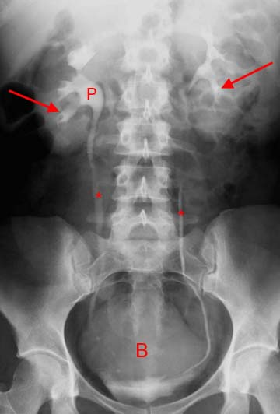

Slide 10
Kidneys
Right kidney is 2 cm lower than the left kidney
Long axis of the kidneys is directed downward and outward, parallel to the lateral border of the psoas muscles
In lateral plane, the axis is directed downward and anteriorly
Lower pole is 2-3 cm anterior to the upper pole

Slide 11
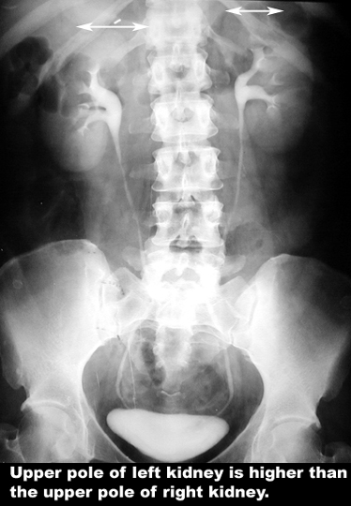

Slide 12
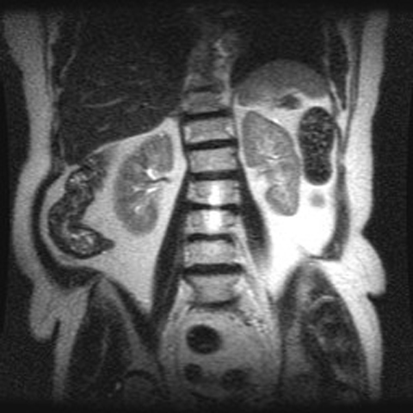
MRI showing Left Kidney is higher than Right Kidney

Slide 13
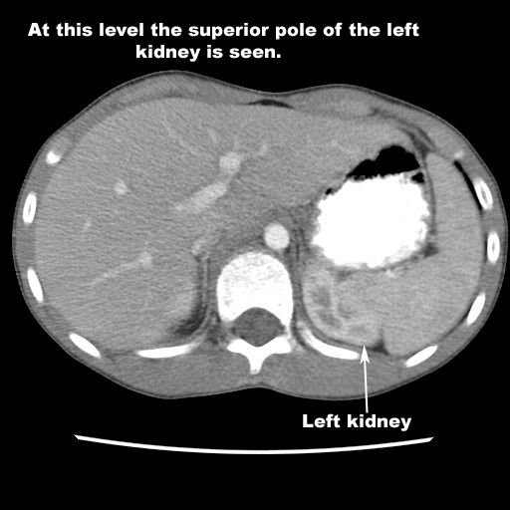
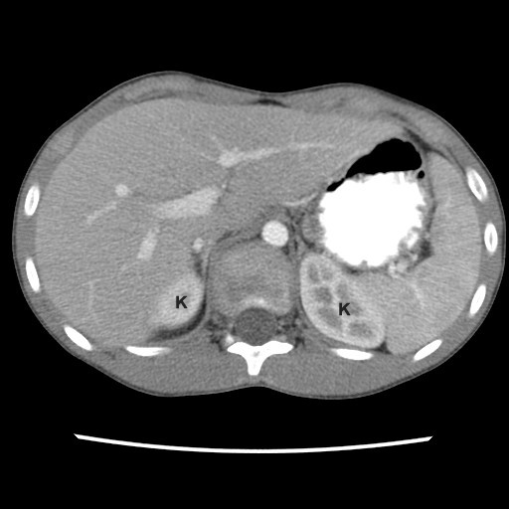
CT Scan showing left kidney higher than right

Slide 14
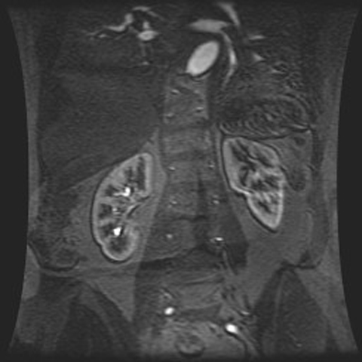
Long axis of the kidneys is directed downward and outward, parallel to the lateral border of the psoas muscles

Slide 15
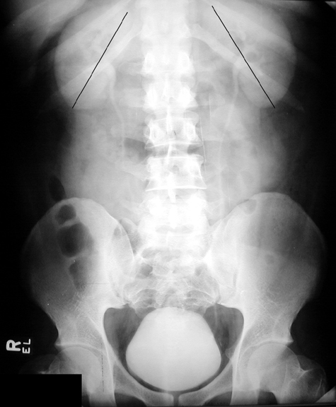
Long axis of the kidneys is directed downward and outward, parallel to the lateral border of the psoas muscles

Slide 16
Kidneys
Normal size – in adults 11 cm
Right kidney is shorter than left kidney by not more than 1.5 cm
As a rule – the length of the kidney is 3.7 +/- 0.37 times the height of the 2nd lumbar vertebra measured on the same film using the posterior margin of the vertebral body

Slide 17
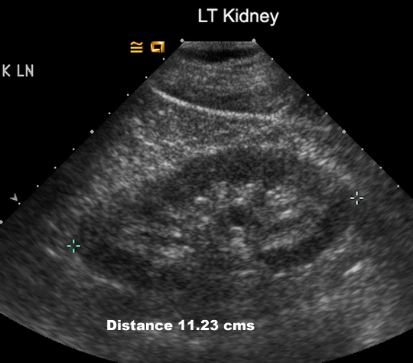
Ultrasound is the best method to measure the size of the Kidney

Slide 18
Kidneys
Bean shaped structure
There may be fetal lobulations – present as notches on the lateral aspect of the kidneys
Local bulge or convexity may be seen along the lateral aspect of left kidney – called dromedary hump
This may be either due to impression of the spleen or fetal lobulation or both

Slide 20
Kidneys
Kidneys are visualized on the X-Ray due to presence of perirenal fat
Kidneys are contained within the renal capsule and surrounded by perirenal fat and enclosed within the Gerota’s fascia
Perirenal hemorrhage, pus and urine are contained within the fascia and detected on CT and Ultrasonography
A layer of paranephric fat surrounds and cushions the kidneys

Slide 21
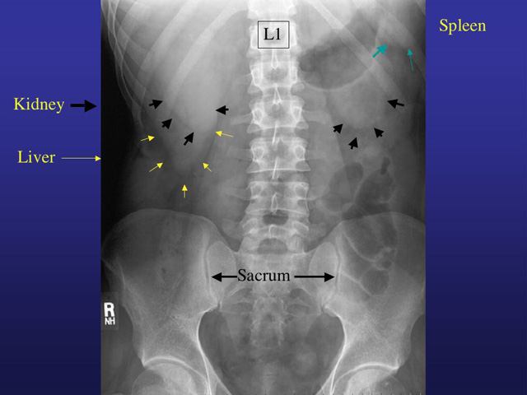

Slide 22
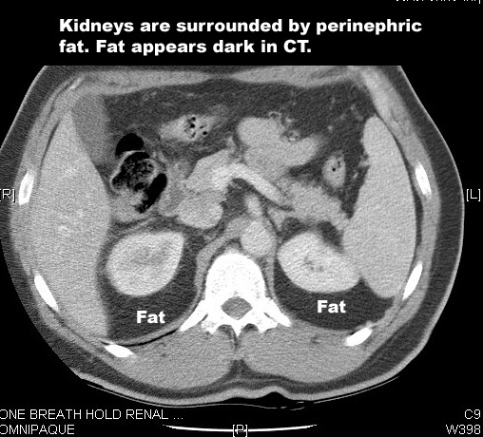

Slide 23
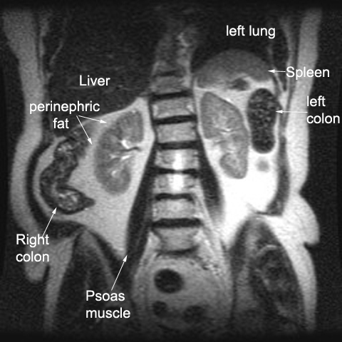

Slide 24
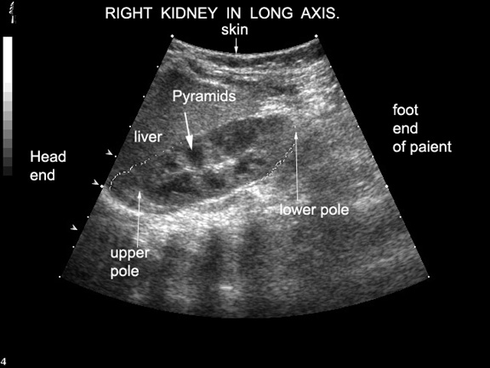
Ultrasound of Right Kidney

Slide 25
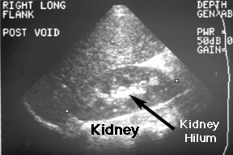
ULTRASOUND OF KIDNEYS

Slide 26
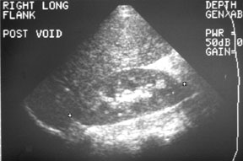
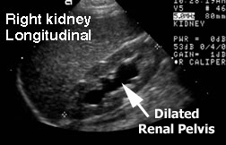
ULTRASOUND OF KIDNEYS
NORMAL STUDY
DILATED RENAL PELVIS

Slide 27
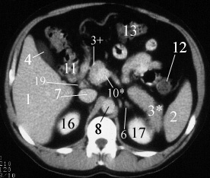
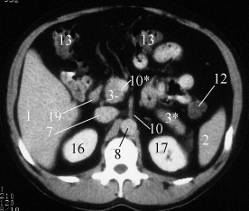
CT Scan of the Kidneys

Slide 28
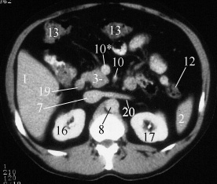
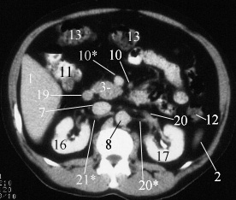
CT Scan of the Kidneys

Slide 29
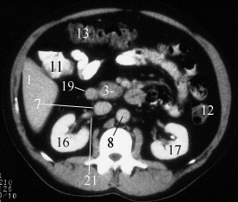
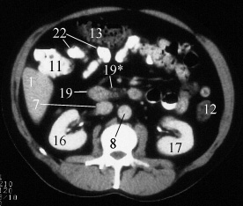
CT Scan of the Kidneys

Slide 30
Spaces Around the Kidney
Perirenal Space – bounded by the leaves of the Gerota’s fascia
The leaves fuse superiorly, laterally and medially
It encloses the kidneys, adrenal glands, renal vasculature and proximal ureter
The fascial envelope is functionally open caudally just above the pelvic brim
Ureter emerges from the perirenal space and traverses caudad in anterior pararenal space

Slide 31
Spaces Around the Kidney
Anterior Pararenal Space- bounded
Posteriorly by the anterior portion of the renal fascia,
Anteriorly by the posterior parietal peritoneum
Laterally by the lateral conal fascia
Contains – pancreas, 2nd,3rd and 4th portions of the duodenum, ascending and descending colon, vascular supply to the spleen, liver, pancreas and duodenum

Slide 32
Spaces Around the Kidney
Posterior Pararenal Space – is bounded
Posteriorly by the transversalis fascia
Anteriorly by the posterior portion of Gerota’s fascia
Contains only fat, scattered vessels and nerves
All three spaces potentially communicate at the pelvic brim

Slide 33
Renal Vasculature

Slide 34
Renal Vasculature
There are many variations of the renal vasculature
Renal arteries branch from the abdominal aorta laterally between L1 and L2, below the origin of the superior mesenteric artery
The right renal artery passes posterior to the IVC
There may be more than one renal artery (on one or both sides) in 20-30% cases

Slide 35
Renal Vasculature
Renal veins drain into inferior vena cava
Renal veins lie anterior to the arteries
Left renal vein is longer and passes anterior to the aorta before draining into the inferior vena cava
The left gonadal vein will drain into to left renal vein while the right gonadal vein drains directly into the inferior vena cava
Common variants include retroaortic and circumaortic left renal veins

Slide 36
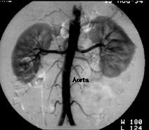
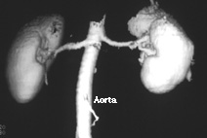
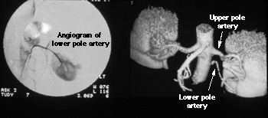
RENAL ANGIOGRAPHY
NORMAL SUPPLY OF BOTH KIDNEYS BY SINGLE RENAL ARTERY
LEFT KIDNEY SUPPLIED BY TWO RENAL ARTERIES

Slide 37
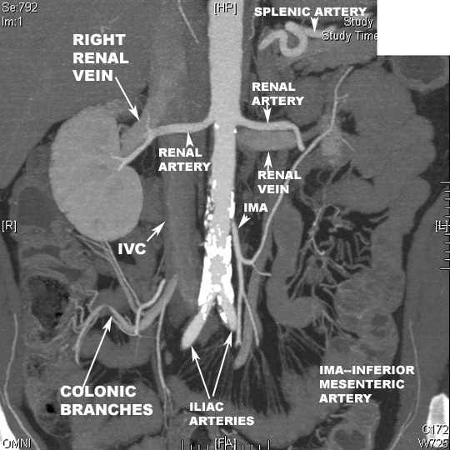

Slide 38
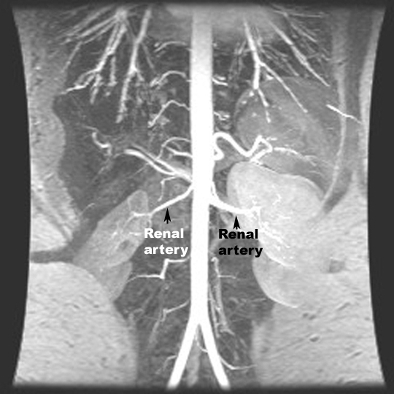

Slide 39
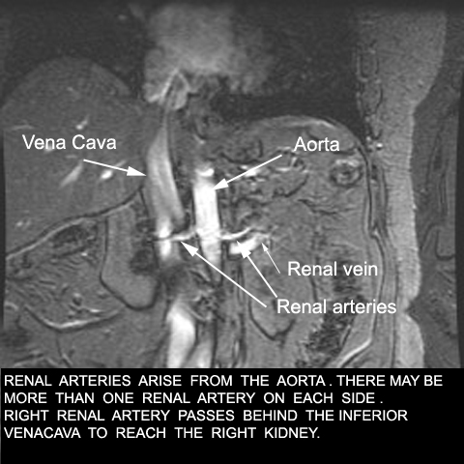

Slide 40
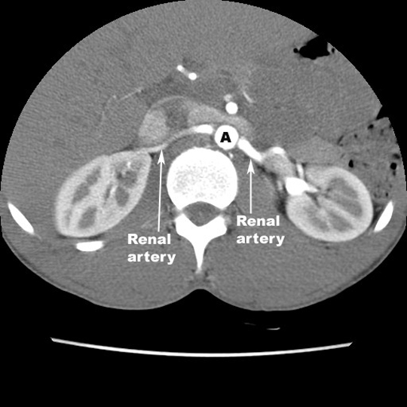
Inferior Vena Cava

Slide 41
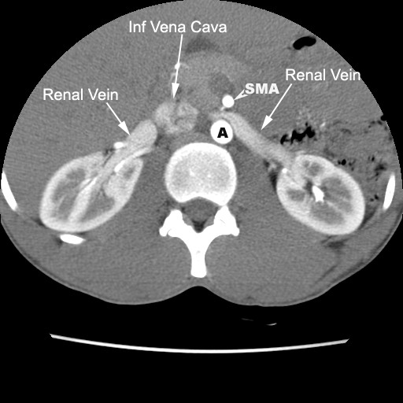
Left Renal Vein Passes Anterior to the Abdominal Aorta

Slide 42
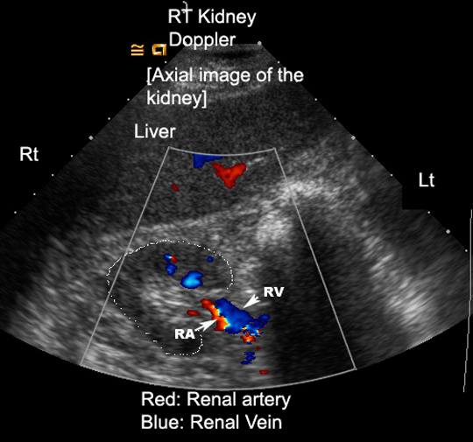
Renal Veins Lie Anterior to the Arteries

Slide 43
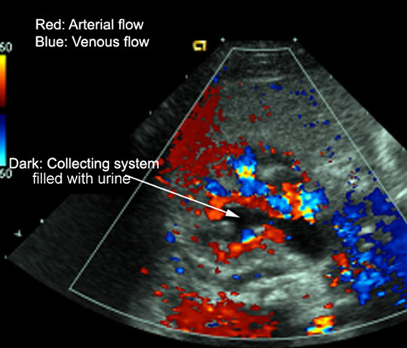

Slide 44
Relationships of the Kidneys

Slide 45
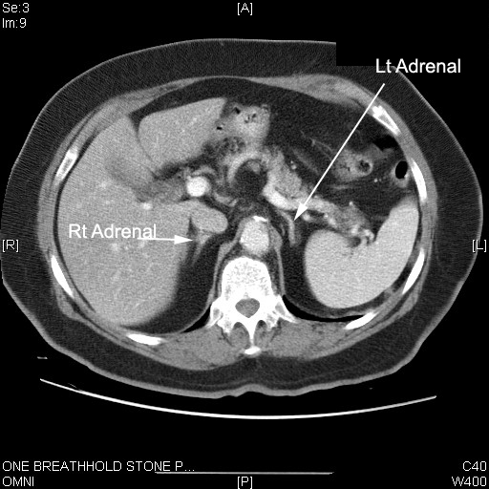
Adrenal Glands are superior to the Kidneys

Slide 46
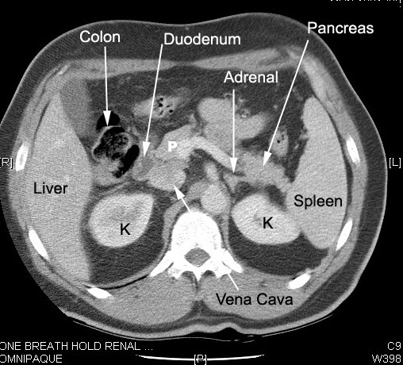

Slide 47
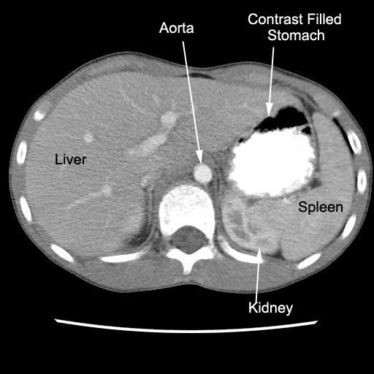

Slide 48
Renal Structure
Thin capsule
Renal cortex
Renal cortex consists of glomeruli and renal tubules
Normal thickness is 2.5 cms
Renal Medulla
Consists of multiple renal pyramids which have their base to the periphery and their conical end directed towards the renal hilum
Their tips are called papillae
Each minor calyx receives 1-3 papillae

Slide 49
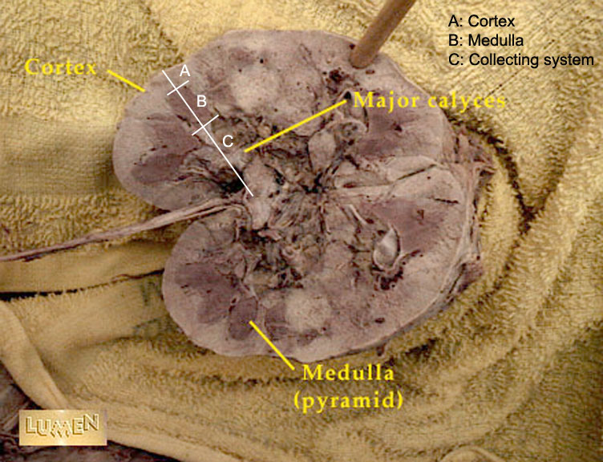
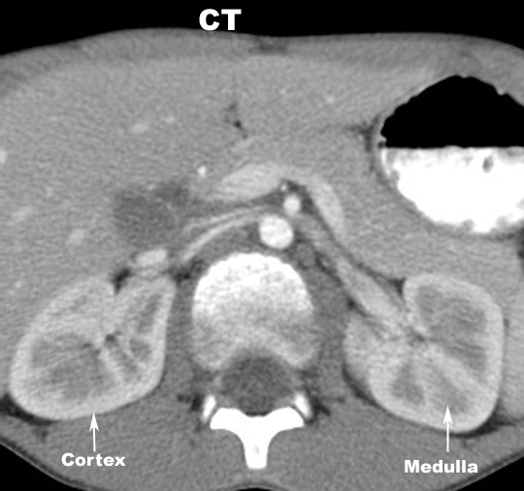

Slide 50
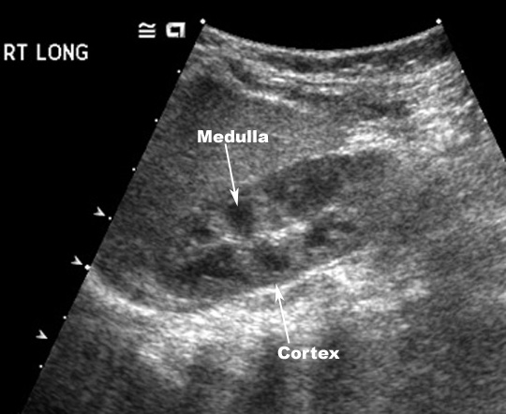
Ultrasound of Right Kidney

Slide 51
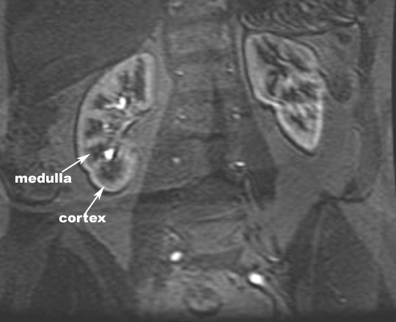
MRI of Kidneys

Slide 52
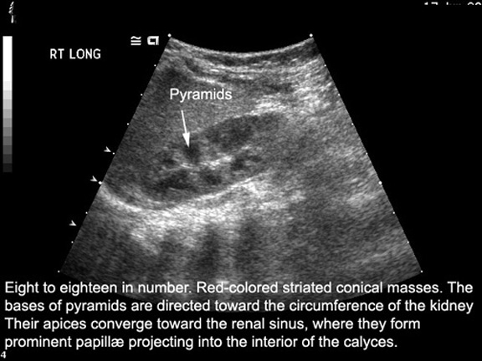

Slide 53
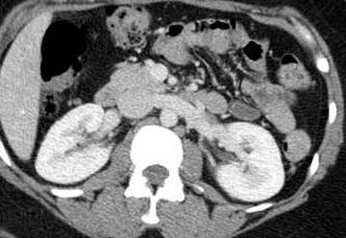
Contrast enhanced CT scan through the kidneys in nephrogram phase (showing corticomedullary differentiation)
This is approximately 100 seconds following contrast administration and would show renal lesions well

Slide 54
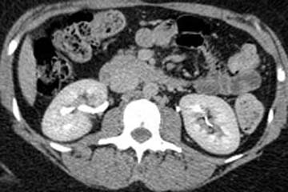
Contrast enhanced CT scan through the kidneys in pyelogram phase (showing excretion of contrast into the collecting system)
This is approximately 8 minutes following contrast administration and would show urothelial lesions well, such as transitional cell carcinoma, stones, blood clot

Slide 55
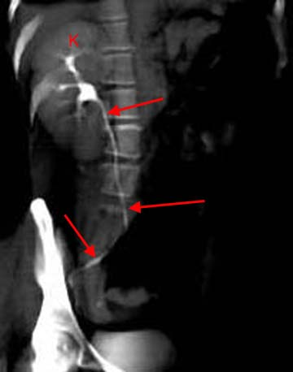
3D reconstructed image from CT scan of the abdomen and pelvis known as CT IVP
This exam is quickly replacing the conventional IV Urogram
3D reconstruction is performed through the right kidney (K) and follows the normal ureter (arrows) all the way to the ureter's insertion into the bladder

Slide 56
Renal Collecting System
Calyces
Medulla sits in the fornix of the minor calyx
Fornix is sharp and concave
Papillae drain into minor calyces
Minor calyces coalesce to form 3 or 4 major calyces
Major calyces combine to form the pelvis

Slide 57
Renal Collecting System
Pelvis
broad dilated part of the urine collecting system, located in the hilum
renal pelvis drains into the ureter

Slide 58
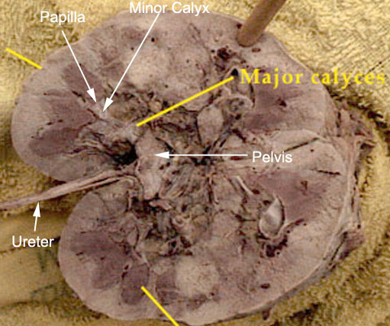

Slide 59
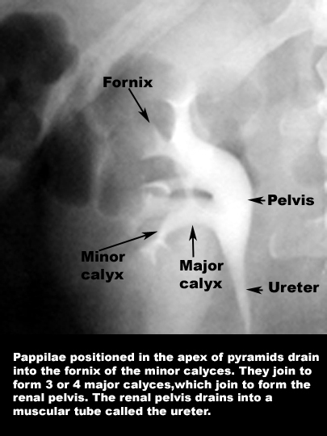

Slide 60
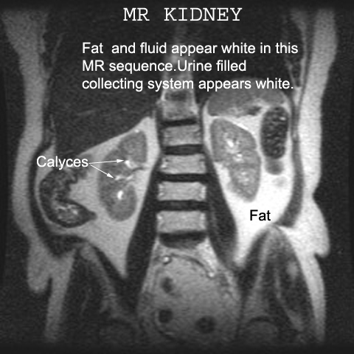

Slide 61
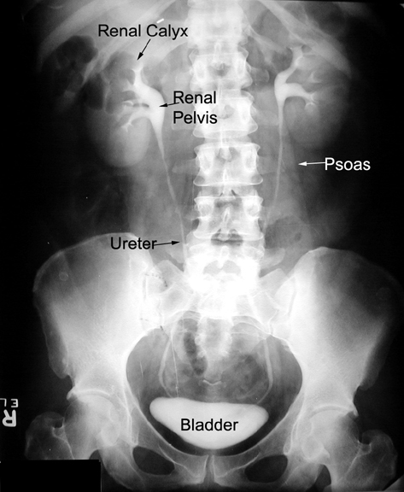

Slide 62
Ureters

Slide 63
Ureters
25-30 cm in length and 3 mm diameter
Course downwards from the most dependent portion of the pelves to the midsacral region
Then turn posterolaterally and course in an arc downwards
Then inward and anteriorly to enter the trigone of the bladder on either side of the midline

Slide 64
Areas of Narrowing
Three areas of normal narrowing:
Ureteropelvic Junction
Bifurcation of the iliac vessels
Ureterovesicle Junction

Slide 65
Ureteral Vasculature
Blood is supplied by the ureteral branches of renal and testicular or ovarian arteries, and abdominal aorta
Renal and testicular or ovarian veins supply venous drainage

Slide 66
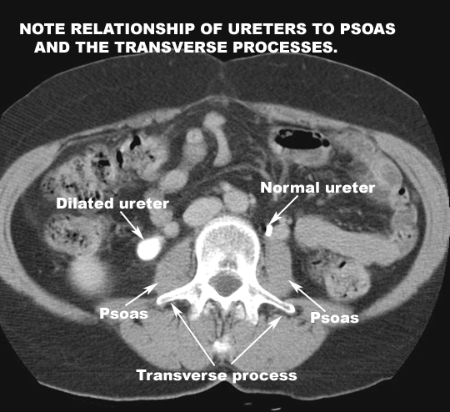

Slide 67
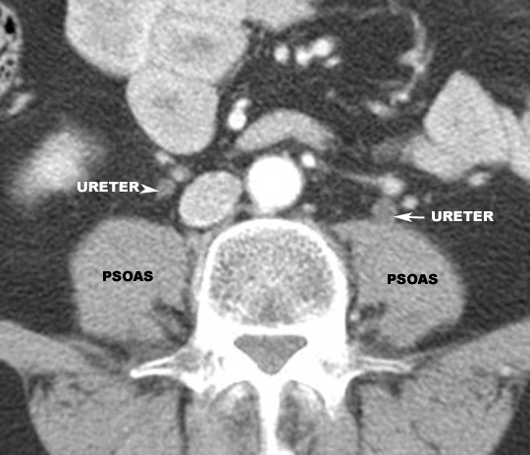

Slide 68
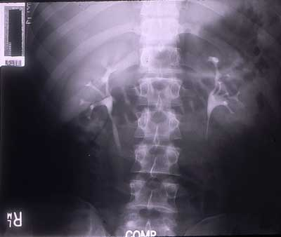
INTRAVENOUS PYELOGRAM

Slide 69
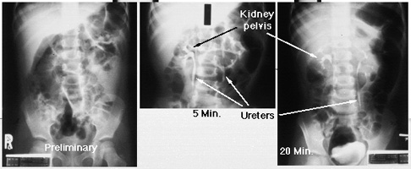
INTRAVENOUS PYELOGRAM
NORMAL STUDY

Slide 70
Urinary Bladder

Slide 71
Urinary Bladder
Hollow muscular vesicle for storing urine temporarily
Bladder is higher in position in children and slightly higher in males than females
It is relatively larger in children than in adults

Slide 72
Urinary Bladder
Size and shape vary considerably
Shape – tetrahedral when empty
transversely oval or round when full
When empty, it is completely within the pelvis
Inferior aspect projects 5-10 mm above the symphysis pubis
Separated from pubic bones by retropubic space
Floor is parallel to superior aspect of the pubic rami
Dome is rounded in male and flat or slightly concave in female

Slide 73
Urinary Bladder
Neck of bladder - lies 3-4 cm behind lower part of symphysis pubis and rests on the prostate in the male
It has the urethral orifice
In females the peritoneum is reflected from the superior surface of the bladder to the anterior wall of the uterus at the junction between the body and cervix
The enclosed space is the vesicouterine pouch

Slide 74
Urinary Bladder
In males the peritoneum is reflected from the bladder to the superior surfaces of the ductus deferens and seminal vesicles
Bladder is relatively free to move except at the neck which is fixed by the puboprostatic ligaments (males) and pubovesicle ligaments (females)
Peritoneal reflection - Rectovesicle pouch in males and vesicouterine and rectouterine pouch in females

Slide 75
Anatomy of Female Pelvis showing the Urinary Bladder

Slide 76
MRI of Female Pelvis

Slide 80
Anatomy of Male Pelvis showing the Urinary Bladder

Slide 81
Voiding Cystourethrogram

Slide 82
Urinary Bladder
Unenhanced CT scan through a normal bladder (B) shows a normal fluid density structure (less than 10 Hounsfield units on CT density scale)

Slide 83
Urinary Bladder
3D reconstructed image of a normal bladder in the sagittal plane following CT IVP
This is delayed image 10 minutes following IV contrast administration, excreted contrast fills an otherwise normal bladder (B)

Slide 84
Urinary Bladder
Transverse image through a normal bladder (calipers "x" and "+" outline the bladder wall) using ultrasound shows normal anechoic structure (anechoic = no echoes = black)

Slide 85
Prostate Gland

Slide 86
Prostate Gland
Largest accessory gland of male reproductive system
Partly glandular and partly fibromuscular
Lies around the first part of the urethra at the base of the bladder
(Tr) 4 cm x 3 cm (height) x 2 cm (AP) in size
Lies behind the symphysis pelvis

Slide 87
Prostate Gland
Surrounded by dense fibrous capsule
Enclosed within a loose sheath derived from the pelvic fascia called the prostatic sheath
Parts –
Base
Apex
Four surfaces

Slide 88
Prostate Gland
Base – closely related to neck of bladder
Urethra enters the base in the middle near its anterior surface
Apex – is related to urogenital diaphragm
Posterior surface
Anterior surface
Anterolateral surfaces

Slide 89
Prostate Gland
Prostate gland can be divided into
An inner gland –transition zone
An outer gland – central and peripheral zones
Transition zone which lies in periurethral location is the site of benign prostate hypertrophy which can occlude the urethra

Slide 90
Prostate Gland
Peripheral and central zones lie posterior and lateral to the transition zone
Peripheral zone is the primary tumor site in 70% patients

Slide 94
Lobes | Corresponding zones
Anterior lobe (or isthmus) | roughly corresponds to part of transitional zone
Posterior lobe | roughly corresponds to peripheral zone
Lateral lobes | spans all zones
Median lobe (or middle lobe | roughly corresponds to part of central zone

Slide 98
Ultrasound of Prostate Gland

Slide 99
CT Scan of Prostate Gland

Slide 108
Thank You For Your Attention

