Slide 1
Data Collection Tools
Ashry Gad Mohamed
Prof. of Epidemiology
College of Medicine, KSU

Slide 2
Session objectives
At the end of this session you should be able to:
Describe various data collection techniques and state their uses and limitations.
Advantageously use a combination of different data collection techniques.
Identify various sources of bias in data collection and ways of preventing bias.
Identify ethical issues involved in the implementation of research and ways of ensuring that your research informants or subjects are not harmed by your study.

Slide 3
Lecture contents
Overview of data collection techniques.
The importance of combining different data
collection techniques .
Bias in information collection.
Ethical considerations

Slide 4
Overview of data collection techniques.
Data-collection techniques are systematically collection of information about study sampling units(people, objects, phenomena) and the study settings .
If data are collected haphazardly, it will be difficult to answer research questions in a conclusive way.

Slide 5
Example:
During a nutrition survey three different weighing scales were used in three villages. The researchers did not record which scales were used in which village. After completion of the survey it was discovered that the scales were not standardized and indicated different weights when weighing the same child.
Can investigators conclude in which village malnutrition was most prevalent?

Slide 6
data collection techniques
Using available information
Observing
Interviewing (face-to-face)
Administering written questionnaires
Focus group discussions
Projective techniques, mapping, scaling

Slide 7
Using available information
Usually there is a large amount of data that has already been collected by others.
Locating these sources and retrieving the information is a good starting point in any data collection effort.
Examples:
health information system data, census data, unpublished reports and publications in archives and libraries. Death registry or birth registry.

Slide 8
The use of key informants:
knowledgeable community leaders .
health staff at various levels.
Other sources of available data are newspapers and published case histories, e.g., patients suffering from serious diseases, or their relatives, telling their experiences and how they cope.

Slide 9
In order to retrieve the data from available sources, the researcher will have to design an instrument such as a checklist or compilation sheet.
In designing such instruments, it is important to inspect the layout of the source documents from which the data is to be extracted.
This will save time and reduce error.

Slide 10
The advantage
Collection is inexpensive.
Disadvantage
it is sometimes difficult to gain access.
The data may not always be complete and precise enough, or too disorganized.

Slide 11
2. Observation
A technique that involves systematically selecting, watching and recording behavior and characteristics of living beings, objects or phenomena.
Observation of human behavior is a common used data collection technique. It can be undertaken in different ways:
Participant observation: The observer takes part in the situation he or she observes.
(For example, a doctor hospitalized with a broken hip, who now observes hospital procedures ‘from within’.)
2. Non-participant observation: The observer watches the situation, openly or concealed, but does not participate.

Slide 12
1. open (e.g., ‘shadowing’ a health worker with his/her permission during routine activities)
2. concealed (e.g., ‘mystery clients’ trying to obtain antibiotics without medical prescription).
Observations can give additional, more accurate information on behavior of people than interviews or questionnaires.
They can also check on the information collected through interviews especially on sensitive topics.

Slide 13
Observations can also be made on objects. For example, the presence or absence of a latrine and its state of cleanliness may be observed. Here observation would be the major research technique.
If observations are made using a defined scale they may be called measurements.

Slide 14
3. Interviewing
An INTERVIEW is a data-collection technique that involves oral questioning of respondents, either individually or as a group.
Answers to the questions posed during an interview can be recorded by writing them down (either during the interview itself or immediately after the interview) or by tape-recording the responses, or by a combination of both.
Interviews can be conducted with varying degrees of flexibility.

Slide 15
The two extremes, high and low degree of flexibility are described below:
1. High degree of flexibility:
The unstructured or loosely structured method of asking questions can be used for interviewing individuals as well as groups of key informants. (For details concerning focus group discussions (FGDs).
2. Low degree of flexibility:
Less flexible methods of interviewing are useful when the researcher is relatively knowledgeable about expected answers or when the number of respondents being interviewed is relatively large e.g. questionnaires.

Slide 16
4. Administering written questionnaires
Self-administered questionnaire) is a data collection tool in which written questions are presented that are to be answered by the respondents in written form.
1. Sending questionnaires by mail with clear instructions .
2. Gathering all or part of the respondents in one place at one time, giving oral or written instructions, and letting the respondents fill out the questionnaires.
3. Hand-delivering questionnaires to respondents and collecting them later.

Slide 17
5. Focus group discussions (FGD)
A focus group discussion allows a group of 8 - 12 informants to freely discuss a certain subject with the guidance of a facilitator or reporter.

Slide 18
6. Projective techniques
When a researcher uses projective techniques, (s)he asks an informant to react to some kind of visual or verbal stimulus.
E.g. She/he may ask the informant: Suppose your child suffered from diarrhea, what would you do?

Slide 19
7. Mapping and scaling
Mapping is a valuable technique for visually displaying relationships and resources.
It gives researchers a good overview of the physical situation and may help to highlight relationships hitherto unrecognized.
Mapping a community is also very useful and often indispensable as a pre-stage to sampling.

Slide 20
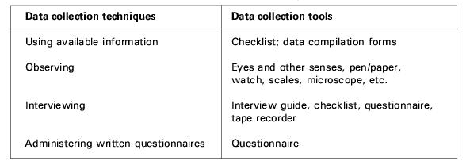
Data collection techniques and tools

Slide 21
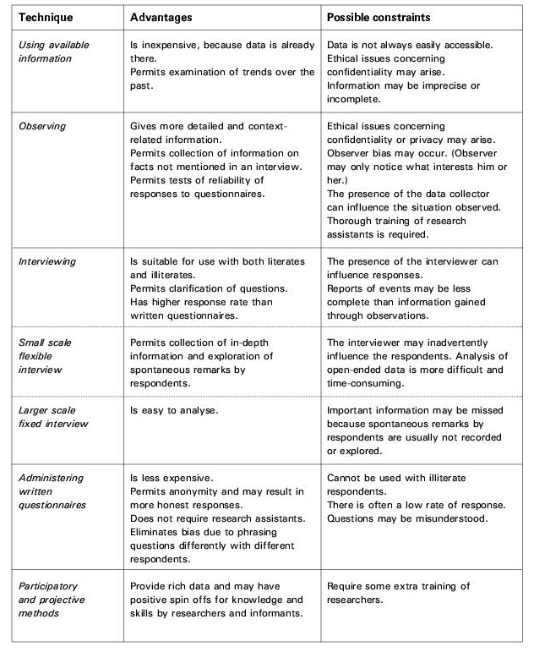

Slide 22
BIAS IN INFORMATION COLLECTION
1. Defective instruments, such as:
Questionnaires with:
little is known about the topic.
vaguely phrased questions;
‘leading questions’ that cause the respondent to believe one answer would be preferred over another.
questions placed in an illogical order.
Weighing scales or other measuring equipment that are not standardized .

Slide 23
2. Observer bias:
Observer bias can easily occur when conducting observations or utilizing loosely structured group- or individual interviews.
There is a risk that the data collector will only see or hear things in which he is interested or will miss information that is critical to the research.

Slide 24
3. Effect of the interview on the informant.
This is a possible factor in all interview situations. The informant may mistrust the intention of the interview and dodge certain questions or give misleading answers.

Slide 25
4. Information bias:
Sometimes the information itself has weaknesses. Medical records may have many blanks or be unreadable.
Another common information bias is due to gaps in people’s memory; this is called memory or recall bias.

Slide 26
Exercise

Slide 27
Determine DV & IV
Total | Stage 1 | Stage 2 | Stage 3 | Duration of symptoms in months
15 | 10 | 3 | 2 | < 3
19 | 6 | 5 | 8 | 4-6
39 | 1 | 18 | 20 | 7-10
54 | 5 | 23 | 26 | 11-12

Slide 28
Study examining if t.v. violence increases aggression in children.
IV: tv violence DV: children's aggression

Slide 29
Study predicting that alcohol drinking will decrease people's reaction time while driving.

Slide 30
IV: alcohol drinking DV: people's reaction time while driving

Slide 31
Study examining if perspective taking improves with age.
.

Slide 32
IV: age DV: perspective taking

Slide 33
Study predicting that high school sports build character.

Slide 34
IV: high school sports DV: character

Slide 35
. How do changes in work space affect employee reaction?
.

Slide 36
IV: changes in work space DV: employee reaction

Slide 37
Study predicting that pedestrians will walk faster on hot days versus cold days.

Slide 38
IV: temperature (hot vs. cold) DV: tempo of pedestrian walking

Slide 39
Are younger siblings treated better by their parents than older siblings?
.

Slide 40
IV: Sibling status (younger/older) DV: treatment by parents

Slide 41
For the following examples, identify
The dependent variable
The independent variable
The experimental condition(s)/experimental group(s)
The control condition/control group

Slide 42
A researcher is studying the effect of sleep on aggression, thinking that less sleep will lead to more aggression. She has some people sleep 6 hours per night, some people sleep 3 hours per night and some people sleep as much as they want. She then monitors aggressive behavior during basketball games among participants.

Slide 43
A researcher is curious to find out what effect classical music has on people’s level of relaxation (as measured by heart rate). He suspects that listening to classical music will make people feel more calm and relaxed. He lets one group listen to classical music for one hour. He lets another group sit in a quiet room for one hour (i.e they hear no music). After one hour, he monitors the heart rate of each participant to measure their level of relaxation.

Slide 44
A researcher conducts an experiment to assess the effects of alcohol on people's sense of balance. He divides his subjects into three groups: in one group the participants drink one ounce of alcohol, in another they drink two ounces of alcohol and in a third group the participants drink soda. He then watches as each participant tries to walk on a straight line from one corner of the room to the next and notes how many times they stumble outside the line.

Slide 45
Thank you

