Slide 1
Pediatric Urinary Disorders
Dr. Hamdan ALHAZMI

Slide 2
Learning Objectives
Recall normal anatomy.
Identify the common congenital anomalies.
How to detect this anomaly on radiological investigations.
Important steps in management.

Slide 3
Normal Anatomy

Slide 4
Urinary tract
Upper
Lower
Genital tract
Male
Female
Kidney
Ureter
Bladder
Urethra
Internal
External
External
Internal
Prostate
Seminal vesicle
Vas deference
scrotum
Testis
penis
Ovary
Fallopian tube
Uterus
vagina
Labia majora
Labia minora
Clitoris
vestibule

Slide 5
Urinary tract
Upper
Lower
Kidney
Ureter
Bladder
Urethra

Slide 6
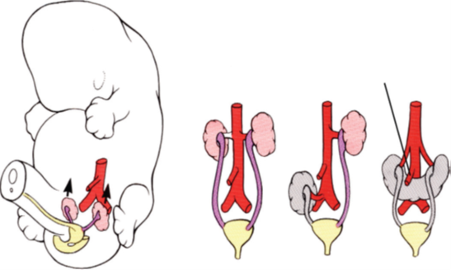

Slide 7
Internal
External
Prostate
Seminal vesicle
Vas deference
scrotum
Testis
penis
Male Genital tract

Slide 8
Female genital tract
External
Internal
Ovary
Fallopian tube
Uterus
vagina
Labia majora
Labia minora
Clitoris
vestibule

Slide 9
Congenital Urinary Disorders
Anomalies of the Upper Urinary Tract

Slide 10
Anomalies of the Upper Urinary Tract
kidney

Slide 11
Anomalies of the kidney
Anomalies of:
  Number
  Ascent
  Form and Fusion
  Rotation
  Renal Vasculature
  The Collecting System

Slide 12
Anomalies of the kidney
Anomalies of:
  Number
  Ascent
  Form and Fusion
  Rotation
  Renal Vasculature
  The Collecting System

Slide 13
Anomalies of Number
Renal Agenesis:
  Unilateral
  Bilateral
Supernumerary Kidney

Slide 14
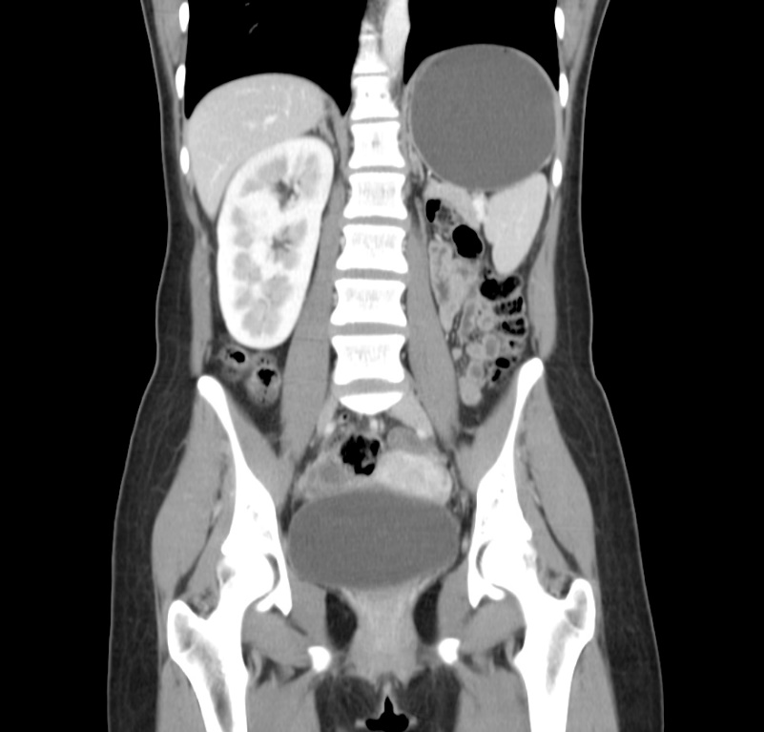
Unilateral Renal Agenesis
1 in 1100 births.
Male: Female of 1.8 : 1
The left side is absent more frequently .
The ipsilateral ureter is completely absent in 50%.
Anomalies of other organ systems are found frequently in affected individuals
  CVS,GIT,MSC

Slide 15
Unilateral Renal Agenesis
Müllerian duct abnormalities occur in 25% to 50% of cases of females with URA compared with wolffian duct anomalies in 10% to 15% of males with URA.
Approximately one fourth to one third of women with müllerian duct anomalies are found to have URA.

Slide 16
Bilateral Renal Agenesis
40% are stillborn.
Do not survive beyond 48 hours due to respiratory distress associated with pulmonary hypoplasia.
The characteristic
  Potter facies.
  Oligohydramnios

Slide 17
Bilateral Renal Agenesis
Ureters are almost always absent.
Bladder is either absent or hypoplastic.
Adrenal glands are usually positioned normally.
Müllerian duct anomalies are commonly observed.

Slide 18
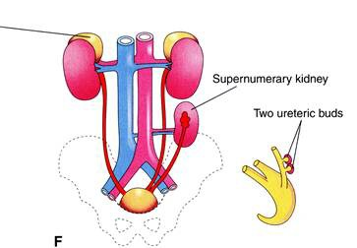
Supernumerary Kidney
Definitive accessory organ with its own collecting system, blood supply, and distinct encapsulated parenchyma.
Either completely separate or loosely attached to the kidney on the ipsilateral side.
The ureteral inter-relationships on the side of the supernumerary kidney can be variable.

Slide 19
Anomalies of the kidney
Anomalies of:
  Number
  Ascent
  Form and Fusion
  Rotation
  Renal Vasculature
  The Collecting System

Slide 20
Anomalies of Ascent
Simple Renal Ectopia
Cephalad Renal Ectopia
Thoracic Kidney

Slide 21
Simple Renal Ectopia
The left is more than the right.
Pelvic ectopia has been estimated to occur in 1 of 2100 to 3000 autopsies.
50% have a hydronephrosis:
  Obstruction: UPJO and UVJO
  Reflux: grade III or greater
  Malrotation
VUR is found in 30%
The incidence of genital anomalies in the patient with ectopia is about 15%.
Most ectopic kidneys are clinically asymptomatic.

Slide 22
Anomalies of the kidney
Anomalies of:
  Number
  Ascent
  Form and Fusion
  Rotation
  Renal Vasculature
  The Collecting System

Slide 23
Anomalies of Form and Fusion
Crossed Renal Ectopia:
  with Fusion
  without Fusion
Horseshoe Kidney

Slide 24
Crossed Renal Ectopia with and without Fusion
Crossed ectopia: kidney is located on the side opposite from that in which its ureter inserts into the bladder.
90% are fused with their mate
the superior pole of the ectopic kidney usually joins with the inferior aspect of the normal kidney.
The ureter from each kidney is usually orthotopic.

Slide 25
A)
Crossed renal
ectopia
with fusion
B)
Crossed renal ectopia
without fusion
C)
Solitary crossed
renal ectopia
D)
Bilaterally crossed
renal ectopia

Slide 26

Horseshoe Kidney
Occurs 1 in 400 persons.
The isthmus is bulky and consists of parenchymatous tissue.
The calyces:
  normal in number
  atypical in orientation.
  pelvis remains in the vertical or obliquely lateral plane
The blood supply can be quite variable.
Horseshoe kidney is frequently found in association with other congenital anomalies.
UPJ obstruction in one third.
60 % asymptomatic.

Slide 27
Horseshoe Kidney
Occurs 1 in 400 persons.
The isthmus is bulky and consists of parenchymatous tissue.
The calyces:
  normal in number
  atypical in orientation.
  pelvis remains in the vertical or obliquely lateral plane
The blood supply can be quite variable.
Horseshoe kidney is frequently found in association with other congenital anomalies.
UPJ obstruction in one third.
60 % asymptomatic.

Slide 28
Horseshoe Kidney
Occurs 1 in 400 persons.
The isthmus is bulky and consists of parenchymatous tissue.
The calyces:
  normal in number
  atypical in orientation.
  pelvis remains in the vertical or obliquely lateral plane
The blood supply can be quite variable.
Horseshoe kidney is frequently found in association with other congenital anomalies.
UPJ obstruction in one third.
60 % asymptomatic.

Slide 29
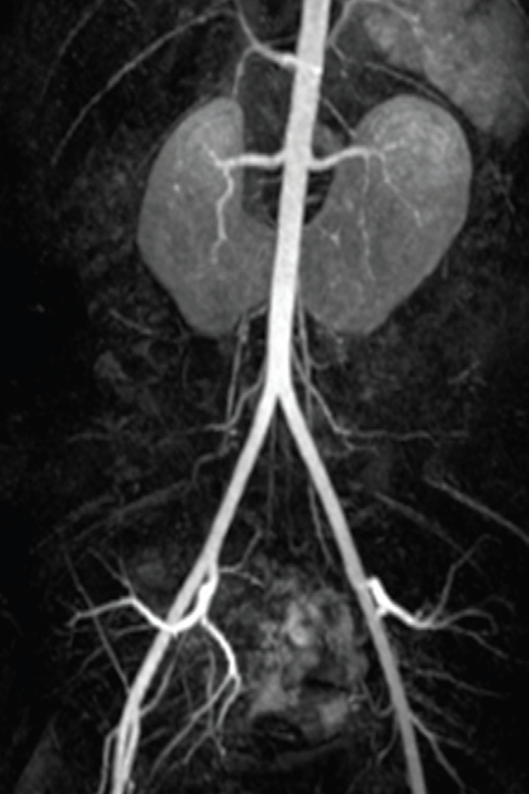
Horseshoe Kidney
Occurs 1 in 400 persons.
The isthmus is bulky and consists of parenchymatous tissue.
The calyces:
  normal in number
  atypical in orientation.
  pelvis remains in the vertical or obliquely lateral plane
The blood supply can be quite variable.
Horseshoe kidney is frequently found in association with other congenital anomalies.
UPJ obstruction in one third.
60 % asymptomatic.

Slide 31
Anomalies of the kidney
Anomalies of:
  Number
  Ascent
  Form and Fusion
  Rotation
  Renal Vasculature
  The Collecting System

Slide 32
Anomalies of Rotation
The kidney and renal pelvis normally rotate 90 degrees ventromedially during ascent
  the calyces point laterally.
  the pelvis faces medially.
When this alignment is not exact, the condition is known as malrotation.
Frequently associated with Turner syndrome.

Slide 33
Anomalies of the kidney
Anomalies of:
  Number
  Ascent
  Form and Fusion
  Rotation
  Renal Vasculature
  The Collecting System

Slide 34
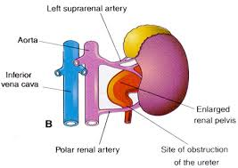
Anomalies of Renal Vasculature
Aberrant, Accessory or Multiple Vessels.
Renal Artery Aneurysm.
Renal Arteriovenous Fistula.

Slide 35
Renal Artery Aneurysm
The overall incidence has been calculated to be between0.1% and 0.3%.
Most renal artery aneurysms are silent, especially in children.
Many asymptomatic renal artery aneurysms are diagnosed during an evaluation of hypertension.

Slide 36
Renal Artery Aneurysm
The diagnosis may be suspected with a pulsatile mass in the region of the renal hilum or when an abdominal bruit is heard.
A wreathlike calcification in the area of the renal artery or its branches (30%) is highly suggestive.

Slide 37
Anomalies of the kidney
Anomalies of:
  Number
  Ascent
  Form and Fusion
  Rotation
  Renal Vasculature
  The Collecting System

Slide 38
Anomalies of the
Collecting System
Calyceal Diverticulum.
Hydrocalycosis.
Megacalycosis.
Unipapillary Kidney.
Extrarenal Calyces.
Anomalous Calyx (Pseudotumor of the Kidney).
Infundibulopelvic Stenosis.
Extrarenal Pelvis.
Bifid Pelvis.

Slide 39
Calyceal Diverticulum
A calyceal diverticulum: a cystic cavity within the kidney that is lined by transitional epithelium and communicates with a calyx or, less commonly, with the renal pelvis through a narrow isthmus.
The incidence based on excretory urography is about 4.5 per 1000.
The diagnosis is best made by CT or MR urography.
Laparoscopy by a retroperitoneal approach for marsupialization of the diverticulum, fulguration of the epithelial lining, and percutaneous marsupialization/ablation are treatment options.

Slide 40
Megacalycosis
Megacalycosis: a non- obstructive enlargement of calyces resulting from malformation of the renal papillae.
It occurs predominantly in males with a ratio of 6 : 1.
Bilateral disease has been seen almost exclusively in males, whereas segmental unilateral involvement occurs only in females.
Long-term follow-up of patients with this anomaly does not usually reveal progression of the anatomic or functional status of the kidney.

Slide 41
Infundibulopelvic Stenosis
A link between cystic dysplasia of the kidney and the grossly hydronephrotic kidney.
Infundibulopelvic stenosis is usually bilateral and is commonly associated with vesicoureteral reflux, suggesting an abnormality of the entire UB.

Slide 42
Anomalies of the Upper Urinary Tract
Ureter

Slide 43
Ureteral Anomalies
Ureteropelvic junction (UPJ) obstruction
Ureterovesical junction (UVJ) obstruction
Megaureters
Ectopic Ureter
Ureterocele
Vesicoureteral Reflux (VUR)
Anomalies of Number:
  - Bifid Ureters - Dublication
  - Triplication - Quadruple Ureters
Fibroepithelial Polyps

Slide 44
Ureteral Anomalies
Ureteropelvic junction (UPJ) obstruction
Ureterovesical junction (UVJ) obstruction
Megaureters
Ectopic Ureter
Ureterocele
Vesicoureteral Reflux (VUR)
Anomalies of Number:
  - Bifid Ureters - Dublication
  - Triplication - Quadruple Ureters
Fibroepithelial Polyps

Slide 45
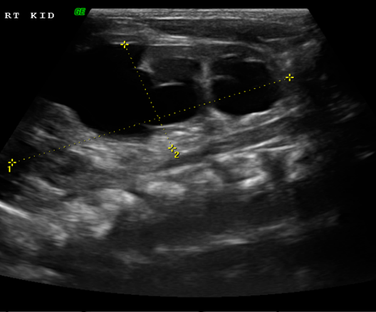
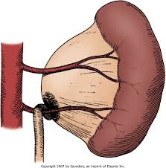
Ureteropelvic junction (UPJ) obstruction

Slide 46
Ureteropelvic junction (UPJ) obstruction
Presentation:
Incidental in Neonates
Incidental in Children
Symptomatic:
  UTI
  Pain
  Mass
  Hematuria
  Stone

Slide 47
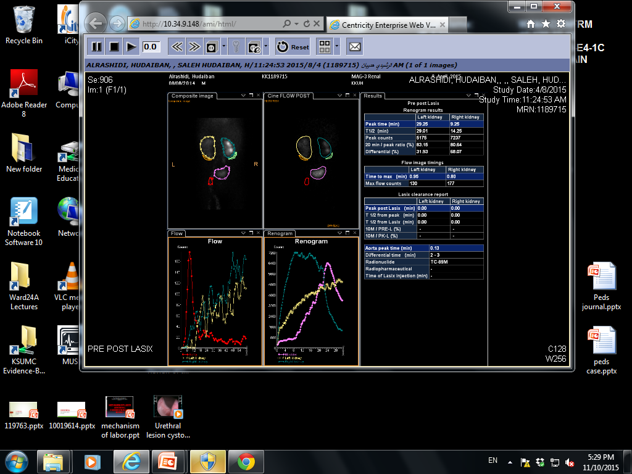
Pelviureteric Junction Obstruction(PUJO)

Slide 48
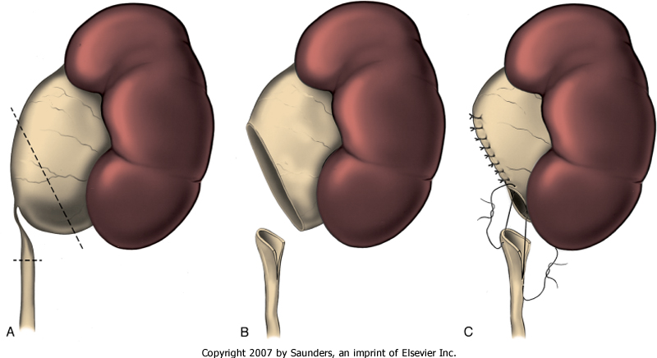
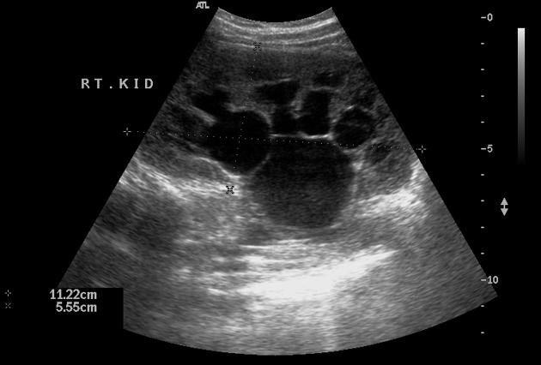
Pelviureteric Junction Obstruction(PUJO)

Slide 49
Ureteral Anomalies
Ureteropelvic junction (UPJ) obstruction
Ureterovesical junction (UVJ) obstruction
Megaureters
Ectopic Ureter
Ureterocele
Vesicoureteral Reflux (VUR)
Anomalies of Number:
  - Bifid Ureters - Dublication
  - Triplication - Quadruple Ureters
Fibroepithelial Polyps

Slide 50
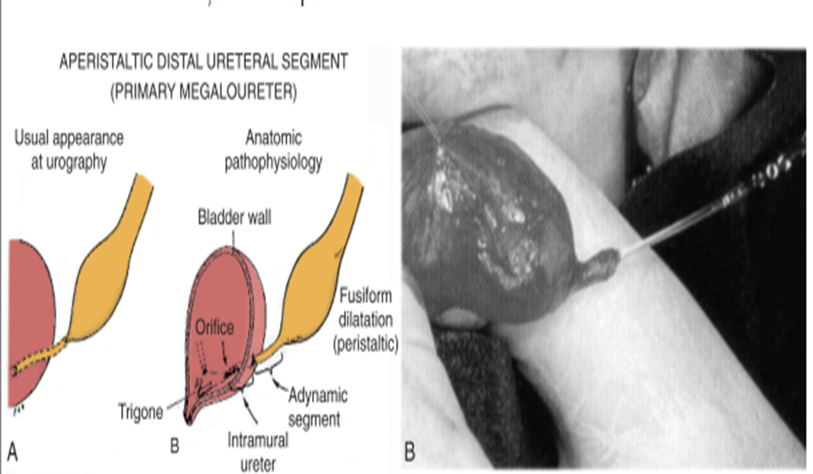
Ureterovesical junction (UVJ) obstruction
Megaureters

Slide 51
Ureteral Anomalies
Ureteropelvic junction (UPJ) obstruction
Ureterovesical junction (UVJ) obstruction
Megaureters
Ectopic Ureter
Ureterocele
Vesicoureteral Reflux (VUR)
Anomalies of Number:
  - Bifid Ureters - Dublication
  - Triplication - Quadruple Ureters
Fibroepithelial Polyps

Slide 52
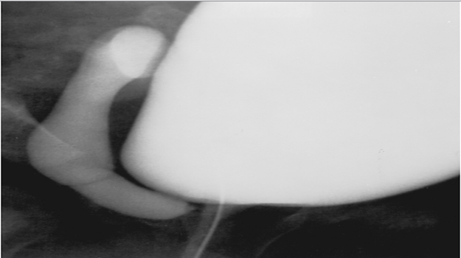
Ectopic Ureter
An ectopic ureter is any ureter, single or duplex, that doesn't enter the trigonal area of the bladder.

Slide 53
Ectopic Ureter
In a duplex system the ectopic ureter is inevitably the upper pole ureter due to its budding from the mesonephric duct later (more cephalad) than the lower pole ureteral bud.

Slide 54
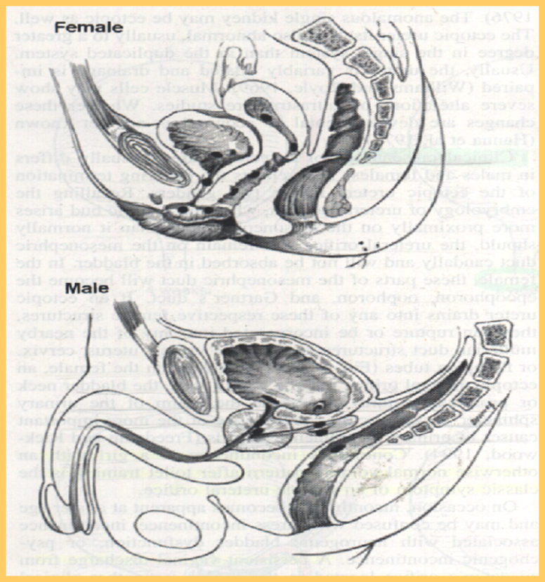
Ectopic Ureter
In females the ectopic ureter may enter anywhere from the bladder neck to the perineum and into the vagina, uterus,and even rectum.
One of the classic symptoms is continuous wetting.

Slide 55
Ectopic Ureter
In males the ectopic ureter always enters the urogenital system above the external sphincter or pelvic floor, and usually into the wolffian structures including vas deferens, seminal vesicles, or ejaculatory duct.

Slide 56
Ureteral Anomalies
Ureteropelvic junction (UPJ) obstruction
Ureterovesical junction (UVJ) obstruction
Megaureters
Ectopic Ureter
Ureterocele
Vesicoureteral Reflux (VUR)
Anomalies of Number:
  - Bifid Ureters - Dublication
  - Triplication - Quadruple Ureters
Fibroepithelial Polyps

Slide 57
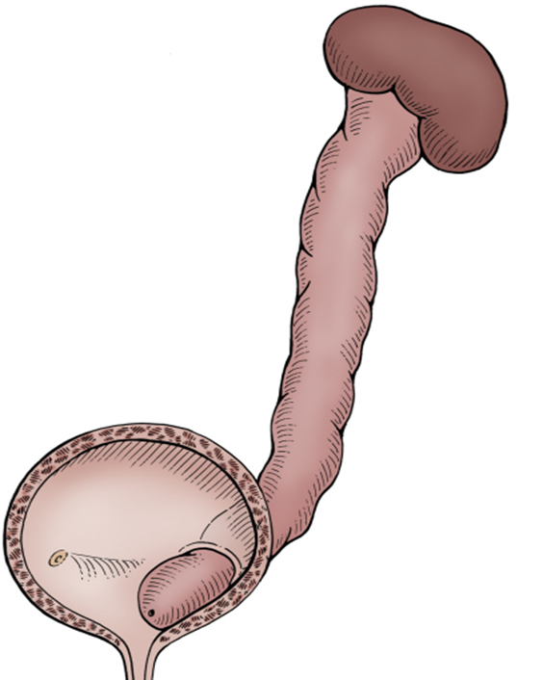
Ureterocele
A cystic dilation of the distal aspect of the ureter
Located either within the bladder or spanning the bladder neck and urethra.
Presentation:
Antenatal (U/S)
Urine retention
Infection
Calculus formation

Slide 58
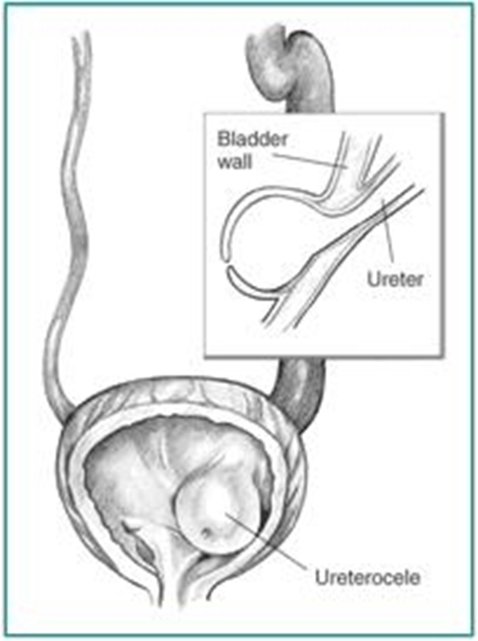
Ureterocele

Slide 59
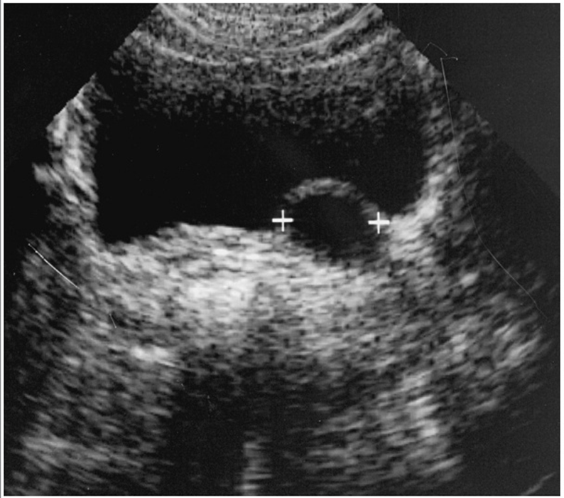
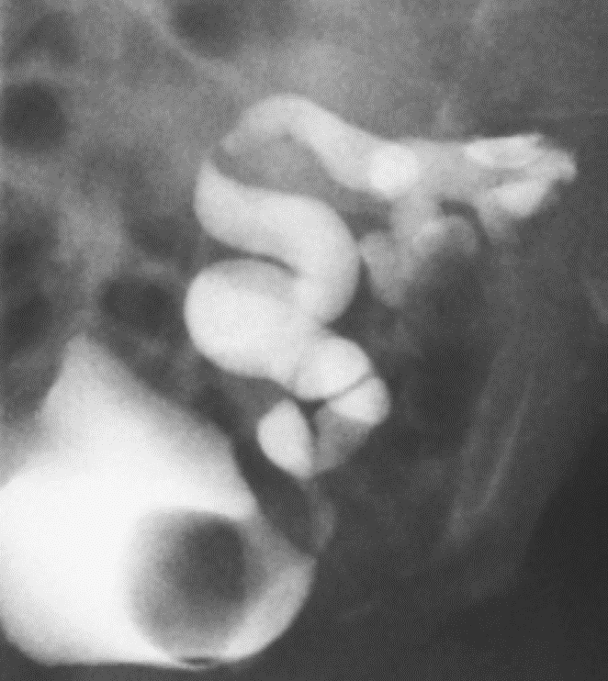
Ureterocele

Slide 60
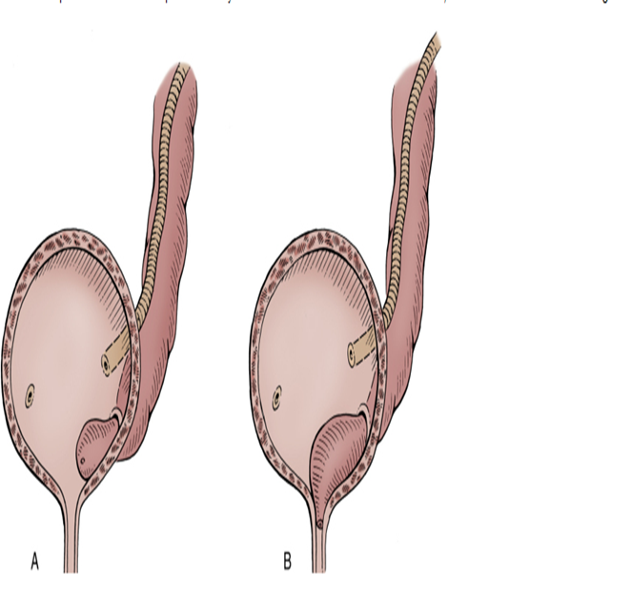
Ureterocele
Types:
Intravesical: Orthotopic, simple, adult type.
Extravesical: Ectopic, duplex system, infant type.

Slide 61
Ureteral Anomalies
Ureteropelvic junction (UPJ) obstruction
Ureterovesical junction (UVJ) obstruction
Megaureters
Ectopic Ureter
Ureterocele
Vesicoureteral Reflux (VUR)
Anomalies of Number:
  - Bifid Ureters - Dublication
  - Triplication - Quadruple Ureters
Fibroepithelial Polyps

Slide 62
Vesicoureteral Reflux (VUR)
GRADE DESCRIPTION:
  Into a nondilated ureter
  Into the pelvis and calyces without dilatation
  Mild to moderate dilatation of the ureter, renal pelvis,and calyces with minimal blunting of the fornices
  Moderate ureteral tortuosity and dilatation of the pelvisand calyces
  Gross dilatation of the ureter, pelvis, and calyces; loss of papillary impressions; and ureteral tortuosity

Slide 63
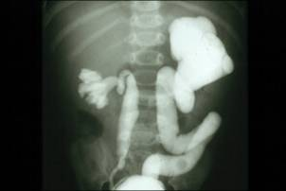
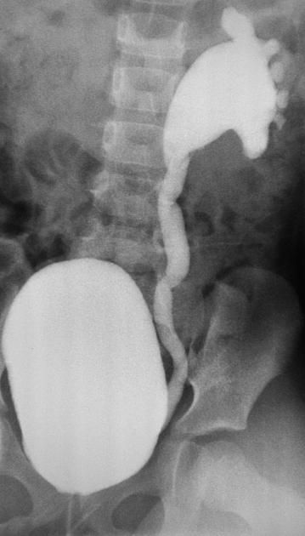
MCUG

Slide 64
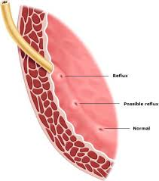
Vesicoureteral Reflux (VUR)
Normal anti-reflux mechanism “Flap valve”
1. Oblique course as it enters the bladder.
2. Proper muscular attachments to provide fixation.
3. Posterior support to enable its occlusion.
4. Adequate submucosal length.

Slide 65
Vesicoureteral Reflux (VUR)

Slide 66
Congenital Urinary Disorders
Anomalies of the Lower Urinary Tract

Slide 67
Anomalies of the Lower Urinary Tract
Urinary Bladder

Slide 68
Bladder Anomalies
Urachal abnormalities
Bladder diverticulum
Bladder duplication
Bladder exstrophy
Other bladder anomalies

Slide 69
Urachal abnormalities
Urachal anomalies are usually detected postnatally due to umbilical drainage.
Imaging possibilities include ultrasound, CT, and VCUG.

Slide 70
Urachal abnormalities
Conservative treatment with observation is justified in asymptomatic cases due to possible spontaneous resolution
Infected urachal remnants are initially treated with drainage and antibiotics, followed by surgical excision.
Nonresolved urachal remnants should be excised due to theincreased risk of later adenocarcinoma formation

Slide 71
Urachal abnormalities
Patent urachus
Urachal cyst
Umbilical-urachus sinus
Vesicourachal diverticulum

Slide 72
Bladder Diverticulum
Bladder diverticula can be detected on prenatal ultrasound, but the gold standard remains VCUG, which will reveal possible accompanying VUR.

Slide 73
Bladder Diverticulum
Primary diverticula
  arise as a localized herniation of bladder mucosa at the ureteral hiatus and are most likely caused by a congenitally deficient bladder wall.
Secondary para-ureteral diverticula
  are acquired and develop due to existing infra- vesical obstruction.
Symptomatic diverticula, especially in conjunction with VUR, should be treated surgically.

Slide 74
Bladder Duplication
Bladder duplication is often associated with duplication anomalies of the external genitalia and lower gastrointestinal tract.
Initial treatment is directed toward
  renal preservation.
  prevention of infections.

Slide 75
Bladder Duplication
Long-term goals include achieving continence and reconstructing the internal and external genitalia.
Due to the rarity of the disease and the large variety of presentations, the surgeries must be individualized

Slide 76
Classic Bladder Exstrophy
The incidence of bladder exstrophy has been estimated as between 1 in 10,000 and 1 in 50,000.

Slide 77
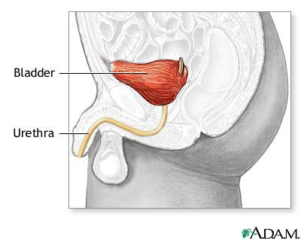
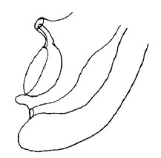
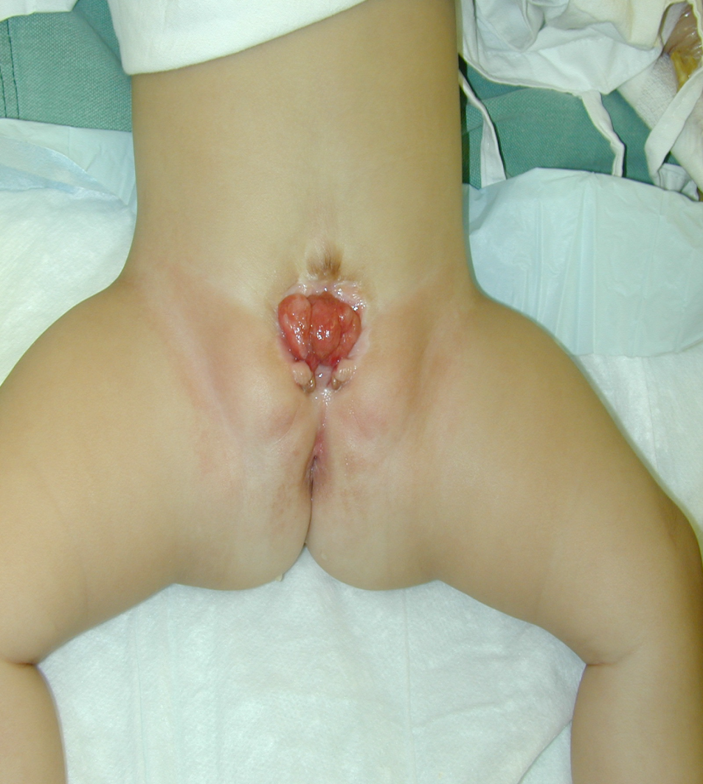

Slide 78
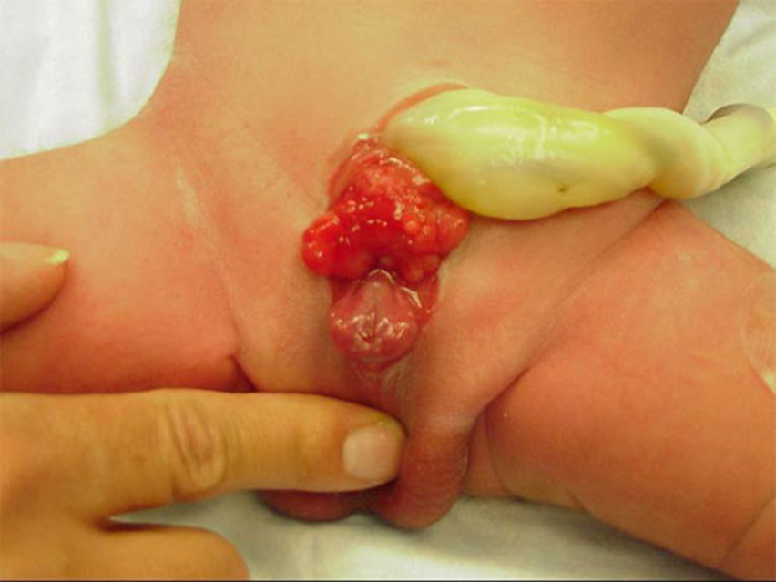

Slide 80
Anomalies of the Lower Urinary Tract
Urethra

Slide 81
Urethral anomalies
Posterior Urethral Valves
Anterior Urethral Valves
Urethral Duplication
Congenital Urethral Stricture
Urethral Polyps

Slide 82
Urethral anomalies
Posterior Urethral Valves
Anterior Urethral Valves
Urethral Duplication
Congenital Urethral Stricture
Urethral Polyps

Slide 83
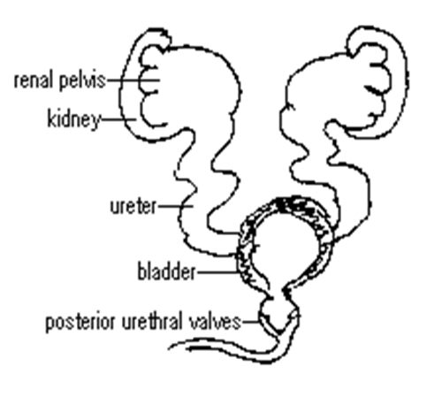
Posterior Urethral Valves
1 in 8000 to 25,000 live births.
Make up 10% of urinary obstructions diagnosed in utero.
Most common cause of urine retention in male infants.
50% have renal impairment.

Slide 84
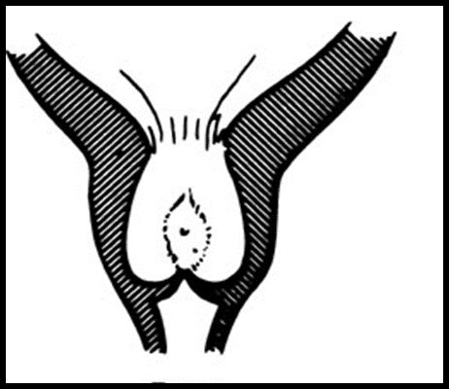
Posterior Urethral Valves
The bladder and the kidneys developed under high pressure and resistance.
Presentation:
1. Antenatal
2. Urine retention
3. UTI
4. Poor urinary stream
5. CRF

Slide 85
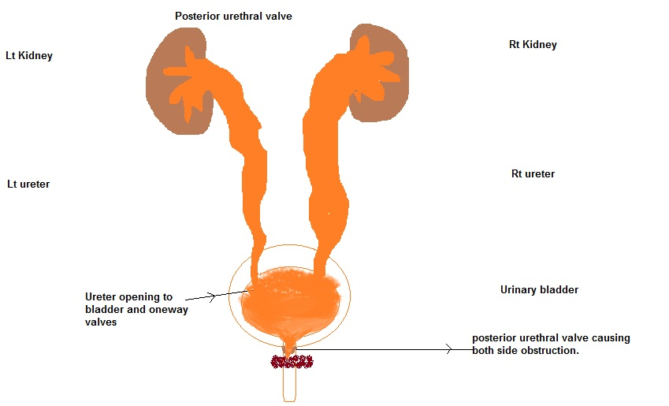
Posterior Urethral Valves
Associated findings:
1. Oligohydramnios.
2. Bilateral renal dilatation
3. VUR: 40%
4. Valve bladder
5. Renal impairment

Slide 86
Congenital Anomalies of the external Genitalia

Slide 87
Congenital Genital disordered
Hypospadias
Epispadias
Micropenis
Bladder Exstrophy
Cloacal Exstrophy

Slide 88
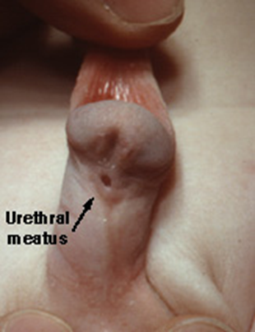
Hypospadias
Abnormal position of the EUM on the ventral surface.
Types:
  Distal hypospadias.
  Proximal hypospadias.
NO Circumcision
6 to 9 months repair.

Slide 89
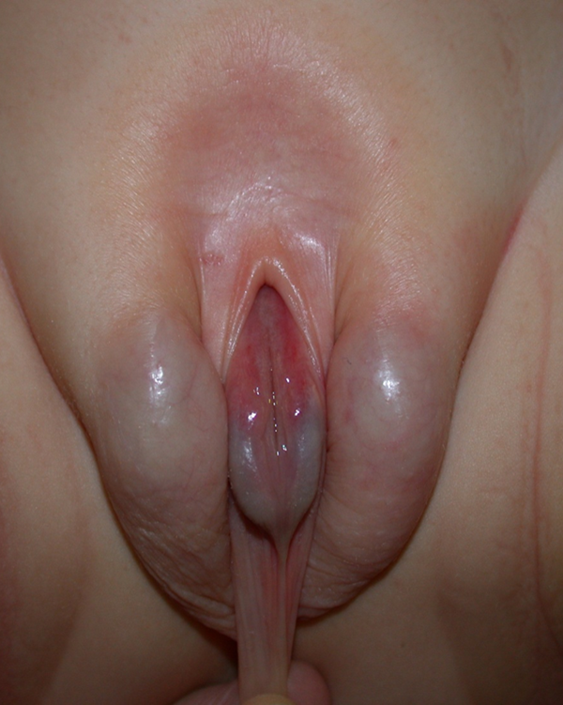
Epispadias
Male
Female

Slide 90
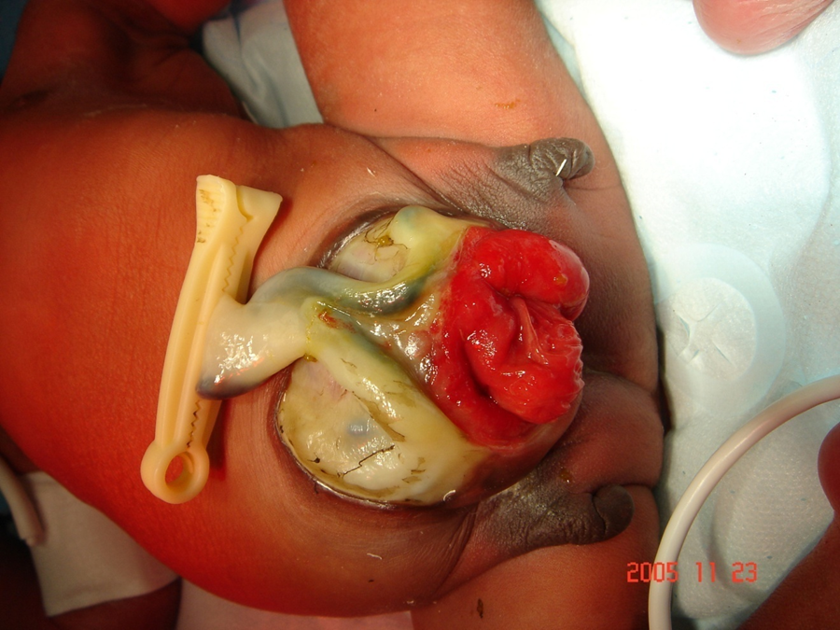
Cloacal Exstrophy

Slide 91
Prune-Belly Syndrome
The incidence :1 in29,000 to 1 in 40,000 live births
The three major findings are
  deficiency of the abdominal musculature,
  bilateral intra-abdominal testes,
  anomalous urinary tract
Other names
  Triad syndrome
  Eagle-Barrett syndrome
  abdominal musculation syndrome

Slide 92
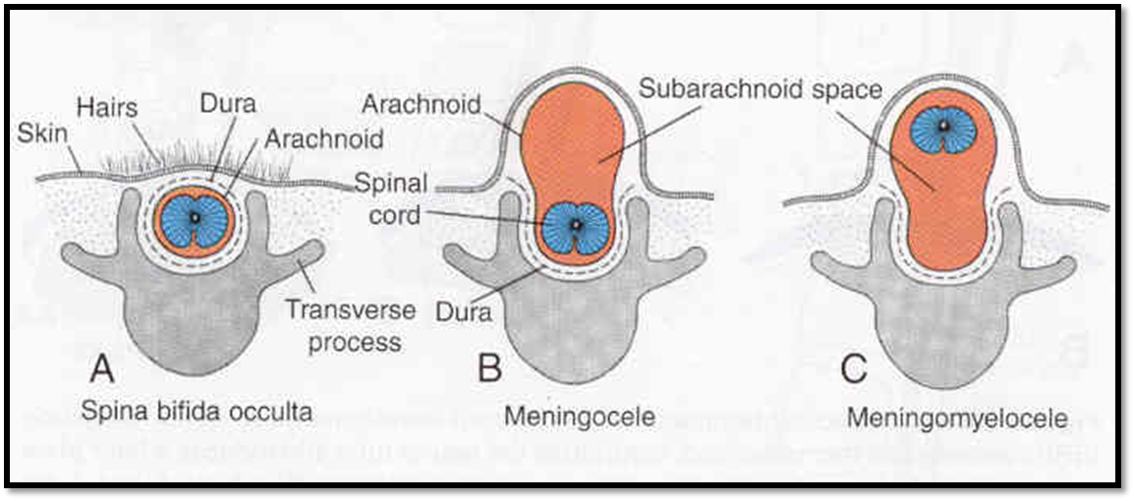
NEUROSPINAL DYSRAPHISMS
The most common cause of neurogenic bladder dysfunction in children is abnormal development of the spinal canal and internecine spinal cord.

Slide 93
NEUROSPINAL DYSRAPHISMS
Cutaneous lesions occur in 90% of children with various occult dysraphicstates.
These lesions vary from
  small lipomeningocele
  hair patch
  dermal vascular malformation
  sacral dimple
  abnormal gluteal cleft.

Slide 94
Antenatal Hydronephrosis(ANH)

Slide 95
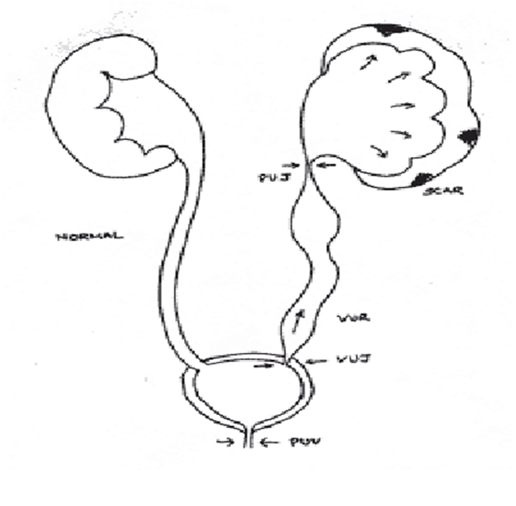
Antenatal Hydronephrosis(ANH)
Causes:
Pelviureteric junction obstruction (41%)
Ureterovesical junction obstruction (23%)
Vesicoureteric reflux(7%)
Duplication anomalies (13%)
Posterior urethral valves (10 %)
MCDK
Others (6%)

Slide 96
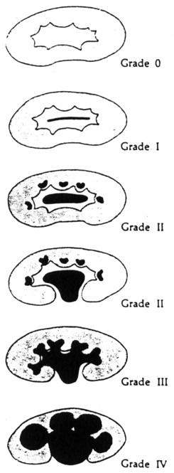
ANH

Slide 97
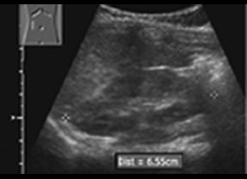
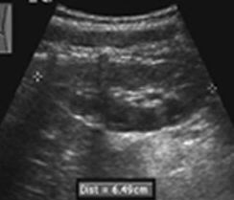
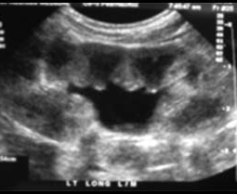
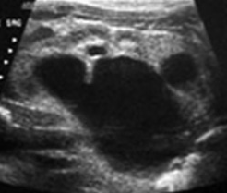
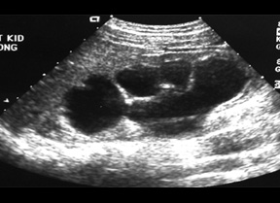
SFU Grading
G0
G1
G2
G3
G4

Slide 98
THANK YOU

Slide 99
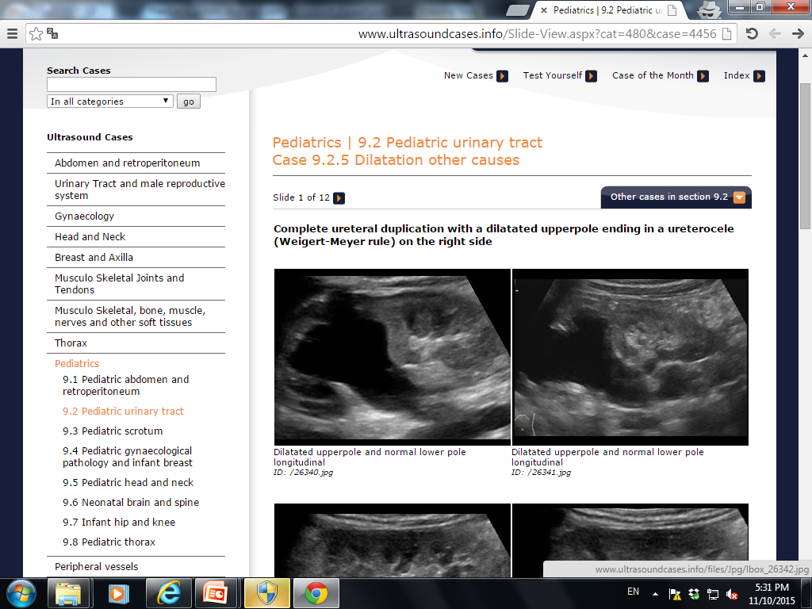
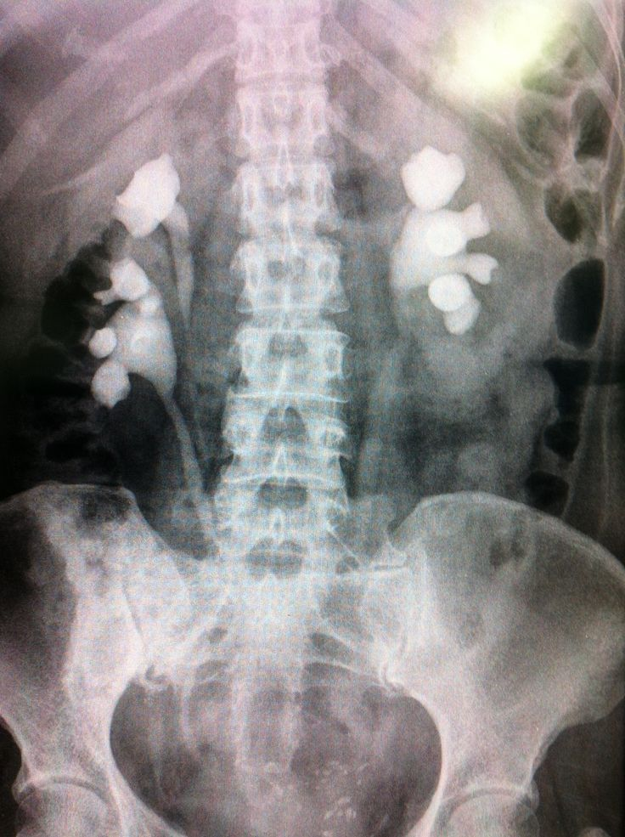
Weigert- Meyer Rule

Slide 100
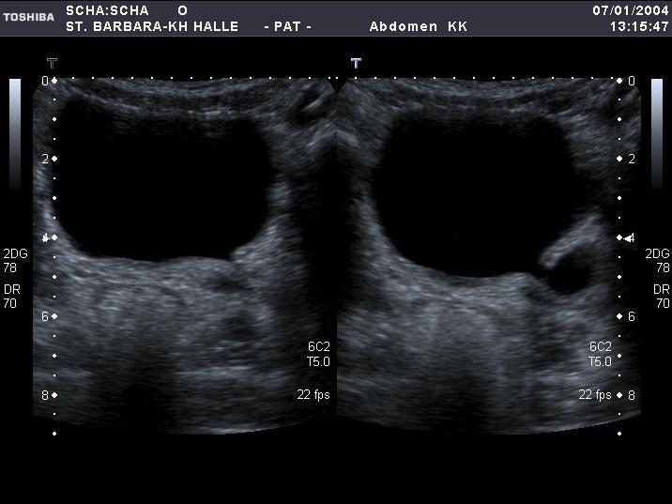

Slide 101
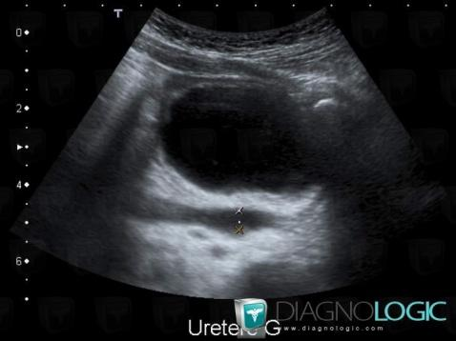
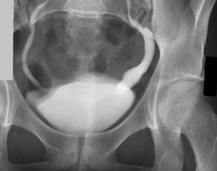
IVP

Slide 102
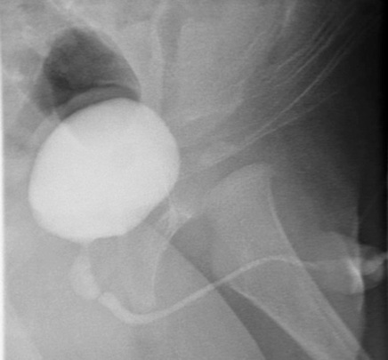

Slide 103
