Slide 1
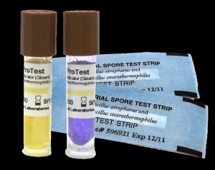
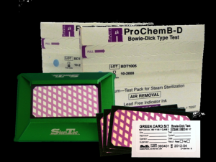
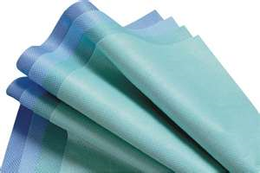
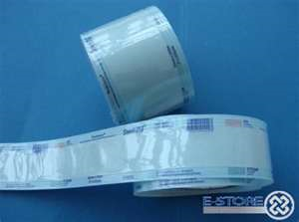
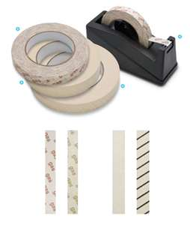
STERILIZATION
&
Operating Room Set Up
By:
Nida J. Salcedo, BSN RN MAN
ADON – O.R.

Slide 2
Main Objectives:
To be able to acquire knowledge and
understanding on the following:
Different methods of sterilization & the sterilization processes.
The principles of aseptic techniques & how to apply them in the clinical areas & O. R.
The Operating Room set up to ensure safe environment & safe surgical practices towards patient safety.

Slide 3
Table of Contents:
Methods of Sterilization
Physical Methods
Cool Chemical Methods
Liquid Chemicals
Other Methods
Sterilization Processes
Preparation of items before sterilization
Steam Sterilization Process
Testing the Effectiveness of the Autoclave
Storage of Sterile Packages
Principles of Aseptic Techniques-O.R. Set Up (Sterile Field)

Slide 4
Terminologies
Asepsis- freedom from infection or the absence of microorganisms that cause diseases.
Sepsis- generalized reaction to pathogenic microorganism which is evident clinically by signs of inflammation & febrile conditions of inflammation.
Sterile-absence of all microorganisms including bacteria, viruses and spores.

Slide 5
Terminologies
Aseptic Techniques-practices that restrict microorganisms in the environment, equipment, supplies & prevention of the normal body flora from contaminating the surgical wound. (Methods by which contamination with microorganisms are prevented).
Contamination-introduction of microorganisms to a sterile field.

Slide 6
Terminologies
Sterilization-process by which all living microorganisms both pathogenic & non-pathogenic including spores are killed.
Disinfection-process by which renders inanimate objects free of pathogenic bacteria.

Slide 7
Terminologies
Antiseptics- agents that renders microorganisms on living tissue inactive by preventing their growth. Used to disinfect body surfaces, skin & tissue. Inhibits the growth of endogenous bacteria. (Combat sepsis)
Disinfectants-agents that kill all growing or vegetative forms of microorganisms thus completely eliminating them from inanimate objects.

Slide 8
The prevention of infection in health care areas is largely dependent on the following:
Rigorous adherence to the principles of aseptic techniques by all personnel who performs any invasive procedures on patients.
Sterility of all items directly used in such procedures.
Disinfection of all surfaces & other items in the immediate environment.
Other methods – Prevention of SSI-Bundle of Care

Slide 9
Remember:
There is no degree of sterility.
An item is either sterile or non-sterile.
It can never be relatively sterile.

Slide 10
Take Note:
Surgical instruments, devices & heat sensitive items are sterilized by the method recommended by the manufacturer.
No disposable sterile items designed for single use should be reprocessed.
Sterilizing agent should be in contact with every part of the item to be sterilized at specific period of time & temperature.

Slide 11
Methods of Sterilization:
Physical Methods:
1. Dry Heat-Hot air ovens, infra red ovens.
2. Moist heat- Steam Autoclave-(Available in KKUH)
Cool Chemical Methods:
1. Plasma Sterilizer (Sterrad)- (Available in KKUH)
2. E.O. (Ethylene Oxide) Sterilizer
3. Liquid Chemicals
Other Methods

Slide 12
Physical Method:
Moist heat, at raised atmospheric pressure
  Steam sterilization (steam under pressure) - most inexpensive & effective method of sterilization. Steam under pressure permits permeation of moist heat to porous substances by condensation & results in destruction of all microbial life. Ex. Steam autoclave
  Method used for sterilizing surgical instruments, dressings, drapes, swabs, laps sponges, culture media, etc.

Slide 13
Types of Autoclaves:
Downward Displacement Autoclave-
Air is removed in two stages & sterilization is by pure steam.( Not available in KKUH)
High Vacuum / High Pressure Autoclave- Air is removed by powerful pump automatically.
Steam penetrates the load & very rapid
sterilization of surgical items & packs is
possible in 30 to 45 minutes at 134ºC & up.
(Available in KKUH)

Slide 14
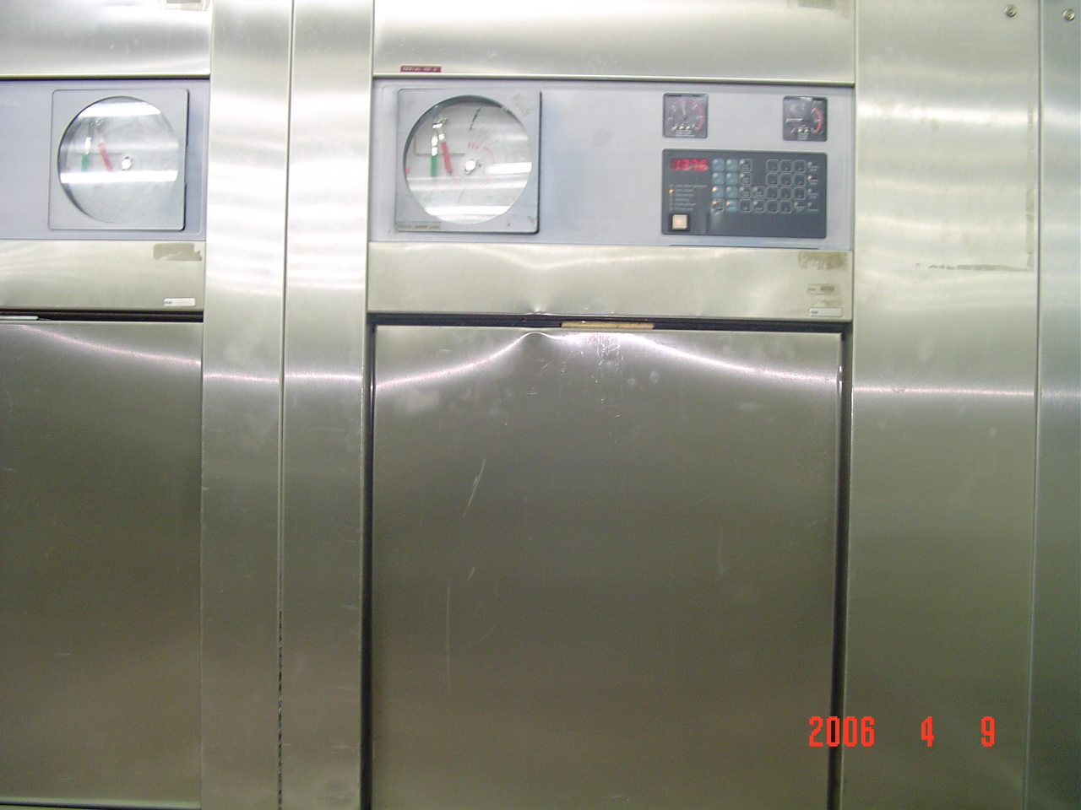
Steam Autoclave
An autoclave is a closed chamber in which items are subjected to steam at high pressure & temperature above 100 ºC.

Slide 15
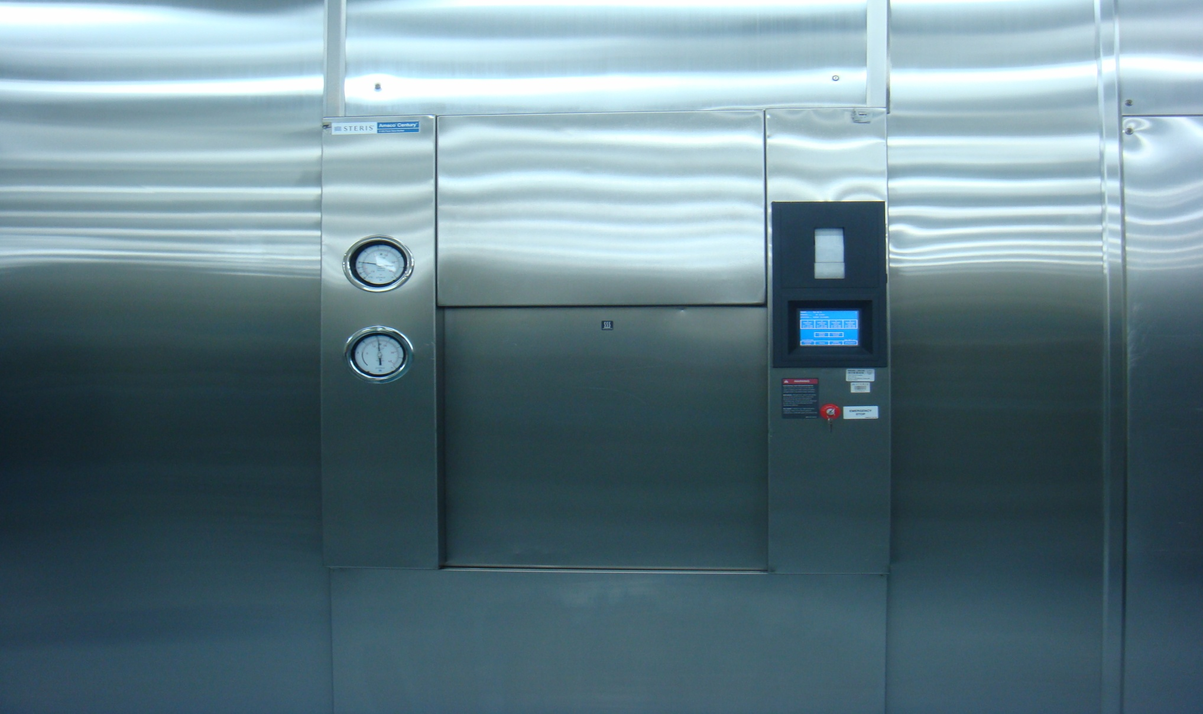
New Steris Autoclave

Slide 16
STEAM STERILIZATION PROCESS –
FIVE DISTINCT PHASES:
PHASE I - Loading phase - in which the objects or packs are loaded in the sterilizer.
PHASE II - Heating phase - in which the steam is brought to proper temperature & allowed to penetrate through the objects in the chamber.
PHASE III - Destroying phase or time temperature cycle - in which all microbial life is exposed to the killing effect of the steam.

Slide 17
THE STEAM STERILIZATION PROCESS
PHASE IV - Drying and cooling phase - in which the objects are dried & cooled then, filtered air is introduced into the chamber, door is opened & packs are removed and stored.
PHASE V - Testing phase - in which the efficiency of the sterilization process is checked. All mechanical parts of sterilizers, including gauges, steam lines & drains should be periodically checked by a competent biomed engineer.

Slide 18
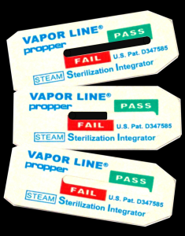
Methods of Testing the
Effectiveness of Autoclaves:
Mechanical- chart & gauges usually carried out by Biomed Engineer.
Chemical- by the use of autoclave tapes, strips and card. A daily test in an empty chamber using a heat sensitive tape. This is for high vacuum/high pressure autoclaves. Ex. Bowie Dick Test Pack- a pack with a chemical indicator both outside & inside to verify that steam has penetrated the pack & to test air leaks.
Biological

Slide 19
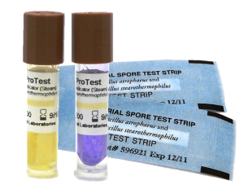
Biological Indicator-
Biological Spore Testing
To test autoclaves regularly with Geobacillus stearothermophilus, which is one of the most heat tolerant species of bacteria.
If sterilization in an autoclave does not destroy the Geobacillus spores, the autoclave is not working properly.

Slide 20


Testing the Effectiveness of Steam Autoclave:
First- Run it empty for one cycle. (Dummy Run) – to warm up the machine.
Second- Put inside in the middle of the chamber, the Bowie Dick Test Pack and run it again and finish the whole cycle. Oh high pressure- to test leaks and presence of air. (Yellow turns black)
Third- Load the items & trays for sterilization ( little bit lower pressure). It is done once daily.
Fourth- Live Organism- done once in every Sunday morning in CSSD, KKUH.

Slide 21
Preparation of Items Before STERILIZATION
Decontamination
Disassembly
Washing
Drying
Packing
Loading in sterilizer

Slide 22
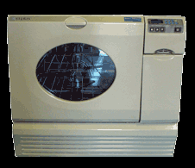
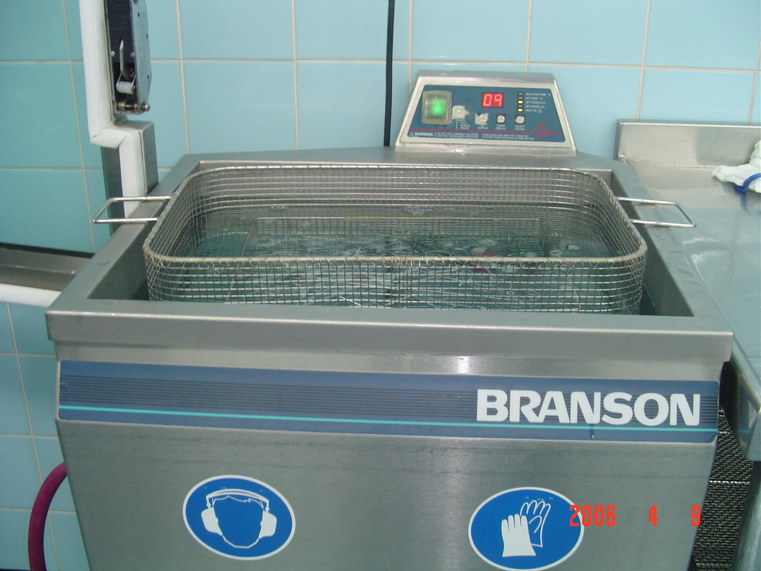
Ultrasonic Washer

Slide 23
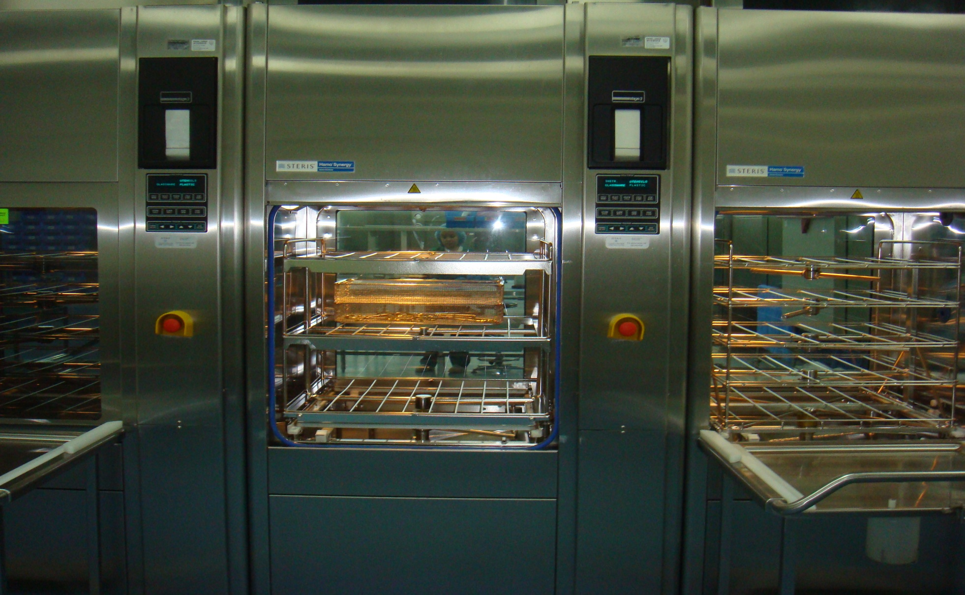
Automated Washer / Dryer

Slide 24
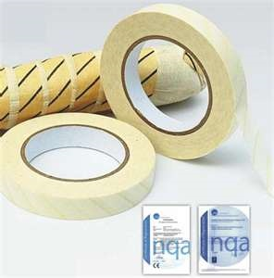

MAKING OF STERILE
PACKS
Should have the following external indications showing that they have been processed:
Autoclave tapes show a pack that has been through a sterilization cycle & should be visible outside every pack sterilized.
Autoclave tape is designed black when specified temperature is reached.
Must be labeled as to its contents with the processing date, autoclave used & load number. This assists locating processed items in case of recall.

Slide 25
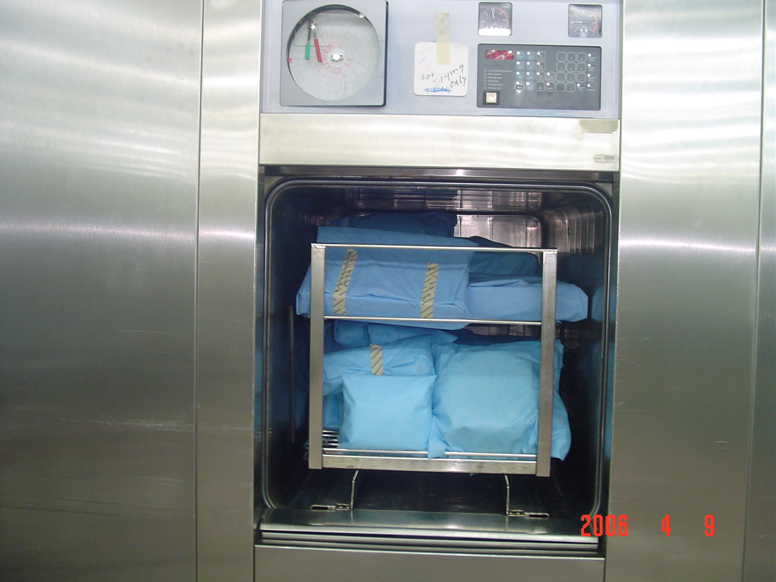
Loading Procedure

Slide 26
STORAGE OF STERILE PACKS
Sterile packs / sets should be left untouched & allowed to cool down before storage to avoid condensation inside.
Must be handled as little as possible to reduce the risk of contamination.

Slide 27
STORAGE OF STERILE PACKS
Sterile packages should be stored on open shelves.
  The lowest shelf should be 8 to 10 inches off the floor.
  The highest shelf should be 18 inches from the ceiling.
  All shelves should be at least 2 inches from the walls.

Slide 28
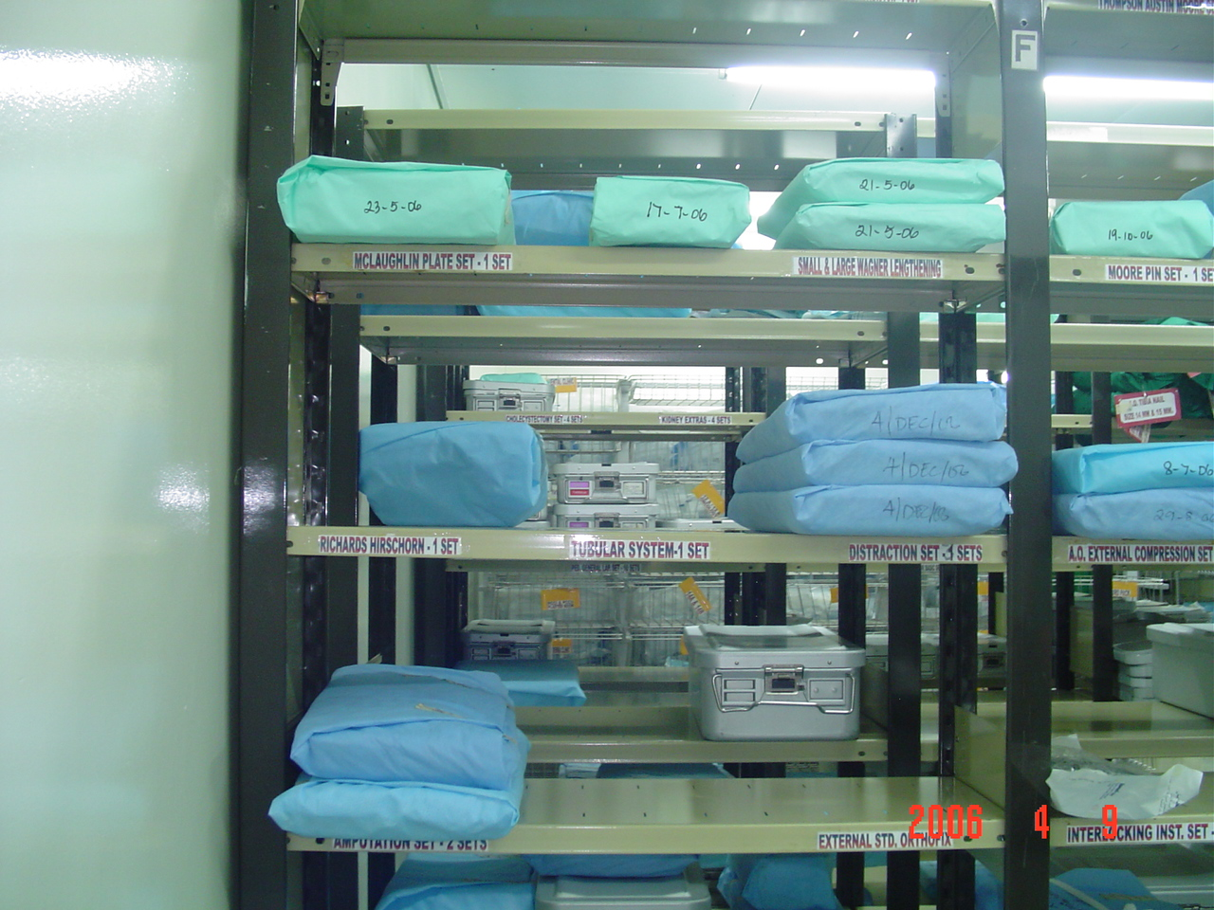
KKUH-CSSD Storage Room

Slide 29
STORAGE OF STERILE PACKS
Either good for 30 days or 6 months to one year depending on how the packages are wrapped & what type of wrappers used.
Shelf life - refers to the length of time a package maybe considered sterile.
Sterile packages must be stored and issued in correct order.
Traceability (Tracking System)

Slide 30
STORAGE OF STERILE PACKS
Storage Room for sterile items.
Traffic is restricted to CSSD personnel & trainees only.
One flow
Subjected to regular adequate pest control to prevent contamination from rodents, ants & cockroaches.

Slide 31
Cold Method –
Plasma Sterilizer
Plasma Autoclave (Sterrad)-
*Low Temperature Hydrogen Gas Sterilizers. *Used to sterilize delicate instruments that are heat & moisture sensitive, such as micro instruments, cameras, scopes & light cords.
*Gentle patented sterilization process with the use of hydrogen peroxide & generation of low temperature gas plasma.
*Spore testing should be performed at the same interval as testing of other sterilizers.

Slide 32
Plasma Sterilization
104°F-131°F (40°C-55°C). – 45 minutes to
I hour.
Advantages of plasma sterilization include: speed, safety of use, & no aeration.
Five phases to the “Sterrad” Plasma sterilization cycle:
Vacuum, injection, diffusion, plasma, vent.

Slide 33
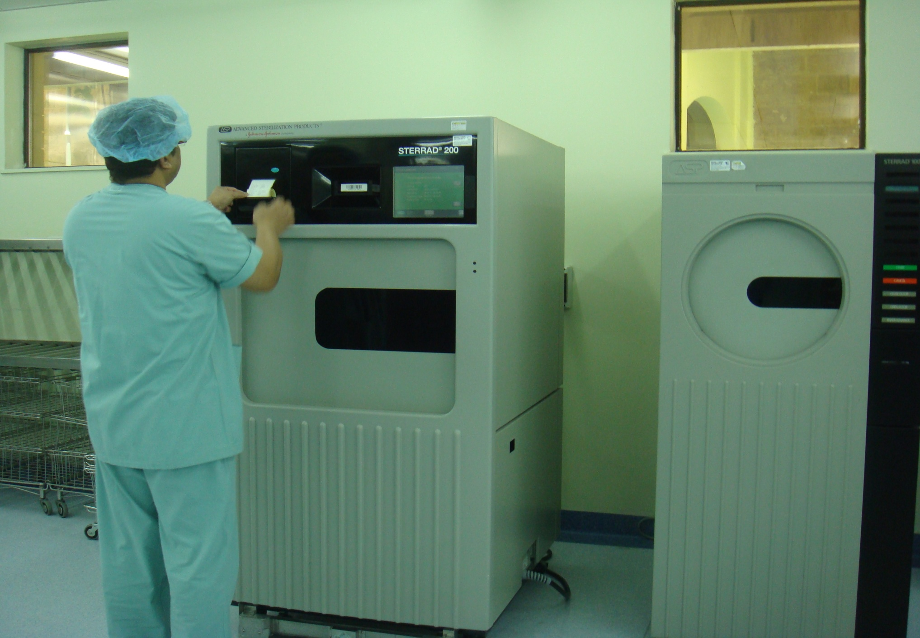
Old & New
Sterrad Plasma Autoclave

Slide 34
COLD METHOD-Chemicals
Ethylene Oxide (EO)- Colorless gas
* Well established technique for sterilizing heat sensitive articles.
* Exposure period of 5 to 7 hours is necessary for complete E.O. sterilization.
* Used for sterilizing vascular & bone grafts, delicate instruments, plastic articles such as disposable syringes, bacteriological media & vaccines. (Used on Commercial basis)
* Requires 6-8 hours of aeration.

Slide 35
DISADVANTAGES OF EO
Lengthy process with long aeration periods.
Expensive & more complex process.
Produce serious burns on exposed skin.
Toxic & may cause Cancer. *Precautions should be taken to protect personnel.

Slide 36
LIQUID CHEMICAL STERILIZATION
Liquid chemo sterilizers can destroy all forms of microbial life including bacterial, fungal spores, tubercle bacilli & viruses.
Can be used for sterilization when steam, gas or dry heat is not indicated or available.

Slide 37
Common Liquid Chemicals - Capable of causing Disinfection / Sterilization.
  Aqueous Formaldehyde- Oldest chemo sterilizers known to destroy spores; rarely used due to its pungent odor.
  Aqueous Glutaraldehyde- Colorless liquid chemical with pungent odor. (CIDEX)-no longer recommended
  * Short soaking (20 minutes-30 minutes) only provides
  disinfection of instruments.
  * Complete immersion in activated glutaraldehyde solution
  for 10 hours achieves sterilization.
  * Any immersion of less than 10 hours must be considered
  as only as disinfection (Spores not killed.
  * Toxic & can cause nasal ( respiratory mucosa), eye & skin
  irritation.

Slide 38
Common Liquid Chemical Disinfectants
  OPA Cidex-(0.55% ortho-phthalaldehyde)-Clear, pale-blue liquid, contains 0.55%the non-glutaraldehyde solution for disinfection of flexible endoscopes and other medical devices.
  Alcohol-70 % Ethyl Alcohol & 70% Isopropyl Alcohol-Effective & rapidly acting disinfectants.
  Chlorexidine-Skin antiseptic & highly active against vegetative bacteria. Ex. Chlorhexidine Hand Rub
  Hypochlorite- Broad spectrum chlorine disinfectant effective against viruses, fungi, bacteria & spores. *Disinfectant of choice against hepatitis B virus.

Slide 39
Other Methods of Sterilization:
Gamma Radiation
Gamma Radiation-Radioactive material, such as a Cobalt-60 source, emits radiation(gamma rays) that effectively kills microorganisms.
Used on commercial basis for the sterilization of a wide variety of pre-packaged hospital items and devices.
Total sterilizing time is measured in days.

Slide 40
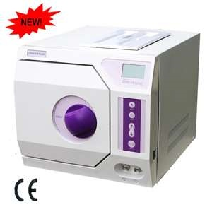
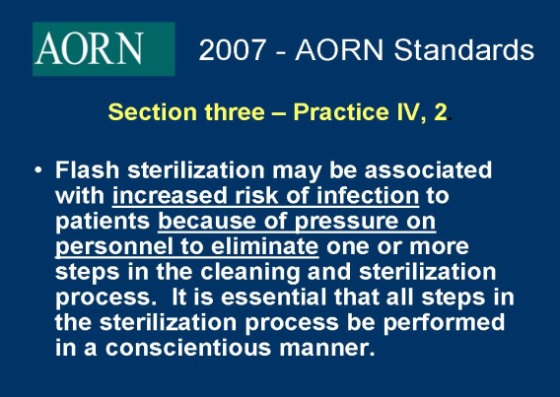
Flash Sterilization
“Flash sterilization” should be used in selected clinical situations & in a controlled manner.
*Use of flash sterilizer should be kept to a minimum &
only for emergency use.
Flash sterilization should not be used as a substitute for proper sterilization methods.
Flash sterilization should not be used for implantable devices.

Slide 41
Principles of Aseptic Techniques
By: Ms. Nida J. Salcedo
ADON-O.R.
For O.R. Set Up
(in Establishing Sterile Field)

Slide 42
Aseptic techniques are sets of practices performed under careful, controlled conditions in order to prevent contaminations of pathogens in the O.R. Sterile Set Up
Most strictly applied in the O.R. because of direct & extensive disruption of skin & underlying tissues.
Practices that ensure safe & effective ways in establishing & maintaining sterile field in which surgery can be performed safely.
Aseptic techniques help to prevent surgical site infection.

Slide 43
All items used within the sterile field must be sterile.
Point of emphasis:
Sterile items presented to the sterile field must be checked for:
* Package Integrity
* Expiration Date
* Chemical Process Indicator
Tears in barriers & expired sterilization dates are considered breaks in sterility.

Slide 44
Use of unsterile items contaminate the sterile field.
Sterile field is created as well as sterile packages are opened as close as possible to time of actual use.
Moist areas are considered not sterile.

Slide 45
Scrubbed personnel should function within a sterile field.
Surgical team is made up of:
* Sterile members or scrubbed personnel-
work directly in the surgical field.
Ex. Surgeons, Scrub nurse, O.R. Technician
* Non-sterile members or unscrubbed
personnel.
Ex. Anesthetists, Circulating nurses,
Anesthesia Technicians, X-Ray Technician

Slide 46
Points of Emphasis:
Surgical team members must wear the scrub suit attire, surgical cap, surgical face mask before performing surgical hand scrub.
First surgical hand scrub should be at least 5 minutes & the subsequent hand scrub, at least 2 to 3 minutes.
Surgical hand scrubbing to be performed prior to donning of sterile gown & sterile gloves.
Substitute for surgical hand scrub is hand rub with 2 antiseptics ( Chlorexidine & Alcohol)

Slide 47
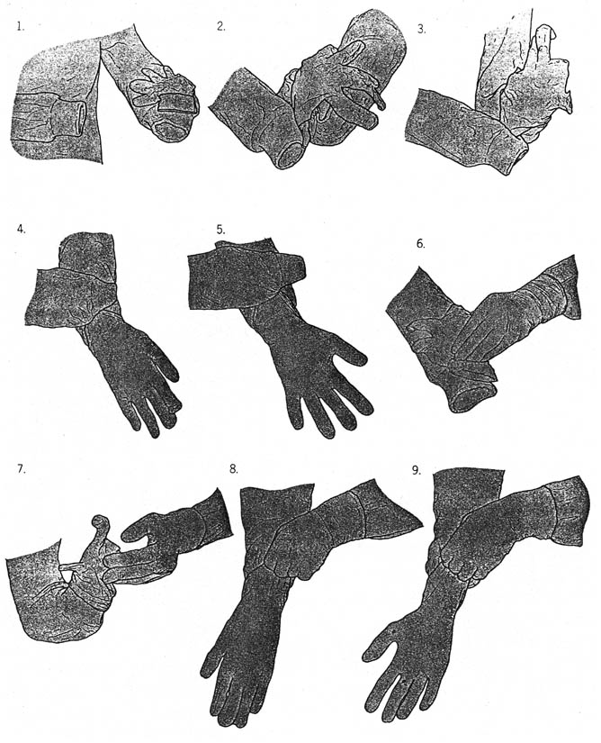
After donning the sterile gown is donning the sterile gloves.(Closed Gloving Technique is recommended in O.R.) Never let the fingers extend beyond the stockinette cuff)

Slide 48
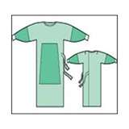
The sterility is limited to the portions of the gowns directly viewed by the scrubbed person.
Gowns are considered sterile only on the:
1. Front of gown from chest to the level of the
sterile field.
2. Sleeves of gown from 2 inches above the
elbow to the cuff.
Note: Cuff should be considered unsterile due
to it tends to collect moisture & it is not an
effective barrier. Therefore, cuff should always
be covered by sterile gloves.

Slide 49
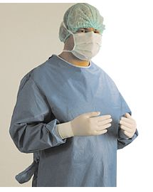
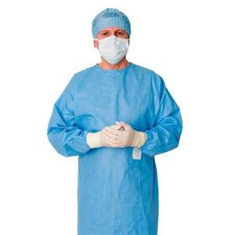
Scrubbed Personnel

Slide 50
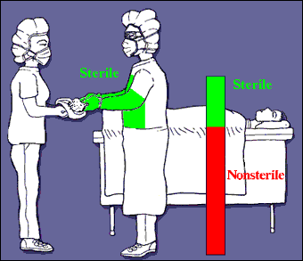
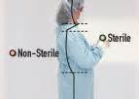
Areas of gown considered unsterile are:
1. Gown’s neckline
2. Shoulders
3. Under the arms
4. Back
Not to allow the hands or any items to fall below the level of sterile field.
No sitting nor leaning against unsterile surface because of great contamination.

Slide 51
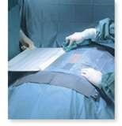
Sterile drapes are used to create a sterile field.
Surgical Drapes are sterile materials used to
maintain the sterility of the operation field.
Surgical Drapes establish an aseptic barrier minimizing the passage of microorganisms from non sterile to sterile areas.
Sterile surgical drapes should be placed on the patient, parts of O.R. table & equipment included in the sterile field, leaving only the incision site exposed.

Slide 52
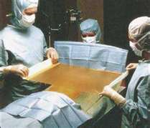
DRAPING PROCESS
Only the scrubbed personnel should handle sterile drapes by cuffing the draping material over the gloved hand.
When draping, it should be compact, held higher than the O.R. table & draped from the prepped incision site to the periphery.
Tables are only sterile at table level.
Once the drape is placed, it should not be moved or re-arranged & only top surface is considered sterile.

Slide 53
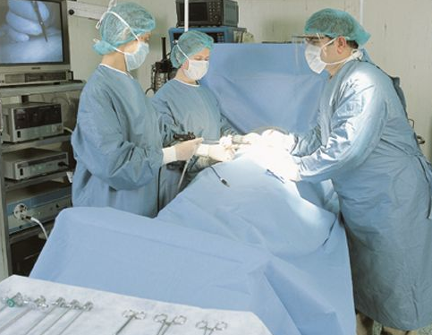

Slide 54
*All items should be dispensed to the sterile field by methods that preserve the sterility of the items & integrity of the sterile field.
After a sterile pack is opened, the edges are considered unsterile.
Either entire bottle contents should be poured into the receptacle or remainder should be discarded.
Solution should be poured slowly to avoid splashing.Splashing can cause strike through & contamination to the sterile field.

Slide 55
A sterile field should be constantly maintained and monitored.
Surgical team members should maintain a vigilant watch on the sterile field & point out any contamination immediately.
When breach of sterility occurs, an immediate action to correct the break in technique.
. Contaminated item must be removed immediately from the sterile field.

Slide 56
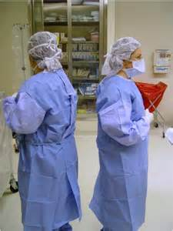
Movement around a sterile field must not cause contamination.
The operative site is the center of the sterile field & all scrubbed personnel should remain close to this area.
Movements can cause contamination to the sterile field.
Surgical team should move only from sterile areas to sterile areas.
Change positions –Should turn back to back or face to face & maintain a safe distance close to the sterile field.

Slide 57

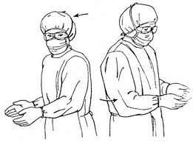
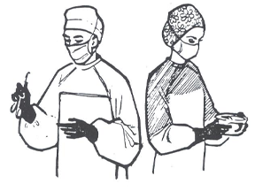
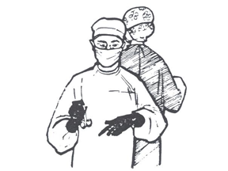
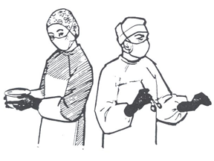

Slide 58
Points of Emphasis-
Scrubbed Personnel
Keep arms & hands within the sterile field at all times to avoid any accidental contact with unsterile areas.
Keep gloved hands in sight & keep at waist level or above because below the waist is contaminated.
Maintain a safe distance when approaching unsterile objects and personnel. Identify safe boundaries.

Slide 59
Unscrubbed Personnel
Remain in non-sterile area to prevent contamination of the sterile field.
Always face the sterile field on approach and should never walk between 2 sterile fields.
O.R. personnel with colds & URTI should avoid working inside the theater.

Slide 60
Items of doubtful sterility must be considered unsterile.
When a sterile barrier is permeated, it must be considered contaminated.
Once set up, the sterile field should be monitored constantly and not be left unattended.
Non sterile items should not cross above a sterile field.
The margin of safety is generally identified as a minimum of 12 inches.

Slide 61
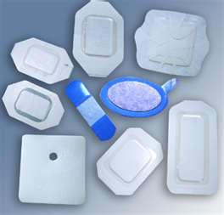
Sterile Wound Dressing
Dressing material should only be opened during wound dressing time.
Wound or surgical site should be cleaned & dried before application of the dressing material.
Applied before surgical drapes are removed to avoid contamination of the incision.

Slide 62

Take note
Surgical team must practice these principles of aseptic technique to prevent transfer of microorganisms into the surgical wound.
Surgical team members’ responsibility to develop a strong surgical conscience, adhere to the principles of surgical asepsis & correct any improper technique witnessed in the OR.

Slide 63
Setting up an Organized Operating Room-Assist the Surgical Team
To work in an efficient & timely manner, which is critical when performing life-saving procedures.
To focus & offer a safe environment & quality surgical services to the surgical patients.

Slide 64
There is nowhere, perhaps, it is more important to preserve the safety of the patients than in the
O.R.
Lives often depend on it…

Slide 65

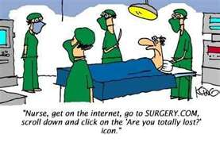
THANK YOU!
Prepared By:
Ms. Trinidad Jerez Salcedo ,BSN RN MAN
ADON-O.R.
KKUH 2015

